Slide 1
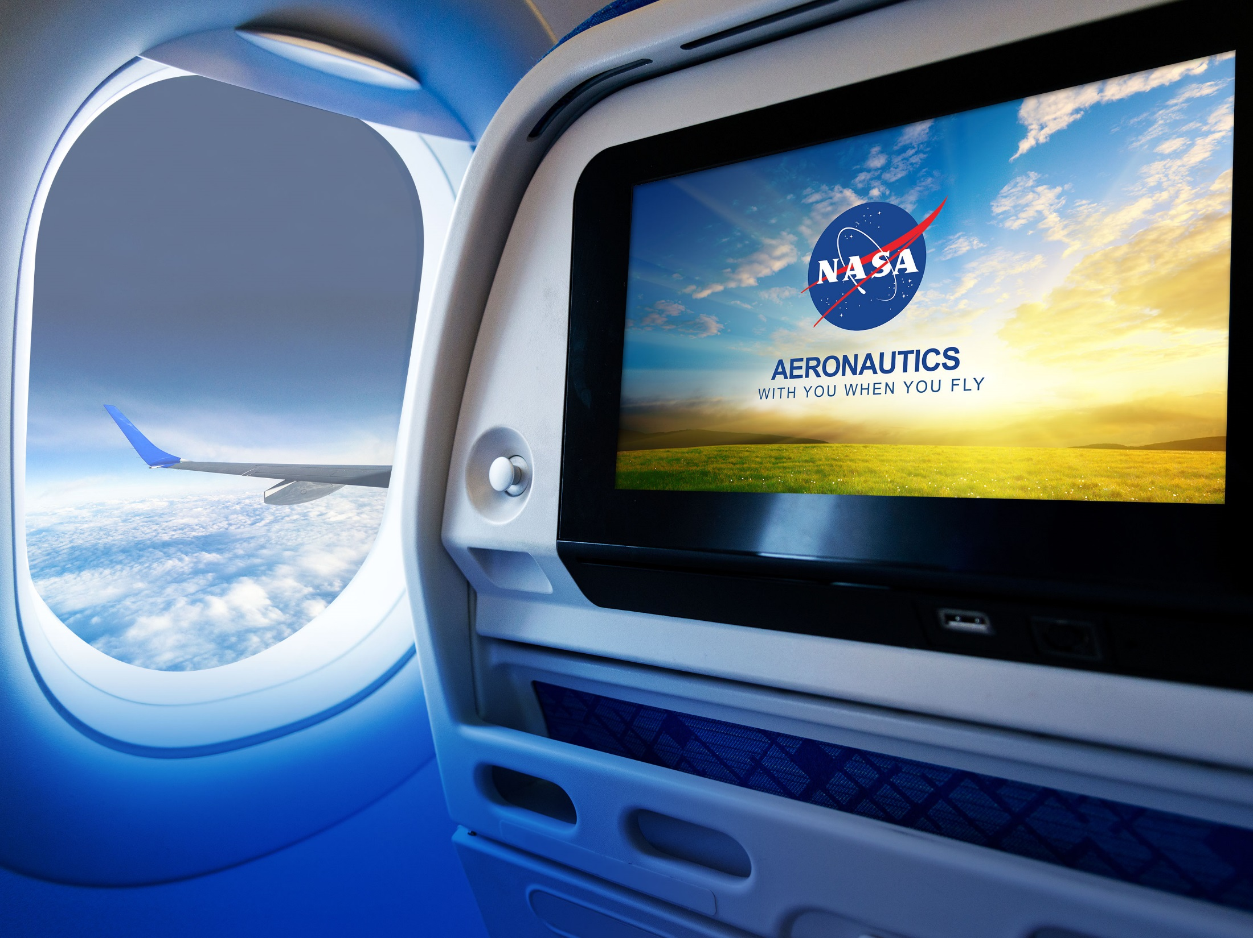
NASA Aeronautics FY 2017 Budget Request
Investing in our Future
Briefing to REDAC Airports Subcommittee Meeting
John Cavolowsky, Director, Airspace Operations and Safety Program
March 16, 2016

Slide 2
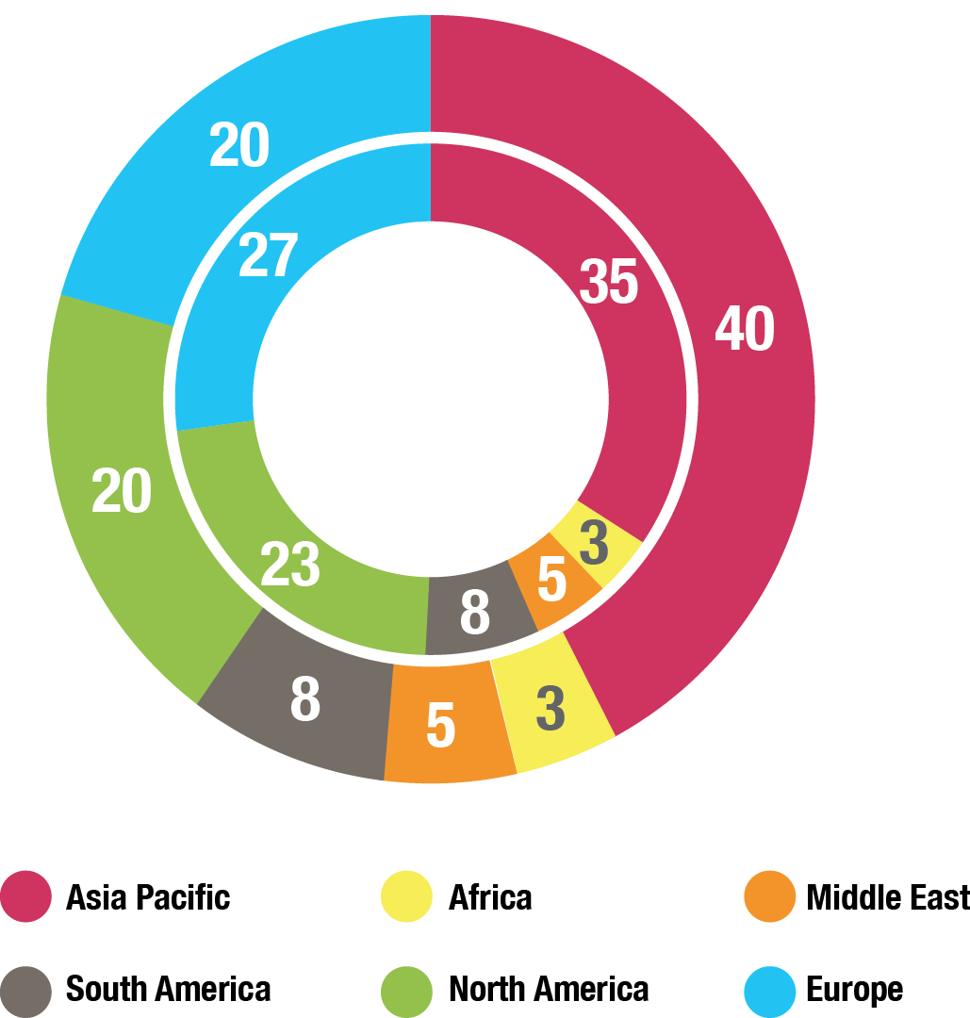
Global Growth in Aviation: Opportunities and Challenges
Global Air Passengers by Region (% of Total)
2014
Global Aviation
Industry
3.3B Passenger Trips
North America and Europe combined is half of all Passenger Trips
58M Jobs
$2.4T GDP
2034
Global Aviation
Industry, est.
7B Passenger Trips
Asia-Pacific Passenger
Trips equal to
North America and
Europe combined
105M Jobs
$6T GDP
Over 36,000 New Aircraft required (replacement and growth) over the
20 year period
($4-$5T value)
Sources: International Air Transport Association, Air Transport Action Group, Boeing
Major Opportunities / Growing Challenges
Competitiveness—New state backed entrants, e.g., COMAC (China); Growing global R&D
Environment—Very ambitious industry sustainability goals; Large technology advances needed
Mobility—More speed to connect the worlds’ major cities; Opportunity for commercial supersonic flight
U.S. Technological Leadership Required!

Slide 3

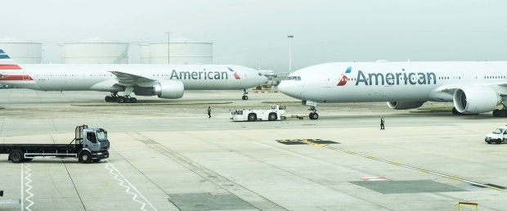
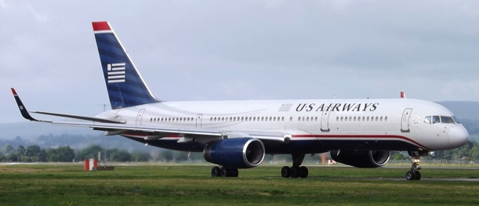
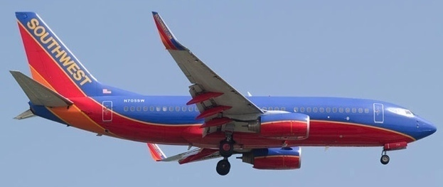
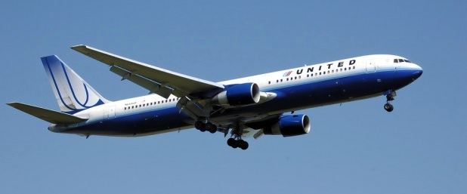
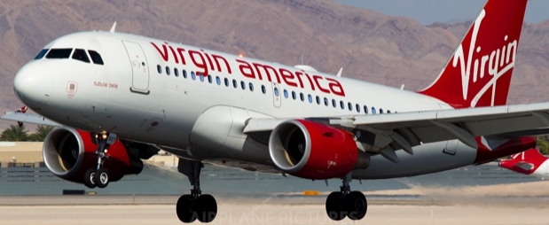
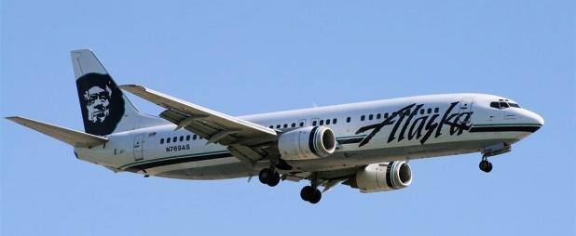
Major US Airlines Collaborating with NASA
American Airlines
US Airways
Southwest
(now part of American Airlines)
Photo credit: markyharky via VisualHunt / CC BY
Weather Rerouting
Changing the non-profitable flights into profitable flights
Terminal Sequencing and Spacing
Increasing throughput and fuel efficiency
for arrivals
Surface Management
Reducing delays and fuel consumption
Data Mining
Improving efficiency and safety
United
Virgin America
Alaska Airlines
Efficient Descent Advisor
Saving time and reducing fuel burn for arrivals
Flight deck Interval Management
Increasing throughput with improved arrival spacing for landing
Traffic Aware Strategic Aircrew Requests
Optimizing time and fuel savings for pilot entered route changes
Flight Awareness Collaboration Tool
Reducing cancellations and delays due to winter storms
Traffic Aware Strategic Aircrew Requests
Optimizing time and fuel savings for pilot entered route changes

Slide 4

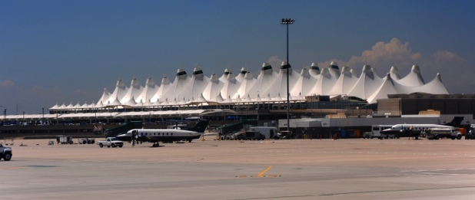
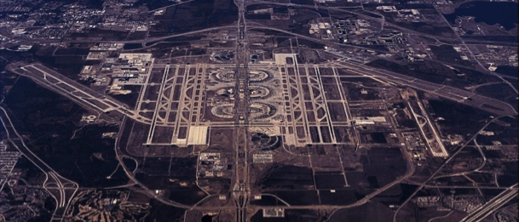
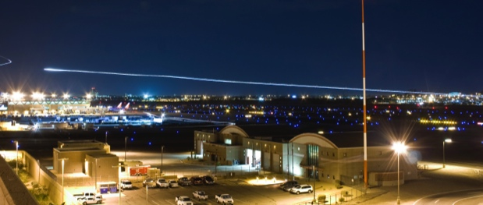
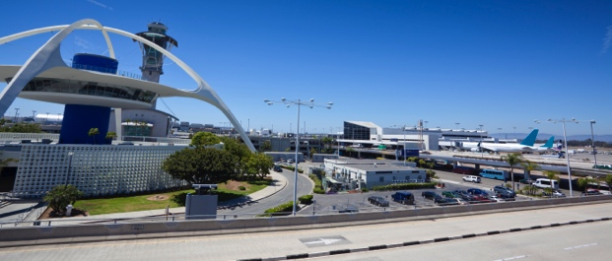
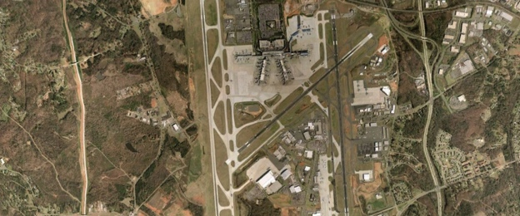
Major US Airports Collaborating with NASA
DEN
DFW
Denver International Airport
Dallas Fort Worth International Airport
Efficient Descent Advisor
Improving arrival efficiencies
Precision Departure Release Capability
Increasing departure time conformance
CLT
PHX
LAX
Charlotte Douglas International Airport
Phoenix Sky Harbor International Airport
Los Angeles International Airport
Integrated Arrival/Departure/Surface (IADS)
Reducing overall departure delay
Terminal Sequencing and Spacing (TSAS)
Increasing throughput and fuel efficiency for arrivals
Flight deck Interval Management (FIM)
Increasing runway throughput for arrivals
Terminal Sequencing and Spacing (TSAS)
Increasing throughput and fuel efficiency for arrivals

Slide 5

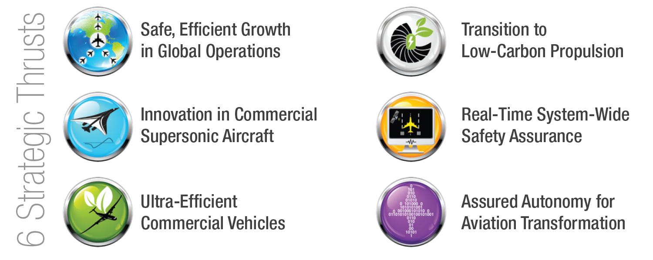
NASA Aeronautics
NASA Aeronautics Vision for Aviation in the 21st Century
U.S. leadership for a new era of flight

Slide 6


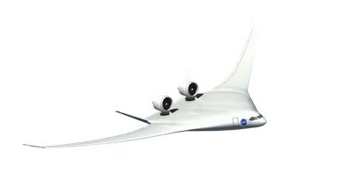



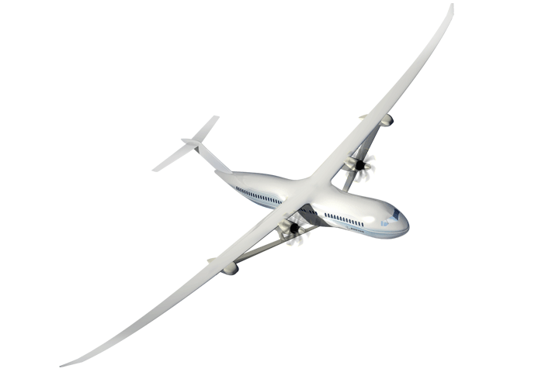
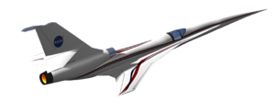



NASA Aeronautics Ready for Flight
Accomplishments and Planning
NASA Aero Vision and Strategy Established
Roadmaps Completed
2008-2013
2014/15
2016/17
2018-2026
N+3 Subsonic & Supersonic Concept/Technology Studies
Ground Testing of N+3 configurations and technologies
LBFD PDR
Completed
UEST PDR
Completed
N+2 Environmentally Responsible Aviation (ERA) Project Initiated
8 Integrated Tech Demos Completed, Tech transitioned to industry. HWB ready for Flight Dem/Val.
Ready for X-Plane Integration & Demonstration
NASA FAA NextGen Research Transition Teams (RTTs) Initiated
Technology Transitions to FAA: MSP, EDA, PDRC, TSAS
ATD-1 Completed and transferred to FAA
ATD-2, 3 Completed
& Transferred to FAA
Ready for NextGen TBO Integration & Demonstration

Slide 7

Ten Year Investment Plan—FY 2017 Budget Accelerates Key Components of NASA Aeronautics Plan
Fund the Next Major Steps to Efficient, Clean and Fast Air Transportation Mobility
New Aviation Horizons
Enabling Tools & Technologies
Revolutionizing
Operational Efficiency
Fostering Advanced Concepts & Future Workforce
UAS
Major series of ground experiments to ready key technologies for flight
Research and ground demonstration for an advanced small engine core for very high bypass engines and as a hybrid-electric propulsion enabler
Development of next generation physics-based models needed to design advanced configurations
Accelerate demonstration of full gate-to-gate Trajectory Based Operations
Strong continued research leadership in enabling UAS integration into the National Airspace. Extending the UAS in the NAS project for an additional 4 years
Start a continuing series of experimental aircraft to demonstrate and validate high impact concepts and technologies. Five major demonstrations over the next 10+ years in the areas of
Ultra-Efficiency,
Hybrid-Electric Propulsion, and Low Noise Supersonic Flight
Increased investment in new innovation through the NASA workforce and Universities
Leverage
Non-Traditional Technology Advances
Hypersonics
Pursue challenge prizes in areas such as energy storage, high power electric motors, advanced networking and autonomy
Increased investment to ensure a strong National fundamental research capability
Major New Initiative within IASP
Increases to AAVP and TACP
Increase to AOSP
Increase to TACP
Increases to IASP and AAVP
Build off of major current developments and accomplishments
Continue to incentivize
new innovation

Slide 8
FY 2017 Budget
$ Millions | FY 2015 | Enacted FY 2016 | FY 2017 | FY 2018 | FY 2019 | FY 2020 | FY 2021 | FY 2022 | FY 2023 | FY 2024 | FY 2025 | FY 2026
Aeronautics | $642.0 | $640.0 | $790.4 | $846.4 | $1,060.1 | $1,173.3 | $1,286.9 | $1,294.2 | $1,307.6 | $1,218.1 | $829.7 | $839.5
Airspace Operations and Safety | 154.0 |  | 159.4 | 159.2 | 176.2 | 189.1 | 221.5 | 198.7 | 200.9 | 193.2 | 175.5 | 167.8
Advanced Air Vehicles | 240.6 |  | 298.6 | 277.4 | 308.8 | 311.6 | 312.6 | 321.3 | 315.0 | 318.9 | 317.7 | 326.7
Integrated Aviation Systems | 150.0 |  | 210.0 | 255.4 | 381.4 | 493.0 | 556.7 | 591.5 | 612.2 | 525.0 | 203.8 | 210.6
Transformative Aeronautics Concepts | 97.4 |  | 122.3 | 154.4 | 193.8 | 179.7 | 196.2 | 182.8 | 179.4 | 181.0 | 132.7 | 134.4
Aeronautics budget includes paid-for 10-year mandatory funding from the Administration’s 21st Century Clean Transportation Plan. See appendix for additional detail.
Mandatory Budget Authority $ Millions | FY 2017 | FY 2018 | FY 2019 | FY 2020 | FY 2021 | Outyears
21st Century Clean Transportation Plan | 100 | 200 | 400 | 500 | 600 | 1900
Airspace Operations and Safety | 18 | 20 | 35 | 45 | 75 | 170
Advanced Air Vehicles | 30 | 41 | 79 | 80 | 65 | 305
Integrated Aviation Systems | 37 | 84 | 196 | 300 | 370 | 1170
Transformative Aeronautics Concepts | 15 | 55 | 90 | 75 | 90 | 255
Low Boom Flight Demonstrator | 56
Integrated Aviation Systems | 56

Slide 9
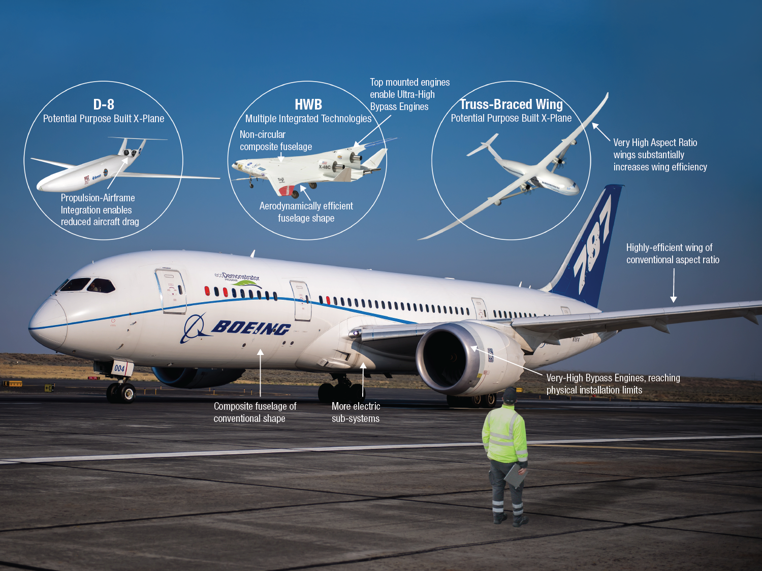
Ultra-Efficient Subsonic Demonstrators
787 image credit: Boeing

Slide 10
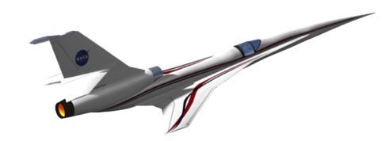
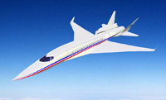
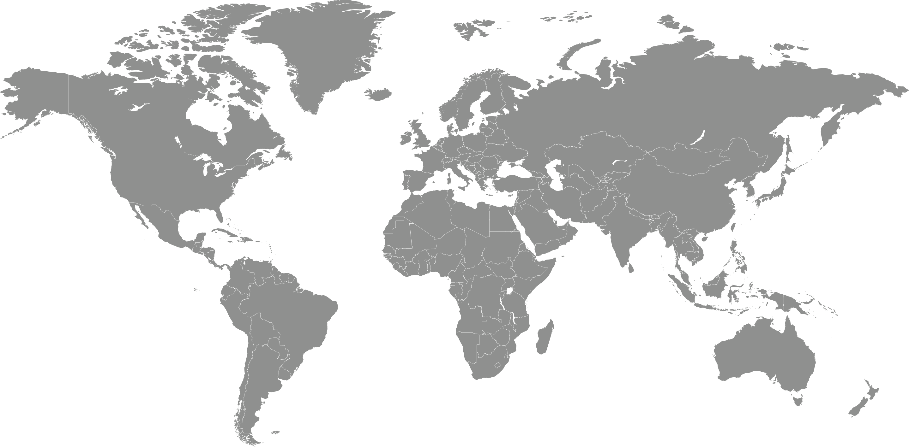
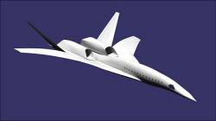
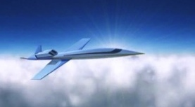
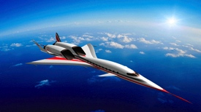
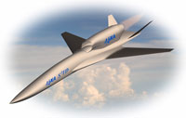
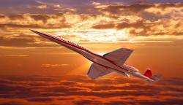
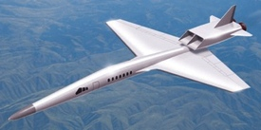
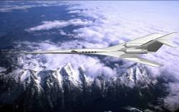
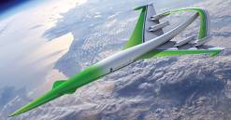
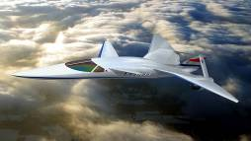
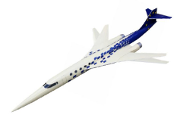

Low Noise Supersonic Flight
First Step to Unlocking a Global Market
JAXA
Hypermach
Dassault
Boeing
Spike Aerospace
S³TD
Aerion
Sukhoi/TsAGI
Gulfstream
Lockheed Martin
Supersonic Aerospace Int’l
Alenia Aeronautica
Low Boom Flight Demonstrator
Demonstrate that noise from sonic boom can be reduced to a level acceptable to the population residing under future supersonic flight paths.
Create a community response database that supports an International effort to develop a noise based rule for supersonic overflight.
Establish U.S. Leadership for this New Global Market
Supersonic Low Boom Flight Demonstration Concept

Slide 11
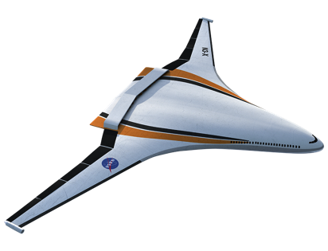
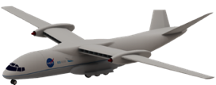



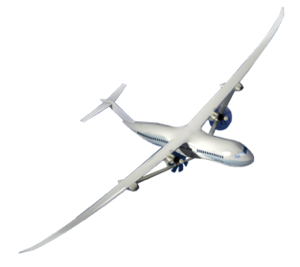
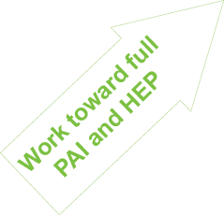
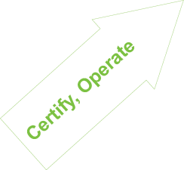
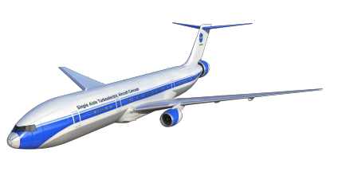
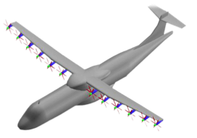
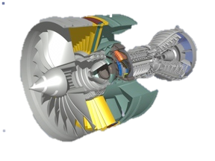
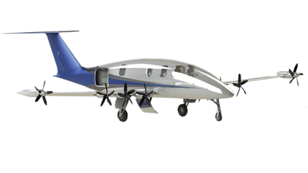
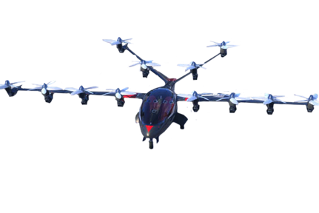
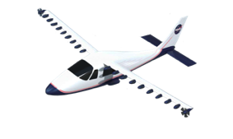

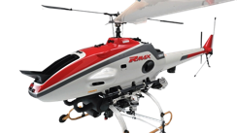
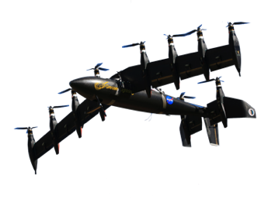
Hybrid Electric Propulsion
Prove Out Transformational Potential
+
Single Aisle Transport
Explore and demonstrate vehicle integration synergies enabled by hybrid electric propulsion
2040
Increasingly electric aircraft propulsion with minimal change to aircraft outer mold lines
2030
Environmental Benefit
Image Credit: Joby
Modeling
2020
Explore Architectures
Image Credit: Yamaha
Test Beds
Small Aircraft
Component Improvements
Gain experience through integration and demonstration on progressively larger platforms
+
Knowledge through Integration & Demonstration
Notes:
We will add the proper links to the sonic boom noises when I get back. If they are desired

Slide 12

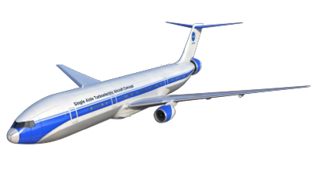


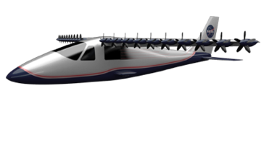
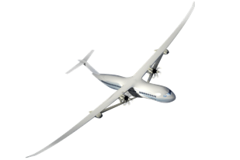
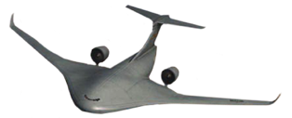
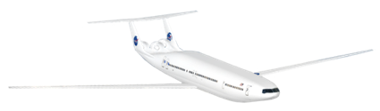


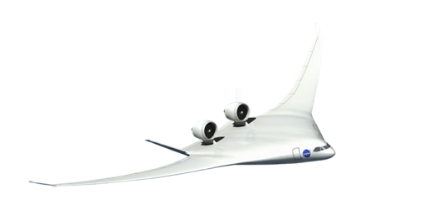


New Aviation Horizons Flight Demo Plan
Hybrid Electric Propulsion Demonstrators
DP
Transport Scale
Preliminary
Design
Total Demonstration Cost ROM: $700M
Ground Test Risk Reduction
Small Scale “Build, Fly, Learn”
Design & Build
Flight Test
Validated HEP Concepts, Technologies
And Integration for U.S. Industry to Lead the Clean Propulsion Revolution
Design & Build
Flight Test
Design & Build
Flight Test
DP
Life Cycle Cost ROM: $400-500M
Ground Test
Risk Reduction
Preliminary
Design
Design & Build
Flight Test
Images Credit: Lockheed Martin
Potential
Candidates
DP
Life Cycle Cost ROM: $400-500M
Ground Test
Risk Reduction
Preliminary
Design
Validated ability for U.S. Industry to Build Transformative Aircraft that use 50% less energy and produce over 40dB (cumulative) less noise
“Purpose-Built” UEST Demonstrators
Design & Build
Flight Test
DP
Life Cycle Early Cost Est: $850M
Preliminary
Design
Design & Build
Flight Test
Fully integrated UEST Demonstrator
DP
Life Cycle Cost Est: $430M
Design & Build
Flight Test
Enables Low Boom Regulatory Standard and validated ability for industry to produce and operate commercial low noise supersonic aircraft
FY17
FY18
FY19
FY20
FY21
FY22
FY23
FY24
FY25
FY26

Slide 13






Trajectory Based Operations: Concept to Demo
Next Step in NASA Research and NextGen Development
Develop and Demonstrate NextGen Capabilities:
Reducing fuel use and flight delays
Concept Validation
Technology Maturation
Demo
Gate-to-Gate
Optimization
Gate-to-Gate 4DT TBO: Complete gate-to-gate flight optimization incorporating
system constraints and user request.
Architectural
Definition
Tech Gap
Assessment
Gate-to-Gate
Trajectory
Based
Operations
Enables airlines to operate increasingly efficient 4D “gate-to-gate” trajectories
Fast-time
Simulation
Human In The Loop
Simulation
Integrated
Field Demo
RTT
deliverable
Initial
Integrated
Demand
Management
Concept Validation
Technology Maturation
IDM TBO: Integrates departure, en route, and descent flight operations for greater optimization
Initial Concept Demo
Fully Integrated Field Demo
ATD-2
RTT deliverable
ATD-2: Coordinated preflight, taxi, takeoff, and departure paths for all outbound flights at an airport
Complex
Terminal Area Trajectory
Management
Enables airlines to optimize efficient operations into and out of busy airports and terminal area airspace
Ground Side
Demo
Flight Side
Demo
ATD-1
RTT deliverable
ATD-1: Efficient descent, approach, and landing for all flights inbound to an airport
2015
2017
2020
2025

Slide 14
New Era For NASA Aeronautics
Investing In Our Future - Investments in NASA’s cutting edge aeronautics research today are investments in a cleaner, safer, quieter and faster tomorrow for American aviation:
A future where Americans are working in stable, well-paying jobs.
A future where we fly on aircraft that consume half as much fuel and generate only one quarter of current emissions.
A future where flight is fueled by greener energy sources.
A future where our air transportation system is able to absorb nearly four billion more passengers over the next 20 years without compromising the safety of our skies.
A future where our airports are better neighbors because aircraft noise is contained well within the airport boundary.
A future where people can travel to most cities in the world in six hours or less in an airplane that can fly faster than the speed of sound on bio-fuels.

Slide 15


Back-Up

Slide 16



Lab-to-Field
Efficient Descent Advisor (EDA)
Provides speed and path advisories to save time and fuel in arrivals descents from En Route airspace to runway
United Airlines, DEN, FAA and Denver Air Route Traffic Control Center
Transferred to FAA in Jan 2012
Operational in Albuquerque Center in 2014
Potential FAA deployment 2018
$143M / year savings
improved meter-fix delivery accuracy
$46M / year savings
reduced fuel burn in en route airspace
60% reduction in metering
related clearances
NASA’s work on these technologies
Transferred to FAA–Jan 2012
Product Benefits
Precision Departure Release Capability (PDRC)
Precision release of tactical departures for efficient en route stream merge; Analogous to cars merging onto a busy freeway
American Airlines, DFW and FAA
Tested at DFW
Transferred to FAA in July 2013
50% increase in departure time conformance
$20M / year savings
to airlines from increased en route slot merge compliance
NASA’s work on these technologies
Transferred to FAA–Jan 2013
Product Benefits
ATD-1: Terminal Sequencing & Spacing Tool (TSAS)
Advanced scheduling and sequencing of arrivals and runway
Terminal controller advisories to maintain precision schedules
American Airlines (formerly US Airways), FAA
TSAS transferred to FAA July 2014
Deployment early 2019 on STARS system
$300-$400M / year savings
increased throughput
>90% PBN conformance during high density, mixed equipage arrival operations improving fuel and operational efficiency
NASA’s work on these technologies
Transferred to FAA–
July 2014
Product Benefits

Slide 17





Lab-to-Field
ATD-1: Flightdeck Interval Management (FIM)
Speed advisories for airborne precision spacing
United Airlines, Boeing, Honeywell, FAA and ACSS
FIM Flight Test Feb 2017
Transfer to FAA in 2017
Improved delivery accuracy during high density arrival operations improving throughput and reducing passenger delay
NASA’s work on these technologies
Flight Test Feb 2017
Product Benefits
ATD-2: Integrated Arrival/Departure/Surface (IADS)
Improves predictability and operational efficiency in metroplex environment, including arrival, departure and surface prediction, scheduling and management
American Airlines, CLT, FAA and NATCA
40% reduction in overall departure delay (estimate)
$8.2B potential savings over 20-year lifecycle (estimate)
Enables flights to absorb delays at the gate with less fuel burn and emissions
Baseline field testing begins Sep 2017
Metroplex testing begins Sep 2019
NASA’s work on these technologies
Status
Product Benefits
ATD-3: Dynamic Weather Reroutes (DWR)
Recovers delay caused by static weather reroute plans in En Route environment
American Airlines Integrated Operations Center (IOC), DFW and FAA
Operational testing in AA IOC since July 2012
Will be extended to develop ATD-3 and transfer
to FAA
Analysis indicates potential savings of about 100,000 flying minutes for 15,000 flights, or about 6.7 minutes/flight on average
NASA’s work on these technologies
Status
Product Benefits
Note: Analysis of all Fort Worth Center traffic in 2013, excluding arrivals to the major Dallas airports, Dallas-Fort Worth International (DFW) and Dallas Love Field (DAL).
ATD-3: Traffic Aware Strategic Aircrew Requests (TASAR)
Pilot onboard automation tool to optimize aircraft’s trajectory
Leverages networked connectivity to real-time operational data
Flight test partners Alaska Airlines and Virgin America
NASA flight test in 2015
Integration with airlines in 2016
Operational testing in airline fleets 2017-2018
Optimizes to save time or fuel;
Projections for carriers optimized for (12 representative city pairs)
Time, 4.2 minutes
Fuel, 575 pounds
Increases ATC approvability through ADS-B IN data
NASA’s work on these technologies
Status
Product Benefits

