Slide 1
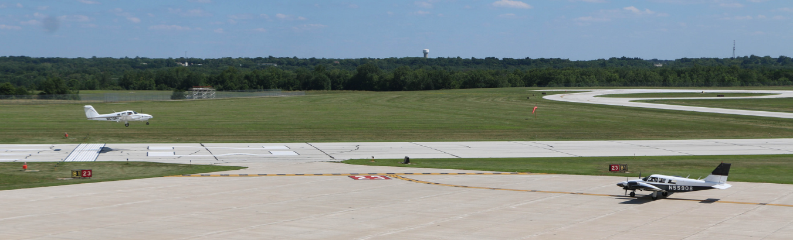
Aviation Rumble Strip Project Update
RPD 133
March 16, 2016

Slide 2
    Utilizing a Center of Excellence
  PEGASAS
Partnership to Enhance General Aviation Safety, Accessibility and Sustainability

Slide 3
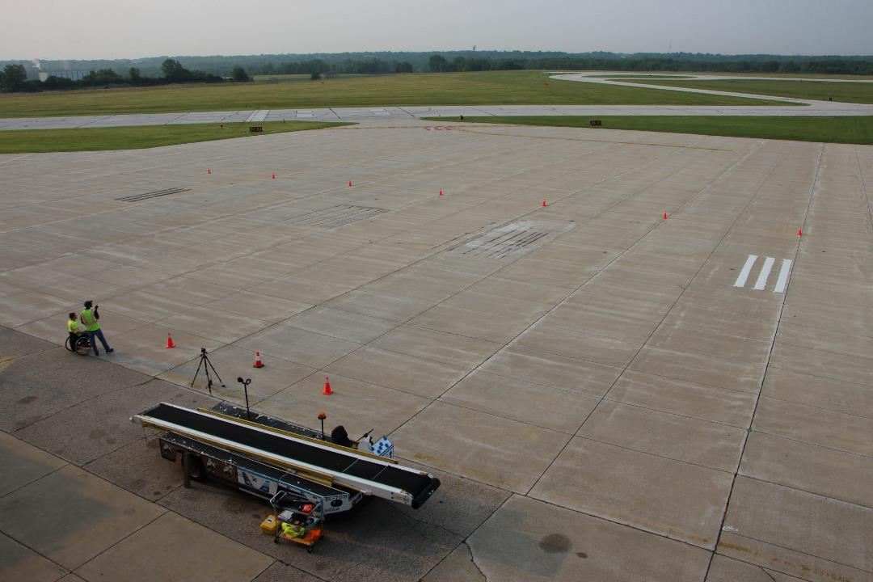
2015 Purdue Airport Rumble Strip Test Site
Temporary
Saw Cut
Thermoplastic

Slide 4
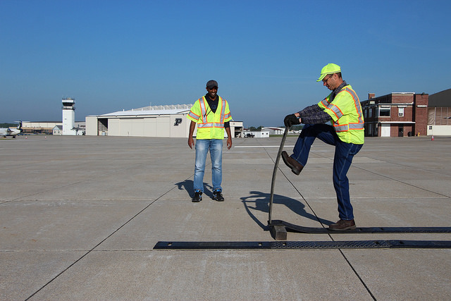
Temporary

Slide 5
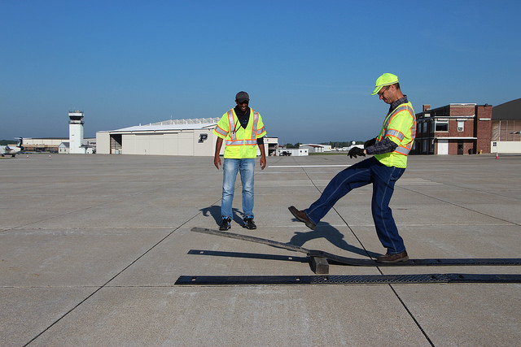

Slide 6
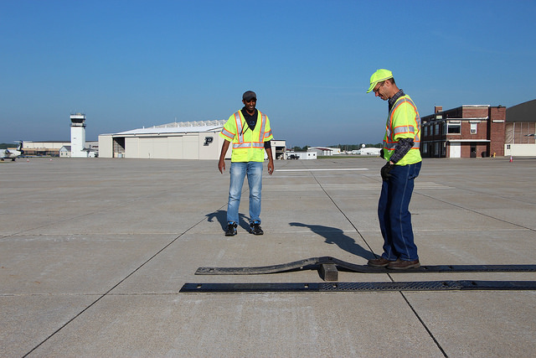

Slide 7
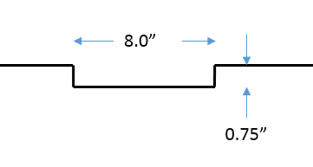
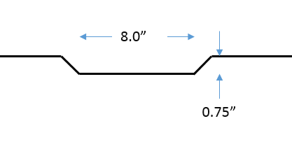
Saw Cut Options
Square Cut
Bevel Cut

Slide 8
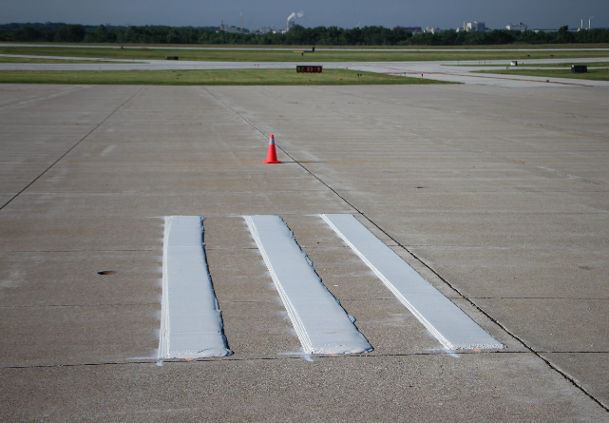
Thermoplastic
Easy to construct
Semi-intrusive
Permanent
Proven to withstand winter ops in roadway environment

Slide 9
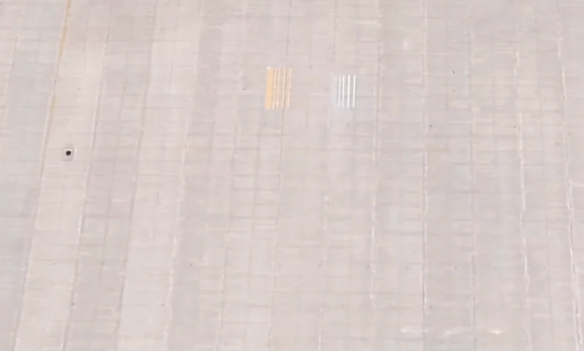
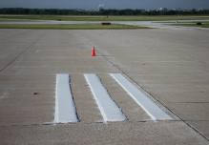
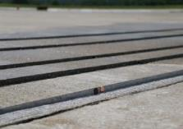
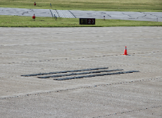
PEGASAS Test Configuration
Thermoplastic Sawcut Temporary

Slide 10
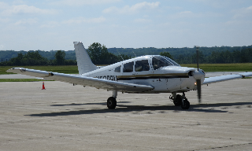
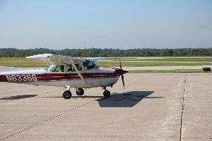
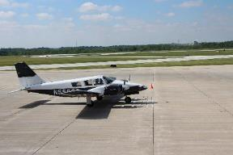
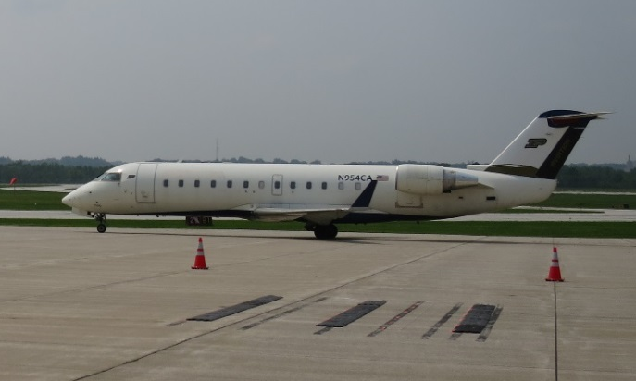
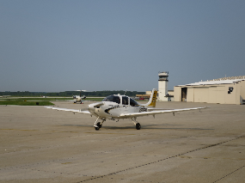
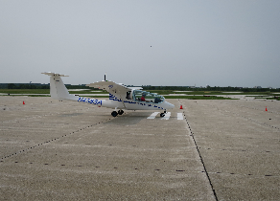
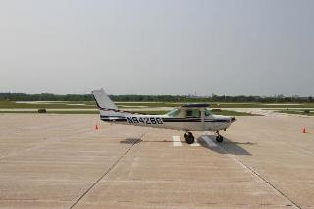
Aircraft Used in Study
PIPER PA 28
CESSNA 172
CESSNA 152
PIPER PA 34
CRJ-100ER
CIRRUS SR20
CESSNA 152
SKY ARROW

Slide 11
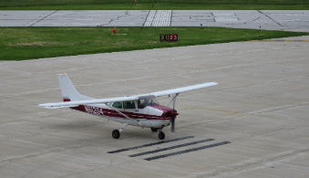
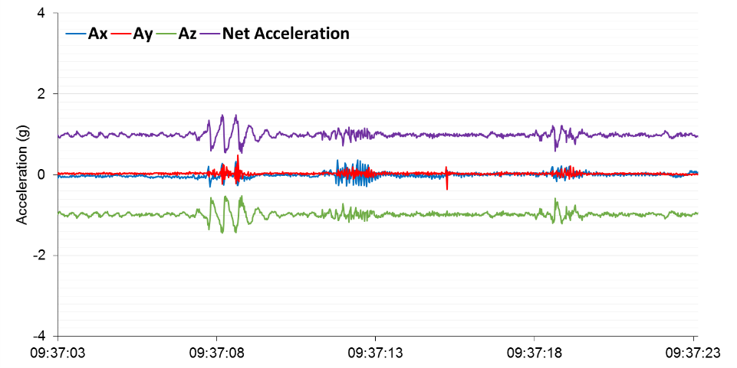
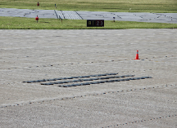
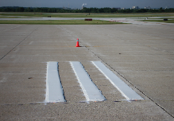
Acceleration Graph
Aircraft: Cessna 172 Speed:5 knots
Temporary
Saw Cut
Thermoplastic
Notes:
bg

Slide 12
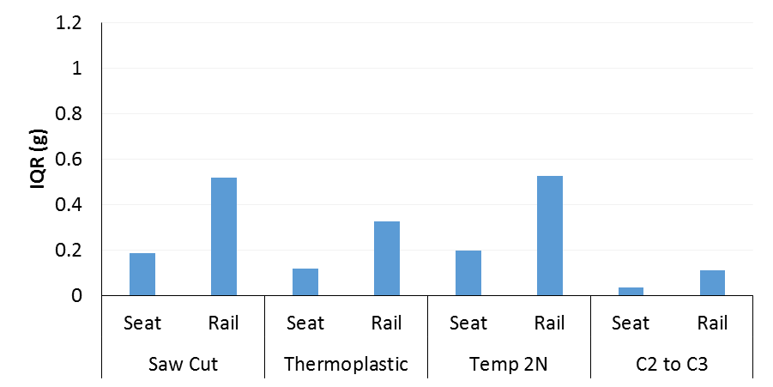
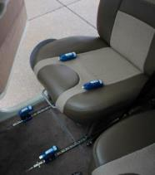
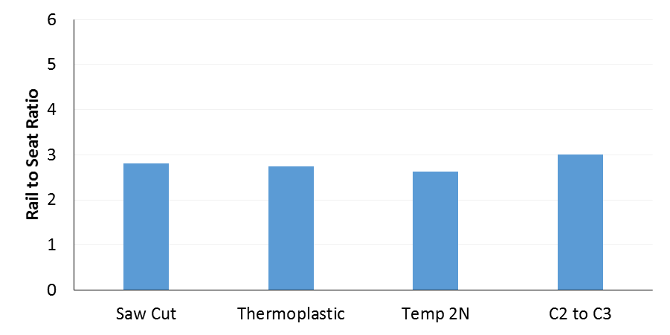
Affects on Pilots and Airframe Rail-to-Seat Plots for 10 kts
Significant airframe acceleration must occur for pilot to feel rumble strip
Seat
vs.
Rail
2.805
2.739
2.63
Airframe affected by
2 to 3X the acceleration force felt by pilot, over time airframe manufacturers feel this may cause damage to the gears.

Slide 13
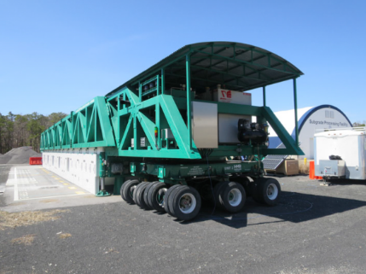
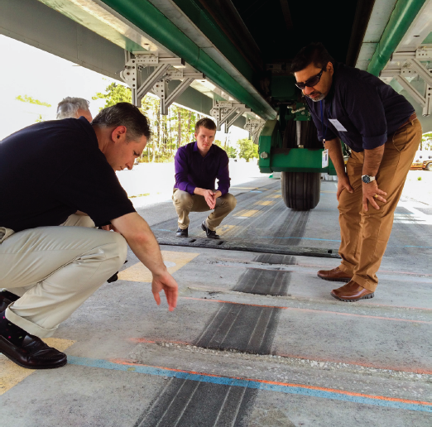
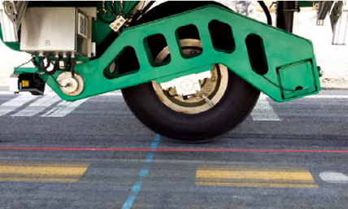
April 2015 Durability Testing

Slide 14
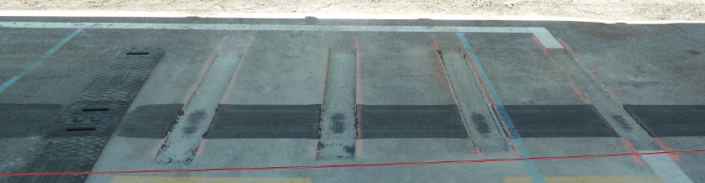
Tech Center Test Results
Day | Load Aircraft | Passes | Square Cut | Beveled | Temporary
Day 1 | 10k lbs. E190 | 1000 passes | Began crumbling at 500 passes | No change | No change
Day 2 | 15k lbs. CRJ-700 | 1000 passes | Continued crumbling | No change | No change
Day 3 | 30k lbs. 757-200 | 1000 passes | Heavily worn | No change | Sign of warn, but no damage
Day 4 | 45k lbs. 738/A321 | 500 passes | Heavily worn | No change | Connection point becoming loose
 | 60k lbs. 748/A380 | 10 passes | Heavily worn | No change | ~1/8” depression

Slide 15
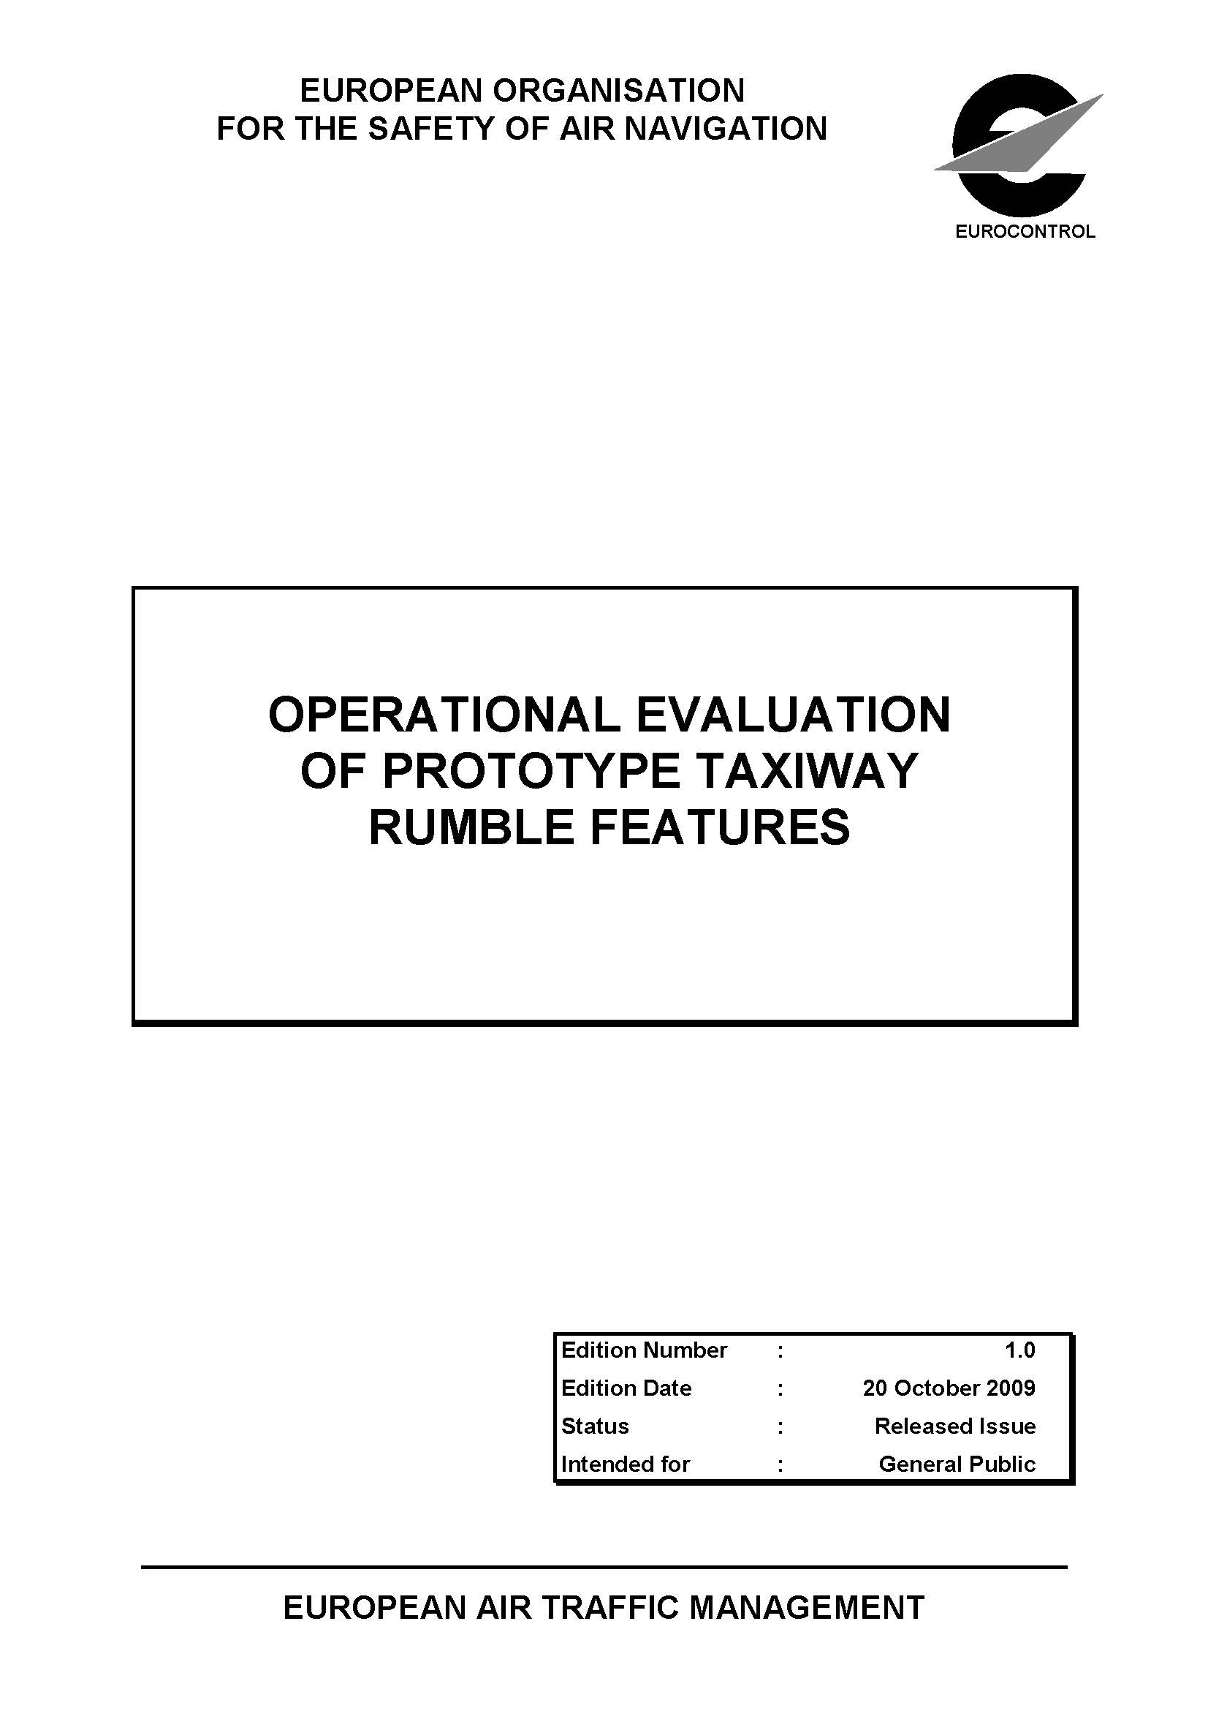

Slide 16
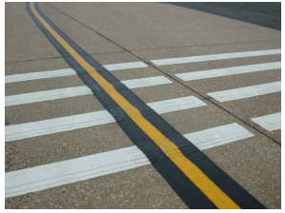
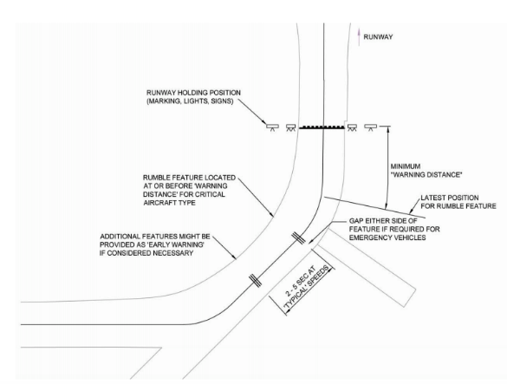
European Rumble Strip Study
Deployed on Active Taxiway for 3 months at Southampton Intl Airport, England
19.7”
19.7”

Slide 17
European Rumble Strip Study
    Feedback invited from pilots (35 responses) and ground vehicle operators (10 reports)
    Pilots report rumble strips were discernible (varied by aircraft) but difficult to differentiate from other taxiway features (e.g., rough pavement)
      Half assessed impact as “excessive”
      Pilots did not recognize purpose and considered rumble strips a distraction
    Did not affect capacity
    Deemed ineffective for incursion prevention
19.7”
Each segment 11.8” wide
39.4’ long
0.47” high
19.7”

Slide 18
Our Evaluation Results

Slide 19
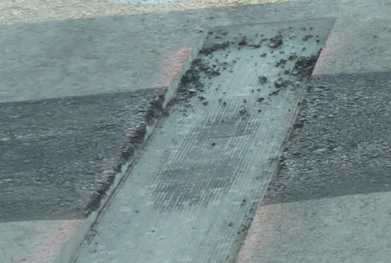
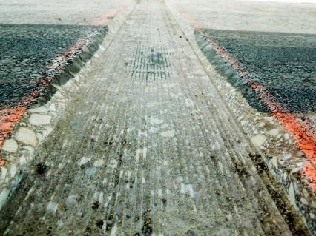
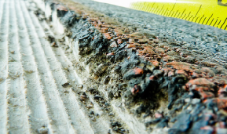
Problems with Durability of 90 degree Saw Cut at KLAF and at NJ Tech Center
Saw Cut

Slide 20
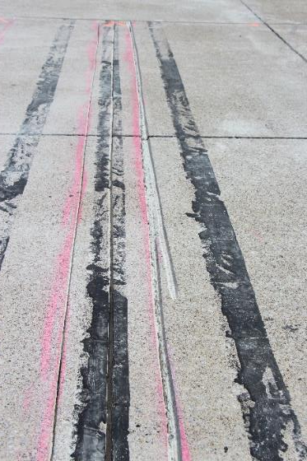
Constructability Challenges with 45 degree Bevel Saw Cut at KLAF and at NJ Tech Center
Saw Cut

Slide 21
Thermoplastic
Easy to construct
Semi-intrusive
Permanent
Proven to withstand winter ops in roadway environment

Slide 22
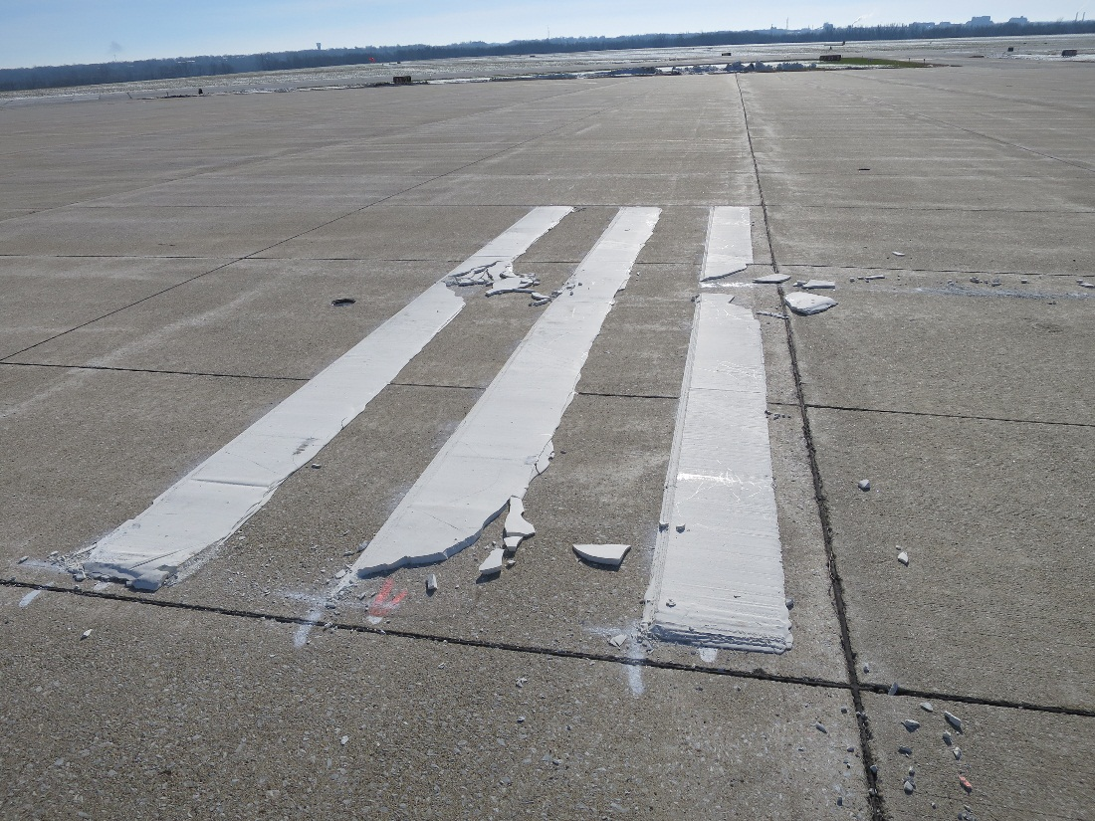
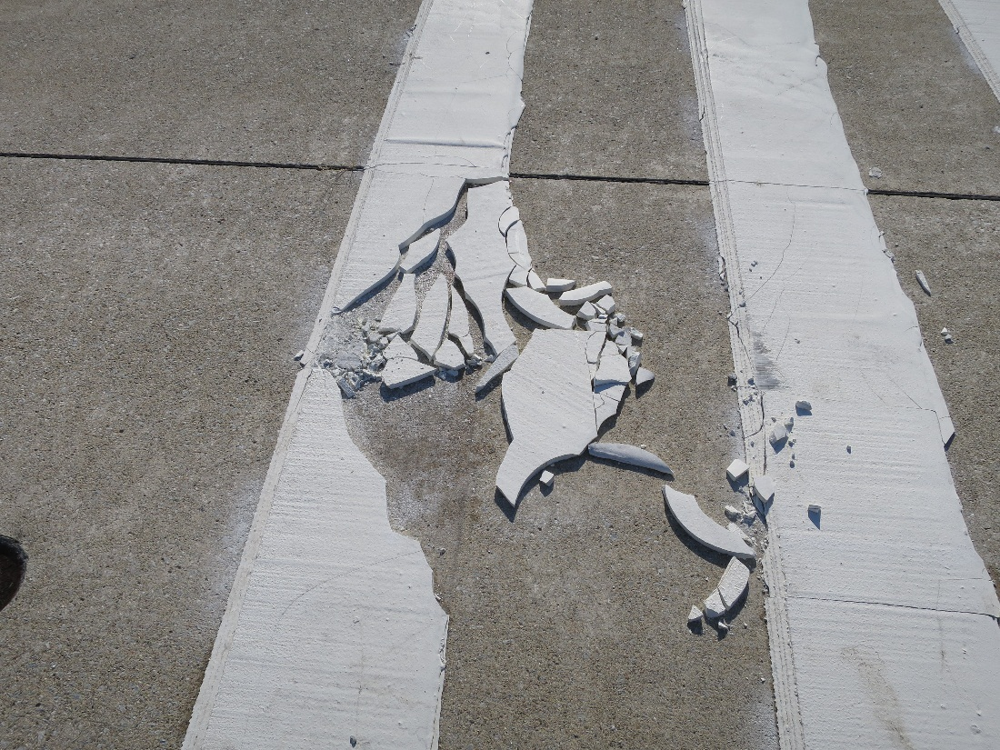
NOT on Airports! Rumble Strips were Damaged by Snowplows after First Snow and Were Subsequently Removed to Avoid FOD on Airfield at KLAF

Slide 23
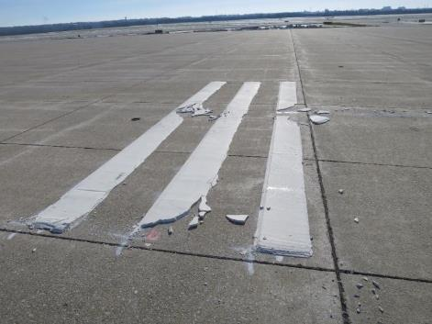
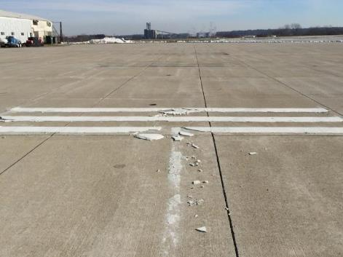
Thermoplastic has Problems with Durability

Slide 24
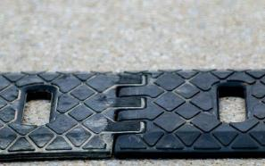
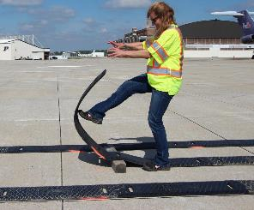
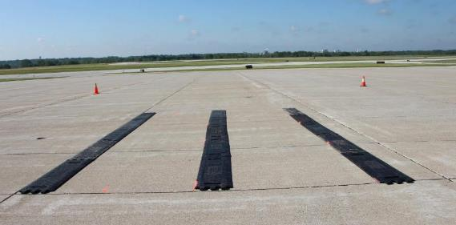
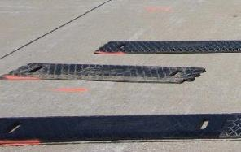
Temporary Rumble Strips
Allows temporary installation
Interlocking joints
Segments: 13” wide, 36” long,
¾” high, 35 lbs
Can be installed by one person

Slide 25
Conclusions
All Rumble Strip types evaluated, if installed permanently, may cause damage, with continual use, to the size of aircraft used in study.
Saw Cut Strip
  Durability of 90 degree
  Constructability with 45 degree bevel
Temporary Rumble Strips may be useful as a tactile warning to aircraft when used to identify a temporary change at an airport such as a construction areas etc.

Slide 26
Questions/Comments?

Slide 27
Infra-Red Requirements for developing a Elevated LED High Intensity Runway Edge Light, L-862(L) (HIRLs) with IR emitter
March 16, 2016

Slide 28
Infra-Red Requirements for LED HIRLs
About 10 years ago, the FAA published a final rule permitting Enhanced Flight Vision System (EFVS) operations to be conducted below DA/DH or MDA down to 100 feet above the touchdown zone elevation.
The EFVS manufacturers addressed concerns about their equipment not being able to see an image on a Heads Up Display (HUD) LED lights in the runway environment, due to little to no heat (IR) in the needed wavelength.
Traditionally, the NAS doesn’t have a requirement for airport lighting to emit IR energy. Airport lighting standards are solely based on the visible spectrum (intensity, brightness, color, beam spread).

Slide 29
Infra-Red Requirements for LED HIRLs
In 2008, the RTCA SC-213, Enhanced Flight Vision Systems and Synthetic Vision Systems committee took on the task to identify the IR amount needed for EFVS. After two years, they were unsuccessful in establishing the required amount of IR.
In 2010, the SAE G-20 Committee was formed and originally tasked by AFS-400 to “address the possible adverse impact to EFVS operations by transitioning airport approach and surface lighting systems from incandescent to LED’s.” They also took on the task to identify the IR amount needed for EFVS. To this date, the they have not been able to identify the IR amount needed for EFVS.

Slide 30
Infra-Red Requirements for LED HIRLs
Because of these concerns, FAA Office of Airports issued the guidance in the AIP handbook Effective September 30, 2014 restricting the use of AIP funds for certain LED lights including LED Obstruction Lights, LED Approach Lights, and LED High Intensity Runway Edge Lights.
In an attempt to lift the AIP restriction from funding LED HIRLs, AAS requested this research to explore the requirements for developing a FAA L-862(L) (HIRL) with an IR emitter, designation to be L-862(L-IR) and to ensure its compatibility with aircraft currently equipped with EFVS.

Slide 31
OBJECTIVES
Develop IR requirement based on legacy L-862 incandescent fixture measurement, and use visual light requirements from FAA AC 150/5345-46 (current version), and FAA EB 67D.
Perform IR measurements (IR power output in watts per steradian, and IR beam pattern) on the legacy tungsten-halogen FAA L-862 (HIRL), which current EFVS system’s utilizes, to determine current IR output.

Slide 32
Process
Post a Broad Agency Announcement (BAA)
Prepare Request for Proposal (RFP) to develop prototype L-862 (L-IR).
Award contract to ultimately build prototypes
Conduct validation operational flight tests through the Office of Flight Standards.
Conduct cost analysis and comparison for LED fixture with IR to LED fixture without IR.

Slide 33
Phase I: Broad Agency Announcement (BAA)
Announcement posted 2/02/16
Announcement closed 2/19/16
Evaluation period 2/22/16 to 3/10/16
Contracts notifies candidates 3/25/16
for Phase II Request For Proposal (RFP)

Slide 34
Three-page Technical Summary
At a minimum summary shall contain:
Purpose of Research
Description of Research and the Science of How and Why it works
Current State of Development
Estimated Time to Complete
Description of testing & Evaluation procedures
Estimated Funds required
Only offers' whose Technical Summary is considered capable of meeting existing or future program requirements will be asked to submit a formal Phase II proposal.

Slide 35
Phase II: Request For Proposal (RFP)
Proposal submission 3/28/16 to 6/25/16
Evaluation period 6/27/16 to 7/25/16
Contracts Award notification of Phase II 8/25/16
Phase II 9/01/16 to 2/28/17
Request for submission of a full proposal does NOT guarantee AWARD selection

Slide 36
Objectives of Contract
Develop prototypes:
Option 1: Produce Six (6) L-863(L-IR) fixtures to meet IR output of L-862 and photometric performance from EB67D.
Option 2: Produce Six (6) Self-contained IR only emitter with necessary optics to meet requirements of item 1 and include design to interface with current runway edge lighting system.
Option 3: Develop a method to activate only the IR emitter when needed for EFVS operations.

Slide 37
Phase II Proposal
Volume I: TECHNICAL proposal (not to exceed 40 pages) should include:
  A Validation Plan
  Steps to develop:
    A FAA L-862(L) with an IR emitter and to ensure their compatibility with current EFVS
    A standalone IR emitter and to ensure their compatibility with current EFVS
Volume II: COST/FUNDING proposal
Cost and Cost proposals will be evaluated as acceptable or unacceptable only.

Slide 38
Phase II Evaluation
4 Technical areas listed in order of decreasing importance:
  Technical Merit
  Utility to the FAA Airport Safety R&D program
  Team Competency and Experience
  Effective Plan for Project Completion

Slide 39
Schedule

Slide 40
Questions/Comments?

Slide 41
RPD 151
By: Robert Bassey
Date: March 16, 2016

Slide 42
RPD 151 – Visual Guidance
Need
Research Goals
Provide better visual cues to pilots to reduce the risk of incursion
Reduced Pilot Disorientation
Increase Surface Operations Safety
FY 2016 Accomplishments
Funding Requirements
 | FY 15 | FY 16 | FY 17 | FY 18
Funding Target ($000) | 2400 | 2400 | 1500 | 1520
Address issues impacting the use of LED lighting technology across the NAS and its impact on safe operations

Slide 43
LED Lighted “X”
Research

Slide 44
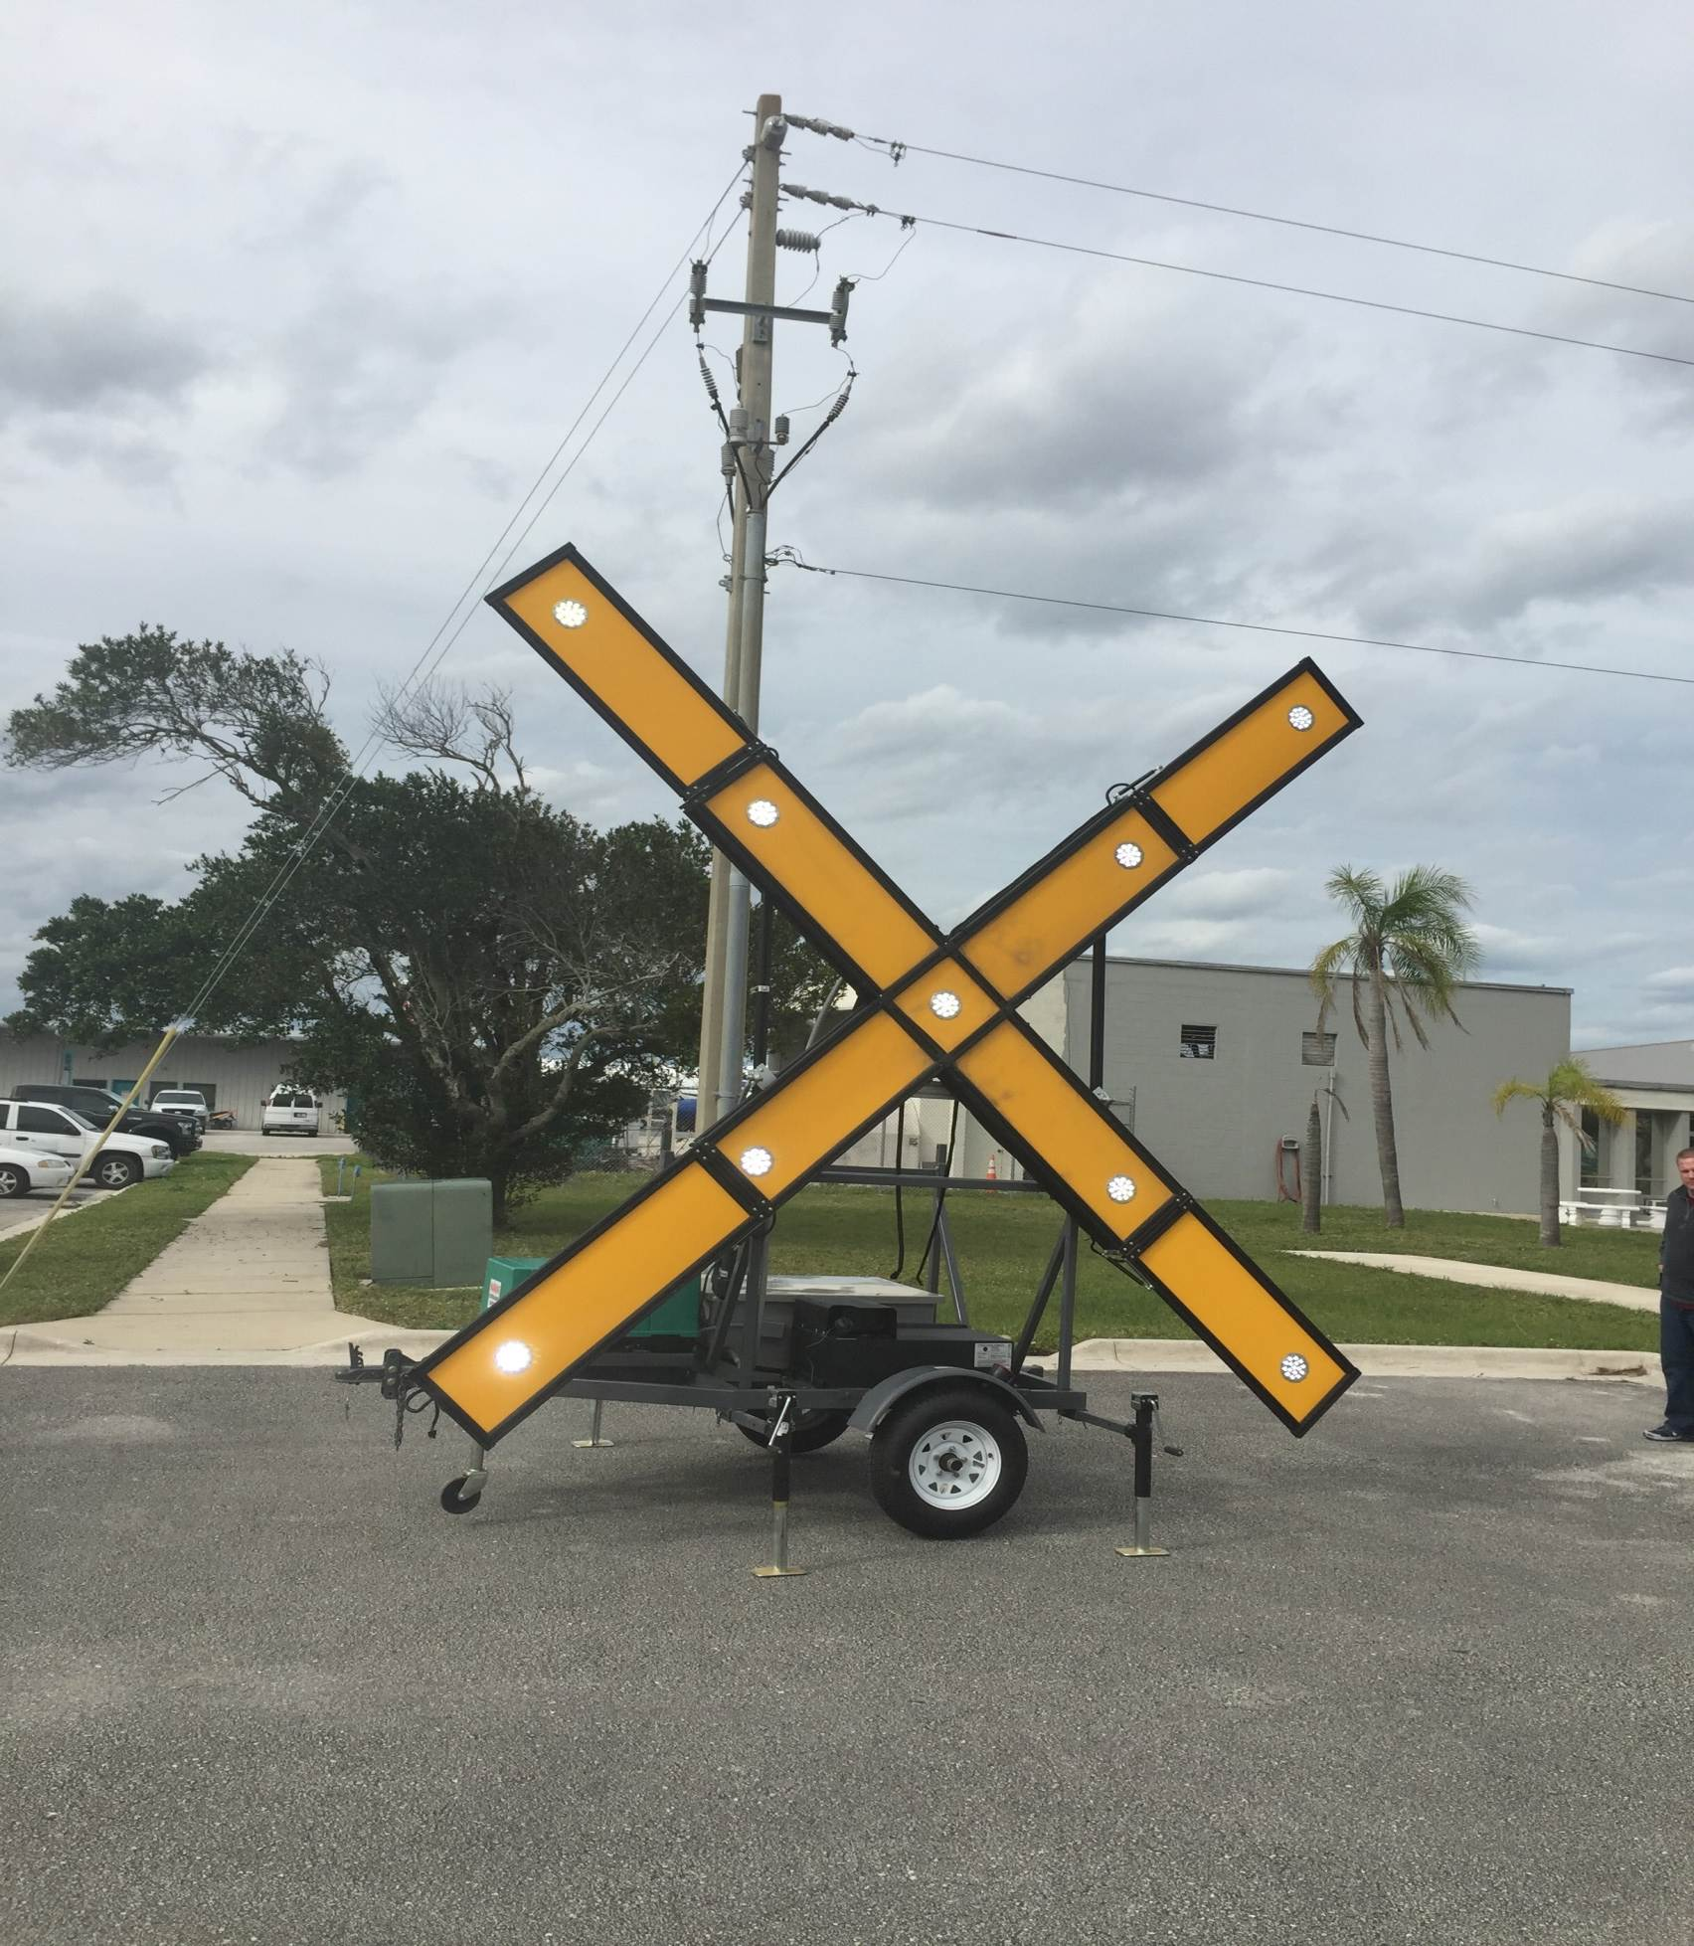
LED Lighted “X” Testing
Notes:
Arms are approximately 15’ 9” long
9 light sources

Slide 45
LED Lighted “X” Testing Overview
Photometrics
  Color (chromaticity) and Intensity (candela)
Performance Standards
  Appearance, Set-up, and Operation
Flight Testing - Incandescent and LED Lighted “X’s”
  Acquisition and Shape Recognition Distances (in nautical miles)
  Visibility
  Brightness
  Glare
Notes:
We are testing the LED lighted X to the incandescent lighted X standards
Photometric Testing
comparative tests – LED and Incandescent
Color testing is complete
Certified by Intertek – February 2016
Performance Standards – Paragraph 3.3 in AC 150/5345-55
Test LED to L893 Performance Standards
All complete except:
Measuring the color of the yellow X. It should be “aviation yellow.”
Photometrics
Appearance = light sources arranged in the shape of an X, light sources equally spaced, arms painted yellow on all sides, flash 2.5 seconds on/off, etc.
Set-Up = portable, set up in >5min on the runway
Takes longer to set-up – not a deal breaker.
All light sources are equally spaced, except two, located in the bottom left of the “X”
Operation = fail safe protection, run 24 hrs on portable power supply, switch between day and night intensities
**The team plans to make recommendations to update the Performance Standards discussed in the AC**
- Examples – set-up time remove or change from 5 min – 10 min?; built in inclinometer (lighted), level (lighted), and photocell
Flight Testing
Day and Night VMC
“X’s” installed on the runway numbers as directed in the Operational Safety During Construction on Airports AC
Flight testing the LED to the conclusions derived from incandescent lighted “X” testing completed in the late 80s
Acquisition distance – 5 nm both day and night
Recognize shape – 1.5 nm both day and night
We are measuring beam spread – 15 degrees each side of runway centerline; vertical coverage from 0 – 10 degrees, at a range of 1.5 NM

Slide 46




Flight Testing
Orlando Melbourne International Airport (MLB); Melbourne, Florida
Purdue University Airport (LAF); Lafayette, Indiana
Ohio State University Airport (OSU); Columbus, Ohio
Notes:
Runway lighting configuration:;
Edge lights off at OSU and Purdue; on at MLB
Airports have various light pollution
Tested by students with various flight certificates (e.g. student pilot – commercial pilot)
Flight instructor flies the flight profile, subject pilot evaluates the “X”
Flight profile – 1,000 feet – straight in approach
day = 10 nm from airport
Night – 15 nm from airport

Slide 47
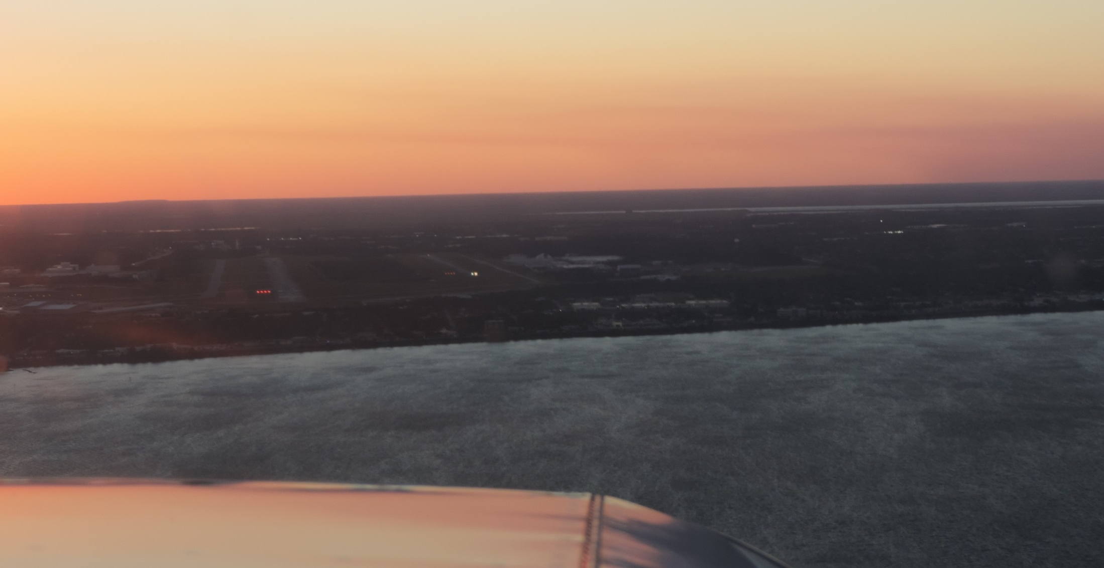
Incandescent and LED Lighted “X’s”
Day Flight - MLB
Notes:
Picture only
Side-by side test – LED (left) Incandescent (right)
This picture was taken when we were on final to land on Runway 27L

Slide 48
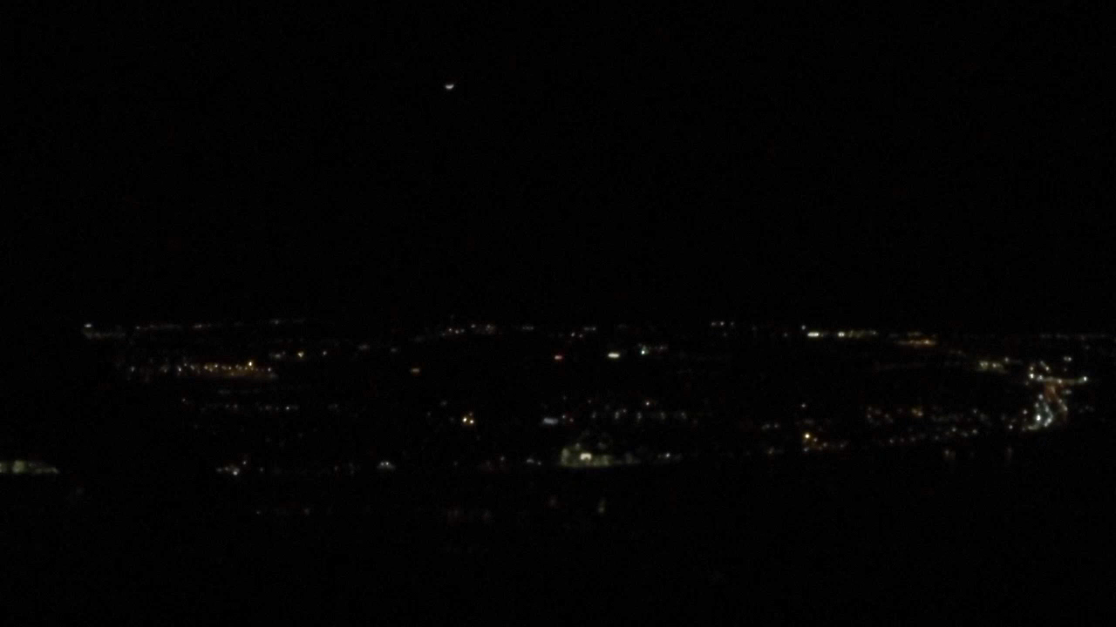
LED Lighted “X” Night Flight - MLB
Notes:
I minute video clip.
Thoughts on having FIT take side-by-side (LED/Incnadescent) go-pro footage. They flight test on Tuesday? I think it would be good to show the group a side by side of the LED and incandescent lighted “X”.
LED lighted X:
Popped, was sharp and crisp.
Was “bright enough”
No glare issue
We could clearly recognize its shape

Slide 49
Project Milestones and Schedule
Milestone | Completion Date
Performance Standards | March 2016
Photometric Testing | April 2016
Flight Testing | March 2016
Final Report | June 2016
Notes:
Performance standards – all completed except measuring color of the yellow X
Photometrics – Chromaticity testing is complete; need to complete intensity testing

Slide 50
LED Electrical Infrastructure
Research

Slide 51
Issues resulting from LED implementation in the Current 6.6A Series Airfield Lighting System
Added complexity and cost to the LED fixture due to the addition of electronics to mimic the non-linear dimming curve of incandescent lighting.
Notes:
Just to review…we’re looking at what the most efficient and effective infrastructure for LEDs.

Slide 52

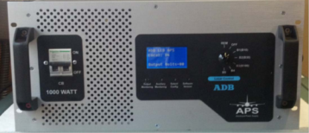
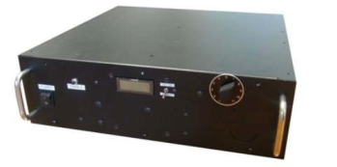






Architectures Tested
Notes:
Examples of the vault centric and fixture centric architecture

Slide 53
Roadmap Testing Phase
Alpha testing at FAATC, May 2015
  Integration including mixing of product
  Fixtures will be instrumented and monitored by FAA equipment to determine performance
  Identify any deficiencies, or adjustments to be made
Beta testing at PEGASAS Airport March, 2016
  Similar set up as alpha testing
  Large circuit
  Legacy mode will be available in case there is an issue with the circuit
Notes:
Upcoming testing

Slide 54

Purdue Airport Taxiway “C” (Beta Test Circuit)

Slide 55


Slide 56


Slide 57
New Technologies
The FAA R&D Visual Guidance Program has continued to explore technologies to increase surface safety and reduce the rate of runway incursions
  A literature review report was completed in November, 2015
  One technology recommended in the report that is being considered for further study at the present time is addressable airfield signage

Slide 58

Previous Addressable Sign Study

Slide 59


Current LED Addressable Signage

Slide 60



Potential Applications (cont.)

Slide 61
Research Proposed
A comprehensive study is proposed to evaluate the human factors challenges and technical requirements for addressable signage
The outcome of this study will be recommendations for standards for addressable signage use and technical specifications

Slide 62
Questions/Comments?
Robert.Bassey@faa.gov
609-485-5816
www.airporttech.tc.faa.gov

