Slide 1
New Facility and Construction Updates

Slide 2
New Facilities – 2017 and Beyond
Photometric Laboratory
NextGen Pavement Lab Expansion Office Space
Airport Safety Tech Storage / Warehouse
March 15, 2016

Slide 3
Technical Center Construction Approval Process
Technical Center Master Planning Approval
Site Selection
Infrastructure Requirements
Environmental Assessment
Review and Approvals by State and Federal Agencies
Design
Plans and Specifications
Construction
March 15, 2016

Slide 4
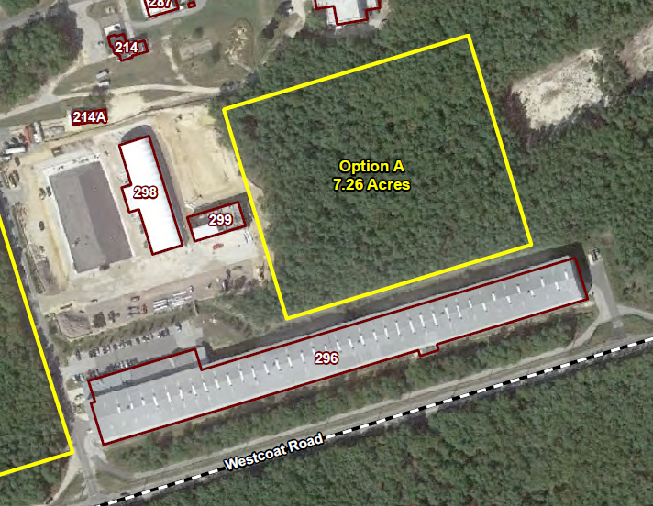
Site Selection
Water; Fire and Sewer Lines were Extended During
Current Construction
March 15, 2016

Slide 5
Site Selection
Can utilize Existing Environmental Assessment Study
Reduced Time and Cost
Water, Fire and Sewer Lines have been Extended to the Site
Produces a More Centralized Campus
Does not Require Personnel to cross Pangborne Ave. to go to Bldgs. 296, 298 or 299
March 15, 2016

Slide 6
New Facility Planning

Slide 7
Technical Center Construction Approval Process
Technical Center Master Planning Approval
Site Selection
Infrastructure Requirements
Environmental Assessment
Review and Approvals by State and Federal Agencies
Design
Plans and Specifications
Construction
March 15, 2016

Slide 8
Status of Environmental Assessment
Environmental Assessment began September 2015
Draft EA submitted February 4, 2016
Included FoNSI, Finding of No Significant Impact
Review comments by FAA have been provided
Revised Draft EA submitted March 2, 2016 for FAA Review
March 15, 2016

Slide 9
Status of Environmental Assessment
Next Steps
FAA submits final EA version to state and Federal regulatory agencies for comment (Est. early April)
Public comment and review period
Comments addressed
June 2016 completion of EA and FONSI

Slide 10
Technical Center Construction Approval Process
Technical Center Master Planning Approval
Site Selection
Infrastructure Requirements
Environmental Assessment
Review and Approvals by State and Federal Agencies
Design
Plans and Specifications
Construction
March 15, 2016

Slide 11
Design
Design Scope of Work is under development through Technical Center Facilities Engineers
Funded possibly with year end money if available
Potential award of design contract August 2016

Slide 12
Thank You
March 15, 2016

Slide 13
QUESTIONS?
Comments?
www.airporttech.tc.faa.gov
Murphy.Flynn@faa.gov
March 15, 2016

