Slide 1
Full-Scale Testing
Overload Update
REDAC Subcommittee on Airports
David R. Brill, P.E., Ph.D.
March 15, 2016

Slide 2
Review - Current ICAO Overload Criteria
ICAO Annex 14, “Aerodrome Design and Operations,” defines the following overload criteria:
  for flexible pavements, occasional movements by aircraft with ACN not exceeding 10 per cent above the reported PCN should not adversely affect the pavement;
  for rigid or composite pavements, in which a rigid pavement layer provides a primary element of the structure, occasional movements by aircraft with ACN not exceeding 5 per cent above the reported PCN should not adversely affect the pavement;
  the annual number of overload movements should not exceed approximately 5 per cent of the total annual aircraft movements.
In addition, overloads should not be allowed on pavements exhibiting distress or failure, or during periods of thaw.
The airport authority should review the pavement condition regularly, and review overload criteria periodically.

Slide 3
CC8 Overload Test
Objectives:
  Evaluate the current ICAO overload criterion (5% above PCN) for rigid pavements.
  Develop new rational overload criteria.
  Bring CC8 test pavement to a suitable condition to receive PCC overlay in next phase (target SCI 80).
Traffic testing began February 22 and continued through March 3 (2 weeks).
Traffic will resume in the spring (exact date TBD).

Slide 4
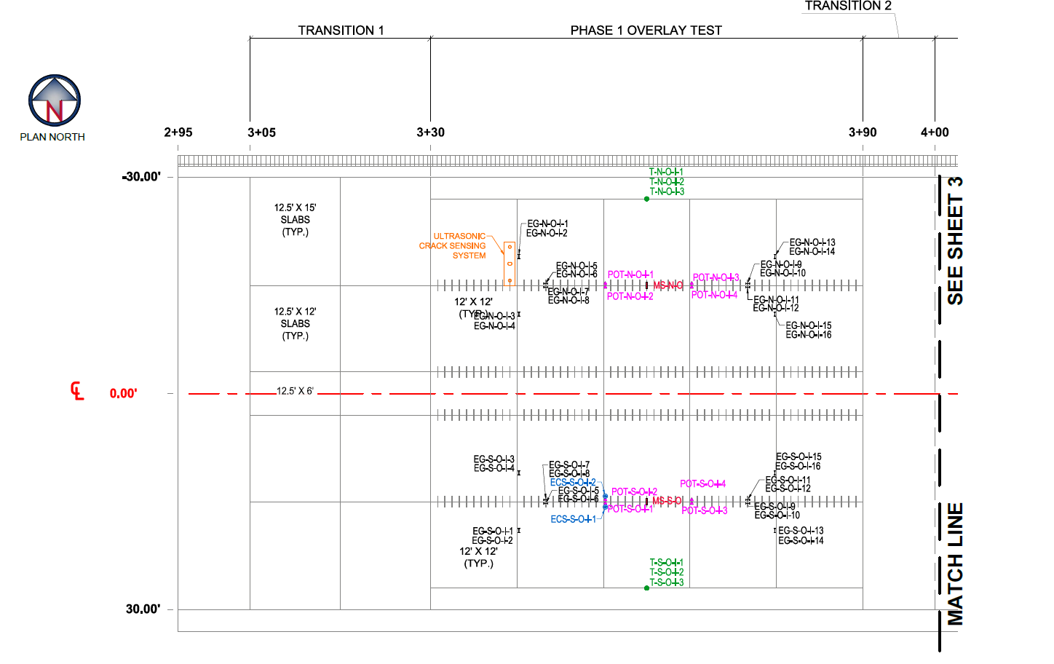
CC8 Test Area Layout
NORTH Test Item (no overload)
SOUTH Test Item (5%-25% overload based on PCN)

Slide 5
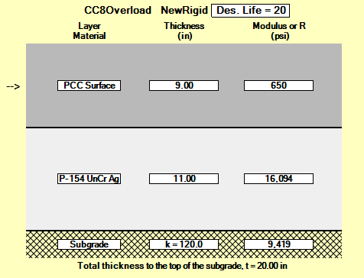
CC8 Test Section
Concrete Flex Strength R = 650 psi
(tested reserved beams at approx. 180 days)
9 in. PCC surface / P-154 base layer (representative of non-hub/GA facility).
FAARFIELD 1.4:
  Use NAPTF dual gear @ 20,000 lbs./wheel.
  FAARFIELD life prediction
  = 10,405 passes.
COMFAA 3.0:
  PCN 21/R/C
  (both test items)
  ACN of dual gear = 20.4/R/C
Subgrade k = 120 pci
(average of preconstruction plate load tests)

Slide 6
Overload Traffic Plan (Initial)
Normal Load (North & South). Run one complete wander pattern (66 passes) on both test items using dual gear @ 20,000 lbs./wheel (ACN = 20.4).
Overload (South test item only) using 2D gear:
Resume normal load (North & South). Continue traffic using dual gear @ 20,000 lbs./wheel until failure is observed (defined as 50% of slabs with 1 through crack).
Overload (nominal) | Overload (actual) | ACN | 2D Wheel Load, lbs.
5% | 4.0% | 21.8 | 21,500
10% | 10.1% | 23.1 | 22,500
15% | 13.2% | 23.8 | 23,000
20% | 19.6% | 25.1 | 24,000
25% | 26.0% | 26.5 | 25,000

Slide 7
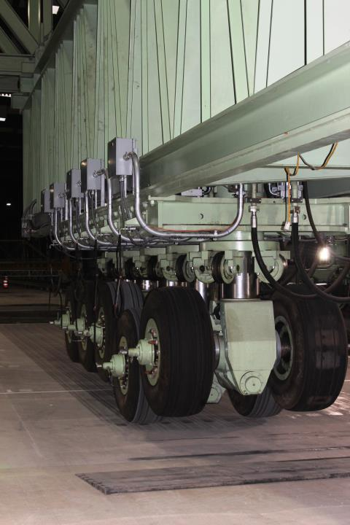
Initial Trafficking (Feb. 22-24)
Trafficking on Feb. 24, 2016
Day | Normal Wanders | Overload Wanders
2/22/2016 | 1 | 5 (5%, 10%, 15%, 20%, 25%)
2/23/2016 | 9 | -
2/24/2016 | 10 | -
Initial trafficking (20 wanders = 1320 passes) caused no visible damage on either test item.
Decided to re-evaluate PCN and increase loads.

Slide 8
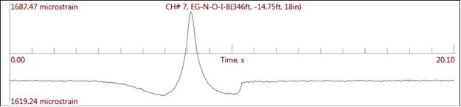
Strain Gage Data Analysis
Average peak tensile strain from all longitudinal bottom gages = 59 μ-strain. Corresponds to max. 319 psi at bottom surface of 9" PCC slabs.
Stress is less than 50% of flexural strength (650 psi) and less than assumed in the original analysis.
Based on the structural capacity obtained from strain gages, increase PCN and revise the test plan.
New PCN = 30/R/C for both test items.
59 μ-strain

Slide 9
Revised Traffic Plan
Normal Load (North & South). Run one complete wander pattern (66 passes) on both test items using dual gear @ 28,000 lbs./wheel (ACN = 29.9).
Overload (South test item only) using 2D gear:
Resume normal load (North & South). Continue traffic using dual gear @ 28,000 lbs./wheel until failure is observed (defined as 50% of slabs with 1 through crack).
Overload (nominal) | Overload (actual) | ACN | 2D Wheel Load, lbs.
5% | 4.7% | 31.4 | 28,500
10% | 9.3% | 32.8 | 29,500
15% | 14.3% | 34.3 | 30,500
20% | 19.3% | 35.8 | 31,500
25% | 24.3% | 37.3 | 32,500

Slide 10
Revised Traffic (Feb. 25 – Mar. 3)
Day | Normal Wanders | Overload Wanders
2/25/2016 | 1 | 3 (5%, 10%, 15%)
2/26/2016 | 8 | 2 (20%, 25%)
2/29/2016 | 10 | -
This slide will be updated based on testing results week of Feb. 29.
First 3 overload wanders caused no visible cracks or damage.

Slide 11
CC7 Overload Update
Objectives:
  Evaluate the current ICAO overload criterion (10% above PCN) for flexible pavements.
  Develop new rational overload criteria.
  Consider ACN, percent used pavement life (CDF), overload gear type (D, 2D, 3D).
Current status:
  12,606 passes have been completed.
  Overloads at ACNs 50% & 75% above PCN and at 1.0 CDF remain to be tested. Planned for spring.
  Traffic is on hold while we complete testing on CC7 North. (Colder temperatures are preferred for North test objectives.)

Slide 12
Preliminary Observations
(review from the last meeting)
Observed an increase in the rate of rutting after overload of 0.5 CDF and 130% of PCN.
Number of wheels in overload gear does not appear to have a significant effect on permanent damage for the same ACN or CDF.
MDDs show rutting accumulates primarily in the P-154 subbase layer.

Slide 13
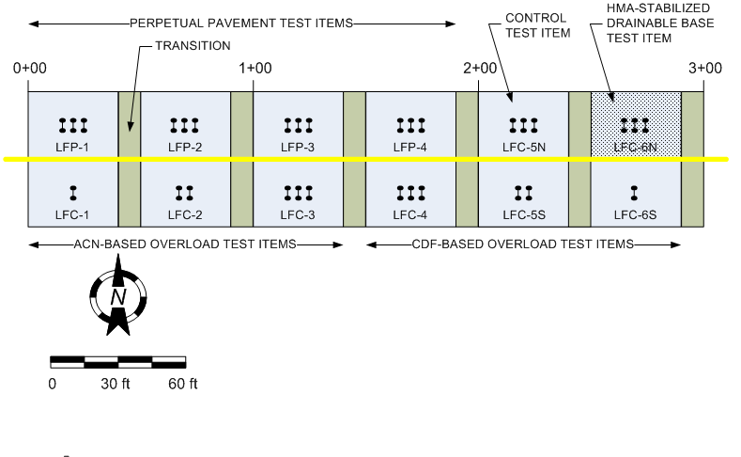
CC7 Test Item Layout

Slide 14
CC7 Overload Test Items
40-ft. (12.2-m) test items separated by 10-ft. (3 m) transitions.
CBR 5 (subgrade category C)
All 6 test items have the same structure.
Thin HMA sections represent GA airports receiving occasional overload operations.
  3 in. P-401
  6 in. P-209
P-154 thickness designed to give nominal PCN = 35/F/C.
  Assumed “lifetime” traffic of 27,000 passes of NAPTF 72,000-lb. dual gear (36,000 lbs. per wheel).
  Use COMFAA 3.0 to compute PCN.

Slide 15
Instrumentation Layout (LFC1-S)
TSG – Transverse Strain Gage
LSG – Longitudinal Strain Gage
MDD – Multi-Depth Deflectometer
PC – Pressure Cell
MS – Moisture Sensor
SS – Suction Sensor
T – Thermocouple

Slide 16
General Test Procedures
ACN-Based Overload Test Items:
  Traffic at “normal” load (D-36) until rate of rut depth accumulation (RRDA) stabilizes*.
  Increase load to 110% PCN. Traffic until RRDA stabilizes, but not more than 1350 passes (5% lifetime traffic).
  Resume traffic at normal load. Observe any change in RRDA or other responses (MDD, strain).
  Increase load to 120% PCN and traffic until RRDA stabilizes.
  Repeat steps 3 & 4 following the overload schedule. Continue until failure is observed.
  * “Stable” is defined as an approximately constant rate of total rut depth accumulation with applied passes, following any initial shakedown phase.
CDF-Based Overload Test Items:
  Traffic at “normal” load (D-36) until rate of rut depth accumulation (RRDA) stabilizes*.
  Apply one wander pattern at overload designed to consume CDF = 0.1.
  Resume traffic at normal load. Observe any change in RRDA or other responses (MDD, strain).
  Apply one wander pattern at overload designed to consume CDF =0.25.
  Resume traffic at normal load. Observe any change in RRDA or other responses (MDD, strain).
  Apply one wander pattern at overload designed to consume CDF =0.5.
  Resume traffic at normal load. Observe any change in RRDA or other responses (MDD, strain).
  Apply one wander pattern at overload designed to consume CDF =1.0.
  If Step 6 does not fail the test item, return to normal load(dual) and traffic until the pavement behavior stabilizes or failure is observed.
  Repeat Steps 8 and 9 until failure.

Slide 17
Overload Schedules
✓ Indicates that overload has been completed.
ACN-Based Overload Test Items LFC S-1, 2, 3
CDF-Based Overload Test Items LFC S-3, 4, 5
ACN Criterion
Gear Type | Overload | ACN | Passes | Wheel Load, lbs.¹
D | 100% PCN | 35.02 | N/A | 36,000
D✓ | 110% PCN | 38.38 | N/A | 39,000
D✓ | 119% PCN | 41.82 | N/A | 42,000
D✓ | 126% PCN | 44.14 | N/A | 44,000
D | 146% PCN | 51.26 | N/A | 50,000
D | 164% PCN | 57.56 | N/A | 55,000
2D✓ | 110% PCN | 38.63 | N/A | 35,500
2D✓ | 121% PCN | 42.44 | N/A | 38,000
2D✓ | 130% PCN | 45.65 | N/A | 40,000
2D | 149% PCN | 52.31 | N/A | 44,000
2D | 175% PCN | 61.30 | N/A | 49,000
3D✓ | 111% PCN | 38.71 | N/A | 34,500
3D✓ | 120% PCN | 42.06 | N/A | 36,500
3D✓ | 130% PCN | 45.56 | N/A | 38,500
3D | 148% PCN | 51.91 | N/A | 42,000
3D | 171% PCN | 59.76 | N/A | 46,000
CDF Criterion
Gear Type | Overload | ACN | Passes | Wheel Load, lbs.²
D✓ | CDF = 0.09 | N/A | 66 (1 wander) | 46,000
D✓ | CDF = 0.25 | N/A | 66 (1 wander) | 52,000
D✓ | CDF = 0.49 | N/A | 66 (1 wander) | 57,000
D | CDF = 0.98 | N/A | 66 (1 wander) | 62,500
2D✓ | CDF = 0.10 | N/A | 66 (1 wander) | 40,500
2D✓ | CDF = 0.25 | N/A | 66 (1 wander) | 45,500
2D✓ | CDF = 0.51 | N/A | 66 (1 wander) | 50,000
2D | CDF = 0.98 | N/A | 66 (1 wander) | 54,500
3D✓ | CDF = 0.10 | N/A | 66 (1 wander) | 37,000
3D✓ | CDF = 0.25 | N/A | 66 (1 wander) | 41,500
3D✓ | CDF = 0.51 | N/A | 66 (1 wander) | 45,500
3D | CDF = 1.06 | N/A | 66 (1 wander) | 50,000
¹Based on COMFAA 3.0
²Based on FAARFIELD 1.4
Wheel loads are adjusted to the nearest 500 lbs. due to vehicle limitations.
OVERLOAD REPEATED

Slide 18
CC7 Overload Test Summary
As of March 15, 2016
Test Phase | Dates | Vehicle |  | Test Items LFC1-S – LFC3-S | Test Items LFC4-S – LFC6-S | Description
 |  | Passes | Wanders | Passes | Passes
1 | 10/6/14 – 10/16/14 | 1-924 | 1-14 | 1-924 | 1-924 | Initial normal load
2 | 10/20/14 | 924-990 | 15 | - | 925-990 | 0.1 CDF Overload
 | 10/21/14 – 10/28/14 | 991-1650 | 16-25 | 925-1584 | - | 10% ACN Overload
3 | 10/29/14 – 11/13/14 | 1650-3168 | 26-48 | 1585-3102 | 991-2508 | Resume Normal Load
4 | 11/17/14 | 3169-3234 | 49 | - | 2509-2574 | 0.25 CDF Overload
 | 11/17/14 – 11/25/14 | 3235-4224 | 50-64 | 3103-4092 | - | 20% ACN Overload
5 | 12/2/14 – 12/4/14 | 4225-4752 | 65-72 | 4092-4620 | 2574-3102 | Resume Normal Load
 | 12/4/14 |  |  |  |  | Test suspended until June 2015
6 | 6/15/15 – 6/22/15 | 4753-5544 | 73-84 | 4621-5412 | 3103-3894 | Resume Normal Load
7 | 6/29/15 | 5545-5610 | 85 | - | 3895-3960 | 0.50 CDF Overload
 | 6/29/15 – 7/6/15 | 5611-6468 | 86-98 | 5413-6270 | - | 30% ACN Overload
8 | 7/8/15 – 8/10/15 | 6468-8778 | 99-133 | 6271-8580 | 3961-6270 | Resume Normal Load
9 | 8/31/15 | 8779-8844 | 134 | - | 6271-6336 | Repeat 0.50 CDF O/L
 | 8/31/15 – 9/10/15 | 8845-10362 | 135-157 | 8581-10098 | - | Repeat 30% ACN O/L
10 | 9/14/15 – 10/19/15 | 10363-12606 | 158-191 | 10099-12342 | 6337-8580 | Resume Normal Load
 | 10/19/15 |  |  |  |  | Test suspended to traffic CC7 North
Total |  | 12606 | 191 | 12342 | 8580

Slide 19
Rut Depth Monitoring
Physical 16-foot straight edge.
Rail-to-rail profile data.
  Generates raw data files at 2.5 mm from Selcom laser.
  Decimate to 25 mm.
  Compute a virtual 16-ft. straight edge rut depth.
360° Ultra-High-Speed Laser Scanner (Leica Model P20)
  New source of highly accurate profile data.
  Use scans to correct rail-to-rail profiles for beam curvature.
  Extracting transverse profiles from acquired scans is a time consuming process. We are working to improve efficiency.
Profile data are collected:
  After every completed wander pattern (66 passes).
  At intermediate passes on the zero track (24 and 48 passes) during overload or if deemed necessary.

Slide 20
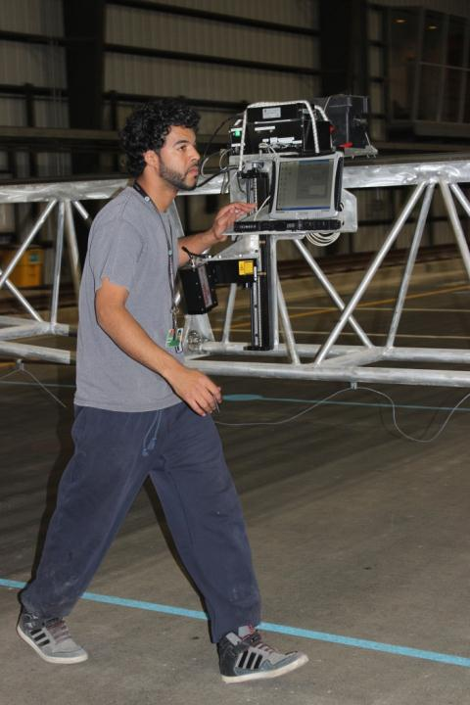
Rut Depth Monitoring
Rail-to-Rail Profiler
New Transverse Profile Monitoring Software
Automatically corrects profile based on fixed reference.
Computes maximum rut depth for “virtual” 16-foot straight edge (or any length).
Gives accumulated rut depth and upheaval at each section.

Slide 21
Transverse Profile Analysis
UPHEAVAL
CORRECTED BASELINE
RUT

Slide 22
Rut Depth/Upheaval – LFC-1
2-Wheel Gear Overload

Slide 23
Rut Depth/Upheaval – LFC-2
4-Wheel Gear Overload

Slide 24
Rut Depth/Upheaval – LFC-3
6-Wheel Gear Overload

Slide 25
Rut Depth/Upheaval – LFC-4
6-Wheel Gear Overload

Slide 26
Rut Depth/Upheaval – LFC-5
4-Wheel Gear Overload

Slide 27
Rut Depth/Upheaval – LFC-6
2-Wheel Gear Overload

Slide 28
Summary – CC7 Overload
Sections were designed for 27,000 passes at the normal load.
Over 12,000 passes applied, including overloads.
  No early structural failure observed yet.
  Max. upheaval outside the trafficked area 0.5 in.
  (up to 0.75 in. at sta. 1+25).
  Deep ruts observed mainly in the P-154 subbase.
Testing will resume with additional high overloads (+50% and +75% PCN, and 1.0 CDF) that may cause obvious structural failure.

