Slide 1
Aviation Rumble Strip Project Update March 16, 2016

Slide 2
Utilizing a Center of Excellence
PEGASAS
Partnership to Enhance General Aviation Safety, Accessibility and Sustainability

Slide 3
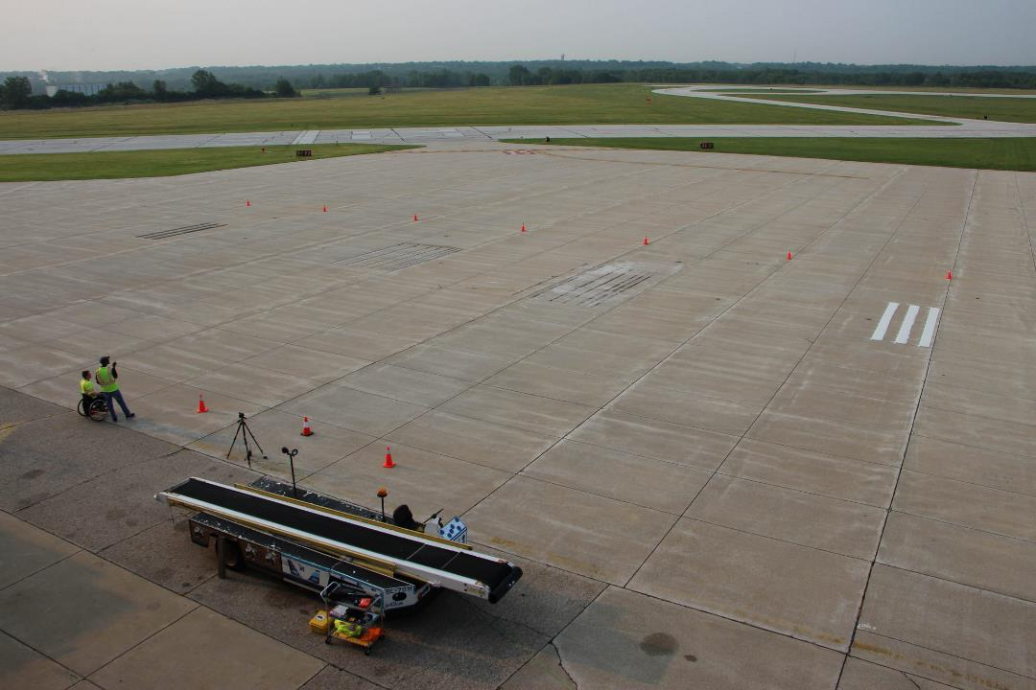
2015 Purdue Airport Rumble Strip Test Site
Temporary
Saw Cut
Thermoplastic

Slide 4
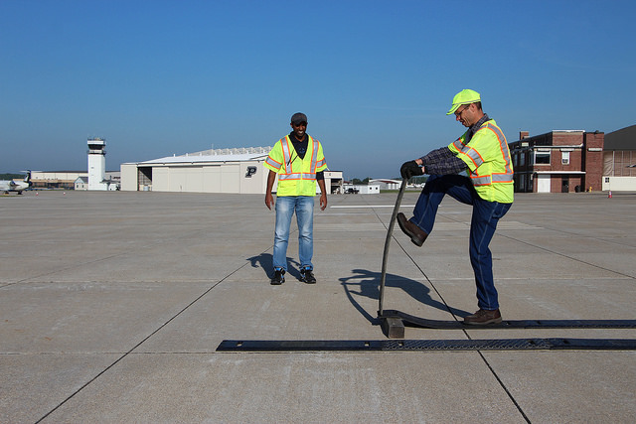
Temporary

Slide 5
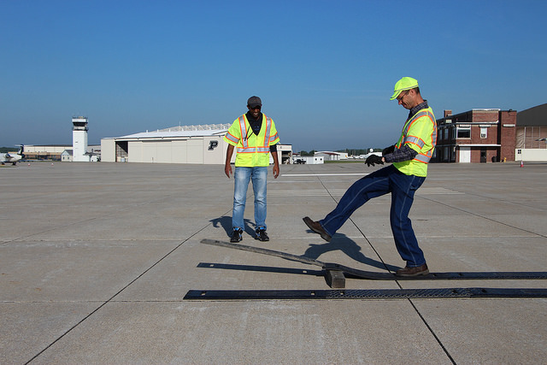

Slide 6
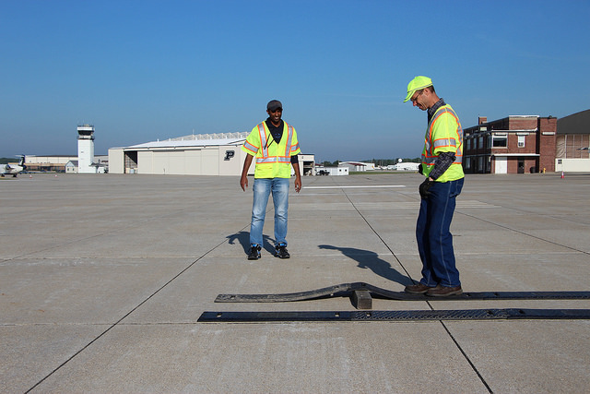

Slide 7
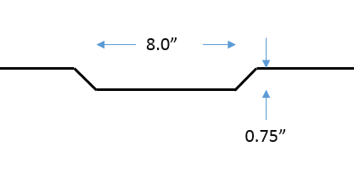
Saw Cut Options
Square Cut
Bevel Cut

Slide 8
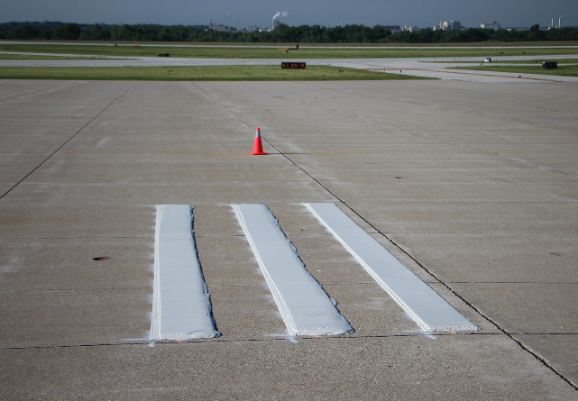
Thermoplastic
Easy to construct
Semi-intrusive
Permanent
Proven to withstand winter ops in roadway environment

Slide 9
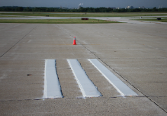
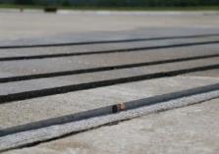
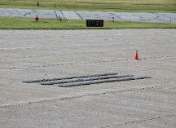
PEGASAS Test Configuration
Thermoplastic Sawcut Temporary

Slide 10
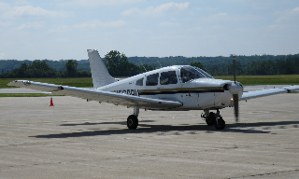
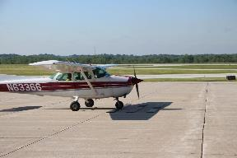
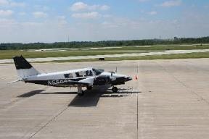
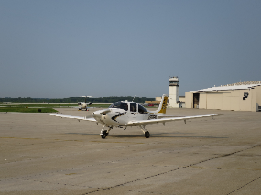
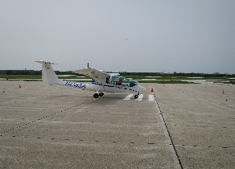
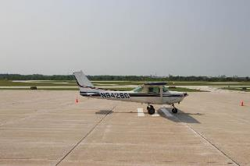
Aircraft Used in Study
PIPER PA 28
CESSNA 172
CESSNA 152
PIPER PA 34
CRJ-100ER
CIRRUS SR20
CESSNA 152
SKY ARROW

Slide 11
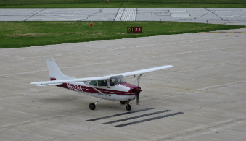
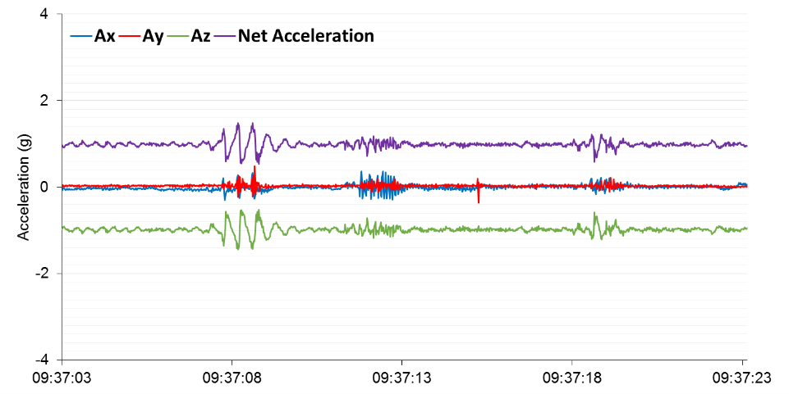
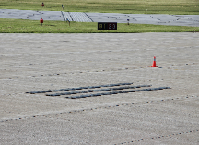
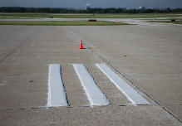
Acceleration Graph
Aircraft: Cessna 172 Speed:5 knots
Temporary
Saw Cut
Thermoplastic
Notes:
bg

Slide 12
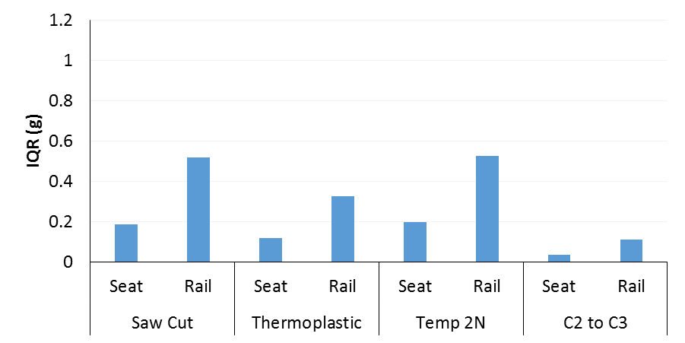
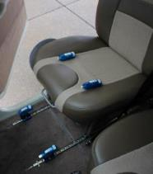
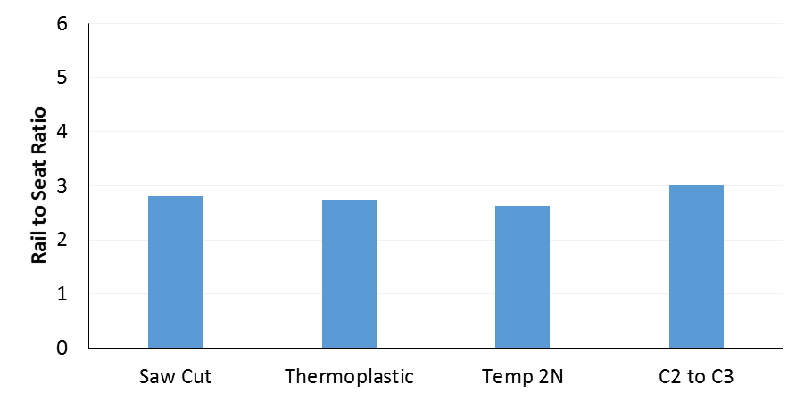
Affects on Pilots and Airframe Rail-to-Seat Plots for 10 kts
Significant airframe acceleration must occur for pilot to feel rumble strip
Seat
vs.
Rail
2.805
2.739
2.63
Airframe affected by 2 to 3X the acceleration force felt by pilot, over time airframe manufacturers feel this may cause damage to the gears.

Slide 13
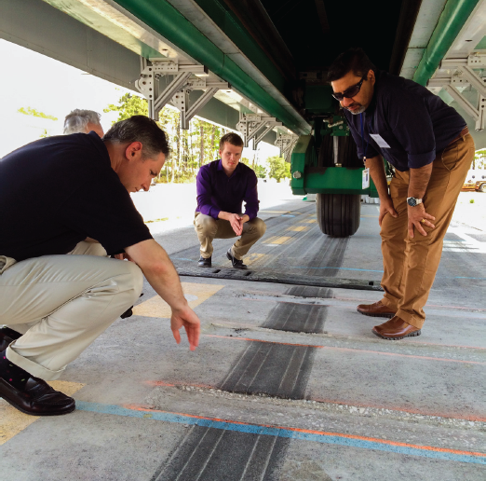
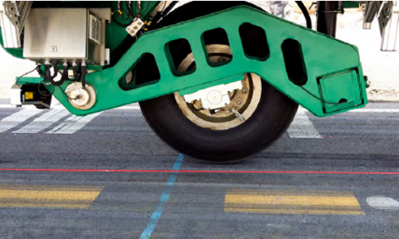
April 2015 Durability Testing

Slide 14
Tech Center Test Results
Day | Load Aircraft | Passes | Square Cut | Beveled | Temporary
Day 1 | 10k lbs. E190 | 1000 passes | Began crumbling at 500 passes | No change | No change
Day 2 | 15k lbs. CRJ-700 | 1000 passes | Continued crumbling | No change | No change
Day 3 | 30k lbs. 757-200 | 1000 passes | Heavily worn | No change | Sign of warn, but no damage
Day 4 | 45k lbs. 738/A321 | 500 passes | Heavily worn | No change | Connection point becoming loose
 | 60k lbs. 748/A380 | 10 passes | Heavily worn | No change | ~1/8” depression

Slide 15
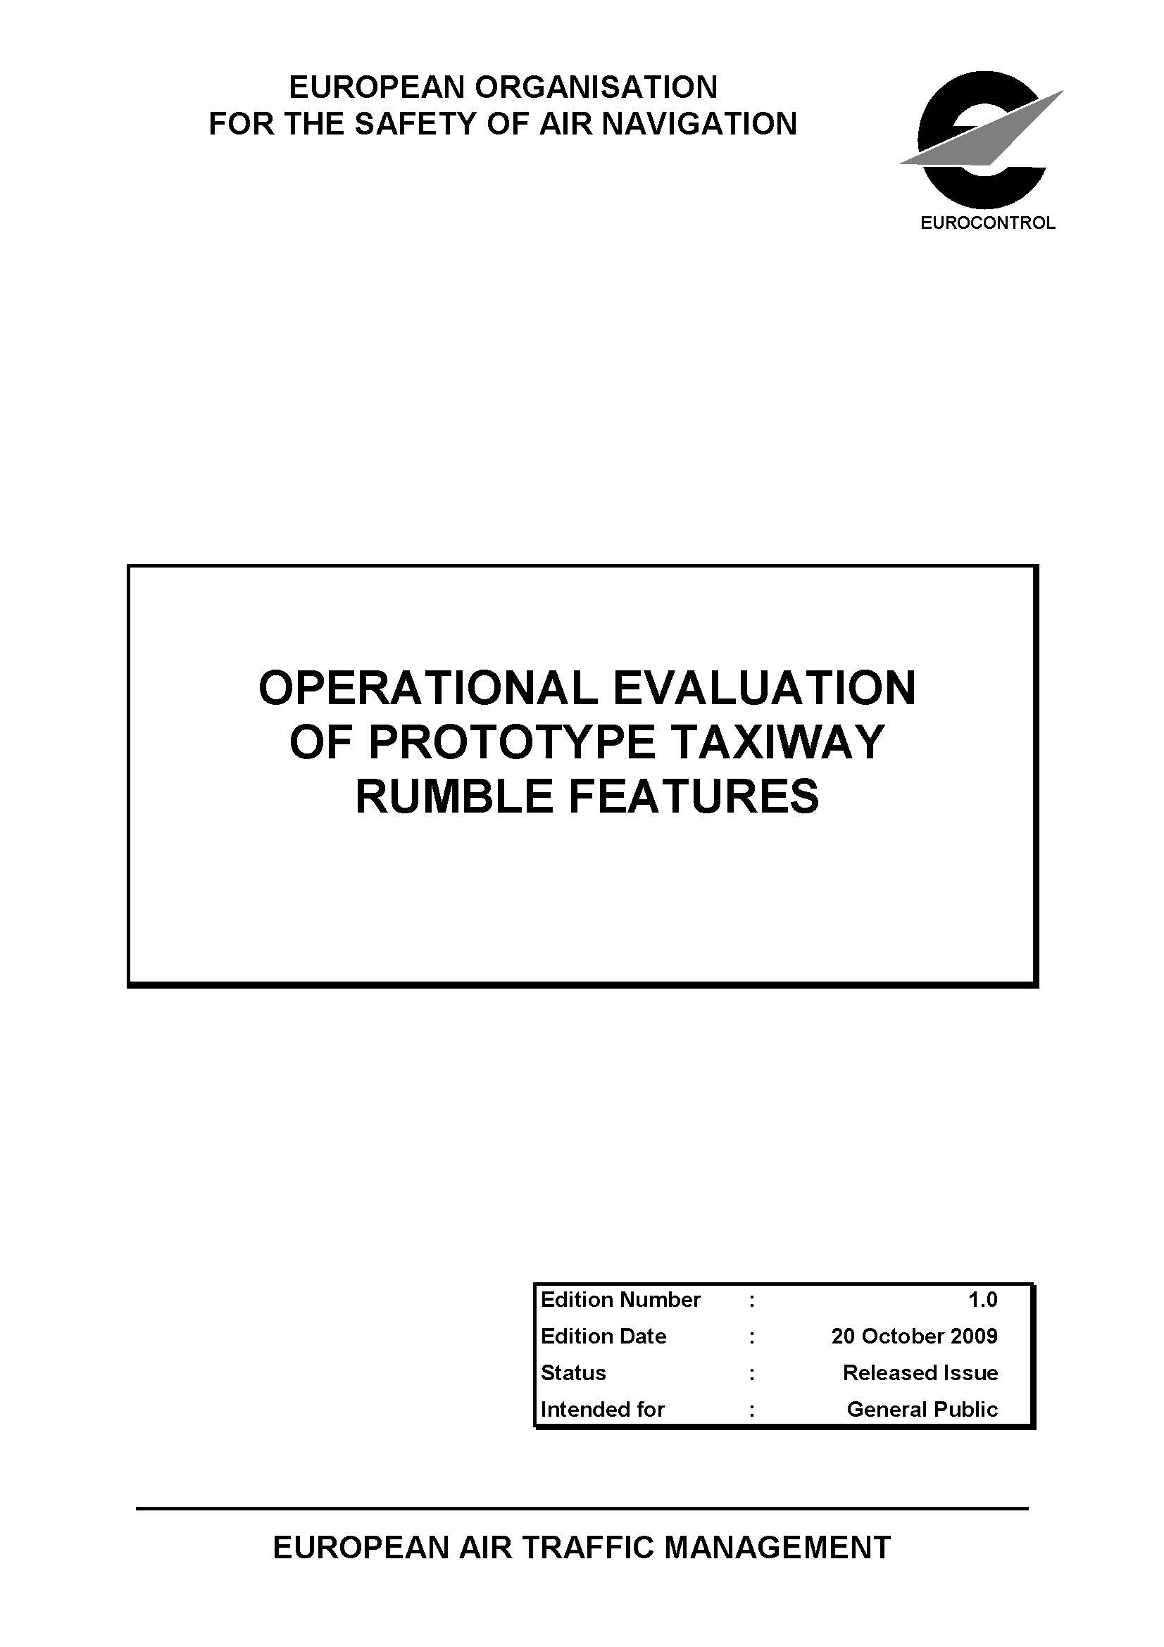

Slide 16
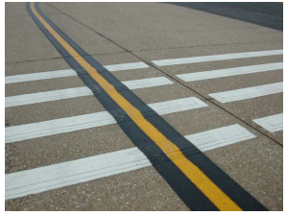
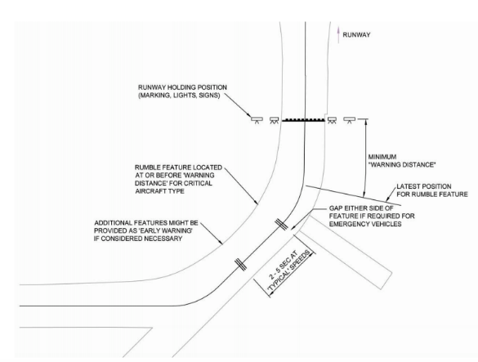
European Rumble Strip Study Deployed on Active Taxiway for 3 months at Southampton Intl Airport, England
19.7”
19.7”

Slide 17
European Rumble Strip Study
Feedback invited from pilots (35 responses) and ground vehicle operators (10 reports)
Pilots report rumble strips were discernible (varied by aircraft) but difficult to differentiate from other taxiway features (e.g., rough pavement)
Half assessed impact as “excessive”
Pilots did not recognize purpose and considered rumble strips a distraction
Did not affect capacity
Deemed ineffective for incursion prevention
19.7”
Each segment 11.8” wide
39.4’ long
0.47” high
19.7”

Slide 18
Our Evaluation Results

Slide 19
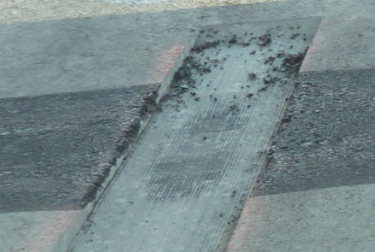
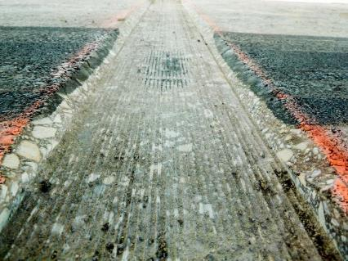
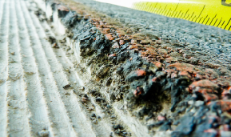
Problems with Durability of 90 degree Saw Cut at KLAF and at NJ Tech Center
Saw Cut

Slide 20
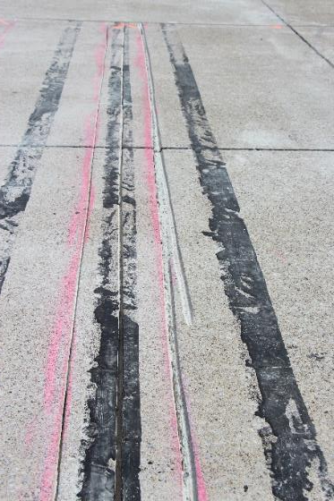
Constructability Challenges with 45 degree Bevel Saw Cut at KLAF and at NJ Tech Center
Saw Cut

Slide 21
Thermoplastic
Easy to construct
Semi-intrusive
Permanent
Proven to withstand winter ops in roadway environment

Slide 22
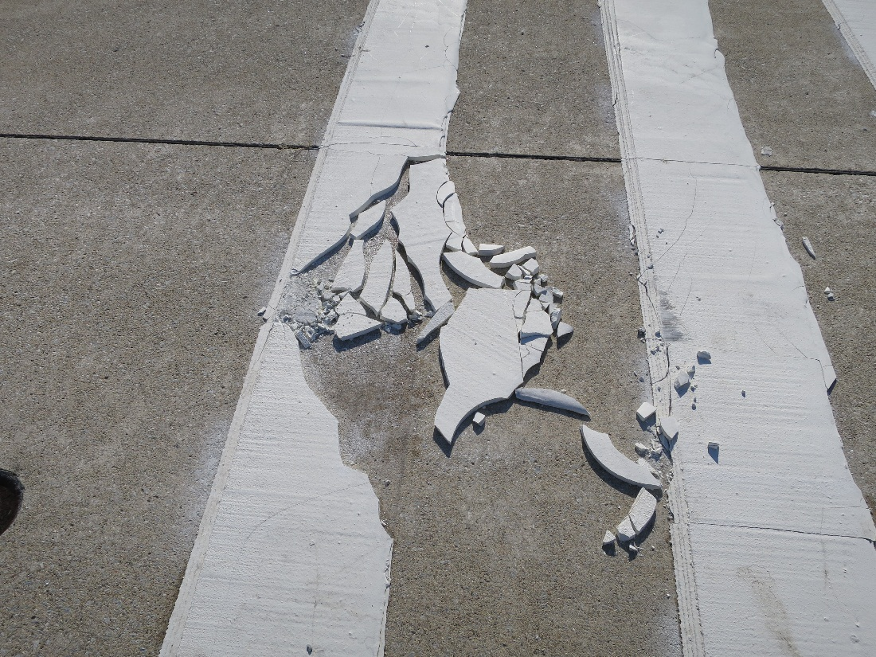
NOT on Airports! Rumble Strips were Damaged by Snowplows after First Snow and Were Subsequently Removed to Avoid FOD on Airfield at KLAF

Slide 23
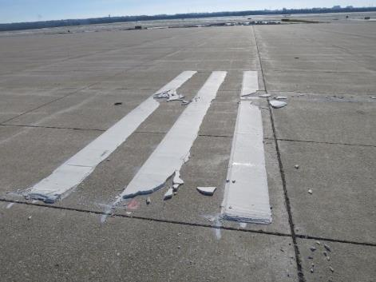
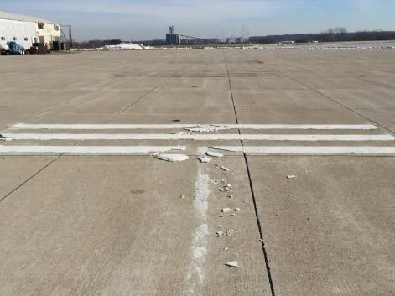
Thermoplastic has Problems with Durability

Slide 24
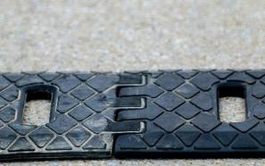
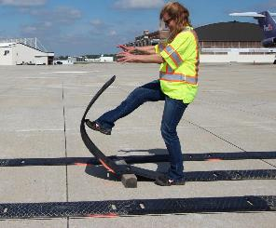
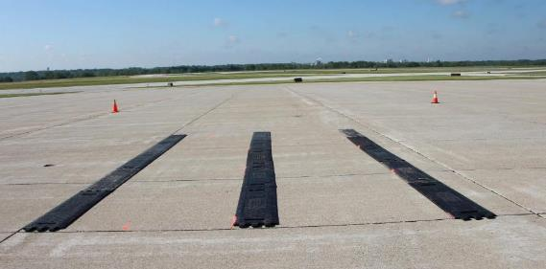
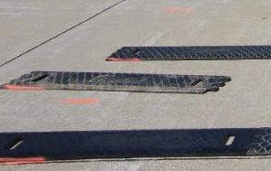
Temporary Rumble Strips
Allows temporary installation
Interlocking joints
Segments: 13” wide, 36” long, ¾” high, 35 lbs
Can be installed by one person

Slide 25
Conclusions
All Rumble Strip types evaluated, if installed permanently, may cause damage, with continual use, to the size of aircraft used in study.
Saw Cut Strip
Durability of 90 degree
Constructability with 45 degree bevel
Temporary Rumble Strips may be useful as a tactile warning to aircraft when used to identify a temporary change at an airport such as a construction areas etc.

Slide 26
Questions/Comments?

