Slide 1
Airport Safety
RPDs – 141, 142 & 149
REDAC Sub-Committee on Airports
Lauren Collins
March 16, 2016

Slide 2
Discussion Topics
Project Updates
RPD 149 - Aircraft Noise & Annoyance
RPD 141 – Data Mining Database
RPD 142 – Complex Geometry (RIM)

Slide 3
RPD 149 – Aircraft Noise & Annoyance Overview
Need
Research Goals
Although the number of people in the U.S. exposed to significant aircraft noise since 1975 has dropped by 95 percent, complaints, opposition and challenges regarding aviation noise have not.
DNL 65 dB has been used as the level of significance for aviation noise. The current landscape leads us to believe that the DNL 65 dB may no longer be appropriate.
Update scientific evidence of the relationship between aircraft noise exposure and its effects on communities around U.S. airports
Conduct surveys out to the DNL 50 dB contour at 20 airports.
Deliverables – Updated national dose-response curve and 20 individual airport dose-response curves.
FY 2016 Accomplishments
Funding Requirements
Began surveying October 2015
 | FY 15 | FY 16 | FY 17 | FY 18
Funding Target ($000) | 1mil | 750 | 750 | 1mil
Notes:
Why: Even though the number of people in the U.S. exposed to significant aircraft noise since 1975 has dropped by 95 percent, complaints, opposition and challenges regarding aviation noise have not.
How it’s done today: Since the late 1970s, DNL 65 dB has been used as the level of significance for aviation noise. The current landscape leads us to believe that the DNL 65 dB may no longer be appropriate.
What is new in the approach: The research and surveys being done will allow for the re-evaluation of the level of significance for aviation noise. It will allow for new data to gain a better understanding on how aviation noise is perceived by communities around airports.

Slide 4
Phases of Study
Phase 1 – Test Plan
ID Airports, Methodology
Phase 2 – Survey Instruments
Mail forms, Phone Interview, FICAN approval, OMB approval
Phase 3 – Data Collection
DNL 50-70 db contours, Mail goal 10,000 Completes, Phone goal 2,000 Completes
Phase 4 – Data Analysis
Create dose-response curves for annoyance
Notes:
Target is 500 mail and 100 phone per airport

Slide 5
Accomplishments Since August 2015
Data Collection began October 13th.
6 Waves
Each wave lasts 2 months
Wave 1 had 4,476 surveys sent
Number of mailings in each wave are adjusted within each noise strata/airport based on returns.
Wave 2 had 5,509 surveys sent
Notes:
All 20 airports simultaneously
For example - To account for differences in number of responses, Wave 2 mailing will mail to 429 subjects for the airport with the lowest Wave 1 response, and to 167 subjects at the airport with the highest Wave 1 response.

Slide 6
Notes:
1. Initial mailing via first class mail $2 bill
2. One week later thank you/reminder postcard
3. 2 weeks later another survey mailed via FedEx
4. 3 weeks later another survey mailed first class
Non-respondants can get up to 3 copies of the survey
Of the respondents, some get phone calls, 20 min interview $10

Slide 7
Data Collection Results to Date
Mail Survey Completes = 3,620*
Phone Survey Completes = 721*
Returns vary by airport and by noise strata within the airports
One inquiry at DOT level
High variations in completes by airports;
Most completes for an airport is 50%,
Fewest completes is ~24%,
Northern and smaller airports higher returns,
Southern airports fewer returns,
Could be a result of vacancy rates for different airports
*As of 2/18/16, Update on 3/10/16
Notes:
Ask Eric for updated info

Slide 8
Next Steps
Continue Data Collection through September 2016
ARP and AEE working on communication plan
Finalize analyses plan and variables
Hypothesize why the 20 individual dose-response curves may be different
Notes:
AEE thinking of changes to policy and what information they would need to defend the policy changes

Slide 9
Future Work
FY 16
Initiate 2 possible projects related to the survey
Interior Criteria for Sound Insulation Based on Changes in Noise Annoyance Threshold
Appropriate NEPA Changes Based on Changes in Noise Annoyance Threshold
FY 17-18
Follow-on work to survey (additional metrics)
Initiate Sleep Study

Slide 10
RPD 141 – Data Mining Database
Need
Research Goals
Comply with the Risk-Based Decision Making Initiative
‘What’s the next big thing?’
Develop an internal database of safety-related incidents and accidents for the Office of Airports.
Conduct analysis to determine risk areas, support data inquiries, conduct focus studies
Milestones – Quarterly Analysis Reports beginning April 2016
Deliverables – Annual Risk Report June 2016
FY 2016 Accomplishments
Funding Requirements
 | FY 15 | FY 16 | FY 17 | FY 18
Funding Target ($000) | 500 | 500 | 500 | 500
Re-design the database interface for ease of use and accessibility (web-based)

Slide 11
RPD 141- Data Mining Database
ASRS/NTSB/RI/ATQA/SDRS
Airport Safety Database
Notes:
To conduct an analysis of surface events to identify airport safety factors that may have contributed to aviation accidents and incidents on or at an airport.
NASA Aviation Safety Reporting System (ASRS)
NTSB Accident/Incident Database
FAA Office of Runway Safety RI Database
FAA Air Traffic Quality Assurance (ATQA) Database - PDS and VPDS
FAA Service Difficulty Reporting System (SDRS)

Slide 12
A Look at the Legacy Database – FY 2016
Microsoft Access based
Date range: 01/01/01 – 03/31/2015
Airports: 769 total
Event Records: 24,033
Continues to be an asset to the Office of Airports
Notes:
We are behind on pulling in data due to focus on the re-design.

Slide 13
Accomplishments Since August 2015
Data Requests from AAS-100:
Finalized Wrong Runway Landing/Takeoff and Taxiway Takeoff and Landing Report (FY 2008 – FY 2014)
Runway Incursion trends at VGT airport
MOS support at TPA for markings on TWY D
Runway excursions from runways less than 4200’
Veer offs for Code E aircraft

Slide 14
Accomplishments Since August 2015
Web-based Oracle Database Re-Design
Added data sources from legacy database
Additional airports (3,426 total)
Airport diagram library
New categorization methods
CAST/ICAO Common Taxonomy Team (CICTT)
Event Records = 39,940
Notes:
Prior had 769 airports, added a lot of non primary and GA airports
Airport diagram library will be updated every cycle and achieved.

Slide 15
Short Demo
http://nasasaa.crownci.com:8084/apex/f?p=104

Slide 16
Next Steps
Begin categorization
Quarterly Analysis Reports
Beginning with Q4 FY 2015
Annual Risk Report
Database interface enhancements
Expand data sources (Pilot UAS, Mobile Alerts, AIDS, and others)
OEDs are collected in CEDAR, investigate access
Explore using metrics for analysis and predictive risk assessments
Notes:
Begin categorization – emphasize that when all data is categorized, the DB will be current within 6 mts of the current date, at a minimum.
Quarterly analysis reports will be high level. If we see trends, recurring themes, we can conduct a focused and in-depth analyst of the issue(s), similar to wrong runway report.
Database interface enhancements – high level list of priority items.
Data sources

Slide 17
RPD 141 – Complex Geometry (RIM)
Need
Research Goals
Inventory and prioritize a list of non-standard geometry locations, by incursion frequency.
Estimate construction unit costs for locations identified.
Initiate a 10-year improvement program to correct high-risk areas on airports with complex non-standard geometry.
Milestones – Annual updating of RIM points
Deliverables – RIM Management Tool, RIM Inventory
Analysis of exactly
WHERE
the incidents were happening
FY 2016 Accomplishments
Funding Requirements
 | FY 15 | FY 16 | FY 17 | FY 18
Funding Target ($000) | 1mil | 1mil | 750 | 750
Develop a RIM Management Tool Module inside AGIS.

Slide 18
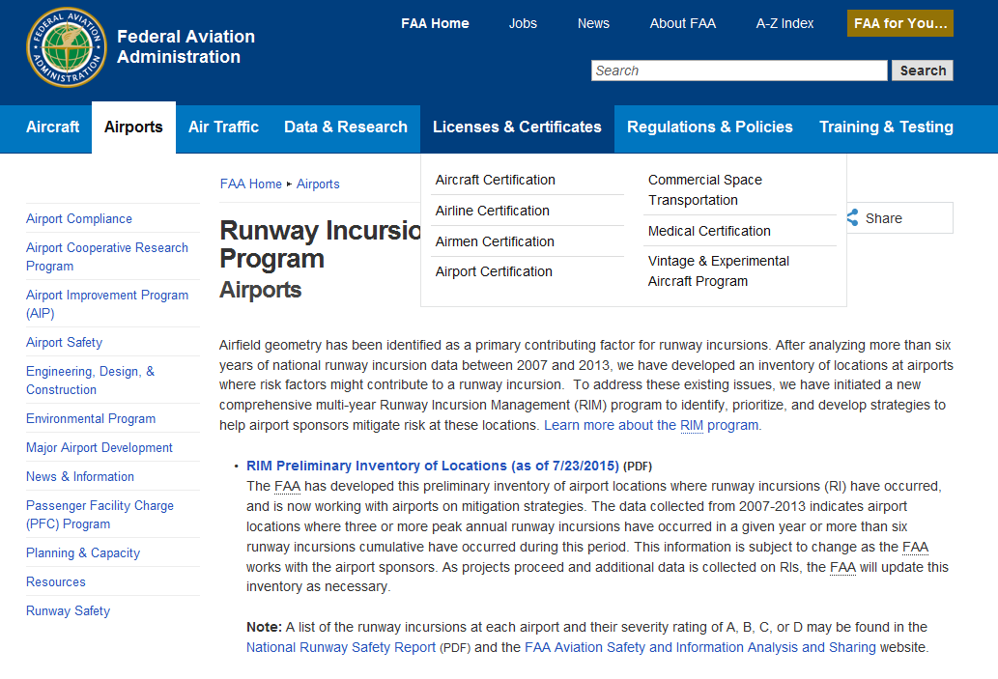
Accomplishments Since August 2015
FY15 BP Milestones met
Sept 2015 – 8 airports
received AIP $ for RIM
projects
RIM Inventory
Updated December 2015
Added 9 since in last
validation round
4 points were mitigated
117 RIM points currently
Began work on Management Tool
http://www.faa.gov/airports/special_programs/rim/

Slide 19
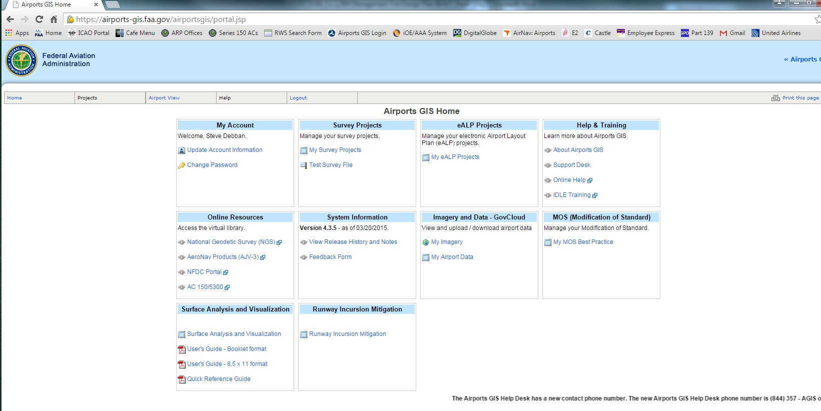
RIM Management Tool

Slide 20
RIM Management Tool
Phase 1 – Airport info, RIM point validation, email notifications, inventory view, various access levels.
Phase 2 – FAA HQ Dashboard
Snapshots, Tracking, RI numbers,
Mitigation Tracking (ALP approval, Grants, Construction Status, Financials

Slide 21
Short Demo
http://96.127.70.87/FAARIM_new/?MyAccessUName=test_HQ&GISUName=testHQ

Slide 22
Next Steps
Phase 2 Complete - March 30, 2016
FY 15 + Remaining CY 15 Data Available – April 1
Training Seminars – Spring 2016
RIM Management Tool Deployment - Spring 2016
Add Hot Spot polygon layer
Annual RIM Cycle –
Maintain the geodatabase, ID non-standard geometry
Pull in RIs, Hot Spots, wrong runway events
Conduct analysis to ID new RIM points
Send out for field validation
Track mitigations, metrics, financials, etc.

Slide 23
Airport Safety R&D
FAA William J. Hughes Technical Center
Airport Safety Technology R&D Section
ANG-E261, Building 296
Atlantic City International Airport, NJ 08405
Lauren.Collins@faa.gov
609-485-8198
www.airporttech.tc.faa.gov

