Slide 1
RPD 155 - Heated
Pavements
ANG-E REDAC Committee
Benjamin Mahaffay, P.E., PMP
March 15, 2016

Slide 2
Presentation Outline
RPD 155 Quad Chart
Current Projects
Future Projects
FY 2017 Plan
FY 2018 Plan
Questions

Slide 3
RPA 155: Heated Pavements Overview
Need
Research Goals
The heated pavements program seeks to develop advanced systems, materials, and construction techniques to economically heat airport pavements and increase efficiency during winter operations.
Engineering Study of Hybrid Heated Pavement Systems
Evaluate the use of Advanced Materials and Nanotechnology
Full-Scale Testing
Reports & AC Updates
FY 2016 Accomplishments
Funding Requirements
Field Implementation
Publish Research Papers for Pavements Community
FAA Financial Viability Report Resulting in Potential Cost Benefits, Greater Operational Safety, Reduced Environmental Impacts, Improved System Efficiency
Projected funding
 | FY 2015 | FY 2016 | FY 2017 | FY 2018 | Total
Funding Target ($000) | $650 | $650 | $650 | $650 | $2.6M

Slide 4







Motivation
Every Year Snow Related Incidents at Airports Make Headlines & Cause Delays

Slide 5


Motivation
Every Year Snow Related Incidents at Airports Make Headlines & Cause Delays

Slide 6
Current Heated Pavement Projects
Radiant Heating (Geothermal) for Airfield Pavements – Greater Binghamton Airport.
  Professor Bill Ziegler, University of Binghamton
Airport Heated Pavement – PEGASAS – Partnership to Enhance General Aviation Safety, Accessibility, & Sustainability.
  Task 1-A: Energy and Financial Viability of Heated Pavement Systems.
    Dr. Halil Ceylan, Iowa State University
  Task 1-B: Hybrid Heated Airport Pavements.
    Dr. Halil Ceylan Iowa State University
  Task 1-C: Potential Use of Phase Change Materials (PCM) to Store Heat in PCCP.
    Dr. John Haddock, Purdue University
  Task 1-D: Advanced Construction Techniques for Heated Pavement Systems.
    Dr. Halil Ceylan, Iowa State University
  Task 1-E: Potential Use of Phase Change Material to Store Heat in HMA.
    Dr. John Haddock, Purdue University
Conductive Concrete for Airfield Heated Pavement
  Dr. Christopher Tuan, University of Nebraska - Lincoln

Slide 7
Greater Binghamton Airport
OBJECTIVES: - Phase II Stage II
Install a 450 SF control building with the heat pumps, fluid moving pumps, controls, and power
supply.
Install the balance of the snow melt piping to the control building, extending piping previously
installed in Phase I.
Install both vertical and horizontal geothermal field loops including access manholes, valves, and
controls.
Install new electric service and power distribution system to power all equipment.
Install the system sensors and controls to operate the system and monitor performance.
Install software and programming systems to monitor and log system performance.
Install a small display and interactive public kiosk
to educate the public in regards to the system and
potential benefits to airport users.
PERIOD OF PERFORMANCE:
Original: July 2010 – March 2015

Slide 8
Greater Binghamton Airport
May 2009 – Binghamton Students Won National Design Competition for Universities
July 2010 – Initial Grant Awarded (10-G-009) to Design & Build Prototype System
April 2011 – Construction Begins on Radiant Heating System & Control Vault
2011 – 2012 Winter – Preliminary Test of System Conducted
December 2013 – Heat Exchange Facility Construction Begins
April 2014 – Geothermal Portion of System Construction Begins
July 2014 – Heat Exchange Equipment is Installed & 500 ft. Wells Drilled
August 2014 – Well Field Control Vault Installed
2014 – 2015 Winter – Prototype Radiant Heating System is Fully Functional
March 2015 – Well-field is Connected to the Terminal Building
April 2015 – Interactive Kiosk install in the Secure Passenger Facility
May 2015 – Geothermal System Assist with Cooling the Terminal Building
Present – Monitoring & Data Collection via Installed Sensors for Further Advancement

Slide 9
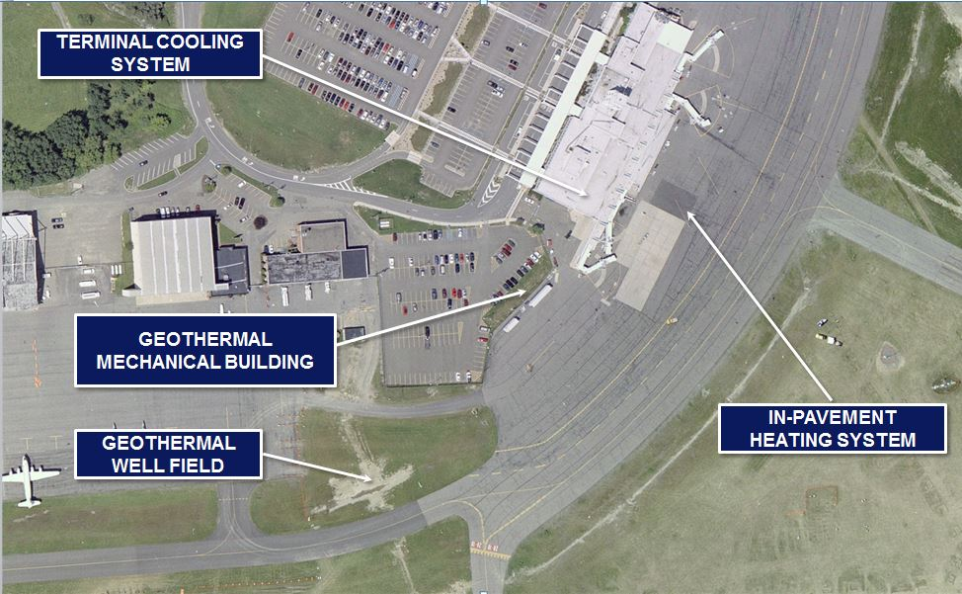
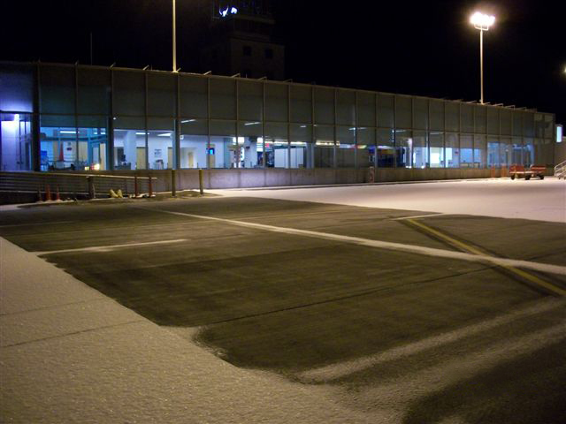
Greater Binghamton Airport

Slide 10
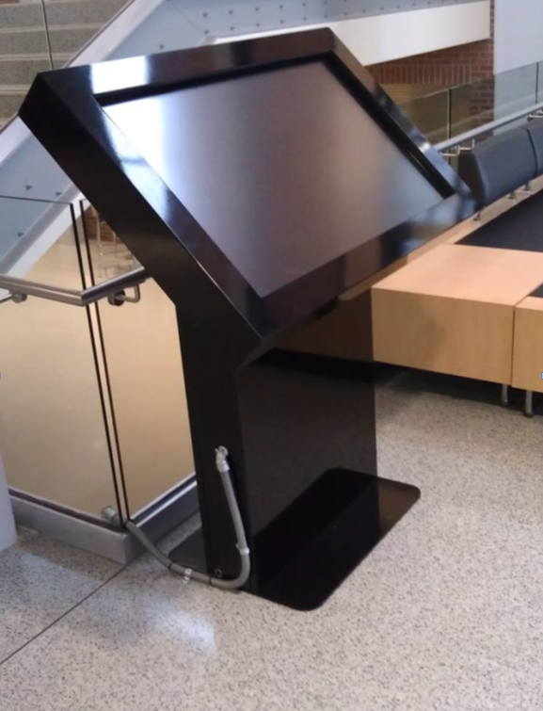
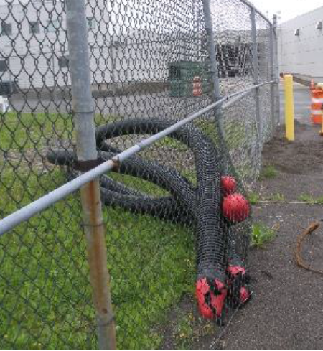
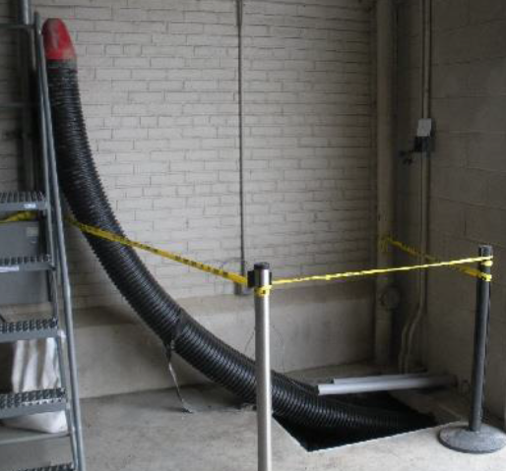
Greater Binghamton Airport
Interactive Kiosk in the
Secure Waiting Lounge
Connections providing cooling from the well-field to the terminal building are completed
Connectors to/from the Well-field
Connectors inside the terminal building

Slide 11
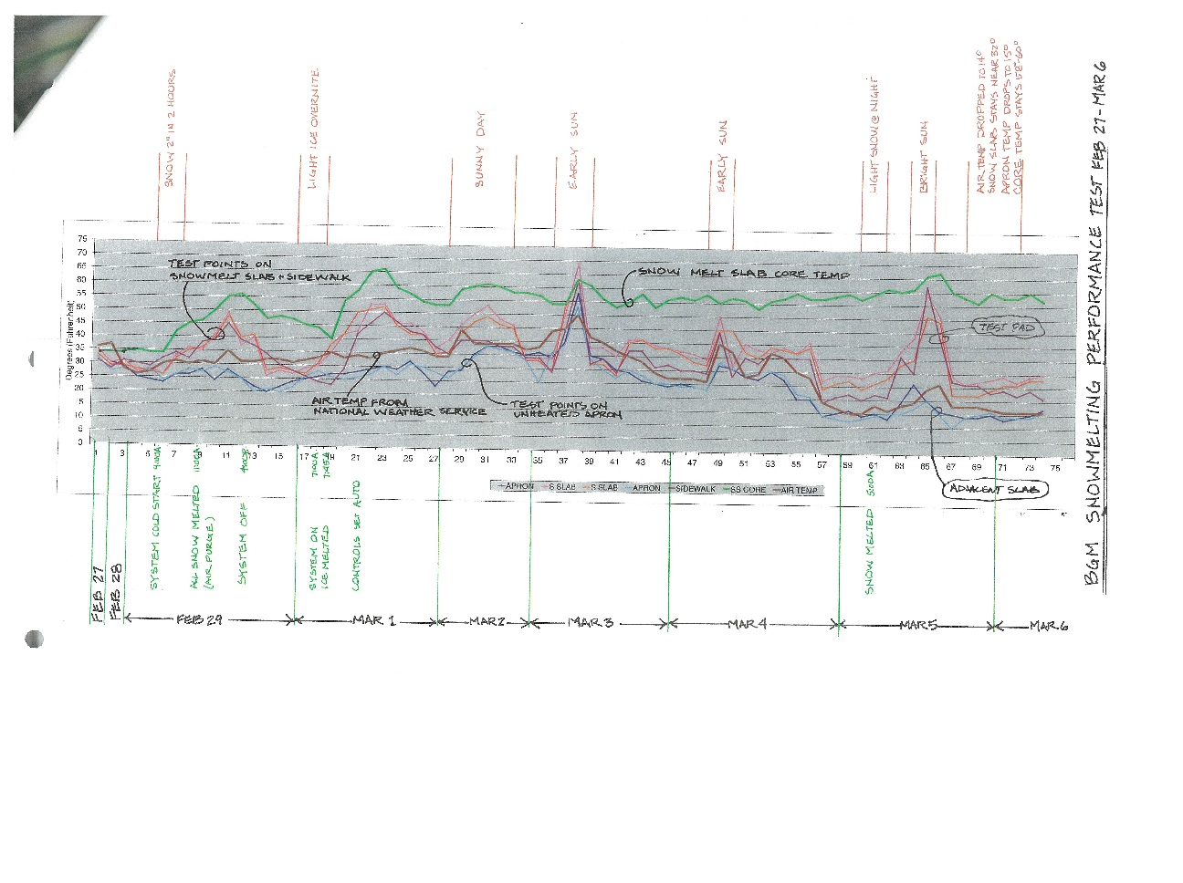
Greater Binghamton Airport
Heated Pavement System is now fully functional and successful in keeping the pavement surfaces free from snow and ice.
Currently collecting data from 46 system sensors, every 15 minutes, 24 hours a day, 365 days per year. The diagram below is a small sample of the ongoing data analysis of what will amount to 1,611,840 data points analyzed per year.

Slide 12
Task 1-A: Energy and Financial Viability
OBJECTIVES:
A-1: Identify Potential Airports Sites for Conducting Benefit Analysis.
A-2: Collect Data on Energy and Cost Requirements from Identified Airport Sites.
A-3: Perform Cost/Benefit Analysis.
A-4: Develop a Protocol to Enable Future
Heated Pavement Systems to be Readily
Evaluated Based upon the Data Collected
during the Study.
A-5: Submit Final Report Documenting the
Entire Research Effort.
PERIOD OF PERFORMANCE:
Original: July 2013 – October 2014
Extended: July 2013 – July 2016
Completed: July 2016

Slide 13
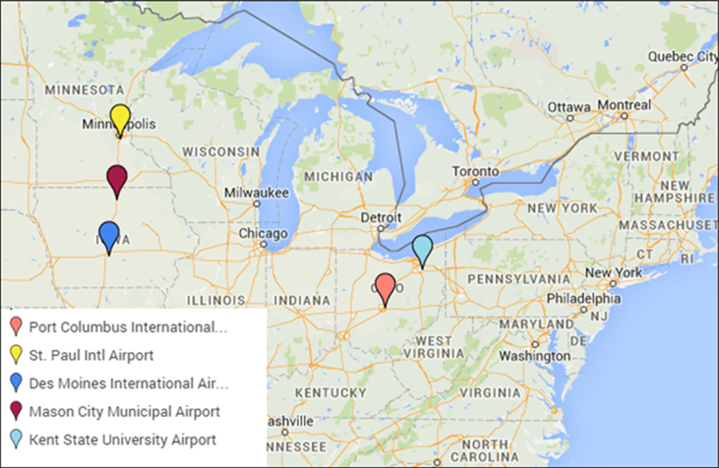
Task 1-A: Energy and Financial Viability
Commercial Service Airports (CS)
1. MSP: St. Paul Intl Airport, Minneapolis, MN
2. CMH: Port Columbus International Airport, OH
3. DSM: Des Moines Intl Airport, Des Moines, IA
General Aviation Airports (GA)
4. MCW: Mason City Municipal Airport, Mason City, IA
5. 1G3: Kent State University Airport, Kent, OH

Slide 14

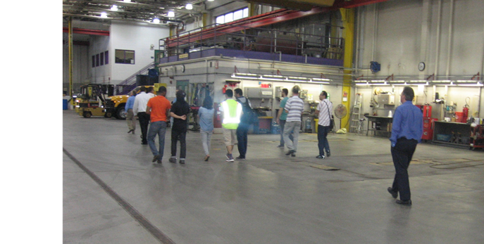
Task 1-A: Energy and Financial Viability
Data Collection:
Site Visits
Interviews
E-mail Surveys
Prototype Slab Test
Literature & Web Search
  Key Input:
  Insufficient staffing levels
  High cost of chemicals
  Ramp clearance times during large events is an issue
  Aircraft parking position snow removal is the most critical issue; difficult to meet customer expectations for simultaneous snow removal operations in 125 gates

Slide 15
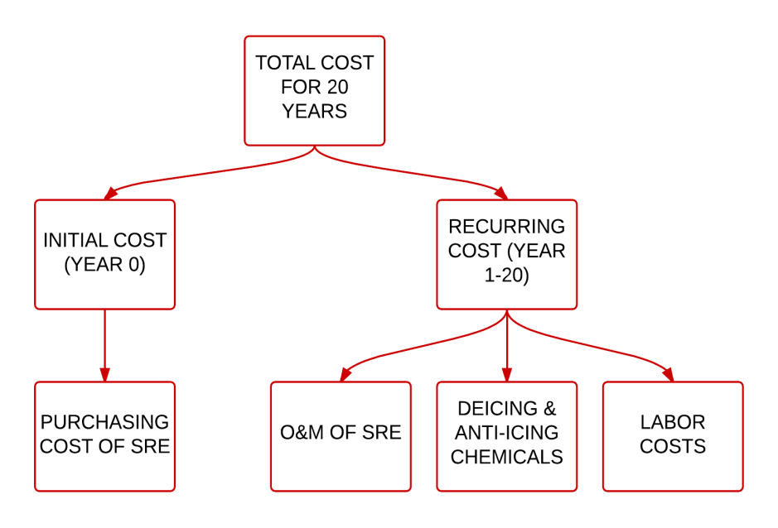
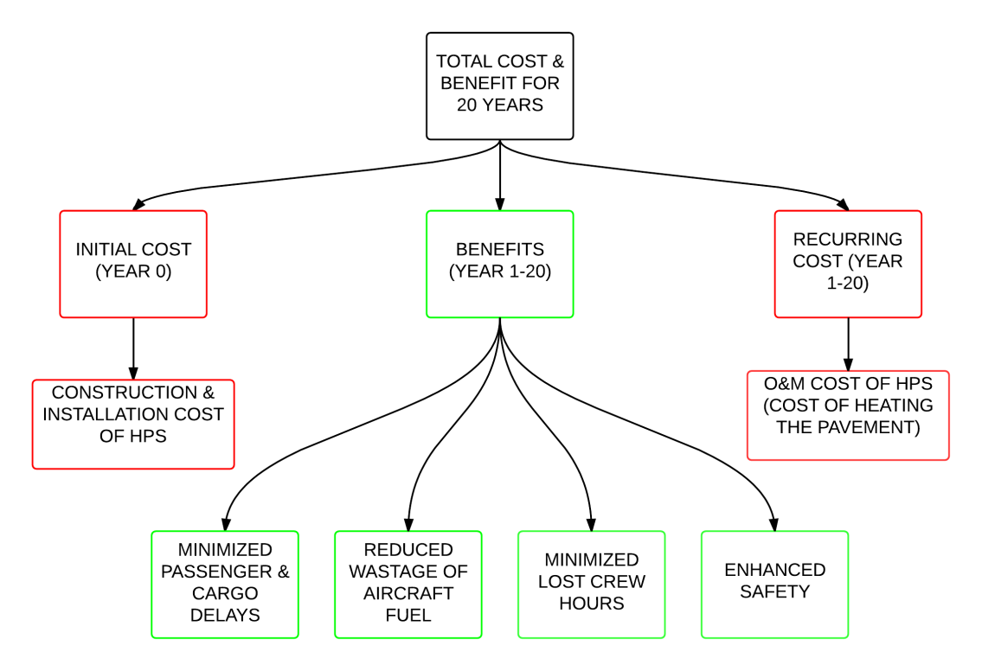
Task 1-A: Energy and Financial Viability
Base Case: Conventional Methods
Alternative Case: Hydronic Heated Pavements with Natural Gas Heat Source
Net Present Value (NPV): Calculate ROI on a Project. Project is feasible if NPV > 0
Benefit/Cost Analysis (BCA): Economic Analysis for Evaluating a Project. B/C > 1
Sensitivity Analysis (SA): Method to determine how different values of certain variables impact BCA

Slide 16
Task 1-A: Energy and Financial Viability
Net Present Value
Benefit Cost Ratio
16

Slide 17
Task 1-A: Energy and Financial Viability
Sensitivity Analysis
Heated pavement system (HPS) application is a viable option from an energy or financial viability perspective for achieving pavement surfaces free of ice/snow without using mechanical or chemical snow and ice removal methods. Benefit-to-cost ratios are greater than 1.0 for a large number of airports
The BCR is very sensitive to the duration of delays and percentage of delays
Increase in the initial cost has a negative effect on the BCR, but as the time period of analysis increases, the BCR witnesses a steep rise, as expected.
BCR doesn’t show much variation with the changes in snowfall rates considered in the sensitivity analysis
Natural gas had the highest BCR
17

Slide 18
Task 1-A: Energy and Financial Viability
Potential Benefits
Reduces the downtime required to clear ice and snow
Reduces the adverse environmental impacts of using deicing chemicals
Reduces the amount of labor and equipment costs associated with using/applying deicing methods
Improves safety for ground crews servicing the aircraft at the gate areas
Mitigates pavement durability related failures due to the use of deicing chemicals which could increase the life of airfield pavement systems
Advancements in HPS technology and construction practices are expected to greatly bring down the installation costs
18

Slide 19
Task 1-A: Energy and Financial Viability
Sustainability Assessment
Develop sustainability assessment framework for the operation of airfield heated pavements by using life-cycle assessment (LCA) and carbon footprint analysis
  Assess energy consumptions and greenhouse gas emissions
    Traditional Snow Removal System (TSRS)
    Hydronic Heated Pavement System using geothermal energy (HHPS-Geothermal - G)
    Hydronic Heated Pavement System using natural gas furnace (HHPS-Natural Gas - NG)
    Electric Heated Pavement System (EHPS)
19

Slide 20
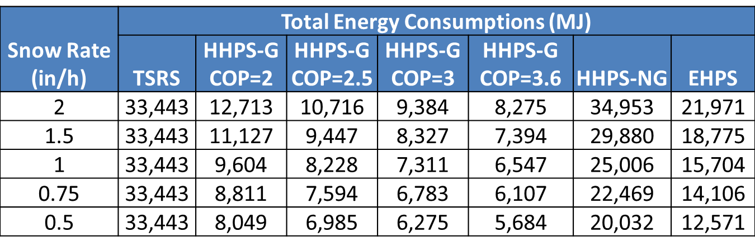
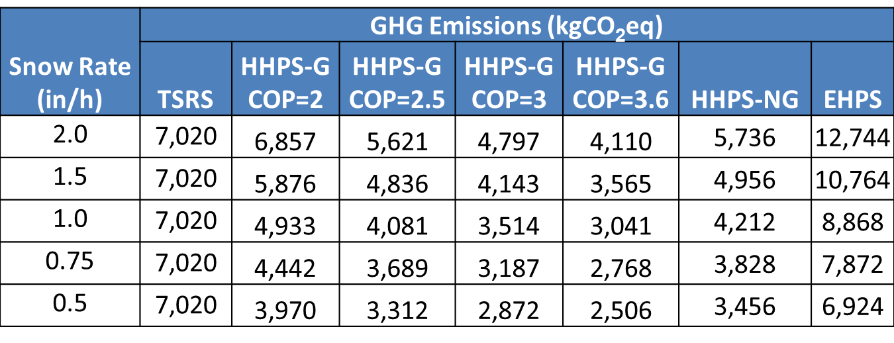
Task 1-A: Energy and Financial Viability
Sustainability Assessment
20

Slide 21
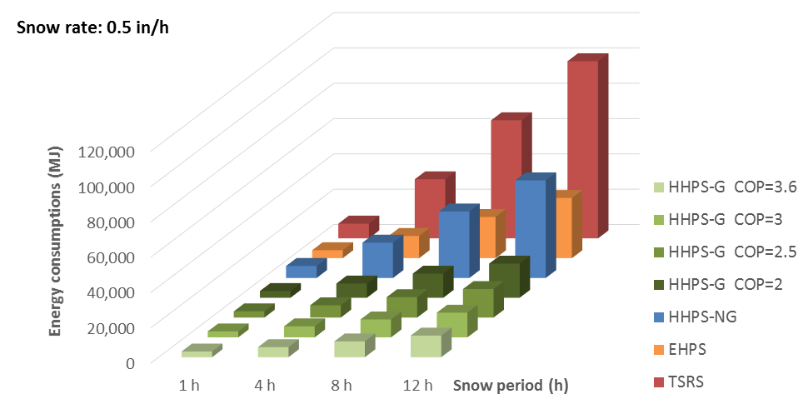
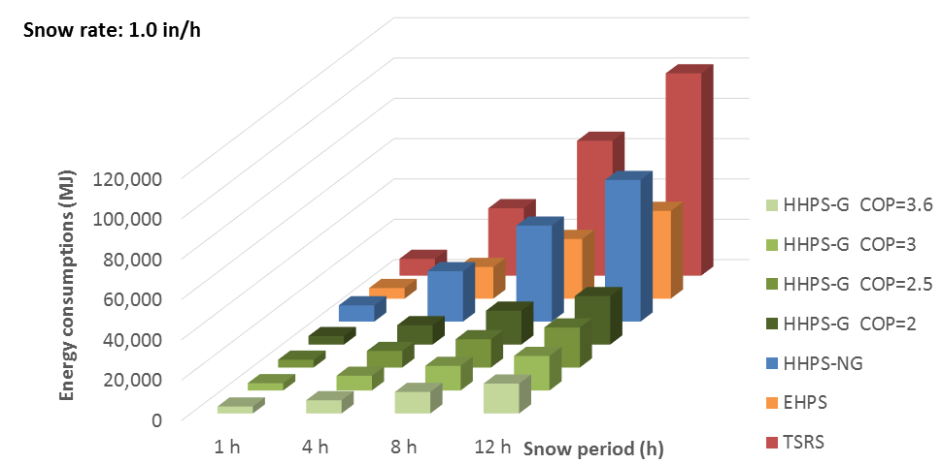
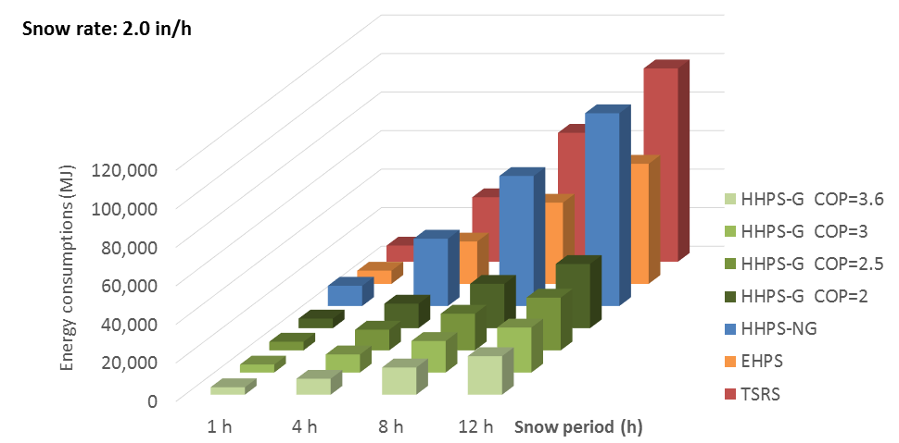
Task 1-A: Energy and Financial Viability
Sustainability Assessment – Energy Consumption
21

Slide 22
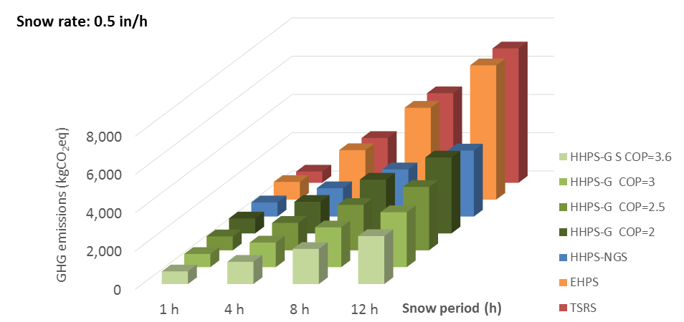
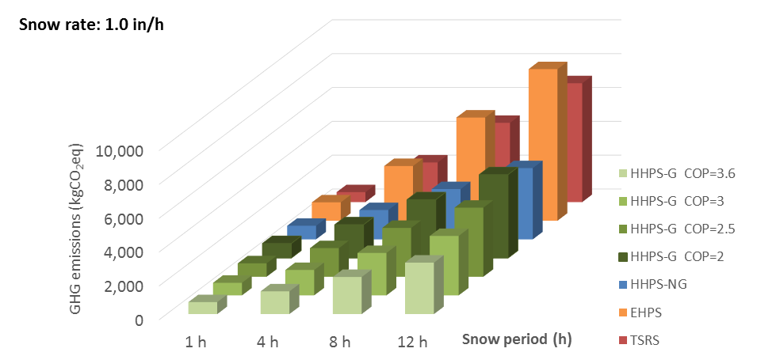
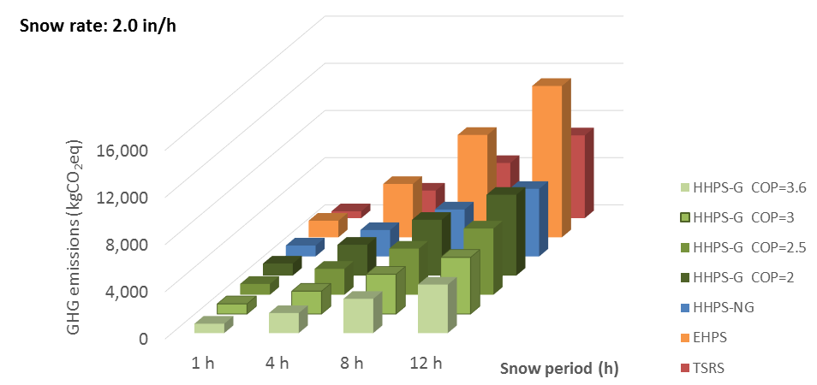
Task 1-A: Energy and Financial Viability
Sustainability Assessment – GHG Emissions
22

Slide 23
Task 1-A: Energy and Financial Viability
Sustainability Assessment
The use of heated pavement systems as an alternative to chemical de-icers enables effective snow removal with reduced energy consumption and GHG emissions
Energy demand and GHG emissions from the operation of heated pavement systems are significantly determined by snowfall rate and snow period
From an environmental impact perspective, natural gas, with a relatively low emission factor, has the potential to replace electricity or diesel oil as a more environmental-friendly energy source
With the availability of more data and studies, the LCA models used in this study could be fully developed and calibrated to reflect realistic airport scenarios and help achieve airport authorities “Airport Sustainability Planning”
23

Slide 24
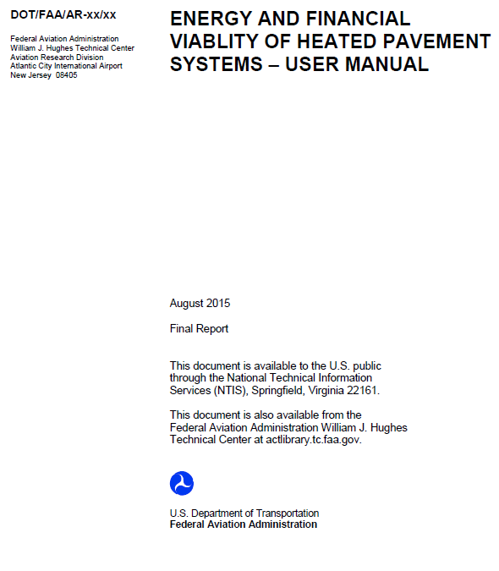
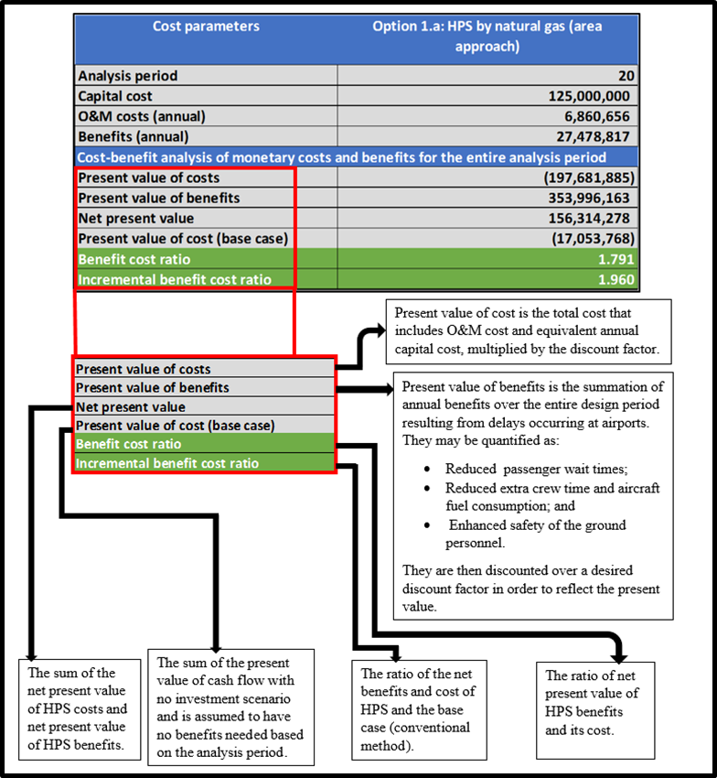
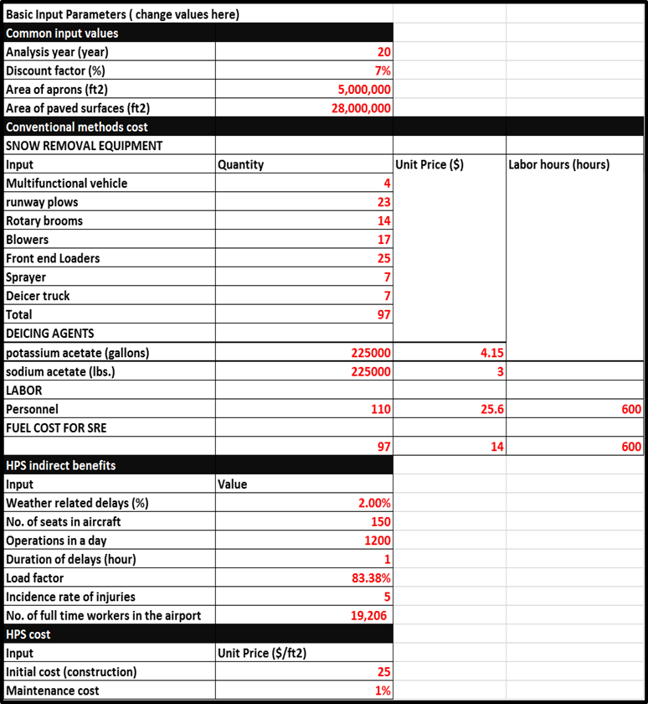
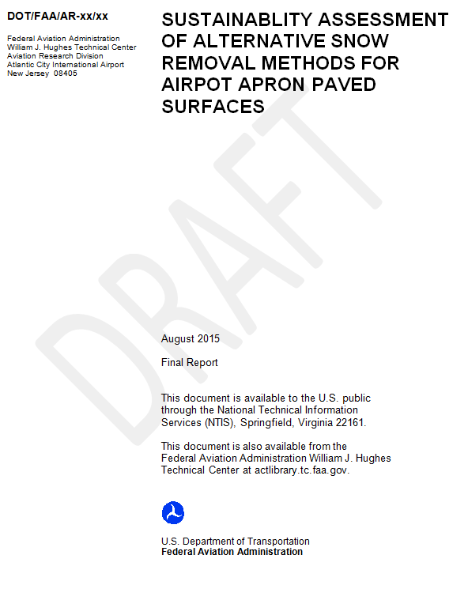
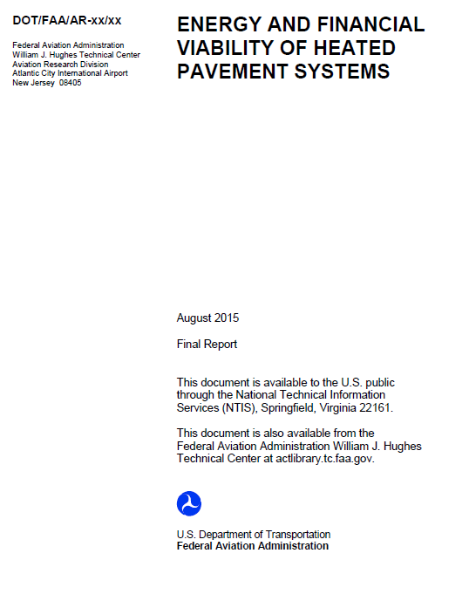
Task 1-A: Energy and Financial Viability
Comprehensive Final Report with User Manual
24

Slide 25
Task 1-B: Hybrid Heated Airport Pavement
OBJECTIVES:
B-1: Identify Overall System-level Requirements and Potential Challenges
B-2: Construct a Prototype Hybrid Heated Pavement System for Laboratory Testing and Evaluation
B-3: Examine the Potential of Nanotechnology in Helping to Improve Overall System Performance and Cost-effectiveness.
B-4: Demonstrate Proof-of-Concept and Evaluate Performance of Prototype Hybrid Heated Pavement System in the field under Thermal Cycling.
B-5: Investigate Pavements Performance Degradation
Issues Resulting from Embedded Conductive Material
and Superhydrophobic Surfaces of the Hybrid Heated
Airport Pavement System.
B-6: Submit Final Report Documenting the Entire
Research Effort.
PERIOD OF PERFORMANCE:
Original: July 2013 – October 2014
Extended: July 2013 – July 2016
Extension to be Requested

Slide 26
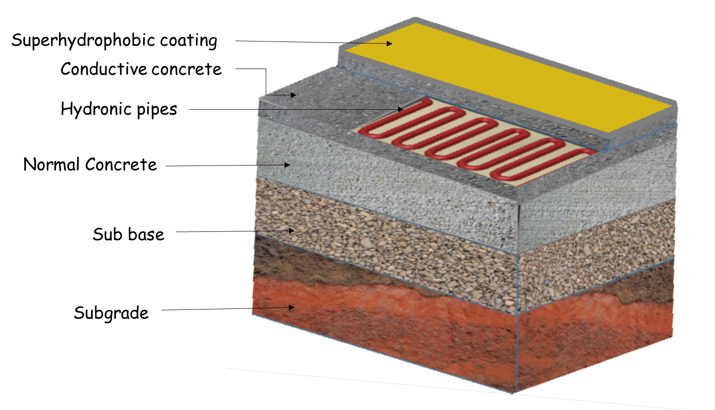
Task 1-B: Hybrid Heated Airport Pavement
Identify Overall System-Level Requirements

Slide 27
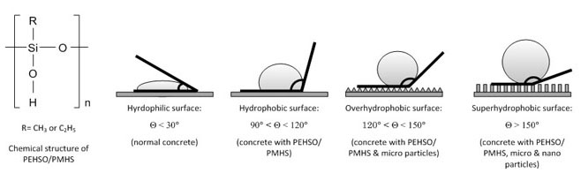
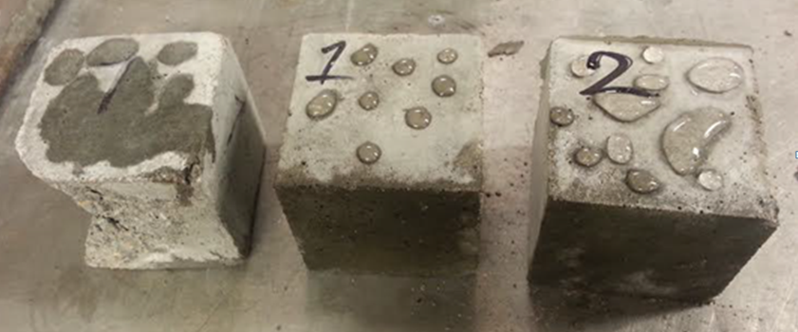
Task 1-B: Hybrid Heated Airport Pavement
Defining Superhydrophobicity and Hydrophobicity
From left to right: control, 2% PTFE, and 5% PTFE modified mortar specimens

Slide 28
Task 1-C: Investigating the Potential to Use Phase Change Material (PCM) to Store Heat in Concrete Pavement
OBJECTIVES:
C-1: Literature Review.
C-2: Parametric Assessment of Temperature Response for Application to Anti-icing Performance.
C-3: Identification and Evaluation of Low Temperature Phase Change Materials.
C-4: Evaluation of the Heat Capacity and
Thermal Conductivity of Concrete.
C-5: Large Section Evaluation.
C-6: Final Report.
PERIOD OF PERFORMANCE:
Original: July 2013 – October 2014
Extended: October 2014 – July 2016
Complete: July 2016

Slide 29
Phase Change Materials for PCC Pavements
Main objective:
To examine the role that PCM may have in storing heat in pavements to melt snow and ice at airports
  PCMs can store thermal energy from the environment
  Stored energy can be released and melt ice and snow
  Improves anti-icing practices in airfield pavements
  Increases the safety of airport pavement
Energy released from PCM
Melted Snow and Ice
LWA with PCM
Concrete Pavement

Slide 30
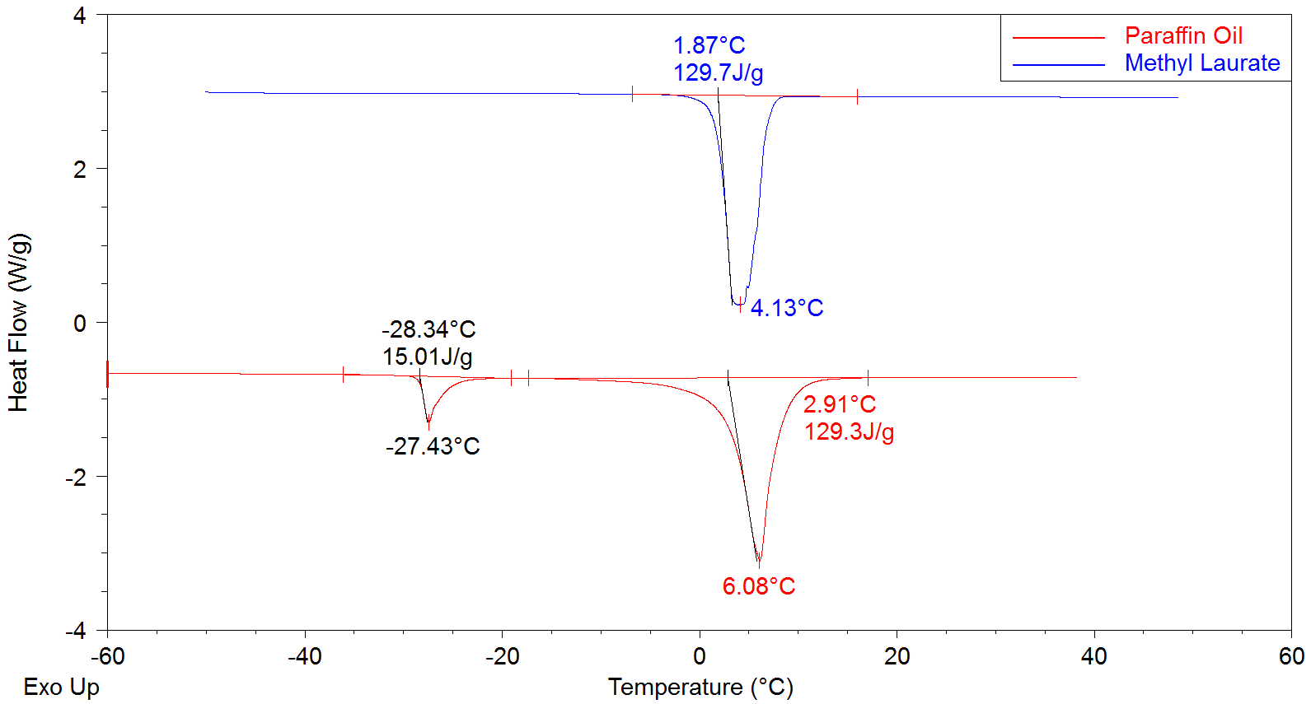
Phase Change Materials for PCC Pavements
Ideally the PCM phase transition temperature occurs at 3-6 ºC, has a high latent heat of fusion (ΔH), is chemically compatible with concrete, and is economic/commercially viable
Many PCM tested paraffin oil and methyl laurate have a desired thermal behavior for portland cement concrete pavement application
Developed quick tests to assess optimal PCMs
Able to change PCM freezing temperature for different climate conditions
Area under the curve shows the energy.

Slide 31
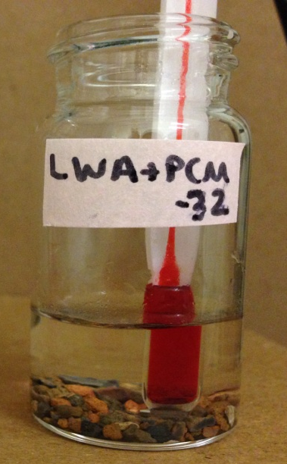
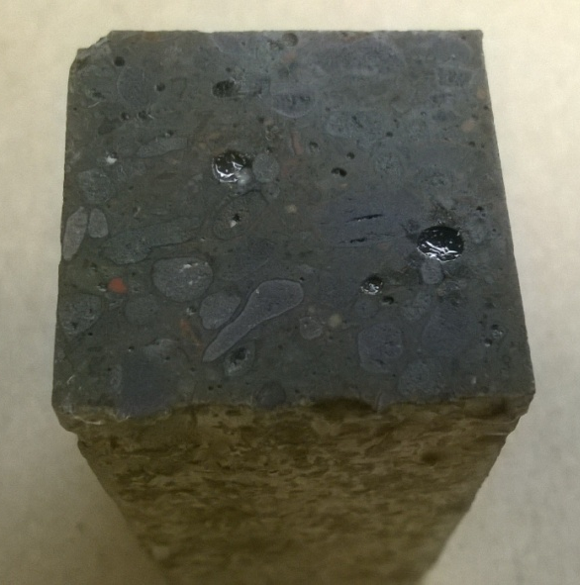
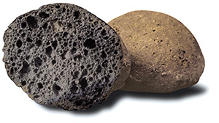
Phase Change Materials for PCC Pavements
Lightweight aggregates (LWA) were soaked in PCM and then were used to make concrete.
The same procedure can be used in the field to make concrete pavement using conventional paving operations
Using lessons learned and tools developed this will be extended to HMA during the coming year (Hard shell m&m)
Concrete with
LWA + Paraffin Oil
LWA

Slide 32
Task 1-D: Advanced Construction Techniques for Heated Pavements
OBJECTIVES:
D-1: Conduct Comprehensive literature review on advanced pavement construction techniques and their potential for heated pavement construction.
D-2: Develop an assessment framework (methodology/matrix/criteria) of advanced pavement construction techniques highlighting their applicability and potential for heated airport pavement construction.
D-3: Develop guidance on evaluated the relative cost and benefits of implementing various advanced construction techniques in heated airport pavement construction projects.
D-4: Develop framework for 3D visualization of the
advanced construction techniques for heated pavement
systems and for monitoring heated airport pavement
performance.
D-5: Develop a collection of advance construction
techniques and practices for large-scaled heated airport
pavement construction projects.
D-6: Submit final report documenting the entire
research effort.
PERIOD OF PERFORMANCE:
Original: July 2013 – October 2014
Extended: July 2013 – July 2016
Extension to be Requested

Slide 33
Task 1-D: Advanced Construction Techniques for Heated Pavements
  Develop advanced techniques to best automate and accelerate the construction of large-scale heated pavements at airports
  Significant problems to be addressed include material selection, joint interfaces, new equipment necessary for installation of heating elements, time factors for installation, and location of ancillary equipment at the airport

Slide 34
Task 1-D: Advanced Construction Techniques for Heated Pavements
Developing conceptual designs for heated pavement system
  Hydronic heated pavement system
  Electrically conductive concrete (ECC) based heated pavement system
Developed design for a prototype of ECC slab to be casted in ISU PCC lab
  Reviewed electrode types to improve bonding between conductive concrete and electrode
  Reviewed slab size design considerations for electrical heated pavement systems
  Compared between alternating current (AC) and direct current (DC)

Slide 35
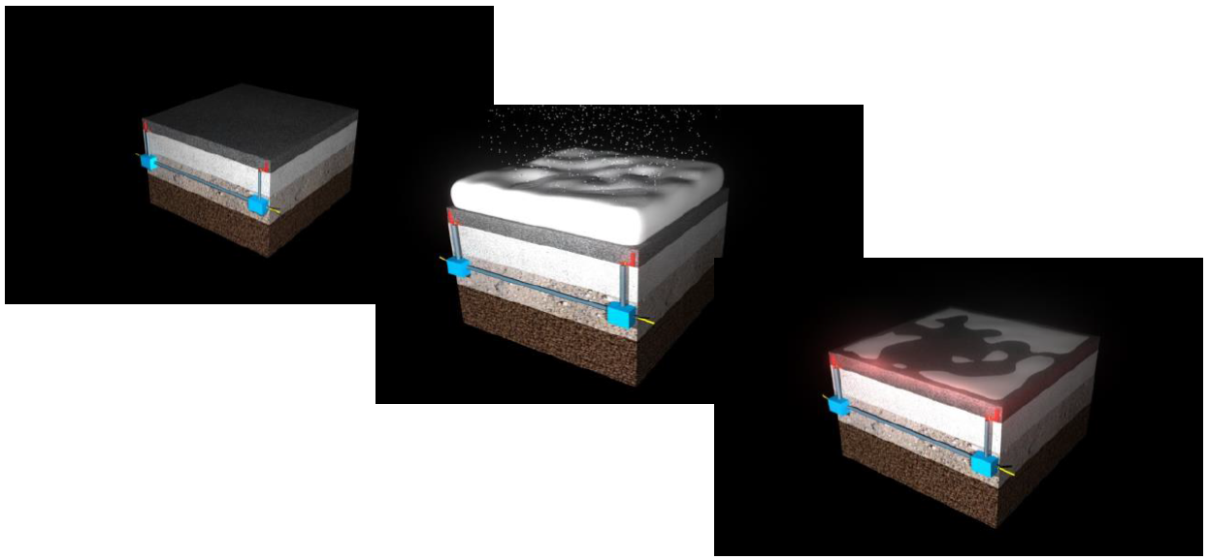
Task 1-D: Advanced Construction Techniques for Heated Pavements
Conceptual design of heated pavement systems: 3D artist rendition and visualization of conductive concrete

Slide 36
Task 1-E: Investigating the Potential to Use Phase Change Material to Store Heat in Asphalt and Layered Pavement
OBJECTIVES:
E-1: Develop approaches to consider the higher processing temperature.
E-2: Extend the finite difference model for PCC to asphalt and layered systems.
E-3: Review potential PCM based on their effectiveness and cost.
E-4: Prepare samples demonstrating how
PCM can be placed in asphalt
E-5: Evaluate the performance of the PCM
in asphalt pavements.
E-6: Final Report.
PERIOD OF PERFORMANCE:
Original: July 2013 – October 2014
Extended: July 2013 – July 2016
Completed: July 2016

Slide 37
Phase Change Materials for HMA Pavements
Develop approaches to consider the high processing temperatures used in asphalt pavement production
Extend the PCC model to asphalt mixtures and identify the ideal properties of the PCM given the impact of solar heating and layered systems
Review potential PCM based on their effectiveness and cost
Prepare samples demonstrating how PCM can be placed in asphalt mixtures
Evaluate the performance of the PCM in asphalt pavements
Encapsulation of PCMs from double emulsion

Slide 38
Conductive Concrete for Airfield Heated Pavements - UNL
OBJECTIVES: Phase I
Previous efforts were focused on using conductive material with the best quality available as opposed to maximizing cost.
Maximize the benefit/cost ratio for conductive concrete mix the yields the lowest cost while still provide adequate deicing performance and durability.
Selecting conductive material, conducting
mechanical and accelerated durability test
on conductive concrete specimens, and
evaluating the deicing performance of
small slabs.
PERIOD OF PERFORMANCE:
Original: July 2013 – September 2015
Extended: July 2013 – March 2016
Extension to be Requested

Slide 39
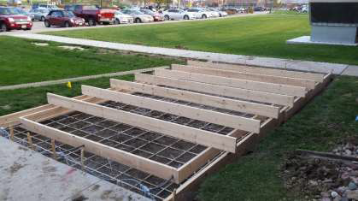

Conductive Concrete for Airfield Heated Pavements - UNL
Test Pad: 20 ft. x 10 ft. x 6 in.
5,000 psi reinforced with fiber-reinforced polymer (FRP) rebar
Weather station: wind speed/direction, relative humidity, and ambient temperature data
Energized using 208V power to the two outer electrodes with one circuit
Weather station and power data is currently being collected and analyzed.

Slide 40
Conductive Concrete for Airfield Heated Pavements - UNL
Insert Video Clip Here.

Slide 41
Future Heated Pavement Projects
Electrically Conductive Asphalt Concrete for Heated Airfield Pavements
  Snow and ice removal from electrical heating
  Health monitoring from sensing capacity and self healing from induction heating
Superhyrophobic and Icephobic Materials for Nano-Modified Heated HMA Pavements
  Mitigate formation of ice crystals by being water-repellent
  Self cleaning of asphalt surface layer
  Mitigate HMA moisture damage (e.g. stripping)
Heat Wires at Pavement Surface
Full scale airport heated pavement testing
  Construction based on most cost effective techniques for heating airfield pavement
  Full scale testing on performance evaluation and structural integrity under actual aircraft loads and tire pressures
  Full economic and sustainability analysis of construction, maintenance and operation costs would be performed

Slide 42
FY 2017 Plan
Construction and testing of promising heated pavement technologies at NAPTF/NAPMRC or a participating airport.
Research alternative energy solutions for heating pavements or facilities.

Slide 43
FY 2018 Plan
Construction and testing of promising heated pavement technologies at NAPTF/NAPMRC or a participating airport.
Data collection and analyses on large scale implementation projects.
Research alternative energy solutions for heating pavements or facilities.

Slide 44

Questions?

