Slide 1
RPA - P2
NAPMRC
(National Airport Pavement & Materials Research Center)

Slide 2
RPA P2 Overview - NAPMRC
Need
Research Goals
Research Goals
More durable, long-lived airport pavements, reduced lifecycle costs, better prediction of pavement service life, and accurate assessment of aircraft-pavement compatibility
Standards/specification for new asphalt technologies such as WMA, SMA, RAP, etc.
Deliverables
Technical Reports, technical papers.
NAPMRC provides the ability to test the surface layers, pavement materials, and alternative pavement materials. Improved paving materials characterization will conserve airport development funds and reduce the downtime of runways from construction and maintenance activities. Test results will help in developing standards/specification for new asphalt technologies such as WMA, SMA, RAP, etc.
FY 2018 Accomplishments
Funding Requirements
Milestones
- TC1 Posttraffic tests – In Progress
- Completed fatigue tests on HMA (PG76-22) at 214-psi
tire pressure (unplanned)√
- Completed fatigue tests on HMA (PG76-22) at 254-psi
tire pressure (unplanned)√
- Complete fatigue tests on WMA (PG76-22) at 254-psi
tire pressure (unplanned) – In Progress
- Complete fatigue tests on WMA (PG76-22) at 214-psi
tire pressure (unplanned)
- Complete construction of TC2 test sections.
- Start tests on TC2 test sections.
NAPMRC FY 2017 through FY 2019.
 | FY 2017 | FY 2018 | FY-19
Funding Target ($000) | $1,700 | $1,530 | $1,620
P2.1: Pavement Construction | $400 | $360 | $270
P2.2: Facility Operation | $1,100 | $950 | $1,010
P2.3: Facility Maintenance | $200 | $220 | $340

Slide 3
Research at NAPMRC
EVALUATION OF NEW ASPHALT TECHNOLOGIES FOR AIRFIELD PAVEMENTS
Warm Mix Asphalt, Stone Matrix Asphalt, Polymer Modified Binders,
RAP Mixes, Full-Depth Rehabilitation
PROBLEM: Lack of Guidance/Standards/Specifications
Lack of Performance Data
Laboratory Performance Evaluation
Full-Scale APT
NAPMRC
Field Performance Evaluation
Evaluate:
Rutting
Fatigue
Moisture Susceptibility
Durability
Low Temperature Cracking
Full-Scale APT:
Rutting
Fatigue
Tire Pressure Effects
WMA
RAP/RAS
Full Depth Reclamation
Compare to P-401 HMA
Field Projects:
Lab Evaluation of Field Mixes
Construction Evaluation
Evaluate:
Mix Design Production, Construction
Support from AAS-100, ADO

Slide 4
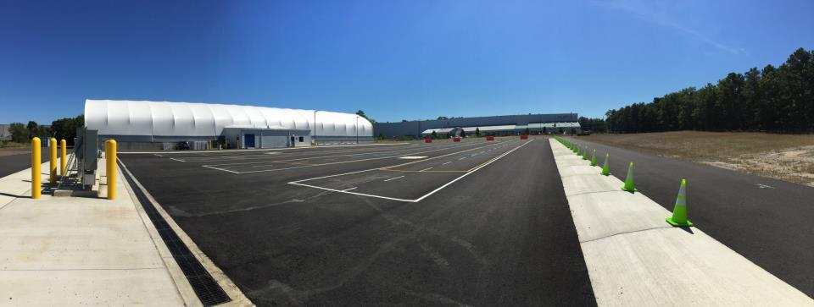

Slide 5
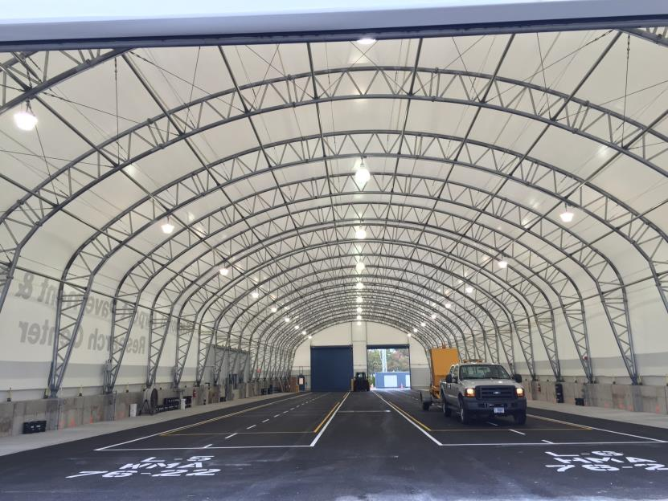

Slide 6
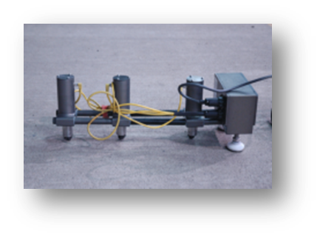
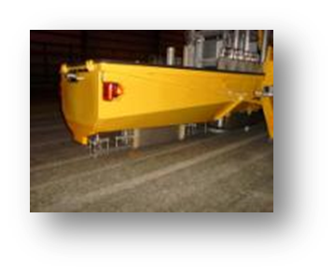
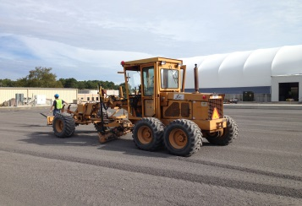
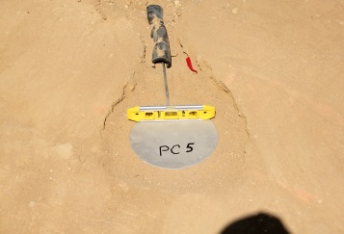
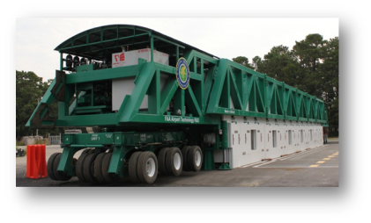
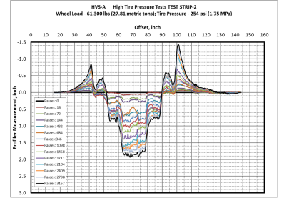
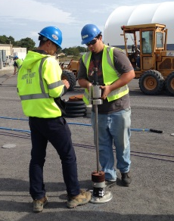

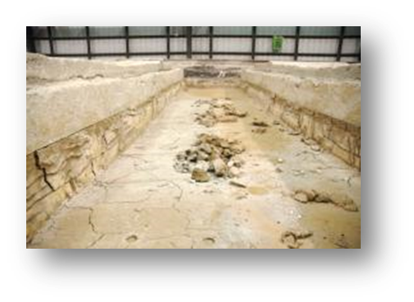
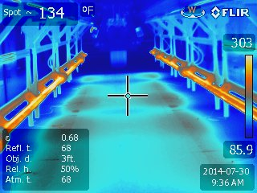
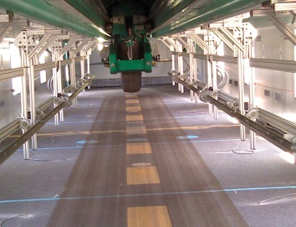
Objectives, Pavement
Construction, Sensors
NDT & Pavement
Characterization
TEST CYCLE (TC) AT NAPMRC
Posttraffic Testing
Full-Scale APT,
Pavement Evaluation

Slide 7
Test Cycle 1 (TC1) Objectives
    • Compare Warm Mix Asphalt (WMA) performance with P401 Hot Mix Asphalt (HMA) performance (rutting);
    • Effect of tire pressure on pavement rutting;
    • Effect of polymer modified binder (PMA) on pavement rutting;
    • Effect of temperature on pavement rutting.

Slide 8
MATERIAL
WMA
WMA
P401
HMA
P401
HMA
WMA
P401
HMA
254
psi
254
psi
254
psi
254
psi
254
psi
254
psi
TIRE
PRESSURE
NAPMRC
Test Cycle-1
(TC-1)
210
psi
210
psi
210
psi
210
psi
210
psi
210
psi
BINDER
TYPE
PG
76-22
PG
64-22
PG
76-22
PG
64-22
PG
76-22
PG
76-22

Slide 9
Pavement Cross Sections

Slide 10
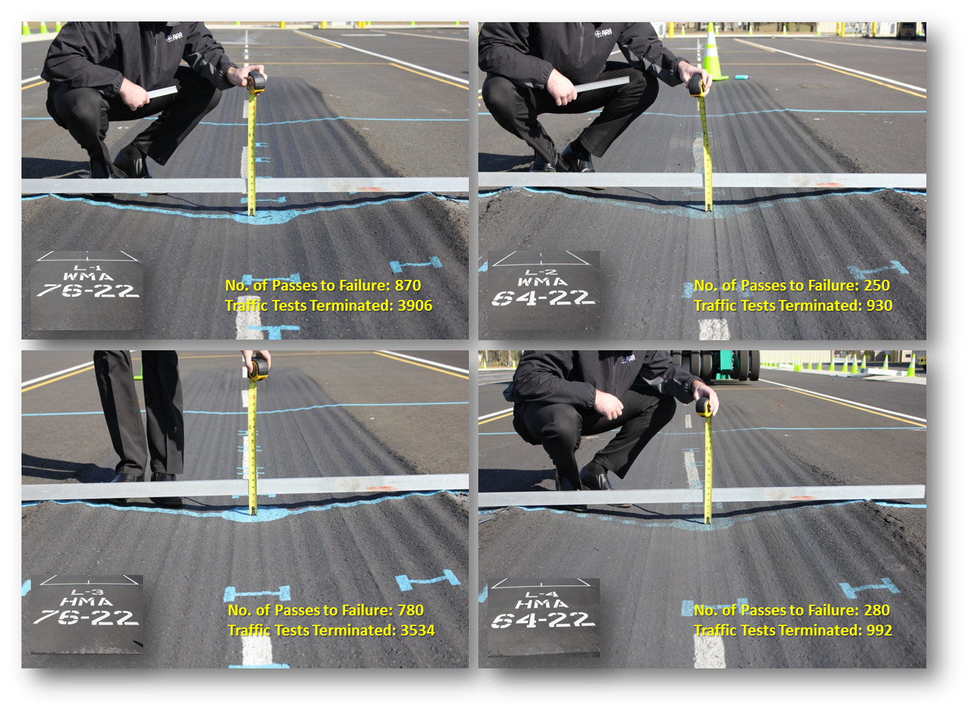
NAPMRC-TC1 SOUTH TEST AREA (210-psi; 120°F)

Slide 11
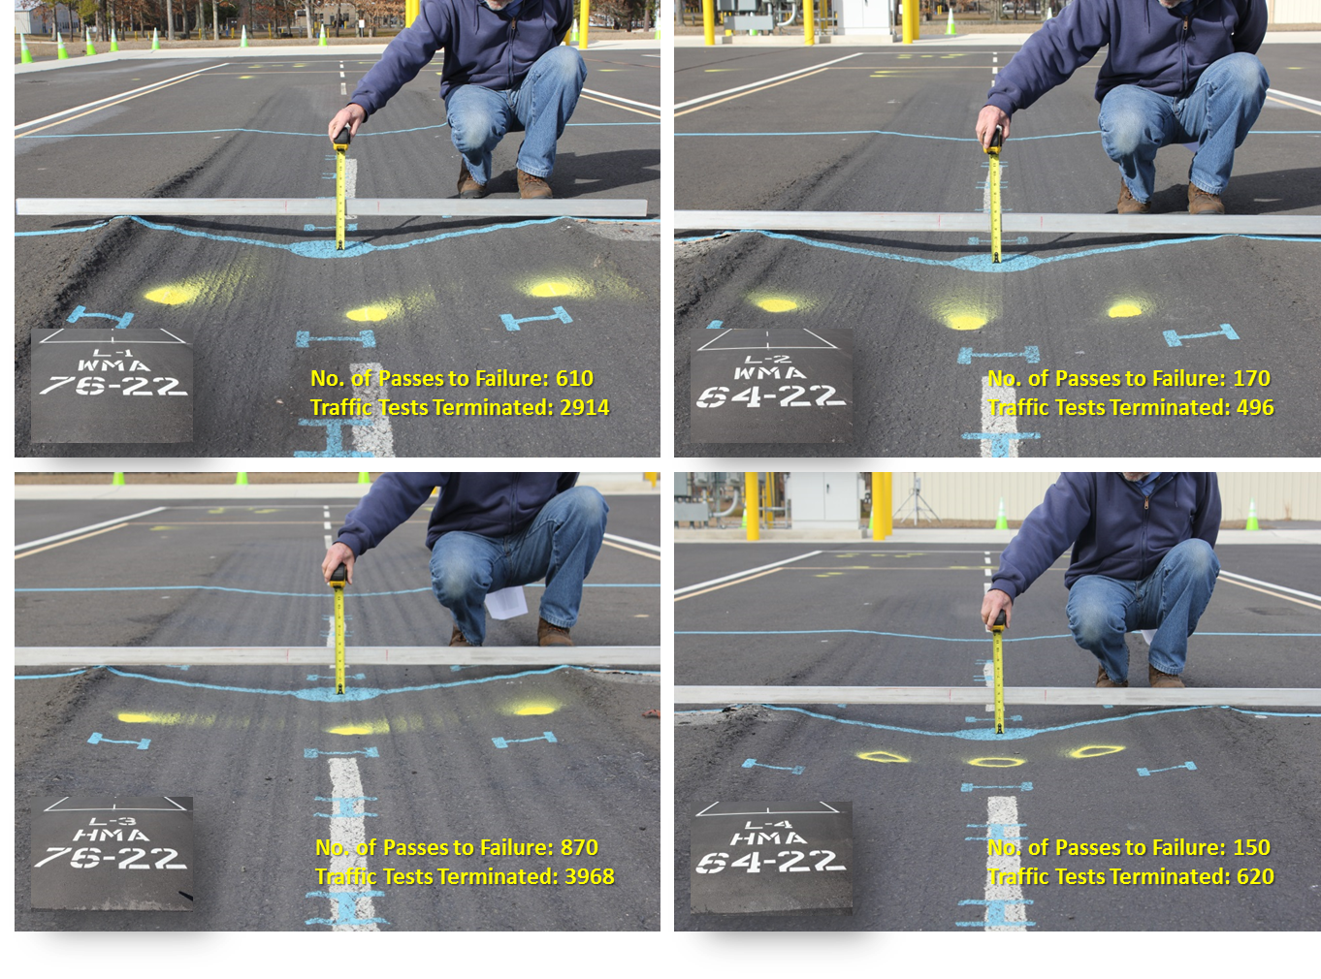
NAPMRC-TC1 NORTH TEST AREA (254-psi; 120°F)

Slide 12
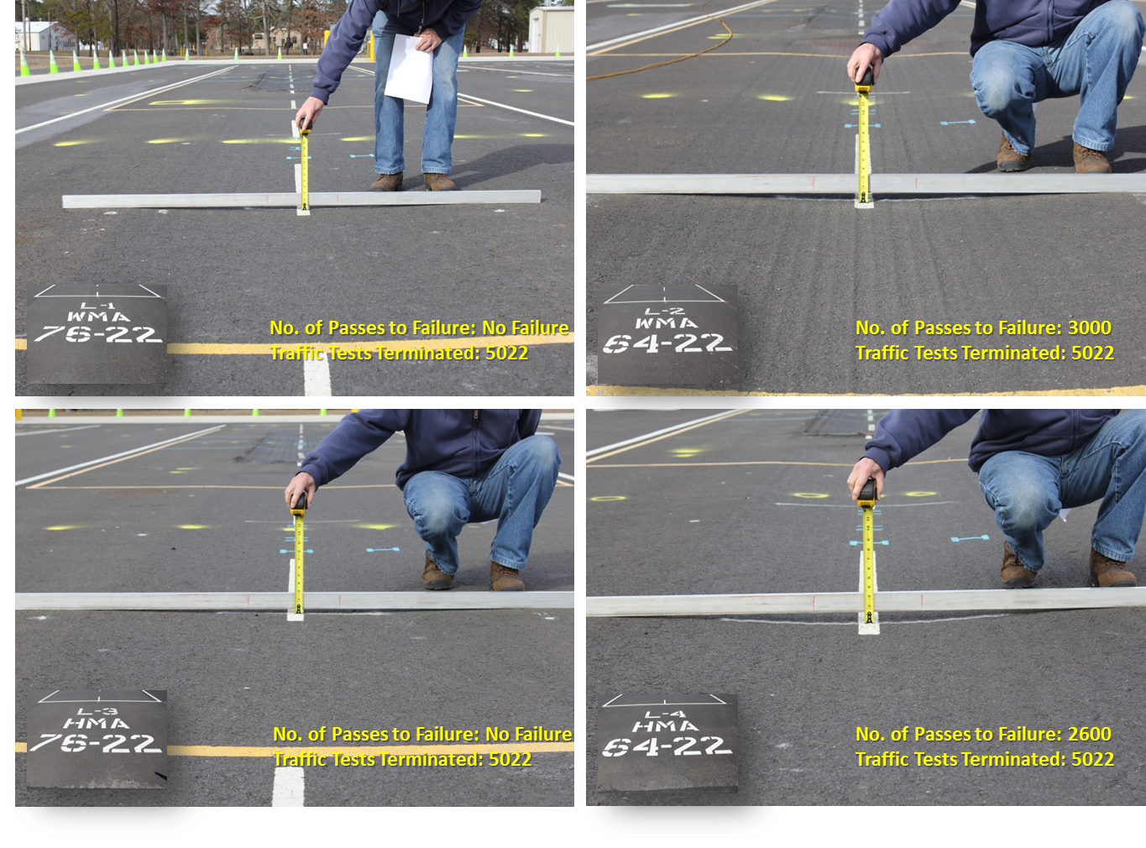
NAPMRC-TC1 CENTER TEST AREA (254-psi; 90°F)

Slide 13
Summary of TC1 Tests
    • Compare Warm Mix Asphalt (WMA) performance with P401 Hot Mix Asphalt (HMA) performance (rutting);
    Comparable Performance in rutting.
    Cracking performance need to be evaluated (TC2)
    • Effect of tire pressure on pavement rutting;
    Significant effects on mixes with unmodified binders.
    Insignificant effects on mixes with PMA.
    • Effect of polymer modified binder (PMA) on pavement rutting;
    Improves rutting performance significantly.
    • Effect of temperature on pavement rutting.
    Rutting performance of HMA/WMA is more sensitive to temperature than tire pressure.

Slide 14
TC1 Posttraffic Tests

Slide 15
TC1 Posttraffic Tests

Slide 16
TC1 Posttraffic Tests
Laboratory test results from posttraffic tests will be presentedpresented.

Slide 17
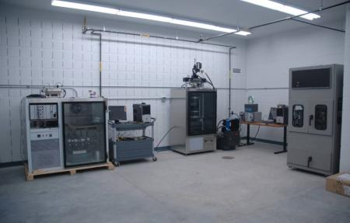
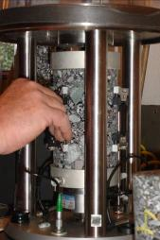
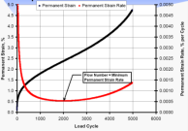
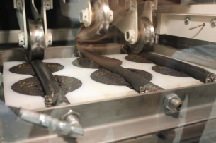
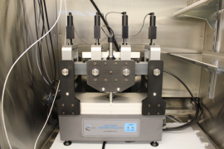

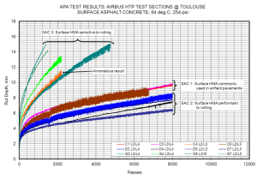
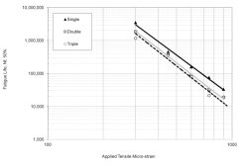
LABORATORY CHARACTERIZATION

Slide 18
Laboratory Characterization
Asphalt Mixtures:
  Dynamic Modulus Test
  Repeated Creep-Recovery Tests at Variable Stress Levels
  Repeated Creep-Recovery Tests at Variable Rest Periods
Asphalt Binders:
    Multiple Stress Creep-Recovery (MSCR)
Granular Materials:
  Resilient Modulus Test
  Repeated Creep-Recovery
  Triaxial Test to Calibrate CAP Model

Slide 19
Modelling – Texas A&M University
Standalone PANDA-AP:
Considers failure mechanisms
Can be used as a supplement to FAARFIELD for refined analysis
Allows for the definition of different gear configurations, loading type, and pavement structure
User-friendly and customized for airfield pavements
Will be free to public and Independent of commercial FE software, such as Abaqus and Ansys

Slide 20
Modelling – Texas A&M University
Performance Simulations:
Create 2D and 3D FE representation of airfield pavements subjected to different gear configurations
Analyze available lab experiments on FAA previous NAPTF materials
Conduct performance simulations of NAPTF sites to further validate and refine PANDA-AP
  Compare field rutting of NAPTF-CC3 sections with FE simulations

Slide 21

MATERIAL
P401
HMA
WMA
1
WMA
2
WMA
3
RAP
1
RAP
2
RUTTING
(test at high
temperature)
NAPMRC
Test Cycle-2
(TC-2)
CRACKING
(test during
winter)
PG
76-22
PG
76-22
PG
76-22
PG
76-22
PG
64-22
PG
64-22
Tire Pressure
254 psi

Slide 22




Pavement Cross Sections
P-401 HMA/WMA SURFACE
9 inches
P-209 CRUSHED STONE BASE
8 inches
P-154 SUBBASE
12 inches
SANDY SUBGRADE
CBR 15
NAPMRC TC-2 PAVEMENT CROSS SECTION

Slide 23

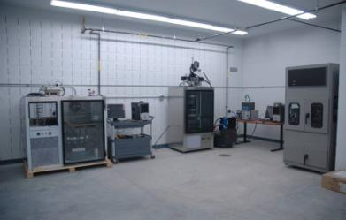


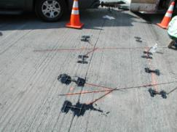

Slide 24
