Slide 1
RPA – P3 Field Instrumentation & Testing

Slide 2
RPA P3 Overview – Field Instrumentation & Testing
Need
Research Goals
Provides better understanding of long term pavement behavior in the field under varied climatic and operating conditions, and improved paving materials characterization will conserve airport development funds and reduce the downtime of runways from construction and maintenance activities.
Research Goals
More durable, long-lived airport pavements, reduced lifecycle costs, better prediction of pavement service life, and accurate assessment of aircraft-pavement compatibility
Pavement performance data under different climatic conditions.
Deliverables
Technical Reports, technical papers.
FY 2016-2017 Accomplishments
Funding Requirements
Finite Element Analysis for JFK project - Underway.
Milestones
- Completed sensor installation at BOS. √
- Completed lab tests on materials collected at BOS. √
- Complete sensor installation at PHL.
- Complete lab tests on materials collected at PHL
- Complete in-situ tests at PHL.
- Install sensors at FDR project at Davis, CA (tentative).
Field Instrumentation & Testing FY 2017 through FY 2019.
 | FY 2017 | FY 2018 | FY 2019
Funding Target ($000) | $900 | $825 | $865
P3.1: Sensor Installation | $350 | $325 | $350
P3.2: Material Testing | $300 | $250 | $265
P3.3: Data Analysis | $250 | $250 | $250

Slide 3
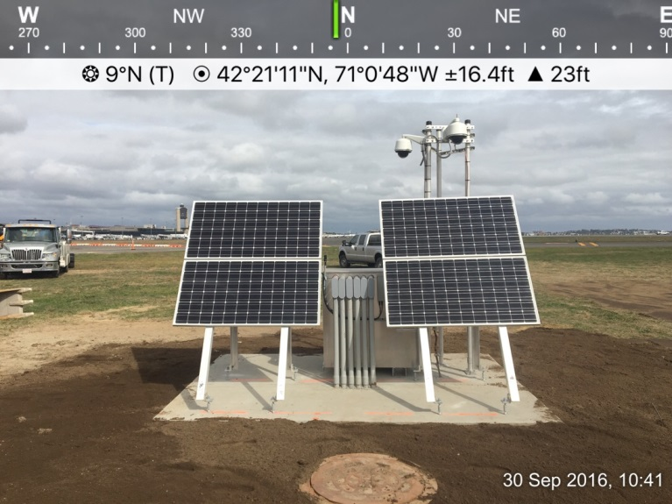
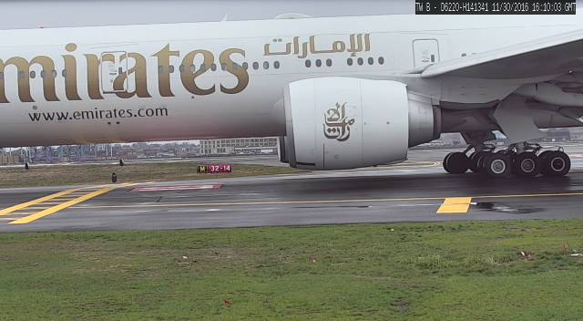
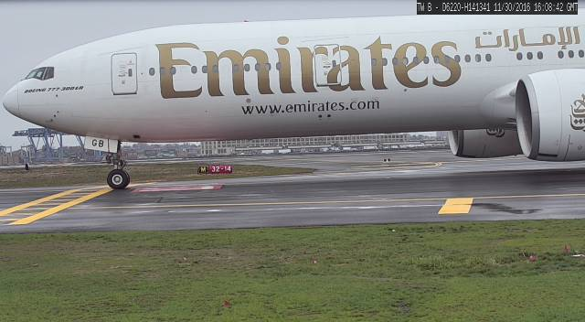
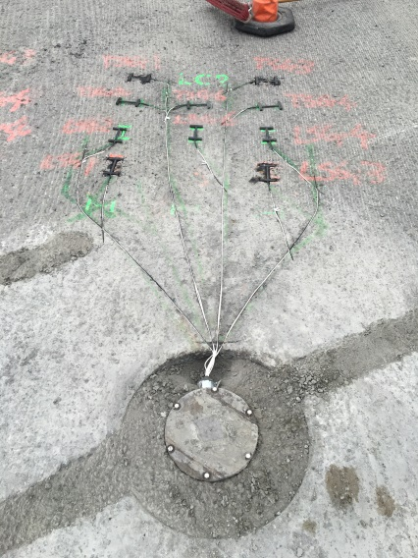
Field Instrumentation & Testing Program
Airports Completed
Denver (DEN)
Atlanta (ATL)
Newark (EWR)
New York (JKF)
Boston (BOS)
Future Installation
Philadelphia (PHL)
Current Discussions
Seattle-Tacoma (SEA-TAC)
Phoenix (PHX)
San Francisco (SFO)

Slide 4
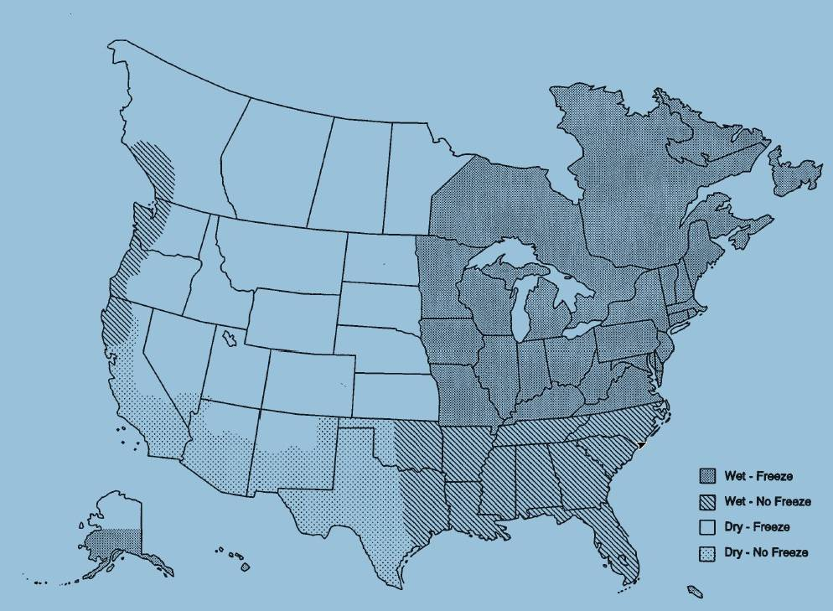
Current FAA Airport Instrumentation Projects
= Completed
= Under Construction
= FAA Consideration
SEA-TAC
JKF: PCCP
EWR: HMA Overlay
BOS: HMA Overlay
UCD Airport
SFO
PHL: HMA/PCCP
DEN
PHX: HMA/PCCP
ATL: HMA/PCCP

Slide 5
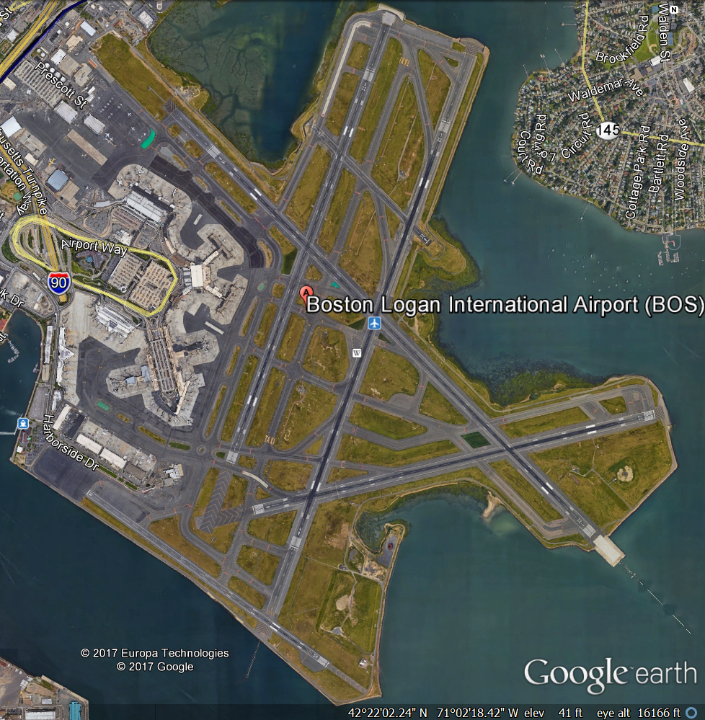
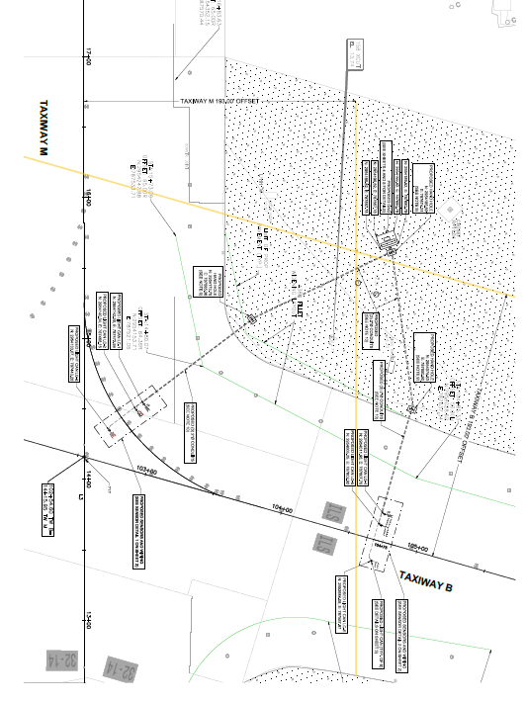
Boston Logan International Airport (BOS)
Taxiway M
26
30
Taxiway B

Slide 6
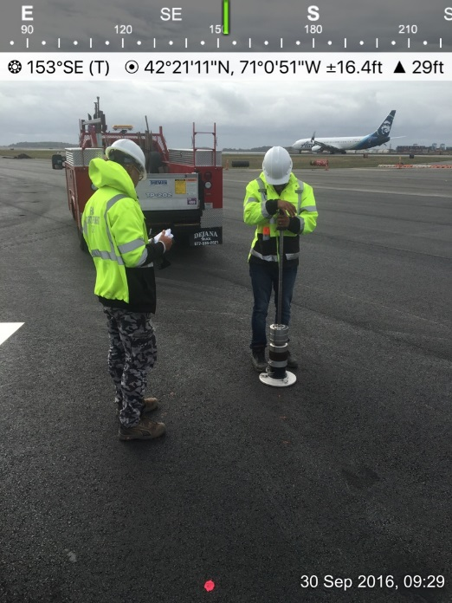
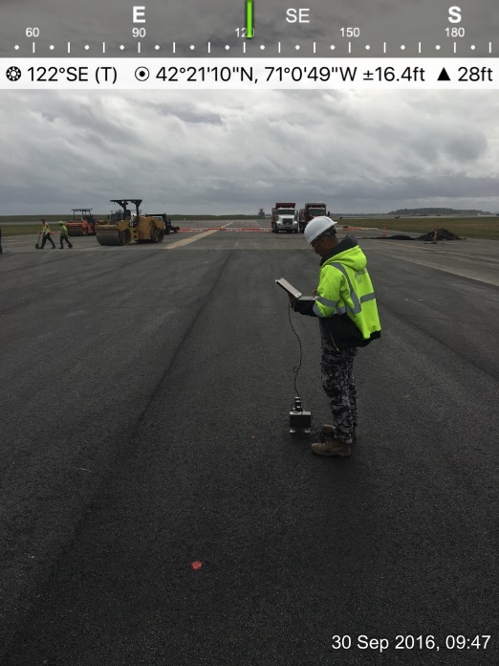
Boston Logan International Airport (BOS)
Data Acquisition Unit
LWD
PSPA
Example Strain Gauge Installation at Taxiway M-Taxiway B Intersection

Slide 7
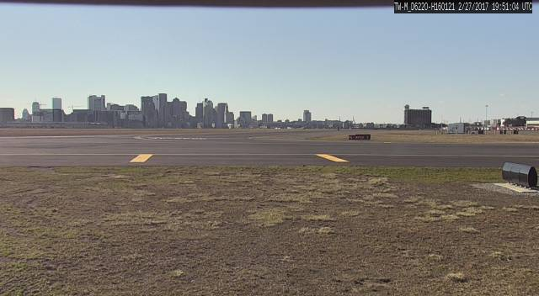
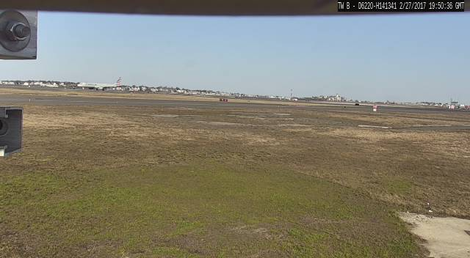
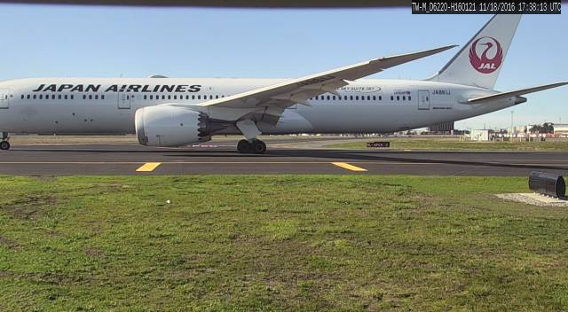
BOS Data Acquisition Cameras

Slide 8
BOS Preliminary Data
Pavement sensor responses under A380 and B787 will be presented.

Slide 9
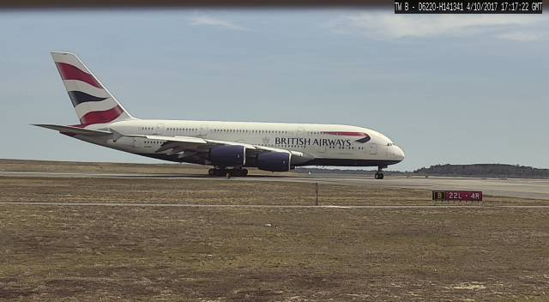
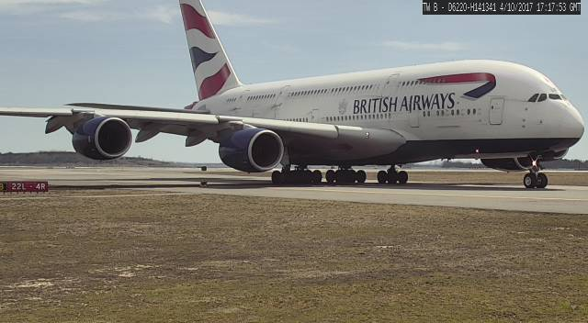
BOS - A380

Slide 10
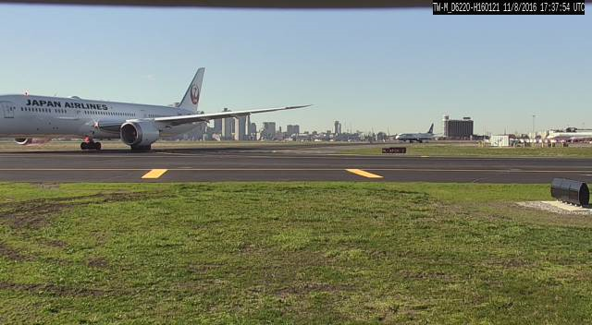
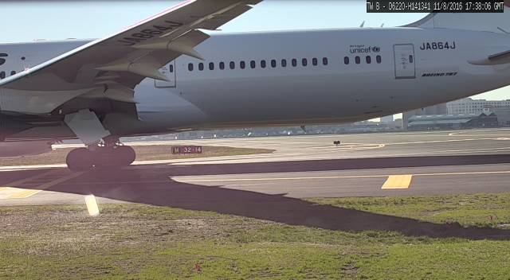
BOS - Boeing 787

Slide 11
BOS Laboratory Test
Property | Test | Status
Modulus | AMPT Dynamic Modulus | Completed
Permanent deformation | AMPT Flow Number High Temperature IDT APA | Completed Completed Completed
Cracking resistance | Flexural Beam Fatigue Semi-Circular Bending DCT Fracture Energy | Completed Completed Completed
Moisture sensitivity | Tensile Strength Ratio | Completed
Air Voids | Gmb and Gmm | Completed
Asphalt Content | Ignition Method | Completed
Gradation | Sieve analysis | Completed

Slide 12
BOS Material Characterization Results
Results from laboratory material characterization tests will be presented.

Slide 13
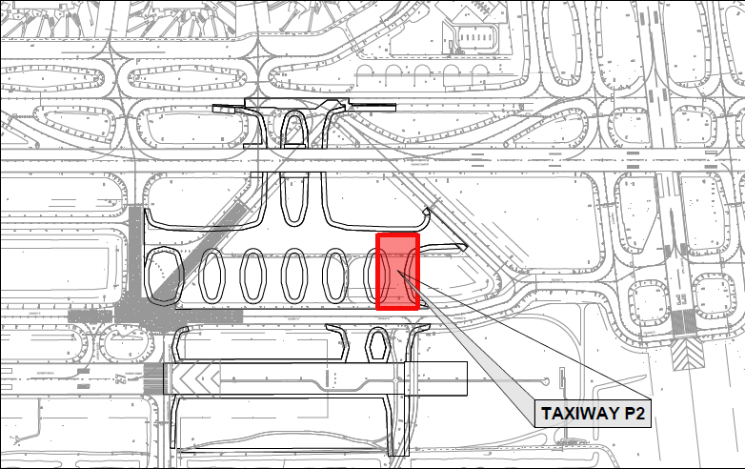
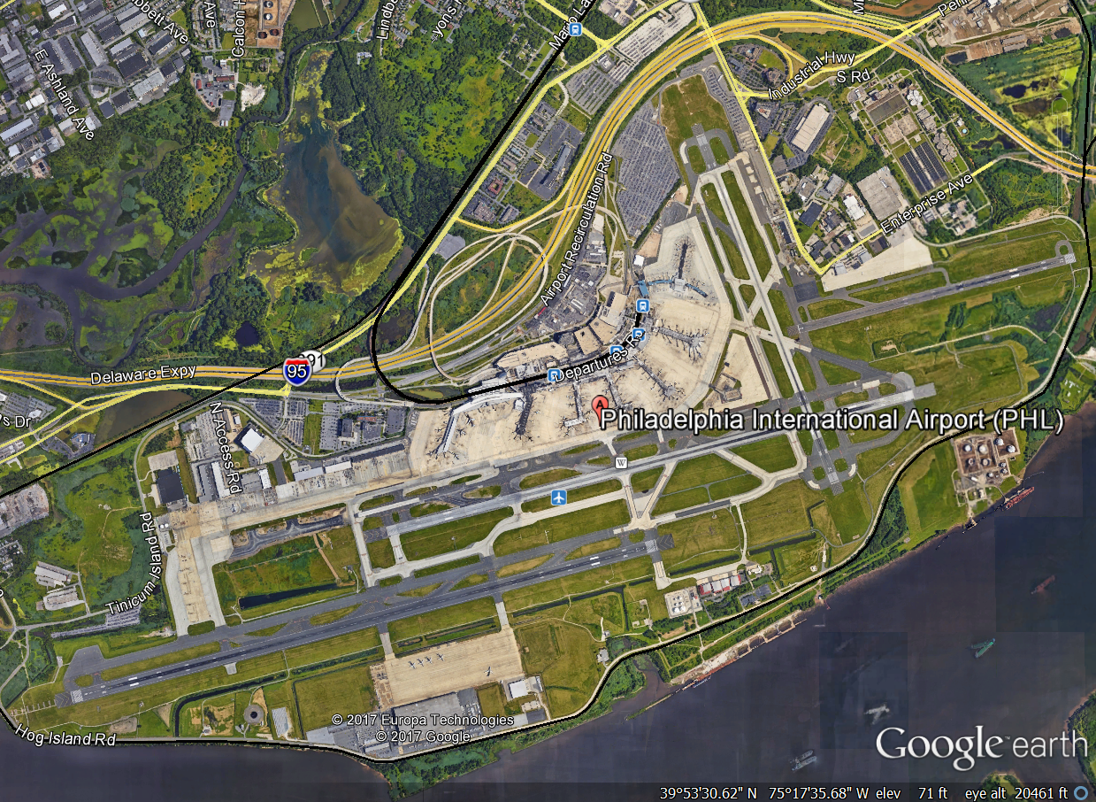
Philadelphia International Airport (PLH)
Runway 27L Extension and Associated Taxiways
New Construction on Taxiway P2:
- 18” P-501
- 17” P-401

Slide 14
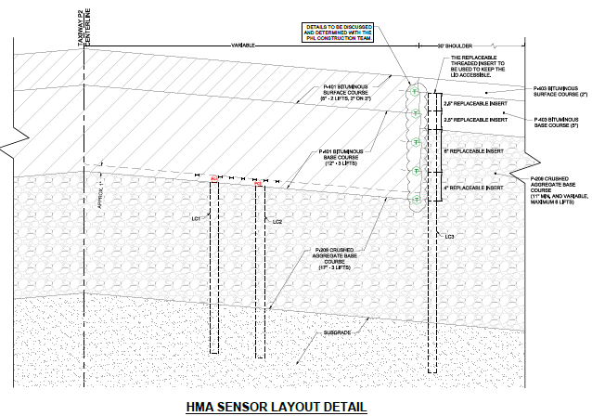
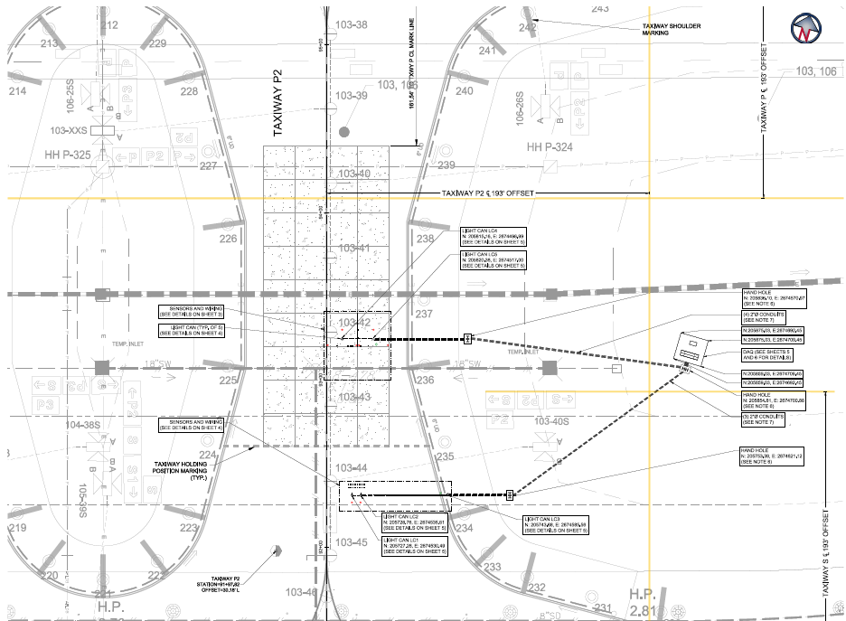
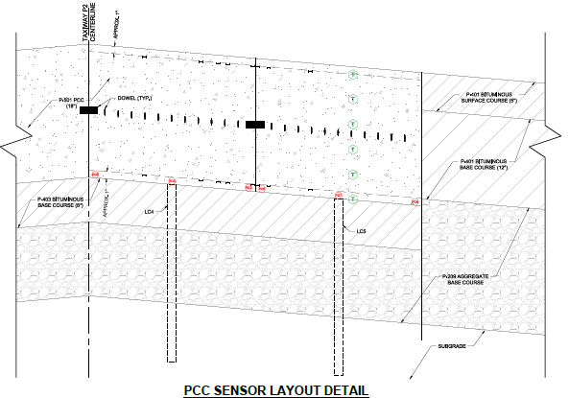
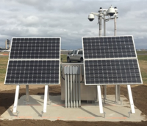
PHL Sensor Installation Layout
18” P-501 Sections
28 Strain Gauges
6 Pressure Cells
17” P-401 Sections
16 Strain Gauges
2 Pressure Cells
DAQ Unit

Slide 15
PHL Objectives
Determine the response of concrete slabs and asphalt concrete under multi-gear aircraft such as A-350, B-777, etc.
Compare the performance of concrete slabs and asphalt concrete under aircraft load.
Evaluate the load transfer efficiency of the joint
Measure the temperature profile in cement pavement and asphalt pavement. Study the effect of temperature profile on pavement response.
Evaluate curling in concrete slabs.
Measure the pressure on top of subgrade and base layer under aircraft load for different pavement structure.
Characterize the subgrade, base, cement concrete and asphalt concrete materials.
FAA Instrumentation team is coordinating with contractors construction schedule to begin installation

Slide 16
