Slide 1
Pavement Design and Evaluation
RPA P5
REDAC Subcommittee on Airports
David R. Brill, P.E., Ph.D.
August 16, 2017

Slide 2
RPA P5 – Pavement Design and Evaluation
Need
There is a need for advanced, computer-based pavement design & evaluation solutions to protect the FAA’s investment in airport pavement. The FAARFIELD program provides confidence that pavements will meet the required service life. Savings to the AIP will result from reduced construction costs and fewer runway closures.
Research Goals
Continue to update and modernize the FAARFIELD design software.
New ACN-PCN system of reporting airport pavement strength by FY17.
Incorporate top-down cracking mode in FAARFIELD rigid design by FY18.
Fully integrate FAARFIELD thickness design with LCCA procedures by FY22.
FY 2016-7 Accomplishments
Released FAARFIELD v. 1.4.
Test new FAARFIELD-based
ACN-PCN method.
Tech Report: Flexible pavement new subgrade failure model.
Prototype new FAARFIELD GUI.
Funding Requirements
Project | Contract Funds ($K)
 | FY 2017 | FY 2018 | FY 2019
P5. Pavement Design and Evaluation | 1200 | 1190 | 1235
P5.1. Design Improvements | 750 | 740 | 870
P5.2. ACN-PCN Improvements | 250 | 225 | 135
P5.3. Analysis | 200 | 225 | 230

Slide 3
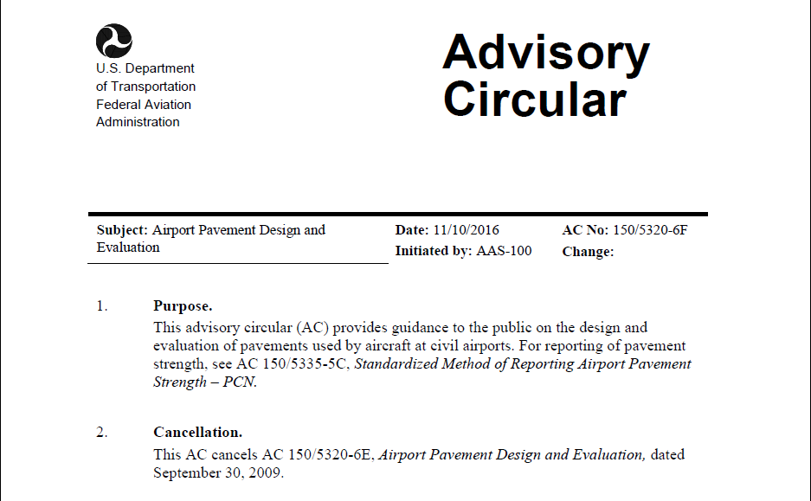
AC 150/5320-6F & FAARFIELD 1.41
Released Nov. 10, 2016

Slide 4
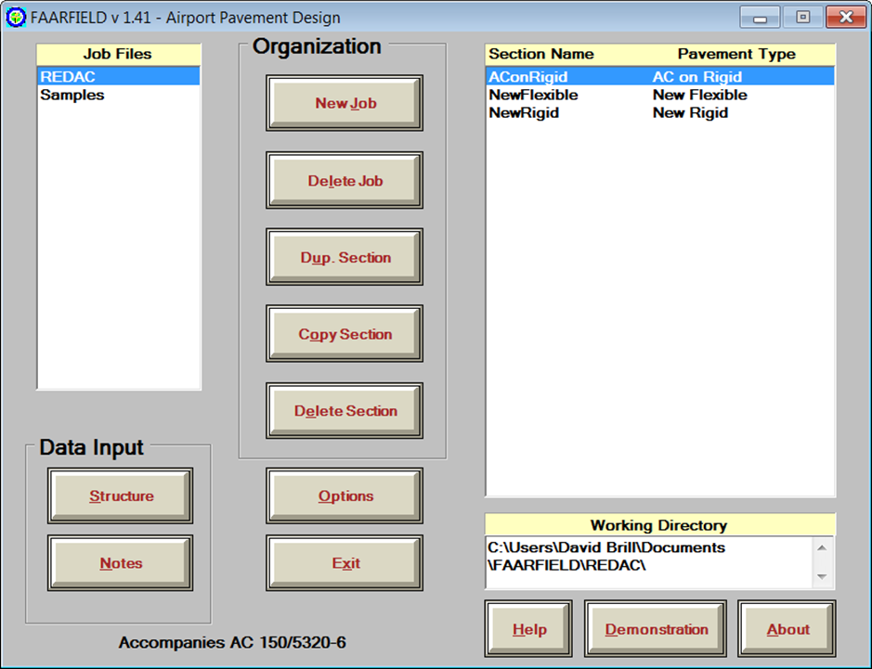
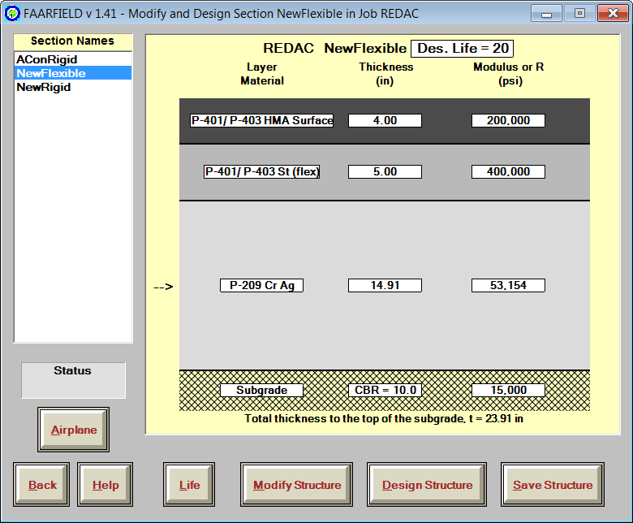
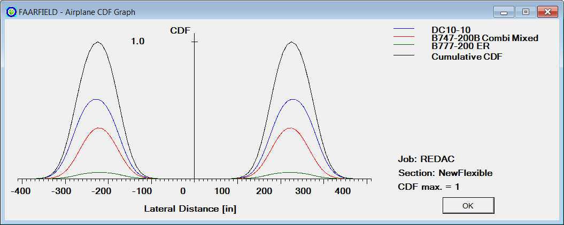
FAARFIELD 1.41
Released Nov. 10, 2016
Accompanies AC 150/5320-6F
FAARFIELD 1.41 workshops held:
  Seattle, WA (AI)
  Chicago, IL (AI)
  Austin, TX (ISCP)
  International:
    Tel Aviv, Israel
    Athens, Greece
    Seoul, South Korea
  Upcoming: Philadelphia, PA (ASCE T&DI Conference)

Slide 5
FAARFIELD 1.4 – What’s New?
Completely revised flexible and rigid failure models based on current NAPTF full-scale test data.
Reduced excess stabilized base thickness requirement.
Improved, more accurate 3D finite element model.
Completely rewritten concrete overlay design procedure.
Automatically generates PDF design report.
Automated, software-based compaction criteria.
Updated aircraft library aligned with COMFAA 3.0.
Include non-airplane vehicles in library (ARFF vehicles, etc.)
Support for user-defined gear configurations.
Advanced, energy-based asphalt fatigue models.
All data files now stored in document directories.

Slide 6
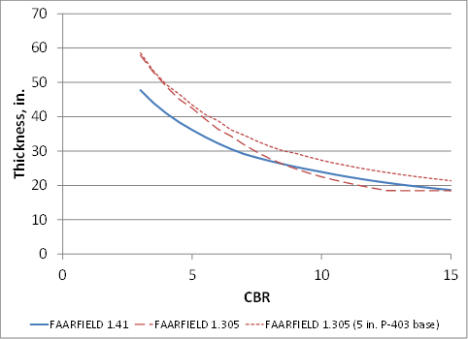
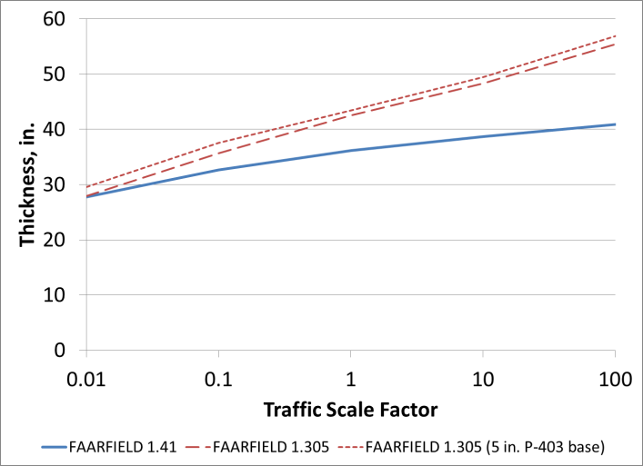
FAARFIELD 1.41 Design Comparisons
Paper for ASCE Intl. Conference on Highway Pavements & Airfield Technology, Phila., August 2017
FLEXIBLE PAVEMENTS
RIGID PAVEMENTS

Slide 7
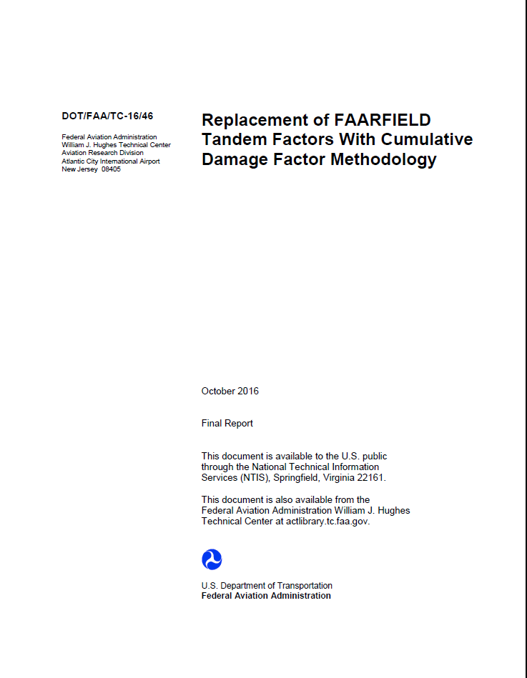
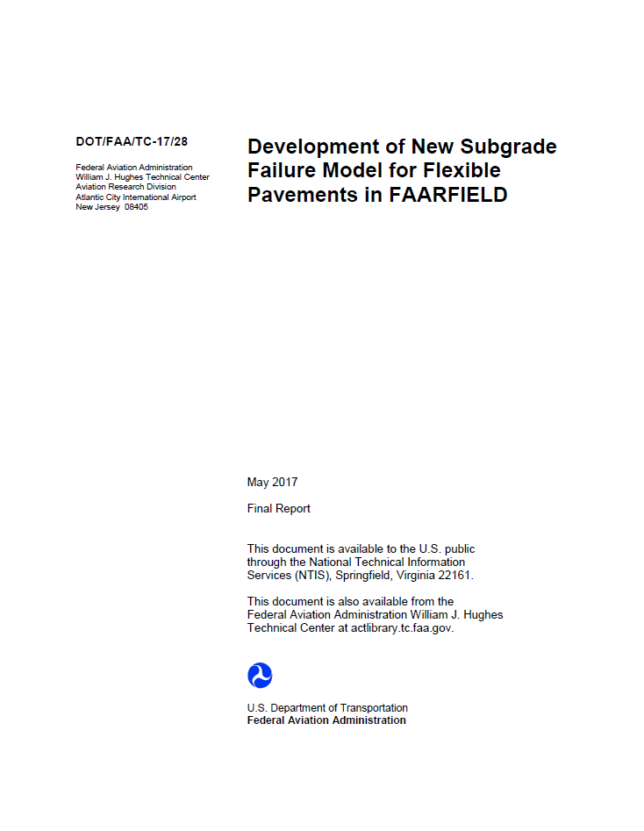
Technical Reports
Replacement of FAARFIELD Tandem Factors with CDF Methodology
October 2016
Documents changes to evaluation of tandem gear damage
Development of New Subgrade Failure Model for Flexible Pavements in FAARFIELD
May 2017
Documents new FAARFIELD 1.41 design models

Slide 8
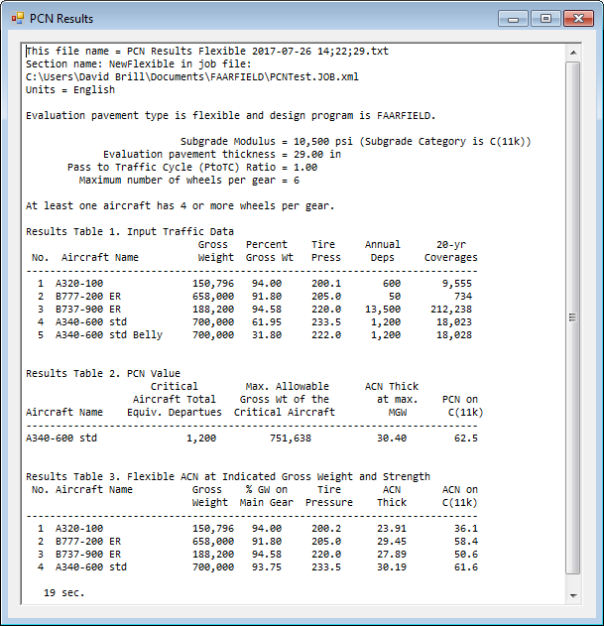
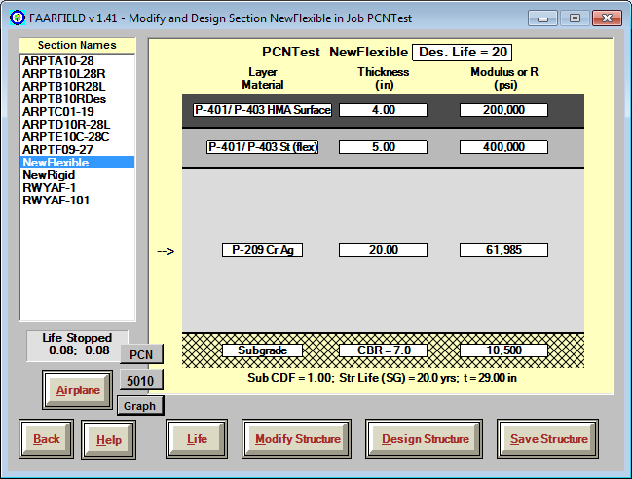
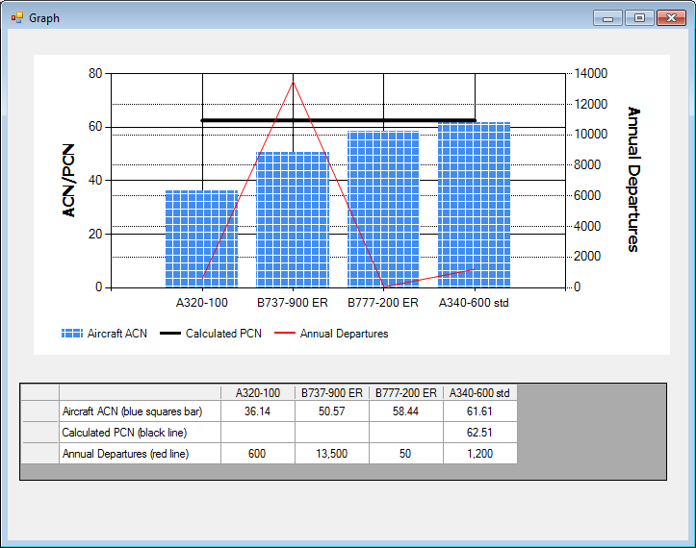
FAARFIELD PCN Evaluation
Directly uses FAARFIELD structure and traffic list.
NO alpha factor, layer equivalency factors, top-of-base k, etc.
Eventual replacement for COMFAA 3.0 & support spreadsheets.

Slide 9
Flowchart of PCN Calculation
No more looping through all aircraft in the list!

Slide 10
FAARFIELD-Based ACN/PCN
Accomplishments:
Created Visual Basic class library to compute layered elastic-based ACNs (rigid & flexible).
  Replacement for legacy ICAO ACN computer programs.
  Open source library – supports linking to any PCN program.
  Defined input & output protocols.
Implemented PCN calculation in FAARFIELD 1.41.
  New algorithm solves problem of computing PCN for mixed traffic (narrow bodies and LR aircraft) without unnecessary operating weight restrictions.
  Seamlessly handles HMA overlays on flexible pavements.
On target for replacement ACN-PCN system with ICAO effective date in 2022.

Slide 11
Legacy Fortran Libraries
Existing Fortran libraries are modified from original 1995 programs.
Still distributed by FAA under a software sharing agreement with Lawrence Livermore National Laboratory, the original NIKE3D developer.
Very significant limitations for .NET programming.
  Unmanaged code.
  Not under the control of .NET memory management services.
  May lead to memory conflicts or crashes at runtime.
  Obsolete data storage and retrieval methods.
  Few young programmers have knowledge of Fortran.

Slide 12
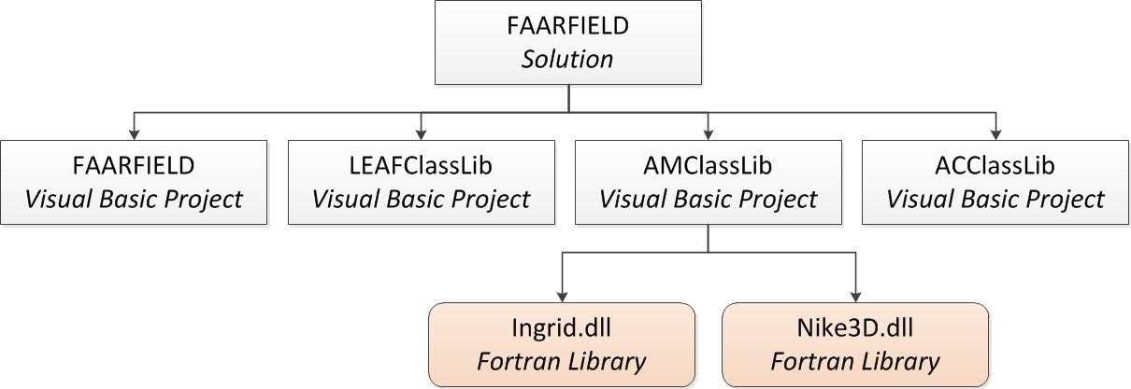
FAARFIELD Calling Structure
REPLACED BY:
FAAMeshClassLib
Visual Basic.NET Class Library
New Visual Basic.NET Class Library to replace NIKE3D.dll
In Progress (FY18)

Slide 13
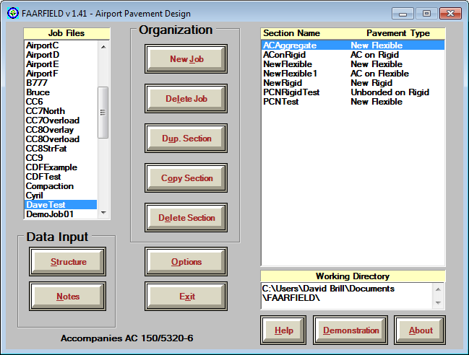
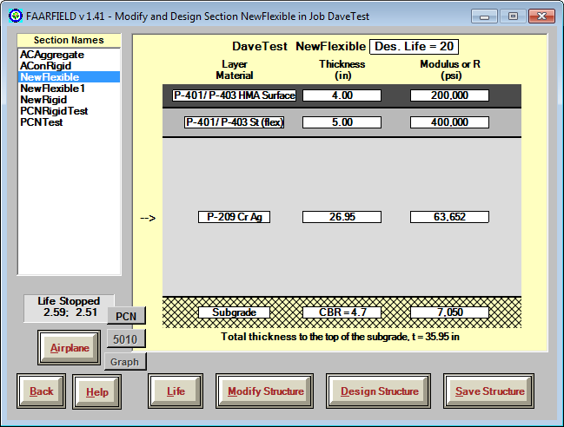
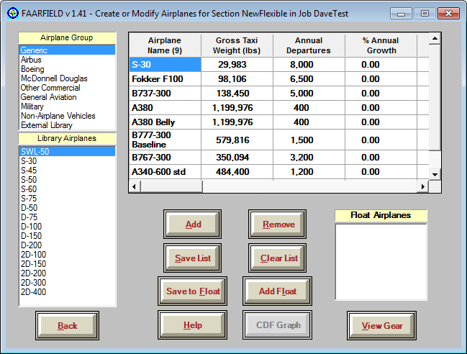
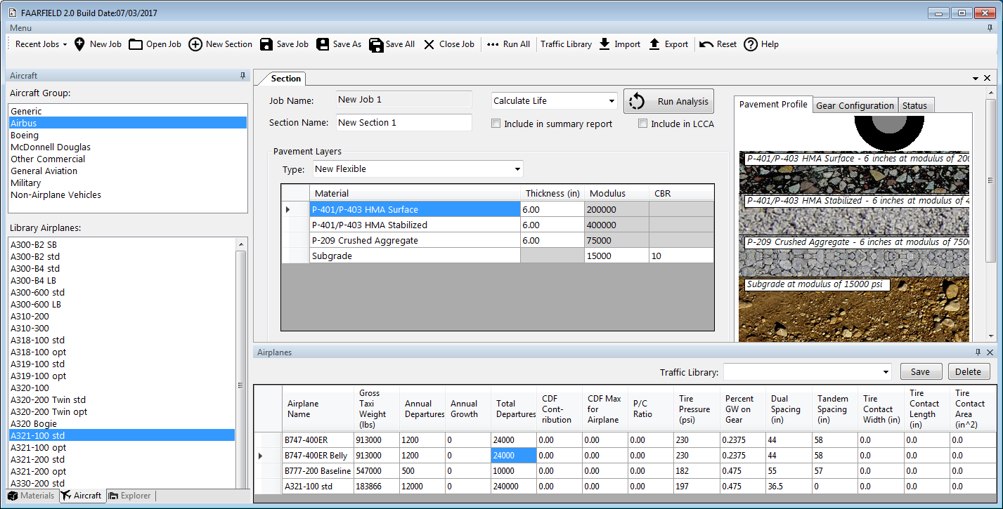
GUI Modernization
Modernize the FAARFIELD graphical user interface (GUI).
  Job and section entry.
  Improved start-up screen.
  Improved screen re-sizing and appearance.
  Improved flow between screens.
  Rationalize data file structure.
  Remove program logic from GUI controls.
Working GUI prototype was demonstrated July 2017.
FAARFIELD 2.0 beta –
Target date July 2018.

Slide 14
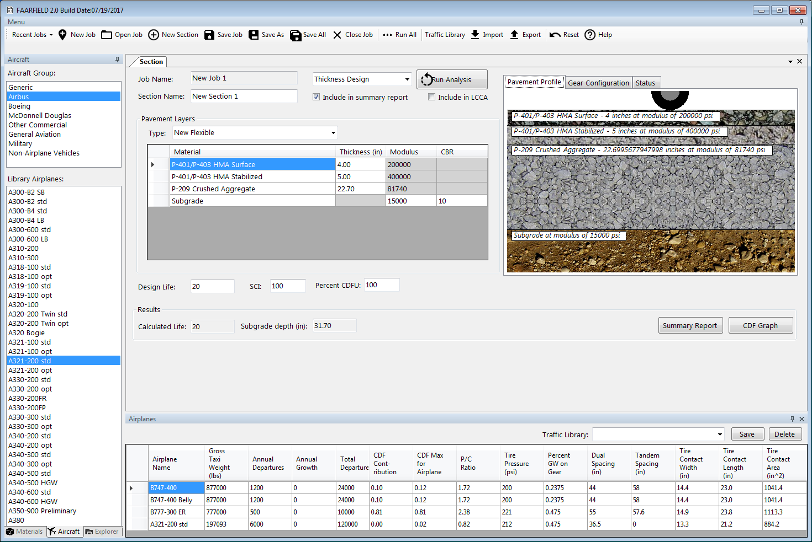
FAARFIELD 2.0 GUI Screenshot

Slide 15
Features of Modernized GUI
Multi-display interface.
Highly configurable process flow.
  Consolidated data entry to single screen.
  Open, resize, move, dock/undock, close screens independently.
  Makes use of right-click context menus.
Resizable screens.
Allows working with multiple jobs & sections.
  Switch between jobs/sections/pavement types with 1 click.
  Cut and paste between jobs.
Standard Windows file management.
  Built-in Windows tools for saving/opening jobs.
  Section and job names follow Windows standards.
Built-in standard pavement section library accessible from menu.

Slide 16
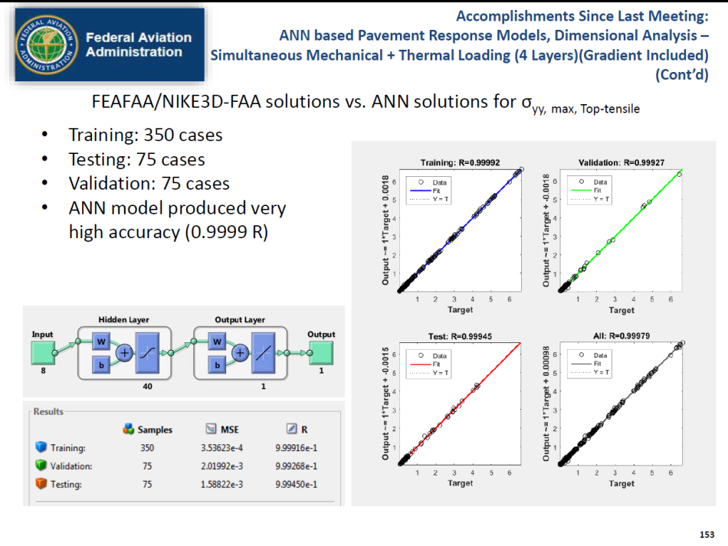
Top-Down Cracking Mode (Rigid)
ANN Development: Input Parameters
Current efforts are focused on artificial neural networks (ANN) for multi-slab model with curling.
Fast, accurate solutions within the defined problem space.
Grant to Iowa State U.
  P.I. Dr. Halil Ceylan
  2nd year of 3-year project.
Paper at 2017 TRB:
  Neural-Network Based Multiple-Slab Response Models for Top-Down Cracking Mode in Rigid Airport Pavements Subjected to Boeing B-777 Loading

Slide 17
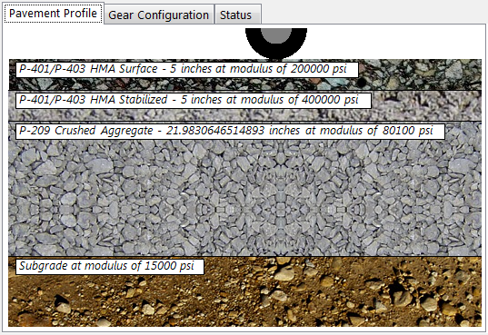
Questions?

