Slide 1
Extended Pavement Life
RPA P8
REDAC Subcommittee on Airports
David R. Brill, P.E., Ph.D.
August 16, 2017

Slide 2
RPA P8 – Extended Pavement Life
Need
Longer design periods for airport pavements, up to double the current standard of 20 years, will provide cost savings to the AIP by reducing lifecycle costs. Extended airport pavement life also provides many green benefits, and minimizes down time at the nation’s busiest airports.
Research Goals
Link PA40 database to historical traffic data sources in ASAIS by FY17.
Develop performance data models (Age-DL and Traffic-DL) by FY18.
Next-generation FAARFIELD program incorporating new 40-year life design procedures by FY22.
FY 2017-8 Accomplishments
Collect field data at LAX 6R-24L.
Update PA40 to PAVEAIR 3.0 standard with active traffic link.
Preliminary performance data analysis – papers at BCRRA17.
Funding Requirements
 | FY 2017 | FY 2018 | FY 2019
Funding Target ($000) | 925 | 775 | 790

Slide 3
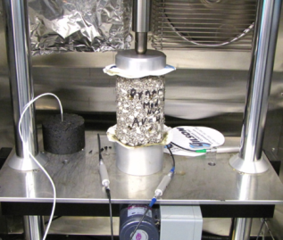
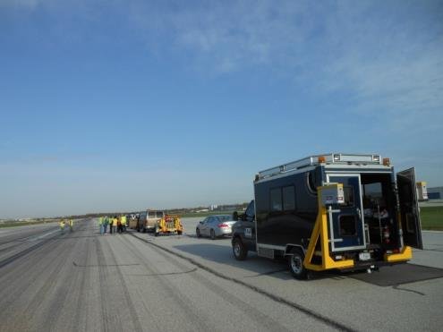
Pavement Life Extension
Runway data collection.
  4-year project – last year.
  Construction and performance data on medium- and large-hub runway pavements.
  Field data collection.
  Current efforts focus on filling known gaps in data.
FAA PAVEAIR database development (PA40).
Pavement life model development.

Slide 4
Updated Runway List
YES
Field work completed 2/23/17

Slide 5
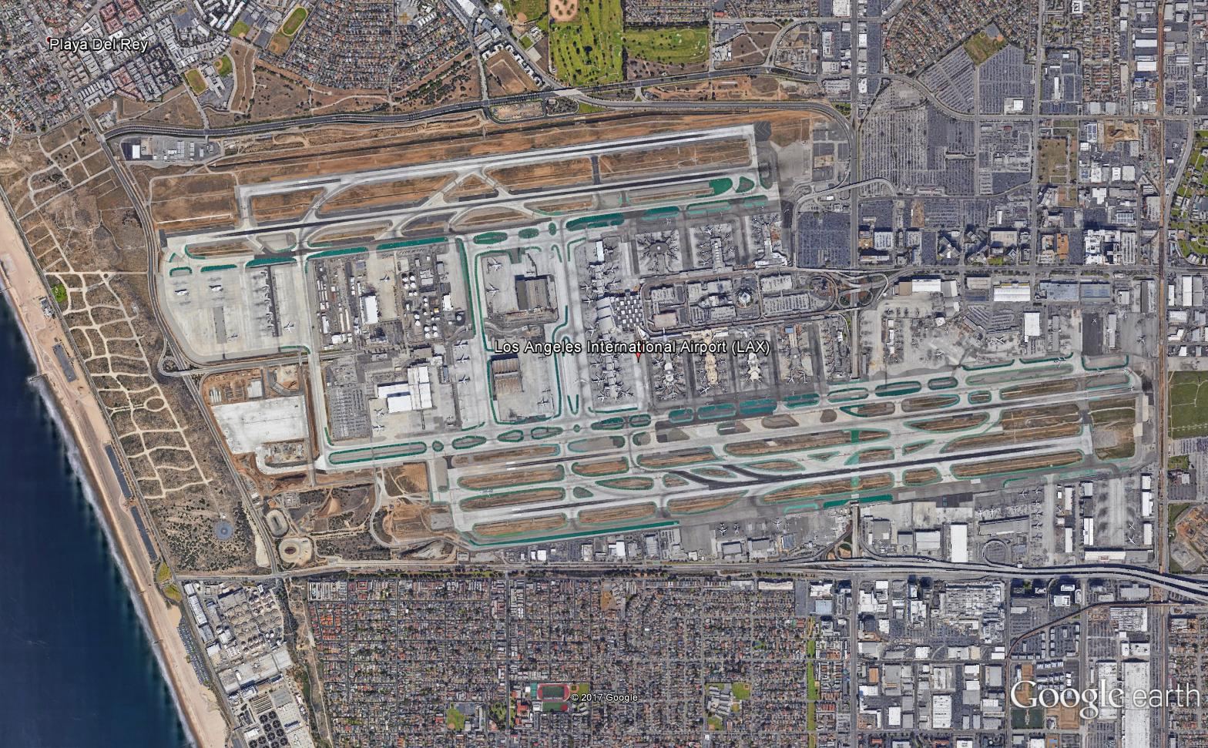
LAX 6R-24L Field Data Collection
Rescheduled for November 2017
RWY 6R-24L
Dry-No Freeze Climate Zone
Original construction 1986 (>30 years).
Old PCC runway exhibiting distresses and near end of life.
Main departure runway; heavy use with large percentage of large WB aircraft.
Coordinating site visit with LAX Operations and FAA Western Pacific Region.

Slide 6
Additional Data Collected
Contractor contacting airports requesting updated PCI, friction, and roughness records for runways.
Also requested traffic counts prior to 2012 that include runway usage data by aircraft type.
New information received to date:
  Traffic counts prior to 2012 from one runway at DEN and 2 runways at SEA.
  Updated PCI information from 2 runways at SLC and one runway at DEN.
  Friction data for BWI, DFW, GSO, IAD, LAX, MIA.
    Complete quarterly friction test data from BWI (2010 – 2016).

Slide 7
PA40 Status – August 2017

Slide 8
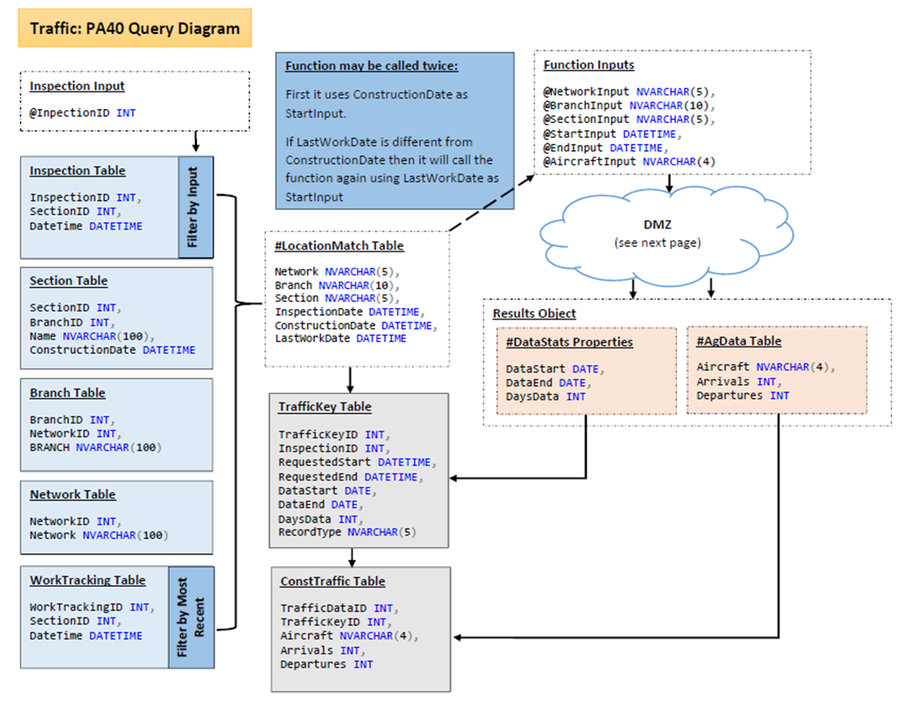
PA40 Traffic Data Integration
Search runway usage data by:
  Aircraft type.
  Runway end.
  Arrival or departure event.
Designed to return runway traffic since:
  Construction or major work date.
  Previous inspection date.
Access threaded track data (TTD) via NPN shared services.

Slide 9
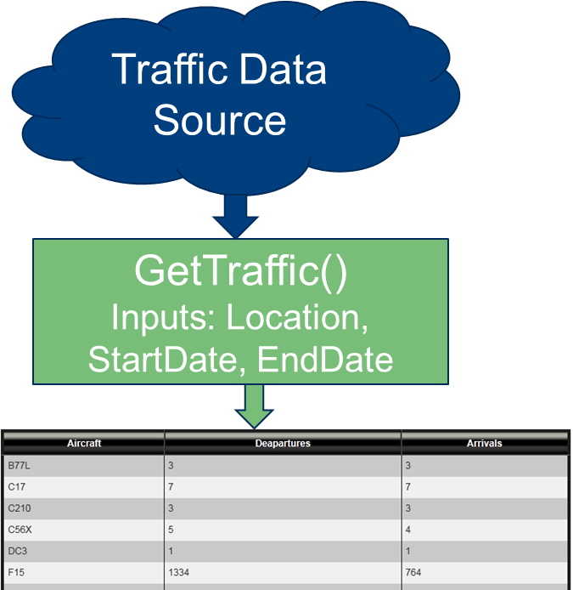
PA40 Traffic Link Status
Added GetTraffic() function to system.
Pulls data from data source.
Gives traffic counts for a given runway (location) and date range.
  Handles different data sources.
  Manages “no available data” and “data source not available” conditions.
  Reports on completeness of data set.

Slide 10
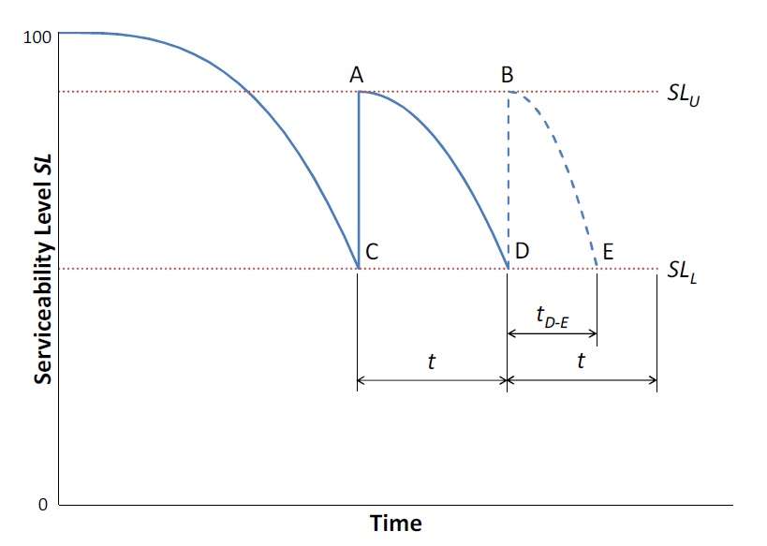

Serviceability Level Concept
Points A and B represent rehabilitations to restore serviceability.
Points C and D represent “end of serviceability.”
Point D also represents “end of life” if:
Goal: find components of SL, and parameters SL_{L}, p such that “end of life” agrees with LCCA-based decision to reconstruct.

Slide 11
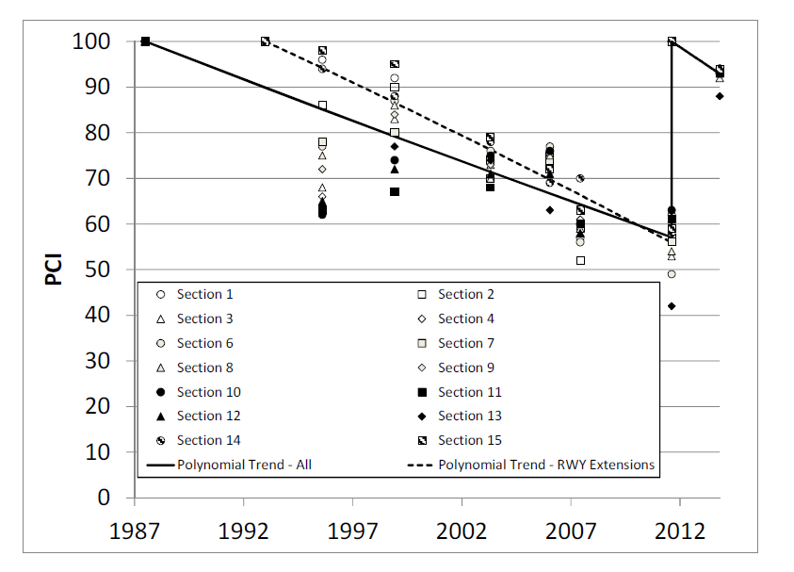
Preliminary Analysis – BWI 10-28
Flexible runway.
  Central sections originally constructed in 1950’s.
  Extended and reconfigured in 1993.
  Full overlay in 2011.
PCI < 60, but elected to rehabilitate not full reconstruct in 2011.
Some sections exhibited structural distress in PCI.

Slide 12
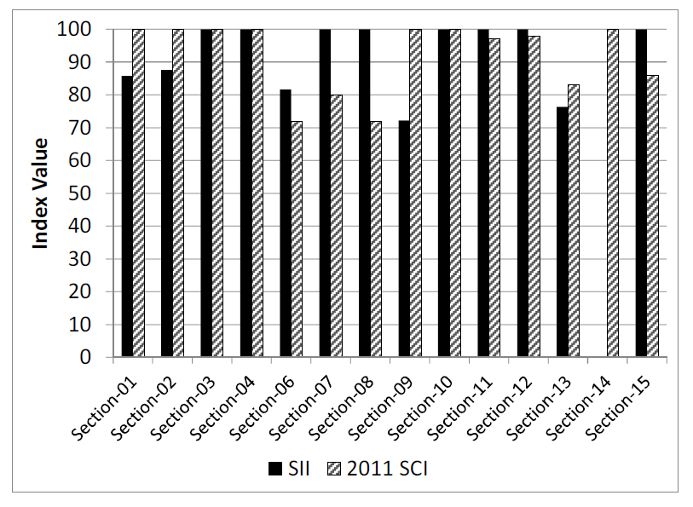
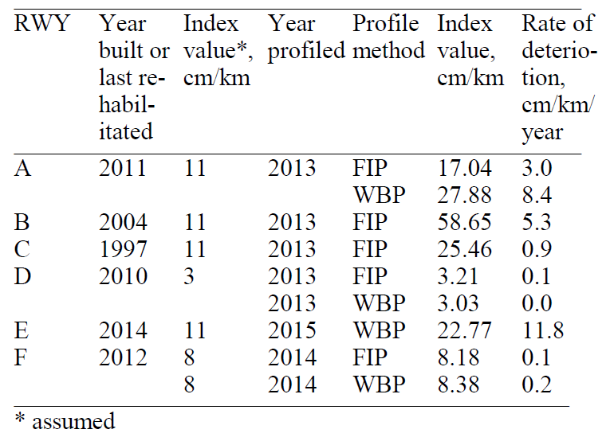
Preliminary Analysis – BWI 10-28
Structural Component
Functional Component
“Anti-SCI”
Groove deterioration
Skid resistance
Profile index:
Flexible “SCI” – Considers only rutting & alligator cracking distresses.
SII – Structural integrity index (ratio of ISM for trafficked & non-trafficked lanes)

Slide 13
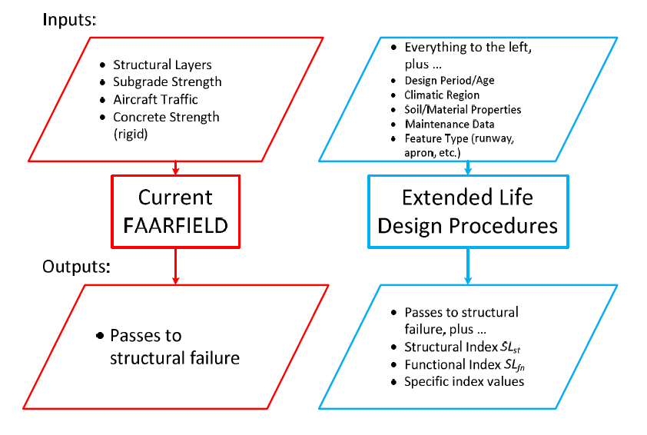
Schematic for Generalizing Design Procedures

Slide 14
FY 2017 Papers/Presentations
Papers presented at Bearing Capacity of Roads, Railways & Airfields Conference (BCRRA 2017), Athens (June 2017).
  Brill & Parsons: Development of New FAA Design Procedures for Extended Airport Pavement Life
  Parsons & Brill: Preliminary Analysis of Pavement Life Indicators of Large- and Medium-Hub Airport Runways
Presentations for 2017 ASCE T&DI Conference, Philadelphia, PA (August 2017):
  Parsons & Brill: Typical Material Properties of Pavements Sampled for the Extended Airfield Pavement Life Program
  Puzin, Mustafa & Speir: Correlation Between Friction, Roughness, Foreign Object Damage, and Pavement Condition Indices for Pavement Extended Life

Slide 15
FY17 R&D Efforts
Complete population of PA40 (TUS, MCI, ATL, LAX).
Perform field data collection at one additional runway selected from those currently in the PA40 database (LAX 6R-24L).
Link to existing databases with historical runway traffic (TTD) and climatic data.
Develop new sets of family curves in PA40 (coordinate with RPA P7.1 – FAA PAVEAIR).
  “DL versus age”
  “DL versus applied traffic”
  Look at index components of DL to satisfy end of life definition.

