Slide 1
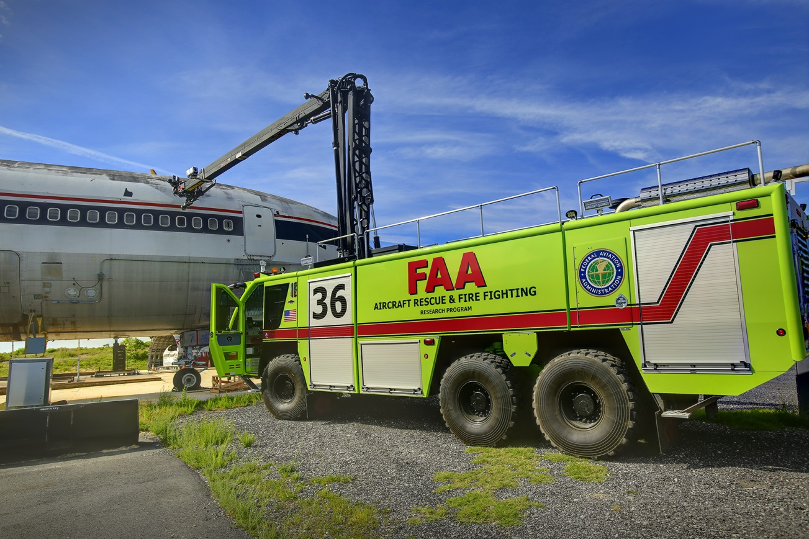
RPA S3 Aircraft Rescue and Fire Fighting
REDAC Briefing
August 15, 2017

Slide 2
RPA S3 Aircraft Rescue and Fire Fighting

Slide 3
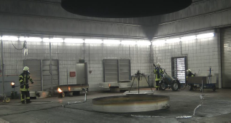
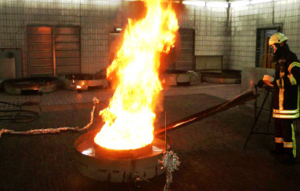
New Fire Test Building
Tests to be performed:
New FF Agents
Environmental
Alternative Fuels
Heat Release Rate (HRR)
Composite Materials
Agent Quantities
Mil Spec / ICAO Protocols

Slide 4
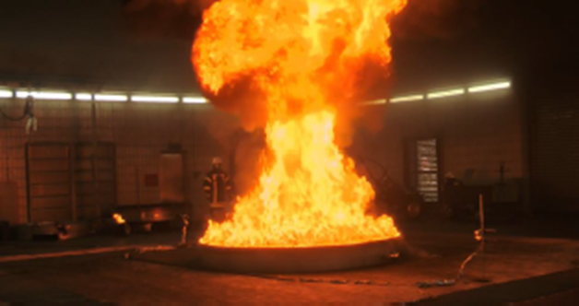
New Fire Test Building
The instrumented section shall consist of:
gas temperature thermocouples
calorimeters
pressure probe
gas sampling probe
smoke density meter.
The hood calorimeter will be capable of accurately measuring the heat release rate of a 15 MW hydrocarbon pool fire (10’ Dia., ICAO Level C).
Building will have color and FLIR video camera array.

Slide 5
Status
FAA TC MPSB approval received May 19, 2015.
FAA 7460 obstruction evaluation approved July 22, 2015.
Completed study on potential emission control levels and state permitting December 2015.
NJ DEP ruled no emission control system required March 24, 2016.
Completed architectural design April 2017.
Anticipate construction contract award FY18.
1011 Test Aircraft
Office Trailer
Storage Shed
Pump House

Slide 6
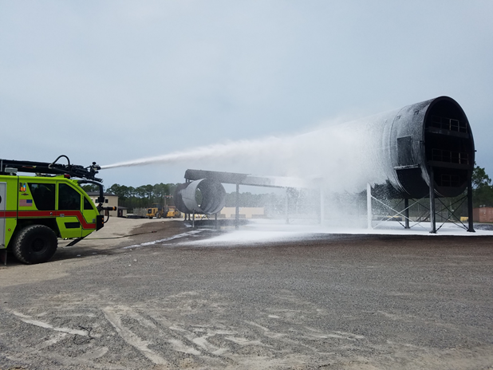
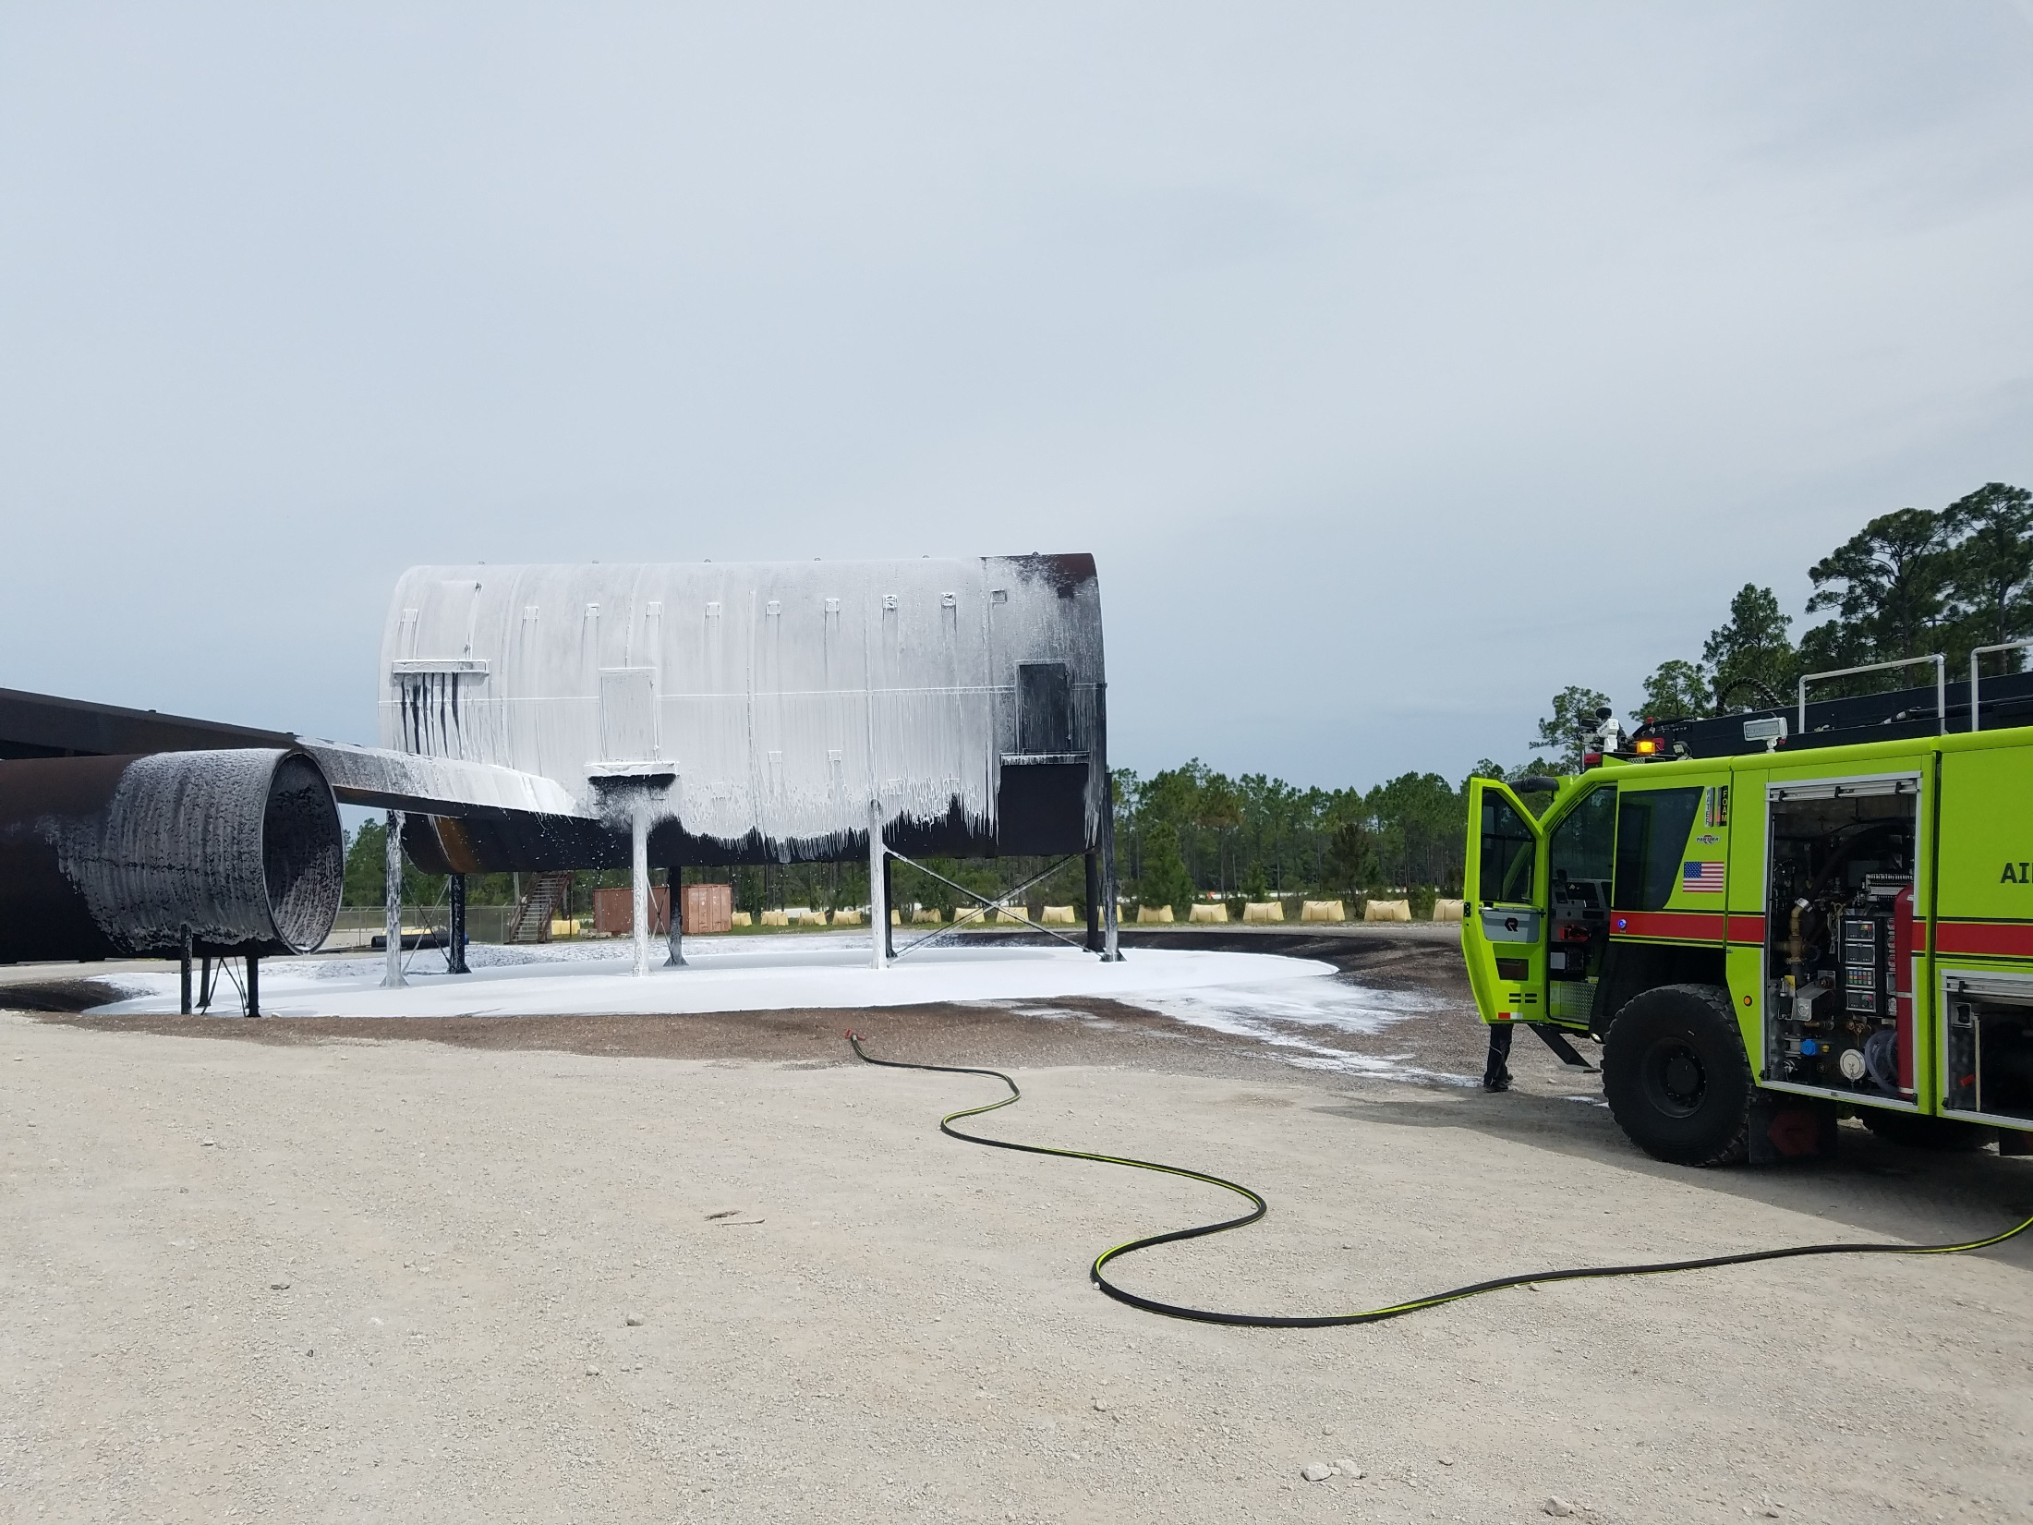
Compressed Air Foam
Tyndall shut down AFFF Ops due to PFCs
Tyndall Reinstated June 2017
Small Scale Testing Resumed
Full Scale Pending

Slide 7
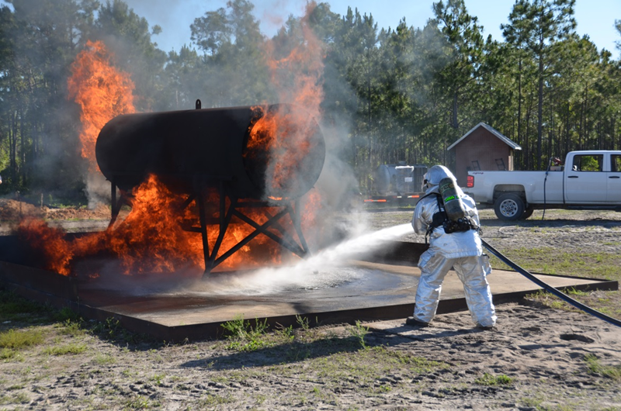
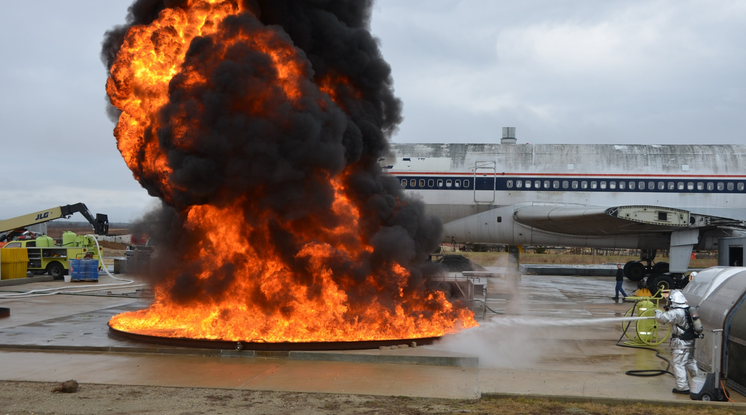
Clean Agent Fire Testing
Part 139.5 defines a clean agent as one that has shown to provide extinguishing action equivalent to halon 1211 under test protocols of FAA Technical Report DOT/FAA/AR-95/87
Evaluating 3M NOVEC 1230 as alternate clean agent
Testing Complete
Draft report being reviewed

Slide 8
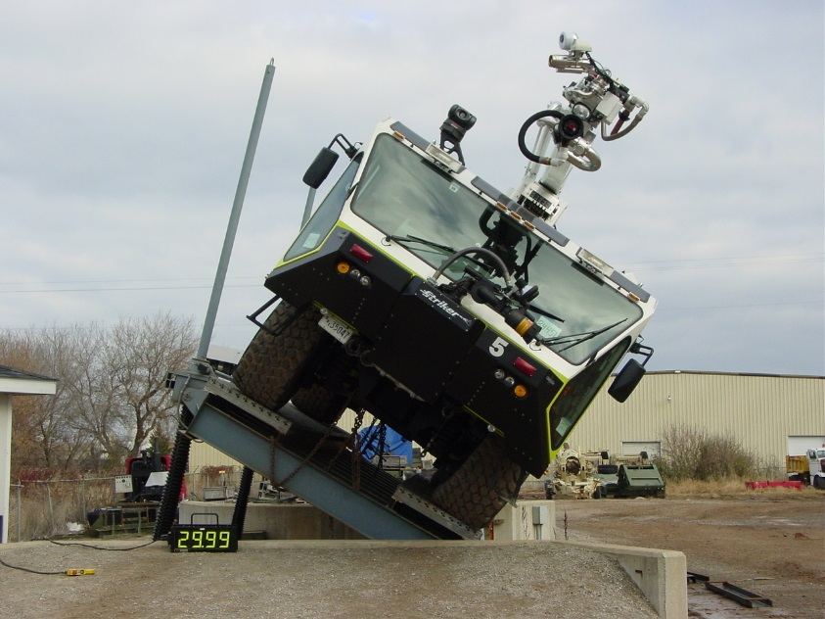
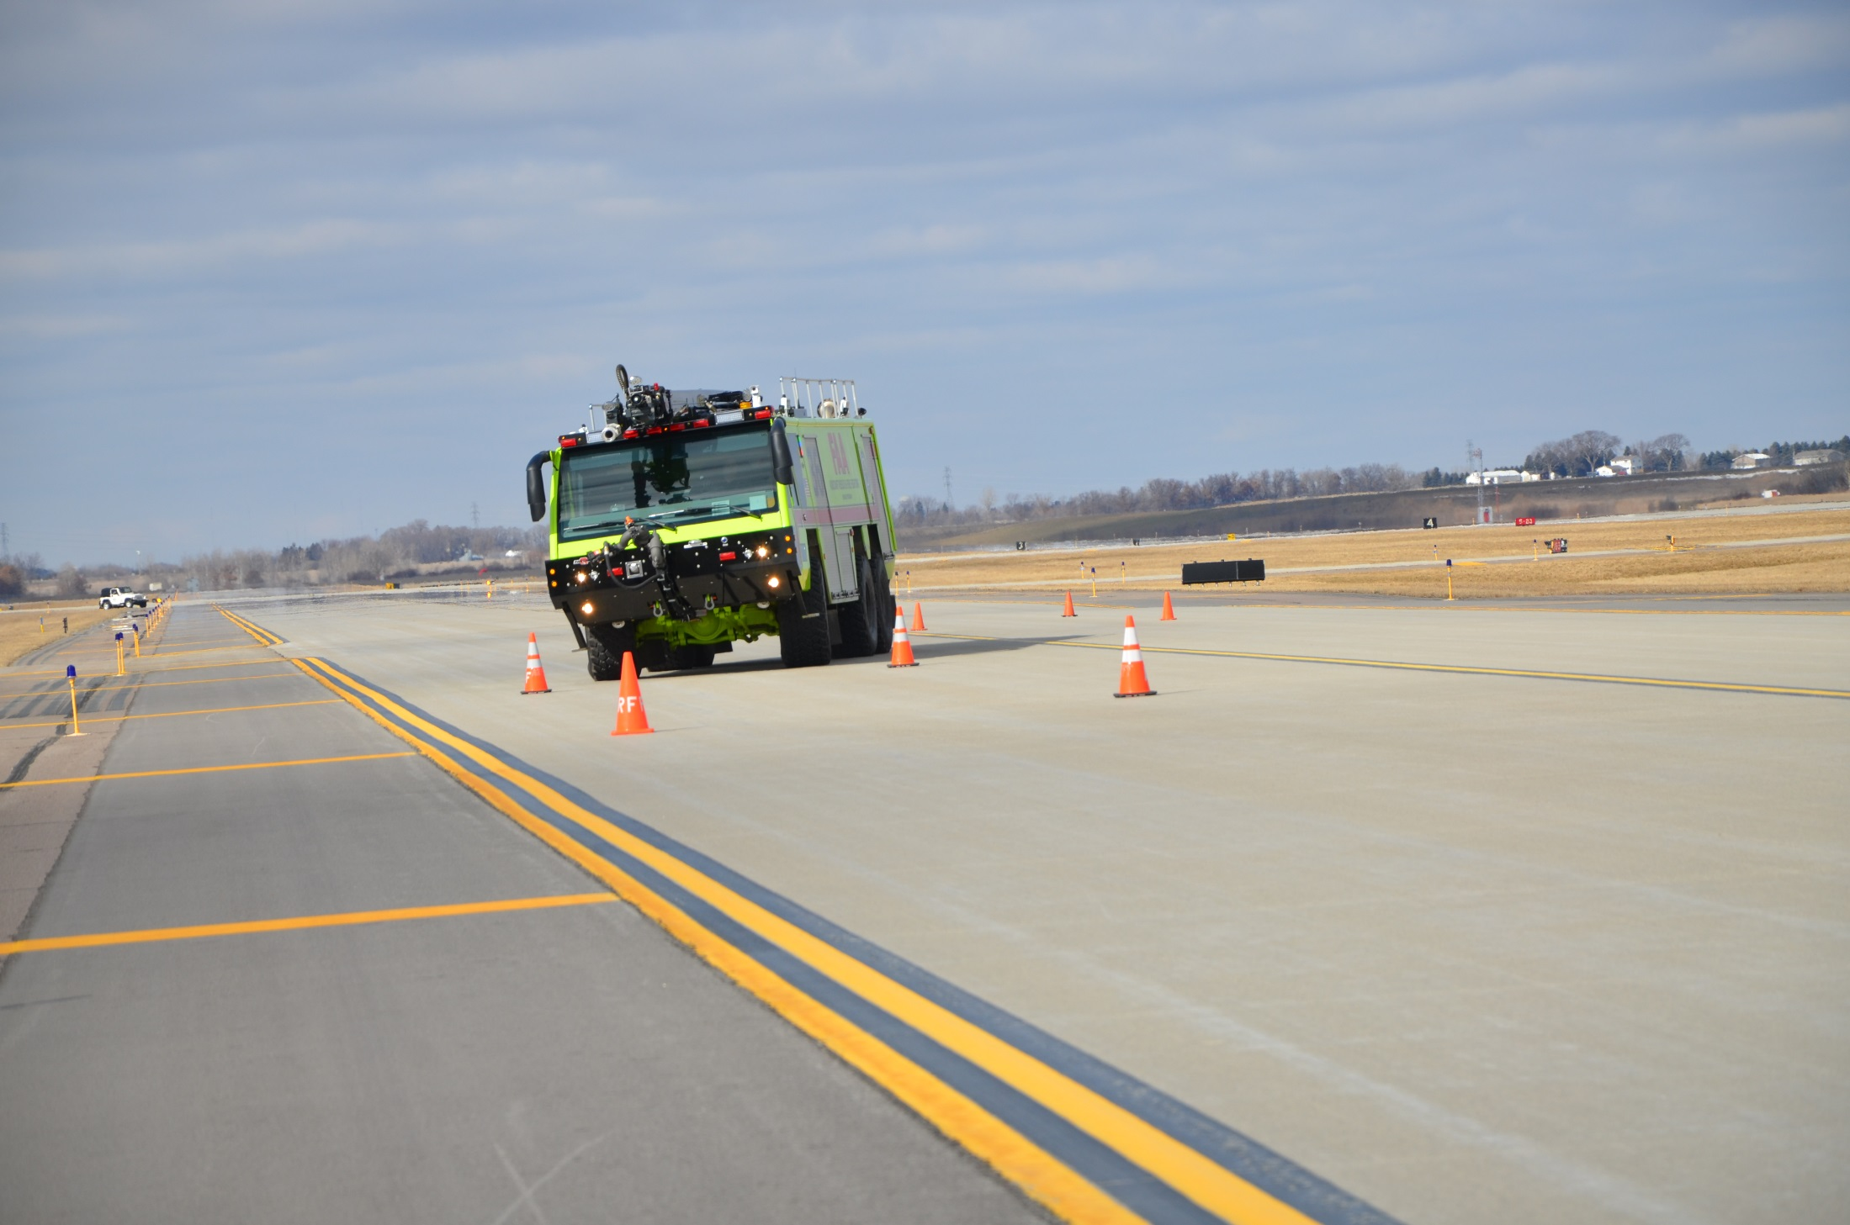
Vehicle Performance Testing Standards
Identify discrepancies in performance testing.
Identify potential 3rd party test requirements.
Identify specific products improvements which warrant Prototype testing.

Slide 9
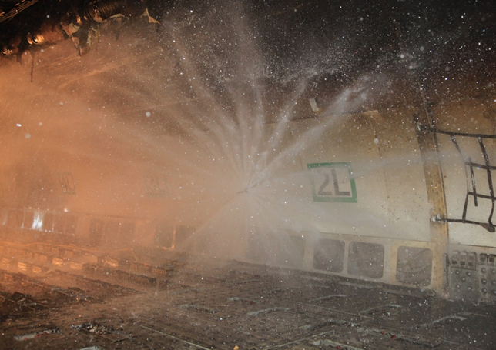
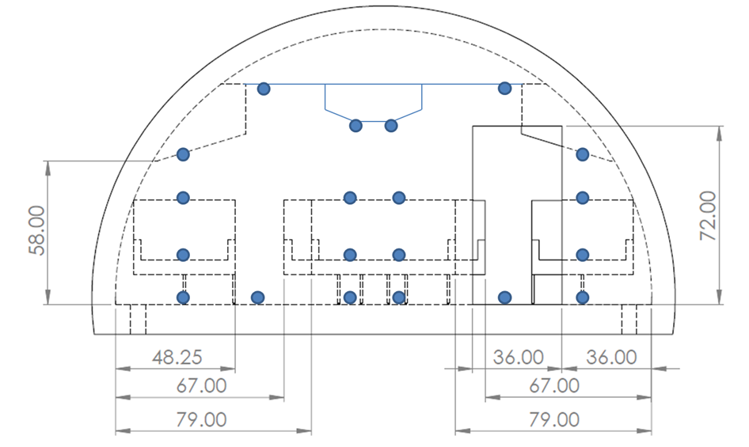
Thermal Balance During Fire Extinguishment
Determine and quantify the effects of ASPN stream pattern and discharge strategy on thermal balance and fire extinguishment efficiency.
Evaluate the interior conditions with regard to victim safety and survivability before, during, and after ASPN discharge.
Develop and test tactics intended to control thermal balance disruption without adversely affecting extinguishment efficiency.

Slide 10
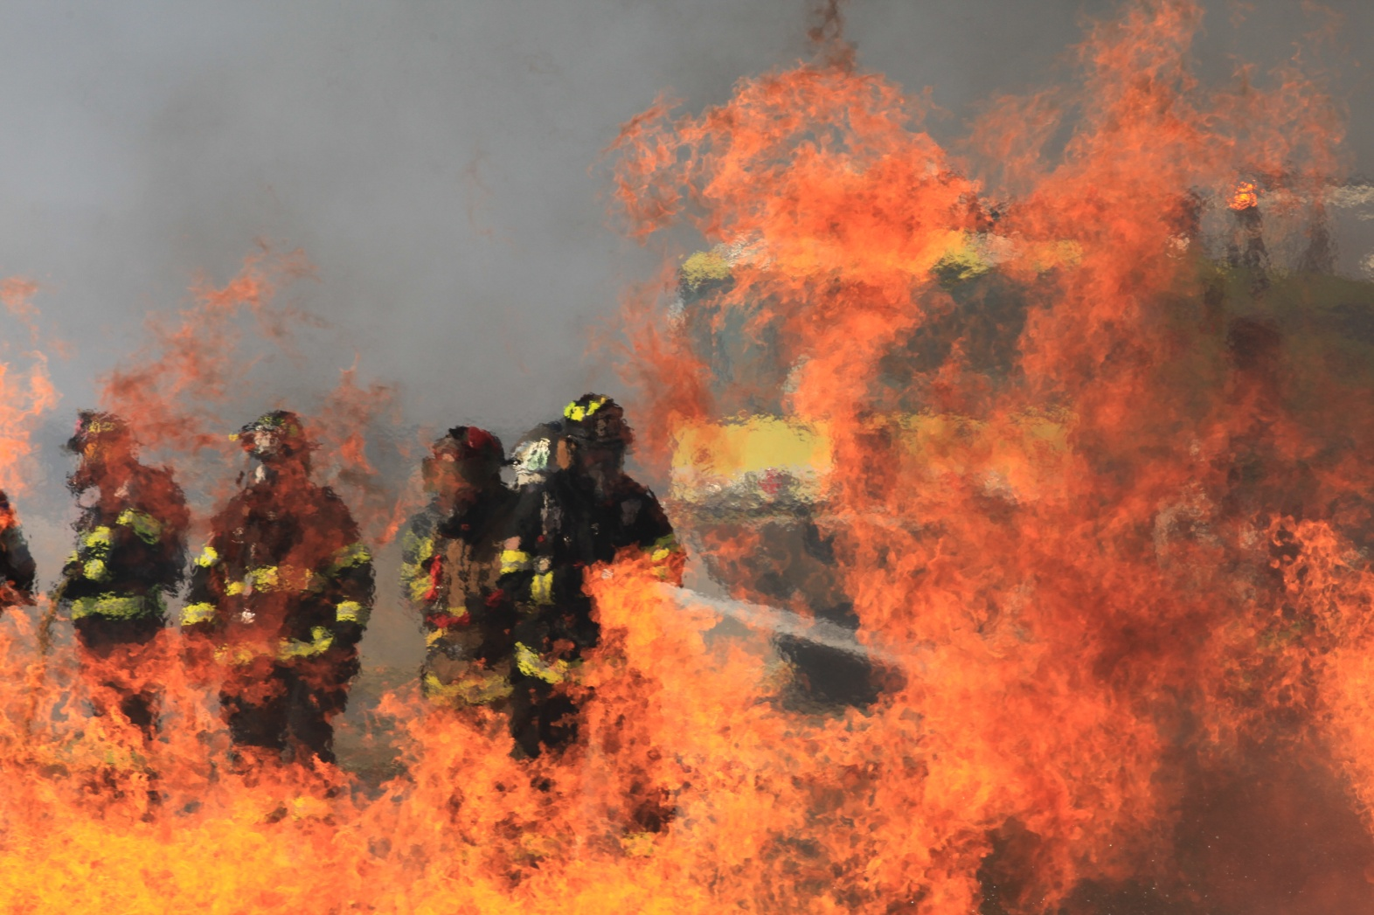
Questions?

