Slide 1
RPA S4 Wildlife Hazard Mitigation
REDAC
Mike Talotta (ANG-E261)
August 15, 2017

Slide 2
RPA S4
RPA S4 - Wildlife Hazard Mitigation | FY17 $1.55M | FY18 $1.43M | FY19 $1.5M
S4.1 Airport Wildlife Management
S4.2 Wildlife Strike Data Collection / Analysis
S4.3 Technology -- Surveillance and Deterrence
Evaluation of Avian Radar
Evaluation of NEXRAD Radar
S4.4 Bird Remains Identification
S4.5 Wildlife Surveillance Concept (WISC)
S4.6 Data Transmission Studies (JUP)

Slide 3
FY17 Funding
 | Contract / Agreement / Grant | Period Of Performance | FY17 Plan $1,960,000 | FY17 Actual $947,243 | Delta $1,012,757
USDA | IA DTFACT-14-X-0007 | 6/20/14 – 6/20/18 (4 years) | $718.117 $208,883¹ | $355,000 $0 | $363.117 $208,883
Smithsonian | IA DTFACT-14-X-0001 | 4/18/14 - 4/18/19 (5 years) | $113,000 $206,117¹ | $113,243 $0 | $243 $206,117
CSRA | Delivery Order Mod 020 | (5 years) | $325,000 | $200,000 | $125,000
CEAT | Grant 12-G-015 | 7/26/14 - POP End Date 9/6/17 | $88,883 | $0 | $88,883
JUP | Grant 16-G-012 | 8/22/16 – 8/22/18 (2 years) | $100,000 | $75,000 | $25,000
WISC | Service Level Agreement | FY17 | $200,000 | $204,000 | $4,000
1. Ops Funding

Slide 4
FY17 BUDGET $1246K
$415K
(OPS)
$831K
(ATR/AIP)
$296K
$271K
Task 1 Services
Task1 Research
Task 2 Research
$119K
$515K
$23K
of $112K

Slide 5
FY17 BUDGET $1246K
$415K
(OPS)
$831K
(ATR/AIP)
USDA Total = $927,000
SI Total = $319,117
$206K
$203K
Task 1 Services
Task1 Research
Task 2 Research
$515K
Should |  | FY17 BUDGET for USDA and SI IAAs = $1,246,117.00
 |  | FAA OPS BUDGET for SERVICES $415,000 |  |  | FAA ATR BUDGET for RESEARCH $831,117
 |  | USDA | SI |  | USDA | SI
 | Item
USDA IAA TASK 1 |  | $208,883.00
Activity 1 | NWSD Data Validation and Quality Management
Activity 2 | NWSD Analysis and Annual Report
Activity 3 | Database Formats and Consolidation
Activity 4 | Attend Meetings and Conferences related to NWSD and Strike Reporting
Activity 5 | Educational Outreach Program |  |  |  | $125,117.00
Activity 6 | General Operational Activities and Sepcial Projects |  |  |  | $ 78,000.00
USDA IAA TASK 2 |  |  |  |  | $515,000.00
Activity 1 | Habitat use, movements and foraging strategies of hazardous wildlife on and near airports
Activity 2 | Research in basic wildlife biology and ecology
Activity 3 | Developing methids and tools to reduce and inform management of wildlife food, water, and cover atractands on and near airports
Activity 4 | Developing risk assessments associated with wildlife-aircraft collistions relateive to management efforts at airports
Activity 5 | General Research Activities and Special Projects
SI IAA
 | Bird Strike Remains Identification with current staff level (Carla, Faridah, Jim, Marcy) |  | $206,117.00
 | Additional staff (This $90K comes from a reduction in USDA/ERAU OPS funding) OR is it ATR Funding?? |  |  |  |  | $ 90,000.00
 | Research Activities of additional staff |  |  |  |  | $ 23,000.00
 | Totals | $208,883.00 | $206,117.00 |  | $718,117.00 | $113,000.00
$209K
$113K

Slide 6
HQ Work Request(s)
Date | Work Request | Status
7/2007 | Research of Stormwater Management Pond Design Characteristics Affecting Bird Use in the SE USA | Complete
4/22/2013 | Request for Research Study of Mitigation Strategies for Gopher Tortoises | Complete
9/17/2013 | Strike Analysis Study on FAA National Wildlife Strike Database | Complete
3/17/2011 | Request for Research and Development Support: Directed Energy Systems for Mitigating Airport Wildlife Hazards | Complete
2/2/2011 | Request for Research and Development Support. Research on bird radar to provide useful information to controllers. | Complete
Challenge: Do not have any open Research Requirements from HQ

Slide 7
Challenge
No current HQ research requests
No current ANG-E261 project plans
No SOWs, no milestones, no deliverables defined
Proposed Solution
Met with AAS-300 management on 7/26/17
Discussed existing funding, work, status
Agreed AAS-300 will generate research requests
Agreed existing Wildlife work is generally aligned with HQ desires
Action to decide what to continue, what to delay, what to start

Slide 8
Wildlife Program Framework
Strategic
Objectives
Strategy
Realized
Value
Benefits
Business Need
Requirements Deliverables Capabilities
Program Definition
Program
Closure
Projects

Slide 9
Wildlife Research Objectives
Enhance and maintain the FAA’s National Wildlife Strike Database to provide the aerospace community the ability to collect, aggregate, analyze and share bird strike data in the NAS and to improve system-wide safety
Research, evaluate and communicate the effectiveness of various habitat management and wildlife control techniques for minimizing wildlife strikes with aircraft at and away from all airports nationwide. These research activities are to provide a scientific basis for FAA policies, regulatory decisions and recommendations regarding airport safety and wildlife
Assess and validate new avian detection technology to support standardization and guidance for airport sponsors
Increase airport, terminal and en-route safety by reducing the number of damaging and potentially fatal bird strikes by providing pilots and controllers with bird advisories.
Research the integration of sensory ecology, physiology, and behavior to understand animal reactions to vehicles, with the goal of developing onboard systems that elicit earlier alert and escape behaviors in response to high-speed aircraft

Slide 10
S4.1 - Airport Wildlife Management (1 of 2)
USDA/APHIS/Wildlife Services Interagency Agreement
Task 1 – Operational Activities on Wildlife Hazards to Aviation
Activity 6 - General operational activities and special projects
Task 2 – Research Activities on Wildlife Hazards to Aviation
Examples of Task 2 USDA research activities
USDA research sponsored by the FAA has implications for other branches of the FAA. For example, USDA research on aircraft lighting, tuned to the visual systems of birds hazardous to aircraft, has implications for AVS. USDA has briefed Dorenda Baker’s group on multiple occasions on this research.
Travis DeVault (USDA) was asked to serve as a consulting member on the ARAC Rotorcraft Bird Strike Working Group. This committee was assembled to develop new regulations for birdstrike protection of civil helicopters regulated by the FAA
John Weller consulted with USDA to draft guidance for Advisory Circular 33 on Hazardous Wildlife Attractant
John Weller consulted with USDA on alternative land uses at airports. Specifically, the section on agriculture being revised with USDA input and based on USDA research
Notes:
Task 1 – Operational Activities
Activity 6 – special projects related to wildlife hazard mgnt.
Task 2 – Research
Activity 1 –
Research on how wildlife use vegetation, structures, and food resources at airports (tagging)
Evaluate WL hazards and management programs at small GA Airports, as needed.
Activity 2 –
Evaluation (analysis) of translocation as a management tool
American Kestrel – preparations for relocating American kestrels in airports in all four fly ways (20 states, possibly more). Coordination with permits
One of top bird strikes reported to WL Strike DB
Movement patterns - Red-tail hawks – re-located 75 mi west of ORD; tagged; several hawks returned to airport
Activity 3 –

Slide 11
S4.1 - Airport Wildlife Management (2 of 2)
IA Agreement expires 6/20/18
USDA requests new IA be signed in 9/2017 (suggest 2/2018)
Financial
$1.7M currently allocated and not invoiced on IA Agreement
USDA having difficult time for past 2 years tracking down discrepancy
As of 7/26/17:
According to Mike Begier, USDA currently has approximately $625K ($425K research and $200K ops)
USDA is in receipt of new $355k contract; processing 7/28
USDA budget team is reviewing IPACs for discrepancies

Slide 12
S4.2 Wildlife Strike Data Collection/Analysis (1 of 3)
USDA/APHIS/Wildlife Services Interagency Agreement
Task 1 – Operational Activities on Wildlife Hazards to Aviation
Activity 1 – National Wildlife Strike Database Quality and Validation
Activity 5 – Educational Outreach Program
Task 2 – Research Activities on Wildlife Hazards to Aviation
Activity 4 – Developing risk assessments associated with wildlife-aircraft collisions relative to management efforts at airports.
Contractor Support (CSRA)
FAA Wildlife Strike Website and Database Enhancements and Maintenance (http://wildlife.faa.gov/)
CSRA doing agile development
Great USDA and Smithsonian user engagement
Notes:
Task 1 – Operational Activities
Activity 1 – WL Strike Validation (DB)
Activity 5 – Educational Outreach – Conferences – Promote DB
Task 2 – Research Activities
Activity 4 - Study to develop a method and model to calculate WL risk at individual airports based on WL Strike data. Organizing and analyzing data.

Slide 13
S4.2 - Wildlife Strike Data Collection/Analysis (2 of 3)
FAA Wildlife Strike Database – Version 4.0
Web Interface Enhancements
Adheres to FAA template requirements
More dropdowns and text extenders
(e.g. auto populated fields)
Enables image uploads
Custom Dashboards
USDA – Wildlife Services
Smithsonian Institution
FAA Administrator (Tech Center)
Database Architecture Redesign
Consolidates multiple strike reports (databases)
into single repository
Planned Release : August 2017
Notes:
Web interface
Same as 5200-7 form
Less free text – more standardized
Custom Dashboards – Workflow (more streamlined)
Info not accessible to public – strike report # / PII
More streamlined
Report – USDA/SI (print and enter to access DB) – ERAU (prep for public DB) – CSRA – DB (several month backlog)
Algorithm to check for duplicate reports based on various parameters
Database Architecture Redesign
Database of submitter reports and web searches

Slide 14
S4.2 - Wildlife Strike Data Collection/Analysis (3 of 3)
The Wildlife Strike Database is now a mature, operational capability with many public users
Support should shift to “FAA Operational” capability mindset
USDA Request: CSRA software support for backlog of data (6 to 9 months effective August 1st)

Slide 15
S4.3 – Technology – Surveillance and Deterrence
USDA/APHIS/WS Interagency Agreement (Task 2)
Activity 2
Evaluation of Acoustic Hailing Devices (AHD) for bird dispersal
Complete
Final Report delivered to FAA in early July
Manuscript on study is “in press” at the Wildlife Society Bulletin
Aircraft Lighting (Year 3 and 4)
Multi-year, multifaceted study
Recent report titled, “Aircraft Lighting Properties that Enable Bird
Detection and Avoidance of Aircraft“ delivered in early July
University of Illinois – Center of Excellence Airport Technology (CEAT) Grant*
Funding (Grant 12-G-015)
2012 to present: $6,532,451.53 Obligated
Not Invoiced: $350,000
Question of how to use CEAT in future
AHD Research
Notes:
Activity 2 – Aircraft Lighting – Biology of birds eye to see diff light wave lengths. Top five most damaging species. Identify what is most conspicuous wave length to birds and engineer light source to put that light out to increase conspicuity of a/c.
Activity 2 – AHD – WL deterrent ; Savannah River Ecology Lab – Manuscript to “Journal of WL Management”
Once engineer light source = field testing.
Pharaoh vision – limitations with range, alerting capability, scan rate, etc. (useful supplement to other technologies)

Slide 16
S4.4 Bird Remains Identification
Smithsonian
Bird remains identification
Level of FAA related work has increased exponentially, while FAA funding level has been flat
Development of new IA planned for late FY18

Slide 17
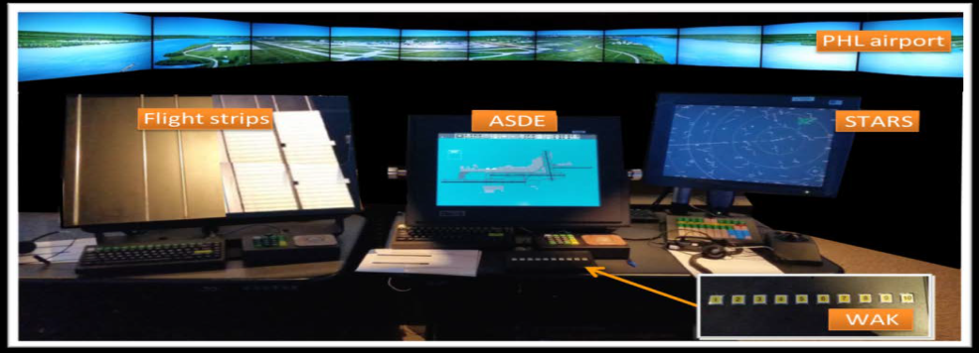
S4.5 Wildlife Surveillance Concept (WiSC) (1 of 2)
Service Level Agreement with FAA NextGen’s Advanced Concepts Branch (ANG-C54)
Phases 1 & 2 - Completed
Knowledge Elicitation Activity (KEA 1) – ATC SME Panel
Knowledge Elicitation Activity (KEA 2) – Avian Radar Site Visits
Quantified Shortfall Analysis
Concept of Operation for application of Airport Avian Radar use by Civil ATC
Human-in-the-Loop Laboratory Demonstration
FAA Publications
FAA Technical Note: WiSC – Avian Radar KEA Activity 1 (April 2016)
FAA Technical Note: WiSC – Human-in-the-Loop Laboratory Demonstration (Oct 2016)
Tower simulator used for Human-in-the-Loop Demonstration
Notes:
Study began in 2013 – Jim White (AAS-2) asked if it is feasible to integrate bird radar info into the ATCT
Phases 1 and 2 – Initial
KEA 1 – Discussions with certified controllers on how bird radar info was handled in operational environment; discussed different scenarios and began discussions on bird radar interfaces (graphical and text). Workload discussions
KEA 2 –DFW and SEA site visit – discussions focused on avian radar technology and bird threats.
Shortfall Analysis – ANG-C54 requirement for new concept. Inability to ID bird threats and prevent WL strikes. $337 mil/yr
CONOPS
HITL – controllers in HF LAB control traffic; 3 ways to provide BR info (text, graphic, and SUP hand delivered to controller). Results favorable (liked graphic best)

Slide 18
S4.5 – WISC (2 of 2)
Phase 3 (FY17)
Site Validation Activity (ongoing)
Concept of Operation 2.0
Socialization/Publications
Incorporating Avian Radar Information in the Airport Traffic Control Tower
Journal of Air Traffic Control Paper (Spring 2017)
Evaluating the Design and Suitability of the Wildlife Surveillance Concept (WISC)
Integrated Communication Navigation Surveillance Conference Paper (April 2017)
Wildlife Surveillance Concept: Validation of Bird Threat Information Requirements for Air Traffic Controllers
Bird Strike Committee Conference Dallas (planned – August 2017)
Notes:
Site Validation – visit 5 ATCT facilities; interview controllers and FLM; validate previous results from phase 1 and 2.
Business/benefits case – external benefits analysis vendor
Refine CONOPS

Slide 19
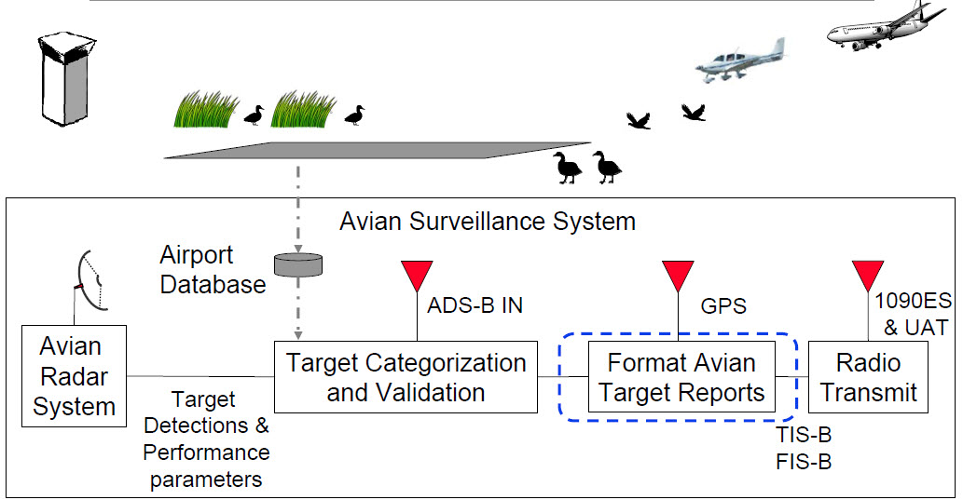
S4.6 – Avian Radar Data Transmission Studies
Grant via Joint University Program (JUP) – Ohio University
Research Plan: Use ground based avian radar and target categorization to transmit bird information to ATC tower and aircraft
Status:
Reviewed 10 RTCA Documents on for Avian Messages
Receiving BSTAR radar data; assessment is limited usefulness
Looking into auxiliary sensors – particularly the Ultra-HD camera
Refining target processor algorithms
Funding:
$100k July 2016
$75k July 2017
Incremental Funding 2018
Notes:
Comm chanels

Slide 20
BACKUP

Slide 21
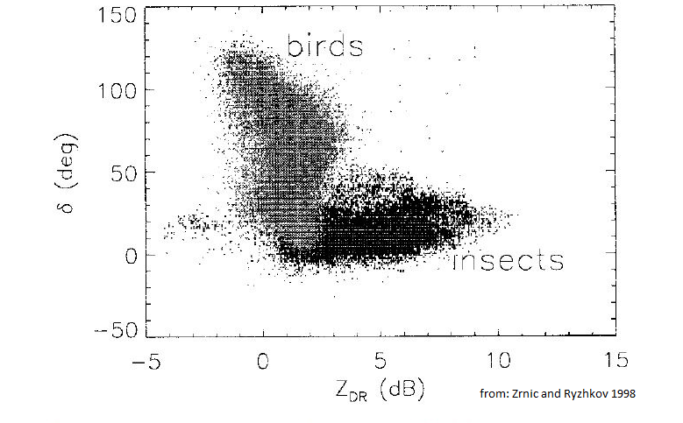
New Work: NEXRAD Bird Identification and Advisory
SO: 2
Background: CEAT has confirmed a capability to differentiate bird targets from other scatterers in NEXRAD data. CEAT has completed statistical analyses of NEXRAD signal return from different types of validated scatterers (weather, different types of birds, insects and bats) using all NEXRAD variables (original moments: base reflectivity, base velocity, spectrum width; and dual-polarization moments: differential reflectivity, cross-correlation coefficient, and differential phase). Results indicate excellent discrimination between meteorological and biological scatterers and between birds and insects.

Slide 22
NEXRAD Bird Identification and Advisory Research (1 of 2)
Output 1 – Applied research on NEXRAD bird detection capability. This capability will form the basis for bird concentration in the atmosphere advisories to pilots and controllers at airports and in terminal and en-route airspace.. This is a multi-year project with the objective of producing output that can be used by the FAA to write an RFP to implement a pilot and controller bird flock advisory capability from the existing network of NEXRAD weather radars (currently 160+ NEXRAD radars). This will be achieved by providing NEXRAD generated data to the terminal STARS system and directly to pilots via ADS-B FIS-B.
FY18
Develop a classification algorithm for NEXRAD reflectivity and dual polarization data to support bird biomass in the atmosphere estimation.
Refiine methods to filter NEXRAD data to eliminate non-hazardous scatterer types.
Refine methods to provide altitude specific biomass estimates.
Refine methods to address bird size and multiple bird flocks.
Develop validation requirements for NEXRAD avian targets.
Develop criteria for data reliability considering aspect to target and bird movement in relation to the radar.

Slide 23
NEXRAD Bird Identification and Advisory Research (2 of 2)
Applied research to develop implementation options for airport and regional hazard advisories
Develop method for implementation of airport and en-route (including arrival and departure zones) bird biomass in the atmosphere estimation
Develop method for integration of multiple radar coverage to enhance en-route information (modeled after NEXRAD weather displays) and demonstrate the analytical approach for regional/local coverage and multiple radar integration using examples from DFW, ORD, SLC, and SEA.
Identify the critical NOAA NEXRAD site location information providing information on location, coverage, and coverage limits and individual location operational information needed for program implementation.
FY19
Technical research on NEXRAD dual polarization radar
Refine methods to address bird size, bird concentration, and flock issues in detection
Proof of Concept completed using known bird target data
Conduct shortfall analysis of bird strikes in the NAS related to NEXRAD estimates of bird concentration.
Applied research to develop implementation options for airport and regional hazard advisories
Refine airport use of NEXRAD data using ongoing wildlife observations and avian radar (if available e.g. DFW and SEA)

Slide 24
Discussion
Work request for NEXRAD bird identification research
Funding
CEAT roles & responsibilities
Schedule

Slide 25
CEAT (1 of 8)
Wildlife Strategic Objective 1 (to partially meet NARP Objective 5b) – Enhance and maintain the FAA’s National Wildlife Strike Database to provide the aerospace community the ability to collect, aggregate, analyze and share bird strike data in the NAS and to improve system-wide safety.
Research Description:
Take advantage of a wide range of data resources (WHA’s, NERAD, avian radars, and airport reporting) and develop methods to aggregate and analyze data resources to better define wildlife hazards.
Driving Factor: Need for analysis and interpretation of wildlife strike data that is airport specific.
Vision Element – Develop a common set of analytical tools that could be used by airports or their consultants to maximize utility of wildlife strike data.
Strategy Element – Establishes a SOP approach that will support integration of strike information to support national safety programs.
Prioritization - Ongoing
Leverages – Leverages public/private partnerships to enhance understanding of bird hazard timing and location supporting mitigation.
Identification of technology, emerging technologies, and knowledge gaps - Will consider new approaches to data mining incorporating sophisticated tools such as genetic algorithms.
Budget impact on research – budget requirement for maintenance of trained specialist.

Slide 26
CEAT (2 of 8)
Wildlife Strategic Objective 2 (to partially meet NARP Objective 2a) – Increase airport and terminal safety by reducing the number of damaging and potentially fatal bird strikes by providing pilots and controllers with bird concentration advisories.
Research Description:
Concentration advisories must be available on scales that include the airport, arrival and departure paths, and regional. This research will have two elements. First, we will continue optical/thermal with new developments in avian radar and demonstrate capability of identifying bird concentration and timing. The second element will be the development of a nationwide system based on NEXRAD to provide information at airport to regional scales.
Driving Factor #1: Need for identification of bird concentrations on, and near, airports using bird detection technologies. that is airport specific.
Vision Element – Develop a common set of analytical tools that could be used by airports or their consultants to maximize utility of wildlife strike data.
Strategy Element – Establishes a SOP approach that will support integration of strike information to support national safety programs.
Leverages – Leverages public/private partnerships to enhance understanding of bird hazard timing and location supporting mitigation.

Slide 27
CEAT (3 of 8)
Identification of technology, emerging technologies, and knowledge gaps - Will consider new approaches to data mining incorporating sophisticated tools such as genetic algorithms.
Driving Factor #2: Need for identification of bird concentrations on, and near, airports, in approach and departure areas, and en route using NEXRAD information.
Vision Element – Take advantage of upgrades to the NEXRAD system that support classification of birds from other atmospheric scatterers providing the capability to provide a national bird biomass in the atmosphere based hazard warning system.
Strategy Element – Uses an existing radar system with national coverage to extract bird hazard data 24/7 and use an understanding of individual radar coverage to provide airport and approach/departure zone advisories. Multiple radars provide the opportunity for integration across the US to provide a comprehensive hazard warning for all aircraft movements. This effort is intended to develop the needed specifications for FAA implementation contracting.
Prioritization - Highest
Leverages – Takes advantage of the FAA’s existing investment in NEXRAD radars to now utilize upgraded capabilities to provide bird specific information to pilots and controllers.
Identification of technology and knowledge gaps emerging technologies and knowledge gaps – This research will identify actual capability to address bird targets meeting the critical data gap of information from approach/departure areas and en route.
Budget impact on research – Will require establishment of a new project area with funding for a 24-36 month program.

Slide 28
CEAT (4 of 8)
Wildlife Strategic Objective 3 (to partially meet NARP Objective 2a) – Research, evaluate and communicate the effectiveness of various habitat management and wildlife control techniques for minimizing wildlife strikes with aircraft at and away from all airports nationwide. These research activities provide a scientific basis for FAA policies, regulatory decisions and recommendations regarding airport safety and wildlife.
Research Description:
Habitat is clearly an ecological issue related to the attraction and maintenance of bird concentrations. There are two elements to this research area. The first is connecting site specific hazards with habitat issues. The second is developing tools for habitat analysis/identification specific to airport bird hazard analysis based on modern remote sensing, GiS, and multispectral imaging. It is suggested that this be a DC led effort involving CEAT, USDA, and others.
Driving Factor #1: Need for integration of a wide range of remote sensing capabilities in the identification of habitat attractive to birds that contribute to aircraft hazards.
Vision Element – Take advantage research conducted by CEAT since 2000, including recent use of high resolution multispectral imaging to report on methods of habitat assessment and identification of critical areas for management and/or mitigation.
Strategy Element – The availability of WHA and WHMP documents at primary airports along with an array of publically available remote sensing data provides new opportunities for wildlife hazard management for areas on, and around airports.
Prioritization - Ongoing
Leverages – Takes advantage of primary airports existing investment in bird hazard assessment to expand coverage to off-airport locations to reduce airport wildlife strike hazards.
Identification of technology and knowledge gaps emerging technologies and knowledge gaps – Identify new data availability from improved remote sensing.
Budget impact on research – Continues the assessment of new optical and thermal bird detection systems recognizing personnel needs in funding.

Slide 29
CEAT (5 of 8)
Driving Factor #2: As an add on to general remote sensing consider site and problem specificity where a significant hazard exists with defined habitat associations.
Vision Element – Take advantage research conducted by CEAT at Salt Lake City Airport where American White Pelicans regularly congregate in the airport flight path in high numbers distributed over altitudes to 10,000 ft. creating a major hazard that has already resulted in serious bird strike damage. CEAT has already identified remote sensing data and has high resolution multispectrum imagery in place.
Strategy Element – Use the availability of existing radar and habitat data supplemented by additional data acquisition (observational, avian radar, and NEXRAD/TDWR) to develop hazard advisories.
Prioritization - High
Leverages – Takes advantage of ongoing airport and Utah Division of Wildlife programs direct to pelican research.
Identification of technology and knowledge gaps emerging technologies and knowledge gaps – Major gap is consolidation of data to develop a threat advisory for SLC airport.
Budget impact on research – Continues a cooperative effort with airport and state agencies with primary impact related to personnel funding.

Slide 30
CEAT (6 of 8)
Wildlife Strategic Objective 4 (to partially meet NARP Objective 5a) Assess and validate new avian detection technology to support standardization and guidance for airport sponsors.
Research Description:
This project identifies the need to sustain the capability and experience of CEAT to assess new technology. In the past new technology assessment has proceeded through a three stage process conducted by CEAT that eventually resulted in airport trials. There is a need to define the regulatory focus and identify needed Advisory Circulars that will be supported by technical analysis provided by CEAT.
Driving Factor #1: The continuing need to identify and assess new technologies that can contribute to airport safety.
Vision Element – Sustain a capability to test new technologies in an environment where bird presence is known and birds are abundant.
Strategy Element – Use a test site equipped with a range of technologies that supports comprehensive testing of new safety, detection, and surveillance technologies. Prioritization - High
Leverages – Takes advantage of an existing field test range that has already accommodated testing of a range of sensor and bird detection system types.
Identification of technology and knowledge gaps emerging technologies and knowledge gaps – Identifies new technologies and provides test data for FAA evaluations.
Budget impact on research – Continues test range operation with primary impact related to personnel funding.

Slide 31
CEAT (7 of 8)
Driving Factor #2: The need to provide technical guidance with technology requirements and standards in Advisory Circulars.
Vision Element – In the past CEAT has conducted technology assessments and contributed directly to the drafting of Advisory Circulars. This has developed capability and provided experience in this critical support role for FAA personnel. This capability will be sustained and efforts focused on a potential avian radar AC update and an AC on optical/thermal systems.
Strategy Element – Sustain a high level technology assessment capability to identify appropriate requirements and standards for airport safety technologies.
Prioritization - High
Leverages – Takes advantage of existing experience and proven capability that has demonstrated integration of multiple resources in AC development.
Identification of technology and knowledge gaps emerging technologies and knowledge gaps – Provides needed technology understanding in development and drafting of Advisory Circulars.
Budget impact on research – Minor budget impact in sustaining mode that may shift based on need.

Slide 32
CEAT (8 of 8)
Wildlife Strategic Objective 2 (to partially meet NARP Objective 2a) – Increase airport and terminal safety by reducing the number of damaging and potentially fatal bird strikes by providing pilots and controllers with bird concentration advisories.
Research Description:
Concentration advisories must be available on scales that include the airport, arrival and departure paths, and regional. This research will have two elements. First, we will continue optical/thermal with new developments in avian radar and demonstrate capability of identifying bird concentration and timing. The second element will be the development of a nationwide system based on NEXRAD to provide information at airport to regional scales.
Driving Factor: Need for identification of bird concentrations on, and near, airports using bird detection technologies. that is airport specific.
Vision Element – Develop a common set of analytical tools that could be used by airports or their consultants to maximize utility of wildlife strike data.
Strategy Element – Establishes a SOP approach that will support integration of strike information to support national safety programs.
Prioritization - Ongoing
Leverages – Leverages public/private partnerships to enhance understanding of bird hazard timing and location supporting mitigation.
Identification of technology, emerging technologies, and knowledge gaps - Will consider new approaches to data mining incorporating sophisticated tools such as genetic algorithms.
Budget impact on research – budget requirement for maintenance of trained specialist.

Slide 33
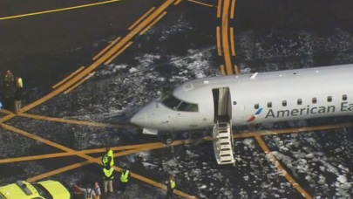
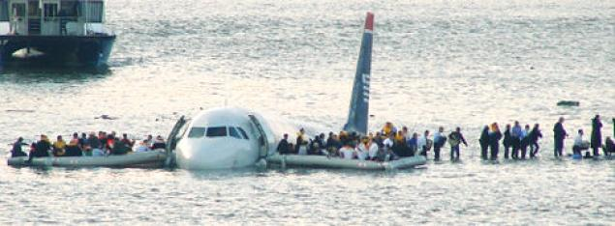
RPA S4 Wildlife Hazard Mitigation Overview
Need
Research Goals
Reduction in Wildlife Strikes with Aircraft
Cost of Wildlife Strikes:
$937 million/year in U.S
$1.3 billion/year Worldwide
255 fatalities worldwide
Minimize collisions between wildlife and aircraft on and near airports
Research enhanced methods and techniques for habitat management at airports
Collect and analyze wildlife strike data
Assess and validate new detection technology to support standardization and guidance for airport sponsors
Develop concepts for delivery of bird hazard information to key stakeholders (e.g. ATC and pilots)
FY 2017 Accomplishments
Funding Requirements
Performed ongoing research on habitat management methods
Published: Wildlife Strikes to Civil Aircraft in the United States, 1990 - 2015 (December 2016).
Ongoing development to the FAA Wildlife Strike Database, Version 4.0
Published: Wildlife Surveillance Concept (WiSC) Human-in-the-loop (HITL) Demonstration Tech Note (October 12, 2016)
RPA S4 – Wildlife Hazard Mitigation | FY17 | FY18 | FY19
 | $ 1,545,000 | $ 1,425,000 | $ 1,450,000
S4.1 - Airport Wildlife Management | $ 595,000 | $ 600,000 | $ 600,000
S4.2 - Wildlife Strike Data Collection/Analysis | $ 425,000 | $ 425,000 | $ 425,000
S4.3 - Technology - Surveillance and Deterrence | $ 225,000 | $ 225,000 | $ 250,000
S4.4 - Bird Remains Identification (Non-ATR $$) | $ - | $ - | $ -
S4.5 - Wildlife Surveillance Concept (WiSC) | $ 200,000 | $ 100,000 | $ 100,000
S4.6 - Data Transmission Studies (JUP) | $ 100,000 | $ 100,000 | $ 75,000

Slide 34
Wildlife Program Strategic Objectives
Wildlife Strategic Objective 1 (to partially meet NARP Objective 5b) – Enhance and maintain the FAA’s National Wildlife Strike Database to provide the aerospace community the ability to collect, aggregate, analyze and share bird strike data in the NAS and to improve system-wide safety. (RPA S4.2)
Wildlife Strategic Objective 2 (to partially meet NARP Objective 2a) – Increase airport, terminal and en-route safety by reducing the number of damaging and potentially fatal bird strikes by providing pilots and controllers with bird concentration advisories. (RPA S4.3, S4.5)
Wildlife Strategic Objective 3 (to partially meet NARP Objective 2a) – Research, evaluate and communicate the effectiveness of various habitat management and wildlife control techniques for minimizing wildlife strikes with aircraft at and away from all airports nationwide. These research activities provide a scientific basis for FAA policies, regulatory decisions and recommendations regarding airport safety and wildlife. (RPA S4.1)
Wildlife Strategic Objective 4 (to partially meet NARP Objective 5a) Assess and validate new avian detection technology to support standardization and guidance for airport sponsors (RPA S4.3)
Wildlife Strategic Objective 5 (to partially meet NARP Objective 2a) Research the integration of sensory ecology, physiology, and behavior to understand animal reactions to vehicles, with the goal of developing onboard systems that elicit earlier alert and escape behaviors in response to high-speed aircraft. (RPA S4.1)

Slide 35
Connection to NARP Objectives
National Aviation Research Plan (NARP)
NARP Goal 2: Accelerate use of new technologies for aerospace vehicles, airports and spaceports
NARP Objective 2a: Applied Innovation. Identify and demonstrate new aerospace vehicle and airport/spaceport technologies that could be adopted by the aerospace community to improve safety, increase efficiency, and reduce environmental impacts
NARP Goal 5: Improve integrated modeling capabilities and system-wide analysis
NARP Objective 5a: Aerospace System. Identify and develop a sufficient scientific understanding of aerospace systems to enable aerospace community’s development of solutions to enhance safety, improve efficiency, and reduce environmental impacts.
NARP Objective 5b: Data Engineering. Identify, develop and validate new methods and analytical and predictive capabilities for the aerospace community to collect, aggregate, analyze and share NAS data to effectively monitor and improve system-wide performance.

Slide 36
Problem Statement: Reduction of Bird Strikes with Aircraft
$1.2B per year for commercial carriers worldwide ¹
$33M per year for the US Air Force ²
3.7 fatalities/year in the United States ³
Destruction of >210 aircraft and >229 deaths worldwide between 1988 and 2000 ⁴

Slide 37
Bird Strikes are Trending Upward
Increase of bird-aircraft collisions during recent decades
Increasing air traffic ¹
Quieter aircraft with fewer engines ²
Increasing population of larger birds ³

Slide 38
S4.5 – WISC (3 of 3)
Phase 4 (FY18 Proposed)
“Wrap Up” all WISC work and package to be used at future date when avian radars are viable for flock advisories
Final Concept Work Package $150k
ATC Qualitative Benefits
Information Requirements
Concept Validation Summary
ConOps Update
Socialization Activities
ICNS 2018 Technical paper(s)
Bird Strike Conference 2018 Update
Airport Ops Business Case $175k

