Slide 1
RPA – S5
Visual Guidance
Presented To: REDAC
By: Donald W. Gallagher & Holly Cyrus
Date: August 2017

Slide 3
Infra-Red Requirements for developing a Elevated LED HIRL with IR emitter

Slide 4
Phase I: Broad Agency Announcement (BAA)
BAA Announcement posted 2/02/16
BAA Announcement closed 2/19/16
Evaluation period 2/22/16 to 3/10/16
Candidates picked for Request For Proposal 4/20/16
RFP Proposal submission period 4/21/16 to 7/31/16
RFP Evaluation period 8/1/16 to 8/19/16
Contracts Award notification 2 companies 9/19/16
Period Of Performance 10/01/16 to 4/03/17

Slide 5
Results
Neither company could duplicate the complete IR signature of the legacy incandescent HIRL.
Each company however, provided technical and test documentation to support their assertion that the prototypes meet or exceed the IR output used by EFVS to acquire the legacy HIRL IR signature.

Slide 6
Results
Company 1:
  Selected an incandescent source for the IR output consisting of two bulbs, rated at a nominal input 20W that can supply a minimum average radiant intensity matching that of a legacy L-862 fixture in the range of 1450-1850 nm.
Company :
  Selected an IR igniter for the IR output rated at a nominal input of 45W that can supply a minimum average radiant intensity matching that of a legacy L-862 fixture in the range of 1400-2500 nm.

Slide 7
Results
Each company contends that current EFVS cameras are designed to operate in the IR range greater than 1300 nm and limited to a maximum of 2400nm due to the glass covers used in the legacy fixture.
Company 1’s prototype fixture combines an LED light module and a IR module into a single fixture. Neither module is certified for operational use.
Company 2’s prototype fixture integrates a separate IR emitter to an already certified LED light fixture.

Slide 8
Status
Company 1:
Legacy L-862 Orange Line versus Chosen Prototype IR Emitter Yellow Line

Slide 9
Status
Company 2:
Legacy L-862 Black Line versus Chosen Prototype IR Emitter Yellow Line

Slide 10
Significant Safety Issues (SSI)
An FAA SSI team was formed to develop a process to collect and prioritize the LOB/SO lists.
By the end of fiscal year (FY) 2015, the SSI team identified a prioritized list of 10 FAA-level, cross-organizational SSI’s.

Slide 11
Significant Safety Issues (SSI)
Three that involved ARP are:
FY15 SSI LED 01: LED-Lit Obstacle Detection (with Night Vision Goggles (NVGs))
FY15 SSI LED 05: Stroboscopic Effect
FY15 SSI LED 06: Loss of Sight of LED Airport Lighting

Slide 12
FY15 SSI LED 05: Stroboscopic Effect
  LED Runway Edge Lights were reported as causing, a “strobing” effect when viewed through the propeller of certain 3 blade single engine aircraft. 3 separate instances were documented.
  Flight tests were performed. At the conclusion of this effort, there does not appear to be a safety concern. Pilots were able to complete their operations safely.
  However, the oscillating or flickering can be annoying. Knowing the circumstances under which the phenomenon appears validates previous research that had been performed on flicker.

Slide 13
FY15 SSI LED 05: Stroboscopic Effect
This phenomenon only appears when the right aircraft at the right propeller speed interacts with a LED lighting fixture operating at medium or low step utilizing a PWM frequency of less than 200Hz. The phenomenon may only occur for an instant while all the aforementioned criteria exist.
Only one company manufactured these fixtures under 200Hz, which they have since changed.

Slide 14
FY15 SSI LED 05: Stroboscopic Effect
Addition was made to Engineering BriefNo.67D Light Sources Other Than Incandescent and Xenon For Airport and Obstruction Lighting Fixtures :
  “2.15 Light Fixture Flicker - All light fixtures that use pulse width modulation (PWM) to facilitate LED brightness changes must not cause perceptible flicker to a moving human observer (example: pilot in an aircraft) throughout the range of brightness steps.”

Slide 15
FY15 SSI LED 06: Loss of Sight of LED Airport Lighting.
This hazard description states “LED directionality is more focused than incandescent lighting. During night VFR (e.g., VFR traffic pattern, circling approach), flight crew loses sight of segments of LED airport lights.”
Tasked to measure the elevated omnidirectional medium intensity runway edge lights (MIRLs) and directional high intensity runway edge lights (HIRLs) (L-861 and L-862 respectively) luminous intensity output from legacy incandescent lights in vertical areas between 15-90 degrees.

Slide 16
FY15 SSI LED 06: Loss of Sight of LED Airport Lighting.
Standard Airport Traffic Pattern “Airplane Flying Handbook 2016” published by the Flight Standards Service

Slide 17
FY15 SSI LED 06: Loss of Sight of LED Airport Lighting.
Given a standard approach pattern of 1,000 feet Altitude at within 1 to ½ mile from runway the angle is 13°to 20°.
This could result at losing the runway edge lights momentarily at a given point during the pattern at angles above specified 15°for an L-861 fixture.
At that same point, runway lights further down the runway such as 1½ to 2 miles would be at angles 10°to 8°respectively which is within the specified 15°beam pattern.

Slide 18
FY15 SSI LED 06: Loss of Sight of LED Airport Lighting.

Slide 20
LED

Slide 23
FY15 SSI LED 06: Loss of Sight of LED Airport Lighting.
STATUS:
  Memorandum dated July 19, 2017 sent to Sponsor
  Technical Note in process to be published

Slide 24
Paint Marking Projects

Slide 25
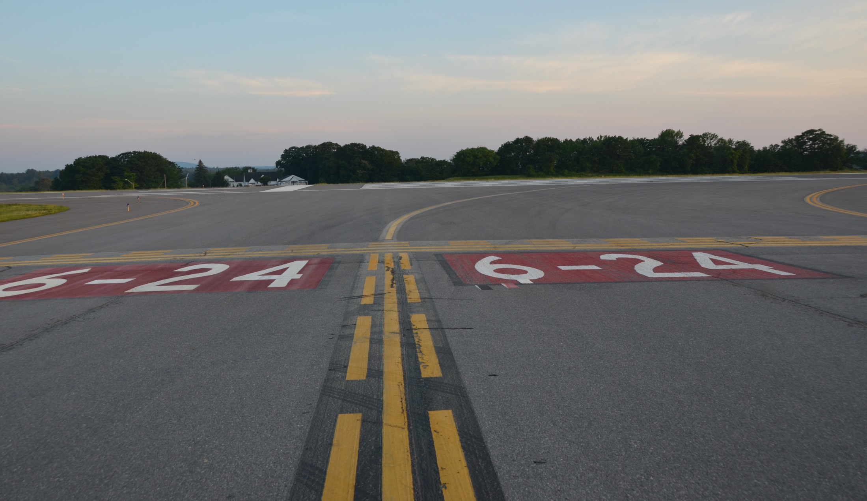
SMMA Manchester Airport (KMHT)
Notes:
Pete

Slide 26
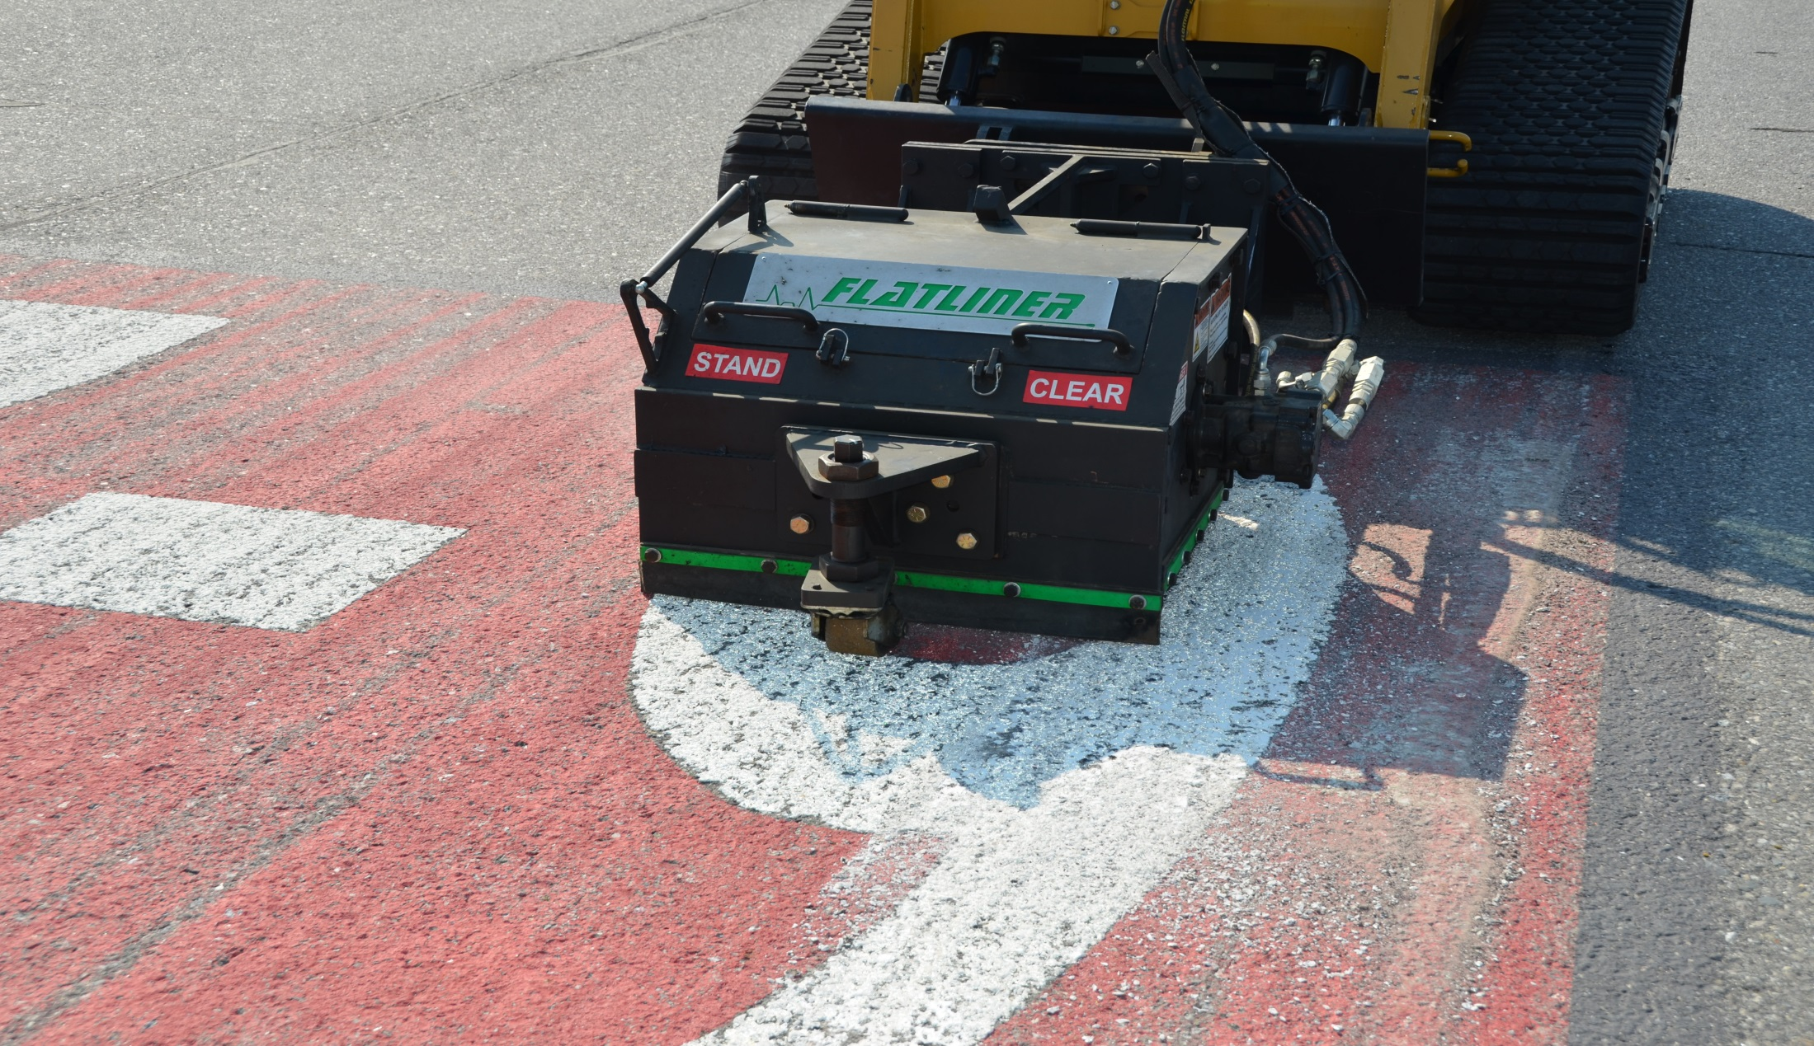
SMMA Manchester Airport (KMHT)
Notes:
Pete

Slide 27
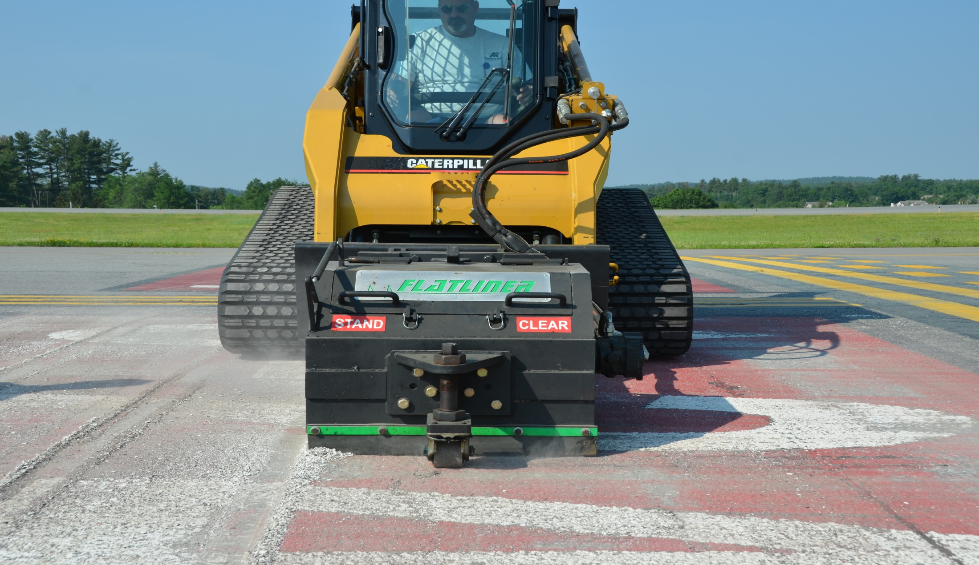
SMMA Manchester Airport (KMHT)
Notes:
Pete

Slide 28
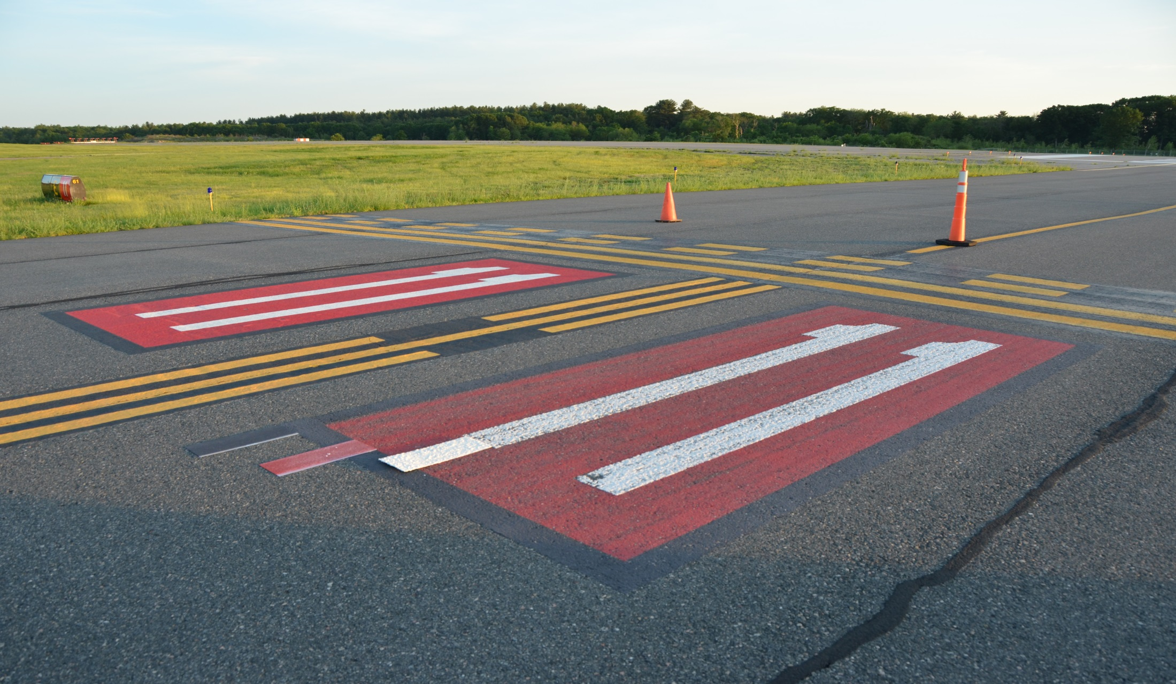
SMMA Hanscom/Bedford Airport (KBED)
Notes:
Pete

Slide 29
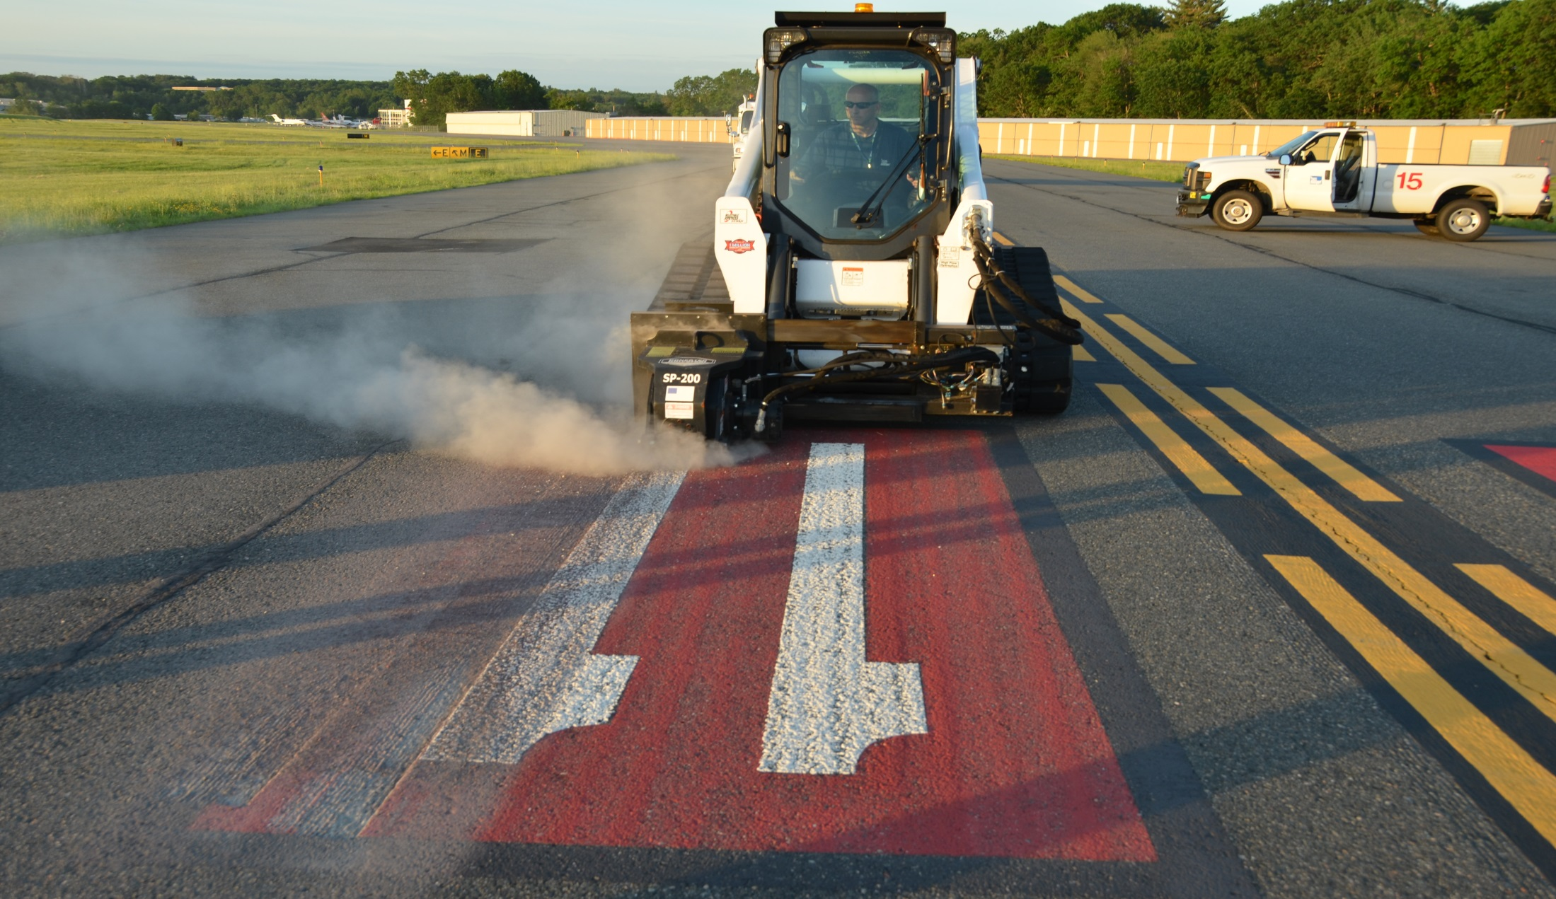
SMMA Hanscom/Bedford Airport (KBED)
Notes:
Pete

Slide 30
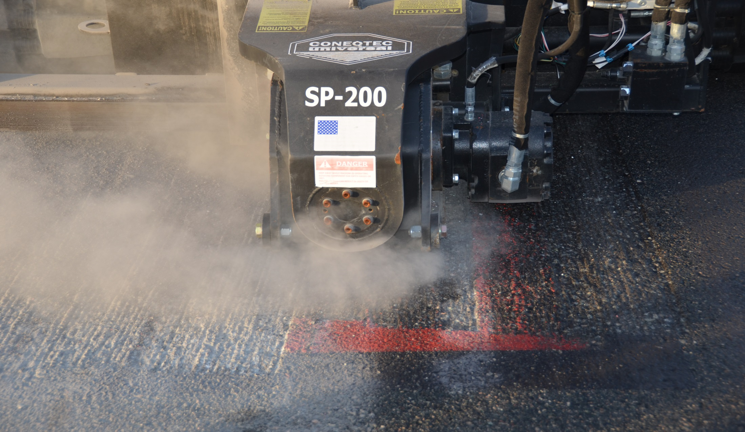
SMMA Hanscom/Bedford Airport (KBED)
Notes:
Pete

Slide 31
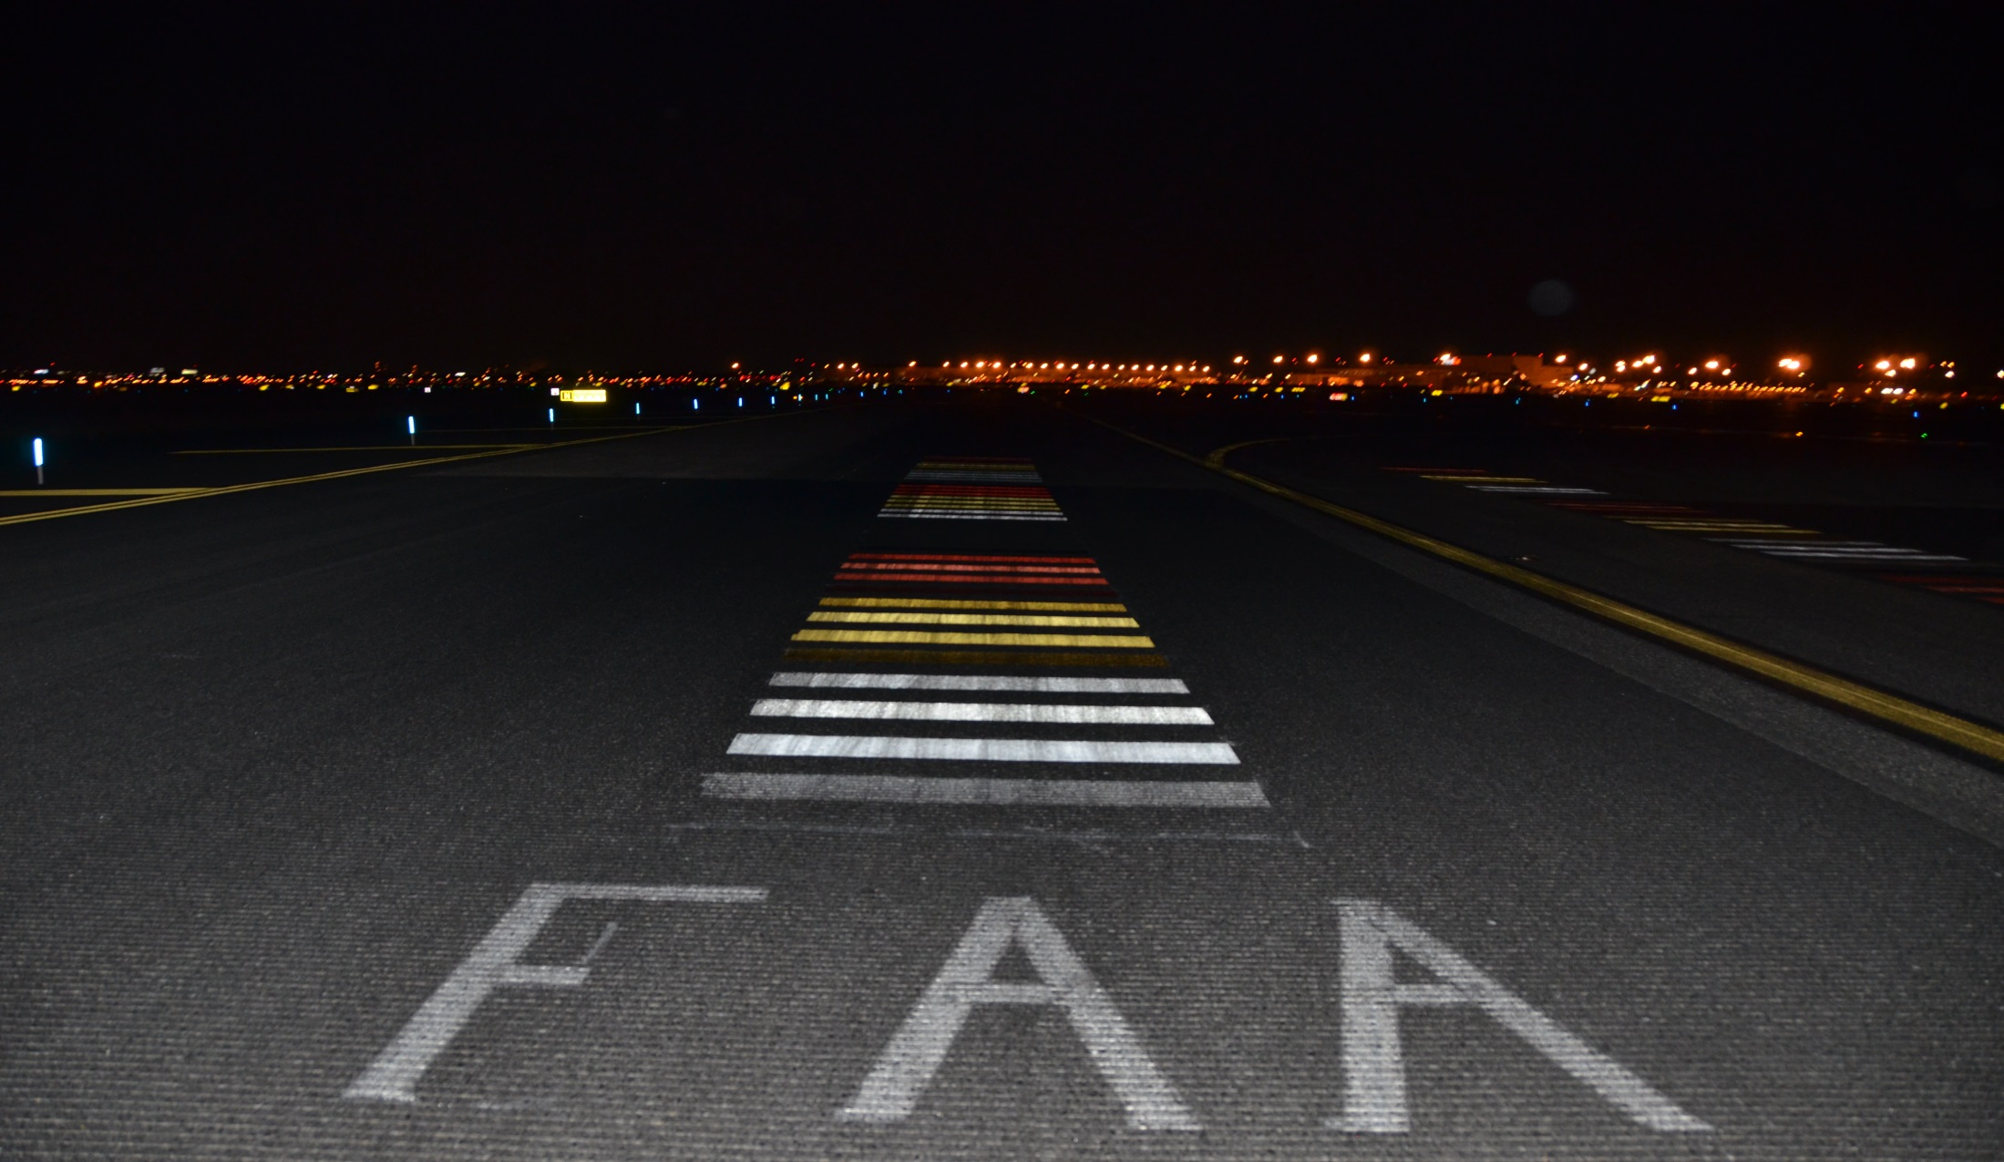
Pavement Marking Durability (KEWR)
Notes:
Pete

Slide 32
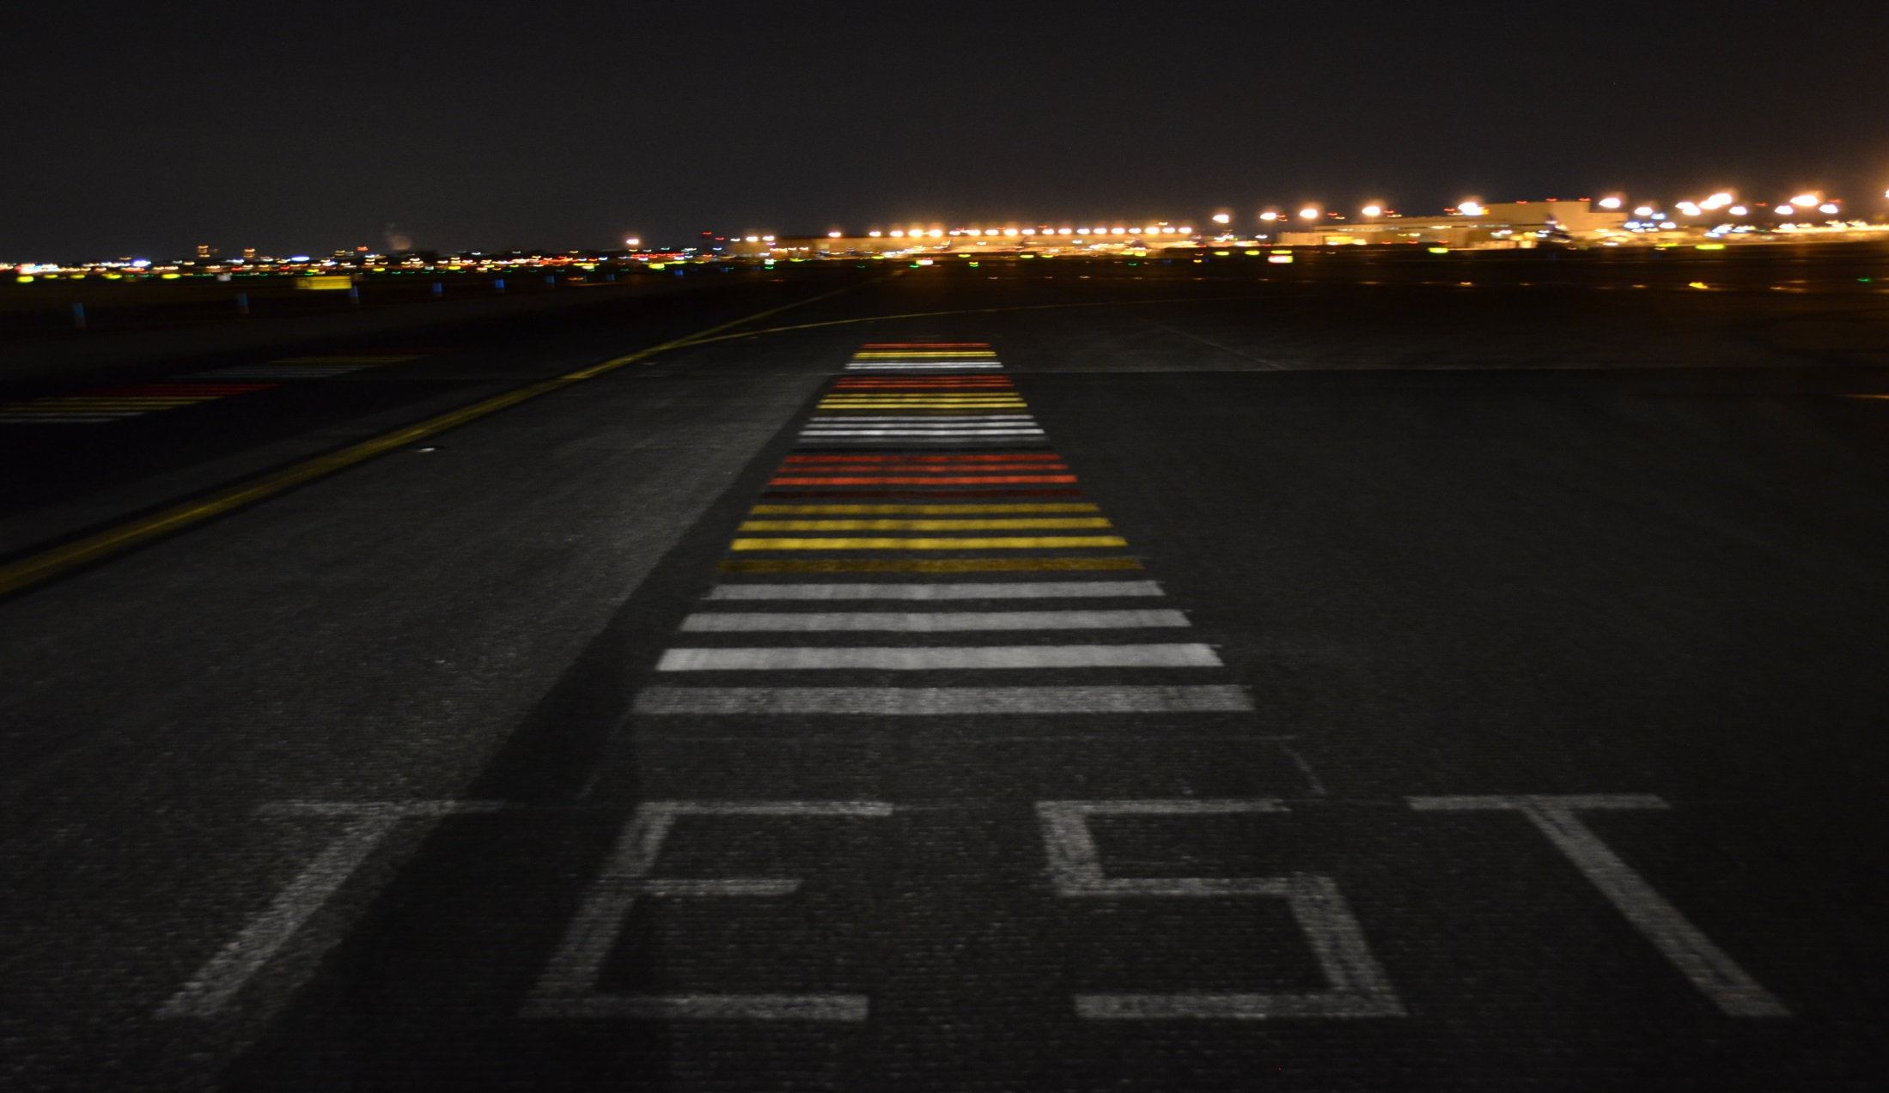
Pavement Marking Durability (KEWR)
Notes:
Pete

Slide 33
Pavement Marking Durability (KEWR)
Waterborne Type I
Notes:
Pete

Slide 34
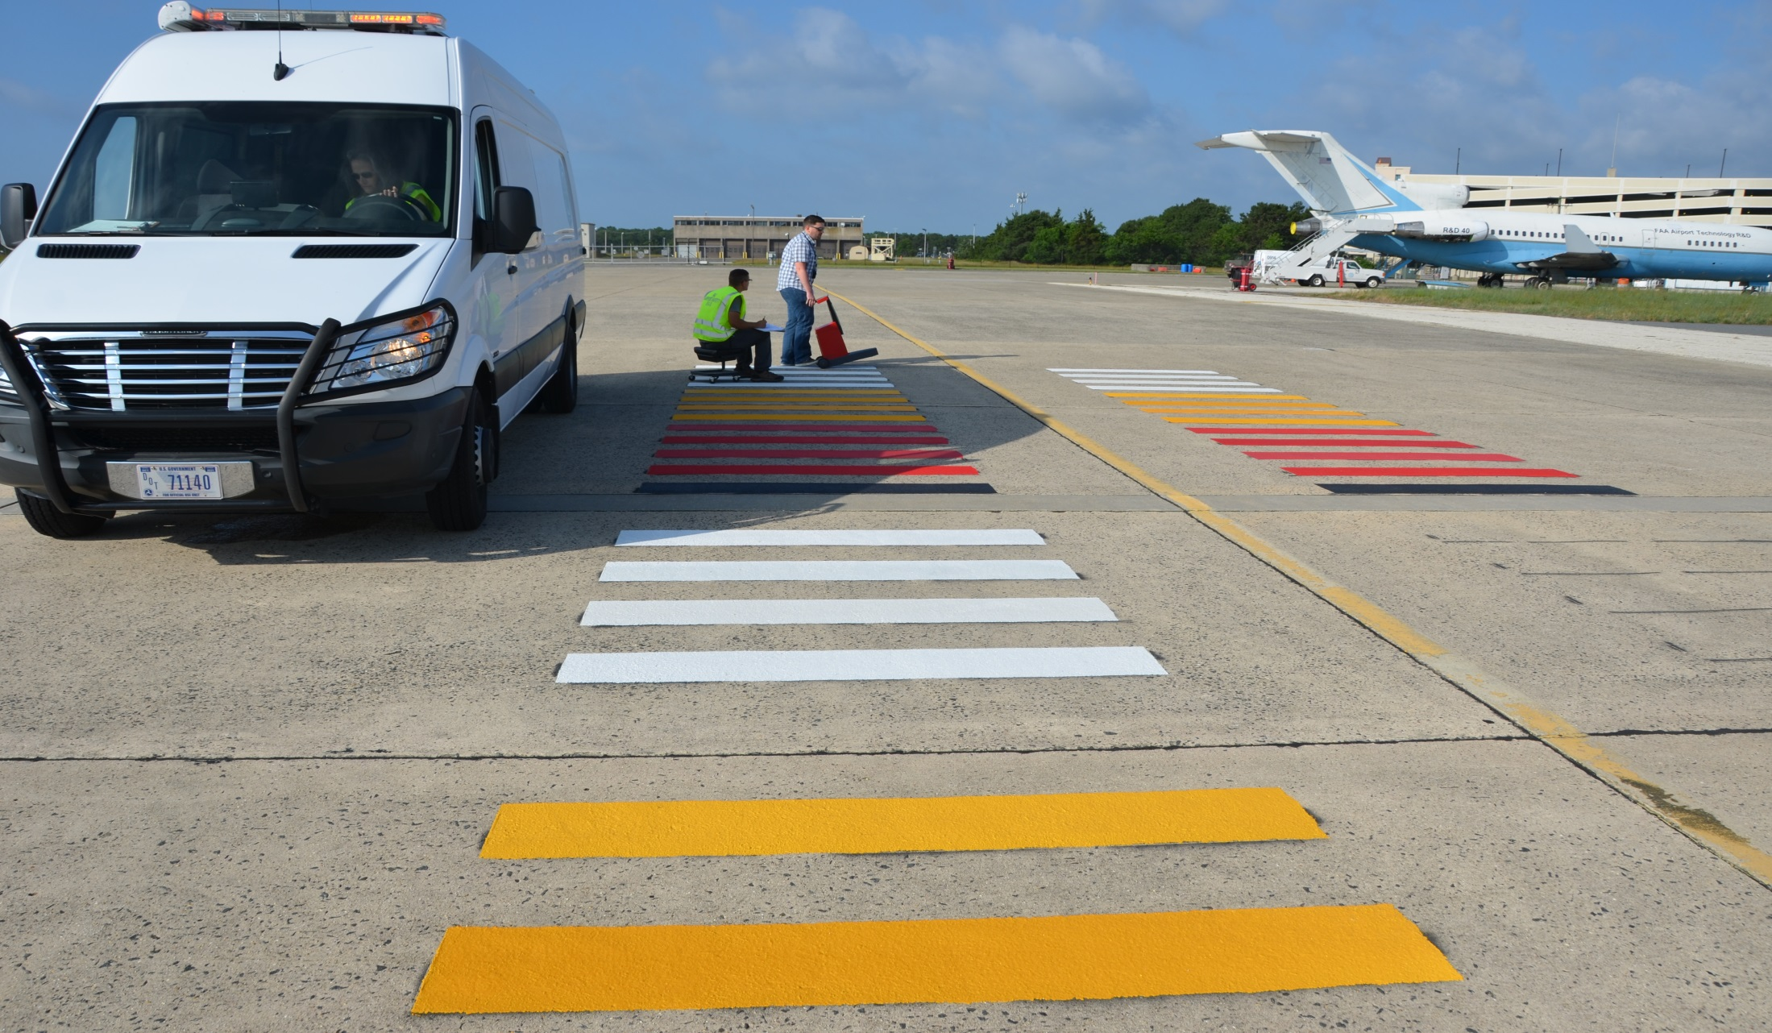
Pavement Marking Durability (KACY)
Notes:
Pete

Slide 35
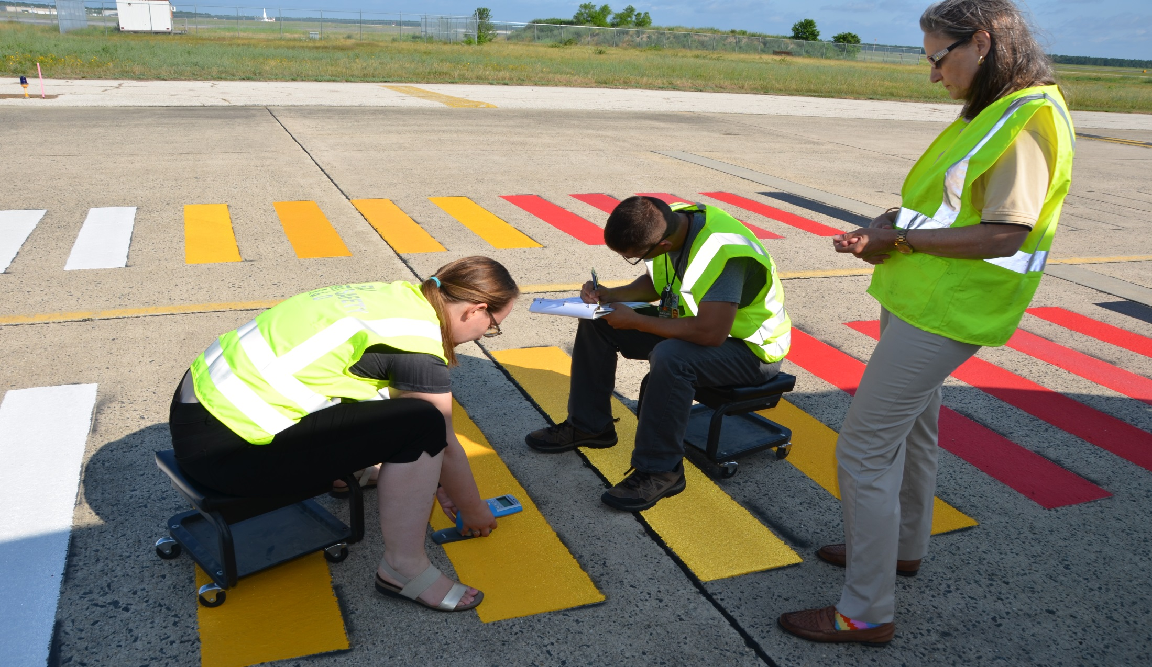
Pavement Marking Durability (KACY)
Notes:
Pete

Slide 36
Pavement Marking Durability (KACY)
Waterborne Type I
Notes:
Pete

Slide 37
Questions/Comments?
Donald.Gallagher@faa.gov
609-485-4583
www.airporttech.tc.faa.gov

