Slide 1
FAA Research Taxiway - RPA S9 & Obstruction Light with IR Testing
REDAC August 2017
Mike DiPilato
August 15, 2017

Slide 2
FAA Research Taxiway
Single site to design, test, evaluate, monitor, and report on the performance of state-of-the-art airport safety and pavement technologies.
Memorandum of Agreement between FAA and Delaware River and Bay Authority (DRBA).
November 15, 2010 through September 30, 2030.
Grants the FAA the “right to construct, operate and maintain Research Infrastructure” at Cape May County Airport (WWD) in Erma, NJ
Taxiway opened in April 2017

Slide 3
FAA Research Taxiway
Taxiway C
Length – 3250’
Width – 50’ (TDG III)
Pavement Width - 150’
Full array of Taxiway and Runway Lights
State-of-the-art Lighting Vault

Slide 4
FAA Research Taxiway

Slide 5
FAA Research Taxiway: Research Plans
Safety Projects
Obstruction lights with IR testing
Electrical infrastructure testing
Runway surface friction
UAS integration at airports
Future LED research efforts
Pavement Projects
Nondestructive Testing
Field and Laboratory Characterization of Pavement Materials
Long Term Aging Study of Various Paving Mixes
Notes:
Friction:
Evaluation of various pavement surfaces over time
Testing of various devices

Slide 6
Obstruction Light with IR Testing

Slide 7
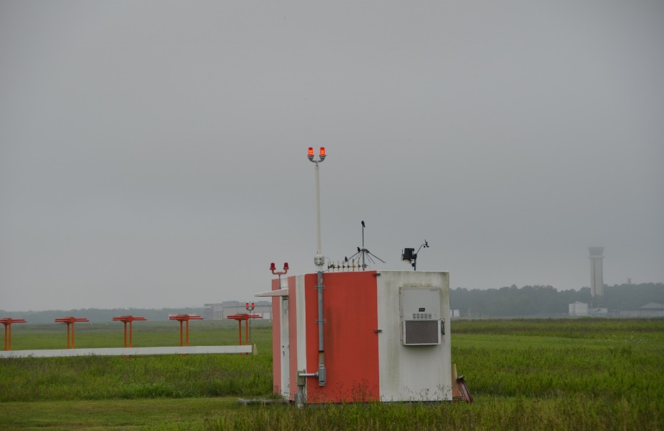
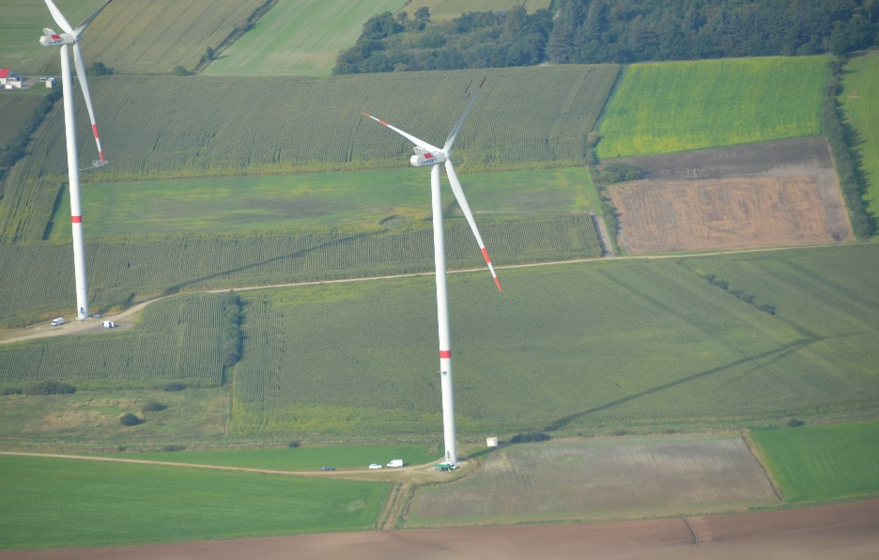
Obstruction Light with IR Testing
Conduct research to develop performance specifications for infrared (IR) emitters to be incorporated into L-810 and L-864 obstruction light fixtures.
L-810
L-864

Slide 8
Obstruction Light with IR Testing: Project Timeline
Milestone | Completion Date
Research Request | February 7, 2017
Project Plan | March 17
Interim Report | June 2
Laboratory Testing | June 26 – July 28
Flight Testing | June 26 - July 19
Final Report | August 10

Slide 9
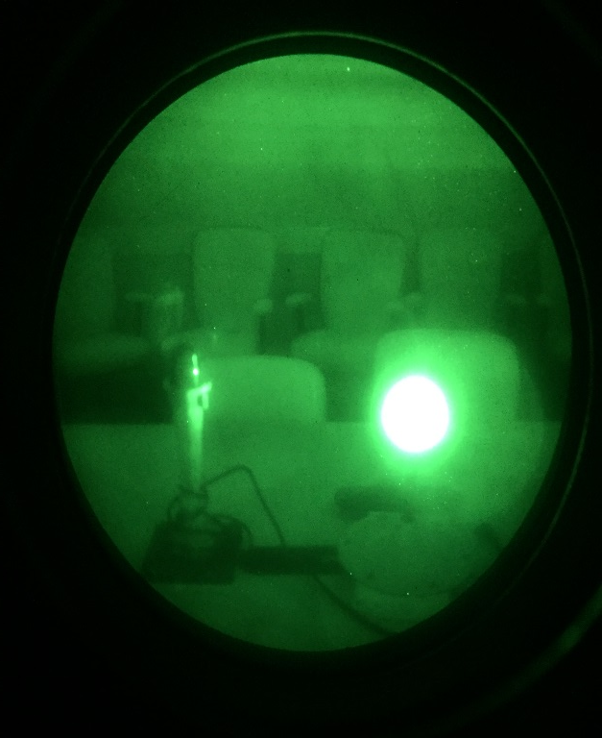
LED and IR Lighting Fixtures seen Through NVGs
Visible LED Light
Visible LED Light seen through NVGs
Visible LED Light (left) IR Light (Right)
seen through NVGs

Slide 10
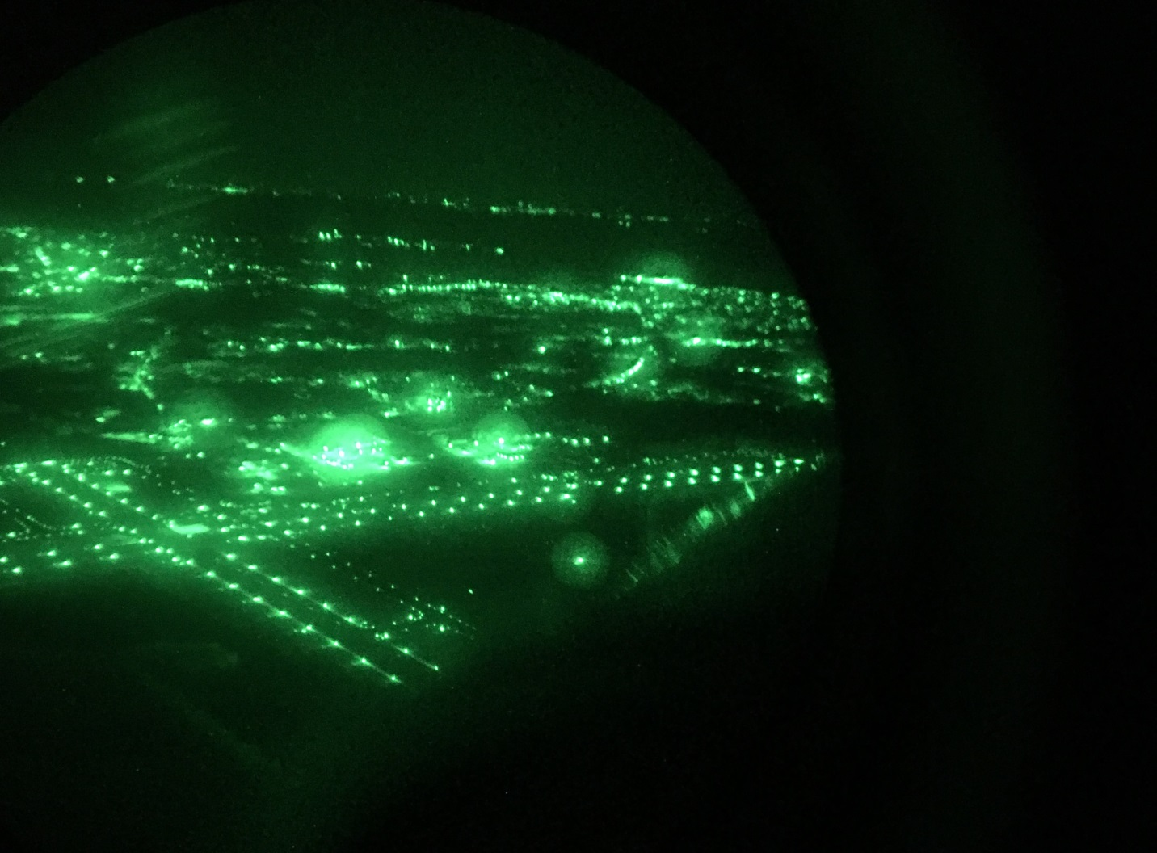
Incandescent L-810 Flight Testing

Slide 11
Questions?
Mike DiPilato
Airport Research Specialist
609-485-7249
michael.dipilato@faa.gov

