Slide 1
RPA 6.6 – TALPA RCAM Analysis
REDAC
Nick Subbotin
August 15, 2017

Slide 2
TALPA RCAM Analysis
Need
Research Goals
FAA Airport Safety and Standards (AAS) requested an analysis of Field Conditions (FICON) reports reported using the Federal NOTAM System.
Results of the analysis will allow AAS to assess how airports are using the RCAM.
Import available FICON data from NOTAM System
Create “Database Analysis Tool”
Present at TALPA Update Meeting in Washington DC, July 11 & 12
Perform in-depth data analysis
Final Report
FY 2017 R&D
Funding Requirements
Imported over 136K FICONS from Oct 1, 2016 to Apr 30, 2017
Created Database Analysis Tool
Presented general aggregate analysis at TALPA Update Meeting in Washington DC
Currently working on in-depth data analysis
Currently working on Final Report
TALPA RCAM Analysis
FY 2017 | FY 2018 | FY 2019
200K | 300K | 300K
Notes:
General Hi-Level Overview
Can be read

Slide 3
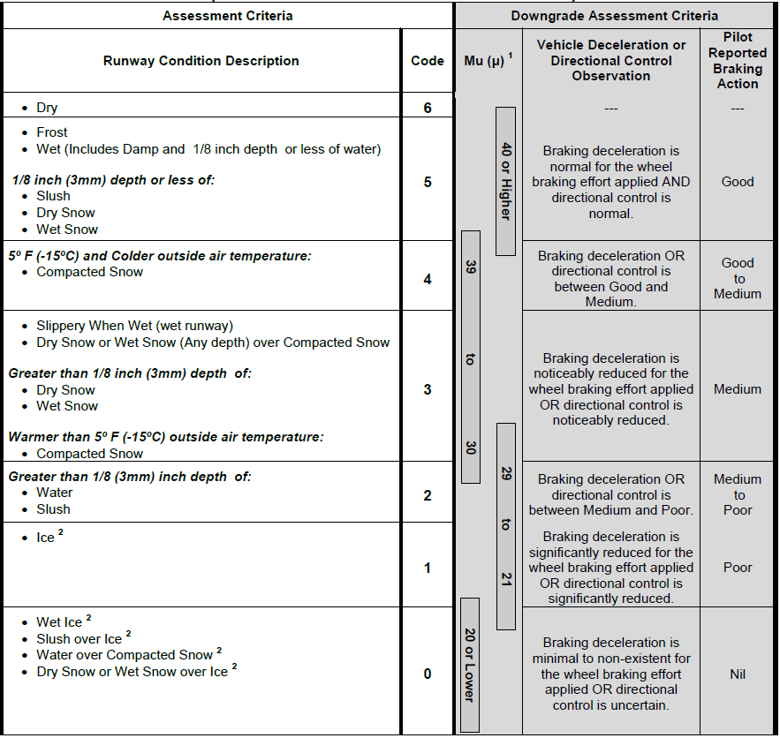
R
unway
C
ondition
A
ssessment
M
atrix
Notes:
RCAM – Airport Operator Version

Slide 4
Objectives
Primary Objective – Data analysis of 2016/17 implementation of the Runway Condition Assessment Matrix (RCAM) and revised winter operations field condition reporting process.
Acquire all FICONs from the NOTAM System (Oct 1, 2016 – Apr 30, 2017)
Develop an analytical toolset/database to accomplish the objective
Import METAR weather data into the database
Perform statistical analysis of all available information (contaminants, RwyCCs, PIREPs, comparisons, etc.)
In-depth analysis in key areas
Explore areas of interest, identify data irregularities, and considerations for improvement
2013 FAA Technical Note (DOT/FAA/TC-TN13/22) provided an overview of the Runway Condition Assessment Matrix (RCAM) validation efforts conducted during 2009-2011
Notes:
Objectives – Can be read
If interested: The analytical toolset included a combination of Excel, SQL Server Management Studio, and LabVIEW.

Slide 5
General Aggregate Data
All FICONs | 136,428
FICONs with RwyCCs | 107,889
FICONs without RwyCCs | 28,539
FICONs with PIREPs | 2,809
FICONs with RwyCCs & PIREPs | 2,473
FICONs without RwyCCs & with PIREPs | 336
Notes:
General Aggregate Data

Slide 6
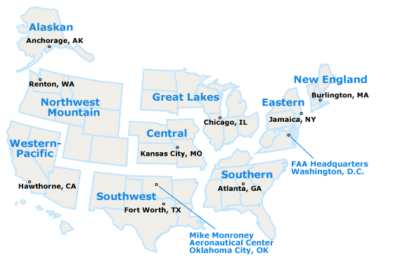
Regional FICON Distribution
Airports that submitted FICONs
REGION | COUNT
AAL | 145
ACE | 167
AEA | 183
AGL | 418
ANE | 89
ANM | 194
ASO | 105
ASW | 81
AWP | 53
 |  | Total FICONs by region
Alaska Region | AAL | 26,059
Central Region | ACE | 6,619
Eastern Region | AEA | 17,021
Great Lakes Region | AGL | 45,517
New England Region | ANE | 13,358
Northwest Mountain Region | ANM | 20,507
Southern Region | ASO | 3,396
Southwest Region | ASW | 2,000
Western Pacific Region | AWP | 1,951
Notes:
Regional breakdown of Airports Reporting and Number of FICONs

Slide 7
FICONs at Airports
Total Number of FICONs | 136,428
Part-139 Airports | 100,220 | 73%
Non-Part-139 Airports | 36,208 | 27%
Total Number of Airports reporting FICONs | 1,435
Part-139 Airports | 427 | 30%
Non-Part-139 Airports | 1,008 | 70%
Notes:
Majority of FICONs came from Part-139 airports.

Slide 8
Breakdown of Wet Contaminant reported in FICONs
FICON Total: 136,428 Entries
FICONs with a WET contaminant reported | 60,899 | 45%
FICONs with WET on all runway thirds reported* | 47,726 | 35%
FICONS with WET 100% runway coverage reported | 41,860 | 31%
FICONs with WET less than 100% coverage reported | 5,866 | 4%
*554 Airports reported WET on all runway thirds
Notes:
Great Interest in the numbers with WET being reported as a contaminant. See table for breakdown.

Slide 9
Questions or Comments?
All the latest TALPA information can be found at the following website:
https://www.faa.gov/about/initiatives/talpa/
Nick.Subbotin@faa.gov
609-485-8034
www.airporttech.tc.faa.gov
Notes:
FINAL REPORT will be delivered to AAS Aug/Sept.

