Slide 1
RPA S6.2
Airport Winter Safety and Operations
REDAC Subcommittee
Joseph Breen
March 14, 2017

Slide 2
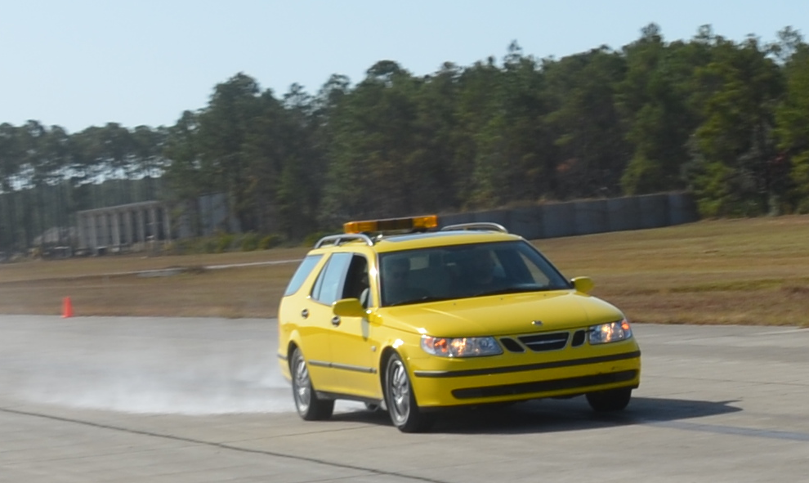
Objectives
Evaluate Airport Runway Surface Assessment and Maintenance Technologies.
Work with ASTM and ICAO in Developing Consistent CFME Equipment Calibration and Measurement Standards.

Slide 3
Recent Accomplishments
Participated in the 2016 International Friction Workshop at the Penn State University Larson Institute.
Conduct Monthly Friction Surveys on ACY Runways 13/31 and 4/22.
Completed Friction Testing on New Calibration Site at Tyndall AFB.

Slide 4
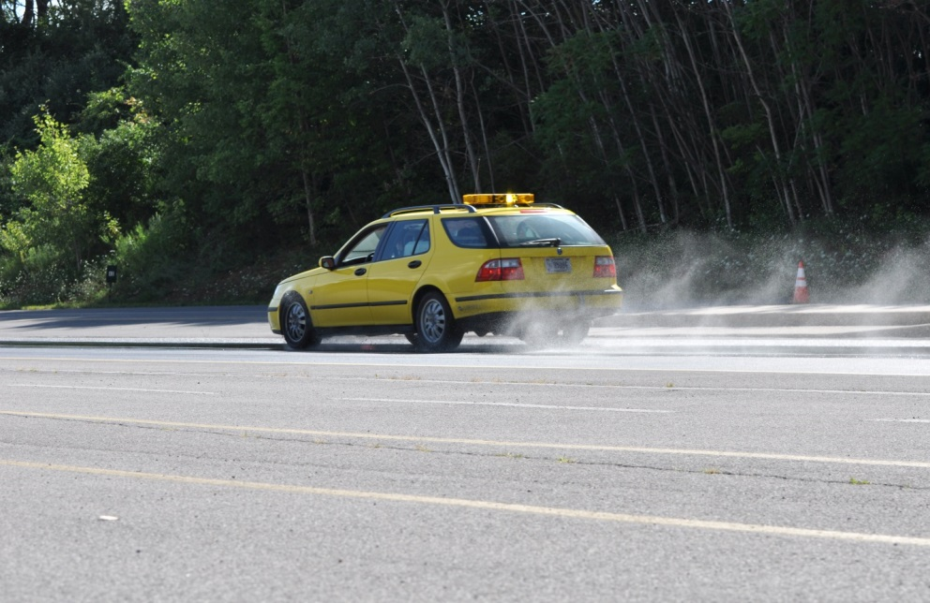
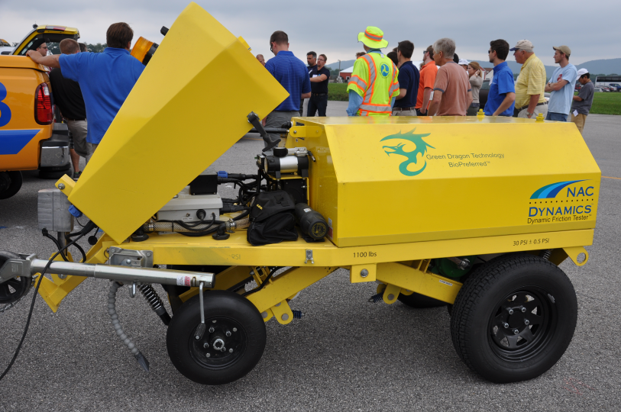
FAA Friction Measuring Equipment
Three FAA Approved Friction Measuring Equipment (CFMEs).
- Dynatest Runway Friction Tester (RFT)
- SARSYS Surface Friction Tester (SFT)
- NAC Dynamic Friction Tester (DFT)

Slide 5
FAA Friction Measuring Equipment (Continued)
Three FAA Approved Digital Decelerometers.
- Vericom RFM4000X Runway Friction Meter
- NAC Dynamic Friction Decelerometer (DFD)
- Bowmonk Airfield Friction Meter MK3

Slide 6
AAS-100 Research Requests
Research Request Submitted to Evaluate the Effect of Vehicle Anti-Lock Braking Systems (ABS) on Decelerometer Performance.
Research Request to be Submitted for Relating Water Film Thickness on Individual Runways to Rainfall Intensity.
- Outflow Meter to be Used for Measurement of Surface Texture and Influence of Runway Cross-Slope.
Research Request for Evaluation of Trapezoidal Grooving will Require Use of Friction Vehicles for Measurement of Mu Characteristics Both Before and After Construction of Test Bed on ACY Runway 4/22.

Slide 7
Influence of Anti-Lock Braking Systems (ABS) on Decelerometer Performance
Influence of Host Vehicle ABS on Decelerometer Measurements of Friction (Mu) is Not Fully Understood.
Disabling of Host Vehicle ABS to Perform Friction Runs Compromises Safety at Airports.
Manufacturers of FAA Approved Decelerometers do not Publish Guidance or Recommended Adjustments to Mu Readings Based on Vehicle ABS.

Slide 8
Evaluate Effect of Anti-Lock Brakes on Decelerometer Performance (Continued)
Obtain Input from Manufacturers of FAA Approved Decelerometers Relating to Influence of Host Vehicle ABS on Decelerometer Performance and Any Appropriate Adjustment Factors.
Conduct Friction Testing with One Host Vehicle and Three FAA Approved Digital Decelerometers, and Three FAA Approved CFMEs.
- Testing to be Conducted on a Wide Range of Texture Surfaces And Contaminated Surfaces.
- Testing to be Conducted at 30, 40, and 50 mph with ABS of Host Vehicle Engaged and Disengaged.

Slide 9
Evaluate Effect of Anti-Lock Brakes on Decelerometer Performance (Continued)
Report on Comparative Friction Values Obtained at Various Speeds for CFME, Decelerometers (ABS Engaged and Disengaged in Host Vehicle), and Address Manufacturer’s Recommendations.

Slide 10
Friction Testing at Tyndall AFB Calibration Site
Schematic View of Tyndall AFB Concrete Surfaces Calibration Site

Slide 11
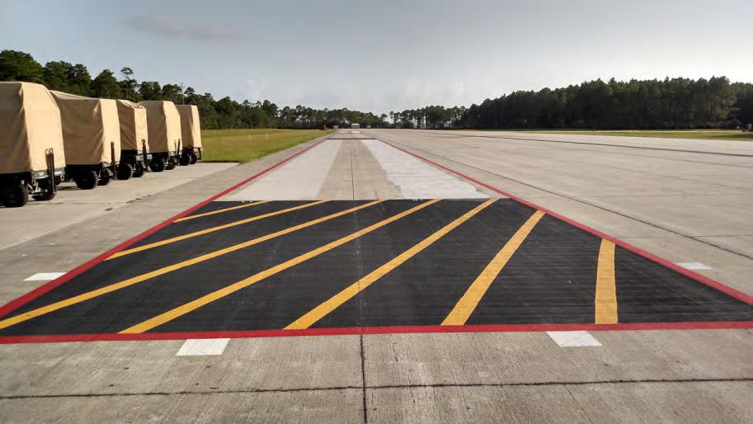
Friction Testing at Tyndall AFB Calibration Site (Continued)
Calibration Site Consists of Two Parallel Lanes with Each Having Three 200 Foot Long Test Sections
Skidabrader Machinery Used to Achieve Calibration Test Surface Texture Variation.

Slide 12
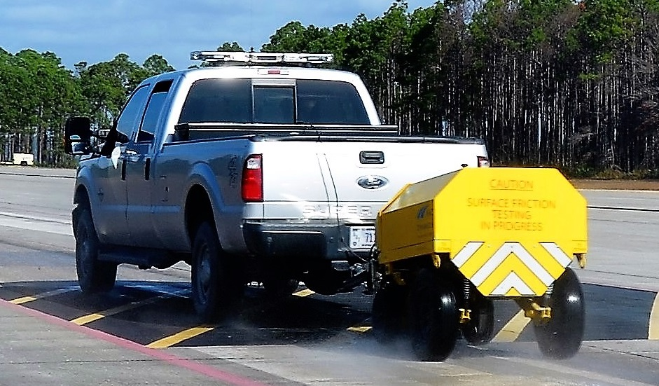
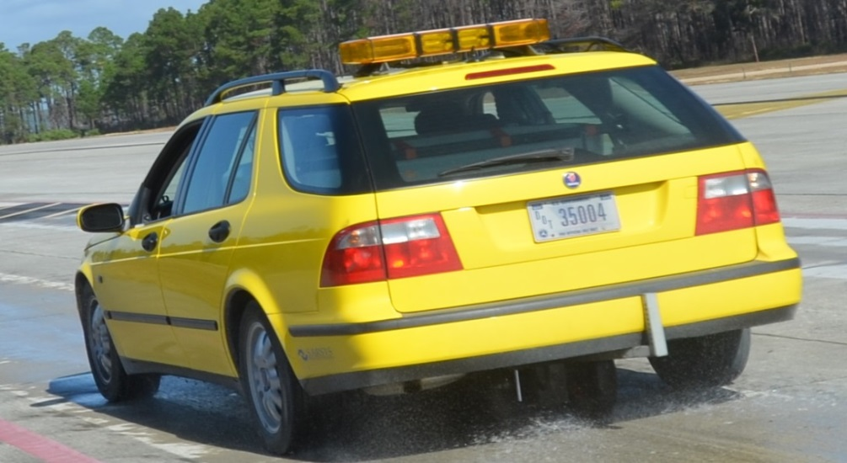
Friction Testing at Tyndall AFB Calibration Site (Continued)
Friction Measurements Taken with SARSYS Surface Friction Tester (SFT) and NAC Dynamic Friction Tester (DFT).
CFME Runs Made at 25, 40, and 60 MPH.
Macro-Texture Measurements Taken in Each Test Section Using ELAtextur Device.
Friction and Texture Measurements will be Used in Post-Test Analysis to Perform International Friction Index (IFI) Evaluation.

Slide 13
RPA Overview
FY 2016/2017 Accomplishments
- 2016 Friction Workshop
- Runway Friction Surveys
- Testing at Tyndall AFB Calibration Site
- Decelerometer Testing with/without ABS.
Funding Requirements
- FY 2017 - $275,000
- FY 2018 - $250,000
- FY 2019 - $275,000

Slide 14
Questions?

