Slide 1
RPA - P2
NAPMRC
(National Airport Pavement & Materials Research Center)

Slide 2
RPA P2 Overview - NAPMRC
Need
Research Goals
Research Goals
More durable, long-lived airport pavements, reduced lifecycle costs, better prediction of pavement service life, and accurate assessment of aircraft-pavement compatibility
Standards/specification for new asphalt technologies such as WMA, SMA, RAP, etc.
Deliverables
Technical Reports, technical papers.
NAPMRC provides the ability to test the surface layers, pavement materials, and alternative pavement materials. Improved paving materials characterization will conserve airport development funds and reduce the downtime of runways from construction and maintenance activities. Test results will help in developing standards/specification for new asphalt technologies such as WMA, SMA, RAP, etc.
FY 2016-2017 Accomplishments
Funding Requirements
Complete traffic tests on Test Cycle – 1 (TC-1) by end of FY2016.
Lab study on SMA & RAP completed. √
Milestones
- Complete tests on HMA at 210-psi tire pressure √
- Complete tests on WMA at 210-psi tire pressure √
- Complete tests on HMA at 254-psi tire pressure √
- Complete tests on WMA at 254-psi tire pressure √
- Indoor and Outdoor Lanes √
NAPMRC FY 2017 through FY 2019.
 | FY 2017 | FY 2018 | FY-19
Funding Target ($000) | $1,700 | $1,530 | $1,620
P2.1: Pavement Construction | $400 | $360 | $270
P2.2: Facility Operation | $1,100 | $950 | $1,010
P2.3: Facility Maintenance | $200 | $220 | $340

Slide 3
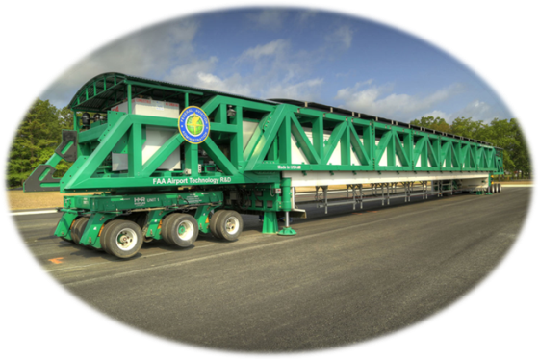
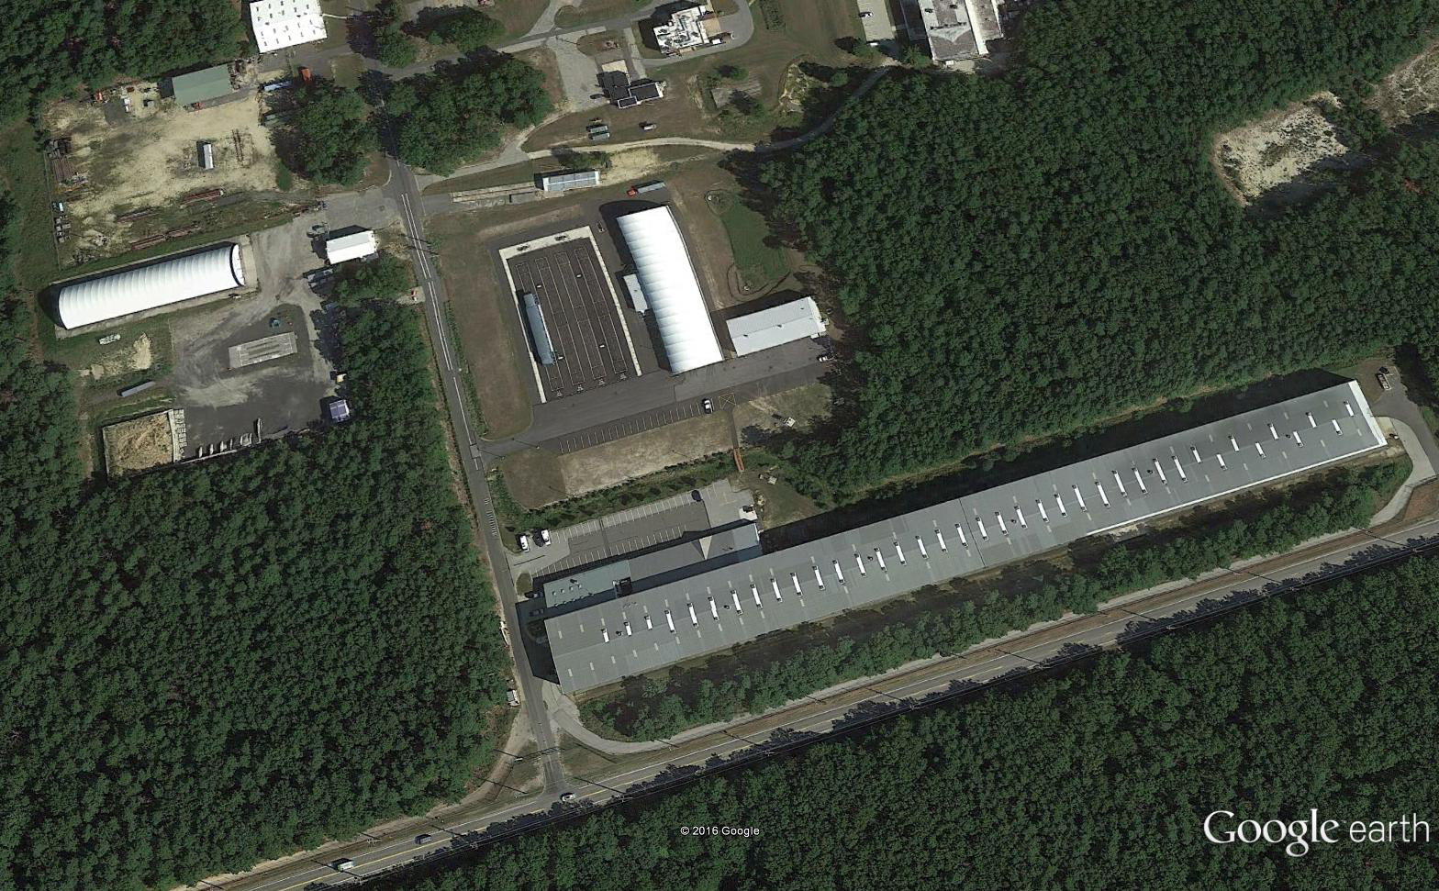
Material Processing
Facility
NAPMRC
NAPTF
Material Testing
Laboratory

Slide 4
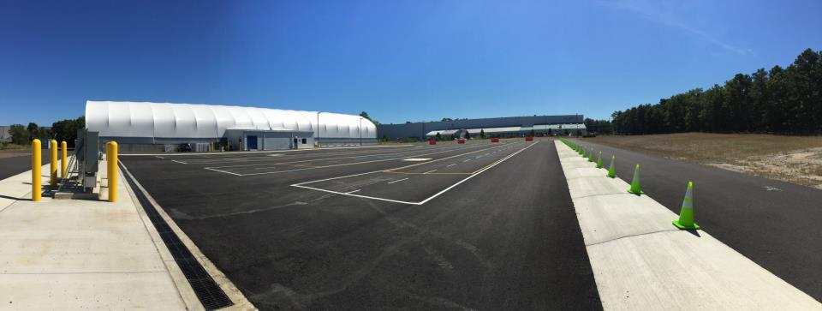

Slide 5
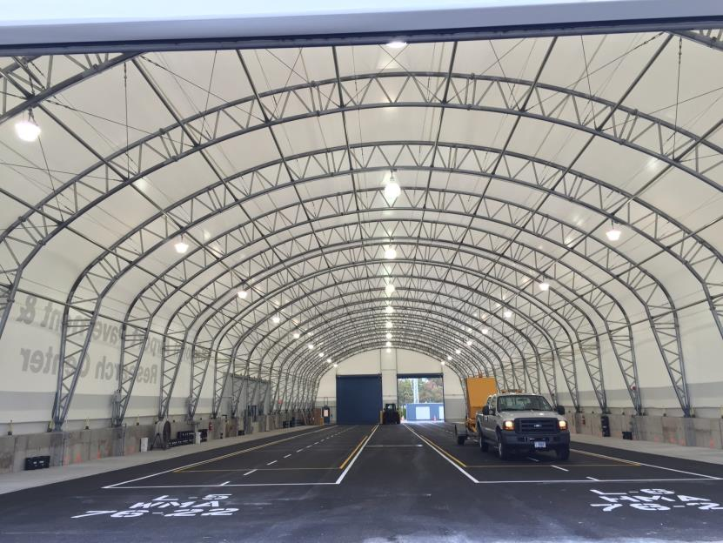

Slide 6
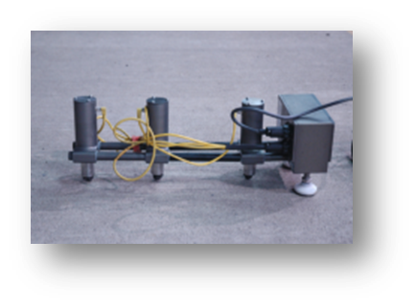
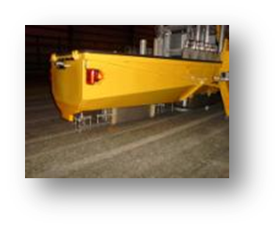
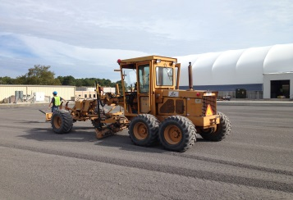
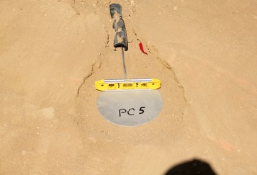
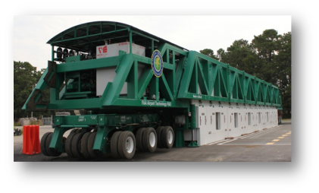
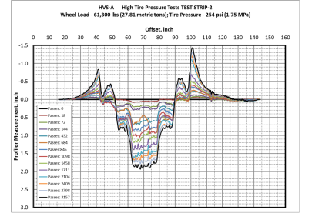
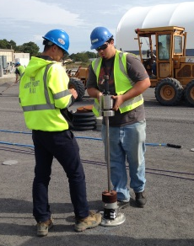

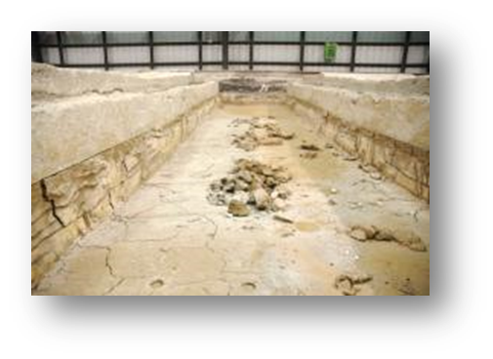
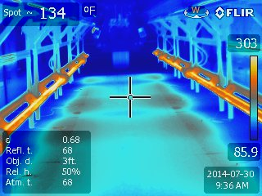
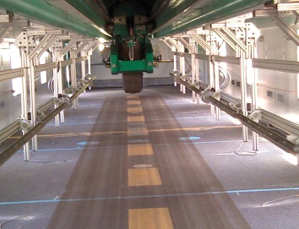
Objectives, Pavement
Construction, Sensors
NDT & Pavement
Characterization
TEST CYCLE (TC) AT NAPMRC
CURRENTLY UNDER
PROGRESS
Posttraffic Testing
Full-Scale APT,
Pavement Evaluation

Slide 7
MATERIAL
WMA
WMA
P401
HMA
P401
HMA
WMA
P401
HMA
254
psi
254
psi
254
psi
254
psi
254
psi
254
psi
TIRE
PRESSURE
NAPMRC
Test Cycle-1
(TC-1)
210
psi
210
psi
210
psi
210
psi
210
psi
210
psi
BINDER
TYPE
PG
76-22
PG
64-22
PG
76-22
PG
64-22
PG
76-22
PG
76-22

Slide 8
Pavement Cross Sections

Slide 9
Test Parameters – Response Tests
Tire pressure to 210-psi for tests on South.
Pavement Temperature: 120 deg. F measured at a depth of 2-inch below pavement surface.
Test Speed: 3-mph
Loading Gear: Single Wheel
Apply 22 passes at wheel loads of 20-kips, 30-kips, and 40-kips respectively.
Lateral Wander Positions

Slide 10
Test Parameters – Traffic Tests
Pavement Temperature: 120 deg. F measured at a depth of 2-inch below pavement surface.
Test Speed: 3-mph

Slide 11
WMA
WMA
P401
HMA
P401
HMA
WMA
P401
HMA
254
psi
254
psi
254
psi
254
psi
254
psi
254
psi
CENTER
SECTIONS
254-psi 90°F
NAPMRC
Test Cycle-1
(TC-1)
210
psi
210
psi
210
psi
210
psi
210
psi
210
psi
PG
76-22
PG
64-22
PG
76-22
PG
64-22
PG
76-22
PG
76-22
Testing Completed

Slide 12
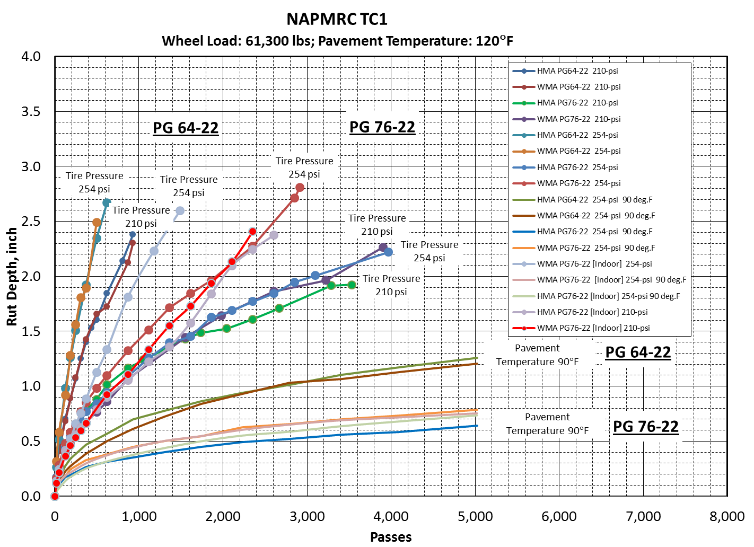
Preliminary Test Results

Slide 13
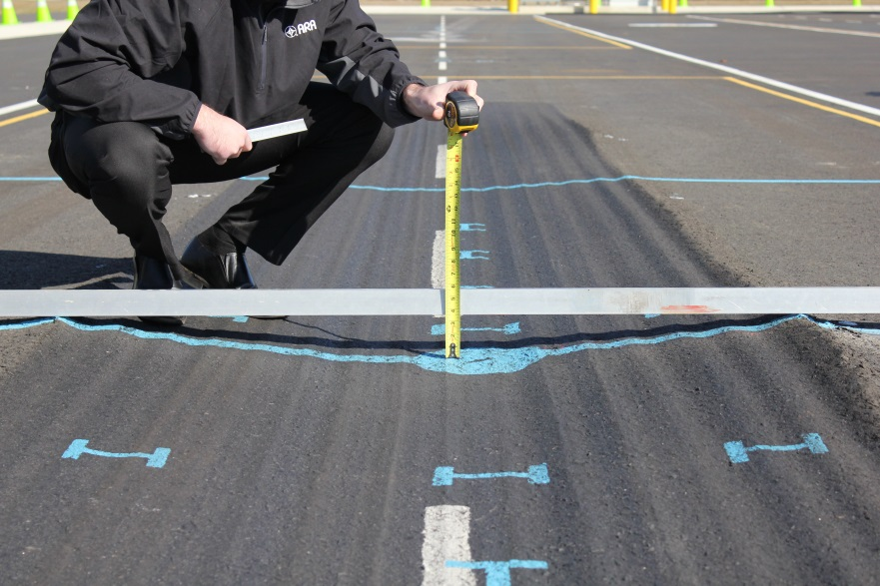
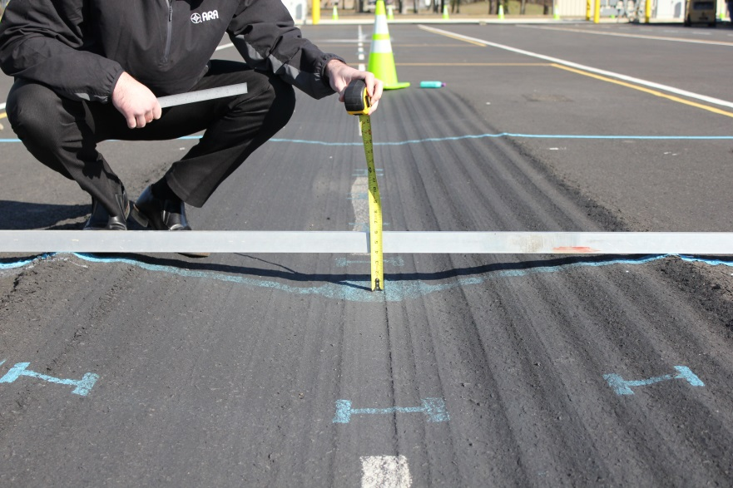


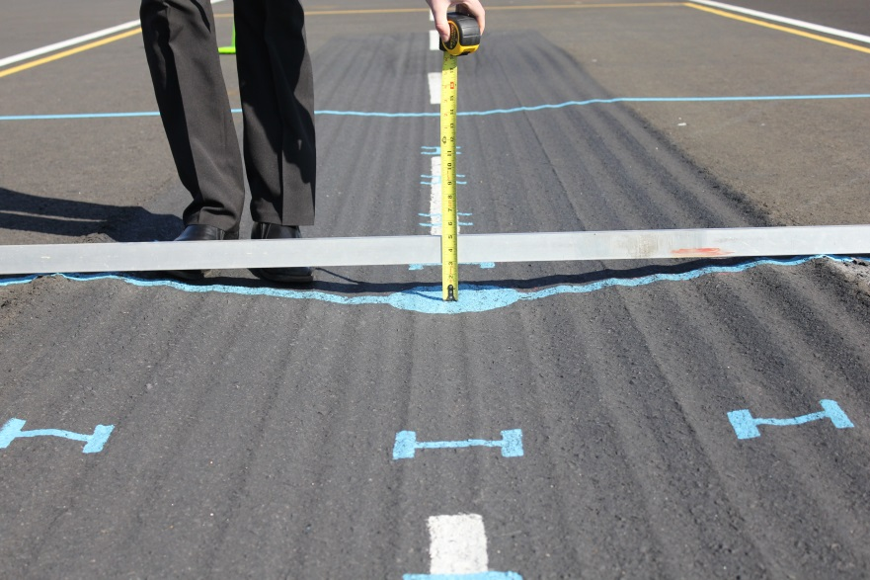
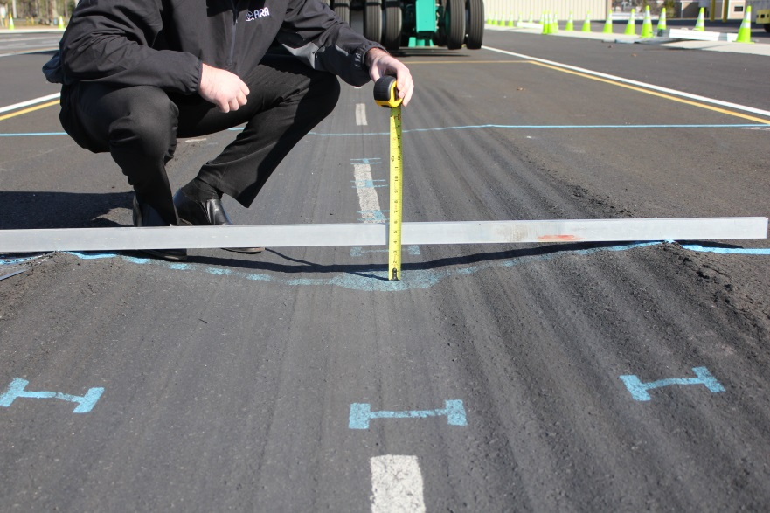


NAPMRC-TC1 SOUTH TEST AREA (210-psi; 120°F)
No. of Passes to Failure: 800
Traffic Tests Terminated: 3906
No. of Passes to Failure: 220
Traffic Tests Terminated: 930
No. of Passes to Failure: 600
Traffic Tests Terminated: 3534
No. of Passes to Failure: 220
Traffic Tests Terminated: 992

Slide 14
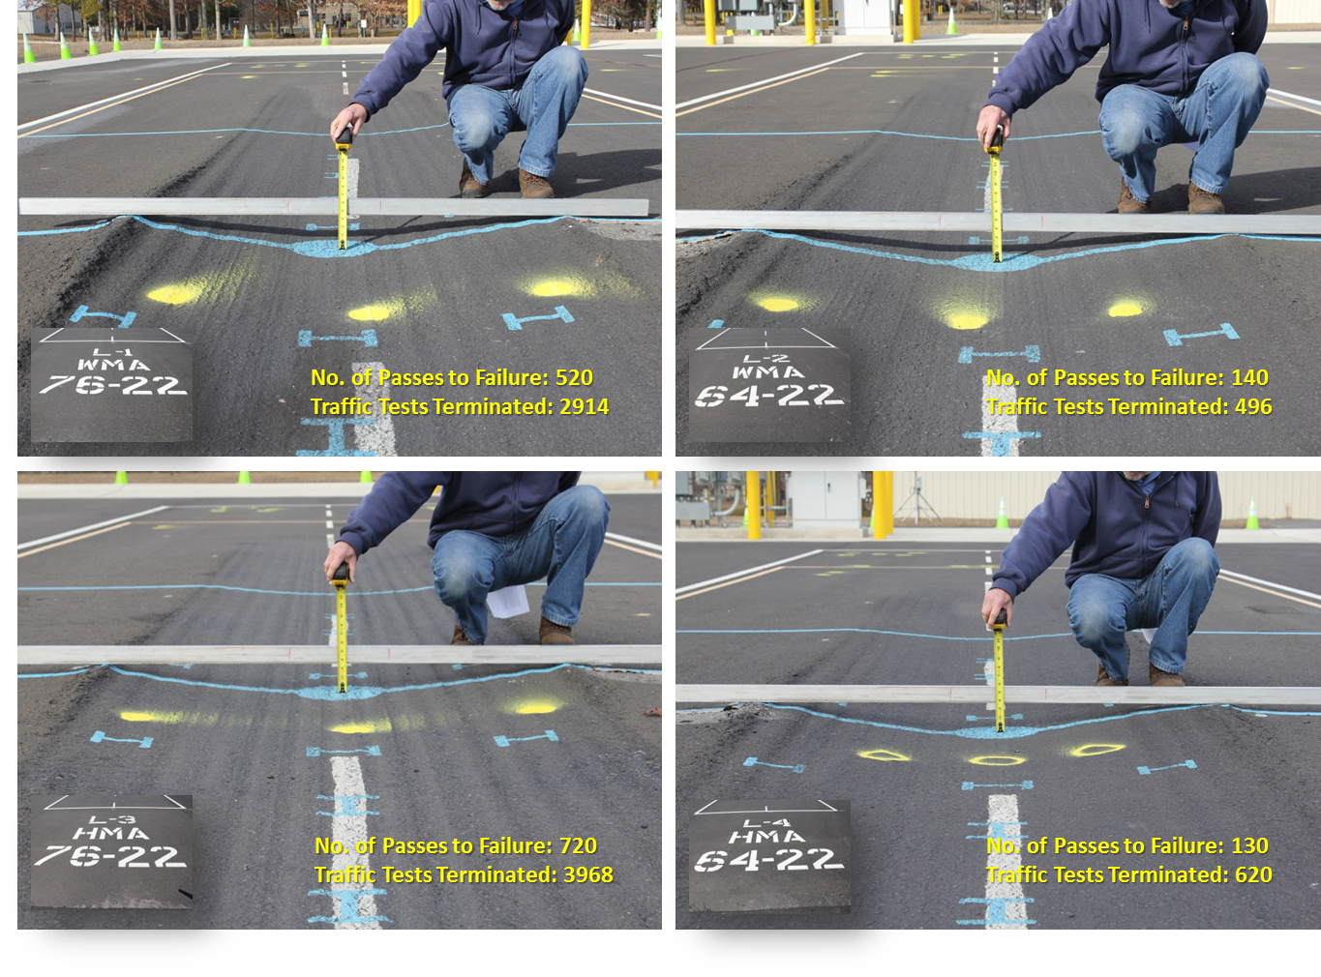
NAPMRC-TC1 NORTH TEST AREA (254-psi; 120°F)

Slide 15
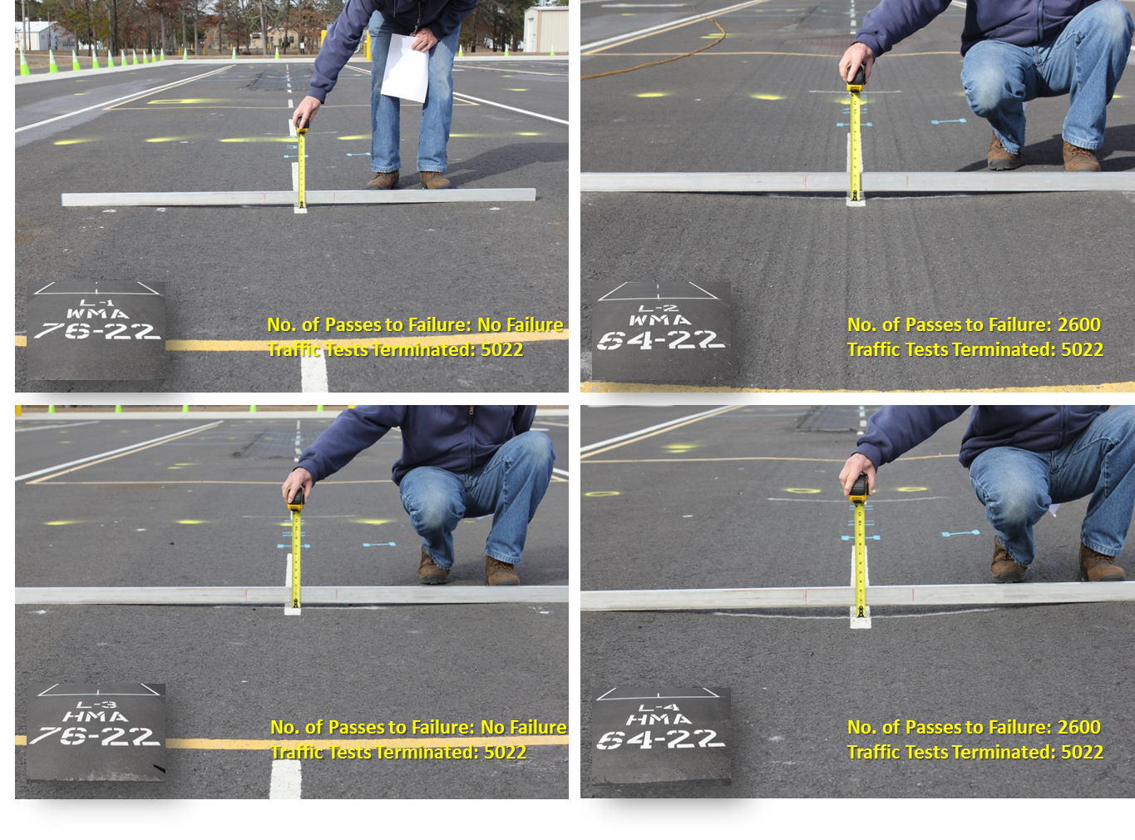
NAPMRC-TC1 CENTER TEST AREA (254-psi; 90°F)

Slide 16
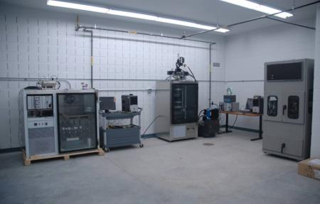
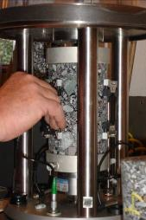
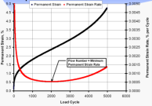
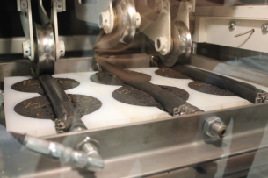
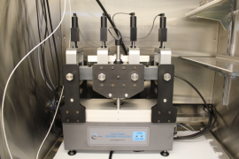

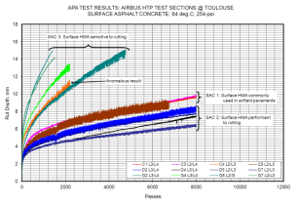
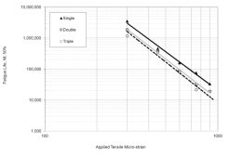
LABORATORY CHARACTERIZATION

Slide 17
Laboratory Characterization
Asphalt Mixtures:
  Dynamic Modulus Test
  Repeated Creep-Recovery Tests at Variable Stress Levels
  Repeated Creep-Recovery Tests at Variable Rest Periods
Asphalt Binders:
    Multiple Stress Creep-Recovery (MSCR)
Granular Materials:
  Resilient Modulus Test
  Repeated Creep-Recovery
  Triaxial Test to Calibrate CAP Model

Slide 18

MATERIAL
P401
HMA
WMA
1
WMA
2
WMA
3
RAP
1
RAP
2
RUTTING
(test at high
temperature)
NAPMRC
Test Cycle-2
(TC-2)
CRACKING
(test during
winter)
PG
76-22
PG
76-22
PG
76-22
PG
76-22
PG
64-22
PG
64-22
Tire Pressure
254 psi

Slide 19




Pavement Cross Sections
P-401 HMA/WMA SURFACE
9 inches
P-209 CRUSHED STONE BASE
8 inches
P-154 SUBBASE
12 inches
SANDY SUBGRADE
CBR 15
NAPMRC TC-2 PAVEMENT CROSS SECTION

Slide 20
Future Research
EVALUATION OF NEW ASPHALT TECHNOLOGIES FOR AIRFIELD PAVEMENTS
Warm Mix Asphalt, Stone Matrix Asphalt, Polymer Modified Binders,
RAP Mixes, Full-Depth Rehabilitation
PROBLEM: Lack of Guidance/Standards/Specifications
Lack of Performance Data
Laboratory Performance Evaluation
Full-Scale APT
NAPMRC
Field Performance Evaluation
Evaluate:
Rutting
Fatigue
Moisture Susceptibility
Durability
Low Temperature Cracking
Full-Scale APT:
Rutting
Fatigue
Tire Pressure Effects
WMA
RAP/RAS
Full Depth Reclamation
Compare to P-401 HMA
Field Projects:
Lab Evaluation of Field Mixes
Construction Evaluation
Evaluate:
Mix Design Production, Construction
Support from AAS-100, ADO

Slide 21
