Slide 1
RPA – P3
Field Instrumentation & Testing

Slide 2
RPA P3 Overview – Field Instrumentation & Testing
Need
Research Goals
Provides better understanding of long term pavement behavior in the field under varied climatic and operating conditions, and improved paving materials characterization will conserve airport development funds and reduce the downtime of runways from construction and maintenance activities.
Research Goals
More durable, long-lived airport pavements, reduced lifecycle costs, better prediction of pavement service life, and accurate assessment of aircraft-pavement compatibility
Pavement performance data under different climatic conditions.
Deliverables
Technical Reports, technical papers.
FY 2016-2017 Accomplishments
Funding Requirements
Finite Element Analysis for JFK project - Underway.
Milestones
- Completed sensor installation at BOS. √
- Continuing lab tests on materials collected at BOS. √
- Complete sensor installation at PHL.
- Complete lab tests on materials collected at PHL
- Complete in-situ tests at PHL.
- Install sensors at FDR project at Davis, CA (tentative).
Field Instrumentation & Testing FY 2017 through FY 2019.
 | FY 2017 | FY 2018 | FY-19
Funding Target ($000) | $900 | $825 | $865
P3.1: Sensor Installation | $350 | $325 | $350
P3.2: Material Testing | $300 | $250 | $265
P3.3: Data Analysis | $250 | $250 | $250

Slide 3
Objectives
    • Evaluate the effects of environment on pavement performance;
    • Determine thermal gradients within asphalt and concrete layers;
    • Determine the effects of material properties and variability on pavement response and performance;
    • Determine the effects of construction quality on pavement response and performance;
    • Determine the effects of specific design features on pavement response and performance;
    • Develop improved material characterization through in-situ and laboratory testing at new construction projects and, when available, subgrade testing for rehabilitation projects.

Slide 4
Type of Data Collected
    • Climatic data (pavement & air temperatures).
    • Pavement response data (strains, pressure, deflections).
    • Material samples for laboratory testing.
    • In-situ test data (non-destructive tests, vane shear, dynamic cone penetrometer, etc.).
    • Heavy Weight Deflectometer tests.

Slide 5
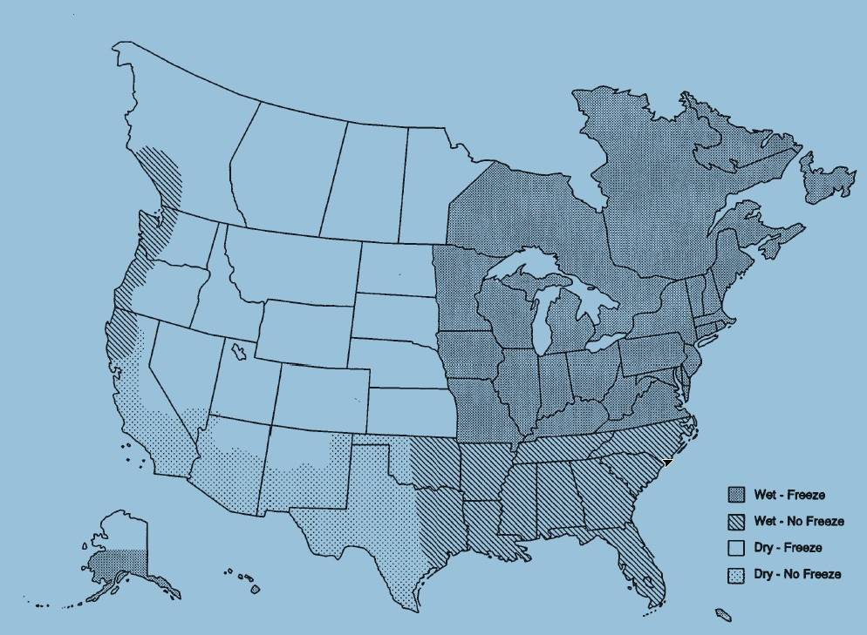
Current FAA Airport Instrumentation Projects
JFK International Airport NY – PCC Pavement
Boston Logan International Airport, MA– AC Overlay Pavement
Newark Liberty International Airport, NJ – AC Overlay Pavement
Philadelphia International Airport, PA– AC/PCC Pavement

Slide 6


Slide 7
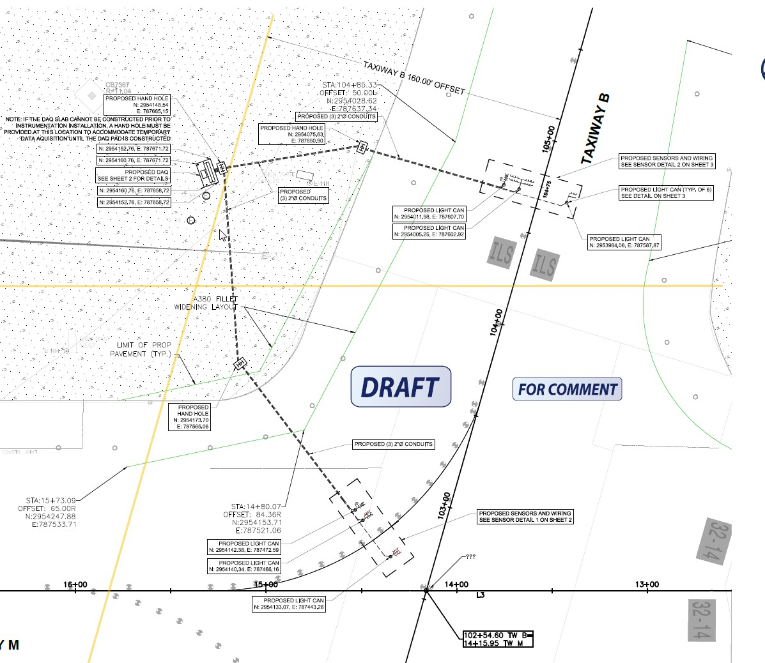
TAXIWAY M

Slide 8
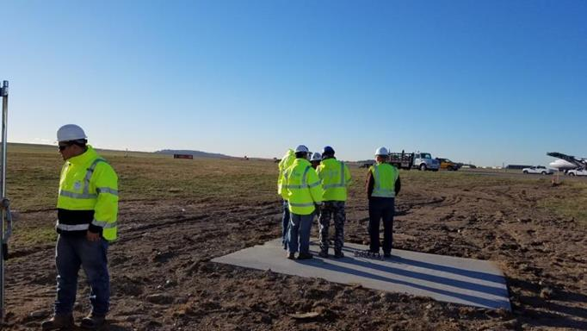

Slide 9


Slide 10
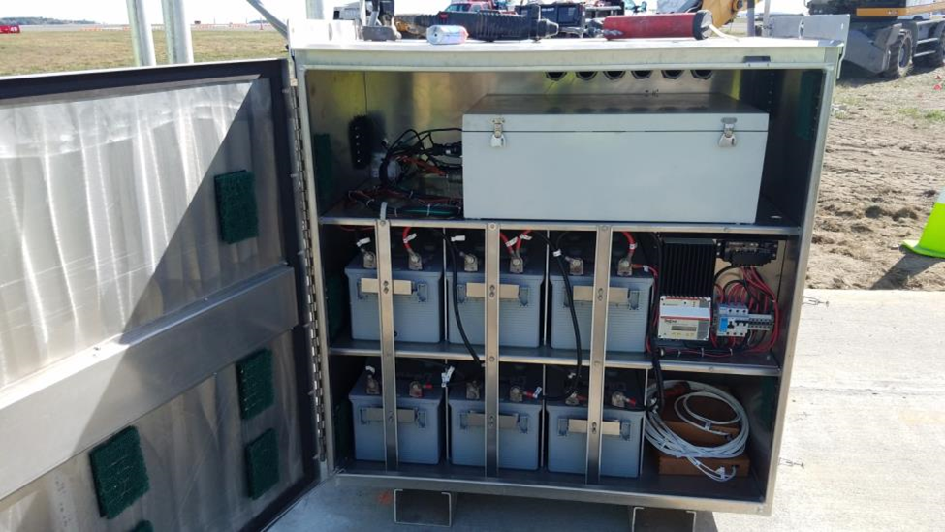

Slide 11

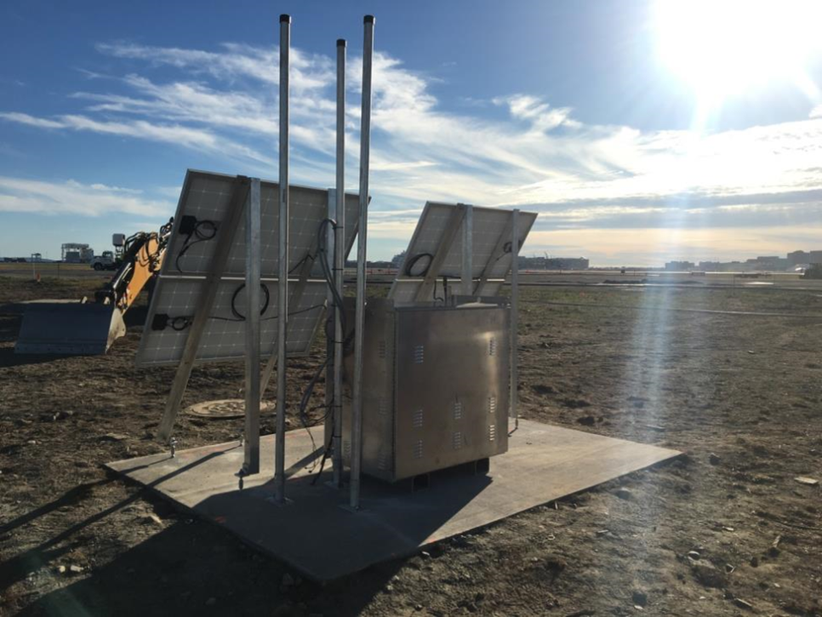

Slide 12
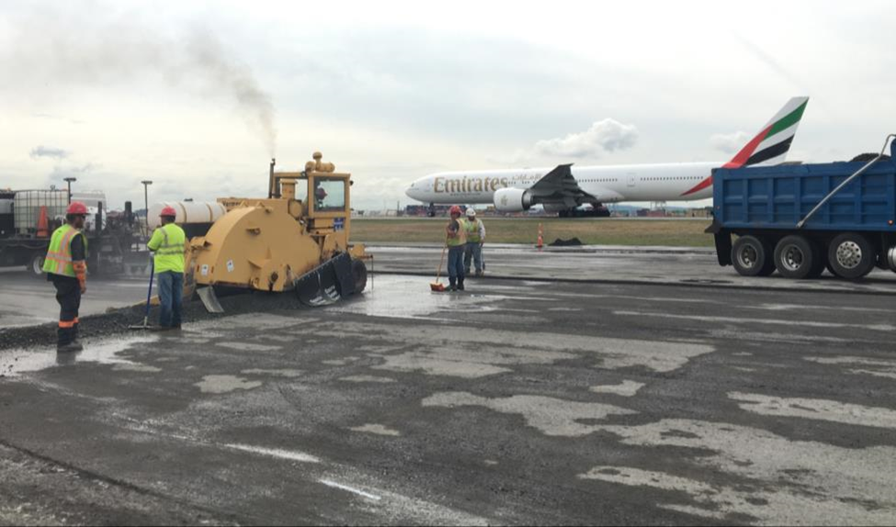

Slide 13
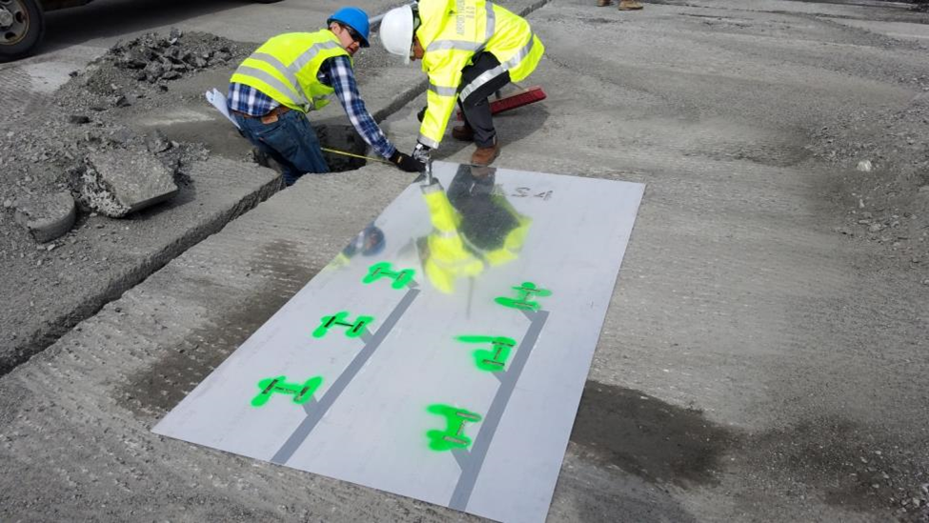
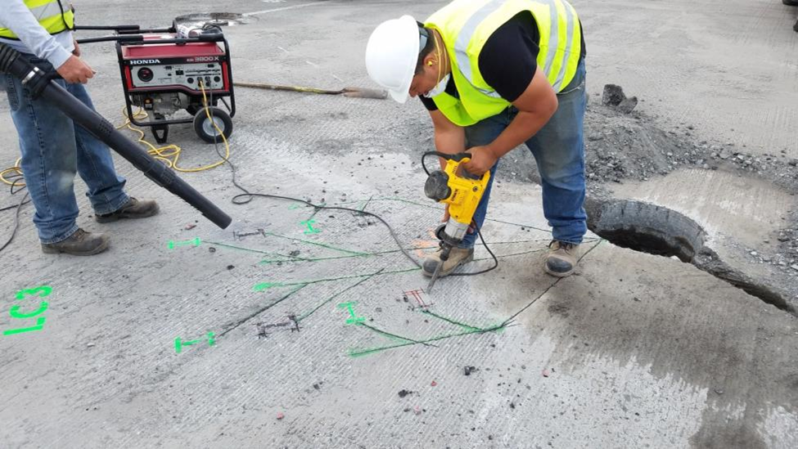

Slide 14
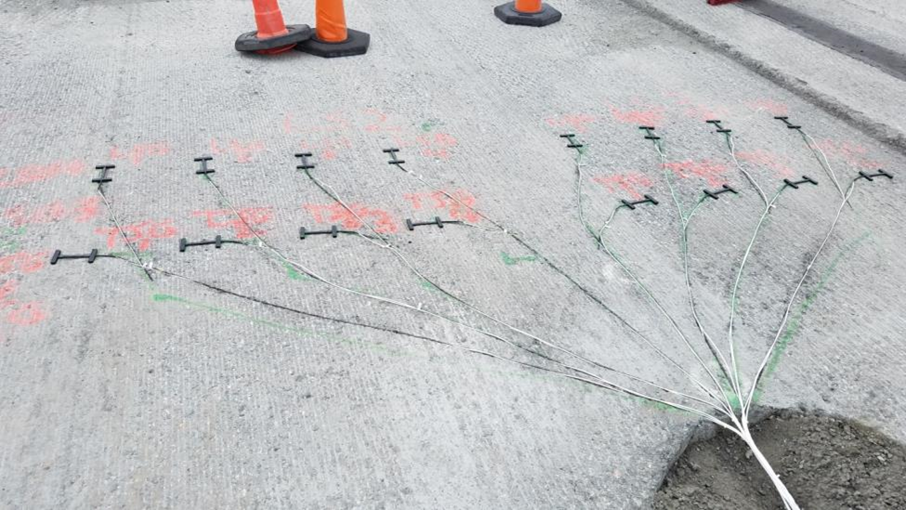
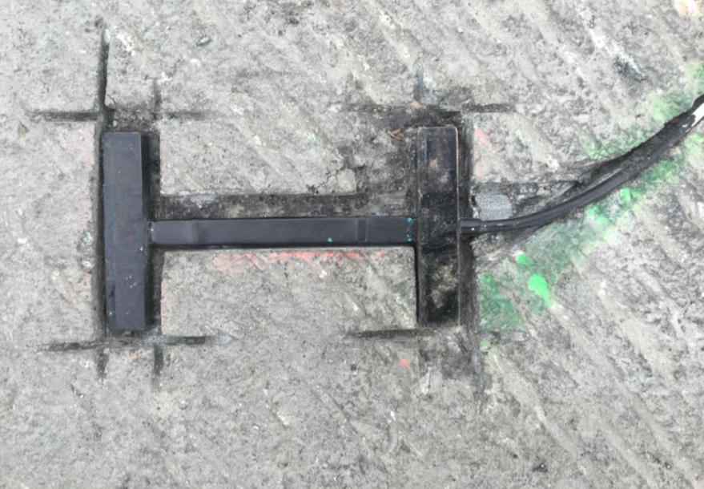

Slide 15
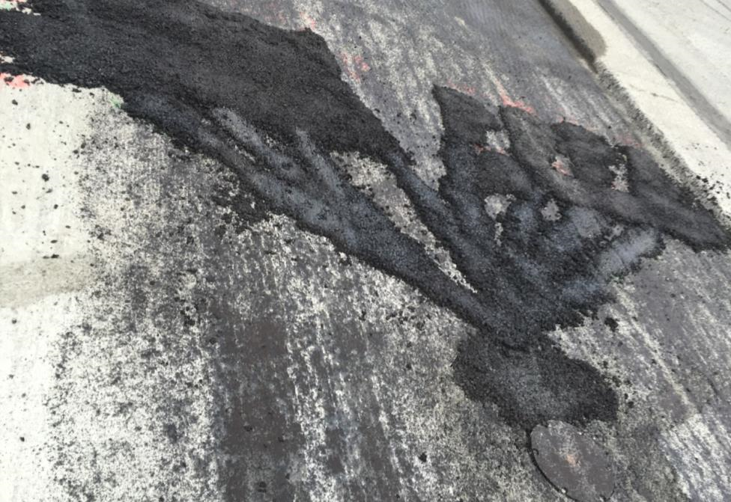

Slide 16


Slide 17
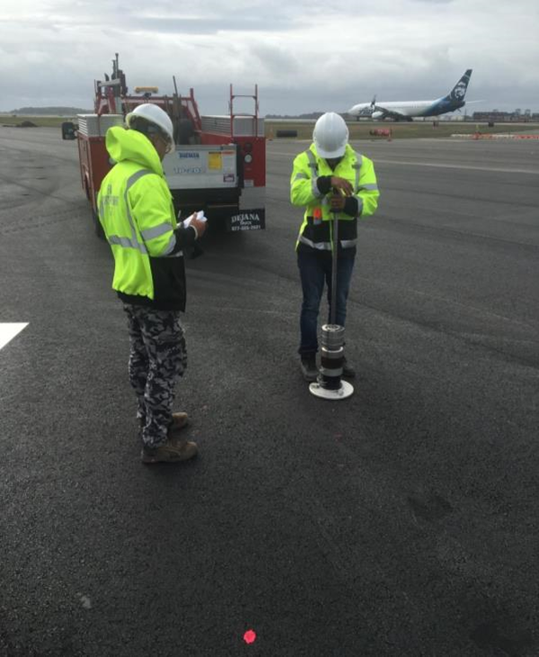

Slide 18
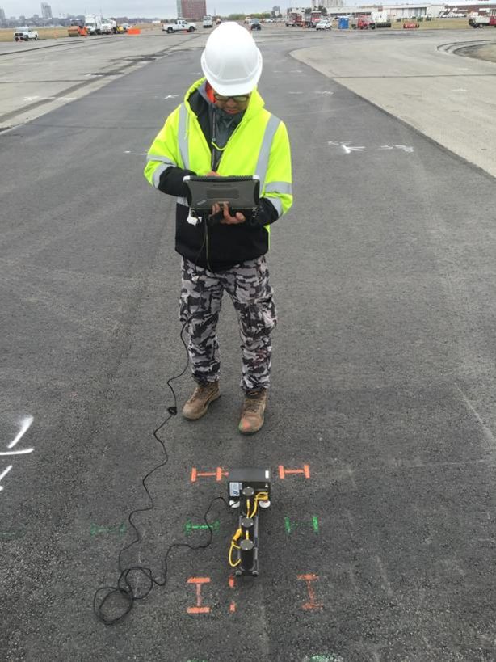


Slide 19
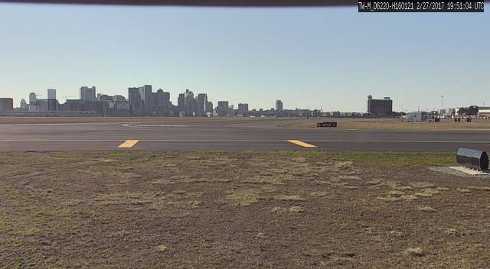
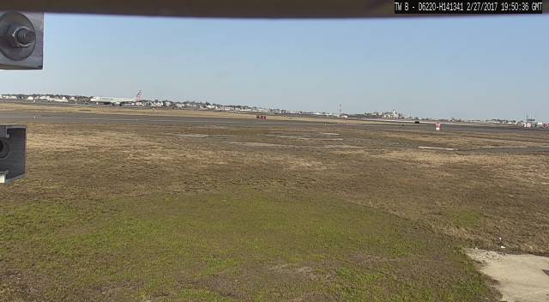

Slide 20
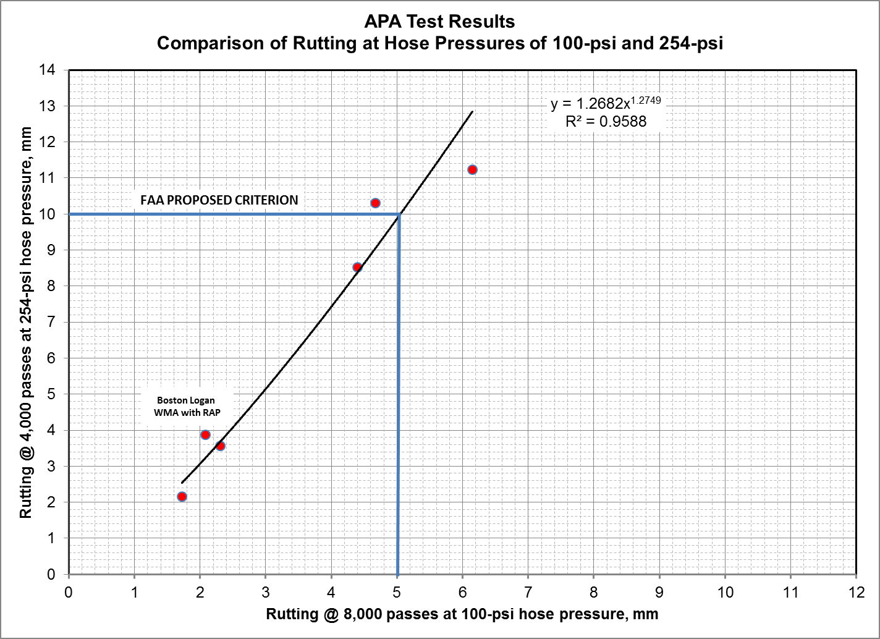

Slide 21
HMA/WMA Charecterization
Compare the asphalt mixture performance of two different asphalt mixtures sampled during production
  Atlantic City Airport
  Logan Airport
Performance Testing
  Mixture Stiffness (Dynamic Modulus)
  Fatigue Cracking (Flexural Beam Fatigue, Overlay Tester, SCB Flexibility Index)
  Rutting Resistance (AMPT Flow Number)

Slide 22
Study Limitations
Conditioning
  Materials tested only after short term conditioning
    Represents early life field aging
  Material performance and resultant comparisons may change after long term conditioning
    Used to simulate >10 years of field aging
Test Temperatures
  Test temperatures used were consistent for each respective test
  Provides good means for direct comparison but may not represent true regional temperatures and therefore actual regional performance

Slide 23
Mixture Stiffness – Dynamic Modulus
Master curves shifted to 20ºC reference temperature
High temperatures
  Logan stiffer than Atlantic City
Intermediate temperatures
  Stiffness similar for both mixtures
Low temperatures
  Logan less stiff than Atlantic City
Desirable Properties
High stiffness at high temperatures
Low stiffness at low temperatures

Slide 24
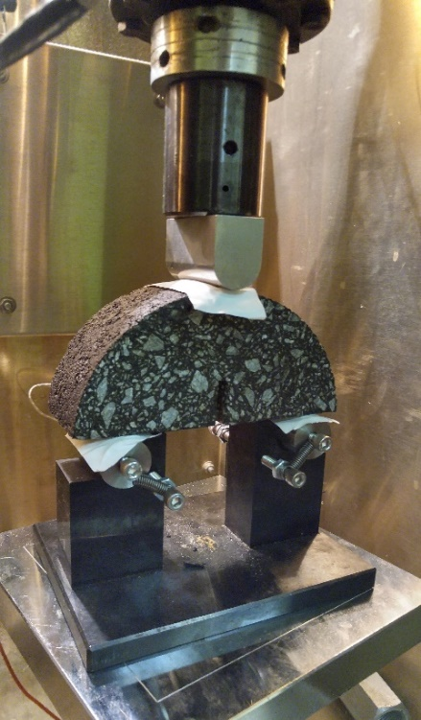
Fatigue Cracking – SCB Flexibility Index
Uses 3-point bending on a semi-circular asphalt sample
Notch cut to initiate cracking
Test evaluates the energy required to fracture the specimen and propagate a crack at the notch
  Work of Fracture
Additional analysis was used to calculate the Flexibility Index (FI)
  Post peak performance

Slide 25
SCB Flexibility Index (FI)
SCB Flexibility Index shows that at a test temperature of 25ºC, Atlantic City Airport mixture more resistance to cracking than Logan Airport

Slide 26

Philadelphia International Airport (PHL)

Slide 27
Objectives
    Determine the response of concrete slabs and asphalt concrete under multi-gear aircraft such as A-350, B-777, etc.
    Compare the performance of concrete slabs and asphalt concrete under aircraft load.
    Evaluate the load transfer efficiency of the joint
    Measure the temperature profile in cement pavement and asphalt pavement. Study the effect of temperature profile on pavement response.
    Evaluate curling in concrete slabs.
    Measure the pressure on top of subgrade and base layer under aircraft load for different pavement structure.
    Characterize the subgrade, base, cement concrete and asphalt concrete materials.

Slide 28
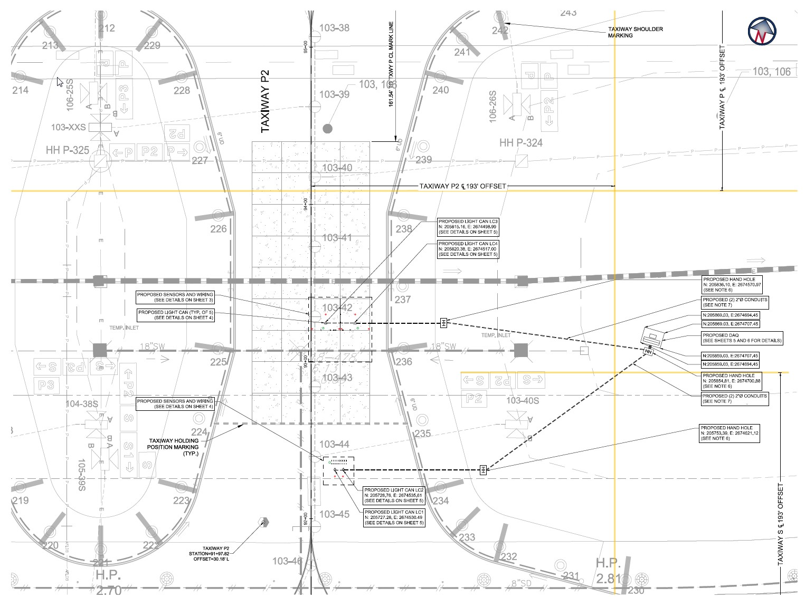

Slide 29
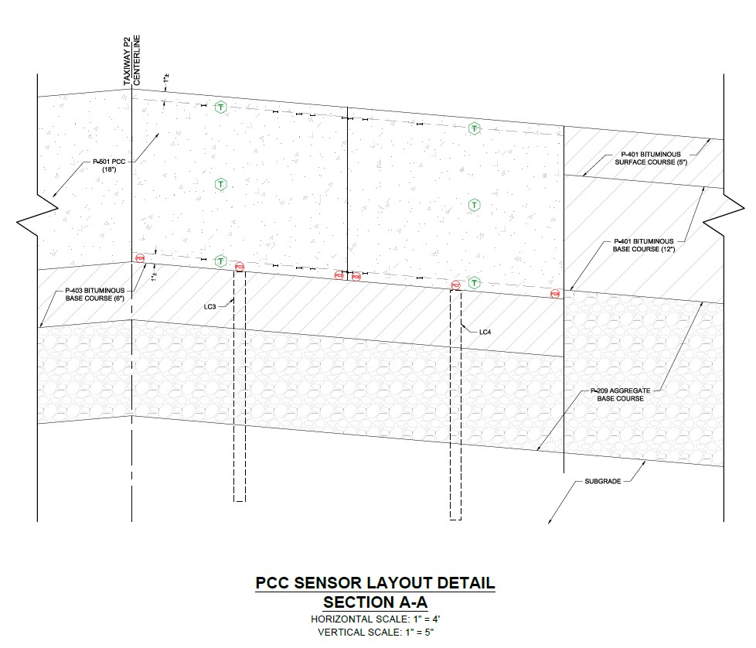
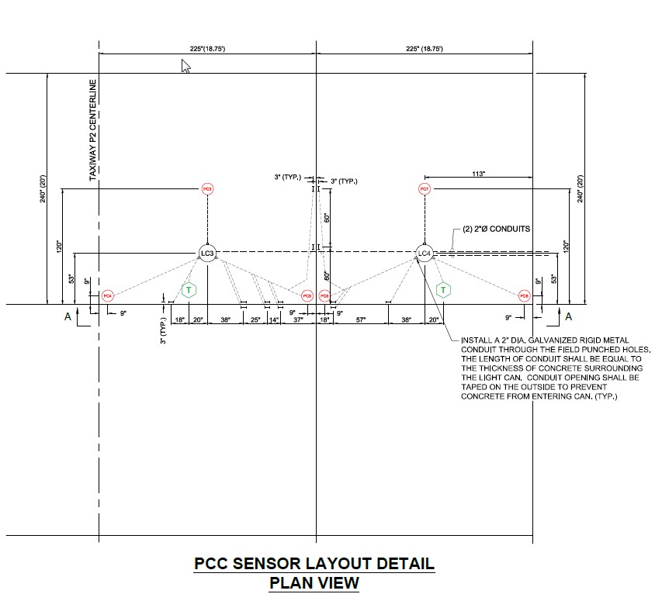

Slide 30
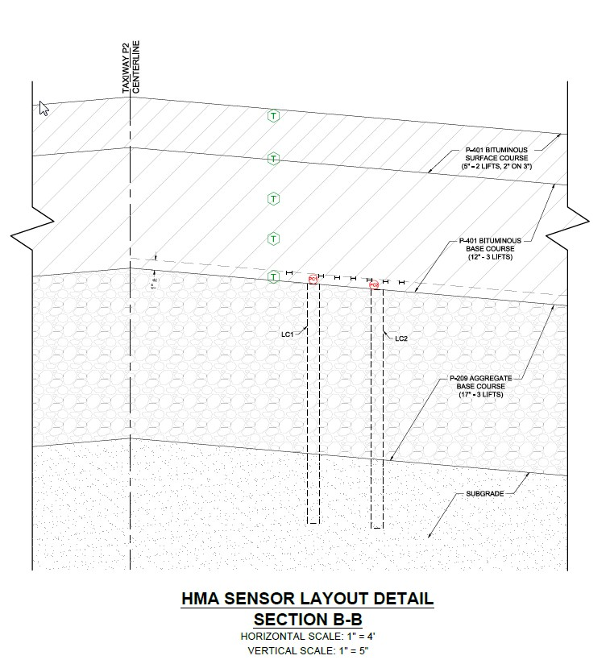
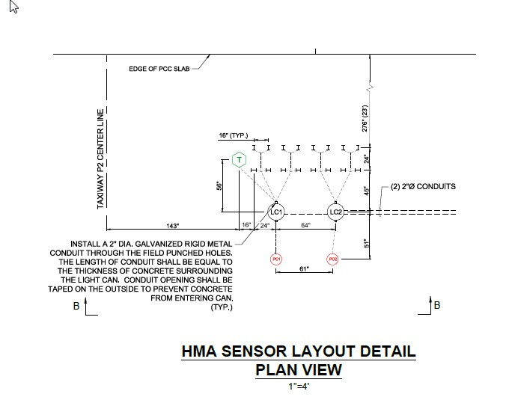

Slide 31
