Slide 1
RPA P4:
Advanced Materials
ANG-E REDAC Committee
Murphy Flynn
March 15, 2017

Slide 2
RPA P4 Advanced Materials
Need
Research Goals
Full scale testing and laboratory testing of modern/advanced pavement technologies for use on airfields
Lab comparison of cracking potential of polymer modified HMA and WMA at colder temperatures for use in full scale testing
Comparison of HMA, PMA, WMA, SMA in the lab and field. (Cape May Research Taxiway and other sites)
Advancements in paving materials and technologies will conserve airport development funds and reduce the downtime of runways from construction and operation and maintenance activities.
FY 2016 Accomplishments
Funding Requirements
Completed Task 1-B and Task 1-C reports for heated pavements under the PEGASAS grants program.
Tested Stone Matrix Asphalt in conjunction with Rutgers University research using FAA’s APA-Airfield
Tested RAP mixes in conjunction with UC Davis research using FAA’s APA-Airfield
Report on use of WMA for airfields
Full Scale Electrically Conductive Concrete at DSM
 | FY 2017 | FY 2018 | FY 2019
Funding Target ($000) | $1,300 | $1,185 | $1,000
P4.1 Heated Pavements | $550 | $440 | $270
P4.2 Geosynthetics | $250 | $260 | $230
P4.3 Advanced Testing | $500 | $485 | $500

Slide 3
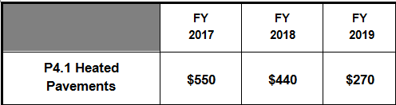
P- 4.1 Heated Pavement Projects
Radiant Heating (Geothermal) for Airfield Pavements – Greater Binghamton Airport
  Professor Bill Ziegler, University of Binghamton
Airport Heated Pavement – PEGASAS – Partnership to Enhance General Aviation Safety, Accessibility, & Sustainability
  Task 1-A: Energy and Financial Viability of Heated Pavement Systems – Finalized 3 Reports
  Task 1-B: Hybrid Heated Airport Pavements – Submitted 2 Reports
  Task 1-C: Potential Use of Phase Change Materials (PCM) to Store Heat in PCCP – 1 Report
  Task 1-D: Advanced Construction Techniques for Heated Pavement Systems
  Task 1-E: Potential Use of Phase Change Material to Store Heat in HMA
  Task 1-F: Feasibility of Using Electrically Conductive Asphalt Cement Concrete
  Task 1-G: Superhydrophobic and Icephobic Materials for Nano-Modified Heated Asphalt
  Task 1-H: Full-Scale Demonstration of Heated Portland Cement Concrete Pavement
    Full Scale (2 Slabs) Implementation Project as DSM
Conductive Concrete for Airfield Heated Pavement
  Dr. Christopher Tuan, University of Nebraska – Lincoln
    Draft Report Submitted – Site Visit

Slide 4
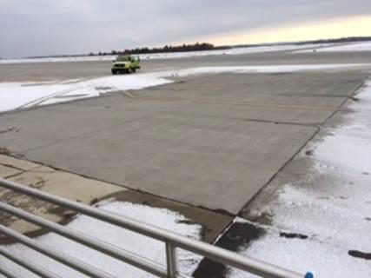
Greater Binghamton Airport
New Grant to be Awarded September 15, 2015
  Optimization of the System
    Optimal Supply Line Temperature Vs. Return Line Temperature
    Optimal buffer tank Temperature
    Pump Cycle Efficiencies
    Vertical Vs Horizontal Well efficiency
  Economic Feasibility Validation
    Establish detailed cost breakdown of construction cost
    Validate the financial viability using the Financial Viability Study created by PEGASAS COE Iowa State
  Establish a Data Management Structure for Raw Data

Slide 5
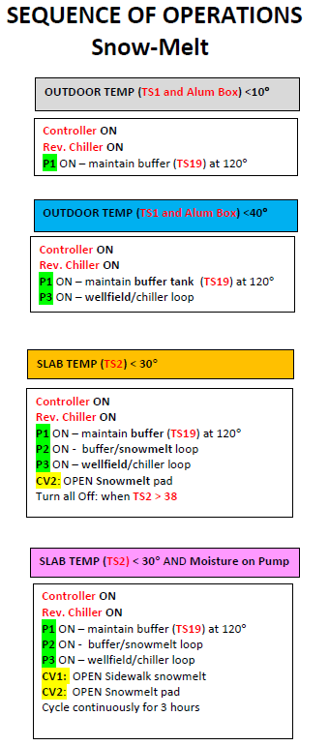
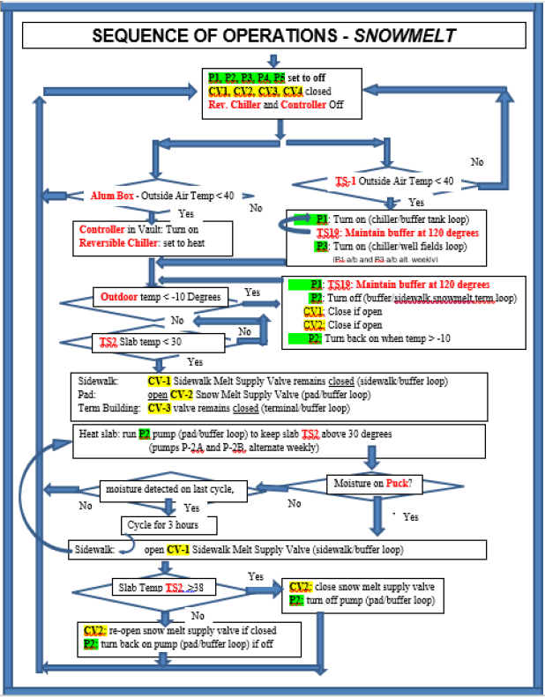
Greater Binghamton Airport
Optimization of the system

Slide 6
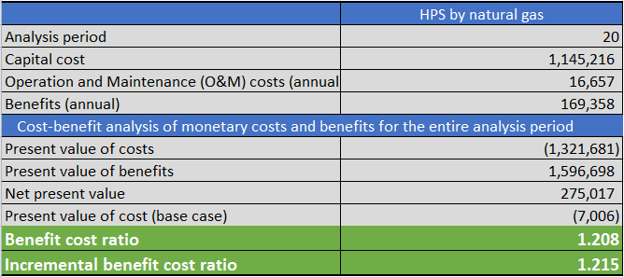
Greater Binghamton Airport
Financial Viability Study Report from PEGASAS (Iowa State)
Actual Data from GBM
GBM provided comments
  Cost associated with housing SRM
  Terminal Cooling Savings
  Utilities to Run System
Above 1.0 = Cost Effective Investment

Slide 7
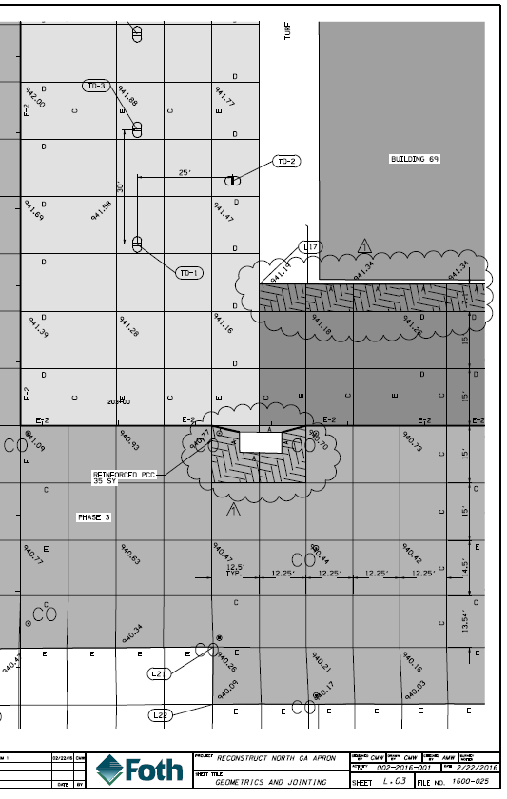
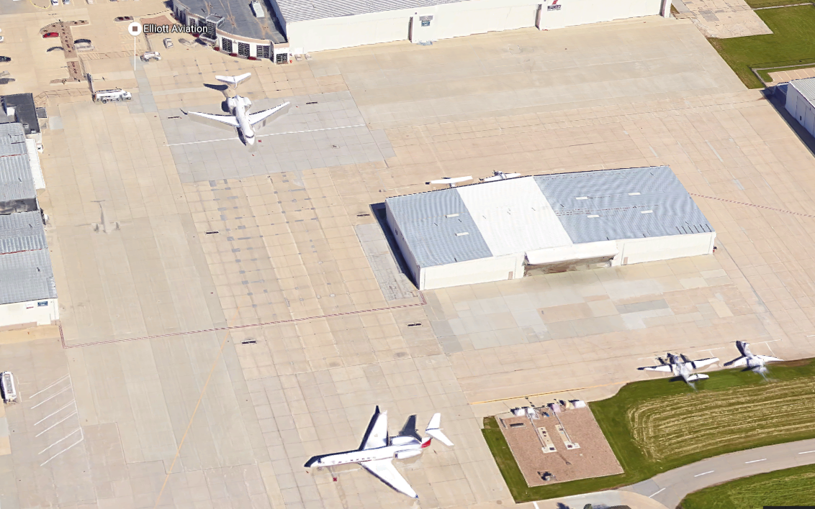
Task 1-H: DSM Conductive Concrete
Iowa State constructed 2 electrically conductive concrete slabs (15’ x 13.5’ x 7.5’’) at DSM airport
Mix Design closely followed our 10-G specifications and construction was completed in November 2017

Slide 8
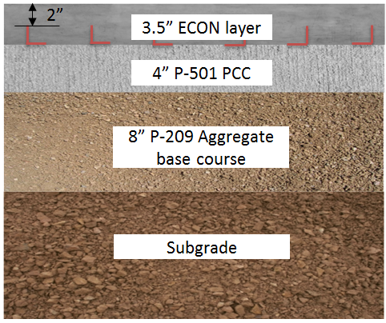
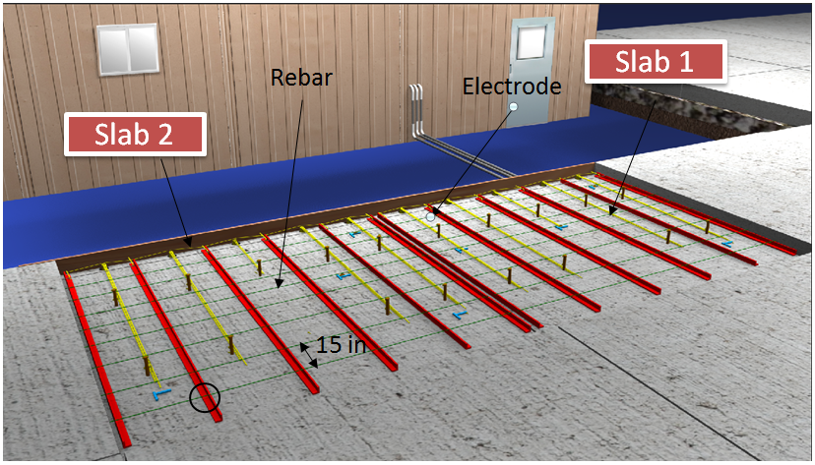
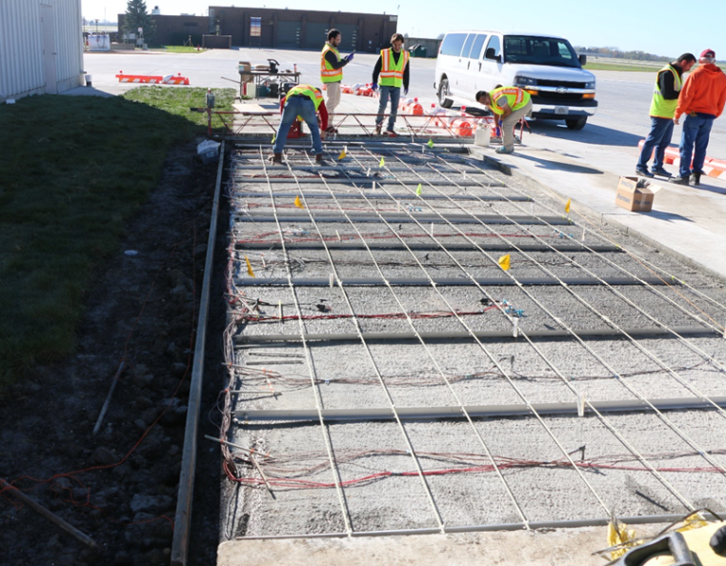
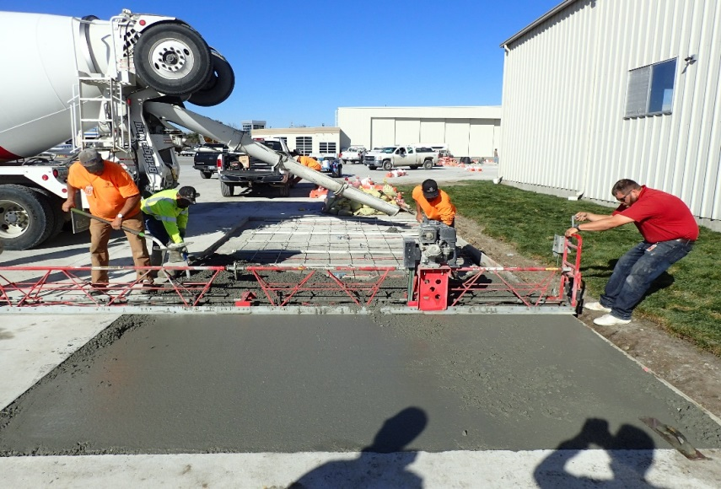
Task 1-H: DSM Conductive Concrete

Slide 9
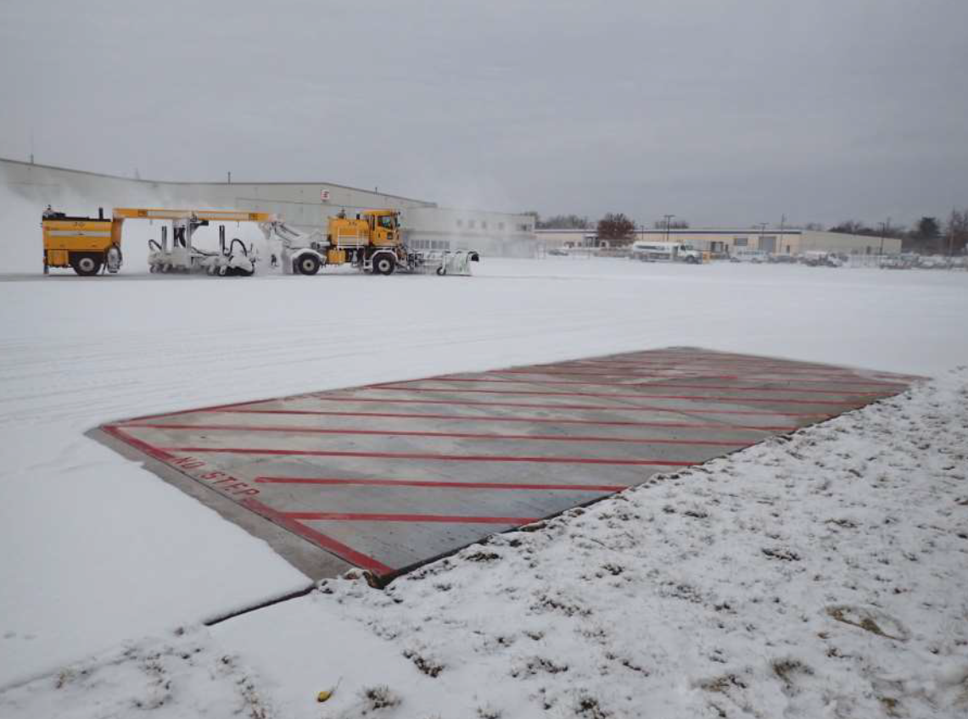
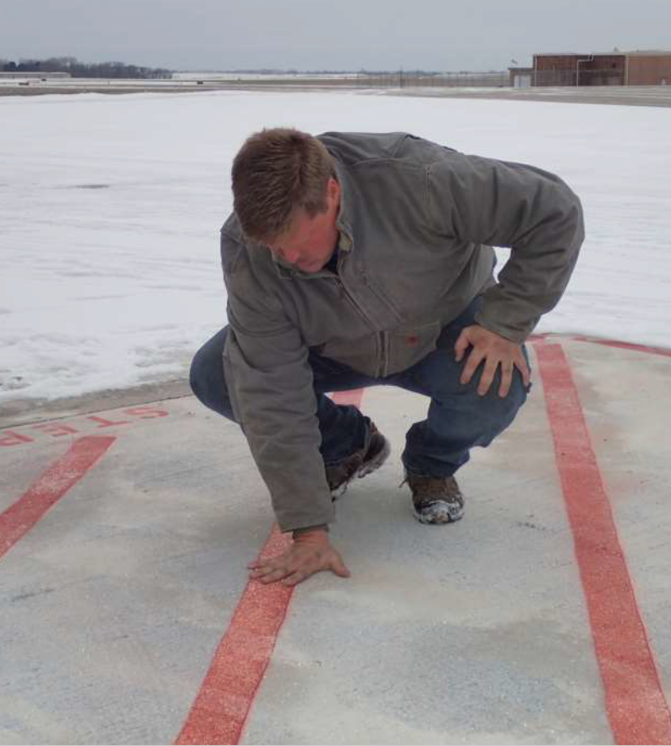
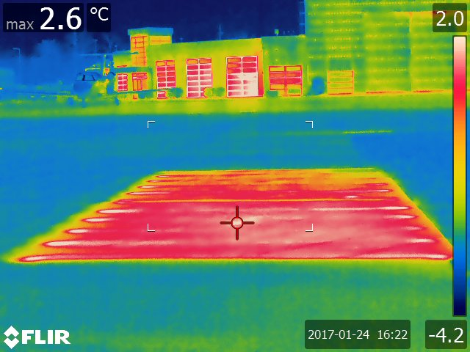
Task 1-H: DSM Conductive Concrete
December 10, 2016: 1.0 inches of snowfall at average 25ºF and 8 mph winds.
System on at 5:40AM to 5:20PM

Slide 10
Task 1-H: DSM Conductive Concrete

Slide 11
Future Heated Pavement Projects
Continue to Monitor Financial Viability of Heated Pavements Systems
Perform Full Scale Implementation of Phase Change Materials
Electrically Conductive Asphalt Concrete for Heated Airfield Pavements
  Snow and ice removal from electrical heating. Health monitoring from sensing capacity and self healing from induction heating
Superhyrophobic and Icephobic Materials for Nano-Modified Heated HMA Pavements
  Mitigate formation of ice crystals by being water-repellent. Self cleaning of asphalt surface layer. Mitigate HMA moisture damage (e.g. stripping)
Focus on Full scale airport heated pavement testing at Airports.
  PCM Concrete slabs at Purdue University Airport.
  Superhydrophobic coatings at DSM Airport.
  Full economic and sustainability analysis of construction, maintenance and operation costs would be performed.
Advisory Circular 150/5370-17 Update
  Larger scale partnerships to construct Heated Pavement systems

Slide 12
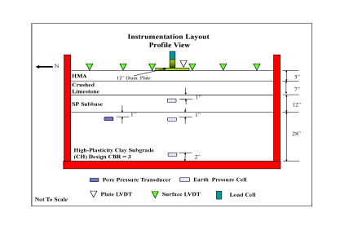
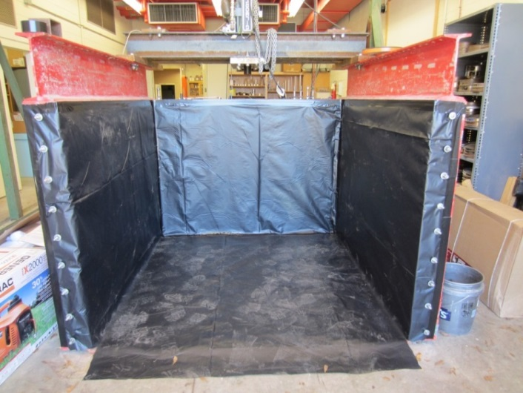
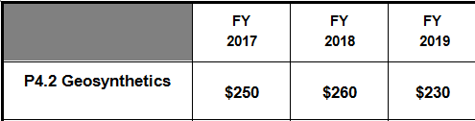
P – 4.2 Geosynthetics
Completed Phase 1 Cyclic Plate Load tests with U.S. Army Corps of Engineers at Vicksburg MS.
  Comments provided to report – Cyclic Plate Testing of Geogrid Reinforced Airport Pavements
  Final draft report to be submitted 1st Quarter FY 17

Slide 13
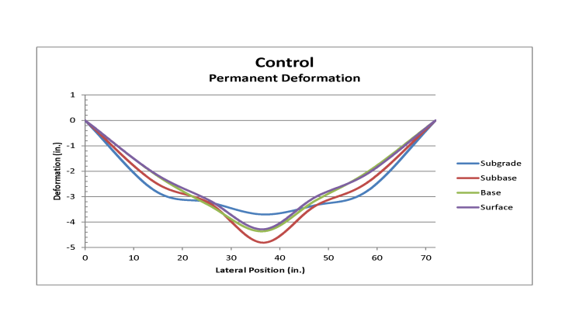
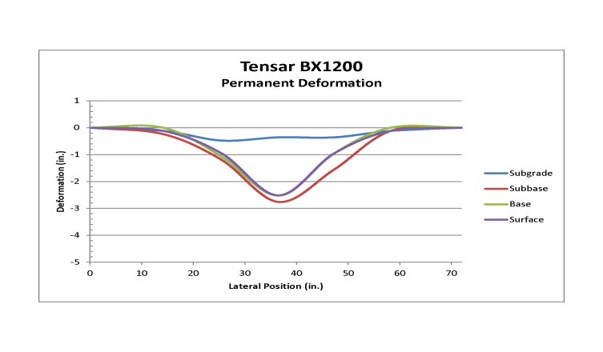
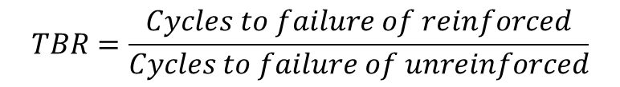
P – 4.2 Geosynthetics
Traffic Benefit Ratio - Defined in AASHTO R 50-09 Standard Practice for Geosynthetic Reinforcement of the Aggregate Base Course of Flexible Pavement Structures
$$TBR=\frac{Cycles to failure of reinforced}{Cycles to failure of unreinforced}$$
ITEM | CYCLES @ 2 in. Deformation | TBR
Control | 1369 | 1.0
TX140 | 4295 | 3.1
BX1200 | 26234 | 19.2
Huesker 30/30 | 34901 | 25.5

Slide 14
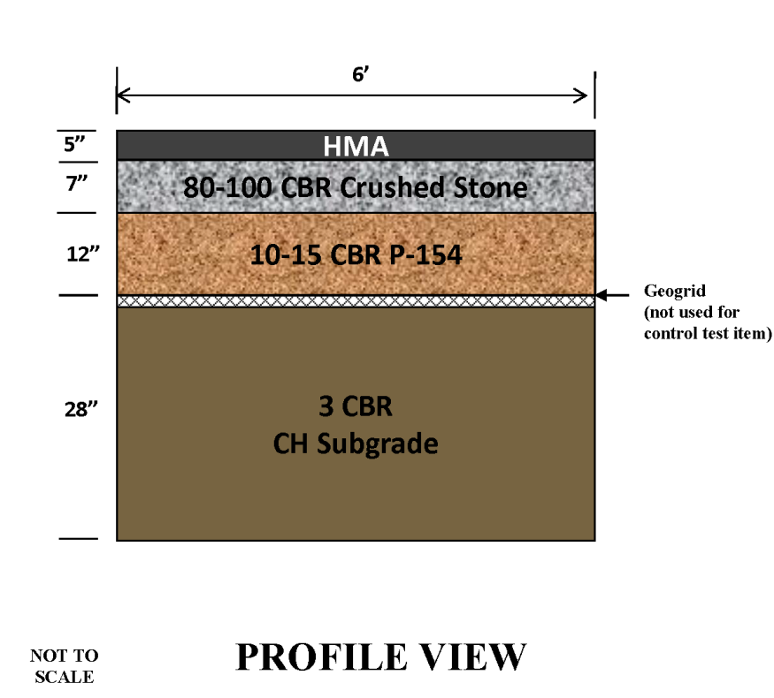
P – 4.2 Geosynthetics
Awarded Phase 2 Cyclic Plate Testing of Geosynthetics
  24-month period of performance
  Geotextiles positioned at subgrade/subbase interface
Materials Selected
  Tensar BX1200
  Tensar TX 140
  Huesker Fornit 40/40
  Tencate RS580i
Quantify Benefit of Material
  Traffic Benefit Ratio
Predictive Models
Recommend Specification

Slide 15

P - 4.2 Geosynthetics
Geosynthetics Materials Association (GMA) – Overview
  Literature Review
    current industry research on applications of Geosynthetics
      Soil Stabilization
      Unbound Aggregate Layer Reinforcement
    Presentation of Literature Review to FAA October 6, 2016
  Establish draft specification for use of Geosynthetics
    Goal - Incorporate into AC 150/5370-10H Update
  Obtain/Analyze data through full scale testing
    Current CC9 design includes two cross-sections with Geotextile/Geogrids
  Modify Specifications for Pavement Design/Construction based on full scale testing results.
    Goal – Include geotextile/geogrid material properties into design software

Slide 16
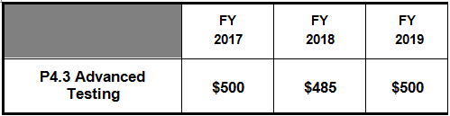
P – 4.3 Operation of Pavement Materials Lab
Maintain AMRL and CCRL Accreditation
  Full Time Lab Manager – P.E.
  2 Full Time Technicians – ACI and NJSAT certs
Provide timely testing of pavement materials for NAPTF and NAPMRC
Provide testing of airport materials for other projects
  PA 40 – Extended Life
  Field Instrumentation
  Non-Destructive Testing
Develop new predictive testing procedures for airport pavement materials

Slide 17

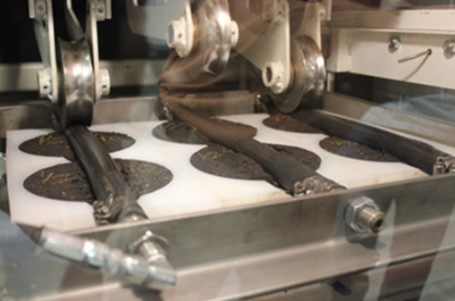
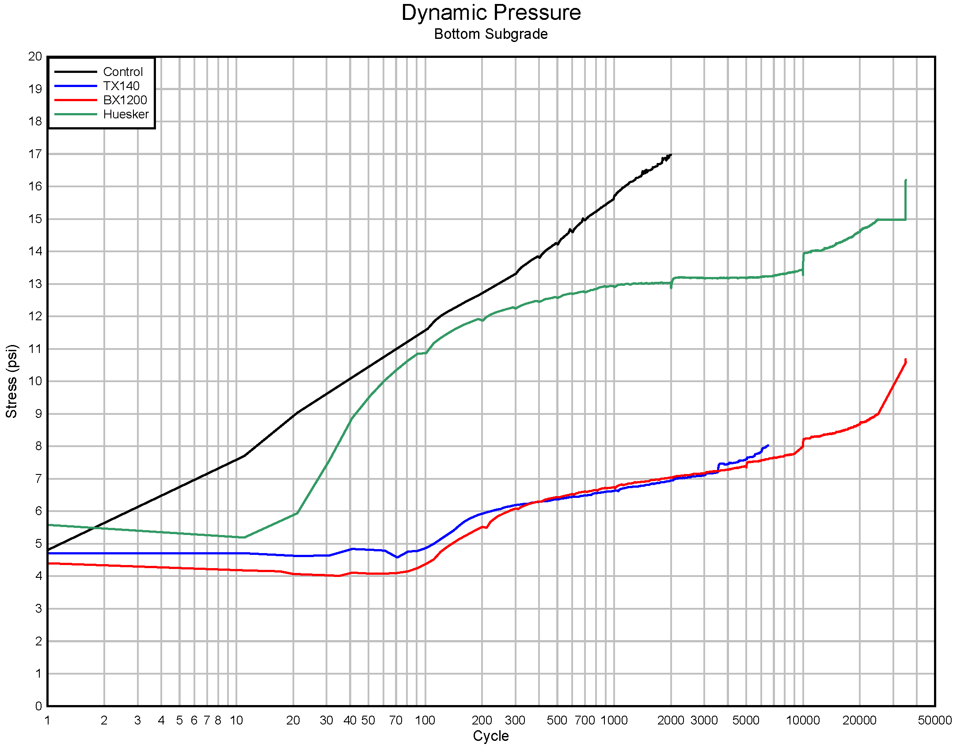
Your Feedback is Encouraged
GBM
Or Questions

