Slide 1
Extended Pavement Life
RPA P8
REDAC Subcommittee on Airports
David R. Brill, P.E., Ph.D.
March 15, 2017

Slide 2
RPA P8 – Extended Pavement Life
Need
Longer design periods for airport pavements, up to double the current standard of 20 years, will provide cost savings to the AIP by reducing lifecycle costs. Extended airport pavement life also provides many green benefits, and minimizes down time at the nation’s busiest airports.
Research Goals
Link PA40 database to historical traffic data sources in ASAIS by FY17.
Develop performance data models (Age-DL and Traffic-DL) by FY18.
Next-generation FAARFIELD program incorporating new 40-year life design procedures by FY22.
FY 2016-17 Accomplishments
Completed field data collection at ATL. Planned for LAX in spring.
Demonstrate PA40 link to NAS runway usage database by April.
Preliminary performance data analysis – papers at BCRRA17.
Funding Requirements
 | FY 2017 | FY 2018 | FY 2019
Funding Target ($000) | 925 | 775 | 790

Slide 3
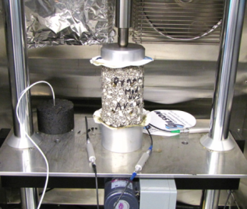
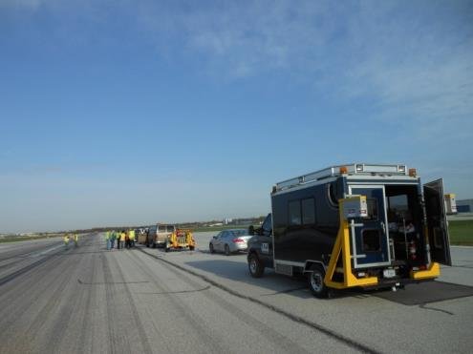
Pavement Life Extension
Runway data collection.
  4-year project – last year.
  Construction and performance data on medium- and large-hub runway pavements.
  Field data collection.
  Current efforts focus on filling known gaps in data.
FAA PAVEAIR database development (PA40).
Pavement life model development.

Slide 4
Updated Runway List
YES
Field work completed 2/23/17

Slide 5
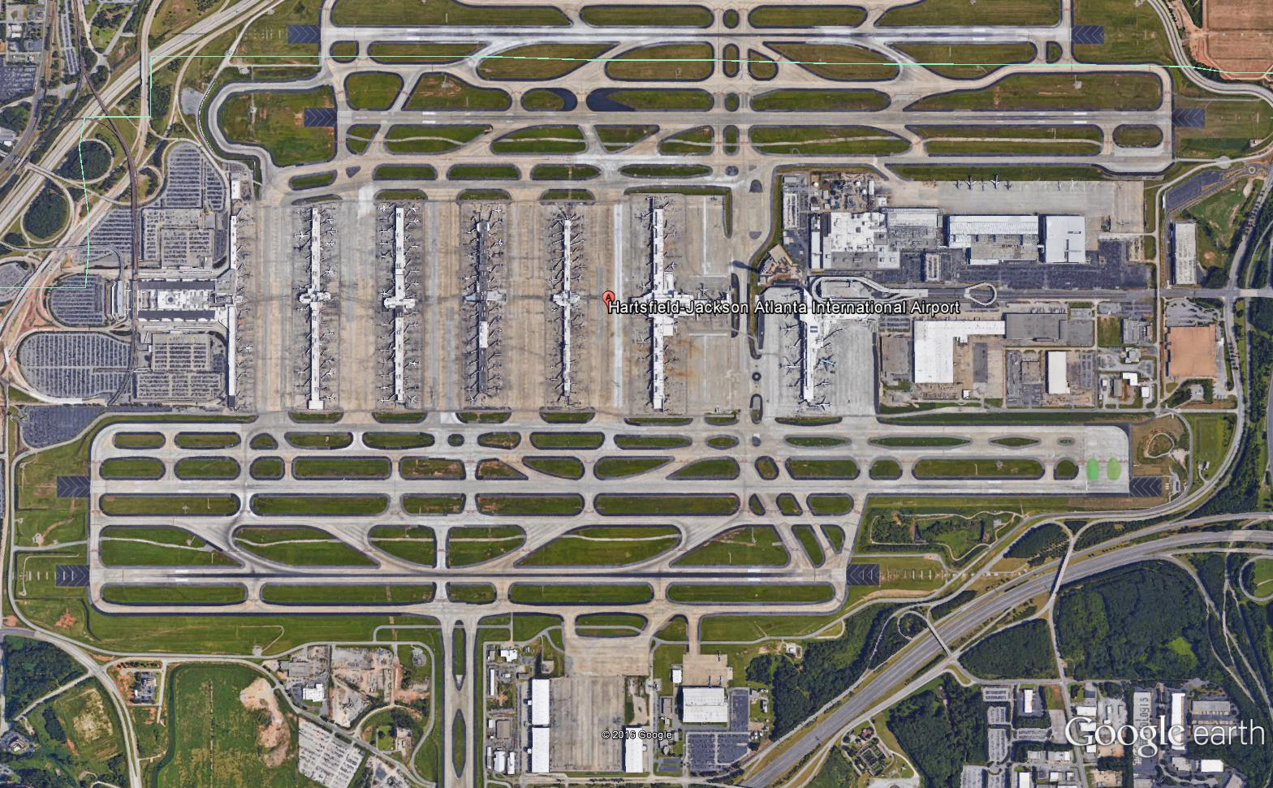
ATL Field Data Collection
February 2016
Performed in conjunction with ATL’s project to update their APMS.
PCI week of Feb. 13.
SurPro profiles Feb. 20.
Inertial profilometer, groove and texture measurements on Feb. 23.
Material samples not collected.
RWY 9L-27R

Slide 6
Additional Data Collected
Contractor contacting airports requesting updated PCI, friction, and roughness records for runways.
Also requested traffic counts prior to 2012 that include runway usage data by aircraft type.
New information received to date:
  Traffic counts prior to 2012 from one runway at DEN and 2 runways at SEA.
  Updated PCI information from 2 runways at SLC and one runway at DEN.
  Friction data for all runways at IAD and GSO.
  Complete quarterly friction test data from BWI (2010 – 2016).

Slide 7
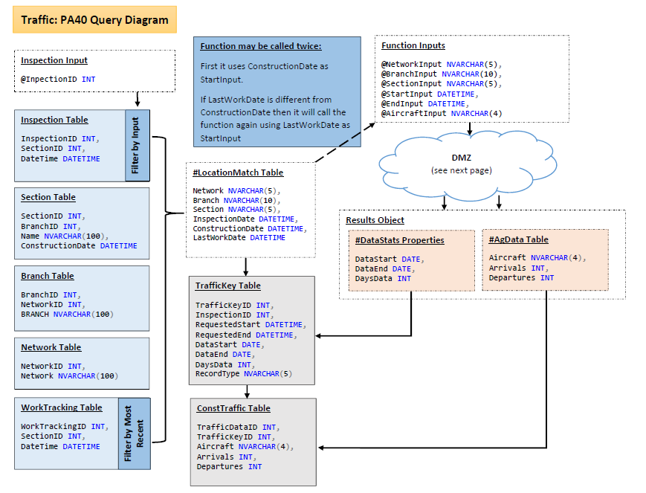
PA40 Traffic Data Integration SQL

Slide 8
PA40 Traffic Data Integration
Search runway usage data by:
  Aircraft type.
  Runway end.
  Arrival or departure event.
Designed to return runway traffic since:
  Construction or major work date.
  Previous inspection date.
Access threaded track data (TTD) via NPN shared services.

Slide 9
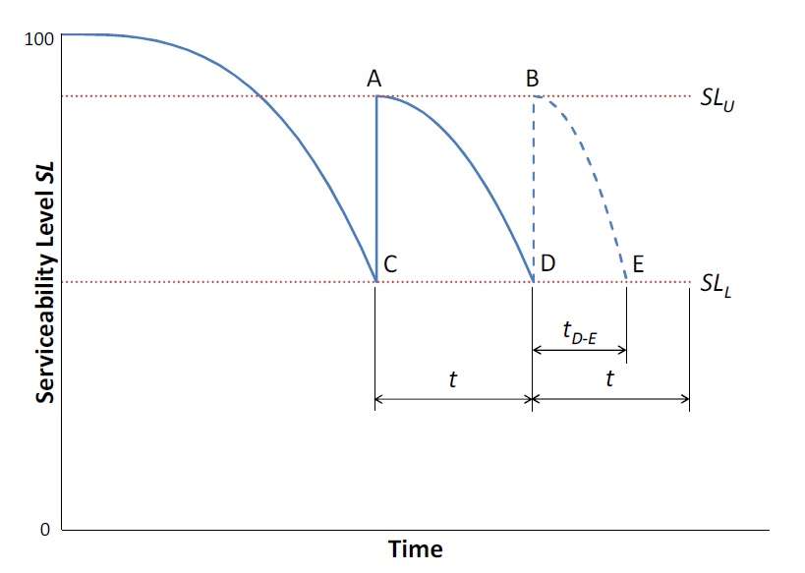

Serviceability Level Concept
Points A and B represent rehabilitations to restore serviceability.
Points C and D represent “end of serviceability.”
Point D also represents “end of life” if:
Goal: find components of SL, and parameters SL_{L}, p such that “end of life” agrees with LCCA-based decision to reconstruct.

Slide 10
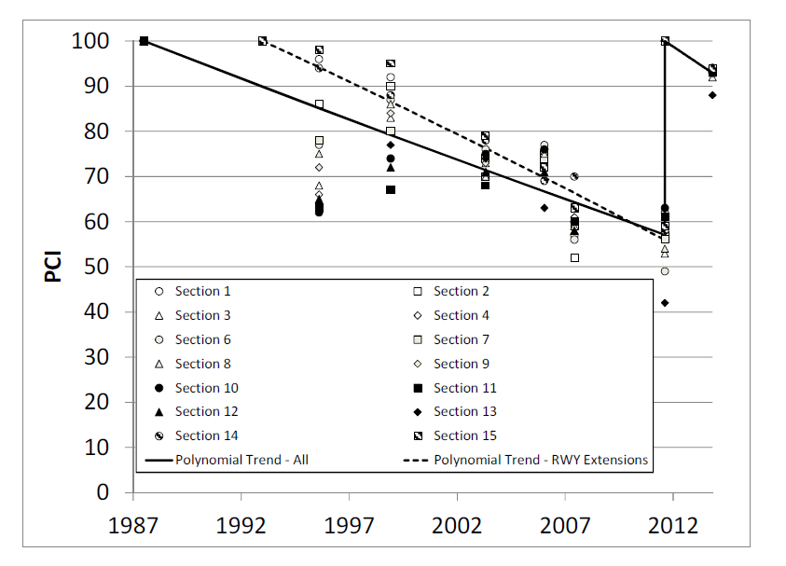
Preliminary Analysis – BWI 10-28
Flexible runway.
  Central sections originally constructed in 1950’s.
  Extended and reconfigured in 1993.
  Full overlay in 2011.
PCI < 60, but elected to rehabilitate not full reconstruct in 2011.
Some sections exhibited structural distress in PCI.

Slide 11
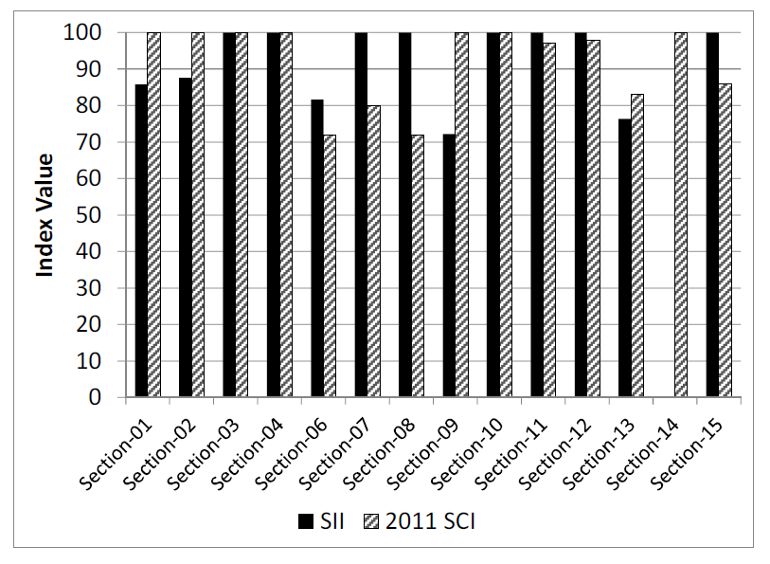
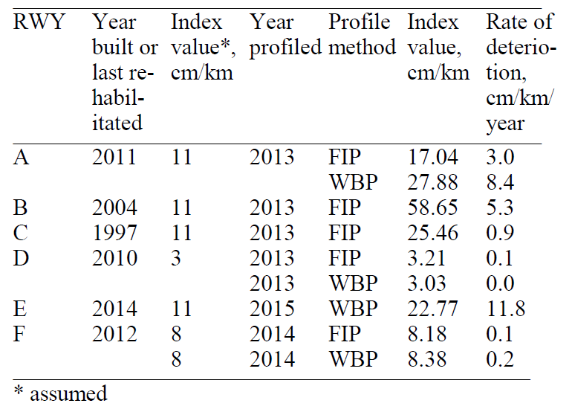
Preliminary Analysis – BWI 10-28
Structural Component
Functional Component
“Anti-SCI”
Groove deterioration
Skid resistance
Profile index:
Flexible “SCI” – Considers only rutting & alligator cracking distresses.
SII – Structural integrity index (ratio of ISM for trafficked & non-trafficked lanes)

Slide 12
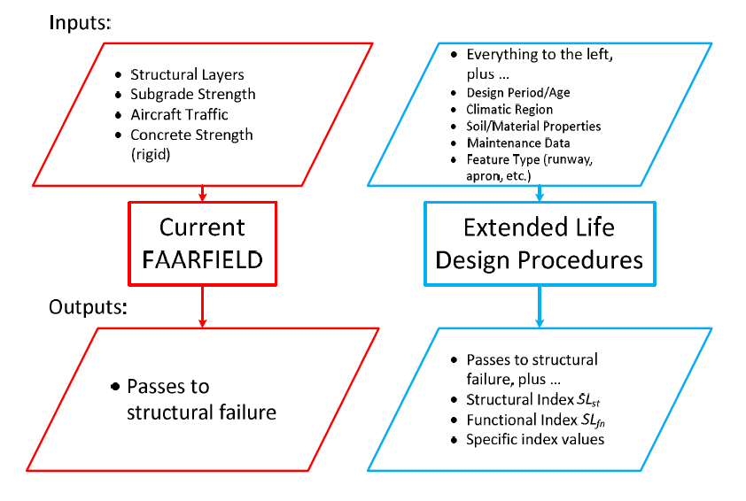
Schematic for Generalizing Design Procedures

Slide 13
BCRRA 2017 Research Papers
Brill & Parsons: Development of New FAA Design Procedures for Extended Airport Pavement Life
Parsons & Brill: Preliminary Analysis of Pavement Life Indicators of Large- and Medium-Hub Airport Runways
Both accepted for presentation at Bearing Capacity of Roads, Railways & Airfields Conference (BCRRA 2017), Athens.

Slide 14
FY17 R&D Efforts
Complete population of PA40 (TUS, MCI, ATL, LAX).
Perform field data collection at one additional runway selected from those currently in the PA40 database (LAX 6R-24L).
Link to existing databases with historical runway traffic (TTD) and climatic data.
Develop new sets of family curves in PA40 (coordinate with RPA P7.1 – FAA PAVEAIR).
  “DL versus age”
  “DL versus applied traffic”
  Look at index components of DL to satisfy end of life definition.

