Slide 1
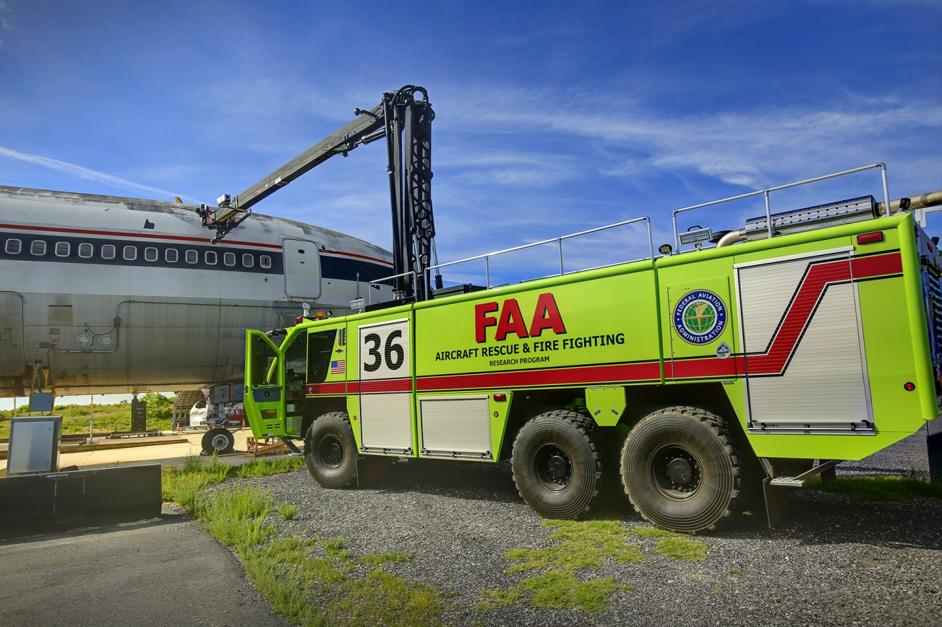
RPA S3
Aircraft Rescue and Fire Fighting
REDAC Briefing
March 14, 2017

Slide 2
RPA S3 – Aircraft Rescue and Fire Fighting
Overview
Need
Research Goals
Develop the first US and international performance based standard for CAFs technology for ARFF vehicles.
Determine the significance of the test variables between Mil Spec and ICAO Level C AFFF performance specifications.
Develop standards for AFFF products with reduced or eliminated PFC content.
Publish report on HRET technology enhancements.
Increase post crash passenger survivability.
Improve current levels of fire fighting effectiveness.
FY 2017 Accomplishments
Funding Requirements
Begin CAFS full-scale testing at Tyndall AFB.
Completed design of new indoor fire test facility.
Complete evaluations on both FLIR technologies and HRET performance studies by end of FY.
 | FY 17 | FY 18 | FY 19
Funding Target ($000) | 2,900 | 2,100 | 1,950

Slide 3
Current Fire Fighting Research Areas
Alternative Aviation Fuels
FLIR Technologies
Compressed Air Foam (CAFS) Technology
Ultra High Pressure Fire Fighting
High Pressure Fire Fighting
HRET Technology Enhancements
Thermal Balance
Foam Proportioner Testing

Slide 4
Today’s Topics
Status of AFFF at US Airports
New Fire Testing Facility

Slide 5














AFFF Availability
Main
Search
Reports
Help
Governing Spec: MIL-F-24385F(1)
The Qualified Product List for the following governing specification was last updated on 19-DEC-2014
Doc
QA FSC QPL Number Governing Spec Doc Date Status
Title
Fire Extinguishing Agent, Aqueous Film-Forming Foam (AFFF) Liquid Concentrate, for Fresh and Sea Water
QPL Notes
Preamble Footnotes
SH 4210 QPL-24385 MIL-F-24385 05-AUG-1994 Active
Search > QPL > Government Parts > Manufacturer Parts
Based on the selected QPL above, Filter for: Filter by:
Based on the selected Government Part to the left, Filter for: Filter by:
--NONE--
--NONE--
Total part count = 2
Click on the appropriate link to see more. If not link, no qualified
source.
Green - Source is Certified, Yellow - Source is due for Certification, Red - Source is overdue for Certification. Contact QA for additional information. Total part count = 4 Click on the appropriate link to see more.
Page 1 of 1 1
Go to Page
Mfr Designation Source Name
CAGE Related
AER-O-WATER 3- EM
KIDDE FIRE FIGHTING, INC.
180 SHEREE BOULEVARD STE 3900
EXTON, PA 193411304 USA
http://kidde-fire.com
Test Reference: NRL Rpt. 6180-752A:CRF
Code Links
11939
[source POC]
Govt Designation
TYPE 3
TYPE 6
NSN
Spec Sheet
CSI Notes
[source
Plants]
Page 1 of 1 1
Go to Page
BUCKEYE 3% BFC-3MS AFFF BUCKEYE FIRE EQUIPMENT COMPANY, INC
110 KINGS RD
KINGS MOUNTAIN, NC 280862090 USA
57658
[source POC]
[source
Plants]
Test Reference: Test Rpt NRL 6180A:RS Dtd 20 Oct 2003, DCMA, Atlanta Ltr Dtd 12 Nov 2003
TYCO FIRE PRODUCTS LP
TYCO FIRE PROTECTION PRODUCTS
1 STANTON ST
MARINETTE, WI 541432542 USA
Fall 2015 Status
CHEMGUARD 3% AFFF C- 301MS
03670
[source
Plants]
TRIDOL M 3%
Test Reference: NRL Rpt. 6180-0047A:FWW 30 January 1997
KIDDE FIRE FIGHTING, INC.
180 SHEREE BOULEVARD STE 3900
EXTON, PA 193411304 USA
http://kidde-fire.com
Test Reference: NRL Rpt. 6180-0103A, 18 Feb 1994
11939
[source POC]
[source
Plants]
Page 1 of 1 1
Go to Page

Slide 6
Environmental Effects of AFFF
Brief History
Perfluorinated Surfactants
PFOS – 3M stopped production around 2002.
  Are all other AFFF’s going away?
  Tech Center program for replacements initiated.
PFOA – All other manufacturers.
  EPA backed off these chemicals.
  Tech Center program slowed.

Slide 7
Environmental Effects of AFFF
Carbon Chains
Long-chain carbons – C8 and above, break down to PFOA
Short-chain carbons – C6 and below, do not break down to PFOA
  Not new, Ansul has 95% C6 AFFF since 1970’s
EU 25ppb PFOA
NavSea – considering limiting PFOA amounts in Mil Spec
New C6 AFFFs do not have PFOA as an ingredient but may be evident as a “contaminant” of other chemicals in the process.

Slide 8
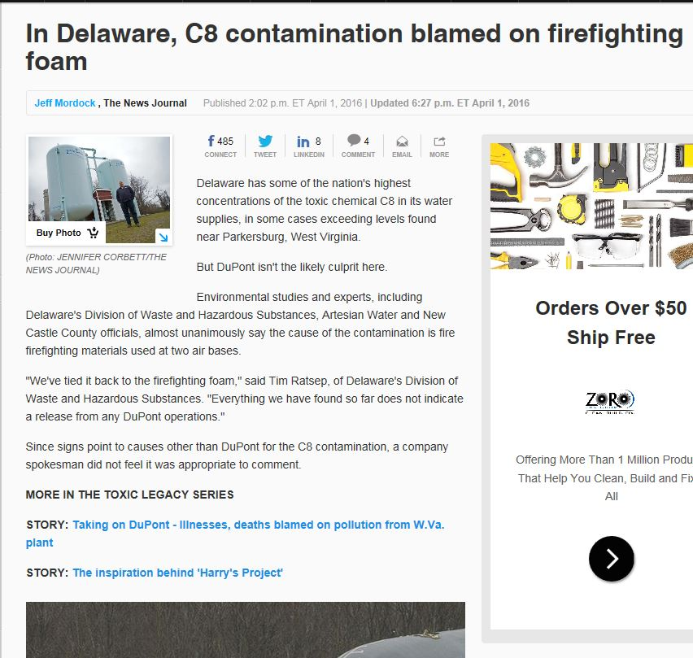
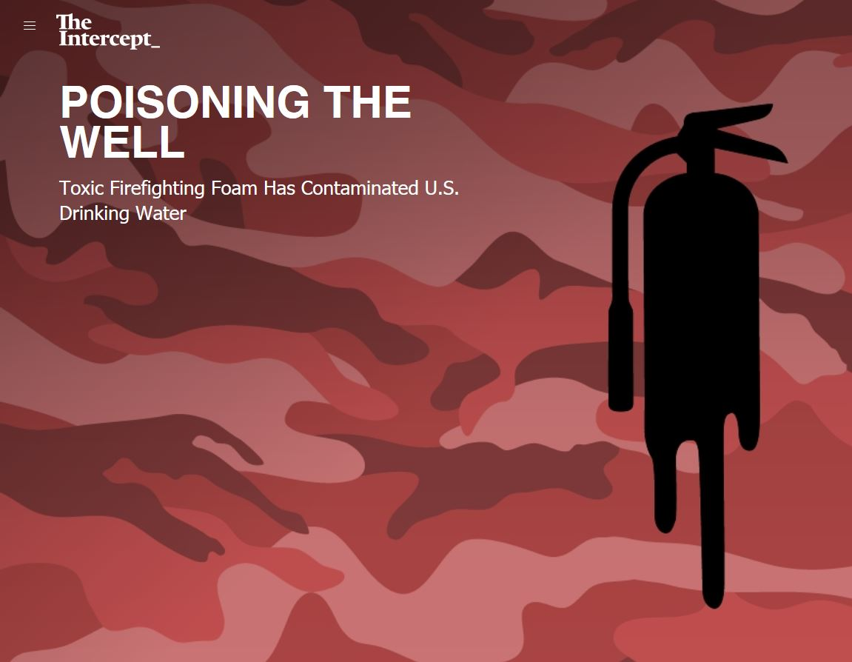
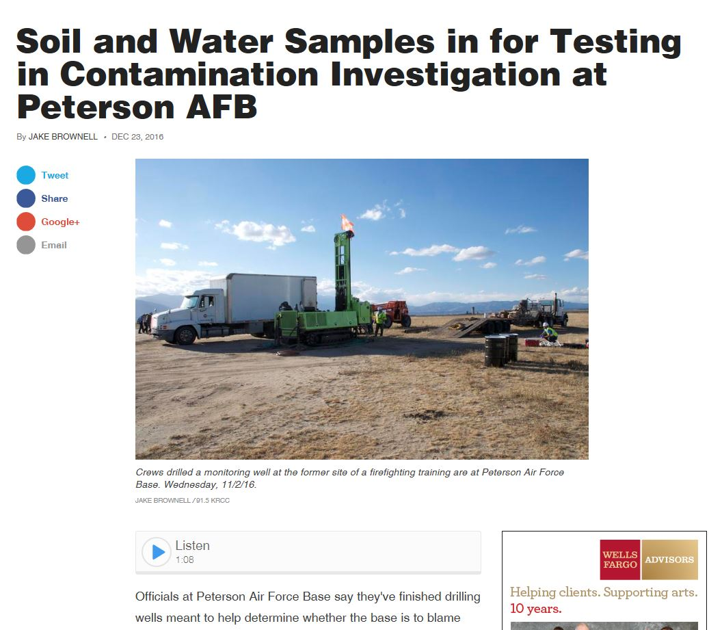
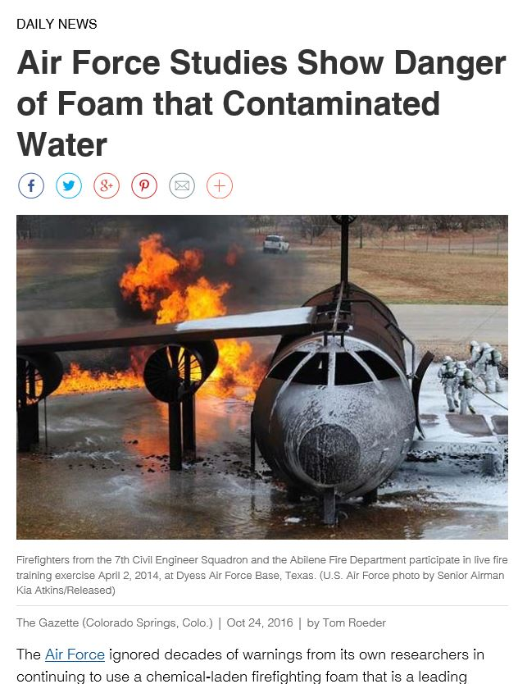
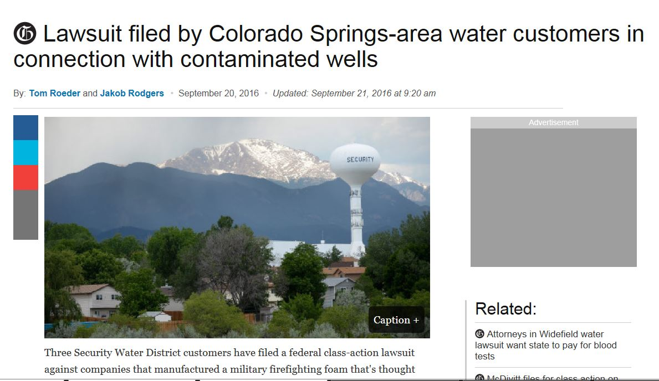
PFC Contamination Headlines

Slide 9
Environmental Effects of AFFF
Current litigation/bans in place
Current litigation related to PFCs (USAF / Municipal Water)
  Oscoda, MI
  Pennsylvania’s Bucks and Montgomery Counties
  Barnstable County, MA
  Peterson Air Force Base, CO
There are several different states which are looking into PFOAs and PFOSs being found in the ground water in and around airports. One state in particular is NY. NY is currently undergoing actual rule making on this issue. NY is the only state which I have heard going to this extent.

Slide 10
Environmental Effects of AFFF
USAF Solution

Slide 11
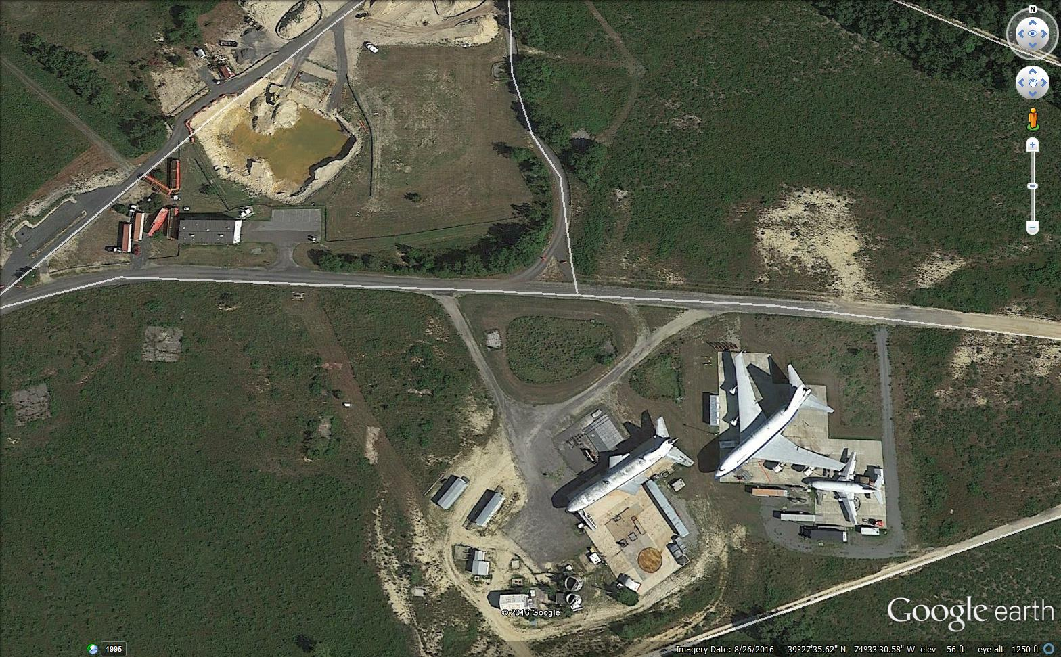
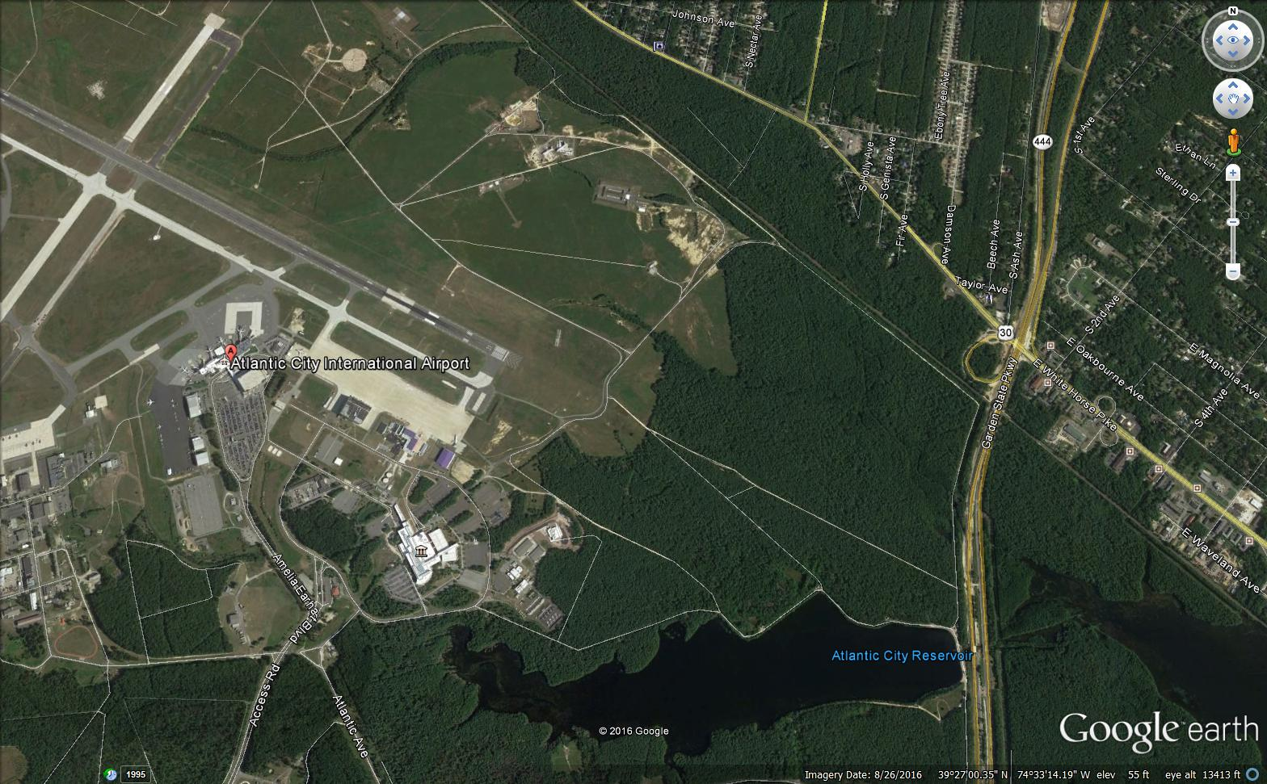
Environmental Effects of AFFF
Current Tech Center testing restrictions
  Major PFC restrictions on the base.
  Brief 4 month shut down of ARFF research fire test pad
  SOP changes in chemical handling, facility wash-down and test wastewater collection.

Slide 12
Environmental Effects of AFFF
What AFFF alternatives are currently available?
None. Mil Spec requirement leads us to using AFFFs with trace amounts of PFCs.
Changing the requirement for use of Mil Spec would mean a reduction in safety.

Slide 13
Environmental Effects of AFFF
What research has been done already?
Some testing at NRL-CBD.
Outdoor facility with minimal data acquisition.
Product demos of alternative agents with none showing promise.

Slide 14
Environmental Effects of AFFF
What research would need to be done in the short-term to find other viable AFFF products?
No short term solutions.
  Limited labs large enough for the required testing.
  None capable of handling the chemical waste collection necessary from this type of testing.
  We would have to fund modifications to existing labs.
  Time for modifications and working with their scheduling would prohibit a short term solution.

Slide 15
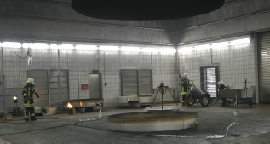
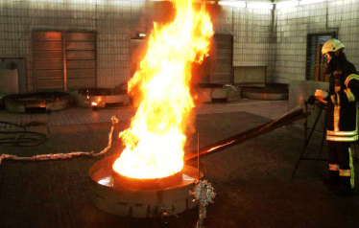
New Fire Test Building
Tests to be performed:
  New FF Agents
    Environmental
  Alternative Fuels
    Heat Release Rate (HRR)
  Composite Materials
    Agent Quantities
  Mil Spec / ICAO Protocols

Slide 16
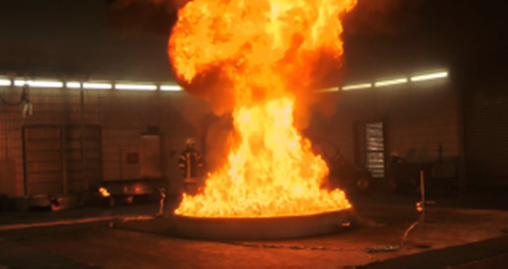
New Fire Test Building
The instrumented section shall consist of:
  gas temperature thermocouples
  calorimeters
  pressure probe
  gas sampling probe
  smoke density meter.
The hood calorimeter will be capable of accurately measuring the heat release rate of a 15 MW hydrocarbon pool fire (10’ Dia., ICAO Level C).
Building will have color and FLIR video camera array.

Slide 17
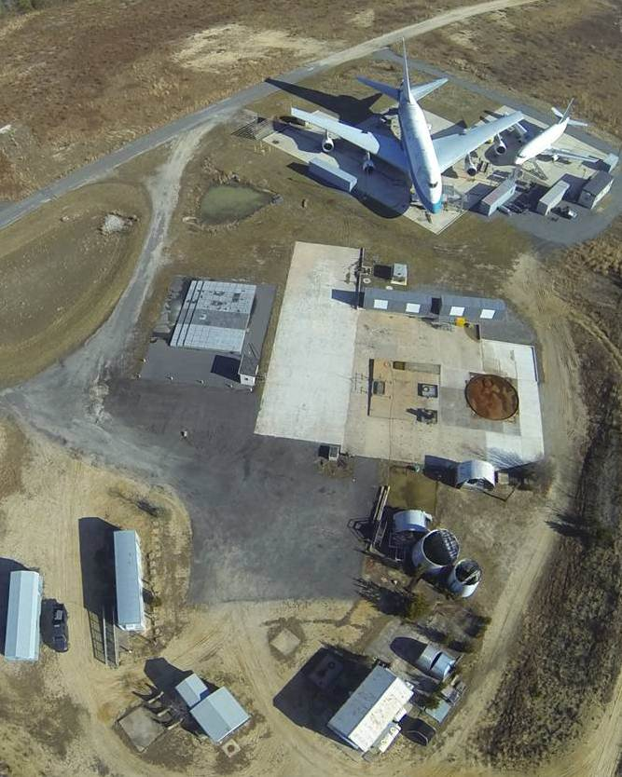
Status
FAA TC MPSB approval received May 19, 2015.
FAA 7460 obstruction evaluation approved July 22, 2015.
Completed study on potential emission control levels and state permitting December 2015.
NJ DEP ruled no emission control system required March 24, 2016.
Currently in architectural design phase (50% completed Feb. 2017)
Anticipate construction contract award by end of FY 17.
1011 Test Aircraft
Office Trailer
Storage Shed
Pump House

Slide 18
New Fire Test Building Design

Slide 19
New Fire Test Building Design

Slide 20
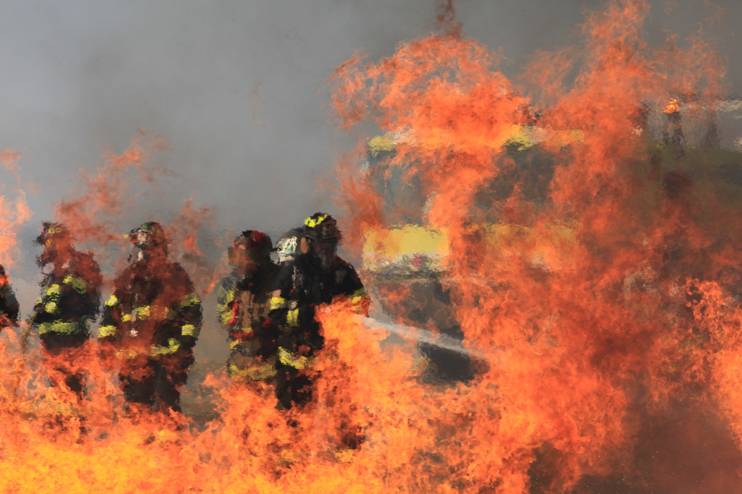
Questions?

