Slide 1
RPA S9
Cape May Research Taxiway
REDAC March
Murphy Flynn
March 15, 2017

Slide 2
RPA S9 Airport Research Taxiway
Need
Research Goals
The FAA's Research Taxiway provides researchers with a single site to design, test, evaluate, monitor, and report on the performance of state-of-the-art airport safety and pavement technologies on a continual basis.
Conduct Airport Safety and Pavement Research Efforts in an Operational Environment, close to the Tech Center
Test bed for airport: signage marking, lighting, electrical infrastructure, safety and security sensors and pavement technologies.
FY 2017 Planned Milestones
Funding Requirements
Construction Completed – Spring 2017
Electrical Infrastructure Research Team Testing
RPA S4 – Airport Research Taxiway | FY17 | FY18 | FY19
 | $ 350,000 | $ 100,000 | $ 100,000

Slide 3
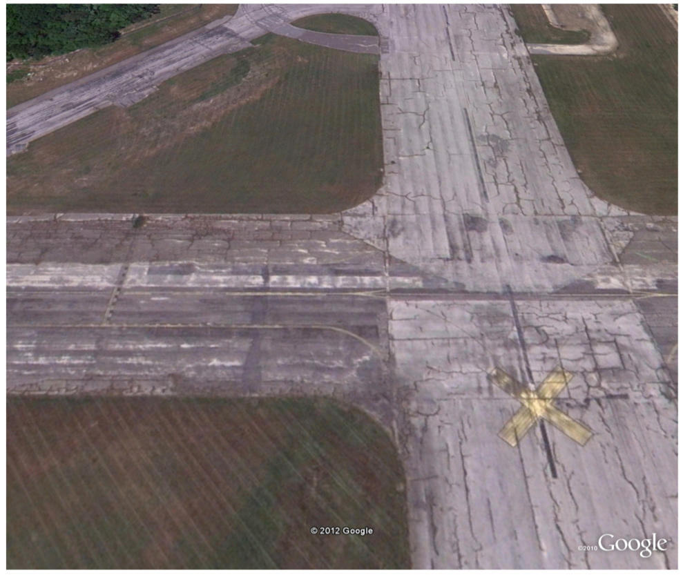
Project Scope
Rehabilitation of 3,250 ft. of TW C between TW B and RW 10-28
Paving and Lighting
Equip the TW with State of the Art Lighting Control System
Lighting Controls can be turned over to DRBA when FAA not conducting Research.
TW C
RW 14-32

Slide 4
Paving Layout
Legend
PG 76-22 Marshal P-410
PG 64-22 Marshall P-401
PG 64-22 Superpave P-401
WMA (PG 76-22) P-401
Stone Matrix Asphalt
NJ State Mix
Electrical Vault
Pavement Sensor Strips

Slide 5
WWD Taxiway C Update
Memorandum of Agreement between FAA and Delaware River and Bay Authority (DRBA).
November 15, 2010 through September 30, 2030.
Grants the FAA the “right to construct, operate and maintain Research Infrastructure” at Cape May County Airport (WWD) in Erma, NJ

Slide 6
WWD Taxiway C Update
Paving completed December 2016
Lighting infrastructure completed February 2017
System commissioning February 24, 2017
Scheduled turnover to Government March 2017

Slide 7
WWD Taxiway C Update
Standard TW Edge lights – Tied to DRBA cabinet for their control when FAA not on site

Slide 8
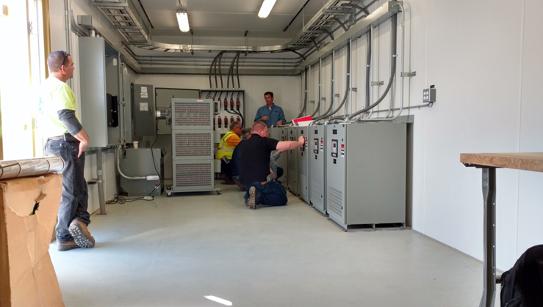
WWD Taxiway C Update
Electrical Infrastructure designed with many-fold spare capacity to run parallel circuits independently.
Oversized electrical vault with room to add systems and devices
Six standard L829 Regulators to power lighting systems

Slide 9
WWD Taxiway C Update
No research light fixtures currently installed, cans in place for:
In Pavement CL Lights
Elevated RW Edge Lights
Two CL Radii configurations at old RW 14-32 intersection
Take Off Hold Lights
Standard RW Entrance Lights
Short Configuration RW Entrance Lights
In Pavement RW Guard Lights
Elevated RW Guard Lights
TDZ Lights
Clearance bar

Slide 10
WWD Taxiway C Update
All field service panels have fiber- Ethernet to communicate directly back to vault – and 120 V outlets
Allows sensors to be put in line to monitor circuits from multiple locations

Slide 11
WWD Taxiway C Update
Numerous empty sign pads for experimental signs.

Slide 12
Safety Research Plans
Support Electrical Infrastructure Research Team (EIRT)
Vault Centric LED Lighting Circuit Architecture
Fixture Centric Architecture Research
Currently being conducted at Purdue University
Bring Research here for more access

Slide 13
Safety Research Plans
Test Bed for Visual Guidance Research
LED and other lighting innovations
Signs and Paint Markings
Runway Surface Safety Research
Friction:
Evaluation of various pavement surfaces over time
Testing of various devices
UAS - Currently an FAA approved test site

Slide 14
Pavement Research Plans
Field Characterization Tests During Construction
Characterize the base and asphalt concrete materials.
Establish the baseline for the environmental effect tests
Verify the binder grade of asphalt used in each mixture
Evaluated the uniformity of the pavement structure.

Slide 15
Pavement Research Plans
Laboratory Characterization
Measure the asphalt mixture properties such as the modulus, rutting resistance and cracking resistance using laboratory tests.
Verify the binder grade of asphalt used in each mixture

Slide 16
Pavement Research Plans
Investigate the effect of environment and aging on asphalt concrete
Utilize HWD, PSPA and strain gauge response under HWD
Evaluate temperature effects on the HWD, PSPA and strain gauge response tests
Develop temperature correction approaches to convert all test results to reference temperature.
Measure the temperature profile in asphalt concrete.
Evaluate the influence of temperature profile on the strain gauge response.

Slide 17
Pavement Research Plans
Field Core Aging Tests
Evaluate the environmental effect on asphalt mixture properties such as the modulus, rutting resistance and cracking resistance using laboratory tests.
Evaluate the environmental effect on asphalt binder using recovered binder from field cores.

Slide 18
Cape May Research TW
Murphy Flynn
Murphy.Flynn@faa.gov

