Slide 1
FAA Office of Environment and Energy (AEE) Research Overview
Presented to: E&E REDAC Subcommittee
By: Dr. Jim Hileman Office of Environment and Energy Federal Aviation Administration
Date: August 6, 2015

Slide 2
Outline
Refresher on AEE Research
New materials
Greening Aviation Banners
U.S. Aviation GHG Emissions Reduction Plan
Websites
Budget summary
Summary

Slide 3
Aviation Environmental Challenges
NOISE AIR QUALITY WATER QUALITY ENERGY GLOBAL CLIMATE
Aviation impacts community noise, air quality, water quality, energy usage, and climate change
Environmental impacts from aviation could pose a critical constraint on capacity growth

Slide 4
Vision and Principles
Vision:
Environmental protection that allows aviation growth
Guiding Principles:
Limit and reduce future aviation environmental impacts to levels that protect public health and welfare.
Ensure energy availability and sustainability.
Want increased mobility with reduced environmental impacts and enhanced energy availability and sustainability
Aviation E&E Policy Statement (Federal Register 77-141, 2012): http://www.faa.gov/about/office_org/headquarters_offices/apl/environ_policy_guidance/policy/media/FAA_EE_Policy_Statement.pdf

Slide 5
Environment & Energy Goals
Aspect | Goal
Noise | Reduce the number of people exposed to significant noise around U.S. airports in absolute terms, notwithstanding aviation growth, and provide additional measures to protect public health and welfare and our national resources (Population exposed to DNL 65 in 2018 is 300,000 people).
Air Quality | Achieve an absolute reduction of significant air quality health and welfare impacts attributable to aviation, notwithstanding aviation growth.
Energy | Improve National Airspace System (NAS) energy efficiency and develop and deploy alternative jet fuels for commercial aviation.
Climate | Limit the impact of aircraft CO2 emissions on the global climate by achieving carbon neutral growth by 2020 compared to 2005 (2020 CO2 emissions equal to 2005 levels), and net reductions of the climate impact from all aviation emissions over the longer term (by 2050).
Aviation E&E Policy Statement (Federal Register 77-141, 2012): http://www.faa.gov/about/office_org/headquarters_offices/apl/environ_policy_guidance/policy/media/FAA_EE_Policy_Statement.pdf

Slide 6
AEE Research Overview
Characterize the Problem and Assess Risk:
Improve our scientific understanding of E&E constraints
Incorporate this scientific knowledge into an integrated tool suite that can characterize the system, assess the risk and inform development of potential mitigation options
Develop mitigation solutions:
Airframe and engine technologies
Sustainable alternative jet fuels
Clean, quiet and energy efficient operational procedures
Environmental standards and policy measures
Manage system performance:
Integrated analysis that engages a wide range of stakeholders to understand the current and future state of the aviation system
Utilize knowledge to provide guidance on system-wide environmental improvements

Slide 7
New Greening Aviation Banners

Slide 8
Greening U.S. Aviation (1 of 3)

Slide 9
Greening U.S. Aviation (2 of 3)

Slide 10
Greening U.S. Aviation (3 of 3)

Slide 11
Environment and Energy Strategy

Slide 12
PILLAR 1: Improved Scientific Knowledge and Integrated Modeling
Decision-making based on solid scientific understanding
Work with research community through the Aviation Sustainability Center (ASCENT)
Understand public health and welfare impacts
Incorporate this knowledge within the Aviation Environmental Tool Suite

Slide 13
PILLAR 2: New Aircraft Technologies
Offer the greatest opportunity to reduce environmental impacts
Partner with industry, research community, NASA, and Department of Defense
Mature new engine and airframe technologies through the Continuous Lower Energy, Emissions and Noise (CLEEN) program

Slide 14
PILLAR 3: Sustainable Alternative Aviation Fuels
Reduce environmental impacts, enhance energy security, and provide economic benefits
Collaborate with stakeholders through the Commercial Aviation Alternative Fuels Initiative (CAAFI)
Test alternative jet fuels to ensure they are safe for use through ASCENT and CLEEN
Analyze their potential for reducing the environmental impacts of aviation

Slide 15
PILLAR 4: Air Traffic Management Modernization and Operational Improvements
Increase efficiency of aircraft operations through the Next Generation Air Transportation System (NextGen)
Engage with industry, research community, NASA, and Department of Defense
Develop advanced operational procedures to optimize gate-to-gate operations
Integrate infrastructure enhancements to the National Airspace System (NAS), improving environmental performance

Slide 16
PILLAR 5: Policies, Environmental Standards, and Market Based Measures
Implement domestic policies, programs, and mechanisms to support technology and operational innovation
Develop and implement aircraft emissions and noise standards
Work within the International Civil Aviation Organization (ICAO) to pursue a basket of measures to address emissions that affect climate, including a global market based measure as a gap filler
Seek international partners to further our environmental and energy strategy

Slide 17
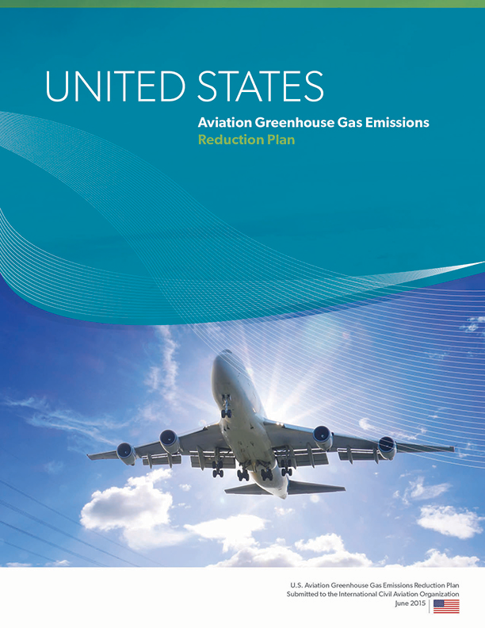
U.S. Aviation GHG Emissions Reduction Plan
Submitted to ICAO in June 2015
Follows five pillar environment and energy strategy
Summarizes efforts across U.S. Government
Includes analysis examining potential for GHG emissions reductions from:
New aircraft technology
Alternative jet fuel use
ATM and operations improvements
State Action Plans (including the U.S. plan) are available at:
http://www.icao.int/environmental-protection/Pages/ClimateChange_ActionPlan.aspx

Slide 18
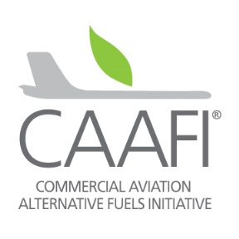
Online Materials
FAA Environment and Energy
http://www.faa.gov/go/environment
Center of Excellence (COE) Program
University research on alt jet fuels and environment
http://ascent.aero (under construction - link)
Continuous Lower Energy, Emissions and Noise (CLEEN)
Reduce aircraft fuel burn, emissions and noise through technology & advance alternative jet fuels
http://www.faa.gov/go/cleen
Commercial Aviation Alternative Fuels Initiative (CAAFI)
Coalition that focuses the efforts of commercial aviation to engage the emerging alternative fuels industry
http://caafi.org
Notes:
COE Technical Areas – Alt Jet Fuels
Feedstock Development, Processing and Conversion Research
Regional Supply and Refining Infrastructure
Environmental Benefits Analysis
Aircraft Component Deterioration and Wear Assessment
Fuel Performance Testing
Technical Areas – Environment
Aircraft Noise and Impacts
Aviation Emissions and Impacts
Aviation Modeling and Analysis
Aircraft Technology Assessment
Environmentally and Energy Efficient Gate-to-Gate Aircraft Operations

Slide 19
Recognizing Excellence and Leadership in Air Transportation for the Environment (RELATE)
Stakeholder Collaboration Program Phases, Activities, and Schedule
Activities | Schedule
FAA established a cross-functional Stakeholder Core Group in collaboration with industry | July 2013 – May 2015
The Core Group continues to discuss further refinements to RELATE Establish RELATE Website http://relate.faa.gov | Spring – Fall 2015

Slide 20
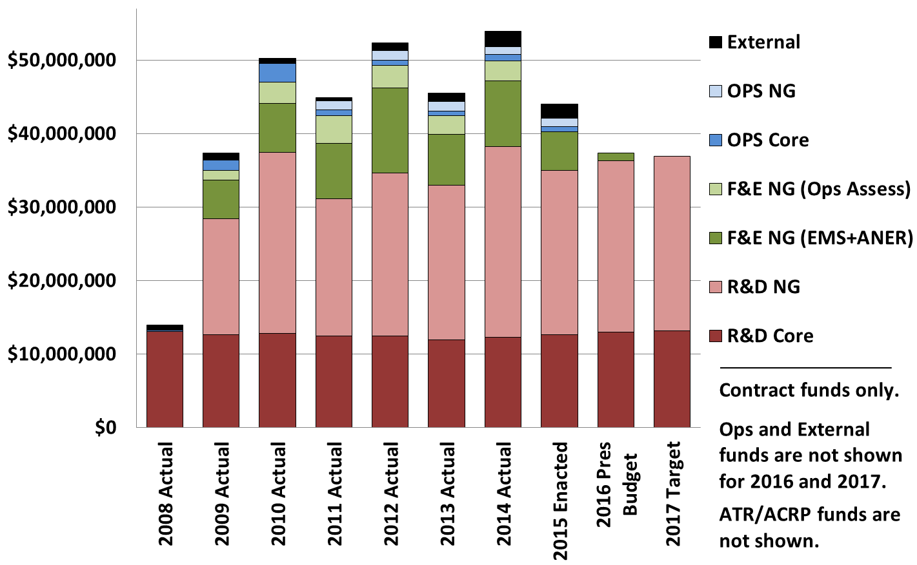
Budget Profile – Broken out by Funding Source

Slide 21
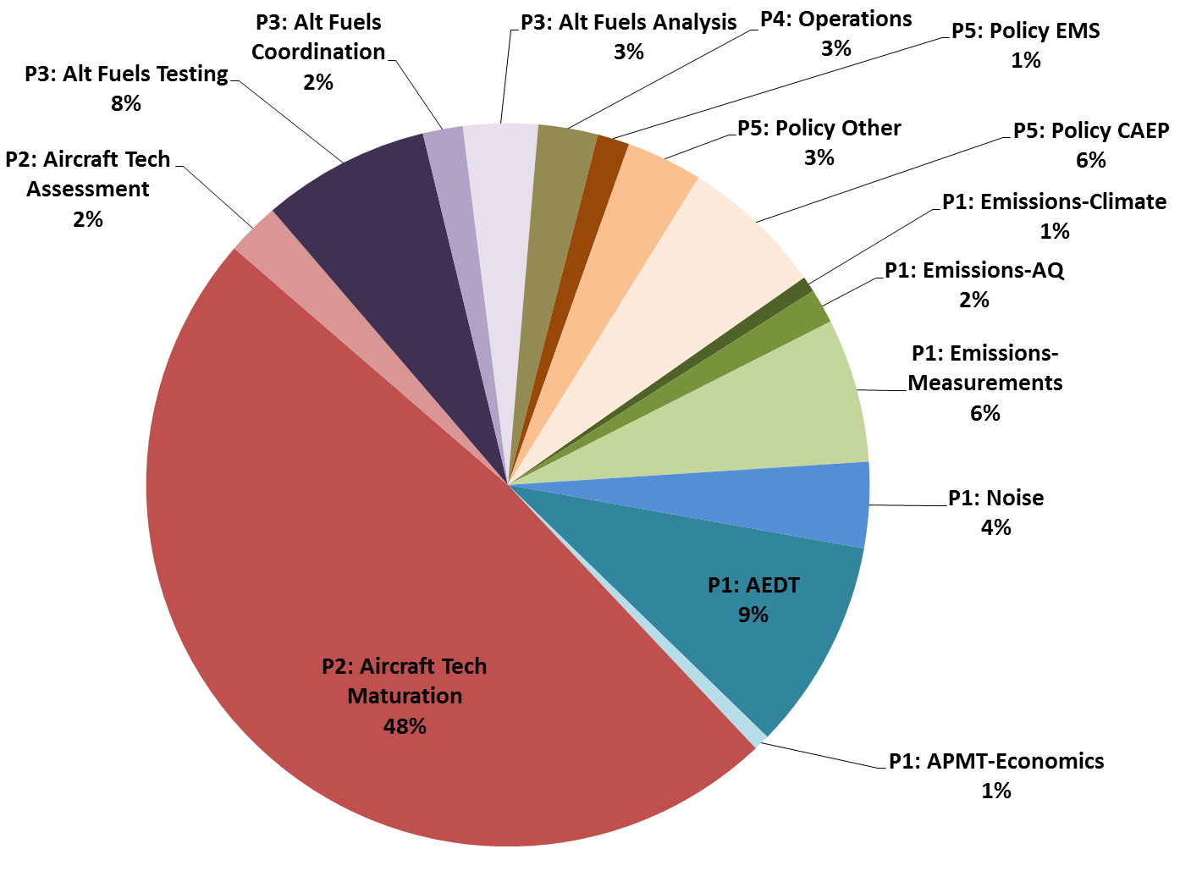
FY15 Budget Allocation by Pillar & Topic

Slide 22
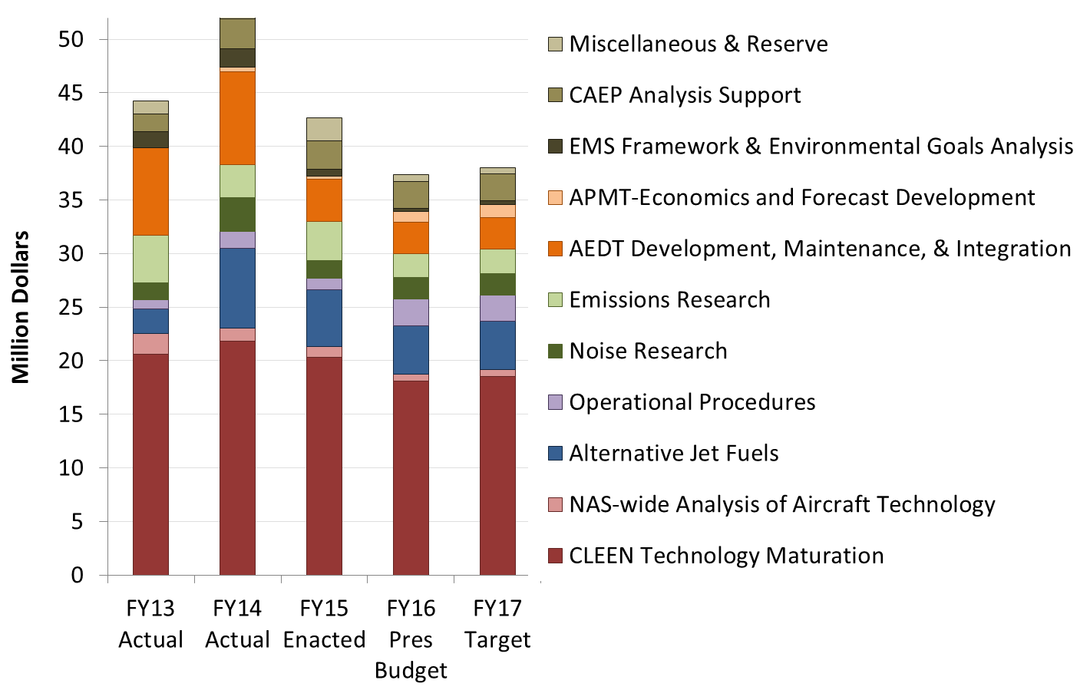
Environment and Energy Program Funding
Office of Airports (ARP) has been providing funding for community noise survey via ATR Program. Starting in FY16 they will be providing additional funds for environment projects.

Slide 23
Summary
Noise, emissions and the need for a sustainable and secure energy supply remain critical issues facing the growth of aviation
Reduced funding limits our ability to develop solutions that could prevent environment from being a constraint on aviation growth
Questions for tomorrow:
Are there R&D areas within the E&E Portfolio that should be lower / higher priority?
Are there R&D areas that AEE is not examining that should be added to the E&E Portfolio?
What do you see coming on the horizon regarding E&E that may require future R&D efforts?

