Slide 1
FAA REDAC Subcommittee on Environment & Energy
International Aircraft CO₂ Standard
August 6 2015 Update
Sahara Desert
Ralph Iovinelli and Laszlo Windhoffer

Slide 2
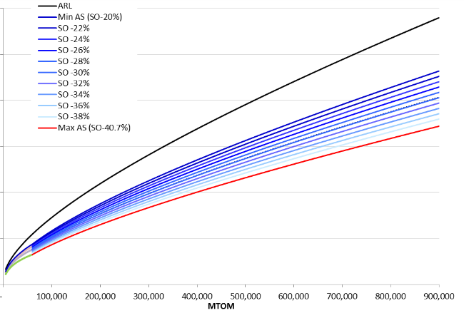
Major Milestones to-date (1)
July 2012:
CO₂ Metric System in May 2012: Instantaneous metric based on “specific air range” (e.g. distance / fuel mass), evaluated at 3 weights and corrected by floor area
February 2013:
Draft ICAO Annex 16 Vol. 3 (i.e. CO₂ certification requirement): Draft flight test procedures and measurement methodology
November 2013:
Stringency Options
Assessed curve shapes for various aircraft types
Defined boundaries and potential stringency options for use as the basis of CAEP CO₂ cost effectiveness analysis
Notional CO₂ standard stringency options: (i.e. regulatory levels)

Slide 3
Major Milestones to-date (2)
September 2014:
Technology responses: Specific aircraft technology responses (pass/fix/fail), and associated non-recurring costs
September 2014:
Draft, wide-range of in-production (InP) applicability options
Scope, Dates of Applicability, Triggers, Regulatory Level(s)
Processes (e.g. voluntary, mandatory reporting type certification)
September 2014:
Modeling framework (scenario cases / data) for CAEP CO₂ cost effectiveness analysis
July 2015:
First round CAEP CO₂ cost-effectiveness analysis results, refined InP applicability options presented to Steering Group

Slide 4
CO₂ Standard Next Steps
October 2015:
Complete CAEP CO₂ cost effectiveness analysis
Framework of a public ICAO CO₂ Certification Database
Finalize InP applicability options
Finalize outstanding topics re Annex 16 Vol. 3 and ETM* Vol 3.
Draft environmental technical manual, change criteria, specialized aeroplane types, and other certification related work items
Feb 2016:
Insert applicability and regulatory level into final Annex 16 Vol. 3
Decision on applicability and regulatory limit
2018:
Annex 16 Vol. 3 and ETM Vol. 3 implemented in ICAO Member State legislative frameworks
*Environmental Technical Manual: Supplemental guidance materials for an associated Annex 16 standard

Slide 5
EPA Rulemaking Update – July 2015
Proposed Endangerment Finding
Links aircraft CO₂ and other GHG emissions with adverse health and welfare impacts
Scientific & technical evidence from 2009 EF (CO₂ and other GHG from cars & trucks) based on IPCC, USGCRP and NRC assessments
Final finding, after notice and comment, would be mandatory first step to establish regulatory framework under Section 231 of the CAA
Advance Notice of Proposed Rulemaking
Overview of ICAO’s rulemaking process
Sets stage for future U.S. aircraft CO₂ regulations
Solicits public comment on key aspects of CO₂ or GHG standard

Slide 6
Rulemaking Schedule
Agency | Description | Date
EPA | Proposed Endangerment + Cause or Contribute Rule, Advance Notice of Proposed Rulemaking | July 2015
ICAO | Final Aircraft CO₂ Emissions Standard | February 2016
EPA | Final Endangerment + Cause or Contribute Rule | About Spring 2016
EPA | Notice of Proposed Rulemaking Aircraft CO₂ Emissions Standard | --
EPA | Final Rule Aircraft CO₂ Emissions Standard | --
FAA | Direct Final Rule | 2019

