Slide 1
Office of Environment and Energy’s (AEE)
Air Traffic Management Modernization / Operations Research Program Update
Presented to:
By:
Date:
REDAC E&E Subcommittee
Julie Marks and Stephen Merlin (AEE-400)
August 6, 2015

Slide 2
Air Traffic Management Modernizations (ATMM) Offer Important Potential E&E Improvements
AEE E&E ATMM Research Program Goals
  Identify and accelerate the implementation of air traffic management concepts that will reduce aviation environmental impacts and/or improve energy efficiency
  Investigate the E&E effects of operational changes implemented by the FAA.
Core Program Elements
  Research Process: Identifies, conducts, evaluates and transitions ATMM research for implementation
  Roadmap: Describes areas for ATMM Research near, medium, and long term.
  Portfolio Metrics: Assesses the portfolio’s balance with regard to addressing E&E issues and the maturity progression of research project.
Coordination/collaboration key to AEE ATMM Research, e.g., with ATO, ANG, NASA, etc.

Slide 3
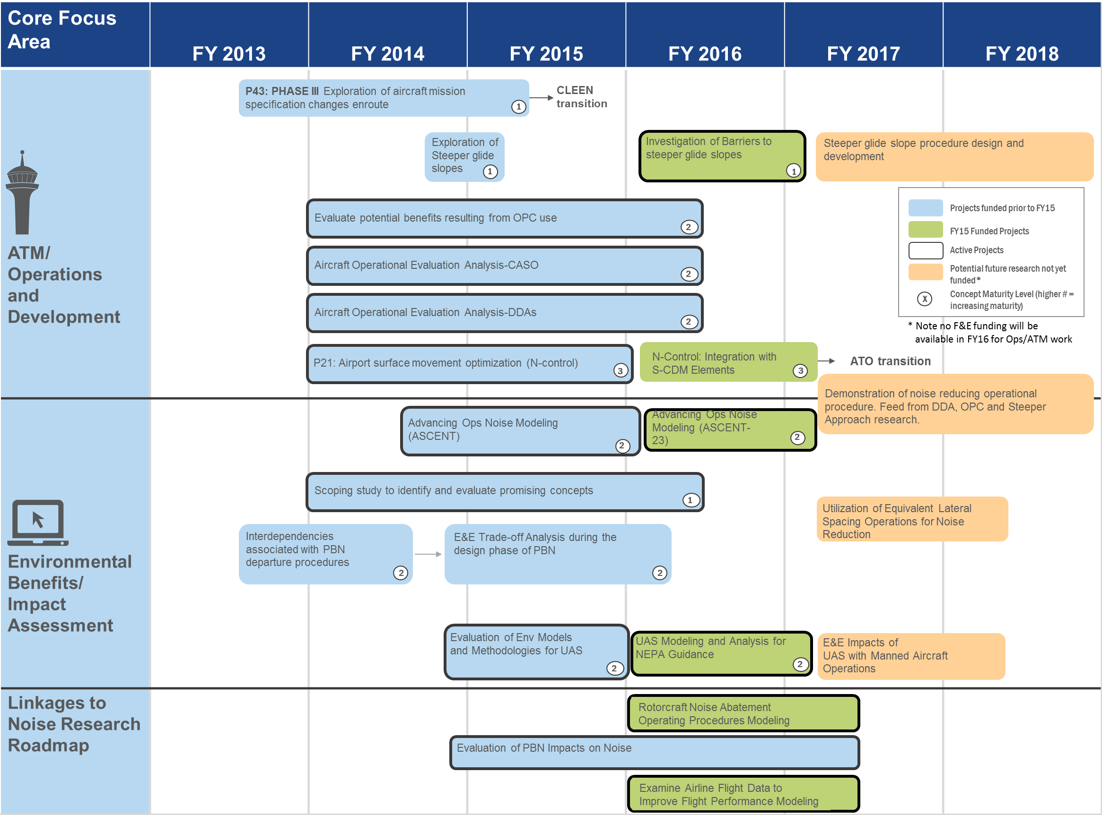

Slide 4
Cruise Altitude and Speed Optimization (CASO)
ASCENT Project 15 (PARTNER Project 32)

Slide 5
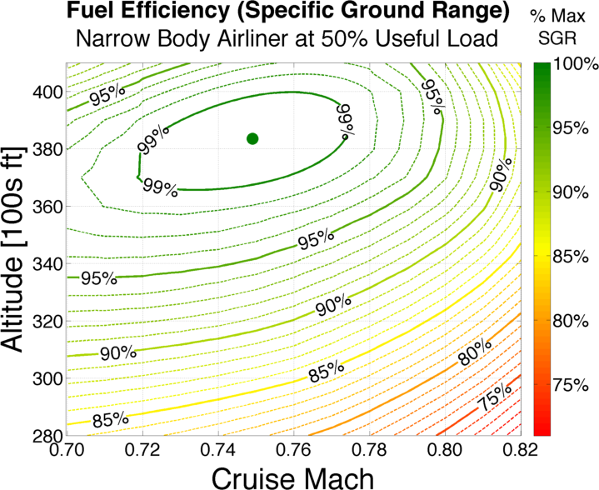
Cruise Altitude and Speed Optimization (CASO)
PARTNER Project 32 / ASCENT Project 15
Identify fuel savings potential from small changes in cruise altitude & speed
Work with airlines to understand operational & business constraints
Find opportunities to realize savings in current & NextGen operations
Typical Operating Regime
(fast,
off-optimal alt)
Optimal Mach/Alt

Slide 6
CASO: Current Status & Next Steps
Refining benefits assessment:
  Assessing North Atlantic operations data from NAV CANADA
  Checking 2012 results against 2014 operations for recent efficiency changes
  Integrating BADA into analysis framework to validate Piano-X derived results (feedback received from US/Europe ATM R&D Seminar)
Begun outreach to airlines to discuss results, solicit feedback on flight planning and speed selection policies, and explore potential applications
Based on airline/ATC feedback and collaboration opportunities, will explore developing operational applications/procedures incorporating CASO concepts
  E.g., prototype Electronic Flight Bag (EFB)/tablet interface to enable cockpit evaluation of cruise condition optimality and potential tactical clearance requests

Slide 7
Delayed Deceleration Approach (DDA)
PARTNER Project 32

Slide 8
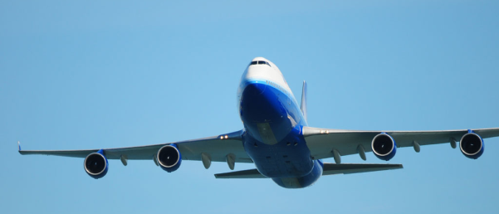
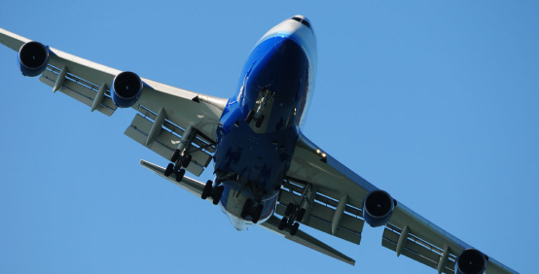
Delayed Deceleration Approach (DDA)
PARTNER Project 32
“Clean” configuration
Keep aircraft “clean” for longer on approach, when appropriate, without impacting terminal area entry or final approach stabilization criteria
Study objective:
estimate & enable DDA
benefits in near-term ops
“Dirty”
configuration
Notes:
Terminal area entry speed and final approach speeds are fixed
Slower is typical because it’s easier to manage the aircraft when they’re going slower

Slide 9
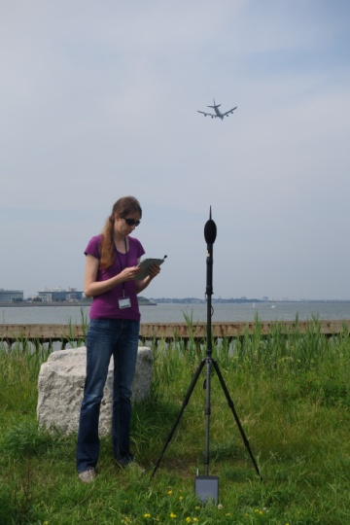
DDA: Current Status
Scoping noise measurement campaign
  Scouted locations in 10-20NM DDA “range” aligned with BOS RNAV arrival procedures
  Recorded quality data using noise monitors and iPad apps
Exploring DDA integration into RNAV procedures
  Simulating aircraft performance on modified procedures using operational FMS testbench
  Validating system against FDR data and refining models

Slide 10
DDA: Next Steps
Analyze drivers of approach speed profile characteristics at target airports
Develop RNAV techniques to increase DDA utilization at target airports
Analyze DDA noise impacts
Promote identified DDA opportunities with stakeholders
Synthesize findings to promote increased use of DDA procedures at target airport(s)

Slide 11
Surface Congestion Management:
N-Control

Slide 12
Surface Congestion Management: N-Control
Hold aircraft at gate or other location with engines off to reduce surface congestion, fuel burn & emissions while not adversely affecting throughput
Evaluate general applicability of N-Control concept to different airport operating environments
Demonstrate potential benefits (in terms of taxi-out time, fuel consumption and emissions reduction)
  Benefits assessment from analysis and trials used to inform/support TFDM business case

Slide 13
N-Control: Current Status & Next Steps
Continuing coordination on potential departure metering demonstration
  Expanded planned analysis to include greater focus on airline operational impacts
Preparing simulation/analysis data for handover to TFDM Investment Analysis Team
Scoping next phase of research
  Focus on effect on departure metering algorithms/benefits of incorporation of S-CDM data elements
  Coordinating w/NASA to harmonize research with planned ATD-2 work
Notes:
Major airline stakeholder is now socializing the finalized plan with senior management but no final decision has been made
ATD-2 = ATM Technology Demonstration 2 – Integrated Arrival/Departure/Surface capability

Slide 14
Continuous Climb Operations

Slide 15
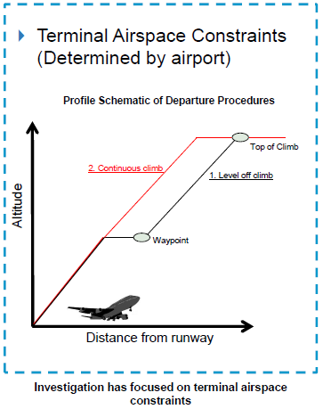
Continuous Climb Operations
Climb phase characterized by high fuel flow configurations (i.e., full throttle and high gross weight)
Constraints such as airspace/sector boundaries can cause level-offs during climb → increased fuel, emissions, noise
Objective of AEE study:
  Quantify prevalence of level-offs in NAS
  Calculate potential benefits of removing level-offs
  Identify causes of level-offs and mechanisms to implement continuous climbs

Slide 16
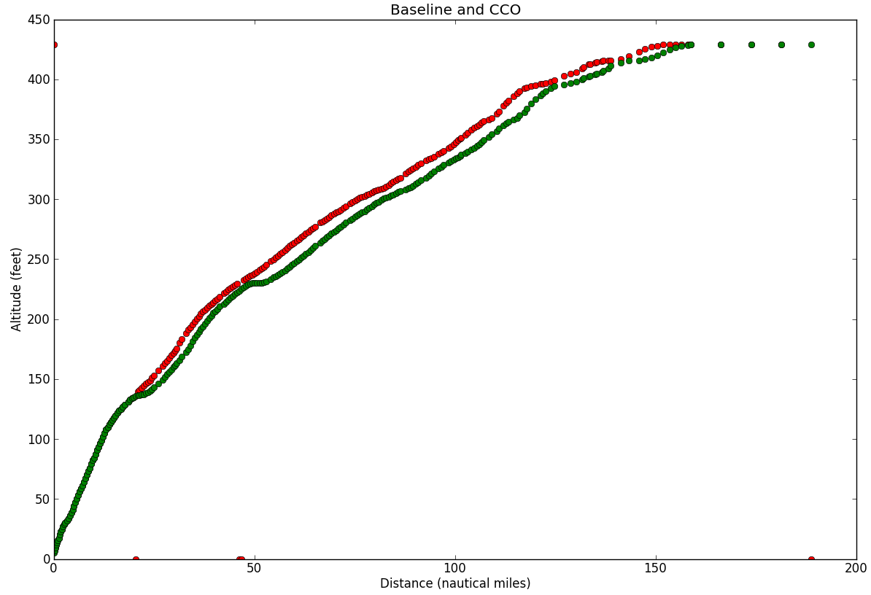
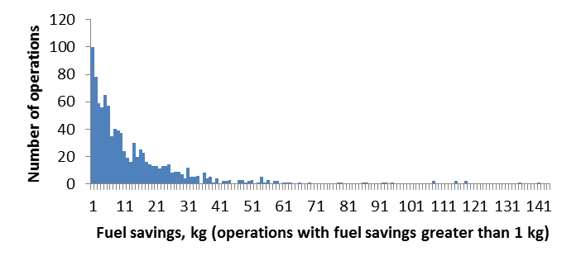
CCO Update & Next Steps
Improved uninterrupted climb algorithm
  Reassessing BOS, DEN, and LAX
Conducting terminal area flow analysis at individual airports to identify causes of level-offs (e.g., flow conflicts, sector handoffs, etc.)
Planning stakeholder outreach
Continue noise & emissions assessment
  Investigate advanced noise metrics, cost index modeling
Long tail of fuel savings can be targeted for focused benefits

Slide 17
UAS NAS Operations

Slide 18
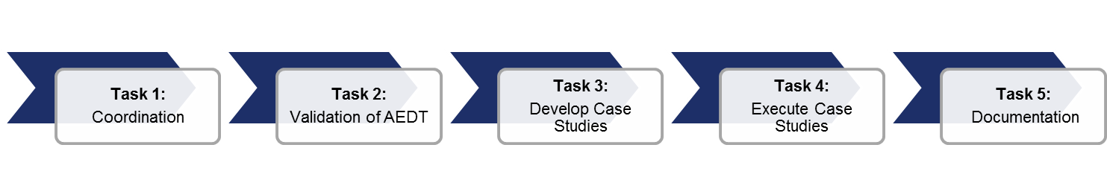
Investigation of E&E Benefits/Impacts of UAS in the NAS – Phase III Project Overview
Objectives
  Build on Phase II and better understand the short/medium term environmental modeling needs in coordination with other agencies
  Collect flight/aircraft data to model E&E footprint of multiple UAS platforms
  Conduct case studies in order to inform/update NEPA processes and guidance
  Model E&E changes due to UAS operations altering aircraft operations at airports
  Fully understand the capabilities of AEDT 2b for modeling of UAS through customization and substitution of aircraft
Major Outcomes
Coordination with key stakeholders to leverage on-going research for information and/or data sharing
Detailed assessment and validation of AEDT 2b for modeling UAS (continuation from Phase II)
Development of case studies to assist in identifying potential updates to NEPA guidance/policy
Modeling guidance and recommendations for aircraft substitutions when modeling UAS
Updated UAS E&E Modeling Research Roadmap to track relevant research by AEE and other agencies

Slide 19
Increased ILS Glide Slope and
Displaced Threshold

Slide 20
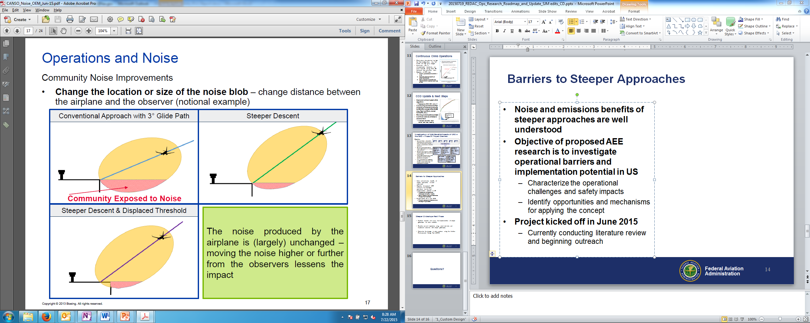
Increased ILS Glide Slope and Displaced Threshold
Noise and emissions benefits of steeper approaches are well understood
Objective of proposed AEE research is to investigate operational barriers and implementation potential in US
  Characterize the operational challenges and safety impacts
  Identify opportunities and mechanisms for applying the concept
Project kicked off in June 2015
  Currently conducting literature review and beginning outreach
Image credit: Boeing

Slide 21
Questions?

