Slide 1
Continuous Lower Energy, Emissions and Noise (CLEEN) Program
CLEEN Update and CLEEN II Status
REDAC Subcommittee on Environment and Energy
Levent Ileri, CLEEN Program Manager
August 6, 2015

Slide 2
Outline
Action Item Follow-Up
CLEEN Program’s 5-year Accomplishments
CLEEN Benefits
CLEEN II
Summary

Slide 3
Action Item Follow-Up
Develop CLEEN Communication Materials
  New web site: http://www.faa.gov/go/CLEEN
  FAA Office of Communications interviews with CLEEN companies 5/2015 for future materials
  Last CLEEN Fact Sheet update completed Aug 2014
  Next Fact Sheet update planned between Sep and Dec 2015
    http://www.faa.gov/news/fact_sheets/news_story.cfm?newsId=16814
CLEEN program technologies’ expected EIS
  TAPS II advanced low NOx combustor starting in 2016 –
    Airbus A320neo, Boeing 737MAX, COMAC C919
  CLEEN model brings technologies to point of readiness for product development
  Other TRL 6-7 technologies in product planning, not publicly announced
  Of the 10 CLEEN technology projects:*
    4 with EIS prior to 2020, >8000 engines
    6 with EIS after 2020, >4000 engines
* Based on November 2014 data. These numbers will increase as soon as the companies finalize their trade studies.
Notes:
Additional public communication of successes:
Boeing presentation at United States Advanced Ceramics Association (USACA) conference on CMC nozzle

Slide 4



Efforts that support Technology Maturation
Continuous Lower Energy, Emissions and Noise (CLEEN)
Reduce aircraft fuel burn, emissions and noise through technology & advance alternative jet fuels
  Public private partnership with 1:1 minimum cost share requirement – Federal funding at $125M
  Enable industry to expedite introduction of novel technologies into current and future aircraft and engines
  Maturation from TRL 3-5 concluding in major demonstrations at TRL 6 or 7 (ground engine or flight test)
Aviation Sustainability Center (ASCENT)
Center of Excellence for Alternative Jet Fuels & Environment
Providing independent assessment of environmental benefits from CLEEN technology introduction
Notes:
COE Technical Areas – Alt Jet Fuels
Feedstock Development, Processing and Conversion Research
Regional Supply and Refining Infrastructure
Environmental Benefits Analysis
Aircraft Component Deterioration and Wear Assessment
Fuel Performance Testing
COE Technical Areas – Environment
Aircraft Noise and Impacts
Aviation Emissions and Impacts
Aviation Modeling and Analysis
Aircraft Technology Assessment
Environmentally and Energy Efficient Gate-to-Gate Aircraft Operations

Slide 5
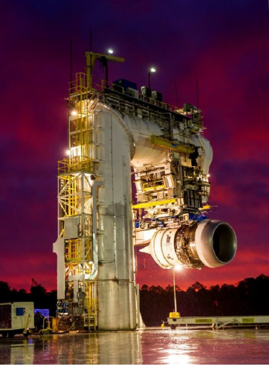
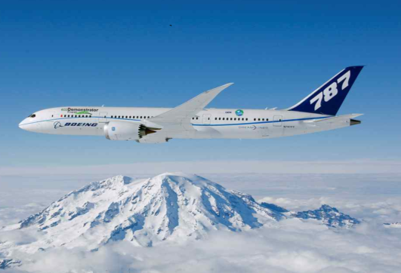
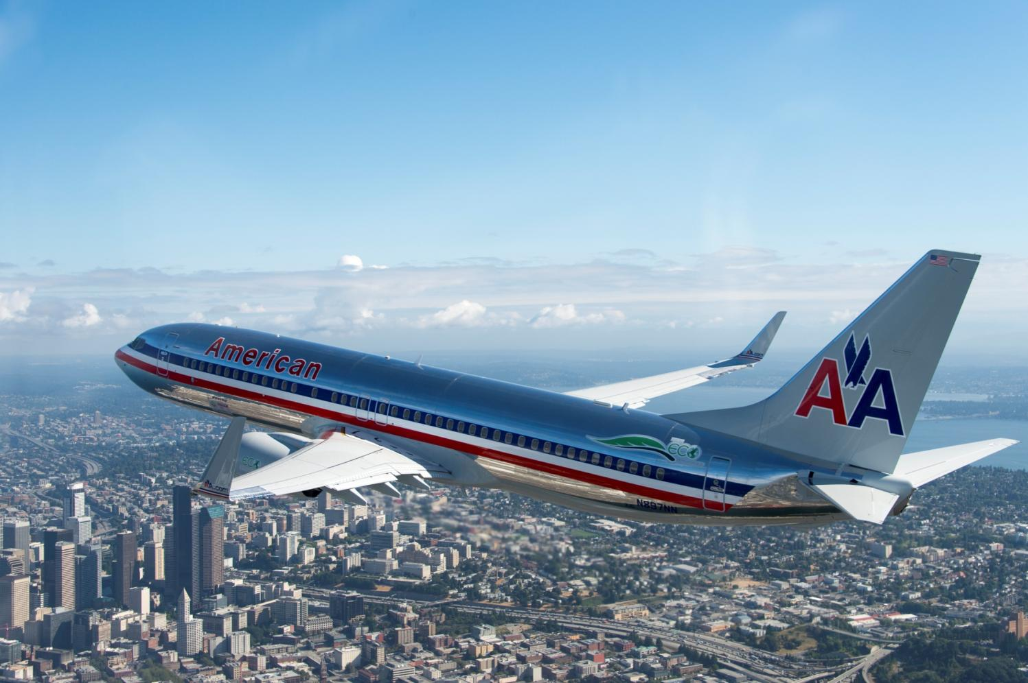
Boeing CLEEN Technologies
Adaptive Trailing Edge
Up to 2% fuel burn reduction, -1.5dB cumulative EPNdB noise reduction.
Ceramic Matrix Composite Acoustic Nozzle
Up to 1% fuel burn reduction
Noise attenuation on parity or better than metallic nozzle.
Photo: Bob Ferguson
Ceramic Matrix Composite Nozzle Ground Test (TRL 6)
Ceramic Matrix Composite Nozzle Flight Test (TRL 7)
Adaptive Trailing Edge Flight Demonstration (TRL 7)
2010 | 2011 | 2012 | 2013 | 2014 | 2015
Images courtesy of Boeing
Notes:
Purpose:
ATE - This technology will improve wing aerodynamic efficiency, reducing fuel consumption, and decrease aircraft approach noise.
CMC- This technology will reduce weight and increase temperature capability of the nozzle.
Demos:
ATE
-Wind tunnel test (May 2011)
-Flight Test on 737 (Summer 2012)
CMC Nozzle
-Engine Ground Test on Trent 1000 (2013)
-Flight Test on 787 (Summer 2014)
Result:
ATE enables the wing to be aerodynamically tailored to improve aircraft performance, and resulted in reduced fuel burn at cruise and reduced noise at takeoff and approach.
CMC nozzle enables more efficient engine operation at higher temperature, while providing weight reduction – thereby fuel burn reduction – and noise attenuation. Both of these technologies are matured to TRL 7.

Slide 6
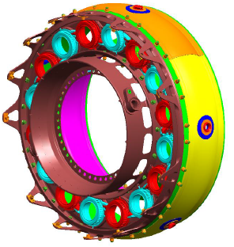
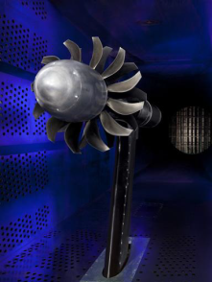


GE CLEEN Technologies (1 of 2)
TAPS II Low NOx Combustor
Demonstrated in rig and core engine test > 60% NOx margin to CAEP/6, exceeding CLEEN goal. – 2016 EIS with ~8000 orders
Open Rotor Fan Blade Development
~26% reduction in fuel burn (re: 737-800) and ~15-17EPNdB cumulative noise margin to Stg. 4
Core Test of TAPS II Combustor (TRL 6)
Open Rotor Wind Tunnel Tests (TRL 5)
TAPS II 2016 EIS with ~8000 orders
2010 | 2011 | 2012 | 2013 | 2014 | 2015
Images courtesy of GE Aviation
Notes:
Purpose:
TAPS II – New combustor design that will greatly reduce Nox emissions.
Open Rotor – New engine architecture to greatly reduce fuel burn and noise.
Demos:
TAPS II
- Core engine test (2011)
Open Rotor
-Scaled wind tunnel test (2012)
Result:
TAPS II provided 60% margin to CAEP/6 LTO NOx. TAPS will be going into service in 2016 with over 8000 orders in place on the LEAP engine.
Demonstrated 26% fuel burn reduction and 15-17 EPNdB noise margin to Stage 4. Open rotor technology cannot be developed into a product until an airframe OEM initiated an integrated design effort.

Slide 7

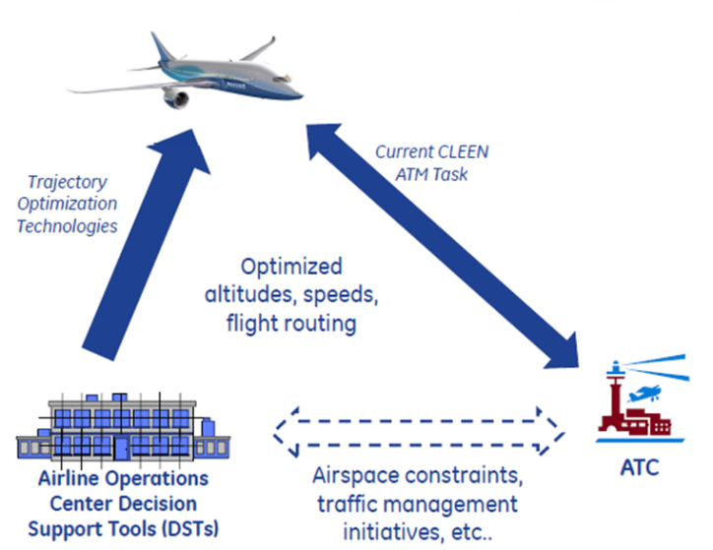

GE CLEEN Technologies (2 of 2)
FMS/ATM Integration
Benefits assessment ongoing.
FMS/Engine Control Integration
Adaptive engine control
Vehicle health management
Flight-propulsion control
Benefits assessment ongoing.
Ongoing Activities:
Engine and flight testing
Completed Dynamic Quiet Climb and Wind Input Optimization Tasks
Completed Trajectory Synchronization Simulation (TRL 6)
FMS/Engine Technology Logic Design Complete
FMS/Engine Effort Complete Q1 2016
2010 | 2011 | 2012 | 2013 | 2014 | 2015
Images courtesy of GE Aviation and Aviation Systems
Notes:
Purpose:
FMS/ATM - Integrate aircraft avionics with aircraft systems sensors and ground-based ATM systems to optimize aircraft trajectories for fuel burn and noise.
FMS/Engine – Mature FMS algorithms to provide adaptive engine control, integrated vehicle health management, and integrated flight-propulsion control.
Demos:
FMS/ATM
-Hardware (FMS) in the loop simulations of optimization algorithms (2013)
FMS/Engine
-Flight testing on LEAP 1-B ( May 2015)
-Engine ground test on GE9X - Upcoming (Aug. 2015)
Result:
FMS/ATM Trajectory optimization explored ATM enhancements that could result by integrating enhanced on board avionics with a/c system sensors and control and ground based ATM systems and using automatics data communications. This integration results in recused atc workload, erroneous collision alerts and impacts of NAS wide disruptions as well as increase capacity and improve environmental performance.

Slide 8
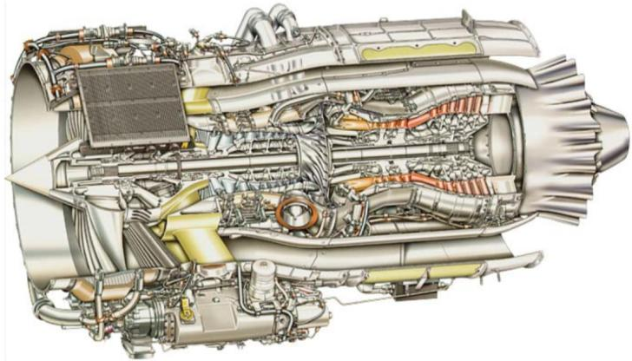
Honeywell CLEEN Technologies
Engine Core Fuel Burn Reduction Technologies
5% fuel burn reduction as part of a 15.7% fuel burn reduction engine package.
Alternative Jet Fuels
Completed study on impact of aromatics on materials
Completed biofuel life cycle analyses with MIT
High Temperature Impeller
Low leakage air-air seals
Advanced materials
Final CLEEN Engine Test (TRL 6) for All Technologies
Early Engine Test Opportunities (Some Technologies to TRL 6)
Core Engine Testing of High T3 Impeller
2010 | 2011 | 2012 | 2013 | 2014 | 2015
Images courtesy of Honeywell
Notes:
Purpose: Mature suite of engine technologies to increase engine efficiency and reducing engine weight. Honeywell is introducing advanced materials and coatings into this engine.
Demos:
Engine ground test (2012, 2014, 2015*)
Core Engine ground test (2015)
Result:
A high temp impeller compressor and a number of turbine engine components that reduce weight and increase operating temperature involving advanced materials and cooling. These technologies enable greater thermal efficiency and lower weight, leading to a total of 15.7% reduction in fuel burn.
Result of AJF:
Support ASTM approval of fuels
8

Slide 9
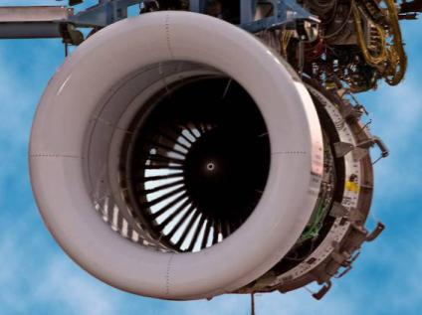
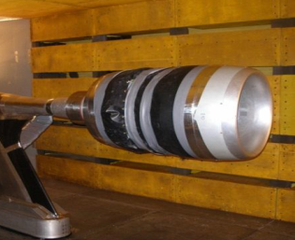
Pratt & Whitney CLEEN Technologies
Ultra High Bypass Geared Turbofan with Advanced Fan System
Technologies expand design space for engine with ~ 20% fuel burn reduction, 25 EPNdB cumulative noise margin to Stage 4
Alternative Jet Fuels
Engine and combustor testing of alternative jet fuels from multiple production pathways
Ground Test
Wind Tunnel Tests
Ultra High Bypass Rig Test with Advanced Fan Exit Guide Vanes
Integrated Ultra High Bypass Rig Demo
CLEEN Engine Design Complete
CLEEN Engine Test Q1 2016
2010 | 2011 | 2012 | 2013 | 2014 | 2015
Images courtesy of Pratt & Whitney
Notes:
Purpose: Ultra High Bypass Geared Turbo Fan – Mature new engine architecture to improve fuel burn and noise.
Demos:
Fan Rig Testing (2014, 2015)
Scaled Engine Testing* - Upcoming (2016)
Result:
A new design of a fan blade and short inlet components of a GTF. Two fan rig tests and an engine ground test demonstration are planned with an option to do a flight test.
Result of AJF:
Support ASTM approval of fuels

Slide 10
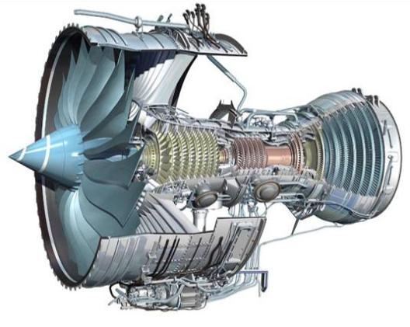
Rolls-Royce CLEEN Technologies
Dual Wall Turbine Airfoils + CMC Blade Tracks
CMC blade tracks offer > 50% reduction in cooling and component weight.
Dual Wall turbine airfoils provide > 20% reduction in cooling and increased operating temperature capability.
CLEEN technologies provide ~1% fuel burn reduction
Novel Alternative Fuels Project
Lab, rig, and APU testing complete
Dual Wall Vane Rig Testing
Dual Wall Vane Engine Test Mid- 2016
CMC Blade Tracks Engine Test 1
CMC Blade Tracks Engine Test 2 (TRL 6)
2010 | 2011 | 2012 | 2013 | 2014 | 2015
Images courtesy of Rolls-Royce
Notes:
Purpose: Introduce novel airfoil designs and CMC materials into turbine to significantly reduce cooling flows, reduce engine weight and increase operating temperature capability.
Demos:
Engine Testing (2013, 2014, 2016*)
Result:
CLEEN technologies will provide 1% fuel burn reduction.
APU: Auxiliary power unit
Engine core efficiency (high temp)
Dual Wall Turbine Airfoils – advanced cooling design – to cool the vane
CMC Blade Tracks - - advanced materials Ceramic Matrix Composites

Slide 11
Benefits of CLEEN Program:
Demonstrated technologies that reduce noise, emissions and fuel burn
Boeing
Adaptive Trailing Edge
~ 2% fuel burn reduction
~ -1.5dB cum in some single and twin aisles
CMC Acoustic Nozzle
~ 1% fuel burn reduction
Parity or better noise reduction compared with treated metallic hot structure
Honeywell
Fuel Burn Technologies
CLEEN technologies contributed to ~5% fuel burn reduction as part of a 15.7% fuel burn reduction engine package
Pratt & Whitney
Geared Turbofan Technologies
CLEEN techs expand design space for engine with ~ 20% fuel burn reduction, 25 EPNdB cumulative noise margin to Stage 4
General Electric
TAPS II Combustor (entering fleet in 2016)
CLEEN 60% margin to CAEP/6 LTO NOx was achieved
FMS/Engine and FMS/ATM Integration
Benefits are being assessed
Open Rotor
~26% reduction in fuel burn (re: 737-800) and
~15-17EPNdB cumulative noise margin to Stage 4
Rolls Royce
Ceramic Matrix Composite Turbine Blade Track
CMC blade tracks offer > 50% reduction in cooling and component weight.
Rolls-Royce – Dual Wall Turbine Airfoil
Dual Wall turbine airfoils provide > 20% reduction in cooling and increased operating temperature capability.
CLEEN tech will provide ~1% fuel burn reduction
11

Slide 12

CLEEN II
Program model based on successful CLEEN I
  Requires cost share and tech maturation from TRL 3-5 to demonstration at TRL 6-7
  Program work conducted 2015-2020
  Requires industry to show path to commercial product so tech realizes benefits in the fleet
Milestones:
  Market survey conducted May-July 2013
  Draft solicitation released publicly November 2013
  Industry day held in Washington D.C. December 2013
  Solicitation Released September 29, 2014
  Solicitation Closed February 2, 2014
  Contract negotiations have begun with selected companies
  Contract award planned for before end of FY2015
Notes:
Summary
CLEEN II is planned as a follow-on effort for new projects in the areas of aircraft technology development and alternative jet fuels. With work planned 2015-2020, technologies are planned to provide fuel burn, emissions, and noise benefit toward advanced goals and enter into service by 2025.
Metrics: Noise -32dB,
-75% LTO NOX emissions,
-40% A/C fuel burn,
and qualitative goals for technologies not affecting certification points. Technologies will be developed from 2015-2020 with the goal of entry into service before 2026. We must recognize however, that market demands will ultimately dictate the timing of when these technologies are commercialized.

Slide 13


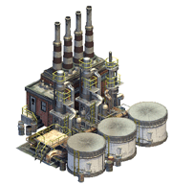

CLEEN + CLEEN II Program Goals
Develop and demonstrate (TRL 6-7) certifiable aircraft technology
 | CLEEN | CLEEN II
Noise (cum below Stage 4) | -32 dB | -32 dB | and/or reduces the noise contour area in absolute terms
LTO NOx Emissions (below CAEP 6) | -60% | -75% (-70% vs. CAEP/8) | and/or reduces absolute NOx production over the aircraft’s mission
Aircraft Fuel Burn | -33% | -40% | and/or supports the FAA’s goal to achieve a net reduction in climate impact from aviation
Advance use of “drop-in” renewable alternative fuels
Bio feedstock
Fuel Production
Jet fuel
Notes:
CLEEN I baseline:1) Certifiable aircraft technology that reduces fuel burn by 33% compared to current technology, reducing energy consumption and greenhouse gas (CO2) emissions;
In CLEEN goal 1, current technology refers to the contractor's current technology reference aircraft and mission.
CLEEN II baseline: 1) - the 40% reduction is to be measured in terms of kilograms of fuel consumed per available ton-kilometer, compared with a year 2000 best-in-class in-service aircraft baseline (e.g., Embraer E-190, Boeing 737-800, Boeing 777-200LR).
These goals are described in the National Aeronautics Research and Development Plan and puts CLEEN in context with NASA’s environmental technology programs.
While initial NASA studies considered a single aisle baseline configuration (B737-800 with a CFM56-7B engine), the CLEEN solicitation did not specify a baseline and encouraged technologies that could apply across multiple aircraft classes.
CLEEN I program goals are to:
1. Develop and demonstrate certifiable aircraft technology at Technology Readiness Level 6-7 that:
a. Reduces fuel burn by 33 percent relative to current subsonic aircraft technology, reducing energy consumption and greenhouse gas (CO₂) emissions;
b. Reduces landing and takeoff cycle (LTO) nitrogen oxide (NOx) emissions by 60 percent, at a pressure ratio of 30, over the International Civil Aviation Organization (ICAO) standard adopted at CAEP 6, with commensurate reductions over the full pressure ratio range, while limiting or reducing other gaseous or particle emissions;
c. Reduces noise levels by 32 EPNdB cumulative, relative to Stage 4 standards;
2. Determine the suitability of new technology for engine and aircraft retrofit to accelerate penetration into the commercial fleet.
3. Develop and demonstrate use of “drop in” alternative fuels in aircraft systems and quantify the benefits. This includes facilitating ASTM International approval of “drop-in” alternative fuels for commercial use.
Committee on Aviation Environmental Protection (CAEP) - The Committee on Aviation Environmental Protection (CAEP) is a technical committee of the ICAO Council established in 1983. CAEP assists the Council in formulating new policies and adopting new Standards and Recommended Practices (SARPs) related to aircraft noise and emissions, and more generally to aviation environmental impact.
Alt fuel goal (industry wide, commercial and military) is 1 billion gallons by 2018
The Continuous Lower Energy, Emissions, and Noise (CLEEN) program will reduce the environmental impact
of aircraft through new engine and airframe technologies and by advancing the use of sustainable alternative
aviation fuels. Our aim is to accelerate development of quieter commercial aircraft that burn less fuel and produce
lower emissions than existing technology.

Slide 14

Planned CLEEN II Timeline
Released
CLEEN II SIR
Sep 29, 2014
2014
2015
Oct
Nov
Dec
Jan
Feb
Mar
Apr
May
Jun
July
Aug
Sep
CLEEN II Proposals -
Due February 2, 2015
Questions -
Nov 7
Answers -
Dec 12
SMEs
Review
Recs -
Mng / Leg
Negotiations
Contract Award(s) / Announced as they are negotiated

Slide 15
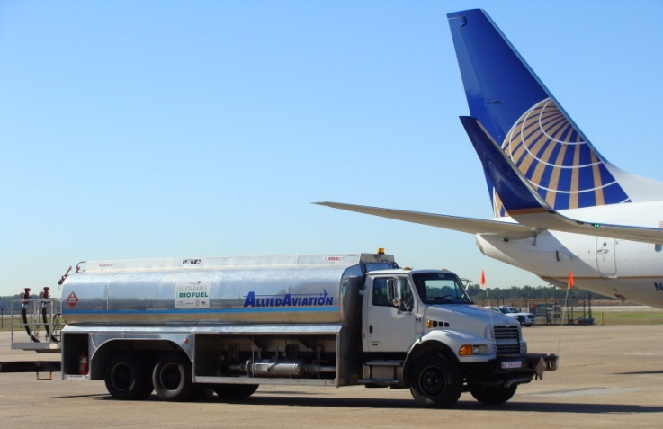
In Summary
CLEEN* has successfully accelerated aircraft technology development to reduce noise, emissions and fuel burn
CLEEN has helped and is helping to accelerate alternative jet fuel development
CLEEN II is coming this year
* For more information on the CLEEN Program, its benefits, and accomplishments to date, please see the CLEEN Program Fact Sheet at
http://www.faa.gov/news/fact_sheets/news_story.cfm?newsId=16814

