Slide 1
FAA Alternative Jet Fuels R&D Update
To: FAA E&E REDAC
By: Nate Brown & Mohan Gupta
Date: August 6, 2015
Notes:
Overview of the program
Alternative jet fuels are a key component of U.S. strategy for meeting aviation environmental goals
FAA efforts are directed to overcoming key challenges via testing, analysis and coordination
Multiple programs and activities focus on different aspects of the challenge
Partnerships across technical areas, and with partners with very different expertise across the supply chain are a key focus
Strong domestic and international coordination necessary for success
FAA Alternative Jet Fuel principles:
must be drop in, have equivalent safety and better environmental performance than petroleum Jet fuel
Enable all possible fuels that meet criteria
Government role to address key barriers
Work through Public-Private Partnerships
Address the whole supply chain
Leverage expertise and resources of other government agencies and other countries
Aviation should be a lead user of alternative fuels

Slide 2




FAA Alternative Jet Fuel Activities
Testing
  Support Cert/Qual testing
  Improve Cert/Qual process
  Emissions measurements
Analysis
  Environmental sustainability
  Techno-economic analysis
  Future scenarios
Coordination
  Interagency
  Public-Private
  State & Regional
  International
2
Notes:
R&D portfolio is to advance our understanding and play our role as a facilitator of the process
Loosely grouped into three categories:
Performance and emissions Testing of Alternative fuels to support ASTM Internaional approval and emission benefits measurement
Support evaluation of fuels for ASTM approval
Reduce test cost and time for qualification
2. Analysis on impacts, economics and availability to:
Improve understanding of environmental and economic sustainability of alternative jet fuel pathways
Improve understanding of the potential availability of alternative jet fuels
3. Coordination and Leveraging efforts across…interagency, public-private, regional level and with international partners
Complement and leverage work of other U.S. agencies
Complement and leverage work of private sector
Support deployment through state/regional supply chain development
Complement and leverage work of international partners
Our means of conducting the work on the right side

Slide 3
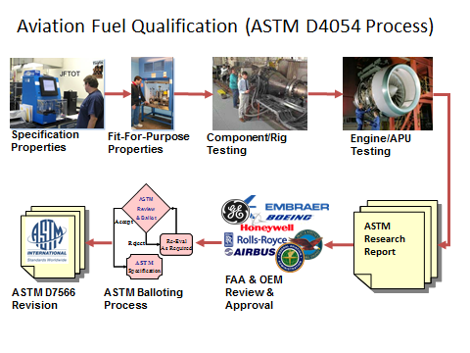
Alternative Jet Fuel Testing
Support ASTM Intl evaluation of alternative jet fuels
Support ASTM D4054 testing activities to develop data for approvals
(CLEEN; Volpe BAA; SEMRS; ASCENT A31; CLEEN II)
Research Report Review
(CLEEN; CLEEN II)
Data Gathering
(ASCENT A33, SEMRS)
Streamline approval process via the National Jet Fuel Combustion Program (ASCENT A25-30, 34)
Notes:
1) Near term effort to Support ASTM D4054 testing activities to enable development of data for approvals
BAA/SEMRS/CLEEN
Honeywell APU testing of 7 fuels underway
ASCENT Project 31
TBD fuels tested
2) Support for Research Report Review & Coordination
Via CLEEN
Support organized approach to fuels in ASTM pipeline
Boeing, GE, Honeywell, P&W, RR and SWRi
3) Data Gathering
Alternative Jet Fuel Test Data Library (ASCENT A33) -- focus on creating a library to catalogue the test data that has and will be collected from previous, current and future alternative fuels testing. Plan to establish a framework for the database, as well as host a web-portal that will make the data collected accessible to the general public.
Worldwide Jet Fuel Data (SEMRS) – Metron & A4A project gathering fuel specification data of conventional jet fuel at airports throughout the US and the world. Track the spec properties at the various airports over time to give insight to the variation of properties in conventional jet fuel, and substantiate a tolerance level for spec properties in alternative fuels. Conventional jet fuel property data at multiple areas can be useful in aircraft emissions modeling and future alternative fuel blending efforts.
4) Mid term effort to streamline ASTM International jet fuels approval process
Develop generic fuel composition/chemistry evaluation methodology
Standardized rig/lab tests
Chemical kinetic/combustion modeling
Collaborative OEM/university/federal effort

Slide 4
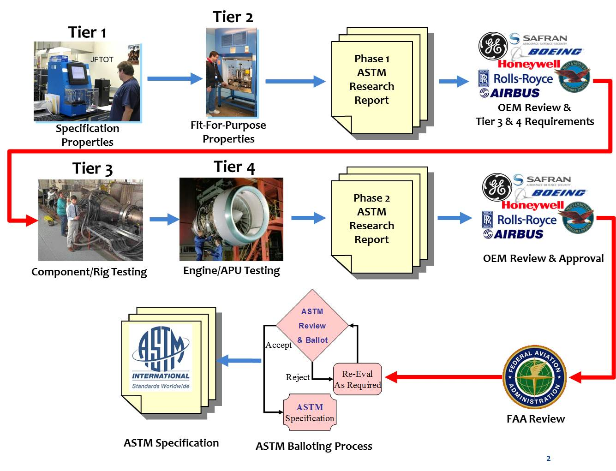
Modified D4054 Fuels Qualification Process

Slide 5
Current Fuel Status and FAA Testing (1 of 2)
Notes:
A checkmark indicates testing for a Tier has been completed by DOD, FAA and/or industry. Due to the iterative nature of the ASTM approval process, additional testing may be required in Tiers where checkmarks are present for those fuels not yet approved.
This chart shows current FAA program testing activity only. Note that in the cells where FAA testing programs are indicated, these efforts may be supplemented by additional industry or other agency testing. We conduct coordination with industry and other agencies to avoid duplicate testing and leverage resources. In locations where TBD is listed there is currently no FAA sponsored testing there may be testing underway by other agencies or industry.

Slide 6
Current Fuel Status and FAA Testing (2 of 2)
1. Mixed alcohols refers to butanol, ethanol, methanol etc.

Slide 7
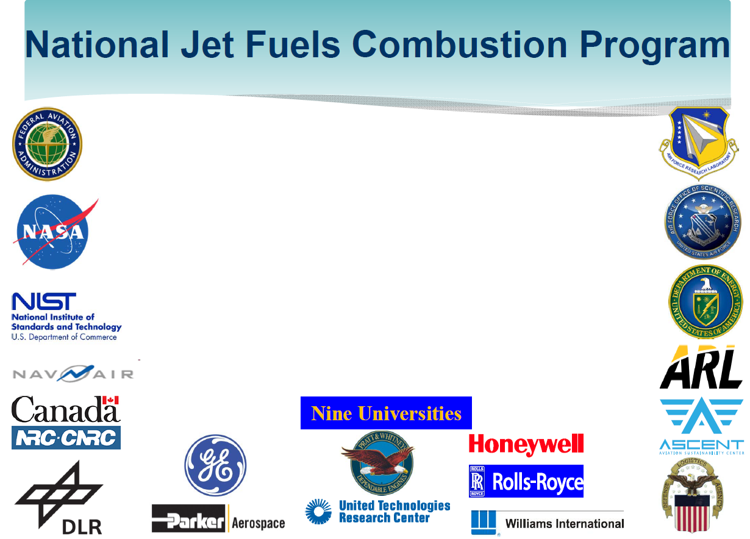
Wide ranging participation from 34 entities
Program is directly funded by FAA, AFRL, NavAir, DLA Energy and DOE
NASA is directly funding modeling areas of NJFCP
AFOSR is supporting some NJFCP areas through its combustion program
Program is supported by in-house funded activities - NRC Canada, DLR (Germany), Army Research Lab and Univ. Sheffield (UK)

Slide 8
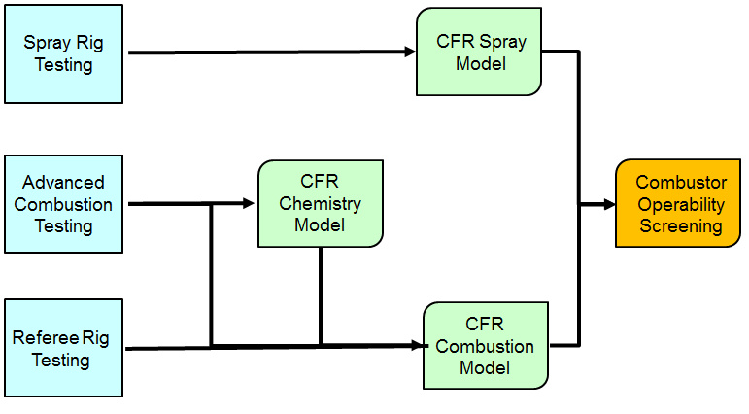
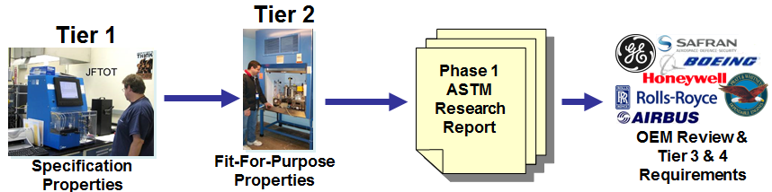
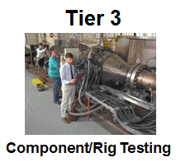
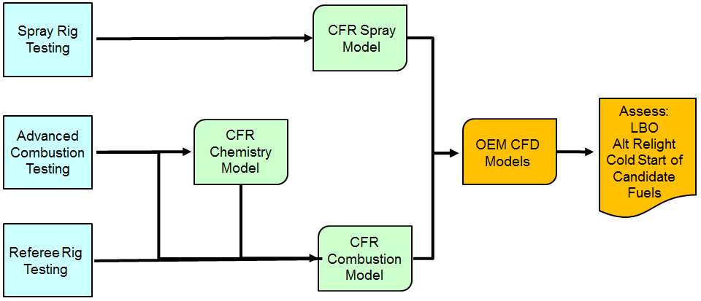
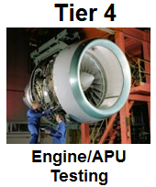
Improved OEM Screening of Fuels with NJFCP Integration
Redesign/Reengineer Fuel Development Pathway
NJFCP: Initial Fuel Screening at a representative operating condition using OEM designed 1-Cup Rig linking fuel to the FOM
Scope of Tier 3/4 Testing Determined by NJFCP Results
Expand & Employ Gained Knowledge Base
Acceptable Combustor Operability?
No
Yes
NJFCP: Detailed Fuel Testing & Combustion Modeling at an extended range of conditions using OEM designed 1-Cup Rig to study FOM
Benefits: Early fuel screening, targeted Tier 3 and 4 tests, and increased OEM confidence

Slide 9
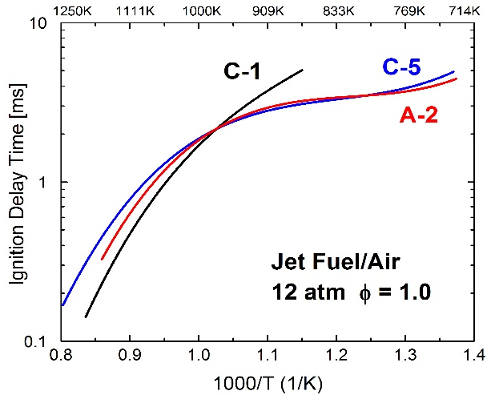
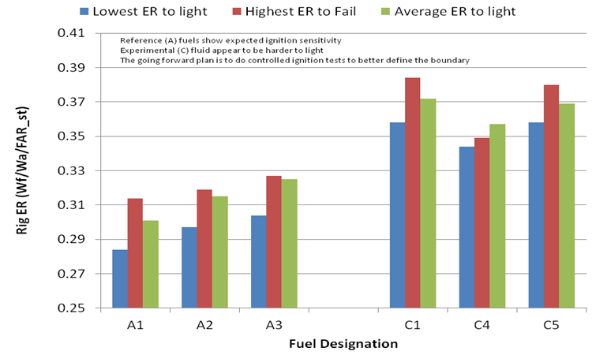
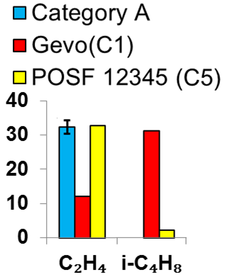
NJFCP: Demonstrated Fuels Sensitivity Through Testing (towards meeting Year-1 program success criterion)
Area 1: Shock Tube
Characteristic spray sensitivity
Completed Fuel Screening Through Testing
Ignition delay fuel sensitivity
Area 3
Area 5
High Sheer Rig
Forced Ignition Rig
C-5
P(ign)_{i} / P(ign)_{A2}
φ=1.5
Area 1: Flow Reactor
Area 6
C-1
C-5
Ignition sensitivity
A-2
A-1
C-1
Speciation sensitivity
Ignition sensitivity
LBO sensitivity

Slide 10
Ongoing and Planned Year -2 Activities
Testing:
Focus on downselected A-2, C-1, C-5 fuels plus ‘new’ fuels (alternative property variation) as suggested by OEMs (e.g. C-6 Virent/Shell fuel)
Repeatability of results
Expanding the fuel testing under wide range of operating conditions (e.g. cold air/cold fuel)
Extending the fuels testing diagnostics
Develop confidence in Referee Rig performance
Modeling
Reduced chemical mechanisms for downselected Category ‘C’ fuels
Focus on semi-quantitative modeling of LBO with some demonstration on ignition modeling
Move towards Fuel ‘X’ approach
Prioritizing and descoping Year-2 activities under reduced budget scenario.

Slide 11
FAA Alternative Jet Fuel Activities
Testing
  Support Cert/Qual testing
  Improve Cert/Qual process
  Emissions measurements
Analysis
  Environmental sustainability
  Techno-economic analysis
  Future scenarios
Coordination
  Interagency
  Public-Private
  State & Regional
  International
11
Notes:
2. Analysis on impacts, economics and availability to:
Improve understanding of environmental and economic sustainability of alternative jet fuel pathways
Improve understanding of the potential availability of alternative jet fuels

Slide 12
Alternative Jet Fuel Analysis
A01 Alternative Jet Fuel Supply Chain Analysis
A13 ACCESS 2 Micro Physical Modeling with NASA
A24 Emissions Data Analysis for CLEEN, ACCESS, and Other Recent Tests
A32 Worldwide Life Cycle Analysis (LCA) of Greenhouse Gas (GHG) Emissions from Petroleum Jet Fuel
Volpe Alternative Fuels Transportation Optimization Tool (AFTOT)

Slide 13
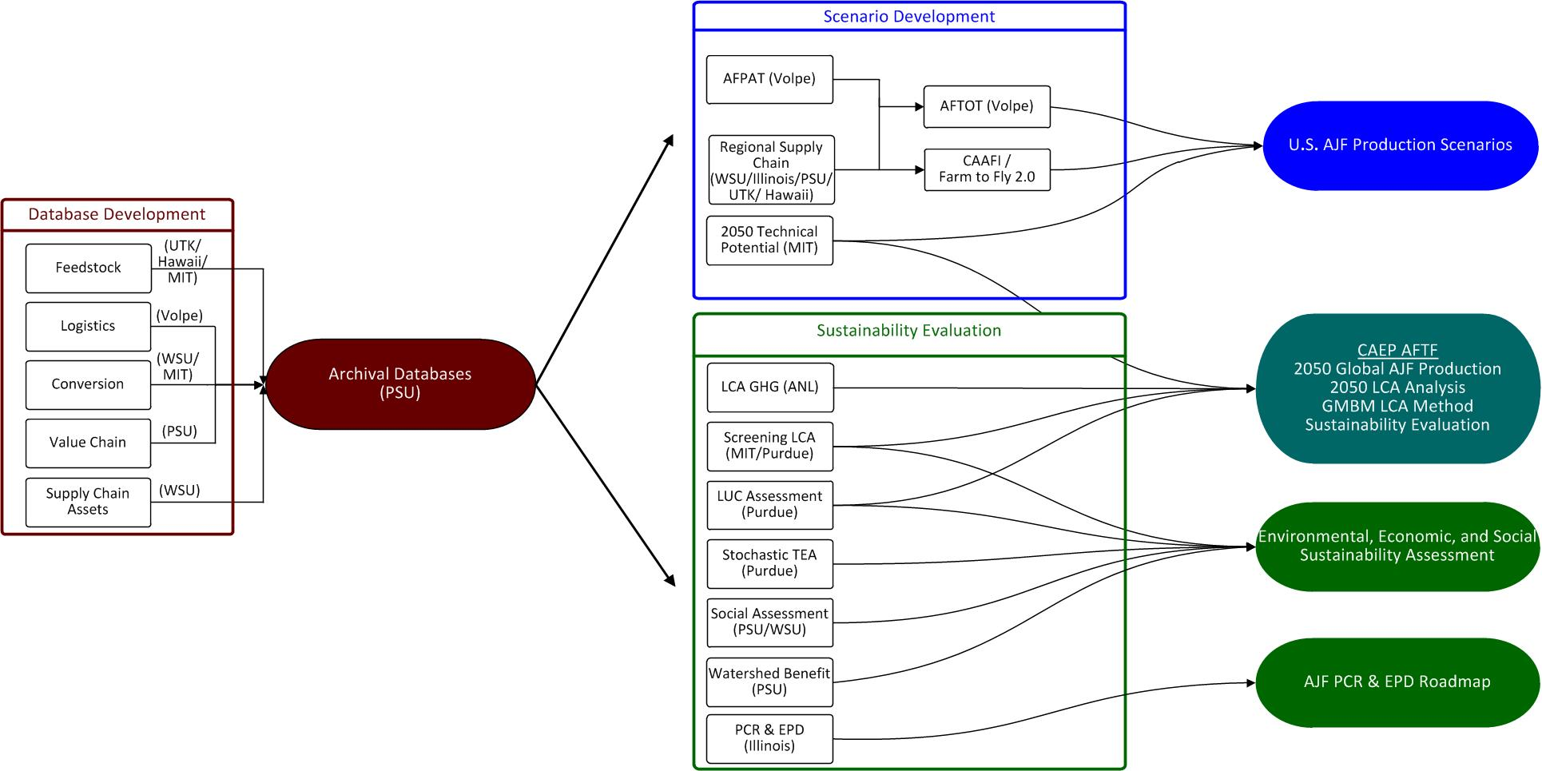
Supply Chain Analysis Update (ASCENT 01)
Database Development
and Archive
Scenario and Sustainability Analysis
Project Outputs
13
Notes:
Purpose of the Project:
Develop information on regional supply chains
Provide holistic evaluation of alternative jet fuel production including feedstock, transportation, and conversion
Evaluate sustainability from environmental, economic and societal perspectives
Develop scenarios of future alternative jet fuel production
Identify the key barriers in regional supply chains that must be overcome
to produce 1 billion gallons of alternative jet fuel by 2018 and
an order of magnitude larger production in the longer term
Support International Civil Aviation Organization (ICAO Committee on Aviation Environmental Protection (CAEP) Alternative Fuel Task Force (AFTF)
Supply Chain Analysis
Feedstock Analysis: Determine the logistics and economic feasibility of feedstock pathways to AJF
Bio-refinery infrastructure analysis: TEA of AJF conversion tech., existing infrastructure inventory
Develop Supply Scenarios (Volpe AFTOT tool): optimal movement, plant locations, costs, supply
Coordinate with stakeholders – e.g. CAAFI, F2F2
Incorporate regional characteristics: Midwest, NE/MidAtlantic, NW, SE
Part 1: Database Development
Feedstock Production Analysis: Determine the logistics and economic feasibility of alternative feedstock pathways to jet fuel.
POLYSYS model:
County level national model representing major crops and livestock commodities.
Same model used for Dept. of Energy Billion Ton Study
Part 2: Scenario Development
Biorefinery Infrastructure Inventory:Inventory existing infrastructure
Retrofit or co-locate with existing facilities
Benefits:
Reuse existing equipment and infrastructure = decreased Capital Expense
Existing skilled workforce in place = jobs saved and created
Environmental (air, water) permits and water rights = decreased start-up delays
Proximity to feedstock
Existing transportation systems
Volpe Alternative Fuels Transportation Optimization Tool (AFTOT):
Optimizes routing to minimize scenario “cost” based on:
Transportation costs
Feedstock supply
Biorefinery capacity
(minimum, maximum)
Facility capital cost
Demand
Selects biorefineries
Part 3: Focus on CAEP
Part 4: Sustainability Evaluation
In 2015:
Added University of Hawaii to the team
Going to work with CAAFI and F2F2 to coordinate with stakeholders – e.g. CAAFI, F2F2
develop data for regional supply chains
Leveraging unique regional characteristics: Midwest, NE/MidAtlantic, NW, SE
forest residues in NW, water quality benefits in midAtlantic
Develop Supply Scenarios (Volpe AFTOT tool): optimal movement, plant locations, costs, supply
Significant contributions to the CAEP AFTF process
-Alternative Fuels Task Force (AFTF) tasked to:
Assess possible range of emissions reductions from use of alternative jet fuels in 2050 (requires both fuel volume and emissions factor)
Develop a methodology to include alternative jet fuels in the global market based measure (GMBM) for international aviation
ASCENT team providing technical expertise and analysis support to AFTF

Slide 14
ASCENT 01 Next Steps for FY15 onward
Support development of life cycle analysis methodology for alternative jet fuels within global market based measure for international aviation (within AFTF of ICAO CAEP)
Project provides a framework to:
  Collect data on regional supply chains
  Conduct regional and national supply chain analyses
  Create production scenarios
  Evaluate alternative jet fuel sustainability
  Identify barriers to alternative jet fuel production
Expanding analysis framework to include:
  Waste streams (e.g., municipal solid waste, crop and forest residue)
  Tropical feedstocks (leverage work examining Hawaiian Islands)
  Watershed benefits (PSU)
14

Slide 15
FAA Alternative Jet Fuel Activities
Testing
  Support Cert/Qual testing
  Improve Cert/Qual process
  Emissions measurements
Analysis
  Environmental sustainability
  Techno-economic analysis
  Future scenarios
Coordination
  Interagency
  Public-Private
  State & Regional
  International
15
Notes:
3. Coordination and Leveraging efforts across…interagency, public-private, regional level and with international partners
Complement and leverage work of other U.S. agencies
Complement and leverage work of private sector
Support deployment through state/regional supply chain development
Complement and leverage work of international partners
Our means of conducting the work on the right side

Slide 16








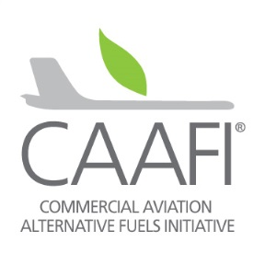
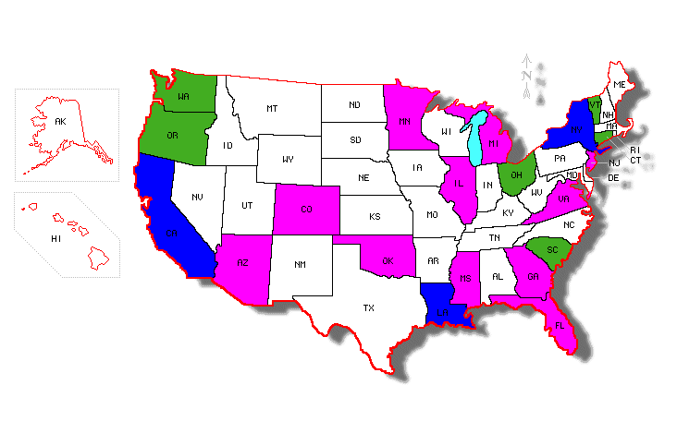










Alternative Jet Fuel Coordination
Interagency coordination across supply chain & National Alternative Jet Fuel R&D Strategy
Commercial Aviation Alternative Fuel
Initiative (CAAFI)
Farm to Fly 2.0 & CAAFI State Activities
International cooperation
Notes:
FAA efforts are part of a broader government and private sector effort that requires coordination across supply chain.
We are depending on the programs, policies and expertise of 8 different agencies.
NAJFS - To identify opportunities and strategically address challenges associated with Research, Development, Demonstration, and Deployment (RD3) along the development path of alternative jet fuels.
An undertaking by Aeronautical Science and Technology Subcommittee of the OSTP/NSTC with input from stakeholder community.
Interagency working group of 8 participating Departments & Agencies: USDA, DOC, DOD, NASA, FAA, DOE, EPA, NSF, DOS
CAAFI
Public – private partnership – coordination, information exchange, direction and support
F2F2
Farm to Fly 2.0 is an agreement to cooperate to develop the supply of alternative jet fuel in the United States.
Signatories: USDA, FAA, DOE and Industry associations Airlines for America (A4A), Aerospace Industries Assoc. (AIA), Airports Council International-North America (ACI-NA), General Aviation Manufacturers Association (GAMA) and the National Business Aviation Association (NBAA) = Entire civil jet-aviation enterprise now represented and engaged
Purpose:
To focus government and aviation industry resources towards jet fuel supply chain development.
Endorsed and adopted FAA goal of 1 billion gallons by 2018.
Supporting feasability studies for fuel production in various U.S. states.
CAAFI state & regional deployment
Supporting “grassroots” supply chain development and fuel production.
Identifying local lead organizations/POCs/stakeholders in states and regions.
Provide context, advice, strategy, benchmarking
Facilitate networks & links between stakeholders (e.g. airlines/airports w/ state bioenergy authorities)
Rural Bioenergy Enterprise Grants (RBEG) and Value Added Producer Grants (VAPG)

Slide 17
Federal Alternative Jet Fuels R&D Strategy: The Latest Status
Development since the last update to REDAC E&E Subcommittee
OMB reviewed the strategy and made suggestions for minor changes
ASTS reviewed and approved the strategy document for submission to COT/NSTC
OSTP reviewed strategy document and suggested some minor edits
Revised version of the strategy document has been submitted to COT/NSTC for review and approval
Current Status
COT/NSTC is currently reviewing the strategy document
  This review may result in some revisions
  Expect to hear about the review in next a couple of weeks
Next Steps
Will work with OSTP and STPI for official release of Federal Alternative Jet Fuels R&D Strategy
Expecting strategy release by next month (September, 2015)

Slide 18
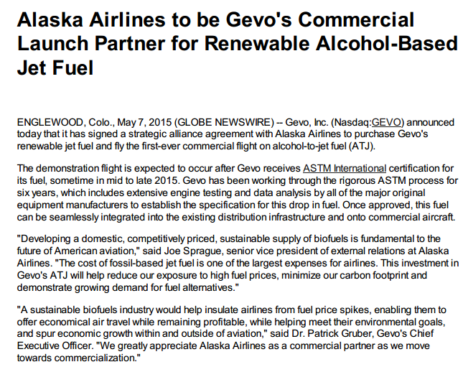

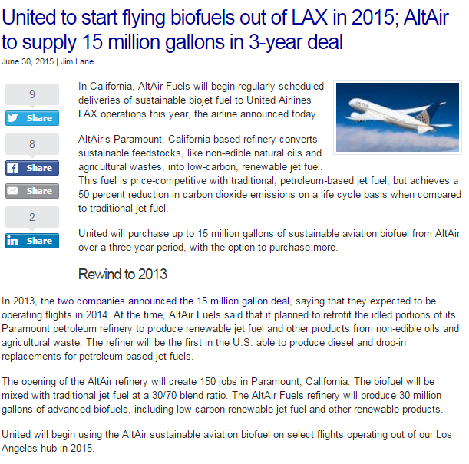


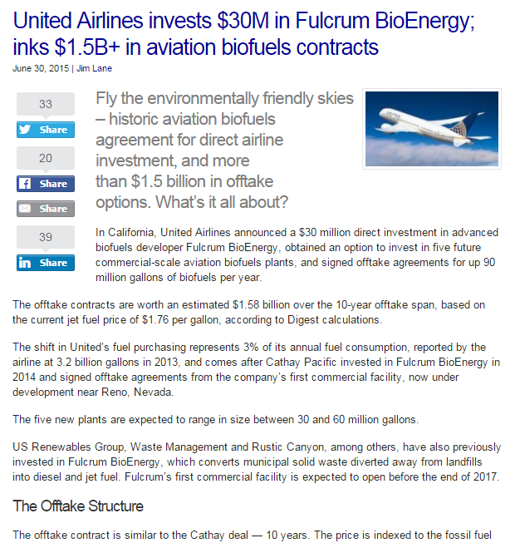

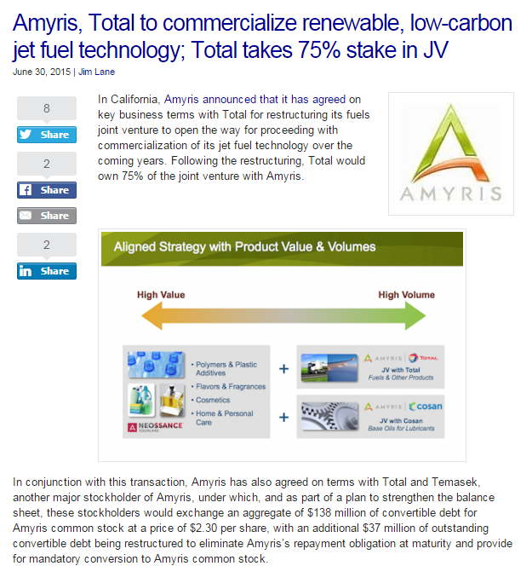
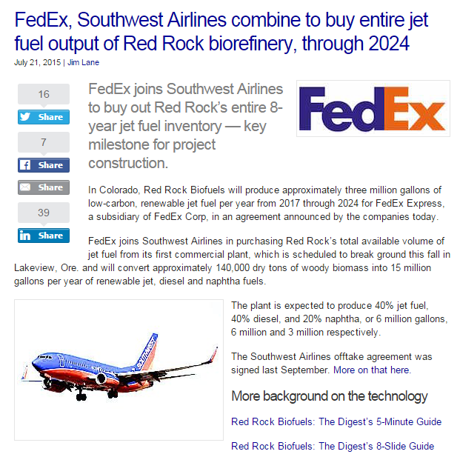
Commercialization News since last REDAC
GEVO
Altair
Fulcrum
Amyris/Total
Red Rock
>100 Million gpy by 2025
Notes:
Five significant announcements between may and july:
4 agreements between 4 Airlines and 4 fuel producers
1 agreement between fuel technology provider & major distributor
Alaska launch partner for GEVO ATJ following approval
United starts delivery this month of 3M gpy of Altair HEFA this month for 5 years offtake
United invest $30M in Fulcrum MSW to FT fuel 5 facilities offtake agreement for 10 year for up to 90M gpy
Total and Amyris joint venture for SIP jet fuel production – oil major taking on production and distribution
FedEx and Southwest to each take 3M gpy of Red Rock MSW to FT fuel for 7 years beginning 2017
Collectively represent More than 10% of our aspirational goal beginning in 2017 through 2025+
Gevo and Amyris deals don’t have numbers but presumably represent quite a bit more fuel
Other projects are in development – also represent many potential gallons.

Slide 19

Nate Brown & Mohan Gupta
Federal Aviation Administration
Office of Environment and Energy
Email: nathan.brown@faa.gov
mohan.l.gupta@faa.gov

