Slide 1
Modeling &
Tools Update
Presented to: E&E REDAC Subcommittee
By: Dr. Jim Hileman
Office of Environment and Energy
Federal Aviation Administration
Date: August 6, 2015

Slide 2
Outline
Overview of tools and analysis
Tools and Analysis roadmap
Updates on efforts to develop tool suite
Future direction

Slide 3
Tools and Analysis
We develop tools for specific purposes:
CAEP analyses
  Noise
  Emissions (NO_{X}, CO₂, and Black Carbon)
  Global Market Based Measure
Technology evaluation (e.g., CLEEN Program)
NextGen analyses
  Performance reporting (annual basis)
  Future goals analysis (out to 2050)
  Assessing benefits of NextGen
Air space and airport design & planning
Note this is not an all-inclusive list
3

Slide 4
Solution Development and Interdependencies
Modeling wide range of solutions and their consequences on fuel use, noise and emissions (e.g., basket of measures for CO₂ and a balanced approach for noise)
Policy and Scenarios
Including outputs from other tools and analyses as appropriate
Aviation Environmental Design Tool (AEDT)
Aviation Environmental Impacts Analysis (APMT-I)
Aircraft Design
Existing Aircraft, New
Aircraft, and/or Generic Fleet
Alternative Fuels
Source and Composition
Single
Flight/Airport
Regional
Global
Studies
Integrated
Noise,
Emissions,
and
Fuel Burn
Analyses
Emissions
Climate
Impacts
Emissions
& Noise
Operations
Air Quality Impacts
Emissions
Aviation Economics (APMT-E)
Noise
Impacts
Noise
Collected
Costs
Emissions,
Noise, & Fuel Burn
Monetized
Impacts
Cost Benefit Analysis
4

Slide 5
Tools and Analysis Roadmap
Objective:
  Develop a multi-year schedule for the development and use of the environmental modeling assessment tools
  Ensure clear linkage of research efforts to AEE analysis needs
  Install environmental modeling assessment tools in the AEE modeling lab
  Develop user manuals for the environmental modeling assessment tools
Process:
  Identify analyses and deadlines for deliverables, (e.g., CLEEN Tech Assessment, Goals Analysis, CAEP)
  Create flowchart of tools and data that are required for each analysis
  Link to other AEE roadmaps, as needed
  Gather information on:
    Existing linkages among tools within the AEE Tool Suite
    Internal (AEE) and external (e.g., ACRP) efforts that could aid analysis and tool development
  Populate flowchart with existing tools and databases
  Identify gaps that need to be met to enable analysis capability
  Create timeline of tool and database development that overcomes identified gaps to deliver analysis capabilities as needed
5

Slide 6
Tools and Analysis Roadmap Status
Initial draft of analysis roadmap complete
  Analysis included are:
    Technology evaluation
    NextGen analyses / Goals Assessment
    Noise, fuel burn and emissions inventories
    CAEP analyses
Tools roadmap is being developed
  Includes current and future tools development for AEE Tools Suite (focusing on AEDT, APMT-Economics and APMT-Impacts)
  Includes installation dates for relevant tools on AEE modeling lab and dates for training sessions
Further efforts
  ACRP projects are being analyzed in detail to gather relevant information for future work to enhance AEE Tools suite

Slide 7
Efforts to build In-House Tools and Analytical Capabilities
Some Previous Efforts:
Leverage existing noise and emissions inventories
Use TASOPT for aircraft technology evaluation
Query PDARS data streams for analysis projects
Efforts in 2015
Use APMT-Impacts in-house
Use rapid fleet-wide assessment tools in-house
Efforts in 2016
Continue to use APMT-Impacts and rapid fleet-wide assessment tools in-house
Install EDS in modeling lab and conduct CLEEN vehicle benefits assessment
7

Slide 8
R&D efforts related to E&E analytical capabilities
AEDT (details provided in following slides)
Rapid, fleetwide, environmental modeling tools
Aircraft performance analysis
APMT-Economics
  Developing multi-year research plan
APMT-Impacts
  Details covered in noise/emissions briefing
  Examining CBA within CAEP context - beyond US-only analysis
Alternative fuels analysis (covered in alt fuels briefing)
Operations modeling (covered in noise/ops briefing)
8

Slide 9
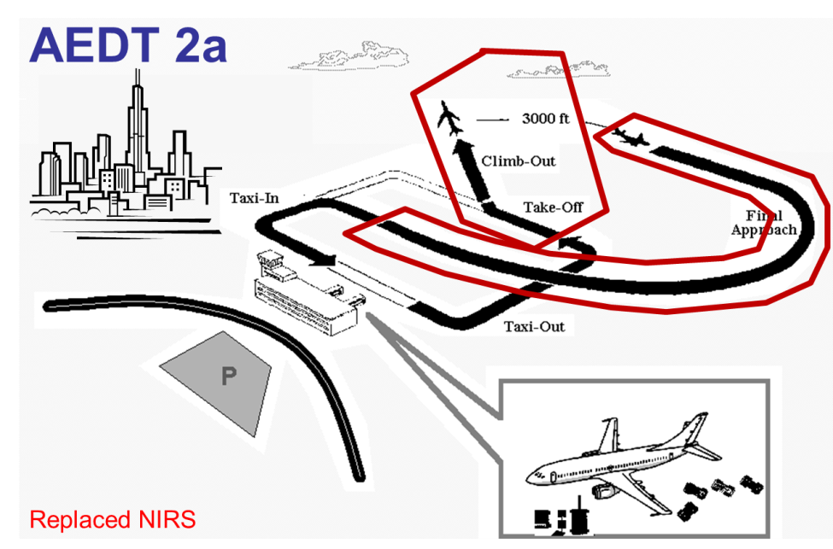
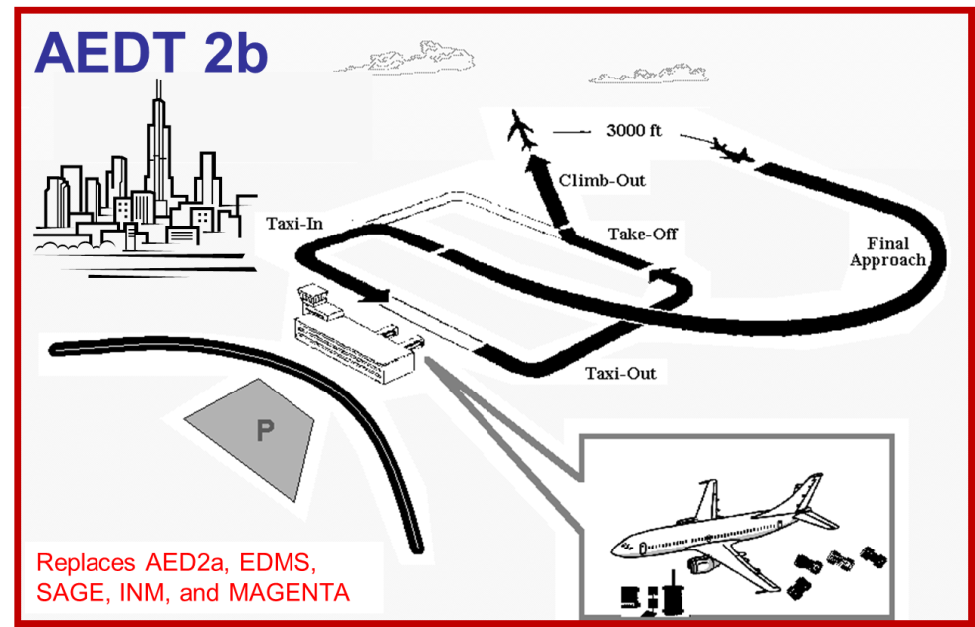
AEDT
AEDT2b released on
May 29, 2015
Available for download at: https://aedt.faa.gov/
9

Slide 10
AEDT - Continuing Projects to Improve Modeling
A11: Rapid Fleet-wide Environmental Assessment Capability
Complement AEDT with lower fidelity screening tool capability to examine large number of policy scenarios that could be quickly analyzed and reduced to a manageable set of scenarios for more focused, high fidelity analysis in the environmental tools suite.
A12: Aircraft Design and Performance Tool Connectivity with AEDT
Extend compatibility of novel and existing aircraft design and performance assessment tools with AEDT to enable assessment of future scenarios using broad range of aircraft models
A23: Analytical Approach for Quantifying Noise from Advanced Operational Procedures
  Developing analytical approach to address current noise modeling gaps such that it will be possible to capture changes in community noise due to the use of advanced operational procedures
10

Slide 11
AEDT - New Development Projects
High fidelity weather full flight modeling project
  Assessing AEDT input data methods and required software modifications
AEDT sensor path modeling development
  Implementing BADA 4 modeling with high fidelity weather for sensor path trajectories
  Performing validation via CFDR data
A35: Airline Flight Data Examination
  Using airline data to improve flight performance modeling
  Examining key performance related parameters such as takeoff weight and reduced takeoff thrust
A36: Uncertainty Assessment of AEDT2b
11

Slide 12
AEDT - Near Term Development Project
Aircraft Performance Module (APM) Improvement
AEDT APM modeling upgrades:
  Implementing BADA 4 modeling
  Using higher fidelity meteorological data
  Improve takeoff weight and takeoff thrust estimates
Enhance the performance calculations in AEDT using outputs from current funded projects and other proposed efforts
  Efforts from previous slide
  Fuel Efficiency Metric Evaluation: Using load factor information in AEDT to calculate payload-based fuel efficiency metric (BAH)
  ACRP 02-41 Estimating Takeoff Thrust Settings for Airport Emissions Inventories (Cadmus/PPC)
  ACRP 02-55 Enhanced AEDT Modeling of Aircraft Arrival and Departure Profiles (ATAC)
  Helicopter performance modeling for fuel burn and noise (VOLPE and PSU)
  Speed Controls (Specify aircraft speed trajectory in terminal area). Not being funded at the moment but possibly funded as part of AEDT APM enhancement
Convening workshop to define AEDT APM improvement needs with those involved in current AEDT development efforts
Need to coordinate effort with domestic and international stakeholders
12

Slide 13
Aircraft Performance Analysis
ASCENT Project 10 (GT, Stanford and Purdue)
  Evaluate broad set of future scenarios out to 2050, showing potential benefits of aircraft technology on fuel burn, emissions, and noise under varied growth scenarios
  Seeking input from aviation community via workshops
    Fleet evolution - one workshop completed and another to come
    Technology evolution – two workshops completed (airframe and engine) – another to come
  Will provide information for the next Goals Analysis effort
ASCENT Project 37 (GT)
  CLEEN II Technology Evaluation
  Model fleet-wide impact of CLEEN II technology use
13

Slide 14
Summary - Analysis/Tools R&D Direction
Developing roadmap to direct tool development to meet analysis needs for CAEP, NextGen, and Planning
Continuing to develop in-house analytical capabilities
Improving AEDT through targeted R&D efforts
Integrate results of ongoing ASCENT Projects relating to rapid fleet-wide modeling, aircraft technology, alternative jet fuels and operations
Started project to quantify benefits of CLEEN II Program
14

Slide 16
Tools and Analysis Roadmap 2015/2018
DUMMIFY THIS

Slide 17
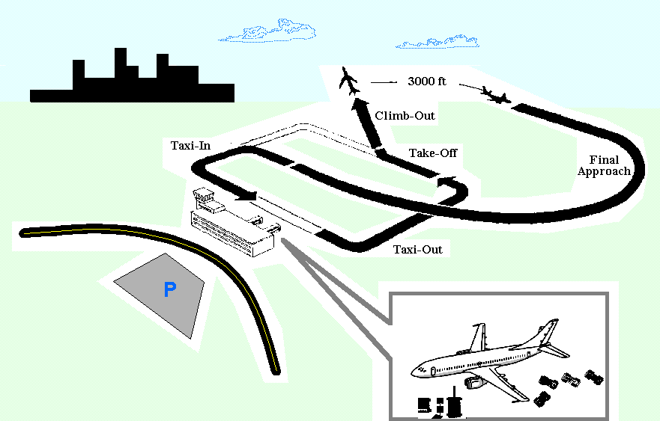
AEDT 2a
Replaced NIRS
Notes:
Runway to runway
No emissions dispersion
Use case: air traffic airspace and procedure actions, in support of FAA ATO and specifically OAPM

Slide 18
AEDT 2b
Replaces AED2a, EDMS, SAGE, INM, and MAGENTA

