Slide 1
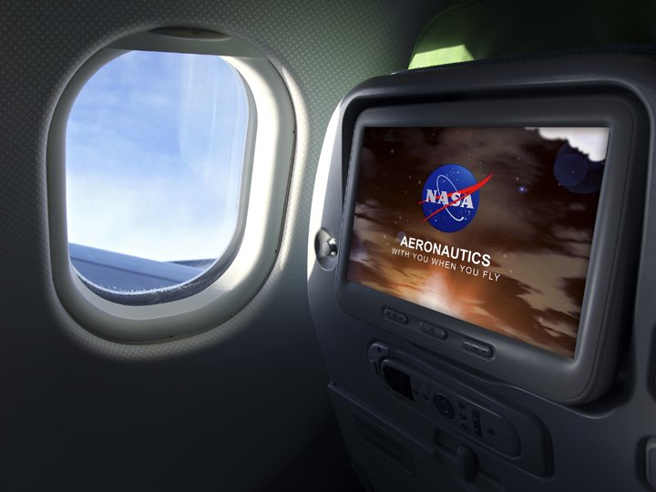
Overview of NASA Aeronautics
Jay Dryer
Program Director
Aeronautics Research Mission Directorate
August 6, 2015

Slide 2









NASA Aeronautics Six Strategic Thrusts
3 Mega Drivers
6 Strategic Research and Technology Thrusts
Safe, Efficient Growth in Global Operations
Enable full NextGen and develop technologies to substantially
reduce aircraft safety risks
Innovation in Commercial Supersonic Aircraft
Achieve a low-boom standard
Ultra-Efficient Commercial Transports
Pioneer technologies for big leaps in efficiency and
environmental performance
Transition to Low-Carbon Propulsion
Characterize drop-in alternative fuels and pioneer
low-carbon propulsion technology
Real-Time System-Wide Safety Assurance
Develop an integrated prototype of a real-time safety
monitoring and assurance system
Assured Autonomy for Aviation Transformation
Develop high impact aviation autonomy applications

Slide 3

ARMD Programs with Strategic Thrusts
Airspace Operations and Safety Program
Advanced Air Vehicles Program
Integrated Aviation Systems Program
Safe, Efficient Growth in Global Operations
Real-Time System-Wide Safety Assurance
Assured Autonomy for Aviation Transformation
Ultra-Efficient Commercial Vehicles
Innovation in Commercial Supersonic Aircraft
Transition to Low-Carbon Propulsion
Assured Autonomy for Aviation Transformation
Flight Research-Oriented Integrated, System-Level R&T support all six thrusts
X-Planes / Test Environment
MISSION PROGRAMS
Transformative Aeronautics Concepts Program
High-risk, leap-frog ideas supporting all six thrusts
Critical cross-cutting tools and technology development
SEEDLING PROGRAM

Slide 4
FY 2016 Budget
Outyears are Notional
Budget Authority | Actual FY 2014 | Enacted FY 2015 | Request FY 2016 | FY 2017 | FY 2018 | FY 2019 | FY 2020
Aeronautics | $566.0 | $651.0 | $571.4 | $580.0 | $588.7 | $597.5 | $606.4
Airspace Operations Safety |  | 154.0 | 142.4 | 153.2 | 159.6 | 160.0 | 163.0
Advanced Air Vehicles |  | 249.6 | 240.9 | 243.2 | 241.2 | 231.0 | 232.8
Integrated Aviation Systems |  | 150.0 | 96.0 | 85.6 | 89.0 | 101.6 | 104.8
Transformative Aeronautics Concept |  | 97.4 | 92.1 | 98.0 | 98.9 | 104.9 | 105.8
Aviation Safety | 80.0
Airspace Systems | 91.8
Fundamental Aeronautics | 168.0
Aeronautics Test | 77.0
Integrated Systems Research | 126.5
Aeronautics Strategy and Management | 22.7

Slide 5
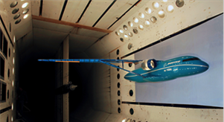
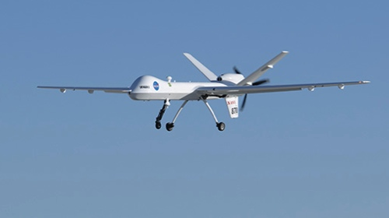
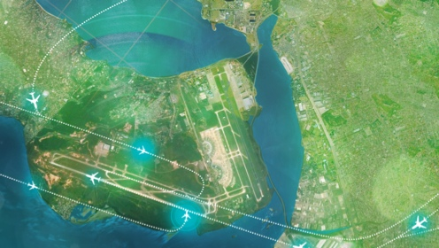
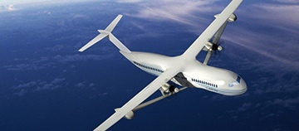
FY 2016 Budget Highlights
World leading UAS integration research:
    Completes a flight test campaign to provide data to the FAA to verify and validate Minimum Operational Performance Standards to enable safe operations of Unmanned Aircraft Systems (UAS) in the National Airspace System.
  Expands upon UAS Traffic Management (UTM) Build 1 capabilities to enable dynamic UAS mission and trajectory adjustments providing increased safety and operational complexity for an expanded range of aircraft and business objectives
Transformative concepts and technologies:
    Develops a detailed conceptual design of a revolutionary hybrid gas-electric propulsion system which has potential benefits of reduced noise, emissions, and energy consumption compared to today’s turbine engines
  Continued success in transitioning NextGen Air Traffic Management (ATM) technologies to FAA:
  Completes development of the prototype Flight-Deck Interval Management Avionics for ATM Technology Demonstration-1 and prepares for future flight trial validation
High-Impact collaborations to reduce aircraft environmental impacts:
Begins a series of flight demonstrations to both mature candidate environmentally friendly technologies and transfer them to US industry
Begins high-fidelity validation experiments to improve accuracy of computational tools used in advanced aircraft design

Slide 6
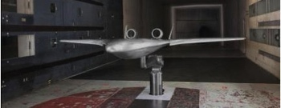
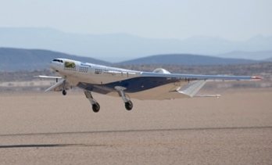
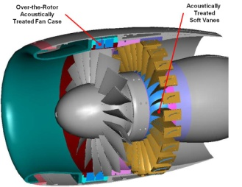
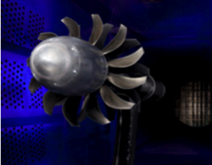
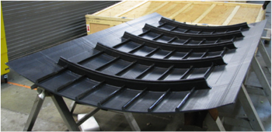
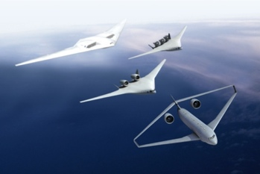
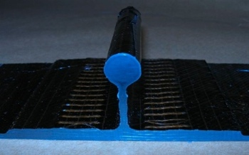
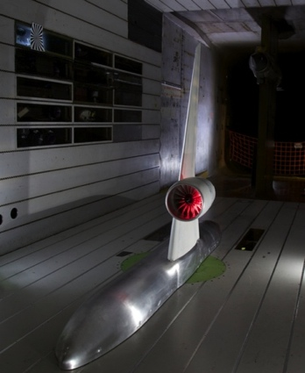
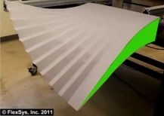
Environmentally Responsible Aviation
Mature technologies and study vehicle concepts
that together can simultaneously meet the NASA Subsonic Transport System Level Metrics for noise,
emissions and fuel burn in the N+2 timeframe.
-75% LTO & -70% Cruise NOx Emissions
42dB below Stage 4 Community Noise
-50% Aircraft Fuel/ Energy Consumption
Technical Focus Areas
Accelerate technology maturation
through integrated system research
Innovative Flow Control Concepts for Drag Reduction
Advanced Composites for Weight Reduction
Advanced UHB Engines for SFC & Noise Reduction
Advanced Combustors for Oxides of Nitrogen reductions
Airframe & Engine Integration for Community Noise Reduction

Slide 7
Opening New Markets – Commercial Supersonics
NASA released an RFI seeking information from the external community to seek input on NASA’s strategic direction for the supersonic portfolio as well as opinions on potential flight demonstration approaches.
NASA hosted a meeting on July 16, 2015 to 1) provide briefings from NASA and the FAA, 2) encourage group discussion of the responses in addition and 3) provide an opportunity for individual discussions with each group.
Continuing to work with the FAA through CAEP on potential new standards.
Good opportunities to coordinate NRA investments with ASCENT research.

Slide 8


Summary
NASA Aeronautics is celebrating 100 years of excellence—from NACA to NASA
NASA Aeronautics is ready to usher in the next 100 years of excellence
    Compelling, community-endorsed vision and strategy
    Demonstrated ability to perform high impact research, complete our
    commitments, and deliver results
    (Environmentally Responsible Aviation Project, Research Transition Teams)
    Taking on the community’s most urgent needs
    (Unmanned Aircraft Systems integration into the National Airspace System)
    Leading the community with transformative concepts and solutions
    (UAS Traffic Management, Future Aircraft Concepts, Computational Fluid
    Dynamics 2030 Vision)
    Successfully collaborating with universities and industry
    (NASA Research Announcements, cost-sharing cooperative agreements)
    Global thought leaders that are leveraging international capabilities
    (International Forum for Aviation Research)

