Slide 1
FY 2017 Environment and Energy Program Proposal
To: REDAC E&E Subcommittee
By: Dr. Jim Hileman Chief Scientific & Technical Advisor for Environment and Energy
Office of Environment and Energy
Date: March 17, 2015

Slide 2
Presentation Outline
Environment and Energy Portfolio Overview
Financial Summary
PPT Financial Summary Table
PPT 5-Year Financial Plan Table
Quad Charts
Summary

Slide 3
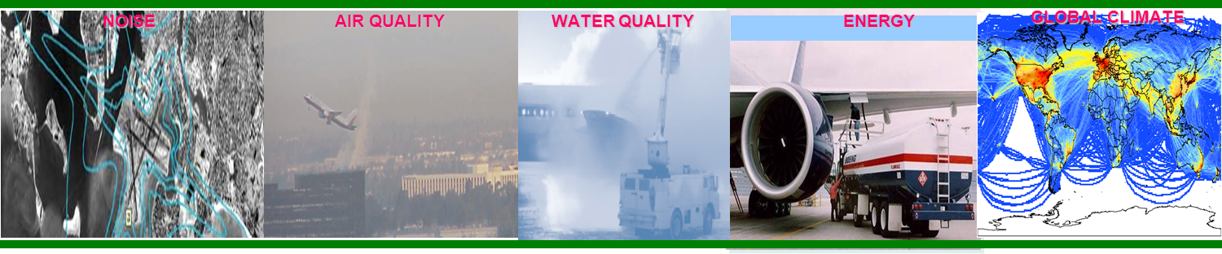
Aviation Environmental Challenges
NOISE AIR QUALITY WATER QUALITY ENERGY GLOBAL CLIMATE
Aviation impacts community noise, air quality, water quality, energy usage, and climate change
Environmental impacts from aviation could pose a critical constraint on capacity growth

Slide 4
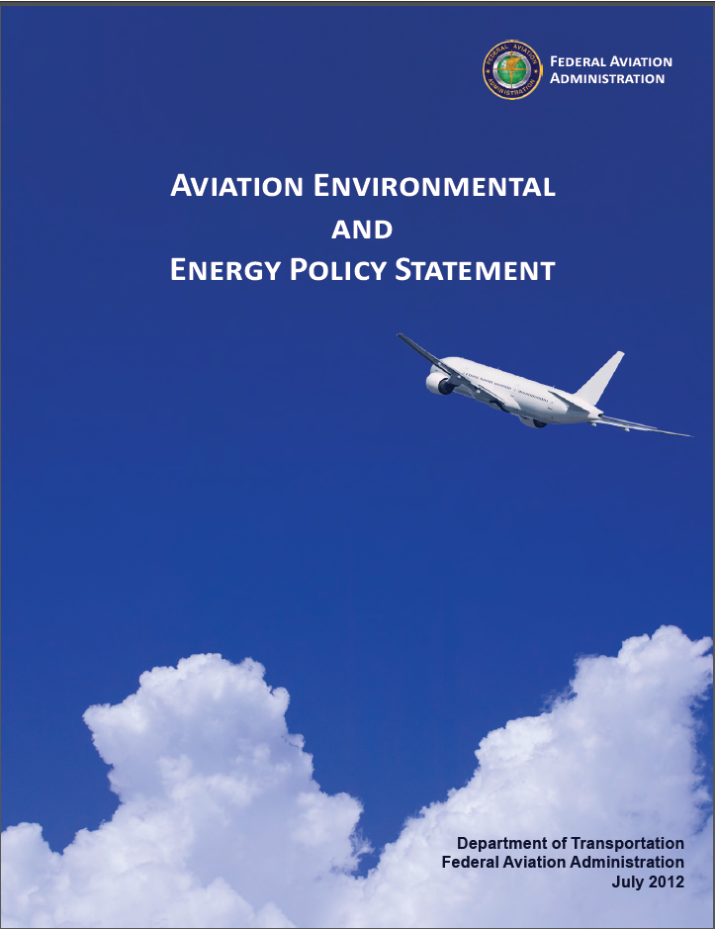
Vision and Principles
Vision:
Environmental protection that allows sustained aviation growth
Guiding Principles:
Limit and reduce future aviation environmental impacts to levels that protect public health and welfare.
Ensure energy availability and sustainability.
Want increased mobility with reduced environmental impacts and enhanced energy availability and sustainability
Aviation E&E Policy Statement (Federal Register 77-141, 2012): http://www.faa.gov/about/office_org/headquarters_offices/apl/environ_policy_guidance/policy/media/FAA_EE_Policy_Statement.pdf

Slide 5
Environment & Energy Goals
Aspect | Goal
Noise | Reduce the number of people exposed to significant noise around U.S. airports in absolute terms, notwithstanding aviation growth, and provide additional measures to protect public health and welfare and our national resources.
Air Quality | Achieve an absolute reduction of significant air quality health and welfare impacts attributable to aviation, notwithstanding aviation growth.
Energy | Improve National Airspace System (NAS) energy efficiency and develop and deploy alternative jet fuels for commercial aviation.
Climate | Limit the impact of aircraft CO2 emissions on the global climate by achieving carbon neutral growth by 2020 compared to 2005, and net reductions of the climate impact from all aviation emissions over the longer term (by 2050).
Aviation E&E Policy Statement (Federal Register 77-141, 2012): http://www.faa.gov/about/office_org/headquarters_offices/apl/environ_policy_guidance/policy/media/FAA_EE_Policy_Statement.pdf

Slide 6
Environment & Energy Strategy
Environmental protection that allows sustained aviation growth
NextGen Five-Pillar Environmental Approach
P1: Improved Scientific Knowledge and Integrated Modeling
P2: New Aircraft Technologies
P3: Sustainable Alternative Aviation Fuels
P4: Air Traffic Management Modernization and Operational Improvements
P5: Policies, Environmental Standards, and Market Based Measures
Aviation E&E Policy Statement (Federal Register 77-141, 2012): http://www.faa.gov/about/office_org/headquarters_offices/apl/environ_policy_guidance/policy/media/FAA_EE_Policy_Statement.pdf

Slide 7
AEE Research Objectives
Resolve key E&E questions relating to the environmental impacts of aircraft noise and emissions and provide sound scientific data to inform policy making relating to aviation’s energy use and environmental impacts.
Develop and implement integrated aviation environmental tool suite that can evaluate environmental impacts of aviation and potential mitigation options.
Identify solutions that will reduce environmental impacts and/or improve energy efficiency.
Investigate E&E effects of solutions with aviation environmental tool suite.
Accelerate solution maturation with our partners in government, industry and academia.
Analyze environmental and economic impacts, trade-offs and cost-benefit assessments of both domestic and international policy options and scenarios.
Evaluate progress toward E&E goals and develop research roadmaps that resolve identified gaps with solutions.
Mitigation Concepts:
Aircraft Technology
Alternative Jet Fuels
ATM Modernization / Ops Improvements

Slide 8
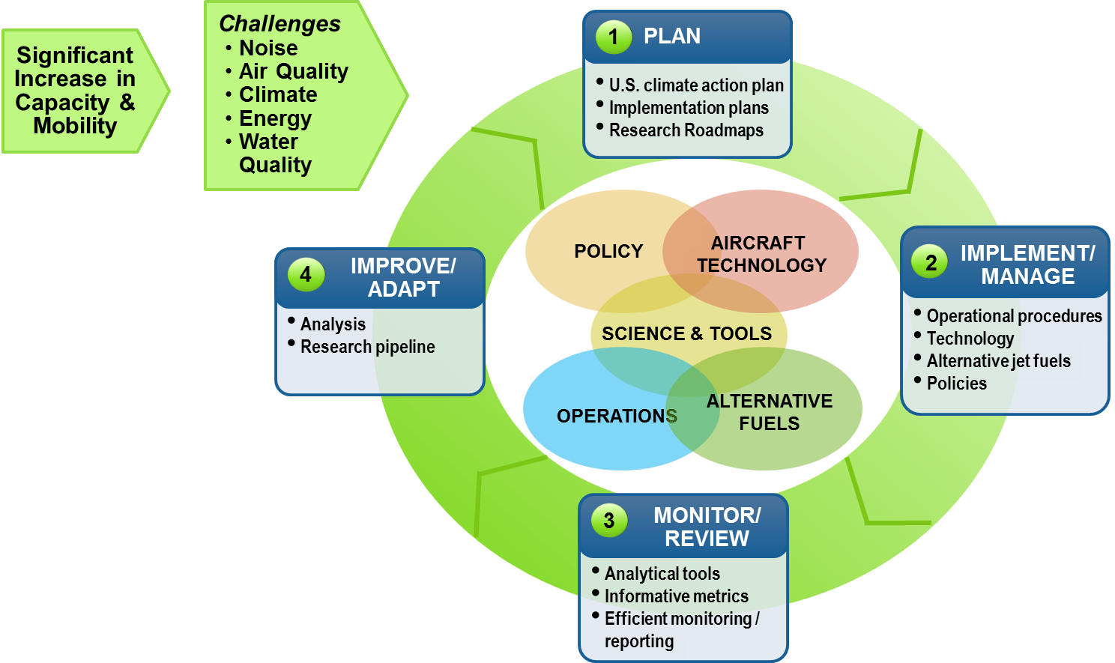
In Summary: Environment & Energy Program
Strategy for Environmentally Sustainable Aviation Growth

Slide 9

Recognizing Excellence and Leadership in Air Transportation for the Environment (RELATE)
Stakeholder Collaboration Program Phases, Activities, and Schedule
Activities | Schedule
FAA established a cross-functional Stakeholder Core Group in collaboration with industry | July 2013 – March 2015
Conduct the Pilot Test Project with a broader set of stakeholders Kickoff Meeting April 28, 2015 Complete Website Phase I http://relate.faa.gov | Spring – Summer 2015
Full launch of RELATE Complete Initial Portal (Phase II) | Spring 2016

Slide 10




Research Programs
Center of Excellence (COE) Program
Focused on university research
PARTNER projects have been transitioned to ASCENT
Continuous Lower Energy, Emissions and Noise (CLEEN)
CLEEN I: 2010-2015
CLEEN II: 2015-2020
Reduce aircraft fuel burn, emissions and noise through technology & advance alternative jet fuels
Additional Research Efforts
Volpe Transportation Center
Contract mechanisms (e.g., SEMRS, PEARS)
PARTNER: http://partner.aero
ASCENT: http://ascent.aero
CLEEN Program: http://www.faa.gov/about/office_org/headquarters_offices/apl/research/aircraft_technology/cleen/
Volpe Center: http://www.volpe.dot.gov/our-work/policy-planning-and-environment

Slide 11
ASCENT Research Areas – Year 1
Continued PARTNER COE Research Areas
Noise research
Emissions measurements
Air quality and climate modeling
Aircraft performance evaluation and tool development
Exploration of novel operational procedures
Analysis and research to support ICAO CAEP
New Research Areas for ASCENT
Helicopter Noise
Alternative Jet Fuel Supply Chain Analysis
National Jet Fuel Combustion Program

Slide 12
ASCENT Project Connectivity An example showing how results from A1, A10, A11, A12 and A23 feed Goals Analysis
ASCENT Project 1
AJF Supply Chain Analysis
Future Alt Jet Fuel (AJF) Production
ASCENT Project 11
Rapid Fleetwide Modeling
Future Aviation Demand
Fleet Evolution
Aircraft Technology Evolution
ASCENT Project 10
Aircraft Technology Evaluation
Scenarios of future fuel burn and emissions
AEDT
(connection enabled by P14, P48, and A12 efforts)
ASCENT Project 23
Improved Modeling of Noise from Op Procedure Changes
Scenarios of future noise, fuel burn and emissions accounting for AJF, technology and operations

Slide 13
ASCENT Projects – Status
ASCENT Projects – funded using previous year budget
Stood up 34 projects with $11.8M of funding
Projects have varied periods of performance as we stood them up over time
A31, A32, and A33 just now being funded
ASCENT Projects – funded using FY15 budget
Anticipate $7.4M going to COE projects from FY15 budget
Some FY14 projects will be funded with current team and project number
Planning for a few new projects
New projects will use same process from last year – have renamed NOI to NFO (Notice of Funding Opportunity) for consistency with other grant programs – going with a fixed timeframe for these new projects (see next slide)
All FY15 funded projects will use new proposal template. Want to ensure:
Project numbers are captured in title of proposal
Reporting is more clearly presented

Slide 14
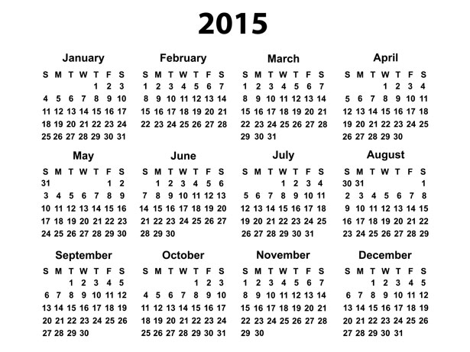
ASCENT Projects Timeline
New project NFOs will be coming out on March 20 with due date of April 10
New project teams will be selected by FAA by April 17
Existing projects that are getting FY15 funds should have their paperwork into grants.gov by April 17
New projects have paperwork into grants.gov by May 15
Existing and new project start dates will be on or after August 15

Slide 15
Continuous Lower Energy, Emissions and Noise (CLEEN) Phase II
FAA R&D Program:
Reduce aircraft fuel burn, emissions and noise through technology & advance alternative jet fuels
Public private partnership with 1:1 minimum cost share requirement
CLEEN I: 2010-2015 ($125M FAA Funding)
Boeing, GE, Honeywell, Rolls Royce, and Pratt & Whitney
CLEEN II: 2015-2020 ($100M FAA Funding)
Following model of first phase of CLEEN program
Solicitation closed – expect award in mid-2015
Initially planned for $15M per year of NextGen RE&D and $5M per year of NextGen F&E funding = $20M per year total funds
Current plan includes $18M per year of NextGen RE&D funding with no F&E funding = $18M per year total funds
Additional information on CLEEN Program: http://www.faa.gov/about/office_org/headquarters_offices/apl/ research/aircraft_technology/cleen/

Slide 16
Environment & Energy Portfolio
Core RE&D (A13.a) Environment & Energy
Improve scientific understanding of environment & energy constraints
Incorporate scientific knowledge into an integrated tool suite
Evaluate policy measures and environmental standards
NextGen RE&D (A13.b) Environmental Research
Mature airframe and engine technologies
Advance sustainable alternative jet fuels
Examine clean, quiet and energy efficient operational procedures and ATM-related technologies
NextGen F&E (1A08D) Environment Portfolio
Environmental analysis support to NextGen
Aviation E&E Policy Statement (Federal Register 77-141, 2012): http://www.faa.gov/about/office_org/headquarters_offices/apl/environ_policy_guidance/policy/media/FAA_EE_Policy_Statement.pdf

Slide 17
PPT Financial Summary
 | FY 15 Enacted |  | FY 16 Request |  | FY 17 Target
Program Title | In-House | Contracts | In-House | Contracts | In-House | Contracts
Base Program (Funding Appropriation)
A13.a. Environment and Energy (R,E&D) | 2,303,000 | 12,618,000 | 2,108,661 | 12,952,134 | 1,983,936 | 13,139,061
Base Subtotal |  |  | 2,108,661 | 12,952,134 | 1,983,936 | 13,139,061
NextGen Program (Funding Appropriation)
A13.b. NextGen Environmental Research – Aircraft Technologies, Fuels and Metrics (R,E&D) | 628,000 | 22,386,000 | 444,011 | 23,379,027 | 440,165 | 23,792,759
Above Target Request |  |  |  |  |  | 5,000,000
1A08D (F&E) NextGen Environment Portfolio |  | 5,500,000 |  | 1,000,000 |  | 1,000,000
NextGen Subtotal | 628,000 | 27,886,000 | 444,011 | 24,379,027 | 440,165 | 24,792,759
With Above Target Request |  |  |  |  |  | 29,792,759
PPT Total | 2,931,000 | 40,504,000 | 2,552,672 | 37,331,161 | 2,424,101 | 37,931,820
With Above Target Request |  |  |  |  |  | 42,931,820

Slide 18
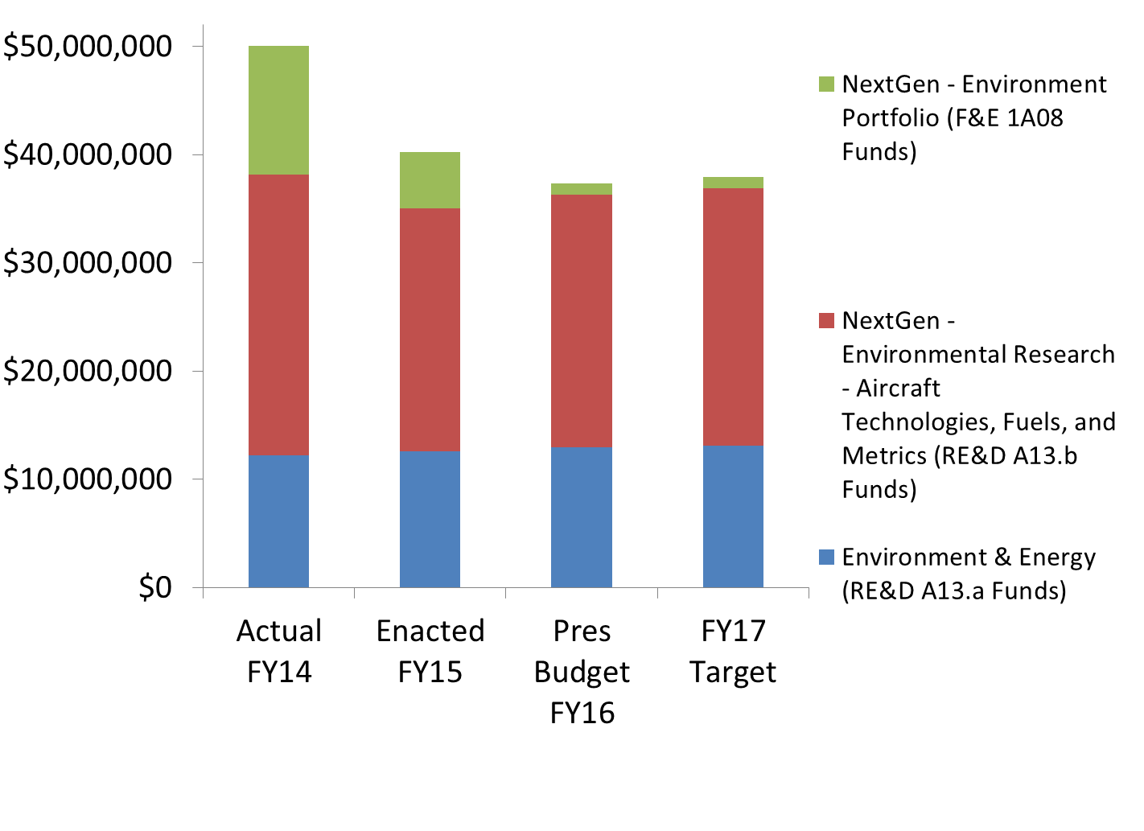
FY14-17 Financial Summary
Not shown on graph:
Office of Airports (ARP) provides ~$1.75M/year for environment projects (partially starting in FY16)
Airports Cooperative Research Program (ACRP) provides ~$5M/year for environment projects
FAA FY 2016 President’s Budget available at http://www.dot.gov/sites/dot.gov/files/docs/FY2016-BudgetEstimate-FAA.pdf

Slide 19
PPT 5-Year Financial Plan
Program | Out-Year Contract Dollars
 | FY 2017 | FY 2018 | FY 2019 | FY 2020 | FY 2021
Base Program (Funding Appropriation)
A13.a. Environment & Energy | 13,139,061 | 13,438,099 | 13,384,035 | 13,441,865 | 13,727,752
Base Subtotal | 13,139,061 | 13,438,099 | 13,384,035 | 13,441,865 | 13,727,752
NextGen Program (Funding Appropriation) | 23,792,759 | 24,354,161 | 24,469,305 | 24,732,078 | 25,290,934
A13.b. NextGen Environment & Energy-Aircraft Technologies, Fuels and Metrics (R,E&D) | 23,792,759 | 24,354,161 | 24,469,305 | 24,732,078 | 25,290,934
Above Target Request | 5,000,000 | 5,000,000 | 5,000,000 | 5,000,000 | 5,000,000
1A08D (F&E) NextGen Environment Portfolio | 1,000,000 | 0 | 0 | 0 | 0
NextGen Subtotal | 24,792,759 | 24,354,161 | 24,469,305 | 24,732,078 | 25,290,934
With Above Target Request | 29,792,759 | 29,354,161 | 29,469,305 | 29,732,078 | 30,290,934
PPT Total | 37,931,820 | 37,792,260 | 37,853,340 | 38,173,943 | 39,018,686
With Above Target Request | 42,931,820 | 42,792,260 | 42,853,340 | 43,173,943 | 44,018,686

Slide 20
Core RE&D Program (A13.a) - Environment & Energy
FAA Strategic Plan
Research Goals
Deliver Benefits Through Technology and Infrastructure
Enhance global leadership
Develop engine exhaust emissions and noise measurement protocols and expand database for aircraft engine emissions and noise certification
Advance scientific understanding of aviation noise and emissions and their environmental, health and welfare impacts to inform decision-making and enable solution development
Improve the quantification of aviation environmental impacts to enable solution development
Develop, implement, and use integrated aviation environmental tool suite to evaluate energy and environmental impacts of aviation and potential mitigation options
Analyze environmental and economic impacts, trade-offs and cost-benefit assessment of both domestic and international policy options and scenarios
Need
Characterize environmental and energy challenges
Develop and implement mitigation solutions
Enhance international leadership on environment and energy matters
FY 2017 Milestones
Advance the understanding of noise impacts on social welfare and health
Improve ability to model the air quality impacts of aviation emissions
Refine methods for estimation of aircraft contribution to climate change and implement them in analytical tools.
Enhance the aviation environmental tool suite to improve its ability to calculate environmental consequences and impacts of aviation
Analyze mitigation options for reducing environmental impacts including policy measures and standards being developed at ICAO CAEP
Out Year Funding Requirements
 | FY 2017 | FY 2018 | FY 2019 | FY 2020 | FY 2021
Funding Target ($000) | 13,139 | 13,438 | 13,384 | 13,442 | 13,728
Note these are contract dollars

Slide 21
NextGen RE&D Program (A13.b) - Environmental Research - Aircraft Technologies, Fuels, and Metrics
FAA Strategic Plan
Research Goals
Deliver Benefits Through Technology and Infrastructure
Enhance global leadership
Via the CLEEN Program, demonstrate certifiable aircraft and engine technology that reduces noise levels, landing and takeoff cycle (LTO) nitrogen oxide emissions, and fuel burn.
Overcome barriers to the development and deployment of sustainable “drop-in” alternative jet fuels.
Develop surface, departure, en route, and arrival operational procedures and ATM-related technologies that could reduce noise, emissions, and fuel burn.
Evaluate progress towards aviation environmental and energy goals to aid in developing new mitigation options.
Need
Characterize environmental and energy challenges
Develop and implement mitigation solutions
Enhance international leadership on environment and energy matters
FY 2017 Milestones
Continue second round of CLEEN activities (CLEEN II) in year 3 to assess and demonstrate aircraft and engine technologies to reduce energy use, emissions, and noise.
Support the approval of additional alternative jet fuel pathways via ASTM International.
Support the inclusion of environmental and economic evaluations of alternative jet fuels into tools and databases for use by government, industry and academia.
Submit a report evaluating progress towards meeting NextGen environmental goals that identifies performance gaps and mitigation solution needs.
Out Year Funding Requirements
 | FY 2017 | FY 2018 | FY 2019 | FY 2020 | FY 2021
Funding Target ($000) | 23,793 | 24,354 | 24,469 | 24,732 | 25,291
Above Target Request | 5,000 | 5,000 | 5,000 | 5,000 | 5,000
This above target request would accelerate the maturation of aircraft technologies and alternative jet fuels that would help to mitigate aviation’s impact on the environment.
Note these are contract dollars

Slide 22
NextGen F&E (1A08D) - Environment Portfolio
FAA Strategic Plan
Research Goals
Deliver Benefits Through Technology and Infrastructure
Enhance global leadership
Develop environmental assessment capabilities that are integrated with NAS design tools, simulation models and performance monitoring systems.
Need
Characterize environmental and energy challenges
Develop and implement mitigation solutions
Enhance international leadership on environment and energy matters
FY 2017 Milestones
Enhance Aviation Environmental Design Tool (AEDT) capabilities.
Further integrate NextGen simulation models and data with aviation environmental tools.
Out Year Funding Requirements
 | FY 2017 | FY 2018 | FY 2019 | FY 2020 | FY 2021
Funding Target ($000) | 1,000 | 0 | 0 | 0 | 0
The elimination of F&E funds will limit the FAA’s ability to evaluate the environmental performance of NextGen
Note these are contract dollars

Slide 23
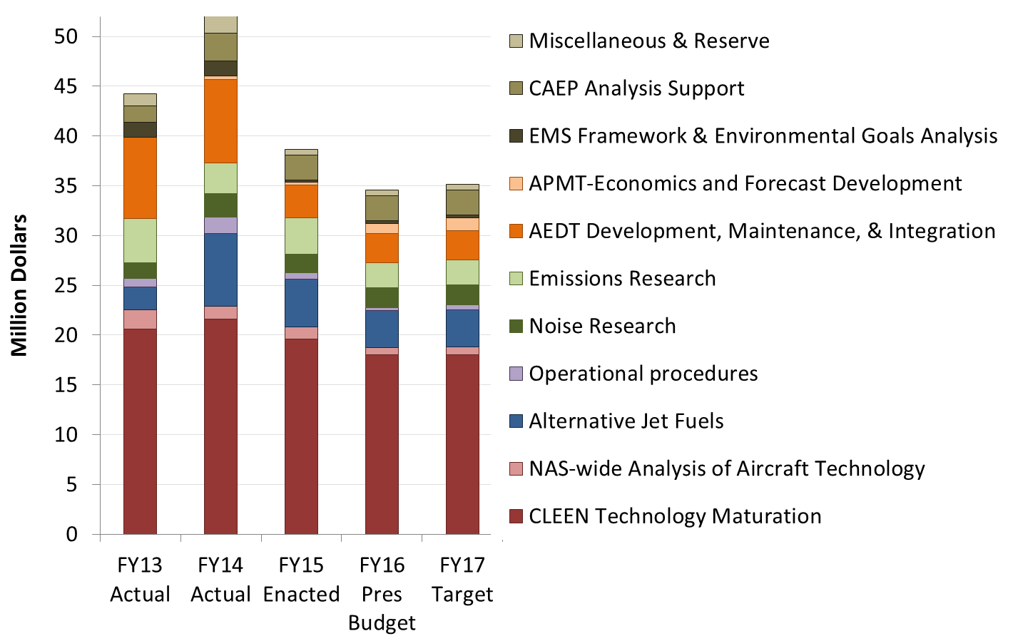
Environment and Energy Program Funding
Office of Airports (ARP) has been providing funding for community noise survey. Starting in FY16 they will be providing additional funds for environment projects.

Slide 24
E&E Subcommittee Action Item
“Provide a briefing at the next meeting on the research that has been dramatically curtailed and cut due to reduction in FY15 budget levels”
These efforts have been dramatically curtailed:
CLEEN aircraft technology maturation
Alternative jet fuel testing and analysis
Operational procedure development and implementation
AEDT2b development
Climate research

Slide 25
ASCENT Funding Summary
Research Area | ASCENT Project #s (N = New) | FY13/FY14 Grant Amount | Est. FY15 Grant Amount
Emissions Measurements | 2 | $2,300,000 | $500,000
Air Quality and Climate Modeling | 18-20, 22 | $800,000 | $800,000
Noise Research | 3-5, 7, 8, 17 | $795,000 | $895,000
Analytical Tool Development | N | $0 | $135,000
Aircraft Technology Modeling | 10-12, N | $1,240,000 | $1,200,000
Alt Jet Fuel Analysis | 1, 13, 21, 32, N | $2,270,000 | $1,250,000
Alt Jet Fuel Testing | 24-31, 33, 34 | $2,995,000 | $1,475,000
Operational Procedures | 6, 15, 16, 23, N | $790,000 | $600,000
Analysis to support Environmental Standard Setting | 14 | $720,000 | $0
Total: |  | $11,760,000 | $7,355,000

Slide 26
Summary
Noise, emissions and the need for a sustainable and secure energy supply remain critical issues facing the growth of aviation
Success in developing capabilities and solutions that are helping today:
CLEEN aircraft and engine technologies appearing in next generation of aircraft with FMS technologies retrofitted into today’s fleet - reduces noise, emissions and fuel use
Certification of three alternative jet fuel pathways – certification enabled United Airlines to sign agreement to buy and use biofuel at LAX
N collaborative surface control – successfully tested at Boston Logan airport and will be tested at New York LaGuardia airport – integration with Terminal Flight Data Management (TFDM) program
Aviation Environmental Design Tool being used for metroplex assessments
Integrated tool suite and analyses are supporting international environmental standard setting for noise and emissions; alternative jet fuels and a global market based measure for international aviation
Standing up CLEEN II Program
Reduced funding limits our ability to develop solutions that could prevent environment from being a constraint on aviation growth – above target request would help to overcome this

