Slide 1
PM Measurement and Standard Development
REDAC E&E Subcommittee
S. Daniel Jacob, Ph.D.
March 17, 2015

Slide 2
Outline
Goal and Objectives
nvPM Measurement
Standardized Measurement System
Measurement Campaigns
nvPM Standard
CAEP/10 Transition Standard
CAEP/11 LTO based Standard
Notes:
It is well known that there is no PM standard for aircraft engines. The first order approximation is used to estimate PM mass concentrations from certification smoke number measurements. It should be noted that the smoke number standard was developed originally as a visibility standard.

Slide 3
Goal and Objectives
Goal:
Develop an international non-volatile particulate matter (nvPM) emissions standard for turbofan engines of rated thrust > 26.7 kN
Objectives to accomplish the goal:
Development of a standardized nvPM measurement system
Provide international leadership and information to the ICAO CAEP standard setting process for the development of nvPM emissions standard for engines.
Contributions from: EPA, NASA, Transport Canada, Swiss FOCA, EU EASA, MS&T, Aerodyne, NRC Canada, Swiss EMPA, Swiss ETH and many Industry Partners
Notes:
The overall goal of the emissions measurements that are presented here is to facilitate the development of a standardized non-volatile particulate matter (nvPM) sampling system. This is the first step toward developing a certification requirement and a PM standard at the ICAO CAEP level.

Slide 4
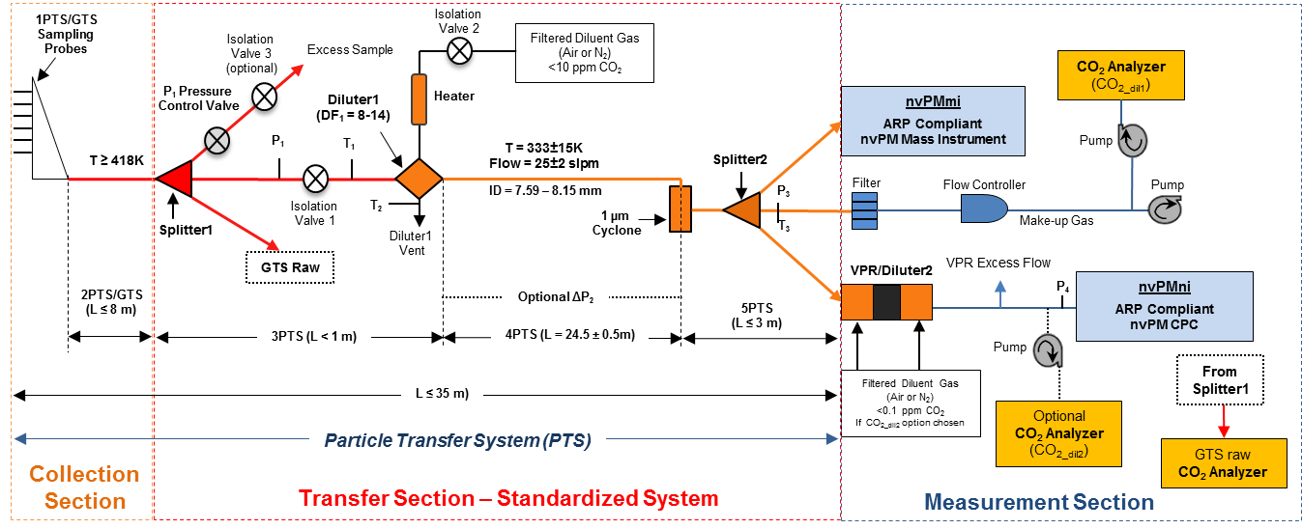
Standardized nvPM Measurement System - Certification Grade
AIR 6241 (Nov 2013) + Added Instrument Requirements
Mass
Number
Notes:
While research grade PM sampling systems have been used to acquire nvPM mass and number concentrations, a conceptual non-volatile PM sampling system was developed by January 2011 by SAE E31. The probe is on the left with FS1 indicating the first splitter. Until the first splitter, the particle or gas transfer system remains identical to that of the Annex 16 gaseous sampling system. At the first splitter, there is a 1:3 split with one line continuing on to the Annex 16 system. A PM line connects to an eductor where the PM sample is diluted with Nitrogen to prevent volatile PM from forming. The sample is then taken downstream through a standard length of line through a cyclone in to the mass and number concentration measuring instruments.

Slide 5
nvPM Measurement Systems
Reference Systems
FOCA Empa ETH

Slide 6
Measurement Campaigns
System Development and Validation:
Alternative Aviation Fuels EXperiment II – Mar 2011: Palmdale, CA
“APRIDE 2” SR Technics Campaign – Dec 2011: Zurich, Switzerland
“APRIDE 4” SR Technics Campaign – Nov 2012: Zurich, Switzerland
System Robustness and Intercomparison:
“APRIDE 5” SR Technics Campaign – August 2013: Zurich, Switzerland
Three systems (North American, EU and Swiss Reference Systems)
OEM Demonstration, System Intercomparison and Data Acquisition:
Pratt & Whitney Canada – April 2013: Ontario, Canada
Williams International Campaign – May 2013: Walled Lake, MI
Pratt & Whitney US – March 2014: East Hartford, CT
Honeywell – July 2014: Phoenix, AZ
Rolls Royce North America – March 15-22, 2015: Indianapolis, IN
GE Aviation – Apr-May 2015: Peebles, OH (Two engine tests)
Pratt & Whitney US – April 2015: East Hartford, CT

Slide 7
Current Status
Mass Instrument Bias:
One mass instrument consistently read lower in more recent tests
Additional requirement added to the specifications
Testing at Rolls Royce UK supported by Transport Canada will address correction of already acquired data
AIR 6241 will inform ICAO Annex 16 Vol II Update:
ICAO – SAE MoU issues affecting schedule
Near term solution is for CAEP WG3 to update Annex 16 Vol II for Certification Requirement
ARP not needed with this approach

Slide 8
Transition Standard (1/2)
CAEP/10 nvPM Standard
Equivalent to Smoke Number and is a first step to a full standard
Named “Transition Standard” by WG3
Metric = maximum nvPM mass concentration
Measured by CAEP/10 nvPM Certification Requirement which includes reporting of:
nvPM mass & number EIs for 4 LTO points
Maximum nvPM EI mass
Maximum nvPM EI number
Regulatory Level = Curve for maximum nvPM mass concentration calculated from existing maximum Smoke Number (SNmax) curve

Slide 9
May 17, 2012
May 30, 1958

Slide 10
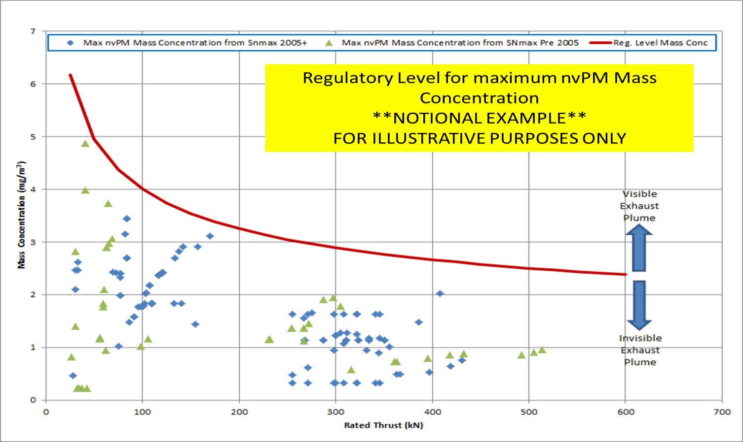
Transition Standard (2/2)

Slide 11
Benefits of a Transition Standard
Invokes Certification Requirement for nvPM mass and number
Allows for a robust nvPM dataset to be generated in 6 years (by 2020)
Establishes initial ground work to replace SN standard with nvPM mass and number standard after 2020
Corrections for ambient conditions, fuel sensitivity and engine-to-engine variability not needed for compliance at this time

Slide 12
CAEP/11 LTO Based nvPM Mass and Number Standard
Full Standard Setting Process in CAEP/11:
Develop metric system
Develop stringency options
Develop technology response
Conduct cost effectiveness analyses
Determine LTO-based nvPM mass and number regulatory levels
Requires data from 25 representative engines by February 2017
Refine and finalize corrections for ambient conditions, fuel sensitivity and engine-to-engine variability
Refine steps to replace SN standard with nvPM mass and number standard

Slide 13
2014
2015
2016
2017
2018
2019
NVPM MODELING V&V
(MDG & FESG)
NVPM CE Initial Analysis
(MDG & FESG)
Nov 2018
NVPM CE
Final Analysis
(MDG & FESG)
CE ANALYSIS
MDG
MDG→FESG
SG
SG
CAEP10
SG
SG
SG
CAEP11
TECH ANALYSIS
STRINGENCY OPTION
DEVELOPMENT
WG3
TECHNOLOGY RESPONSE
DEVELOPMENT
WG3/WG1
NVPM MODELING METHOD
WG3/MDG
ANALYSIS PREPARATION
Analysis Framework
MDG/FESG
Analysis Cases
WG3/FESG/MDG
NVPM STANDARD
CAEP/10 Cert
Requirement and
“Transition Standard”
Insert Applicability
& Limit
WG3
WG3
WG3
Draft ETM update
DATA
ANNEX 16 VOL.II CAEP/10 UPDATE
Reporting Req’ts
ANNEX 16 VOL. II CAEP/11 UPDATE (draft applicability & regulatory limit text)
Max Concentration and
Equivalent Smoke Number
Metric
Equiv. Reg. Level
LTO nvPM Mass and Number Metric
Metric
Values
Representative Engine Data
COLLABORATIVE REPORTING
COLLABORATIVE REPORTING
Forecast, COD, Retirement Curves, G&R plus Δmetric values, Industry Response
CE Analysis
Data
MESG Inputs
Final nvPM method
Line Loss Method
CAEP10 STANDARD ADOPTION

Slide 14
25 Representative Engines
GE – US
1 Done
2 Funded
4 Unfunded
P&W – US and Canada
1 Done
3 Funded
3 Unfunded
Rolls Royce – UK & Germany
2 Done
1 Funded
2 Unfunded
US$ 300-500k per test
Honeywell – US
1 Funded
1 Unfunded
Rolls Royce – US
1 Funded
Snecma – France
2 Unfunded
Significant Data Gap
12 Unfunded Engines
Negotiations to support six unfunded US Engine tests have started

Slide 15
Smoke Number to Max Mass Concentration Transition Timeline
2015
2016
2017
2018
2019
SG
CAEP10
SG
SG
SG
CAEP11
Correlation Data Base (CDB)
Populate
SN to Mass Concentration
Transition Standard
Develop
Correlation
ANNEX 16 VOL.II CAEP/10 UPDATE
CAEP/10 Cert
Requirement and
“Transition Standard”
Representative Engine Data
COLLABORATIVE REPORTING
TRANSITION STANDARD REPORTING
SN Replacement
SN to Mass Concentration Update
Updated Correlation Data Base (uCDB)
Updated SN to mass concentration
ANNEX 16 VOL.II CAEP/11 UPDATE TO REMOVE SN and REPLACE WITH MAX MASS CONCENTRATION
CAEP10 STANDARD ADOPTION

Slide 16
Summary
Good Progress is being made
Engine/ Combustor Rig Tests toward development of corrections for ambient conditions sensitivity and fuel specifications and engine to engine variability
FOCA Fuel Sensitivity Test - Complete
NASA Rig Test (Ambient Conditions and Fuel Sensitivity) – After Q3 2015
GE Ambient Conditions Testing – Q4 2015
Opportunities to quantify engine to engine Variability being explored

