Slide 1
FAA REDAC Subcommittee on Environment & Energy
International Aircraft CO₂ Standard
(March 17 2015 Update)
Sahara Desert
Laszlo Windhoffer

Slide 2
Background & Objectives
Concerns over aviation’s impact on climate change
Aircraft contribution to greenhouse gas emissions may be reduced via:
Aircraft Technologies, Operational Improvements, Alternative Fuels, Policies
International aircraft-level CO₂ standard is being developed under the International Civil Aviation Organization’s (ICAO) Committee on Aviation Environmental Protection (CAEP)
Encourage CO₂ emissions reductions beyond what would be achieved by expected market forces
Encourage fuel burn reduction technologies
Avoid unintended consequences on how aircraft are operated

Slide 3
Near-term CO₂ Standard Schedule
2012
2013
2014
2015
2016
CO2 CE Initial Analysis
(MDG & FESG)
Nov 2015
CE ANALYSIS
Sample Problem Analysis (MDG & FESG)
CO2 CE Final Analysis
(MDG & FESG)
MDG→FESG
CAEP9
SG
SG
SG
CAEP10
TECH ANALYSIS
STRINGENCY OPTION
DEVELOPMENT
WG3
INDUSTRY RESPONSE
DEVELOPMENT
SP
WG3/WG1
CO2 SCALING METHOD
DEVELOPMENT
SP
WG3/MDG
ANALYSIS PREPARATION
Analysis Framework
WG3/FESG/MDG
MDG/FESG
Analysis Cases
Production Assumptions
FESG
CO2 STANDARD
In-Production/
Reporting Req’ts
WG3
WG3
Draft ETM (if req’d)
WG3
CERT PROCEDURES
ICAO ANNEX 16 VOL. III (draft applicability & regulatory limit)
DATA
Insert Applicability & Limit
Metric
Values
Sample
Problem Data
CE Analysis
Data
Forecast, Retirement Curves, Δmetric values, Industry Response, CO2 Scaling Method

Slide 4
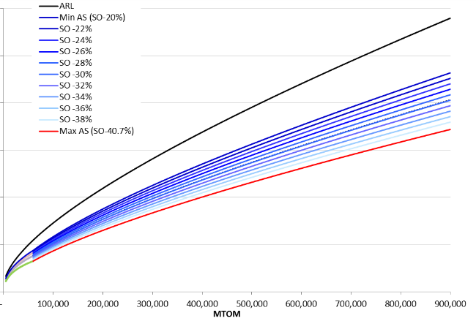
Major Milestones to-date (1)
July 2012: CO₂ Metric System in May 2012
Instantaneous metric based on “specific air range” (e.g. distance / fuel mass), evaluated at 3 weights and corrected by floor area
February 2013: Draft ICAO Annex 16 Vol. 3 (i.e. CO₂ certification requirement)
Draft flight test procedures and measurement methodology
November 2013: Stringency Options
Assessed curve shapes for various aircraft types
Defined boundaries and potential stringency options for use as the basis of CAEP CO₂ cost effectiveness analysis
Notional CO₂ standard stringency options: (i.e. regulatory levels)

Slide 5
Major Milestones to-date (2)
September 2014: Technology responses
Specific aircraft technology responses (pass/fix/fail), and associated non-recurring costs
September 2014: Draft, wide-range of in-production (InP) applicability options
Scope, Dates of Applicability, Triggers, Regulatory Level(s)
Processes:
No in-production (InP) applicability and no voluntary action
Voluntary Reporting
Voluntary Type Certification
Mandatory Reporting
Mandatory Type Certification of selected InP types
Mandatory Type Certification of all InP types
September 2014: Modeling framework (scenario cases / data) for CAEP CO₂ cost effectiveness analysis

Slide 6
Applicability to In-Production Airplanes
Current work is focusing on mandatory in-production (InP) applicability options with a Type Certification (TC) process
September 2014 draft options remain as possibilities
Key elements of the mandatory, TC-based InP applicability options include:
Scope: Same Max Take-Off Mass range as for NT
Dates of Applicability: 2023, 2025, 2028
Triggers: Certificate of airworthiness and/or change criteria
Regulatory Level: Single or separate levels for InP/NT
Process: Type Certification
Options should aim for an appropriate balance between costs, administrative burden and the robustness of data

Slide 7
CO₂ Standard Analysis Framework
Cases consider applicability to new types (NT) in 2020 or 2023, and to in-production types (InP) in 2023, 2025 or 2028
Case for NT and InP: Full Technology Response / Out of Production
Analysis of stringency options using all technology responses defined by WG3/WG1 –and– aircraft are assumed to go out of production at the implementation dates if they cannot be made compliant to a stringency option level. To inform both InP and NT applicability.
Case for NT-Only: Alternative Response / Production
Analysis of stringency options at the implementation dates for NT-only applicability using responses informed by market considerations since manufacturers would not have a legal deadline to bring InP types to levels required under an NT-only standard. Thus, although an aircraft may be technically eligible for response, in practice market forces could influence the manufacturer to not have some aircraft types respond; for example, when the costs to respond outweigh the benefits generated by the improvements.

Slide 8
CO₂ Standard Next Steps
Mid/End 2015: Complete CAEP main cost effectiveness analysis round 1/round 2, respectively
End 2015: Develop a Public CO₂ Databank
End 2015: Finalize InP applicability options
End 2015: Finalize outstanding topics re Annex 16 Vol. 3
Draft environmental technical manual, change criteria, specialized aeroplane types
Feb 2016: Insert applicability and regulatory level into final Annex 16 Vol. 3
Feb 2016: Decision on applicability and regulatory limit
End 2018: Annex 16 Vol. 3 implemented in ICAO Member State legislative frameworks

Slide 9
Questions?

Slide 10
CO₂ Metric System
CO₂ emissions ∝ fuel burn
Main drivers of CO₂:
Two major metric types categories were assessed:
Instantaneous and Mission Performance Measurement
CAEP technical analyses resulted in selection of an instantaneous metric based on:
Specific Air Range (e.g. distance / fuel mass) evaluated at 3 weights
Correlated with Maximum Take-Off Mass (i.e. normalize for fairness)
Corrected by a floor area factor
Key criteria such as fairness, ease of certification, account for fundamental aircraft performance, and limiting unintended consequences

