Slide 1
Continuous Lower Energy, Emissions and Noise (CLEEN) Program
Update
REDAC Subcommittee on Environment and Energy
Levent Ileri, CLEEN Program Manager
March 18, 2015

Slide 2
Outline
Action Item Follow-Up
CLEEN Overview and Goals
CLEEN Benefits
Completed Technology Demonstrations
CLEEN II
Summary
Notes:
Good afternoon. Today, I will provide an update on the CLEEN program since the last REDAC meeting in August. Today’s presentation includes:
The Continuous Lower Energy, Emissions, and Noise (CLEEN) program will reduce the environmental impact
of aircraft through new engine and airframe technologies and by advancing the use of sustainable alternative
aviation fuels. Our aim is to accelerate development of quieter commercial aircraft that burn less fuel and produce
lower emissions than existing technology.

Slide 3
Action Item Follow-Up
Develop CLEEN Communication Materials
Last CLEEN Fact Sheet update completed 8/1
Next Fact Sheet update planned for 5/2015
http://www.faa.gov/news/fact_sheets/news_story.cfm?newsId=16814
November 2014 CLEEN Consortium Meeting presentations made available on website
https://www.faa.gov/about/office_org/headquarters_offices/apl/research/aircraft_technology/cleen/2014_consortium/
CLEEN program technologies with expected EIS
TAPS II advanced low NOx combustor starting in 2016 –
Airbus A320neo, Boeing 737MAX, COMAC C919
CLEEN model brings technologies to point of readiness for product development
Other TRL 6-7 technologies in product planning, not publicly announced
Notes:
Additional public communication of successes:
Boeing presentation at United States Advanced Ceramics Association (USACA) conference on CMC nozzle
158-174 seat narrow-body twin-engine airliners to be built by the Commercial Aircraft Corporation of China

Slide 4
Roadmap of the CLEEN program with expected EIS
Under CLEEN, there are 10 technology projects*
4 with EIS prior to 2020, >8,000 engines
6 with EIS after 2020, >4,000 engines
* Based on Nov 2014 data. These numbers will increase as soon as the companies finalize their trade studies
CLEEN contributed to the approval of 2 alternative jet fuels (HEFA and SIP) by ASTM Intl.
.
Notes:
Engine level; we have CMC Acoustic Nozzle
CMC Blade Tracks
TAPS II Combustor
Dual Wall Turbine Vane
Aircraft level; we have
FMS/Engine and FMS/ATM – Trade studies are currently being conducted
Wing ATE

Slide 5
Efforts that support Technology Maturation
Continuous Lower Energy, Emissions and Noise (CLEEN)
Reduce aircraft fuel burn, emissions and noise through technology & advance alternative jet fuels
Public private partnership with 1:1 minimum cost share requirement
Enable industry to expedite introduction of novel technologies into current and future aircraft and engines
Maturation from TRL 3-5 concluding in major demonstrations at TRL 6 or 7 (ground engine or flight test)
Aviation Sustainability Center (ASCENT)
Center of Excellence for Alternative Jet Fuels & Environment
Providing independent assessment of environmental benefits from CLEEN technology introduction
Notes:
COE Technical Areas – Alt Jet Fuels
Feedstock Development, Processing and Conversion Research
Regional Supply and Refining Infrastructure
Environmental Benefits Analysis
Aircraft Component Deterioration and Wear Assessment
Fuel Performance Testing
COE Technical Areas – Environment
Aircraft Noise and Impacts
Aviation Emissions and Impacts
Aviation Modeling and Analysis
Aircraft Technology Assessment
Environmentally and Energy Efficient Gate-to-Gate Aircraft Operations

Slide 6
CLEEN Program Overview
Five year program (2010-2015)
Industry partners: Boeing, General Electric, Honeywell, Pratt & Whitney, Rolls-Royce
Federal Funding: $125M (1:1 minimum cost share is required)

Slide 7
CLEEN Program Goals
Develop and demonstrate (TRL 6-7) certifiable aircraft technology
 | CLEEN
Noise (cum below Stage 4) | -32 dB
LTO NOx Emissions (below CAEP 6) | -60%
Aircraft Fuel Burn | -33%
Advance use of “drop-in” renewable alternative fuels
Bio feedstock
Fuel Production
Jet fuel
Notes:
40% fuel burn goal for CLEEN II is relative to contactor’s best in service 2005 baseline. CLEEN I fuel burn goal was set vs. contractor chosen baseline also circa 2005 best in service.
These goals are described in the National Aeronautics Research and Development Plan and puts CLEEN in context with NASA’s environmental technology programs.
While initial NASA studies considered a single aisle baseline configuration (B737-800 with a CFM56-7B engine), the CLEEN solicitation did not specify a baseline and encouraged technologies that could apply across multiple aircraft classes.
Committee on Aviation Environmental Protection (CAEP) - The Committee on Aviation Environmental Protection (CAEP) is a technical committee of the ICAO Council established in 1983. CAEP assists the Council in formulating new policies and adopting new Standards and Recommended Practices (SARPs) related to aircraft noise and emissions, and more generally to aviation environmental impact.
Alt fuel goal (industry wide, commercial and military) is 1 billion gallons by 2018
The Continuous Lower Energy, Emissions, and Noise (CLEEN) program will reduce the environmental impact
of aircraft through new engine and airframe technologies and by advancing the use of sustainable alternative
aviation fuels. Our aim is to accelerate development of quieter commercial aircraft that burn less fuel and produce
lower emissions than existing technology.

Slide 8
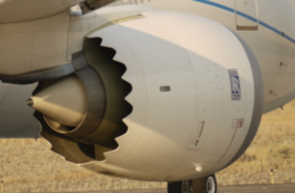
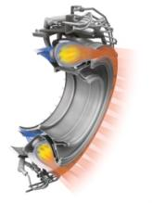
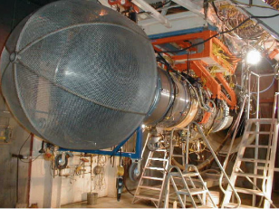
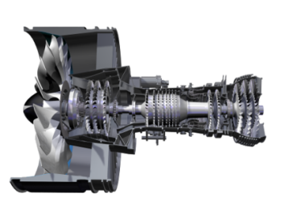
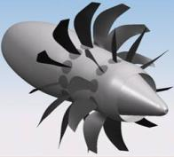
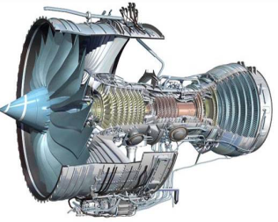
CLEEN I Technologies
Boeing
Ceramic Matrix Composite Nozzle
Adaptive Trailing Edge
Honeywell
New coatings, higher temperature impeller, advanced seals and improved turbine cooling.
General Electric
Flight Management System / Air Traffic Integration
Flight Management System / Engine Integration
Twin Annular Premixing Swirler (TAPS) II Low NO_{X} Combustor
Open Rotor Engine
Pratt & Whitney
Ultra-high Bypass Ratio Geared Turbofan
Rolls-Royce
Ceramic Matrix Composite Blade Tracks
Dual-Wall Turbine Airfoils

Slide 9
Benefits of CLEEN Program: Demonstrated technologies that reduce noise, emissions and fuel burn
Boeing Adaptive Trailing Edge ~ 2% fuel burn reduction ~ -1.5dB cum in some single and twin aisles
CMC Acoustic Nozzle
~ 1% fuel burn reduction
Parity or better noise reduction compared with treated metallic hot structure
Honeywell Fuel Burn Technologies
CLEEN technologies contributed to ~5% fuel burn reduction as part of a 15.7% fuel burn reduction engine package
Pratt & Whitney
Geared Turbofan Technologies CLEEN techs expand design space for engine with ~ 20% fuel burn reduction, 25 EPNdB cumulative noise margin to Stage 4
General Electric TAPS II Combustor (entering fleet in 2016) CLEEN 60% margin to CAEP/6 LTO NOx was achieved FMS/Engine and FMS/ATM Integration
Benefits are being assessed
Open Rotor ~26% reduction in fuel burn (re: 737-800) and ~15-17EPNdB cumulative noise margin to Stage 4
Rolls Royce Ceramic Matrix Composite Turbine Blade Track CMC blade tracks offer > 50% reduction in cooling and component weight.
Rolls-Royce – Dual Wall Turbine Airfoil Dual Wall turbine airfoils provide > 20% reduction in cooling and increased operating temperature capability. CLEEN tech will provide ~1% fuel burn reduction
9

Slide 10
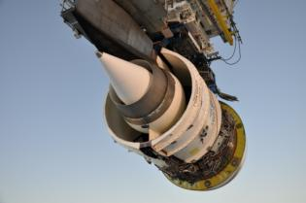
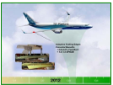
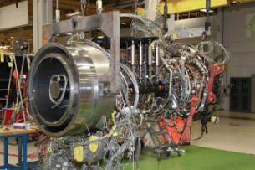
Completed Technology Demos (2011-2013)
Exceeded CLEEN Goal
Boeing 737 with Adaptive Trailing Edge
Landing and Takeoff NOx reduced 60% re CAEP 6
Boeing Flight Demonstration (TRL 7)
Boeing - Ceramic Matrix Composite Nozzle Ground Test (TRL 6)
Boeing - Ground Demonstration (TRL 6)
GE Open Rotor Wind Tunnel Tests (TRL 5)
GE Dynamic Synchronization Simulation
(TRL 6)
General Electric (GE) – TAPS II Core Engine Test (TRL 6)
Dec
Jan
Jul
Sep
Jan
Mar
2011 | 2012 | 2013

Slide 11
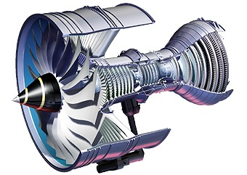
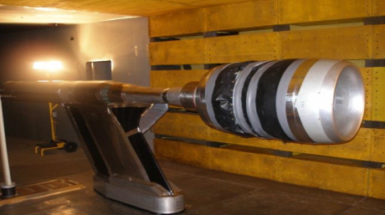
Completed Technology Demos in 2014
Rolls-Royce - CMC Turbine Blade Track Engine Ground Testing
Pratt &Whitney - Fan Rig Wind Tunnel Test
Boeing - CMC Flight Test on ecoDemonstrator (TRL 7)
Honeywell – Engine Test (TRL 6)
May
Jul
Nov
2014
Notes:
2015 demonstrations:
Not all information public, but by company:
GE: 2
Honeywell: 2
Pratt & Whitney: 1
Rolls-Royce: 1

Slide 12
Planned Demonstrations for 2015
GE
Engine ground and flight tests of FMS-engine control technologies: Q2 2015 and Q4 2015-Q1 2016
Honeywell
High T3 impeller core engine test: Q2 2015
Final CLEEN engine test: Q2 2015
Pratt & Whitney
Integrated ultra-high bypass fan rig test: Q2 2015
Preparation for 2016 engine test
Rolls-Royce
Dual wall turbine vane testing: Q3 2015
Notes:
2015 demonstrations:
Not all information public, but by company:
GE: 2 → In Phase 1: High efficiency cruise, performance seeking control, deterioration-based clearance adjustment and water-wash advisory concepts will be flight tested on the first LEAP-1B flying test bed in 2Q2015.
In Phase 2: Performance seeking control and stall margin optimization concepts will be flight tested on the second LEAP-1B flyting test bed in 4Q2015-1Q2016.
All of the models use a software development methodology and optimizes certain variables that control the engine’s operation.
The performance seeking control compares what the engine is doing versus the designed “optimal” model, and as the engine operates, it constantly adjust its control parameters to fit to the model. This results in reduction in fuel.
During the operation of the engine, parts wear and does not function at the ideal efficiency. Both deterioration-based clearance adjustment and water-wash advisory concepts help detect and remedy this issue. Deterioration-based clearance adjustment does this actively as the engine runs, and water-wash advisory allows the service crew to when to wash and service the compressor for better efficiency. This results efficient engine operation, resulting in reduction in fuel and subsequently noise.
When you design an engine, we set it to operate at a conservative level to prevent it from reversing the flow in the compressor (called “stall”). Thus, the stall margin optimization concept enables us to be smarter about how close the engine is to a potential stall. This means we can be more efficient by not being overly conservative on the engine operation. This results reduction in fuel.
Honeywell: 2
Pratt & Whitney: 1
Rolls-Royce: 1
RR Vane testing = combustor rig test → a full annular combustion rig using the EFE combustor in 2015
RR will conduct the engine testing in 2016 →complete cyclic endurance testing in the Rolls-Royce Advance 3 core demonstrator vehicle in 2016. This testing will confirm TRL6 for the vanes to the demonstrated turbine temperature levels. Further cyclic endurance testing at increased turbine temperatures will be conducted in a Trent XWB 97K engine in 2017.

Slide 13
CLEEN Program Overview
CLEEN I Program (2010-2015)
Industry partners: Boeing, General Electric, Honeywell, Pratt & Whitney, Rolls-Royce
Federal Funding: $125M (1:1 minimum cost share is required)
CLEEN II Program (2015-2020)
Solicitation opened on September 29, 2014
Solicitation closed on February 2, 2015
Proposals from 10 companies with over 35 technologies submitted
Contracts to be awarded by mid-summer 2015
Federal Funding: $100M (1:1 minimum cost share is required)

Slide 14
CLEEN II Program Goals
Develop and demonstrate (TRL 6-7) certifiable aircraft technology
 | CLEEN | CLEEN II
Noise (cum below Stage 4) | -32 dB | -32 dB | and/or reduces the noise contour area in absolute terms
LTO NOx Emissions (below CAEP 6) | -60% | -75% (-70% vs. CAEP/8) | and/or reduces absolute NOx production over the aircraft’s mission
Aircraft Fuel Burn | -33% | -40% | and/or supports the FAA’s goal to achieve a net reduction in climate impact from aviation
Advance use of “drop-in” renewable alternative fuels
Bio feedstock
Fuel Production
Jet fuel
Notes:
40% fuel burn goal for CLEEN II is relative to contactor’s best in service 2005 baseline. CLEEN I fuel burn goal was set vs. contractor chosen baseline also circa 2005 best in service.
These goals are described in the National Aeronautics Research and Development Plan and puts CLEEN in context with NASA’s environmental technology programs.
While initial NASA studies considered a single aisle baseline configuration (B737-800 with a CFM56-7B engine), the CLEEN solicitation did not specify a baseline and encouraged technologies that could apply across multiple aircraft classes.
Committee on Aviation Environmental Protection (CAEP) - The Committee on Aviation Environmental Protection (CAEP) is a technical committee of the ICAO Council established in 1983. CAEP assists the Council in formulating new policies and adopting new Standards and Recommended Practices (SARPs) related to aircraft noise and emissions, and more generally to aviation environmental impact.
Alt fuel goal (industry wide, commercial and military) is 1 billion gallons by 2018
The Continuous Lower Energy, Emissions, and Noise (CLEEN) program will reduce the environmental impact
of aircraft through new engine and airframe technologies and by advancing the use of sustainable alternative
aviation fuels. Our aim is to accelerate development of quieter commercial aircraft that burn less fuel and produce
lower emissions than existing technology.

Slide 15
CLEEN II
Program model based on successful CLEEN I
Requires cost share and tech maturation from TRL 3-5 to demonstration at TRL 6-7
Program work conducted 2015-2020 with $100M FF
Requires industry to show path to commercial product so tech realizes benefits in the fleet
Milestones:
Market survey conducted May-July 2013
Draft solicitation released publicly November 2013
Industry day held in Washington D.C. December 2013
Solicitation Released September 29, 2014
Solicitation Closed February 2, 2015
Contract award planned for summer of 2015
Notes:
Summary
CLEEN II is planned as a follow-on effort for new projects in the areas of aircraft technology development and alternative jet fuels. With work planned 2015-2020, technologies are planned to provide fuel burn, emissions, and noise benefit toward advanced goals and enter into service by 2025. Metrics: -32dB, -75%, -40% and qualitative goals for technologies not affecting certification points

Slide 16
Planned CLEEN II Timeline
Released CLEEN II SIR Sep 29, 2014
2014
2015
Oct
Nov
Dec
Jan
Feb
Mar
Apr
May
Jun
July
Aug
Sep
CLEEN II Proposals - Due February 2, 2015
Questions - Nov 7
Answers - Dec 12
SMEs Review
Recs - Mng / Leg
Negotiations
Award(s) Announced as they are negotiated by August 21, 2015

Slide 17
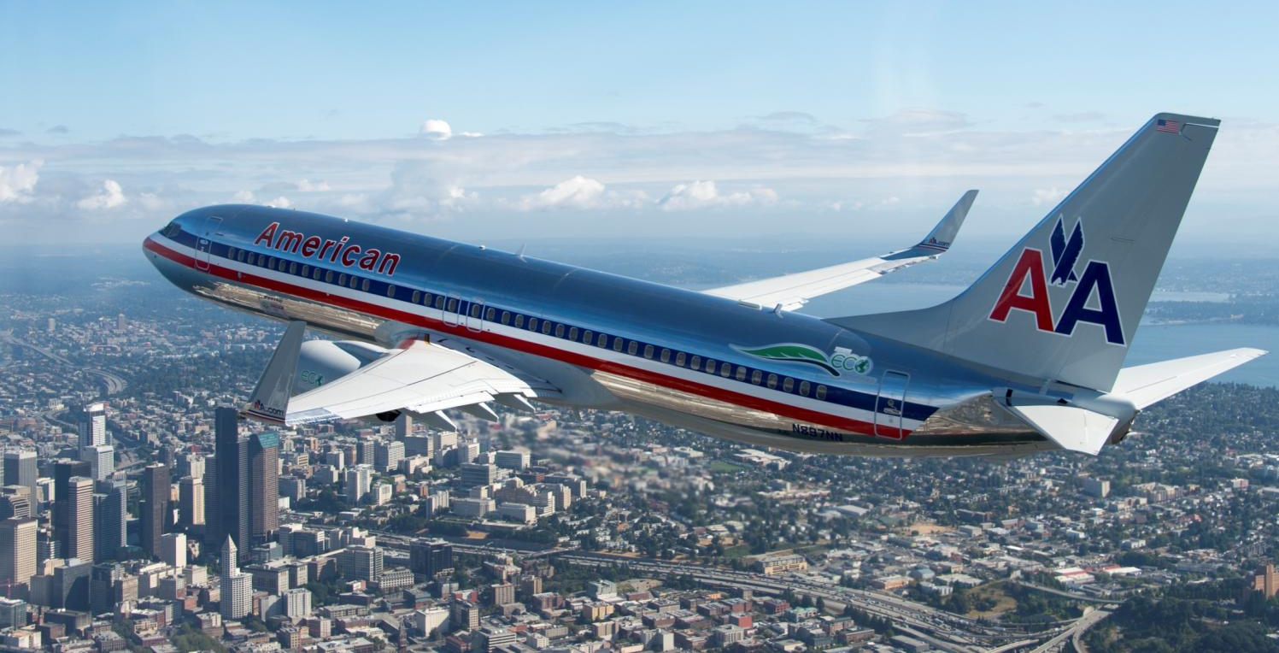
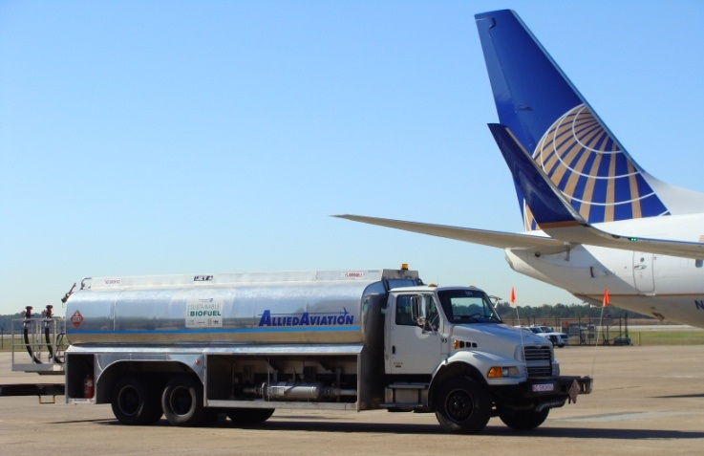
In Summary
CLEEN* has already successfully accelerated aircraft technology development to reduce noise, emissions and fuel burn
CLEEN has helped and is helping to accelerate alternative jet fuel development
CLEEN II is coming this year
* For more information on the CLEEN Program, its benefits, and accomplishments to date, please see the CLEEN Program Fact Sheet at http://www.faa.gov/news/fact_sheets/news_story.cfm?newsId=16814
Notes:
HEFA in 2011 and SIP in 2014
HEFA tests in spring 2011 conducted by Honeywell with funding from CLEEN addressed a key concern with cold temperature performance of the fuel
and Pratt & Whitney engine testing of SIP fuels in 2013 and 2014 contributed data to the ASTM report that enabled approval.

