Slide 1
FAA Alternative Jet Fuels R&D Update
To: FAA E&E REDAC
By: Nate Brown
Alternative Jet Fuel Project Manager, FAA Office of Environment and Energy
Date: March 17, 2015
Notes:
Overview of the program
Alternative jet fuels are a key component of U.S. strategy for meeting aviation environmental goals
FAA efforts are directed to overcoming key challenges via testing, analysis and coordination
Multiple programs and activities focus on different aspects of the challenge
Partnerships across technical areas, and with partners with very different expertise across the supply chain are a key focus
Strong domestic and international coordination necessary for success

Slide 2
Alternative Fuels Principles – FAA Vision
Alternative Jet Fuels must be drop in, have equivalent safety and better environmental performance than petroleum Jet fuel
Enable all possible fuels that meet criteria
Government role to address key barriers
Work through Public-Private Partnerships
Address the whole supply chain
Leverage expertise and resources of other government agencies and other countries
Aviation should be a lead user of alternative fuels
2

Slide 3



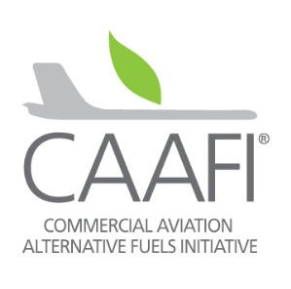
FAA Programs supporting Alternative Jet Fuels
Aviation Sustainability Center (ASCENT)
Center of Excellence for Alternative Jet Fuels and Environment
University team led by WSU and MIT
Continuous Lower Energy, Emissions and Noise (CLEEN)
Reduce aircraft fuel burn, emissions and noise through technology & advance alternative jet fuels
CLEEN I: 2010-2015 ($125M with 1:1 minimum cost share)
CLEEN II: 2015-2020 ($100M with 1:1 minimum cost share)
Commercial Aviation Alternative Fuels Initiative (CAAFI)
Public-Private coalition for commercial aviation to engage the emerging alternative fuels industry
3
Notes:
Three FAA sponsored programs are supporting the exploration and development alternative jet fuels.
ASCENT is a University based research center of excellence (COE). Headquartered at Washington State University (WSU) and Massachusetts Institute of Technology (MIT) it inlcudes 15 Universities that conduct analysis on alternative jet fuel and aviation environment topics inlcuding environmental and economic analysis and performance and emissions testing of alternative jet fuels
The CLEEN program is an FAA technology development program focusing on environmentall friendly aviation technologies to reduce aircraft fuel burn, emissions, noise and facilitate evaluation and use of alternative jet fuels. Through the CLEEN program FAA and industry have conducted crucial testing that has lead to existing alternative jet fuel approvals. CLEEN is currently evaluating proposals for a new round of the program to begin later this year.
CAAFI is a public-Private Coalition focused on coordinating and enabling alternative jet fuel development and deployment. CAAFI was formed by the FAA and industry in 2006 as a forum for information exchange and coordination. CAAFI supports research, environmental, fuel certification and business development efforts to enable alternative jet fuel development and use.

Slide 4




FAA Alternative Jet Fuel Activities
Testing
  Support Cert/Qual testing
  Improve Cert/Qual process
  Emissions measurements
Analysis
  Environmental sustainability
  Techno-economic analysis
  Future scenarios
Coordination
  Interagency
  Public-Private
  State & Regional
  International
4
Notes:
R&D portfolio is to advance our understanding and play our role as a facilitator of the process
Loosely grouped into three categories:
Performance and emissions Testing of Alternative fuels to support ASTM Internaional approval and emission benefits measurement
Support evaluation of fuels for ASTM approval
Reduce test cost and time for qualification
2. Analysis on impacts, economics and availability to:
Improve understanding of environmental and economic sustainability of alternative jet fuel pathways
Improve understanding of the potential availability of alternative jet fuels
3. Coordination and Leveraging efforts across…interagency, public-private, regional level and with international partners
Complement and leverage work of other U.S. agencies
Complement and leverage work of private sector
Support deployment through state/regional supply chain development
Complement and leverage work of international partners
Our means of conducting the work on the right side

Slide 5
FAA Alternative Jet Fuel Activities
Testing
  Support Cert/Qual testing
  Improve Cert/Qual process
  Emissions measurements
Analysis
  Environmental sustainability
  Techno-economic analysis
  Future scenarios
Coordination
  Interagency
  Public-Private
  State & Regional
  International
5

Slide 6
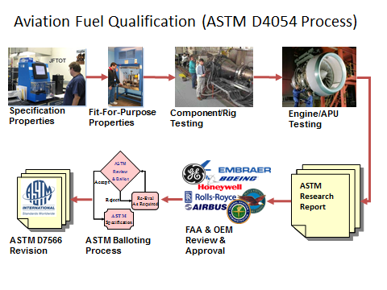
Fuel Qualification Support
Support ASTM Intl evaluation of alternative jet fuels
Support ASTM D4054 testing activities to develop data for approvals
(CLEEN; Volpe BAA; ASCENT
Project 31)
Research Report Review
(CLEEN)
Streamline approval process via the National Jet Fuel Combustion Program (ASCENT)
Notes:
1) Near term effort to Support ASTM D4054 testing activities to enable development of data for approvals
CLEEN Testing of novel fuels
RR lab, rig and apu testing of 4 novel fuels
PW615F turbofan testing of 3 fuels completed
Honeywell HEFA testing and exploration of 100% biofuel & Cooperative testing of Alcohol-to-Jet fuel with USAF
BAA
Honeywell HEFA endurance testing
Honeywell APU testing of 7 fuels underway
ASCENT Project 31
TBD testing
2) Support for Research Report Review & Coordination
Via CLEEN
Support organized approach to fuels in ASTM pipeline
Boeing, GE, Honeywell, P&W, RR and SWRi
3) Mid term effort to streamline ASTM International jet fuels approval process
Develop generic fuel composition/chemistry evaluation methodology
Standardized rig/lab tests
Chemical kinetic/combustion modeling
Collaborative OEM/university/federal effort

Slide 7
ASCENT C/Q Projects (FY14)
P31 Alternative Jet Fuel Test and Evaluation
P33 Alternative Jet Fuel test data library
P25 NJFCP Area 1- Chemical Kinetic Combustion
P26 NJFCP Area 2 -Chemical Kinetic Modeling
P27 NJFCP Area 3 - Advanced Combustion Test
P28 NJFCP Area 4 - Combustion Modeling
P29 NJFCP Area 5 - Atomization Testing
P30 NJFCP Area 6 - Referee Swirl Stabilized Combustor Evaluation
P34 NJFCP Area 7 - Overall Program Integration and Analysis
7
Notes:
With FY14 fund
National program on combustion of jet fuel
ASTM support (P31)
8 projects
2.25 Million for NPCJF
400 K for P31

Slide 8
FAA Alternative Jet Fuel Activities
Testing
  Support Cert/Qual testing
  Improve Cert/Qual process
  Emissions measurements
Analysis
  Environmental sustainability
  Techno-economic analysis
  Future scenarios
Coordination
  Interagency
  Public-Private
  State & Regional
  International
8

Slide 9
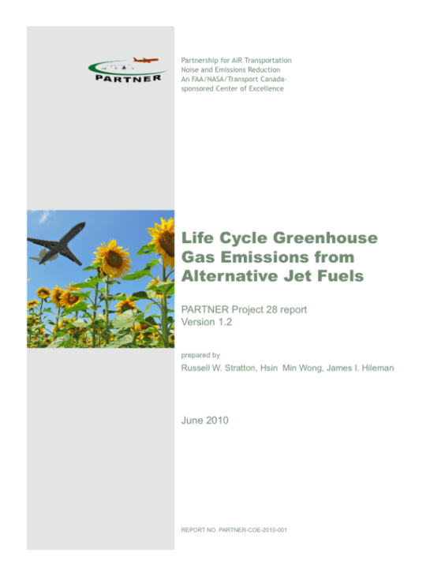
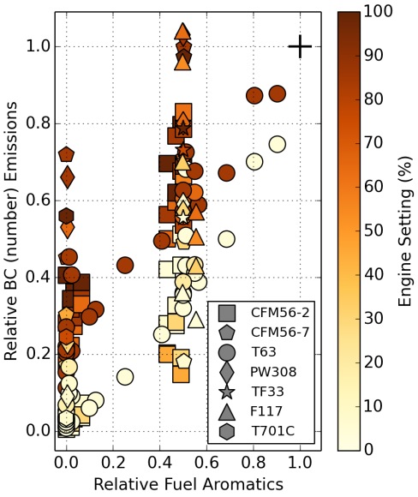
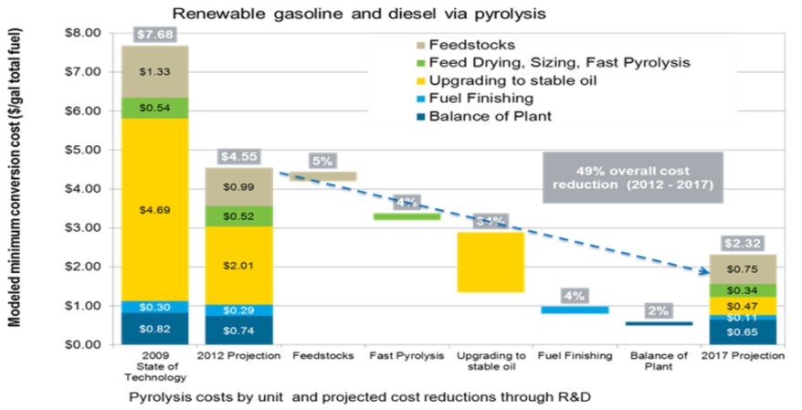
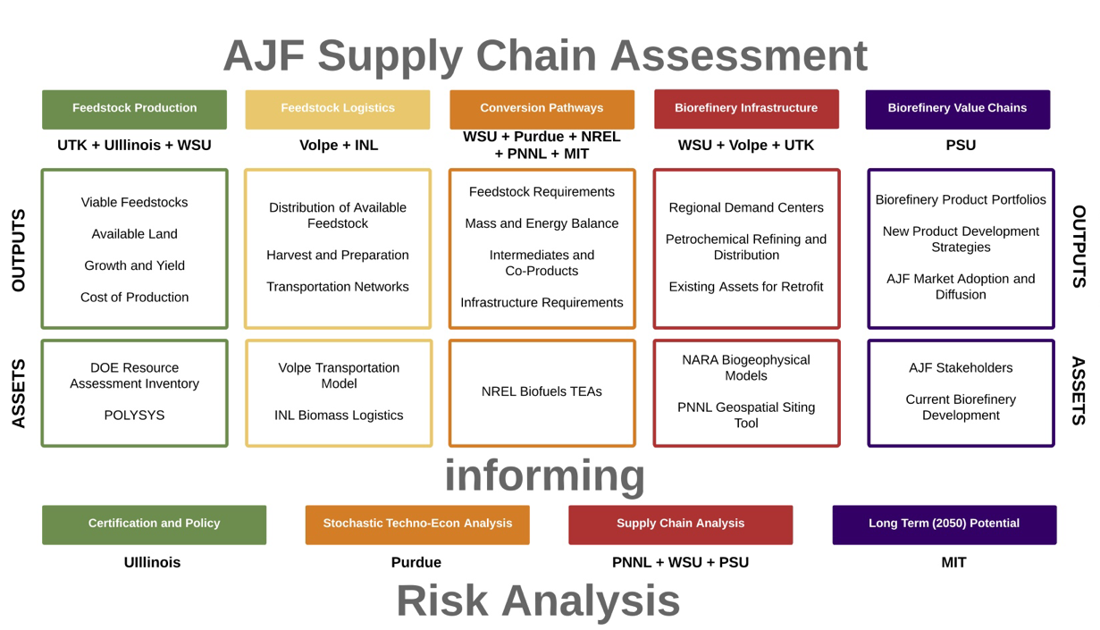
Alternative Fuels Analysis
Environmental Analysis
  Well-to-tank GHG and combustion CO₂ & influential aspects of fuel production on GHG emissions
Economic Analysis
  TEA Multiple pathways & focus on reducing production cost.
Emissions Analysis
  examine test data to understand how fuel composition effects emissions
Future Supply
  Regional supply chain assessment
*http://web.mit.edu/aeroastro/partner/reports/proj28/partner-proj28-2010-001.pdf
Notes:
Environment
Continuing work at PARTNER and now ASCENT has done comparative analysis of more than a dozen JET fuels to analyze the potential greenhouse gas footprints of the fuels.
Results have been incorporated into the DOE (Argonne NL) GREET LCA model (Greenhouse gas and regulated emissions in Transportation model) – which is a widely used U.S. model for calculating GHG results
There are many factors that influence overall GHG footprint, analysis is helping us to identify the levers so that we can reduce these.
Results of this work are also helping to support the work of the ICAO CAEP Alternative Fuels Task Force (AFTF)
Economic
Supporting teams at Stanford and ARI to examine ACCESS results as well as MIT and PSU to examine test data to understand how fuel composition effects emissions
Continuing work at our COE is looking at the potential costs of production for different alternative jet fuel pathways.
There are many factors that influence overall cost of production, analysis is helping us to identify the levers so that we can reduce these.
Results also help to inform us about the circumstances and drivers to allow us to see significant commercial production of these fuels.
Feedstocks; production slate; brownfields
Emissions
COE developing relationship for black carbon emissions based on engine thrust and fuel aromatic content¹
Expanding knowledge to include alt jet fuels that have aromatic content (e.g., HDCJ)
Ongoing analysis effort via ASCENT Project 24
Future Supply
ASCENT Project on regional supply chains now underway
objectives:
Develop information on regional supply chains for use in creating scenarios of future alternative jet fuel production
Identify the key barriers in regional supply chains that must be overcome to produce 1 billion gallons of alternative jet fuel by 2018 and more in the longer term
Useful for understanding the deployment picture and strategy
Supports efforts to develop scenarios and to incorporate sustainability concerns
Complements CAAFI and Farm to Fly 2.0 activities0

Slide 10
ASCENT Analysis Projects (FY14)
P1 Alternative Jet Fuel Supply Chain Analysis
P13 ACCESS 2 Micro Physical Modeling with NASA
P24 Emissions Data Analysis for CLEEN, ACCESS, and Other Recent Tests
P32 Worldwide Life Cycle Analysis (LCA) of Greenhouse Gas (GHG) Emissions from Petroleum Jet Fuel
10
Notes:
Range of additional projects
$2.05M total
$1.6M for P1

Slide 11
FAA Alternative Jet Fuel Activities
Testing
  Support Cert/Qual testing
  Improve Cert/Qual process
  Emissions measurements
Analysis
  Environmental sustainability
  Techno-economic analysis
  Future scenarios
Coordination
  Interagency
  Public-Private
  State & Regional
  International
11

Slide 12








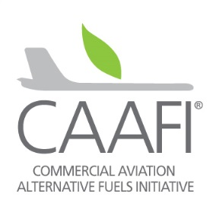





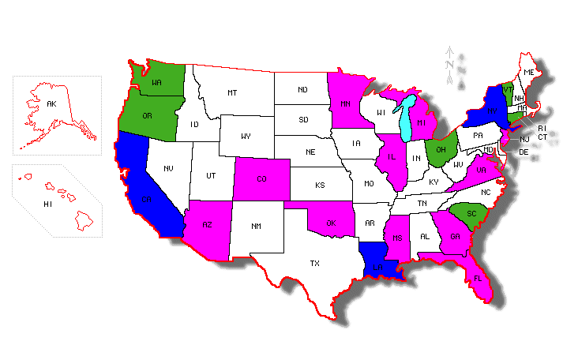
Domestic Coordination
Interagency Coordination across supply chain & National Alternative Jet Fuel R&D Strategy
Commercial Aviation Alternative Fuel
Initiative (CAAFI)
Farm to Fly 2.0
CAAFI State & Regional Deployment
Notes:
FAA efforts are part of a broader government and private sector effort that requires coordination across supply chain.
We are depending on the programs, policies and expertise of 8 different agencies.
NAJFS - To identify opportunities and strategically address challenges associated with Research, Development, Demonstration, and Deployment (RD3) along the development path of alternative jet fuels.
An undertaking by Aeronautical Science and Technology Subcommittee of the OSTP/NSTC with input from stakeholder community.
Interagency working group of 8 participating Departments & Agencies: USDA, DOC, DOD, NASA, FAA, DOE, EPA, NSF, DOS
CAAFI
Public – private partnership – coordination, information exchange, direction and support
F2F2
Farm to Fly 2.0 is an agreement to cooperate to develop the supply of alternative jet fuel in the United States.
Signatories: USDA, FAA, DOE and Industry associations Airlines for America (A4A), Aerospace Industries Assoc. (AIA), Airports Council International-North America (ACI-NA), General Aviation Manufacturers Association (GAMA) and the National Business Aviation Association (NBAA) = Entire civil jet-aviation enterprise now represented and engaged
Purpose:
To focus government and aviation industry resources towards jet fuel supply chain development.
Endorsed and adopted FAA goal of 1 billion gallons by 2018.
Supporting feasability studies for fuel production in various U.S. states.
CAAFI state & regional deployment
Supporting “grassroots” supply chain development and fuel production.
Identifying local lead organizations/POCs/stakeholders in states and regions.
Provide context, advice, strategy, benchmarking
Facilitate networks & links between stakeholders (e.g. airlines/airports w/ state bioenergy authorities)
Rural Bioenergy Enterprise Grants (RBEG) and Value Added Producer Grants (VAPG)

Slide 13













International Coordination
CAAFI
ABRABA/SABB
SWAFEA/Alfabird
Australia / AISAF
ICAO
Aireg
SENASA/ITAKA
Sky NRG
IFP Energy Nouvelle
Formal and informal coordination
  International Events
  Bilateral Cooperation Agreements
  Coordination with R&D organizations
  Global Exchange meeting
ICAO as forum for exchange
Notes:
Effort for alternative jet fuels is truly a global one
Many different initiatives emerging –
public-private partnerships, public R&D initiatives, Supply chain efforts
FAA & CAAFI have been working to coordinate formally and informally
Inlcuding:
Support for AJF visibility at Airshows, IATA fuel forum
Govt. to govt. agreements – non-binding cooperative – umbrella for private sector activity – mutual strengthening at policy making level
Cooperation with other R&D organizations e.g. EC DG Energy; DLR etc.
We also support and participate with[UN organization] ICAO in it’s role for exchange of best practices among member States.

Slide 14

Alt Fuels Focus in 2015
Continue support to ASTM approval of additional fuel pathways; additional approval(s)
Continue engine tests of new fuels to support for approvals
Improve testing methods to reduce cost and time
ASCENT analysis projects established, results will begin to be seen in next year
Continued domestic and international engagement
CLEEN II
14
Notes:
Key issues remain
Bridging valley of death
Supply-chain development
FY15 budget limits ($3M????)
Continue support to ASTM approval of additional fuel pathways
Continue work to improve testing methods to reduce cost and time of Certification / Qualification over longer term
Continue Analysis in support of deployment:
Supply chain analysis
Environmental and economic sustainability analyses
Emissions research to relate measured changes in emissions and fuel performance to fuel composition
Continued domestic and international engagement
CAAFI
Farm to Fly 2.0 working group
ICAO Alternative Fuels Task Force (AFTF) is advancing
CLEEN II is an active solicitation – in the process of proposal review and evaluation.
Covers four areas:
A&B - Continued capability for testing and evaluation of TBD or specific fuels
C - Development of improved methods to reduce cost and time – support to NJFCP efforts
D - Support for the ASTM process – improved time/effort/coordination and work flow.

Slide 15
Summary
Alternative jet fuels are a key component of FAA strategy in meeting environmental goals
R&D efforts making progress on overcoming key challenges via testing, analysis and coordination
Multiple programs and activities:
  Commercial Aviation Alternative Fuels Initiative (CAAFI)
  Continuous Lower Energy, Emissions and Noise
  (CLEEN) Program
  Aviation Sustainability Center (ASCENT)
  Farm to Fly 2.0
Strong domestic and international coordination
15
Notes:
Alternative jet fuels are a key component of U.S. strategy for meeting aviation environmental goals
FAA efforts are directed to overcoming key challenges via testing, analysis and coordination
Multiple programs and activities focus on different aspects of the challenge
Coordination among stakeholders
Certification/Qualification
Environmental analysis
Supply chain analysis
Improving processes
Developing domestic fuel supply
Partnerships across technical areas, and with partners with very different expertise across the supply chain are a key focus
Strong domestic and international coordination necessary for success

Slide 16

Nate Brown
Alternative Jet Fuel Project Manager
Federal Aviation Administration
Office of Environment and Energy
Email: nathan.brown@faa.gov

