Slide 1
Alternative Jet Fuels Supply Chain Project (ASCENT Project 1)
Presented to: REDAC E&E Subcommittee
By: Dr. Jim Hileman Chief Scientific & Technical Advisor for Environment and Energy Office of Environment and Energy
Date: March 17, 2015

Slide 2
Objectives
Develop information on regional supply chains
Provide holistic evaluation of alternative jet fuel production including feedstock, transportation, and conversion
Evaluate sustainability from environmental, economic and societal perspectives
Develop scenarios of future alternative jet fuel production
Identify the key barriers in regional supply chains that must be overcome
to produce 1 billion gallons of alternative jet fuel by 2018 and
an order of magnitude larger production in the longer term
Support International Civil Aviation Organization (ICAO Committee on Aviation Environmental Protection (CAEP) Alternative Fuel Task Force (AFTF)
2

Slide 3
CAEP Alternative Fuels Task Force (AFTF)
Alternative Fuels Task Force (AFTF) tasked to:
Assess possible range of emissions reductions from use of alternative jet fuels in 2050 (requires both fuel volume and emissions factor)
Develop a methodology to include alternative jet fuels in the global market based measure (GMBM) for international aviation
ASCENT team providing technical expertise and analysis support to AFTF
November, 2013
September, 2014
May, 2015
February, 2016
AFTF created by CAEP Steering Group
Additional task
to support GMBM added
2050 methodology finalized
Work and results of AFTF reported to CAEP/10 mtg

Slide 4
Research Team
National Labs:
DOT Volpe Center
Argonne National Lab
Coordination with PNNL, INL, ORNL
Cost share support:
Biojet Canada (TC funded effort)
ITAKA (CLH Aviation, EC funded effort)
Delta Airlines
Byogy
Monsanto
ASCENT Universities:
Washington State (M. Wolcott)
Penn State (P. Smith & T. Richard)
U. Illinois (M. Khanna & J. Endres)
U. Tennessee (T. Rials)
MIT (R. Malina)
Purdue (W. Tyner)
Universities represented:
USDA AFRI Coordinated Agricultural Projects
Northwest Advanced Renewables Alliance (NARA via WSU)
Southeast Partnership for Integrated Biomass Supply Systems (IBSS via U. Tennessee)
Northeast Woody/Warm-season Biomass Consortium (NEWBio via PSU)
Sun Grant Partnership
Bioenergy Science Center (via U. Illinois)
FAA Program Managers:
Steve Renzi, Aniel Jardines, Dan Williams & Jim Hileman
4

Slide 5
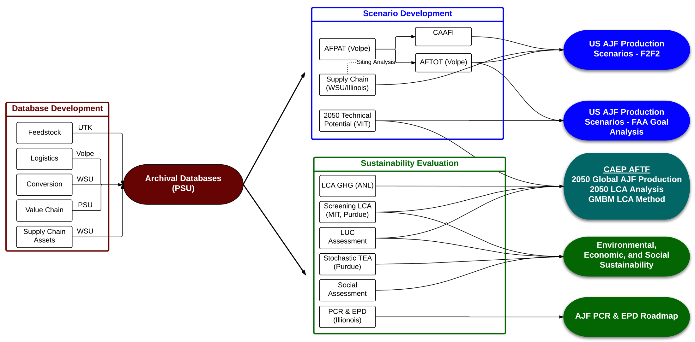
Project Organization
Database Development
and Archive
Scenario and Sustainability Analysis
Project Outputs
5

Slide 6
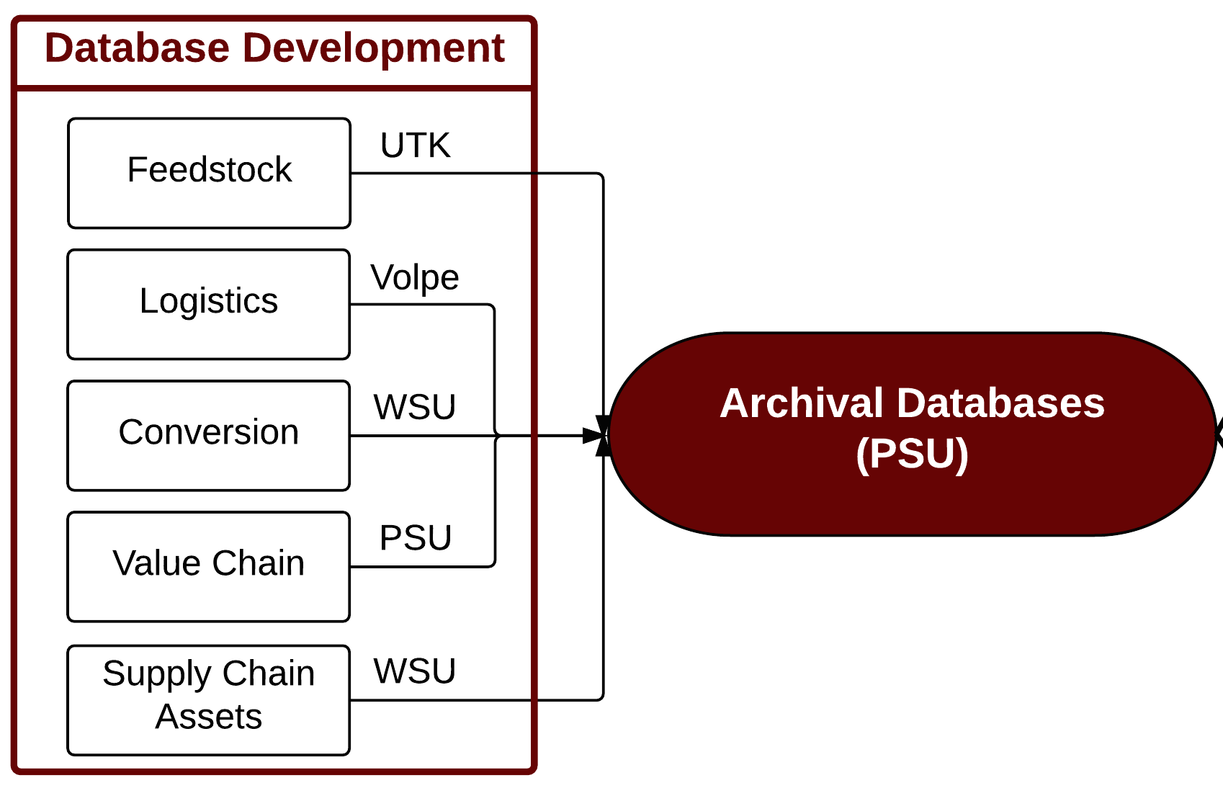
Part 1: Database Development
6

Slide 7
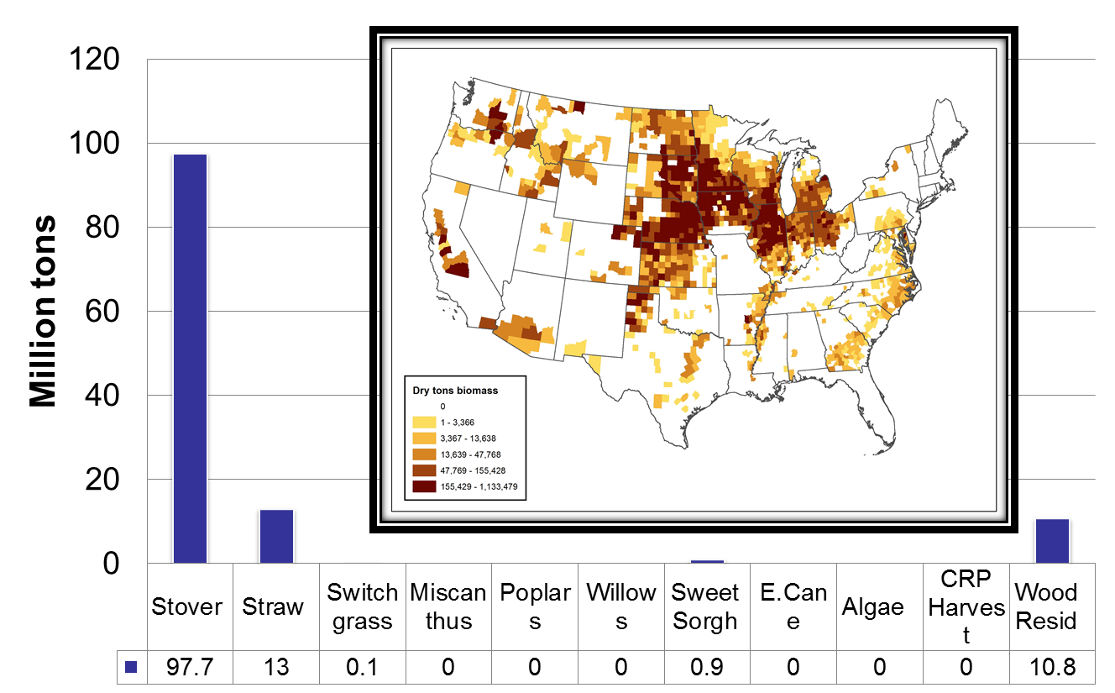
Feedstock Production Analysis
Determine the logistics and economic feasibility of alternative feedstock pathways to jet fuel.
POLYSYS model:
County level national model representing major crops and livestock commodities.
Same model used for Dept. of Energy Billion Ton Study
7

Slide 8
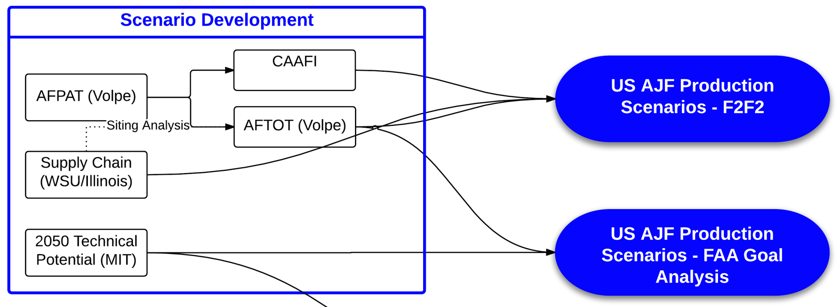
Part 2: Scenario Development
8

Slide 9
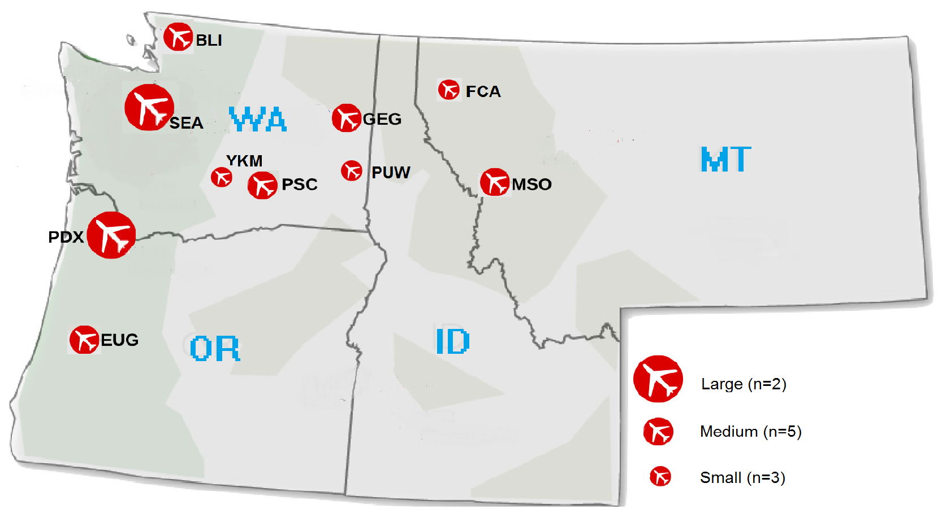
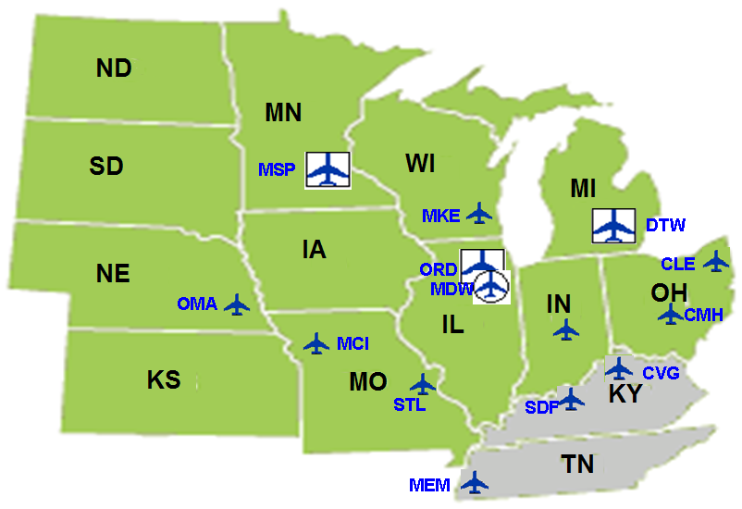
Biorefinery Infrastructure Inventory
Inventory existing infrastructure
Retrofit or co-locate with existing facilities
Benefits:
Reuse existing equipment and infrastructure = decreased Capital Expense
Existing skilled workforce in place = jobs saved and created
Environmental (air, water) permits and water rights = decreased start-up delays
Proximity to feedstock
Existing transportation systems
9

Slide 10
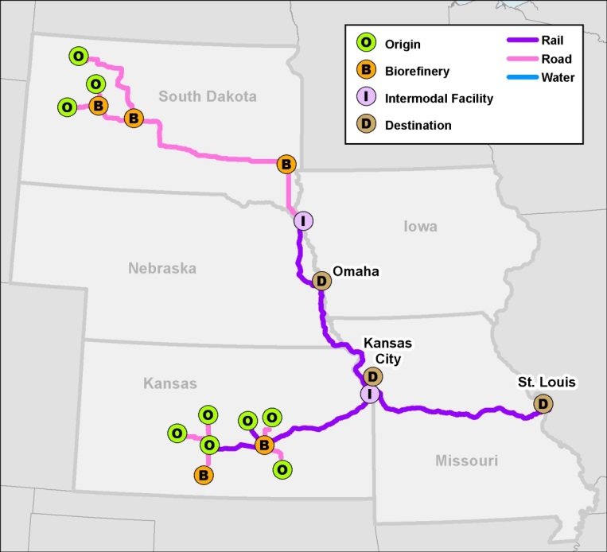
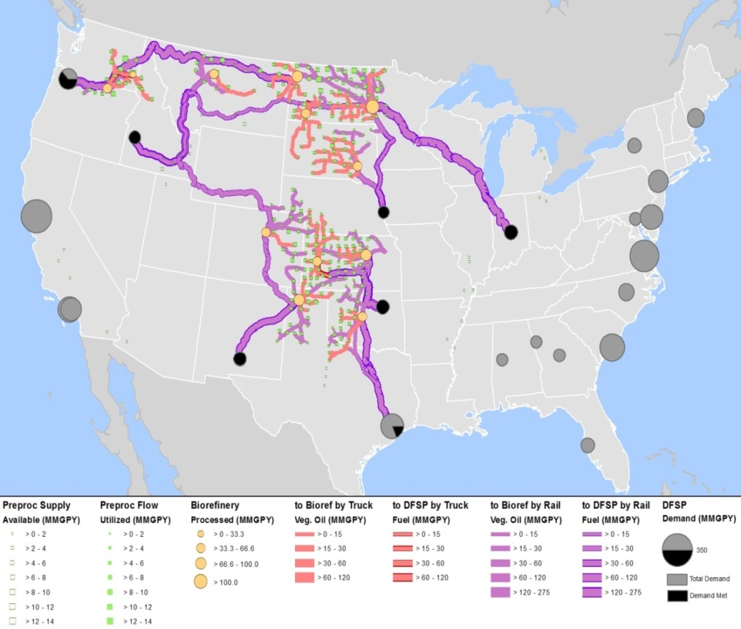
Volpe Alternative Fuels Transportation Optimization Tool (AFTOT)
Optimizes routing to minimize scenario “cost” based on:
Transportation costs
Feedstock supply
Biorefinery capacity (minimum, maximum)
Facility capital cost
Demand
Selects biorefineries
Material exiting biorefinery depends on processing details
Notes:
Allocates starting material to waypoints (biorefineries) and end points based on total cost, including capex to build new facilities (no capex for existing/fixed facilities), minimum volume for facility, feedstock transport distance, and weighted routing cost. Special note that can incorporate various weightings and aspects to adjust outcome. Can explore the space by adjusting things like cost sfor a given mode to evaluate what would turn on a particular rought. Changing price points so that a particular mode becomes more economical. Distiance (scale of scenario) will also play important role in determining relative benefit of different modes.

Slide 11
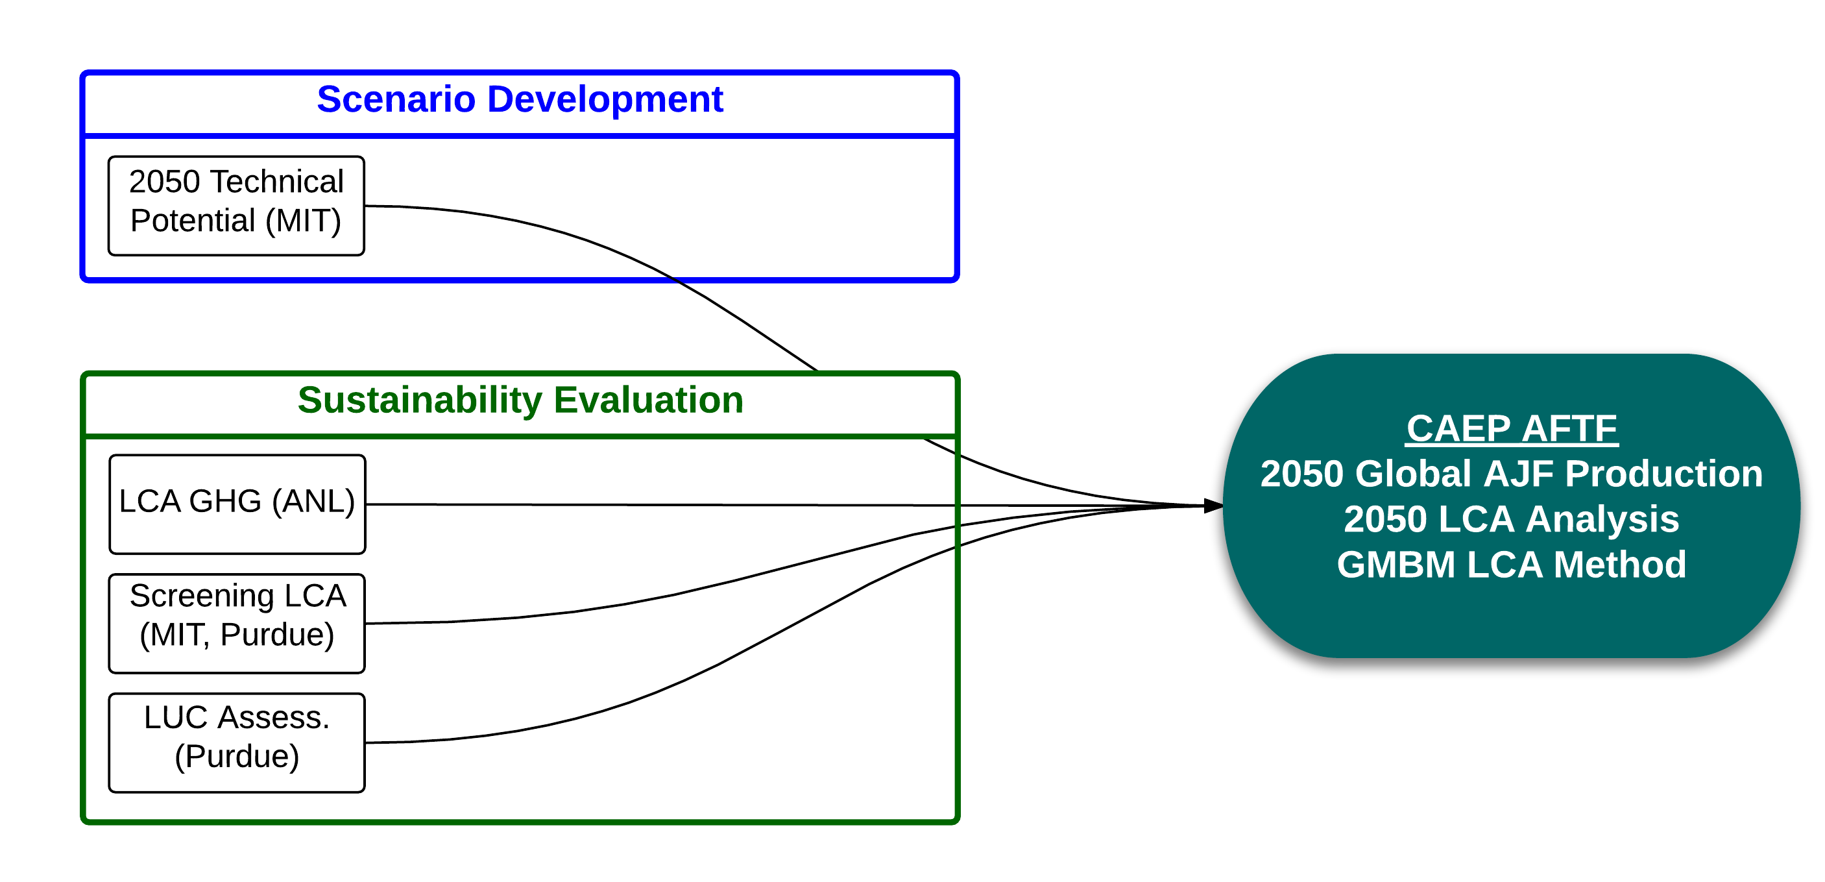
Part 3: Focus on CAEP
ASCENT Project 32 will provide a worldwide life cycle CO2 value for conventional jet fuel
11

Slide 12
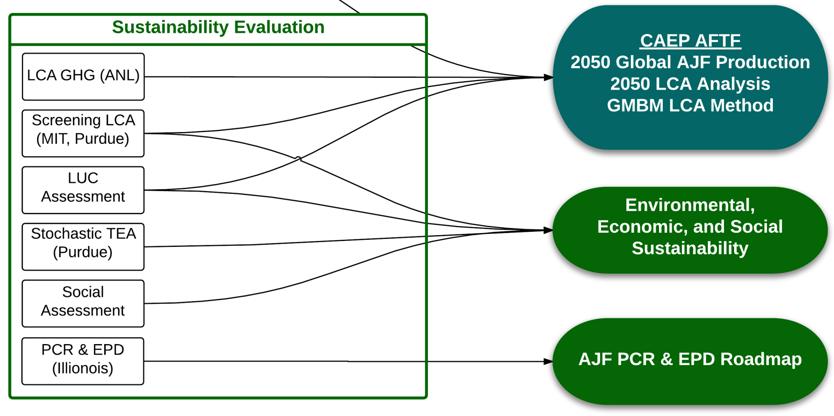
Part 4: Sustainability Evaluation
12

Slide 13
Next Steps for FY15 onward
Support development of life cycle analysis methodology for alternative jet fuels within global market based measure for international aviation
Project provides a framework to:
Collect data on regional supply chains
Conduct regional and national supply chain analyses
Create production scenarios
Evaluate alternative jet fuel sustainability
Identify barriers to alternative jet fuel production
Expanding analysis framework to include:
Waste streams (e.g., municipal solid waste)
Tropical feedstocks (leverage work examining Hawaiian Islands)
13

