Slide 1
Development of National Alternative Jet Fuels (AJF) R&D Strategy – An Update Research, Development, Demonstration, and Deployment Challenges, Opportunities, and Strategic Way Forward
Mohan Gupta, Ph.D. (FAA)
Co-chair of the Interagency Coordination Group (ICG)
and
Other ICG Members from
USDA, DOC, DOD, DOE, DOC, NASA, EPA, NSF and DOS
March 17, 2015
Notes:
Voiceover:
the purpose of this briefing is to update ASTS leadership on progress made on developing the AJF strategy since the last update since the last meeting
-held 2-day workshop (1st day external stakeholders, 2nd day USG)
-developed outline
-developed a matrix of R&D Goals and Objectives
-ready to begin the drafting process

Slide 2
Presentation Outline
Background
Snap-Shot of Current Status
Next Steps
Strategy Development Team
USDA | Harry Baumes, Bill Goldner
DOC | Dan Friend
DOD | Bret Strogen, Tim Edwards
DOE | Zia Haq
EPA | Aaron Levy
FAA | Mohan Gupta (Co-chair), Nathan Brown
NASA | Barb Esker (Co-chair)
NSF | Greg Rorrer
DOS | Dan Birns
STPI | Bhavya Lal, Mike Mineiro, Lucas Pratt and Emily Sylak-Glassman

Slide 3
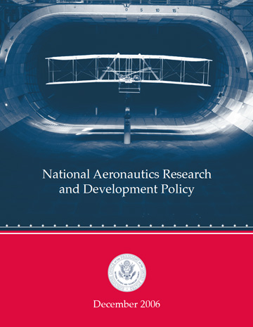
NAJFS - Background
AJF Drivers
Energy Security
Environmental Sustainability
Social and Economic Benefits
Addresses one of the goals of the National Aeronautics R&D Plan
Support and help to grow the Bioeconomy
National AERO R&D Plan focuses on 17 aeronautics goals in four areas –
Mobility, Security, Safety and Environment and Energy
Energy Availability, Efficiency & Environmental Protection
Goal 1: “Enable new aviation fuels derived from diverse & domestic resources to improve fuel supply security & price stability

Slide 4
Coordination Efforts
Coordination needed across all links in the Development Path
Alternative Jet Fuel Development Path
Economic and environmental sustainability analysis across the entire Development Path
Feedstock Production &
Development
Feedstock Logistics
Conversion Process Scale-up/Integration
Fuel Testing/Evaluation
Fuel Conversion
Fuel Performance
Environment Assessment
Enable Production
End User/ Buyer
R&D for feedstock options & cost
Reduce cost & risk of feedstock production
Reduce cost to finance first-of-a-kind plants
R&D for conversion & improved conversion cost
R&D for testing of fuels; transparent process for certification/qualification
Production incentives; investment
Fuel purchases
Guidance for airport use/handling
Improve analysis of benefits & work towards converging standards for crediting
Notes:
Purpose to collaboratively exchange information on respective agencies’ role and responsibilities – specific to alternative jet fuels.
This coordination fills a niche in the communication.
This is not the only communication or coordination effort. Researcher-to-researcher coordination/communication efforts that occur. Project leadership-level (eg, CLEEN to SFW & ERA), & under CAAFI.
Also very high-level information exchange opportunities such as the Inter-Agency Working Group (IAWG) on Alternative Fuels. This interaction is specifically information exchange between the participating agencies. It also encompasses alternative fuels in the most broad definition – bio-diesel, alternative fuels for ground and marine vehicles, etc – not only aircraft. And the nature of the info exchanged is broad, eg, policy perspectives from DOS or large procurement activities by DLA. Participants are generally at the HQ or Program level. IAWG Objective: Identify & discuss challenges facing a U.S. alternative fuels industry & the roles an agency may take in order to meet those challenges and reach mutual energy goals. Goals:1. To create an environment for the effective exchange of information on domestic alternative fuels by senior agency representatives for senior management. 2. To use this information to enhance our respective agency efforts to strengthen energy security in an economically and environmentally favorable manner. NASA is a relatively new participant in these meetings (Jan 2011). IAWG chartered in 2006.
Overview of the supply chain and the areas in which agency programs are supporting development of “drop in” jet biofuels.
Provides an across government perspective/presentation of the information of who and how each agency is providing support
Supply chain columns:
Feedstock production –- identification, assessment and improvement of potential jet fuel feedstock crops
Feedstock logistics— support for harvesting/movement of the feedstock to where it needs to be
Fuel Conversion—R&D to develop and optimize alternative jet fuel conversion processes
Conv. Process and scale up – out of lab and pushing towards commercialization—prove scaled production
Fuel performance—how engine/a/c performs using the fuel → key to qualification and certification
Env. Assessment—air quality improvements & GHG LCA
Enable Production—govt. incentives to support a new industry such as USDA and DOE loan guarantee and grant program, RFS2, DOC investor education/webinars
End user—Agencies that use fuels (DoD), and in case of airlines (close coordination with FAA)

Slide 5
AJF Development Path: Interagency Contributions
Feedstock
Development & Production
Scale-up Fuel Conversion & Production
Fuel Testing & Evaluation
Feedstock Logistics
Fuel Conversion
Fuel Performance
Environment Assessment
Enable Production
End User/ Buyer
USDA |  |  |  |  | ---
DOC | ✓ | --- | ✓ | ✓ |  |  | ---
DoD | --- | --- | --- | ---
DOE |  |  |  |  | --- |  |  | ---
EPA | --- | --- | --- | --- | --- |  |  | ---
FAA | --- |  | --- |  |  |  | ---
NASA | --- | --- | --- | --- |  |  | --- | ---
NSF |  |  |  | --- | --- | --- | --- | ---

Slide 6
Development of National Alternative Jet Fuels (AJF) R&D Strategy
Intended Purpose
Identify opportunities and strategically address challenges associated with Research, Development, Demonstration, and Deployment (RD3) along the development path of alternative jet fuels.
National AJF R&D Strategy – A mechanism to
Articulate Aspirational yet Achievable Objectives, Measurable Performance Metrics and Timeline to achieve the goal
Mobilize the federal and non-federal stakeholders community towards achieving the common goal and objectives
Understand industry needs and align federal strategic R&D efforts to address RD3 challenges along the alternative jet fuels supply-chain
Integrate, align and coordinate interagency activities
Promote increased collaboration
Enhance technology transfer
An undertaking by the Aeronautical Science and Technology Subcommittee (ASTS) of the NSTC with input from stakeholders community.
Goal Statement of the Strategy:
Enable the development, production, and use of environmentally sustainable, cost-competitive and socially responsible alternative jet fuel with stable supply to significantly meet the needs of U.S. jet aviation.

Slide 7
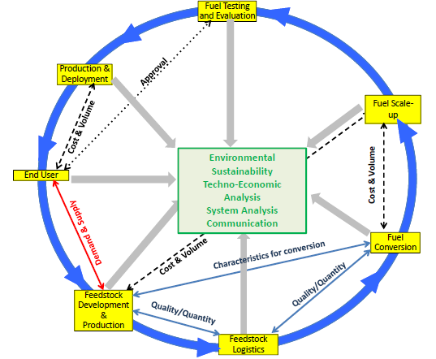
Alternative Jet Fuels Development Path: System-Wide Challenges & Non-Linearities
A complex enterprise in which the elements of the Development Path are inter-related.
Strategy document utilizes the linear model of the Development Path.
However, each of the elements of the Development Path are influenced by other elements. Examples:
Current and projected demand by End Users directly affects the desirability of investment in Feedstock Development & Production and Fuel Conversion & Scale-Up.
Perceptions about the complexity and amount of fuel required to succeed in the fuel certification process (part of Fuel Testing and Approval) directly affect the desirability and investment needed in Fuel Conversion Scale-Up.
Strategy recognizes these interactions and provides rationale for cross-cutting efforts that integrate multiple elements of the Development Path.

Slide 8
National Alternative Jet Fuels R&D Strategy
Feedstock Development & Production
Scale-up Fuel Conversion & Production
Fuel Testing & Approval
Feedstock Logistics
Fuel Conversion
Fuel Performance
Environment Assessment
Enable Production
End User/ Buyer
Feedstock Production & Logistics
Conversion & Scale-up
Fuel Testing & Evaluation
Organization of Strategy Goals and Objectives
Three thematic topic sections
Feedstock Development, Production and Logistics
Fuel Conversion and Scale-up
Fuel Testing & Evaluation (including certification and qualification)
Section on Integrated Challenges – considerations that span entire development path and the interfaces
Categorized objectives along three time horizons: Near- (<5 years), Mid- (5-10 years) and Far- (>10 years) term - similar to National Aeronautics R&D Plan
Acknowledge non-R&D context of policy (e.g., RFS), economic factors/challenges, & international considerations

Slide 9
Strategy Development: Timeline and Process for Information Collection
April 4, 2013: Interagency kickoff meeting
June, 2014: First draft released following interagency review
Nov 3, 2014:
Meeting with ASTS on next steps
Fall, 2013: Stakeholders online survey
Summer, 2010: Idea seeded
2010
Ist Qtr 2013: ASTS Go Ahead
2nd Qtr 2013: OSTP meetings with Industry
Jan 7, 2014:
Workshop with stakeholders
Aug/Sep, 2014:
Briefings to IAWG and BRDI
Jan 19, 2015: Received Workshop participants comments on the draft Strategy
Current Status
Addressing comments received from the stakeholders
Next Step
Conduct another round of D&A review
Secure review and approval from ASTS and CoT/NSTC for Strategy release

Slide 10
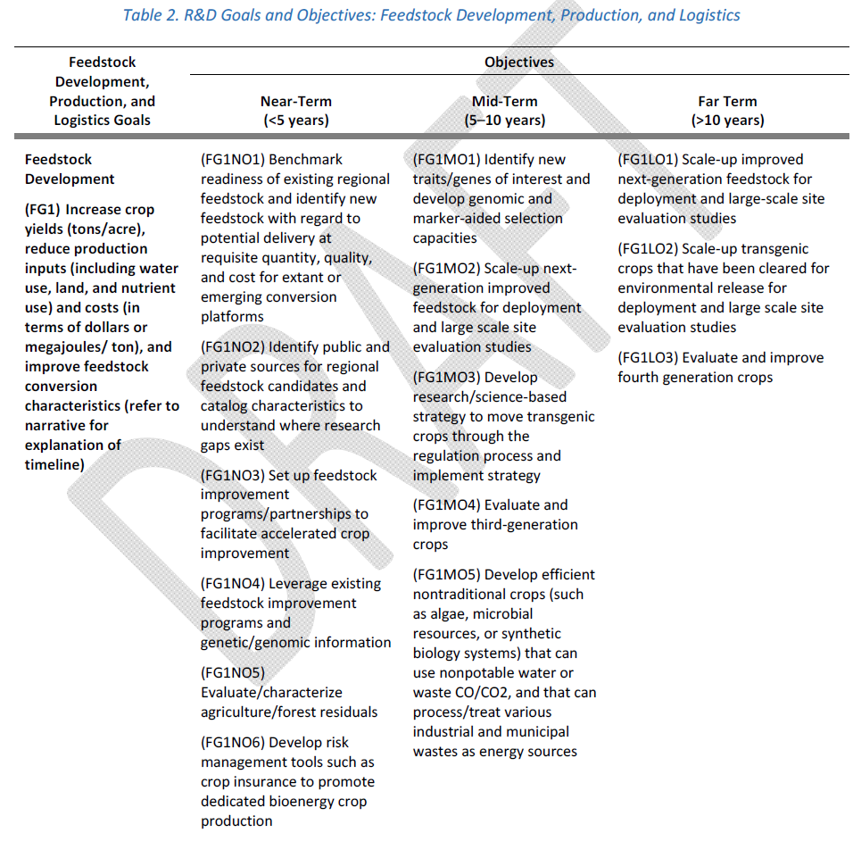
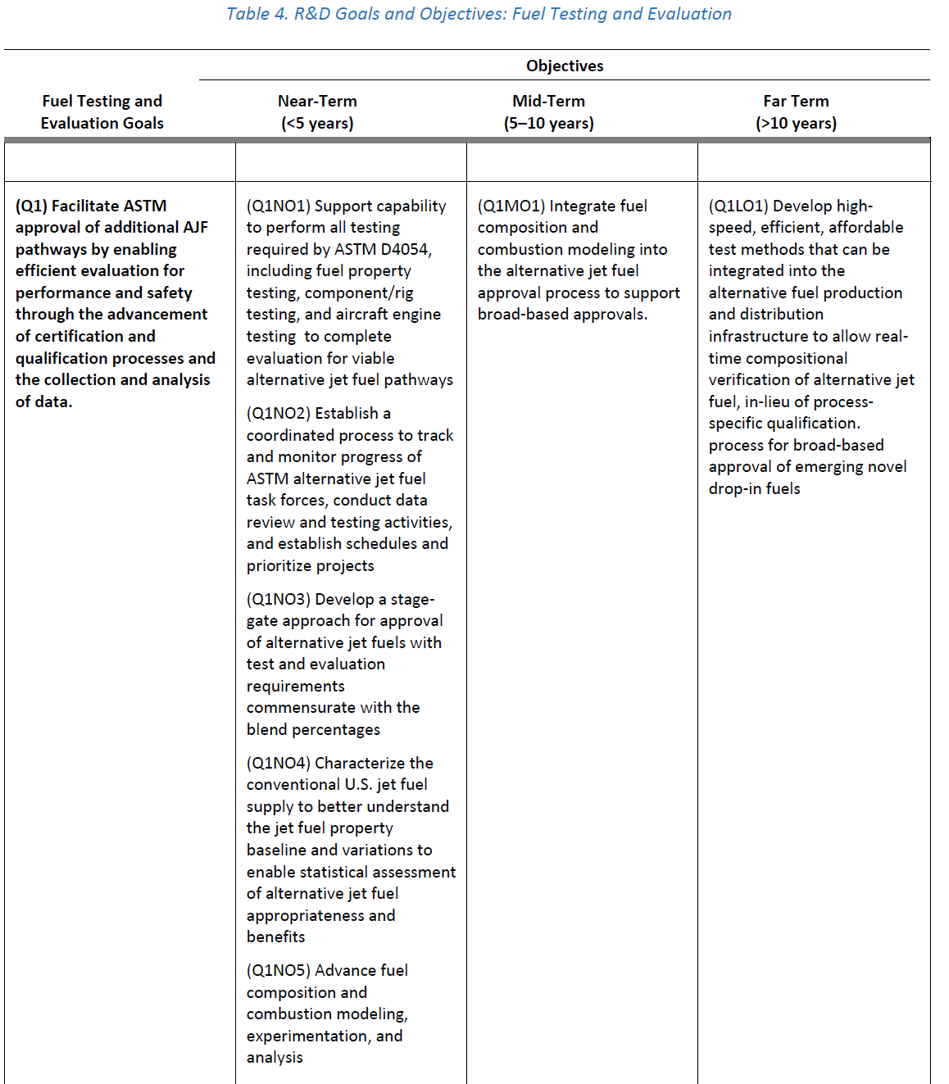
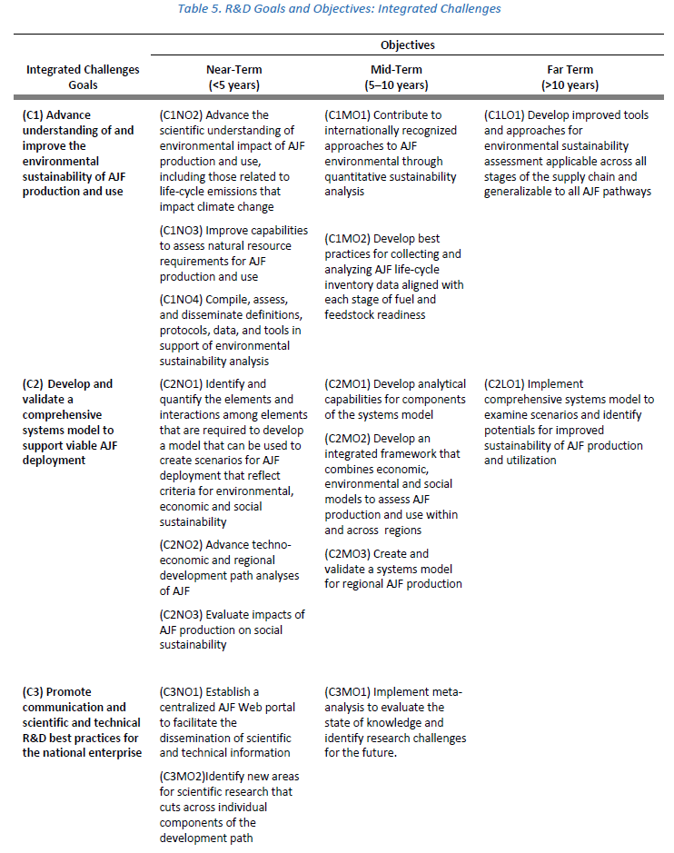
Example – Goals & Objectives Table (multiple time horizon)
DRAFT

Slide 11
US Agencies recognize the complex, inter-related nature of the alternative jet fuel enterprise.
Summary
The complexity of the enterprise warrants close, inter-agency communication and coordination.
NASA
Federal Agencies have self-organized to not only more closely coordinate but also codifying their coordination and common goals in an actionable National strategy.
DOC
DOE
FAA
Academia
International
DoD
NSF
EPA
USDA
DOS
Industry

