Slide 1









National Jet Fuels Combustion Program
Status Update
Mohan Gupta, Ph.D.
Asst. Chief Scientist
Office of Environment and Energy
Federal Aviation Administration
REDAC E&E Subcommittee Meeting
March 17, 2015

Slide 2
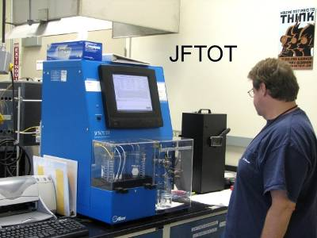
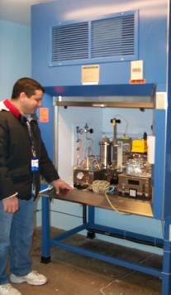
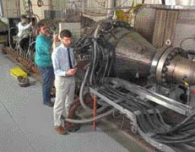
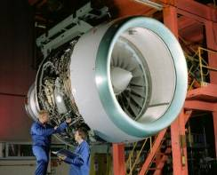
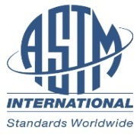





Objective: Streamline Fuel Approval Process
ASTM D4054 Qualification Process
PRIMARY COST DRIVER
TIER 1
TIER 2
TIER 3
TIER 4
~$500K, 500 gal
~$5,000K, 10,000+ gal
Specification Properties
Fit-For-Purpose Properties
Component/Rig/APU Testing
Engine/APU Testing
ASTM Research Report
ASTM Specification
OEM Review
& Approval
ASTM Balloting
Process

Slide 3
Challenges
Challenges to Alternative Fuel Approval Process
  Cost/duration of fuel approval process
    Fuel quantities for rig/engine tests
  OEMs uncertainty over effects of novel fuel composition and chemistry on combustor operability

Slide 4
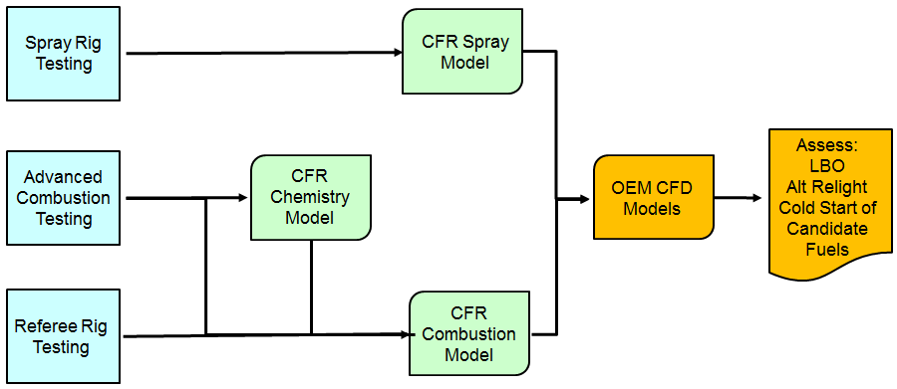
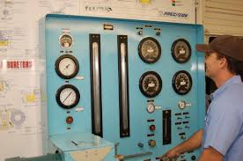
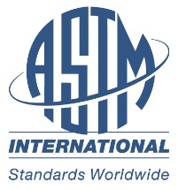


ASTM D4054 Alternative Qualification Process
TIER 3
TIER 4
Primary FOMs
TIER 1
TIER 2
Specification Properties
Fit-For-Purpose Properties
Other Rig/Engine Testing
ASTM Research Report
ASTM Specification
OEM Review & Approval
ASTM Balloting Process

Slide 5
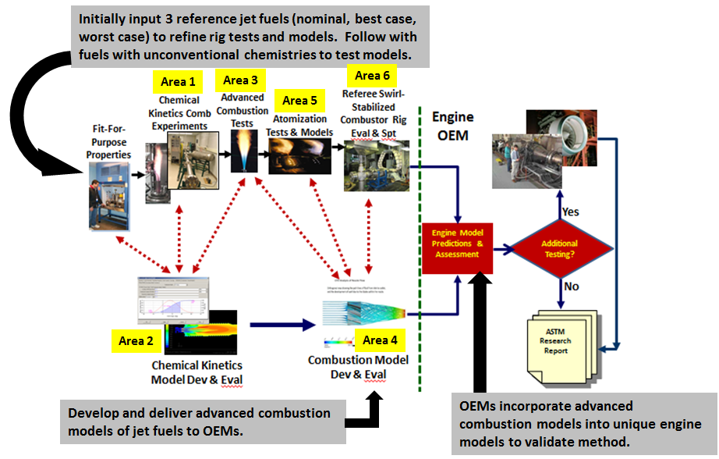
Integrated Approach
An applied research program with near-term utility to support ASTM approval process – one of the Objectives of the National Alternative Jet Fuels R&D Strategy
Employ a number of both conventional and alternative jet fuels for screening, survey and detail testing and modeling.
Area # 7

Slide 6
Year 1 Objectives
Characterize sensitivities of Cat A fuel, Cat C fuel, and dodecane
Develop basic modeling approaches and demonstrate sensitivities to rig test fuels
D4054 FFP Data
Spray Rig Testing
CFR Spray Model
Enablers for future cost savings
Advanced Combustion Testing
CFR Chemistry Model
OEM CFD and Spray Models and guidance for fuels testing
Assess FOM:
LBO
Alt Relight
Cold Start of Candidate Fuels
CFR Combustion Model
Referee Rig Testing
Demonstrate models can be integrated into common LES platform
Characterize flow quality and diagnostics
Bring rig tests on-line

Slide 7
Year 1 Data Flow and Modeling Development
Generate ignition delay and species data for Cat A and C fuels
Develop chemical kinetics models for Cat A and C fuels
Area 1
Advanced Combustion Testing
CFR Chemistry Model
D4054 FFP Data
Area 2
Area 3
CFR Combustion Model
Generate combustion data for Cat A and C fuels
Area 4
Reduce kinetics model, develop advanced combustion models, and simulate turbulent combustion experiments
OEM CFD and Spray Models and guidance for fuels testing
Assess FOM:
LBO
Alt Relight
Cold Start of Candidate Fuels
Generate spra data for Cat A and C fuel
Develop property-dependent spray model and perform LES of spray rigs
Enablers for future cost savings
Spray Rig Testing
Area 5
CFR Spray Model
Area 5
D4054 FFP Data
Referee Rig Testing
Area 6
Map rig characteristics, generate LBO data for Cat A fuels and selected and Cat C fuels
National Jet Fuels Combustion Program
REDAC E&E Subcommittee Meeting
March 17, 2015

Slide 8
Benefits
Streamlines current ASTM approval process
  Fewer rig/engine tests
    Eliminates duplicative OEM testing
  Reduces costs and accelerates schedule
  Increases throughput of new fuel approvals
  Help eliminate unsuitable fuels in early stage of fuel testing
Reduces fuel quantities required for approval
  Replace/reduce combustor/engine tests with rig tests/modeling
Reduces engine OEM risk/uncertainty
  Provides greater understanding of fuel chemistry effects on combustion
  Provides greater understanding of the performance of novel fuel chemistry
  OEM participation in development of tests and models
Improved industry modeling and design tools
  Supports compositionally-based fuel approvals
  Supports identification of acceptable fuel composition boundaries for future engine designs

Slide 9
Program Success Criteria for the First Year
Demonstrate that one or more tests have sensitivity to a test fuel over a range of conditions that offer the potential of their being used as part of a methodology for simplifying the alternative fuel certification process
Demonstrate that a validated surrogate chemistry model can be developed that has the potential of being used to predict fuel-sensitive test results over a suitable range of conditions
Demonstrate a combustion modeling approach that can be integrated into an OEM’s procedures that offers the potential of being used to predict fuel effects on combustor operability and simplify the alternative fuel certification process
Program continuity depends upon meeting the First Year Program Success Criteria.

Slide 10
Program Organizational Structure
Program Leadership
Mohan Gupta (FAA) and Mel Roquemore (AFRL)
Overall Program Direction and Guidance
Steering Committee
(Feds+OEMs+Research Team Leads+Med Colket)
One Month-end formal plenary telecon with both WGs
(and as often as needed)
Technical Coordination, Integration and Analysis
Area 7
Med Colket and Josh Heyne
One mid-month formal telecon individually with each WG
(and as often as needed)
Modeling Working Group II (Areas 2, 4 and 5 PIs + Other Research Leads)
Success Criteria II
Subject-specific Ad hoc Subcommittees
Testing Working Group I
(Areas 1, 3, 5, and 6 PIs + Other Research Leads)
Success Criteria I
Modeling-Data Validation and Integration
(in coordination with Med and Josh)
Working Group III
(Will be formed later)
Success Criteria III

Slide 11
NJFCP - Timeline
Program continuity depends upon meeting the success criteria
We are here
Oct-end, 2015 Semiannual Meeting:
Status towards meeting success criteria
Oct 27-30, 2014 MACCCR Meeting
Report on Fuels Survey & Screening
Progress Report
Jan
Feb
Mar
Apr
May
Jun
Jul
Aug
Sep
Oct
Nov
Dec
Jan
Feb
Mar
Dec 3-4, 2014
Kickoff Meeting
ASCENT and CAAFI Meetings
May 21-22, 2015
Semiannual Meeting (to be held at GE, Cincinnati): Progress towards meeting success criteria and adaptations needed going forward
Nov-end, 2015:
Submission of first-year results and deliverables
Mid-month 2-hour telecon with each WG
Month-end 2-hour Plenary telecon
OEM input and feedback throughout the year
Initial Program Duration

Slide 12
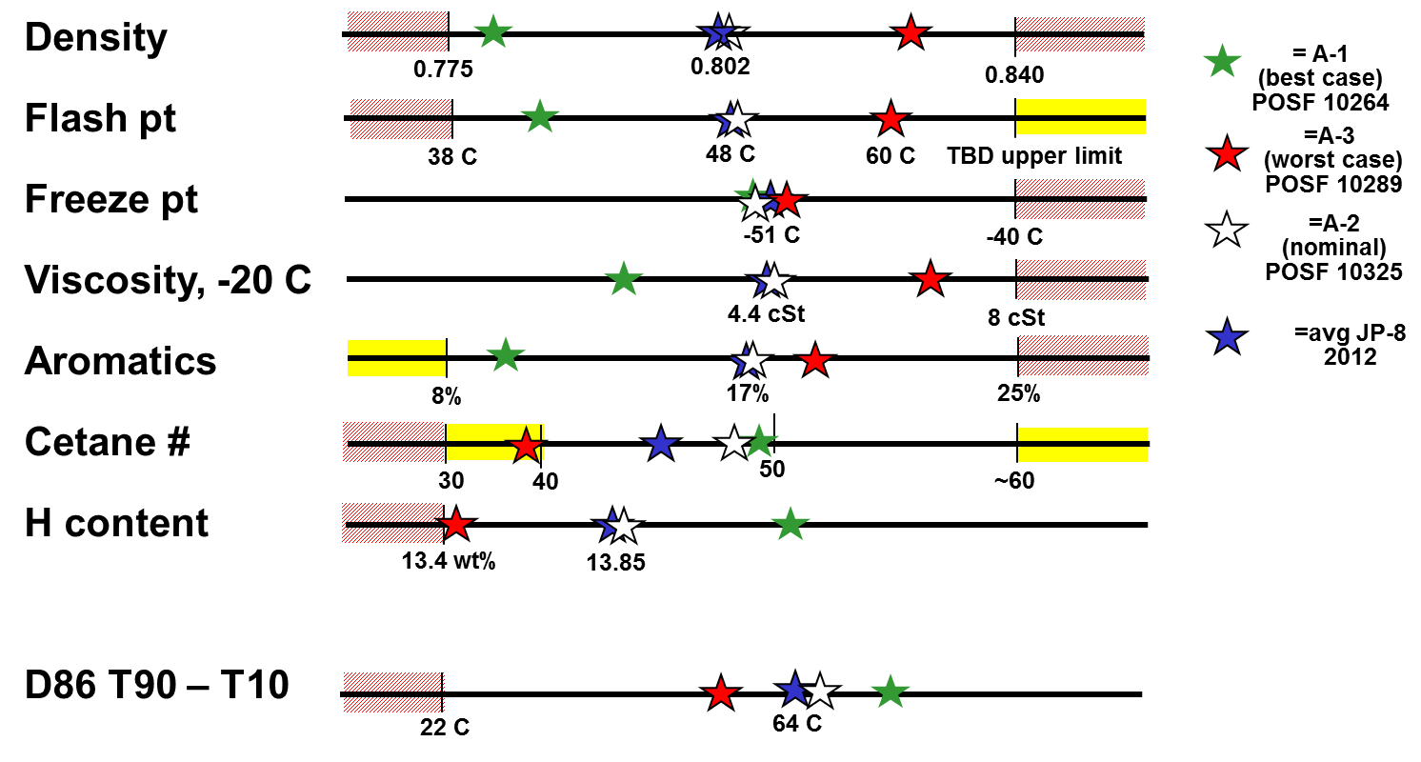
Category A Fuels
Represent range of currently available fuel properties and compositions
  Worst case = high viscosity, high density, low H content
Inventory
(gal)
3180
3476
18295
Fuels have been sent out to all teams
National Jet Fuels Combustion Program
REDAC E&E Subcommittee Meeting
March 17, 2015

Slide 13
Category C Fuels Prioritized
Highly unusual fuel – Neat Gevo ATJ-SPK – low Cetane (~15), highly biomodal, very flat boiling (~21 C)
Bimodal carbon distribution fuel – Aromatic front end – trimethyl benzene & C14 iso-paraffins (C14: T10=217, T90=234 C)
Low cetane number fuel – 50/50 or 60/40 blend of Gevo ATJ-SPK/Sasol IPK – low Cetane (~20-25), otherwise jet like carbon dist & distillation curve
Flat distillation curve fuel – C10 n-paraffins/iso-paraffins (T10=163, T90=167) – trimethyl benzene can be added to make fully-synthetic fuel (TMB 165 C)
High viscosity fuel – A blend including Amyris SIP
High cyclo-paraffin content fuel – Neat or higher blend of Virent HDO SK
Will employ tiered fuels evaluation approach
Will also test n-dodecane fuel to support modeling groups.
Currently, sending fuels to all testing teams
National Jet Fuels Combustion Program
REDAC E&E Subcommittee Meeting
March 17, 2015

Slide 14

NJFCP Area Highlights: 1 of 2
Testing Working Group:
Area 1 Chemical Kinetic Studies (Hanson/Bowman): Ignition delay and speciation data collected for Cat A fuels; small differences observed for petroleum-based fuels above 1100K. Shifting to lower temperatures and alternative fuels
Area 3 Turbulent Combustion Experiments (Lieuwen): Developed system for rapid switching between fuels. Preparing for pre-screening tests to determine optimum tests conditions for fuel screening tests.
Area 5 Spray Measurements (Lucht): Diagnostic approaches established. Awaiting confirmation on fuel nozzle (done), operating conditions, and resolution of ITAR issues.
Area 6 Referee Rig Tests (Stouffer): Combustion instabilities mapped, fully engaged with OEMs, and undergoing rig shakedown. OEM Committee established to set preferred operating conditions for screening tests. Experimental refinements in progress.
National Jet Fuels Combustion Program
REDAC E&E Subcommittee Meeting
March 17, 2015
14
Federal Aviation
Administration
14

Slide 15
NJFCP Area Highlights: 2 of 2
Modeling Working Group:
Area 2 Chemical Kinetic Modeling (Wang): Beta-version of hybrid kinetics mechanism developed for A-2 fuel, demonstrated pressure dependence and ability to reduce species for CFD. Validating model against rich side chemistry and product species.
Area 4: Fuel-Dependent CFD Modeling (Menon/Sankaran/Ihme): Example n-dodecane kinetics model reduced to 24 species and demonstrated application in LDI burner. Grid generated for referee rig. New combustion model developed. Awaiting kinetics model for A-2 fuel and boundary/inlet conditions.
  Area 5 Spray Modeling (Ihme): Working on development and implementation of non-ideal droplet evaporation, multicomponent evaporation using functional group-based approach (UNIFAC) and group contribution methods to determine vapor pressure and model verification. Next step: description of Cat-A evaporation.
National Jet Fuels Combustion Program
REDAC E&E Subcommittee Meeting
March 17, 2015
15
Federal Aviation
Administration
15

Slide 16
Program Sponsors, Contributors, Performers and Industry Members
STEERING COMMITTEE
(Federal, OEMs, University PIs)
Guidance
Fed Gov’t
NJFCP
ASCENT Universities: GaTech, UDRI, UIUC, Stanford, Purdue, OSU Non-ASCENT: Princeton, UConn
Industry
-FAA
-ARL
-AFRL
-NASA
-NIST
-DLA
-Navy
-DOE
-Chem/Kinetics Modeling
-Engine Operability
-Fuel Evaluation Methodology
-Reduced cost
-Honeywell
-GE
-Pratt & Whitney
-Williams
-Rolls-Royce
-Fuel Producers
-Parker Hannifin
-Funding
-Test Facilities
-Fuels
Other Contributors:
NASA, AFRL, NIST, Army Lab, NRC Canada, DLR, Sandia Lab, OEMs
International: NRC Canada & DLR
Guidance
A total of 34 entities
ASCENT Advisory Committee Members
(CAAFI, Boeing, Shell, Gevo)
National Jet Fuels Combustion Program
REDAC E&E Subcommittee Meeting
March 17, 2015

Slide 17
Industry/International Interaction and Involvement
Role of OEMs
OEMs are recipient of the outcomes of this program in terms of validated streamlined generic fuels testing and modeling capability for ASTM approval
Serve in the Program Steering Committee
Perform in-house research (testing and modeling) activities
Fuels Selection
Cost-share with ASCENT universities
Role of CAAFI and Fuel Industry
Participation through ASCENT Advisory Committee
Help the program on emerging alternate jet fuel types and their chemical composition to guide the program direction
Role of International Partners
NRC-Canada:
  Will conduct high altitude and fuel nozzle spray tests ($500K NRC investment)
  Provided cost-share to ASCENT universities
DLR: Will perform tests using the same/similar fuels. Participation will help to understand the delta and trends even though test devices used will be different.
National Jet Fuels Combustion Program
REDAC E&E Subcommittee Meeting
March 17, 2015

