Slide 1
Noise Research
Roadmap and Update
REDAC – E&E Subcommittee
Rebecca Cointin, Manager, AEE-100
March 18, 2015

Slide 2
Noise Goal
Reduce the number of people exposed to significant noise around U.S. airports in absolute terms, notwithstanding aviation growth, and provide additional measures to protect public health and welfare and our national resources.
Specifically, by 2018, have the U.S. population exposed to significant aircraft noise around airports have been reduced to less than 300,000 persons

Slide 3
Drivers of Research
Even though the number of people in the U.S. exposed to significant aircraft noise since 1975 has dropped by 95 percent, complaints, opposition and challenges continue to be an issue
Ability to answer the question on whether there has been a significant change in public perception of noise.
Gather new, updated data to have a strong scientific support for any policy decisions regarding aviation noise

Slide 4
Noise Research in AEE Research
AEE Research Overview:
Characterize the Problem and Assess Risk
Develop mitigation solutions
Manage system performance
NextGen Five-Pillar Environmental Approach
P1: Improved Scientific Knowledge and Integrated Modeling
P2: New Aircraft Technologies
P3: Sustainable Alternative Aviation Fuels
P4: Air Traffic Management Modernization and Operational Improvements
P5: Policies, Environmental Standards, and Market Based Measures

Slide 5
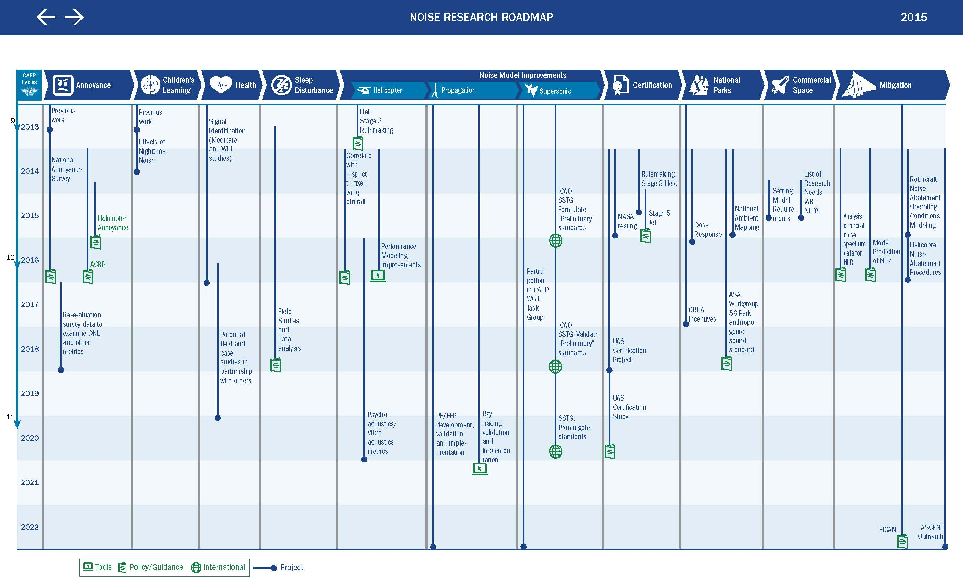

Slide 6
Commercial Space Noise Research
Goal: Tool Development and Guidance
Launch Noise and Sonic Boom Modeling Methodology
Developing guidance of required elements for a modeling methodology
Goal is to have this part of the FAA Order 1050 Desk Reference
Current Sonic Boom Modeling completed using PCBoom
ACRP solicitation released which will develop a launch noise and sonic boom tool
Developing a research plan centered around NEPA needs
Example is appropriate metrics to represent launch noise and sonic boom

Slide 7
UAS Noise Certification
Goal: Policy/Guidance on UAS Certification
Since there are no size, weight, use or other configuration specifications that preclude UAS from qualifying as aircraft for certification purposes, they are required to comply with the noise certification requirements of Title 14 of the U.S. Code of Federal Regulations Part 36 (Part 36)
Coordinating Internationally through CAEP WG1
Collecting information from States on their procedures
Determining if an internationally agreed upon process is needed (similar to what we have developed for other aircraft types)

Slide 8
UAS Noise Certification
AEE has initiated a project aimed at reviewing and developing noise certification requirements and procedures that would apply to UAS.
The objective for the project is to investigate and evaluate a broad set of options for addressing noise certification issues of the current and future UAS fleet.
Working to collect UAS noise data to support possible Part 36 modifications for UAS and to obtain noise data for modelling purposes.
Coordinating to try to leverage the UAS Test Sites

Slide 9
UAS Noise Research Beyond Certification
Continuing to review potential uses for UAS and types of noise analysis may be needed
Potential metrics
Modeling methodologies

Slide 10
Helicopter Noise
Los Angeles Helicopter Initiative
Continuing to endorse Voluntary Measures
Led by the Western-Pacific Region with AEE providing technical assistance as needed
Large group of stakeholders including operators and homeowner associations
Correlated Complaints (i.e. Noise Complaint System)
Response to Recommendations from 2013 Report to Congress
Scheduled to go live March 31
Helicopter Annoyance
Two projects examining two potential methodologies to collect helicopter annoyance data
Both projects also look at non-auditory factors and non-auditory reactions to helicopter versus jet traffic

Slide 11
Helicopter Noise
Rotorcraft Noise Abatement Procedures
Expanding research on noise abatement procedures
Collaboration with AHS and HAI to update fly Neighborly Operational Procedures
Exploring helicopter recertification
Fleet Analysis and Technology Review
Through CAEP WG1

Slide 12
Supersonic Aircraft Research
Domestic
Exploring the protocol for noise test community engagement
Determining other needs for reassessment of Part 91.817
CAEP WG1
SSTG to formulate applicable supersonic aircraft, sonic boom noise standard by defining applicability, boom metrics, acoustical measurement & acquisition, flight test procedures and noise limits.
Metric Selection – determining appropriate metric for noise certification
Procedure Development – developing flight test procedures, including flight profiles, aircraft states and ground microphone set ups

Slide 13
Noise Complaint Initiative
Representatives from across the lines of business and staff offices
Kicked off in September with about a year’s duration
Two Goals:
Identify a consistent agency-wide process for addressing noise complaints
Identify actions the FAA might take to better address the underlying issues raised by the complaints, including increased community engagement and further minimizing noise impacts where possible

Slide 14
Performance Based Navigation Research
Examining the effects of PBN procedures which may focus of noise on populations
Focused on three airports where RNAV/RNP has been implemented
Currently completed two phases:
Phase I: Calculated noise levels for multiple scenarios covering pre- and post-implementation of RNAV/RNP procedures
Phase II: Normalized scenarios to ensure equitable comparisons and re-examine noise changes at each of the study airports and looked at additional supplemental noise and operations metrics to describe noise associated with the PBN changes

Slide 15
PBN Research (continued)
Findings:
Many changes are happening at a single airport over multiple years
No single metric has yet to be identified to best represent impact of PBN procedures
Metrics Examined: DNL, Number Above LAMAX 75dBA and Number of Flight Operations Over Receptors (within 0.5 nm of receptor)
Changes seen in the study can be grouped in three categories:
Lateral Shifts (conventional to RNAV or RNAV to RNAV)
Change in Procedure usage
Profile/Vertical changes
Additional Research on Metrics will be the focus of the next phase of work
Project team includes members of AJV-114 (part of ATO)

Slide 16
Update on National Survey
Objective
Conduct a new nation-wide survey to update the scientific evidence of the relationship between aircraft noise exposure and its effects on communities around airports
Survey Method
Survey people around airports in 5 dB bands from DNL 50 to 70 dB
500 completed mail surveys around each airport (100 in each band)
Will resample the mail surveys to interview 107 people around each airport by phone (21 – 22 in each band)
Status
OMB Review

Slide 17
FY15 Noise Projects
AEE Funded
Noise Impact Health Research
Noise emission and propagation modeling
Civil, supersonic over flight, sonic boom (noise) standards development
Noise Outreach
Sleep Disturbance
Support ASA Workgroup on dose-response for National Parks
Ray Tracing Development for Modeling
Launch Noise and Sonic Boom Research
Aircraft Certification (CAEP support, validation tool development, validation)
Rotorcraft Noise Abatement Procedure Development
Examine airline flight data to improve flight performance modeling
PBN Research
ARP Funded
Annoyance Survey
Noise Level Reduction Work (Potential)

Slide 18
Considerations for FY16 and 17 Projects
Larger Sleep Study
Metric Re-evaluation with Survey data
Additional Helicopter Work
Annoyance and/or Metrics
Additional UAS Measurement (if needed)
Children’s Learning (compliment ACRP project outcome)
Additional Park Dose-Response work
NPS as a partner
Continued work in
Supersonics
Health
Propagation

