Slide 1
Office of Environment and Energy’s (AEE)
Air Traffic Management Modernization / Operations Research Program Update
Presented to:
By:
Date:
REDAC E&E Subcommittee
Julie Marks and Chris Dorbian (AEE-400)
March 18, 2015

Slide 2
Air Traffic Management Modernizations (ATMM) Offer Important Potential E&E Improvements
AEE E&E ATMM Research Program Goals
  Identify and accelerate the implementation of air traffic management concepts that will reduce aviation environmental impacts and/or improve energy efficiency
  Investigate the E&E effects of operational changes implemented by the FAA.
Core Program Elements
  Research Process: Identifies, conducts, evaluates and transitions ATMM research for implementation
  Roadmap: Describes areas for ATMM Research near, medium, and long term.
  Portfolio Metrics: Assesses the portfolio’s balance with regard to addressing E&E issues and the maturity progression of research project.
Coordination/collaboration key to AEE ATMM Research, e.g., with ATO, ANG, NASA, etc.

Slide 3
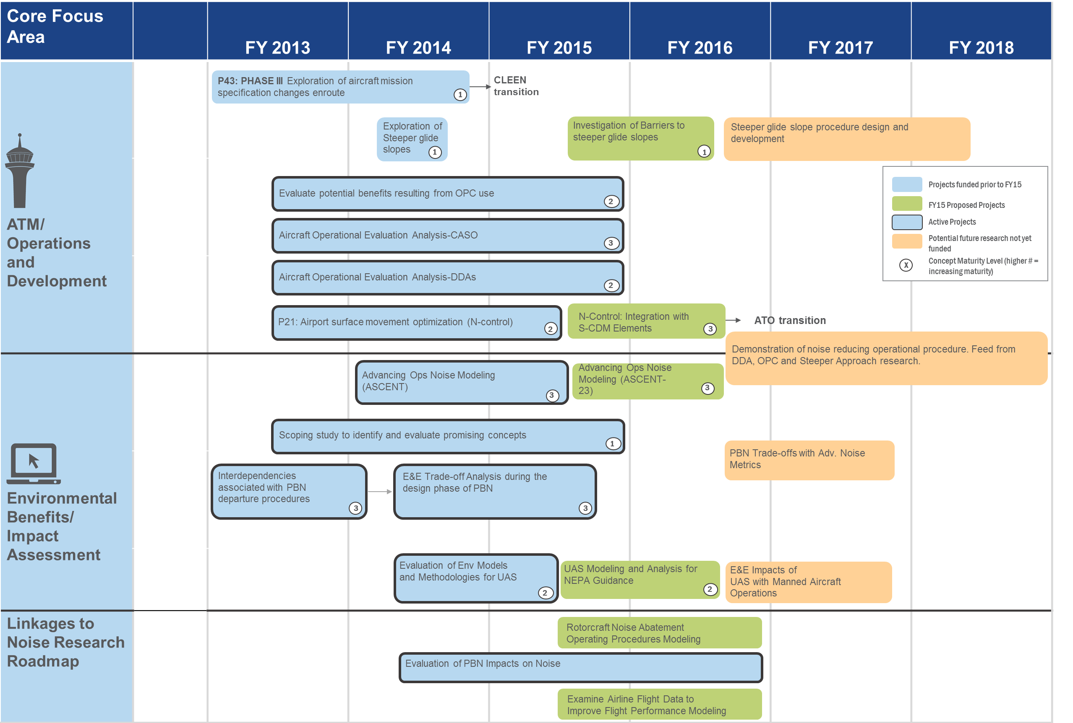

Slide 4
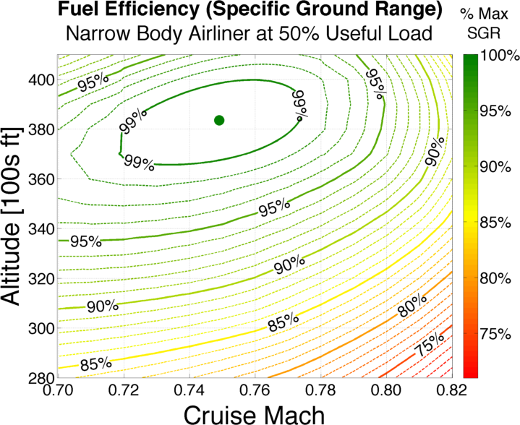
Cruise Altitude and Speed Optimization (CASO)
PARTNER Project 32 / ASCENT Project 15
Identify fuel savings potential from small changes in cruise altitude & speed
Work with airlines to understand operational & business constraints
Find opportunities to realize savings in current & NextGen operations
Typical Operating Regime
(fast,
off-optimal alt)
Optimal Mach/Alt

Slide 5
CASO High-Level Approach
Radar Tracks
(~200,000 flights)
Modified Trajectory
(Speed/Altitude)
Improved Fuel Burn
(from changed speed/alt)
Speed/
Altitude Optimizer
Aircraft Fuel Burn Model
Lissys PianoX
Weight
Estimation
Weather Correction
Wind/Temp
CASO Benefits
Baseline (As-Flown) Trajectory
As-Flown Fuel Burn

Slide 6
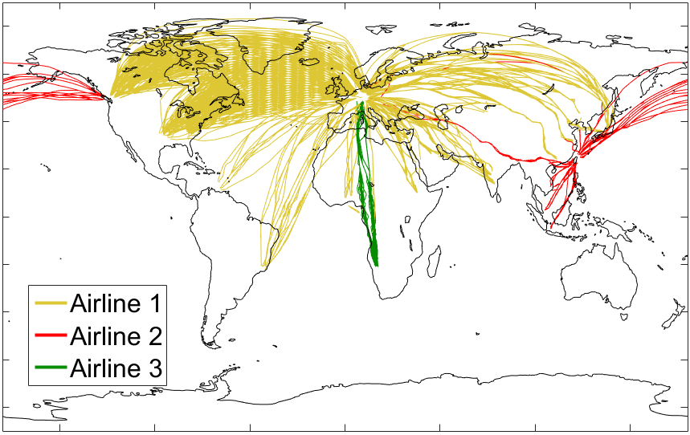
CASO Update – Global Analysis
Analysis of long haul int’l. flights
IAGOS atmospheric research program
  3,763 flights from three airlines and five individual A340s from 2010-2013
Comparison of efficiency benefits from CASO in domestic US

Slide 7
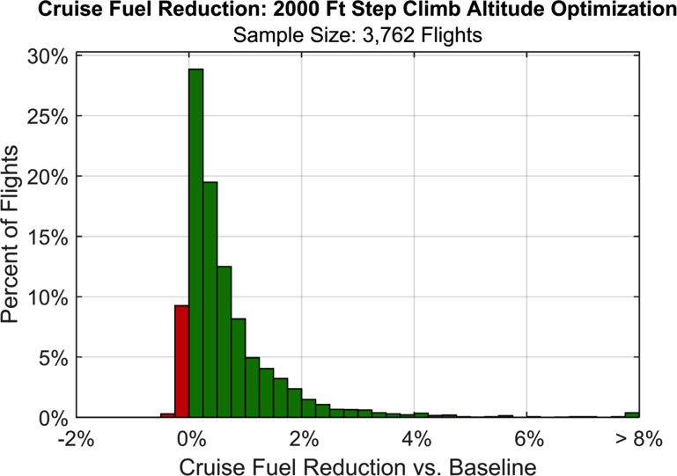
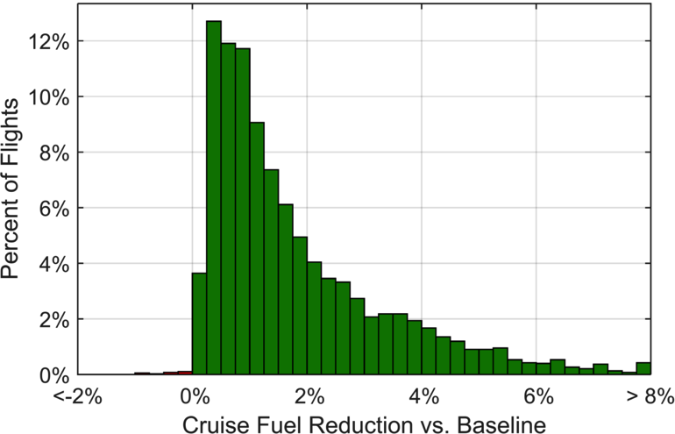
Global Analysis Results
 | US Operations | IAGOS Global Operations
Altitude Optimization Mean Fuel Savings | 1.75% - 1.96% | 0.65% - 0.87%
Speed Optimization Mean Fuel Savings | 0.93% - 1.93% | 0.89% - 1.81%
2000-ft step climb altitude optimization
Smaller % benefits in global operations, but absolute fuel savings potential per flight much larger
Limited dataset – different operators approach flight planning / fuel management in different ways
Merits further investigation w/expanded data
MRC speed optimization

Slide 8
CASO Next Steps
Extended analysis using ANSP flight plan, amendment, and clearance records for North Atlantic Tracks
  Coordinating with NAV CANADA via NEXTOR to get data
Check 2012 results against 2014 operations for recent efficiency changes
Meet with stakeholders to discuss current operational planning methods and opportunities
  Airline technical operations departments and dispatchers
  Air traffic controllers and air traffic managers
Evaluate options for knowledge transfer and deployment
  E.g., Electronic Flight Bag (tablet) app prototype
Notes:
- MIT has another project under NEXTOR to understand benefits of ADS-B in the North Atlantic

Slide 9
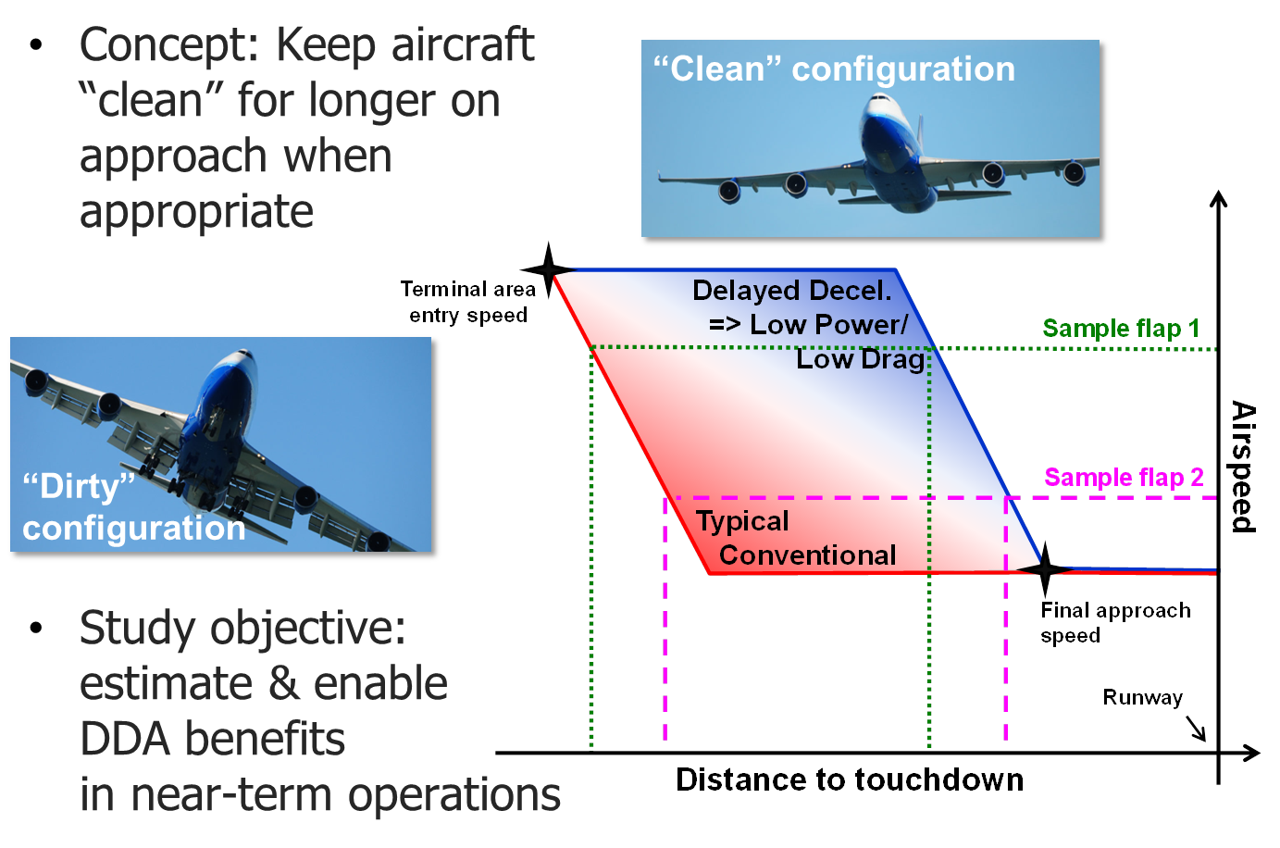
Delayed Deceleration Approach (DDA)
PARTNER Project 32

Slide 10
DDA Summary
DDA concept has 30-50% fuel saving potential below 10,000 ft
Approach speed analysis at key US airports indicates potential for later decelerations during some operations
Significant variability
between airports,
configurations, weather
conditions, etc.
Opportunity for
meaningful fuel &
emissions reductions…

Slide 11
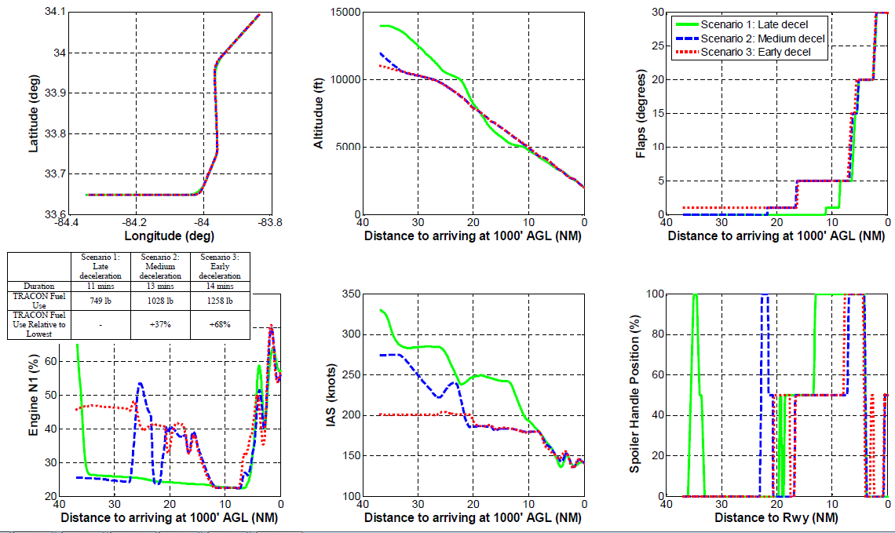
DDA Update – FMS Simulation
B757 ATL RNAV DDA approaches on FMS testbench

Slide 12
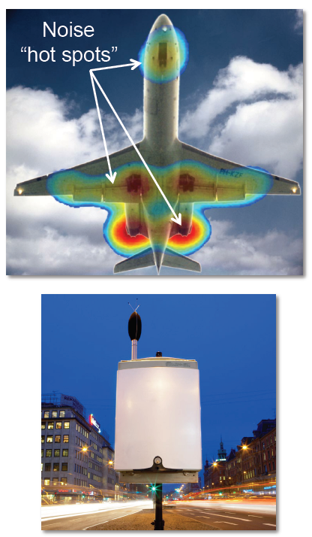
DDA Update – Noise Analysis
Need to understand DDA noise impacts
  Reduced power = reduced engine noise
  Higher airspeed + clean configuration = ? airframe noise
Received sample noise monitor data from Massport
Correlating with radar data (PDARS) to understand potential DDA noise impact
Related project → ASCENT-23: Analytical Approach for Quantifying Noise from Advanced Operational Procedures
Notes:
Because noise from approach operations is a combination of engine and airframe components, the net noise impact of DDA is currently unknown given engines are at a lower thrust setting through their use, but airframe noise may be impacted by the higher airspeeds

Slide 13
DDA Next Steps
Continue coordination with Massport to collect larger sample of noise monitor data and expand noise analysis
Continue exploring DDA integration into RNAV approach procedures
Discuss concept with airline and ATC stakeholders
  Meeting planned with BOS Tracon to understand current procedures, human factors considerations, etc.
Evaluate options for knowledge transfer and deployment, including targeted opportunities

Slide 14
Surface Congestion Management: N-Control
Incorporation of systematic control techniques into current operational procedures with minimal controller workload and procedural modifications
  Rate-based control (i.e., suggest rate of aircraft pushbacks)
  Aggregate control, as opposed to flight-specific control
  Risk-mitigation
    Begin at high value of N_{ctrl} and decrease gradually
    Carefully monitor and address off-nominal events/other issues
Evaluate general applicability of N-Control concept to different airport operating environments
Demonstrate potential benefits (in terms of taxi-out time, fuel consumption and emissions reduction)
  Benefits assessment from analysis and trials used to inform/support TFDM business case

Slide 15

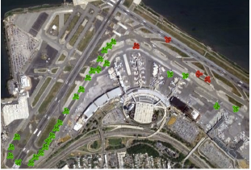
N-Control Update: LGA Demo
Coordinated with FAA and LGA stakeholders
Addressed potential implementation challenges / operator concerns through simulations
Queuing network model of airport taxi operations (developed & validated using 2012-13 ASPM data) used to:
  Assessed impact of gate constraints
  Assessed sequence basis and fairness
  Simulated overall benefits:
    Taxi-out time reduction over 62 days
    47,000 min (No limit on gatehold)
    31,000 min (Max 10 min gatehold)
Targeting demonstration in spring/summer 2015

Slide 16
N-Control Next Steps
Data from trials will be analyzed to evaluate impacts of strategy
Focus of N-Control has been:
  Tactical congestion control with 15-minute planning horizon
  Aggregate rate control with no leveraging of Surface Collaborative Decision Making (S-CDM) elements (e.g., Earliest Off Block Time [EOBT])
Investigate effect on departure metering algorithms and benefits of:
  Planning window increases (e.g., 30-60 min)
  Incorporation of other data elements, especially EOBTs and gate information
Explore conducting further field trials incorporating lessons learned and enhanced data elements; BOS, LGA, or third site (possibly with AEFS)
Will be driven by what’s of most value to FAA (though coordination with ANG, TFDM, Surface Office, etc.)

Slide 17
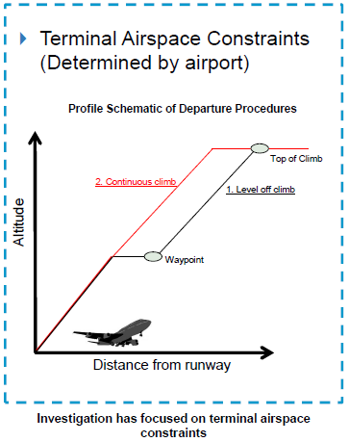
Continuous Climb Operations
Climb phase characterized by high fuel flow configurations (i.e., full throttle and high gross weight)
Constraints such as airspace/sector boundaries can cause level-offs during climb → increased fuel, emissions, noise
Objective of AEE study:
  Quantify prevalence of level-offs in NAS
  Calculate potential benefits of removing level-offs
  Identify causes of level-offs and mechanisms to implement continuous climbs

Slide 18
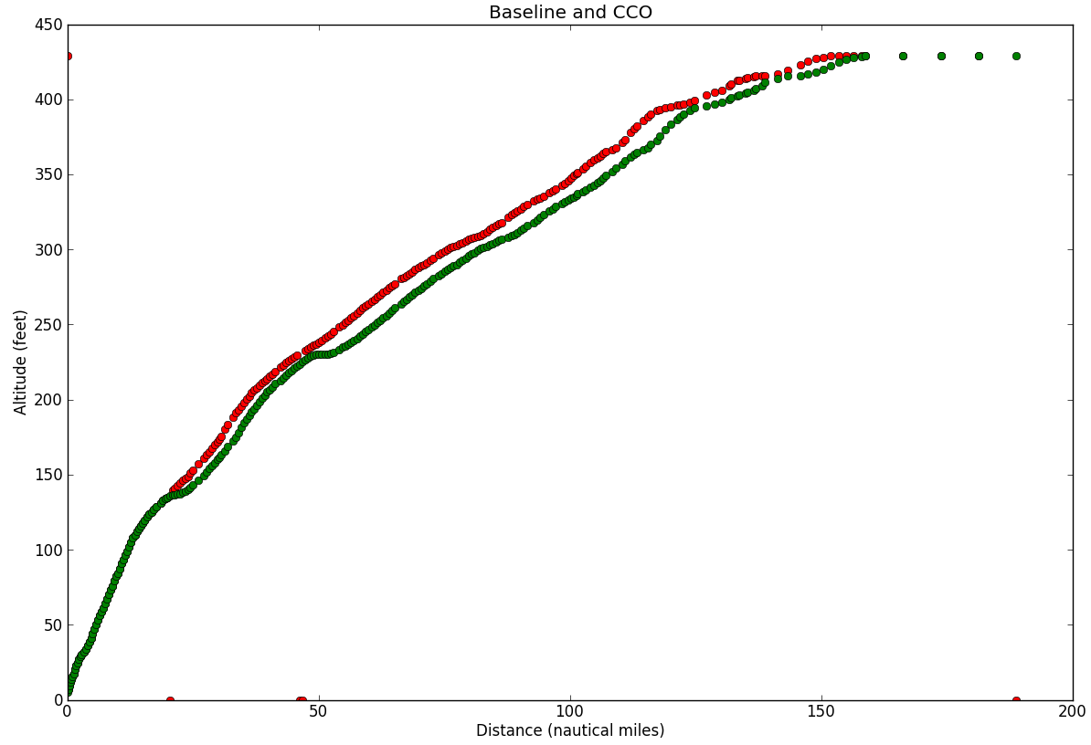
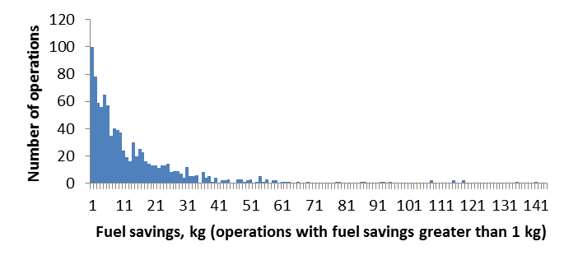
CCO Update & Next Steps
Improved algorithm for level-off identification/removal in operational data
Continued data mining and correlation analysis
Planning stakeholder outreach
  Vet results
  Identify causes of departure inefficiencies
  Scope potential for implementation
Continue noise & emissions assessment
Long tail of fuel savings can be targeted for focused benefits

Slide 19
Modeling of Potential Environment and Energy Benefits/Impacts of UAS in the NAS
Work Stream 1
Modeling of Small UASs and VTOL Aircraft
Work Stream 2
Development of UAS Analysis Support Roadmap
Coordination
  E.g. FAA, ACRP Projects, UAS Integration Office, NASA
Assessment of AEDT
Modeling of VTOL Aircraft
Modeling and Assessing Life Cycle Emissions
Modeling Capabilities for New UAS
New Modeling Techniques and Methodologies
Tasks
Documentation of areas of overlap in on-going UAS research
Refine short-term/long-term needs as necessary
Assessment of AEDT to evaluate current modeling capabilities and quantitative results
Documentation of VTOL models, methodologies and results
Documentation of currently available modeling tools and techniques
Guidance on assessing the life cycle emissions of small UASs
Documentation of modeling non-standard UAS for E&E assessment
Development of a data collection matrix
Documentation of the results of qualitative evaluation
Development of general guidance on modeling of UAS for E&E assessment
Development of a UAS Analysis Support Roadmap
Anticipated
Results

Slide 20
UAS Next Phase (FY15 Funding Proposed Task)
Continue research to help understand short/medium term environmental modeling needs based on research efforts of other agencies
Collect flight/aircraft data in coordination with COE for UAS/DoD/NASA/Academia to model the environmental footprint of UAS platforms
Identify and conduct case studies in order to inform/update NEPA processes and guidance
Investigate the potential system-wide changes due to UAS operations altering of aircraft fleet mix, operations and trajectories at airports

Slide 21
Barriers to Steeper Approaches (FY15 Funding Proposed Task)
Noise and emissions benefits of steeper approaches are well understood
Concept has been demonstrated/implemented
  E.g., London City, Frankfurt, Boeing ecoDemonstrator trials, DLR trials…
Objective of proposed AEE research is to investigate operational barriers and implementation potential in US
  Characterize the operational challenges and safety impacts
  Identify opportunities and mechanisms for applying the concept

Slide 22
Questions?

