Slide 1
Modeling & Tools Update
Presented to: E&E REDAC Subcommittee
By: Dr. Jim Hileman Office of Environment and Energy Federal Aviation Administration
Date: March 18, 2015

Slide 2
Outline
Background
AEDT Update
Fuel Efficiency Metric Development
ASCENT Project 10 - Aircraft Technology Modeling and Assessment
Roadmap Effort
2

Slide 3
Tools and Analysis
We develop tools for specific purposes:
CAEP analyses
Noise
Emissions (NO_{X}, CO₂, and Black Carbon)
Global Market Based Measure
Technology evaluation (e.g., CLEEN Program)
NextGen analyses
Performance reporting (annual basis)
Future goals analysis (out to 2050)
Assessing benefits of NextGen
Air space and airport design & planning
Note this is not an all-inclusive list
3

Slide 4
Solution Development and Interdependencies
Modeling wide range of solutions and their consequences on fuel use, noise and emissions (e.g., basket of measures for CO₂ and a balanced approach for noise)
Policy and Scenarios
Including outputs from other tools and analyses as appropriate
Aviation Environmental Design Tool (AEDT)
Aviation Environmental Impacts Analysis (APMT-I)
Aircraft Design
Existing Aircraft, New Aircraft, and/or Generic Fleet
Alternative Fuels
Source and Composition
Single
Flight/Airport
Regional
Global
Studies
Integrated Noise, Emissions, and Fuel Burn Analyses
Emissions
Climate
Impacts
Emissions
& Noise
Operations
Air Quality Impacts
Emissions
Aviation Economics (APMT-E)
Noise
Impacts
Noise
Collected
Costs
Emissions, Noise, & Fuel Burn
Monetized
Impacts
Cost Benefit Analysis
4

Slide 5
Efforts related to AEE analytical capabilities
AEDT
AEDT Development
Methods to accurately capture operational procedures
APMT-Economics
Aircraft performance analysis
Rapid, fleetwide, environmental modeling tools
APMT-Impacts
Covered by noise and emissions briefings
Alternative fuels analysis
Covered in alt fuels briefing
5

Slide 6
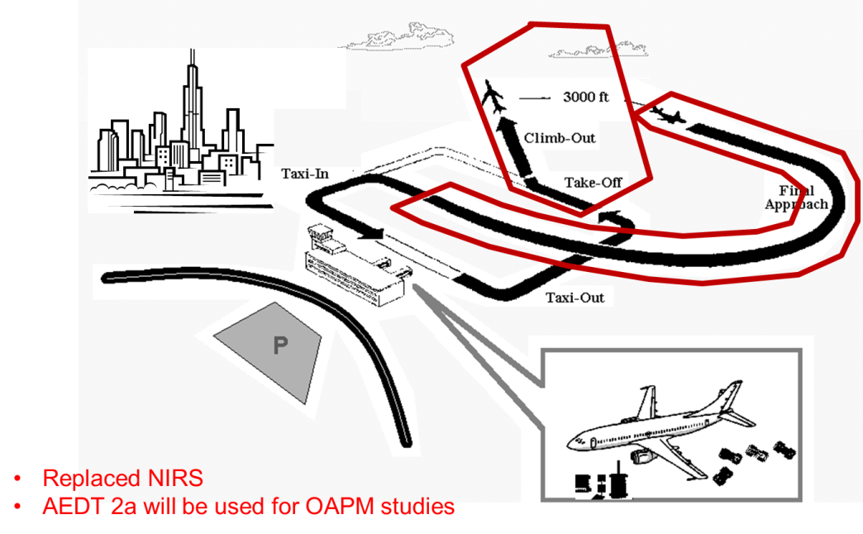
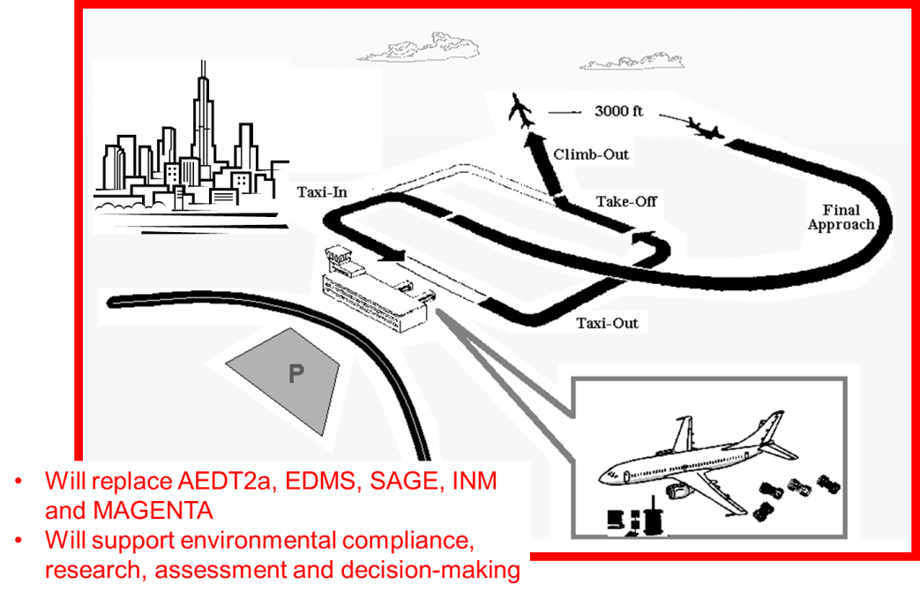
AEDT Development
AEDT 2a
AEDT 2a release: March 2012
AEDT2a Service Pack 2 release: Feb. 2014
AEDT2b Design Review Group (DRG) Evaluation: Dec 2014 - April 2015
AEDT2b code freeze: April 22, 2015
AEDT2b release: May 29, 2015
AEDT 2b
6

Slide 7
Planning to AEDT 2b release date (May 29)
AEDT development relies on the Scrum Agile methodology
New product release to stakeholders feedback group every 3 weeks
Flexibility in planning allows responding to feedback received
Test driven development facilitates the product’s quality control (QC)
Short development cycles allow review and calibration of upcoming development efforts
Planning can readily respond to changes in development pace, unforeseen issues, or priorities changes
Added flexibility allows balancing of tasks and resources in the context of the overall development plan and timeline
Stakeholder Feedback Group and Design Review Group involvement provides independent real-world feedback to the development team
7

Slide 8
Tool QC and Improvements
AEDT is going to both replace and improve upon the legacy environmental tools
Extensive testing and comparison to legacy tools output has uncovered unnoticed issues in the legacy applications (e.g. handling of runway elevation in INM, takeoff ground roll emissions distribution in EDMS)
Implementation of new integrated modeling approaches allows the tool to calculate aircraft performance in all regimes of flight from departure to arrival gate
Leveraging of new hardware and software technologies (distributed processing, database servers, and GIS) expands the tools ability to handle larger studies with greater volumes of higher detail data
External review groups provide independent testing of workflows and functionality and a two-way communication channel with the user base
8

Slide 9
Post Release Planning
Service Pack contingency plan
Plans are in place in case issues and/or deficiencies are uncovered after the official release of the software despite all planning and QA/QC procedures
AEDT 2b development projects
Following the release of the tool additional functionalities will be tackled in the form of smaller and focused development projects
Three such projects are currently planned
High fidelity weather full flight modeling project - aimed at assessing AEDT input data methods and required software modifications, as well as performing validation via CFDR data
AEDT sensor path modeling development – aimed at implementing BADA 4 modeling with high fidelity weather for sensor path trajectories
Flight performance modeling improvements based on airline data - research project focusing on key performance related parameters such as takeoff weight and reduced takeoff thrust
9

Slide 10
Fuel Efficiency (FE) Metric Research
Motivation
In 2003, FAA established a NAS-wide fuel efficiency (FE) goal for the FAA Flight Plan with a 1% annual improvement
In 2009, FAA goal was harmonized with the annual 2% FE improvement aspirational goal set by the International Civil Aviation Organization
However, FAA and ICAO FE metrics were not harmonized:
$${FE}_{FAA}= \frac{Fuel Burn }{Track Distance }$$
Historical FAA metric shortfalls:
Not expected to meet the 2% per year goal
Does not account for payload
Use of track distance masks technology and operational improvements
Objectives
Assess robust system-wide fuel efficiency metrics using publically available data
Harmonize existing metrics
Improve the understanding of system-wide benefits of NextGen in terms of tracking of year-on-year changes
$${FE}_{ICAO}= \frac{Fuel Burn }{Revenue tonne kilometers (RTK)}$$
10

Slide 11
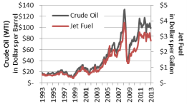
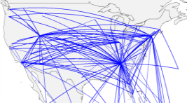
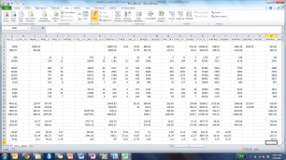
Fuel Efficiency Metric Research - Approach
Research Data Sets
Lit review of existing metrics
Coordinate w/stakeholders
Collect data
ID relevant data sets
3. Develop Fuel Efficiency Metric
Scope & develop metrics
Statistical analysis
Compare with existing metrics
5. Generate Inventory Trends
2. Evaluate Data Sets
4. Compare to CO₂ Metric
6. Investigate Operational Efficiency Trends
Publishable paper
Final Report
Summary:
Evaluate wide range of available datasets and metrics
Identify an improved fuel efficiency metric and generate metric values
Analyze operational trends and document the work
11

Slide 12
Fuel Efficiency Metric Research - Current Status
Fuel efficiency metric that best meets all objectives is Fuel Burn / RTK¹
DOT’s Bureau of Transpiration Statistics (BTS) and FAA’s Aviation Environmental Design Tool (AEDT) databases best support this metric:
BTS characteristics…
Fuel burn coverage is limited to US carriers
Payload² coverage has domestic and international operations for all carriers
AEDT characteristics…
Wide coverage of domestic and international operations for all carriers
Payload held constant at 65%
AEDT Inventory
Payload information
Complete inventory of flight operations with radar tracks
Estimate Load Factors by aircraft class
Use AEDT and BTS payload data to compute fuel burn and RTK for all the cases
BTS
$$\frac{{Fuel}_{via AEDT ops \& BTS payload}}{{RTK}_{BTS Payload x GreatCircleDistance}}$$
¹RTK = Revenue Tonne Kilometers
²Payload includes passenger, mail and freight.
12

Slide 13
ASCENT Project 10: Aircraft Technology Modeling and Assessment
Objective:
Define range of scenarios that bound the demand for future aviation activity and assess the effects of different fleet composition and aircraft technology on fuel burn, emissions, and noise from aviation
Evaluate broad set of future scenarios out to 2050, showing potential benefits of technology on fuel burn, emissions, and noise
Developing scenarios as a first step toward more probabilistic assessments
Support Goals Analysis
Team:
Awarded to a university team of Georgia Tech, Purdue, and Stanford
Planned as a two year project starting in August 2014
Studies will be performed by university team using each organization’s in-house expertise and tools in complementary areas
Leverage full expertise of ASCENT COE
13

Slide 14
ASCENT Project 10: Aircraft Technology Modeling and Assessment
Approach:
Develop a range of scenarios representing possible futures
Model advanced aircraft technologies and advanced vehicles expected to enter the fleet through 2050
Perform vehicle and fleet level assessments
Outcomes:
Publicly available scenario definitions developed through consensus building; available for future analyses to use/reference
Analysis results, showing projected vehicle and fleet fuel burn, emissions, and noise for scenarios (provide tech contribution)
14

Slide 15
Tools and Analysis Roadmap
Objective:
Organize AEE modeling capabilities to meet AEE analysis needs
Ensure clear linkage of research efforts to AEE analysis needs
Process:
Identify analyses and deadlines for deliverables, (e.g., CLEEN Tech Assessment, Goals Analysis, CAEP)
Create flowchart of tools and data that are required for each analysis
Link to other AEE roadmaps, as needed
Gather information on:
Existing linkages among tools within the AEE Tool Suite
Internal (AEE) and external (e.g., ACRP) efforts that could aid analysis and tool development
Populate flowchart with existing tools and databases
Identify gaps that need to be met to enable analysis capability
Create timeline of tool and database development that overcomes identified gaps to deliver analysis capabilities as needed
15

Slide 16
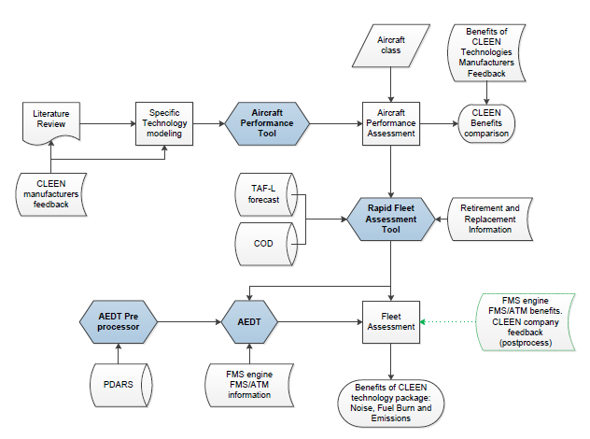
CLEEN Technology Evaluation Flow Chart
16

Slide 17
FY16/17 Analysis/Tools R&D Direction
Improve AEDT through targeted R&D efforts
Integrate results of ASCENT Projects relating to rapid fleetwide modeling, aircraft technology, alternative jet fuels and operations
Stand up effort to evaluate benefits of CLEEN II Program
Develop roadmap to direct tool development to meet analysis needs for CAEP, NextGen, and Planning
Continue to develop in-house analytical capabilities
17

Slide 18
Backup

Slide 19
APMT-Economics
Starting work to improve model
Current capability:
Model long-term aviation market response to introduction of environmental policy measures that directly affect aviation industry
Creates a fleet of aircraft and operations based on demand forecast and scenario inputs (economic and policy)
Outputs: aircraft operating costs, aviation demand, and fleet
Potential areas for improvement
Improved usability
Ability to support Terminal Area Forecast (TAF) development
Increased functionality to model potential industry response
BAH is leading effort to examine potential tool improvements (former PARTNER students at BAH are leading this effort)

Slide 20
Aircraft Performance Analysis (1 of 2)
PARTNER CoE Projects on aircraft technology evaluation have concluded and we are currently evaluating results.
Environmental Design Space (EDS) - P14: Georgia Tech
CLEEN EDS - P36: Georgia Tech
Mission Specification Changes - P43: Stanford, Georgia Tech and BAH
System Level Uncertainty Quantification - P48: MIT
New ASCENT Projects
Aircraft technology assessment (see next slide)
Helicopter performance (also discussed in noise briefing)
Notes:
For those technologies funded under CLEEN, proprietary test data will be used in Phase II to improve existing Phase I models. EDS results will be compared to CLEEN company results and analysis.
In addition, a range of technologies from the various CLEEN companies will be combined on generic representations of the five aircraft classes to assess which technologies will meet CLEEN goals
EDS assessments will also identify technology combinations that are synergistic and those that are incompatible
The impact of these technologies at the aircraft level will also be assessed at the fleet level AEDT is a software system that dynamically models aircraft performance in space and time to produce fuel burn, emissions and noise. Full flight gate-to-gate analyses are possible for study sizes ranging from a single flight at an airport to scenarios at the regional, national, and global levels. AEDT is currently used by the U.S. government to consider the interdependencies between aircraft-related fuel burn, noise and emissions.
In 2014, AEDT2b will also become the next generation aviation environmental consequence tool, replacing the current public-use aviation air quality and noise analysis tools such as the Integrated Noise Model (INM – single airport noise analysis) and the Emissions and Dispersion Modeling System (EDMS – single airport emissions analysis).

Slide 21
Aircraft Performance Analysis (2 of 2)
ASCENT project (NOI-10) for aircraft technology assessment
Provide modeling and assessment mechanism for CLEEN / CLEEN II
Evaluate broader future scenarios out to 2050
Supports NextGen Goals Analysis and CAEP trends assessment
Project team:
Georgia Tech, Purdue and Stanford.
Other ASCENT researchers will be invited to participate (e.g., MIT) as well as gov’t and industry.
Primary Tasks:
Define scenarios and assumptions to examine with gov’t, industry, academia stakeholders in a workshop fashion
Model aircraft technologies and configurations, heavily leverage existing work
Assess vehicle and fleet level performance

Slide 22
ASCENT Projects to Improve Modeling
Rapid Fleet-wide Environmental Assessment Capability
Complement AEDT with lower fidelity screening tool capability to examine large number of policy scenarios that could be quickly analyzed and reduced to a manageable set of scenarios for more focused, high fidelity analysis in the environmental tools suite.
Aircraft Design and Performance Tool Connectivity with AEDT
Extend compatibility of novel and existing aircraft design and performance assessment tools with AEDT to enable assessment of future scenarios using broad range of aircraft models
Analytical Approach for Quantifying Noise from Advanced Operational Procedures
Developing analytical approach to address current noise modeling gaps such that it will be possible to capture changes in community noise due to the use of advanced operational procedures

