Slide 1
NextGen Environmental Management System
Goals Analysis Status Update
REDAC E&E Subcommittee
Chris Dorbian, AEE-400
March 18, 2015

Slide 2
Goals and Targets Background
FAA Goal Category | FAA Performance Metric*
Climate | Carbon neutral growth, starting in 2020, relative to the 2005 emissions level
Energy: Alternative Fuels | 1 billion gallons of renewable jet fuel used by aviation by 2018
Energy: Energy-Efficiency | Notional annual improvement of 2% NAS-wide using metric of fuel burned per revenue tonne kilometers (kg/RTK)
Noise | Less than 300,000 people exposed to “significant aircraft noise” by 2018
Air Quality | Minimize aviation air quality impacts, notwithstanding aviation growth
Aviation Environmental and Energy (E&E) Goals
U.S. Climate Action Plan, E&E Policy Statement
Noise, air quality, climate, and energy
“Goals Analysis”
Forecasting progress against FAA performance goals using AEDT
“System Improvements” scenario considers improvements from operations, technology, and alternative fuels
* Goals are subject to revision based on Administrator’s strategic priorities

Slide 3
Current Process
Scenario | Airframe and Engine Tech Assumption | Operational Improvements Assumption | Alternative Jet Fuels Assumption
Baseline | No post-2010 technology In-production (2010) technology for 100% of fleet growth and replacement | Operational efficiency fixed at 2010 levels | Conventional jet only
System Improvements | PARTNER P36 (EDS Assessment of CLEEN Technologies) – Includes CLEEN-funded tech as well as NASA N+1 and N+2 tech | Unimpeded, laterally-direct travel | Derived from One Billion Ton Study (US DOE) - 1/3rd of available biomass → AJF - 75% LC-CO2 reduction

Slide 4
Latest Results – Moderate Airframe/Engine Improvements and Alternative Jet Fuels
Life-Cycle CO₂e (Indexed to 2005)
Alternative Fuels
3.6 billion gallons, 0.25 LCA value
5.5 billion gallons, 0.25 LCA value

Slide 5
Latest Results – Aggressive Airframe/Engine Improvements and Alternative Jet Fuels
Life-Cycle CO₂e (Indexed to 2005)
Alternative Fuels
11.5 billion gallons, 0.25 LCA value
17.25 billion gallons, 0.25 LCA value

Slide 6
Noise Study: Work Plan
Baseline Scenario: 2010 Datum (complete)
Baseline Scenario Trends
Phase-outs and stringencies
Improvement Scenario Trends
Moderate Technology Improvement
Aggressive Technology Improvement
Results expected mid-2015

Slide 7
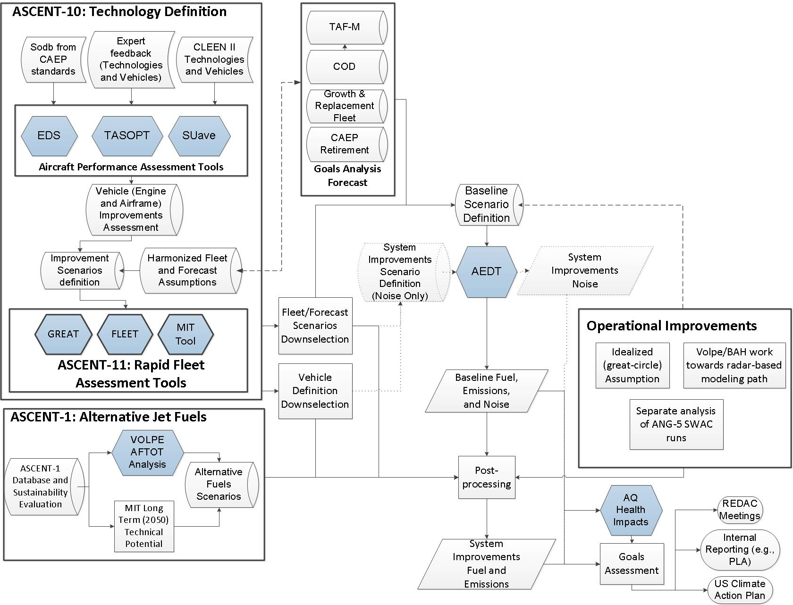
Proposed Future Analysis Process and Linkages

Slide 8
Backup Slides

Slide 9
Validation of Recent Fuel Consumption Trend
Results*
* Preliminary -- please do not cite or quote
Fuel Consumption

Slide 10
Technology Adoption Rates: Airframe and Engine Improvements
Assumptions

