Slide 1
NASA Aeronautics Update
FAA REDAC E&E Subcommittee Meeting
March 18, 2015
John A. Cavolowsky
Director
Airspace Operations and Safety Program

Slide 2



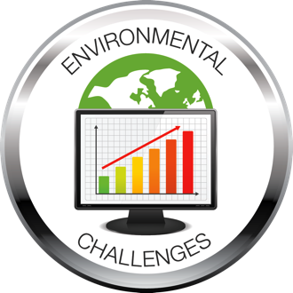


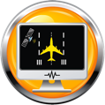

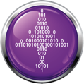
NASA Aeronautics Research Six Strategic Thrusts
Safe, Efficient Growth in Global Operations
Enable full NextGen and develop technologies to substantially
reduce aircraft safety risks
Innovation in Commercial Supersonic Aircraft
Achieve a low-boom standard
Ultra-Efficient Commercial Vehicles
Pioneer technologies for big leaps in efficiency and
environmental performance
Transition to Low-Carbon Propulsion
Characterize drop-in alternative fuels and pioneer
low-carbon propulsion technology
Real-Time System-Wide Safety Assurance
Develop an integrated prototype of a real-time safety
monitoring and assurance system
Assured Autonomy for Aviation Transformation
Develop high impact aviation autonomy applications
Notes:
NASA has used that updated global perspective, along with inputs from the aviation community, to organize our portfolio into six areas where we know we can conduct research and development that will have beneficial outcomes:
Safe, efficient growth in global operations. For example, our Precision Departure Release Capability tool. It’s software that automatically transfers an aircraft’s predicted take-off data to its destination in order to improve arrival scheduling, saving time and fuel. We transferred PDRC to the FAA in August 2013 for future deployment at air traffic control centers.
Innovation in commercial supersonic aircraft. WSPR [“Whisper”] used flight tests, sensors and community surveys to help us decide how low a sonic boom has to go to not be a problem. Prove the boom can be busted and perhaps change the ruling prohibiting supersonic flight over land, and open up a whole new market.
Ultra-efficient commercial transports. We’ve taken two designs for aircraft you might see in 15 or 20 years from paper concept to subscale models to wind-tunnel tests to see if they perform as promised. Things look good for dramatic reductions in fuel use, noise and emissions.
Transition to low-carbon propulsion. ACCESS is a flight campaign that’s investigating emissions from alternative jet fuels to see if they really are less harmful to the environment.
Real-time, system-wide safety assurance. Data mining is key to maintaining safety in the Next Generation Air Transportation System. We develop new algorithms – sets of rules that solve problems – to mine terabytes of aircraft data to diagnose and predict problems. Some airlines are already using our solutions to improve operations.
Assured autonomy for aviation transformation. For example, we’ve flight tested a technology called ADS-B on a NASA unmanned aerial system to see whether its ability to provide more detailed information improved the comfort level of air traffic controllers and other pilots with autonomous aircraft. Phase one flights went very well and tests continue.

Slide 3
ARMD Programs with Strategic Thrusts
Airspace Operations and Safety Program
Advanced Air Vehicles Program
Integrated Aviation Systems Program
Mission Programs
Safe, Efficient Growth in Global Operations
Real-Time System-Wide Safety Assurance
Assured Autonomy for Aviation Transformation
Ultra-Efficient Commercial Transports
Innovation in Commercial Supersonic Aircraft
Transition to Low-Carbon Propulsion
Assured Autonomy for Aviation Transformation
Flight Research-Oriented Integrated, System-Level R&T supporting all six thrusts
X-Planes/Test Environment
Transformative Aeronautics Concepts Program
Seedling Program
High-risk, leap-frog ideas supporting all six thrusts
Critical cross-cutting tool development

Slide 4
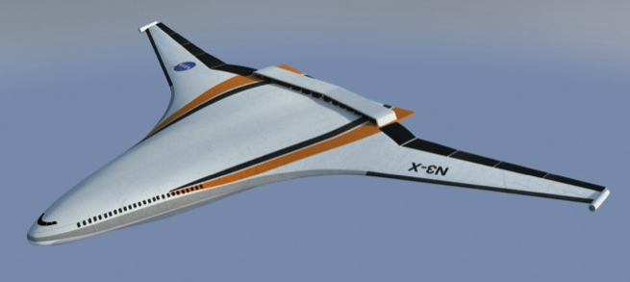
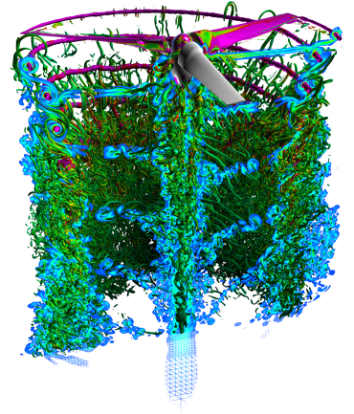
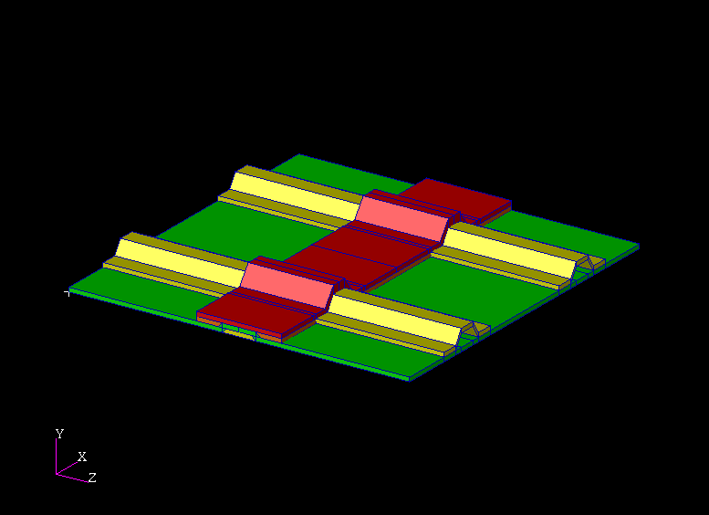
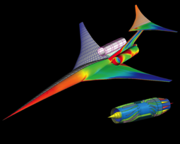
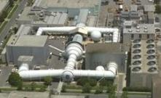
Advanced Air Vehicles Program
  Cutting-edge research that will generate innovative concepts, technologies, capabilities & knowledge to enable revolutionary advances for a wide range of air vehicles.
Advanced Air Transport Project (AATT) Conducts fundamental research to improve aircraft performance and minimize environmental impacts from subsonic air vehicles
Revolutionary Vertical Lift Technology Project (RVLT) Develops and validates tools, technologies & concepts to overcome key barriers, including noise, efficiency, & safety for vertical lift vehicles
Advanced Composites Project (ACP) Conducts research to reduce the timeline for certification of composite structures for aviation
Commercial Supersonics Technology Project (CST) Explores theoretical research for potential advanced capabilities & configurations for low boom supersonic aircraft.
Aeronautical Evaluation & Test Capabilities Project (AETC) Ensures the strategic availability, accessibility, & capability of a critical suite of aeronautics ground test facilities to meet Agency & national aeronautics testing needs

Slide 5



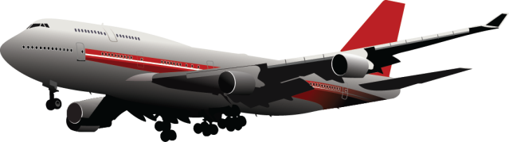
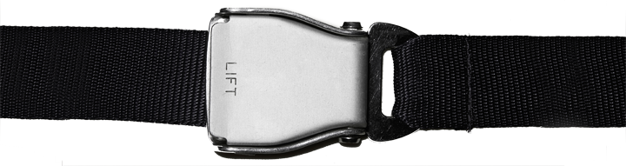
Airspace Operations and Safety Program
This program integrates the Airspace Systems Program and Aviation System Program system safety work
Develops and explores
fundamental concepts, algorithms, and technologies to increase throughput and efficiency of the National Airspace System safely.
Provides knowledge, concepts, and methods to the aviation community to manage increasing complexity in the design and operation of vehicles and the air transportation system.
Mission Program
Airspace Operations and Safety Program
Continues Airspace Systems Program research, and the aircraft state awareness research and system wide safety research that was previously conducted within the Aviation Safety Program.
Projects
Airspace Technology Demonstrations
SMART NAS Testbed for Safe
Trajectory-Based Operations
Safe Autonomous System Operations
Notes:
NASA has used that updated global perspective, along with inputs from the aviation community, to organize our portfolio into six areas where we know we can conduct research and development that will have beneficial outcomes:
Safe, efficient growth in global operations. For example, our Precision Departure Release Capability tool. It’s software that automatically transfers an aircraft’s predicted take-off data to its destination in order to improve arrival scheduling, saving time and fuel. We transferred PDRC to the FAA in August 2013 for future deployment at air traffic control centers.
Innovation in commercial supersonic aircraft. WSPR [“Whisper”] used flight tests, sensors and community surveys to help us decide how low a sonic boom has to go to not be a problem. Prove the boom can be busted and perhaps change the ruling prohibiting supersonic flight over land, and open up a whole new market.
Ultra-efficient commercial transports. We’ve taken two designs for aircraft you might see in 15 or 20 years from paper concept to subscale models to wind-tunnel tests to see if they perform as promised. Things look good for dramatic reductions in fuel use, noise and emissions.
Transition to low-carbon propulsion. ACCESS is a flight campaign that’s investigating emissions from alternative jet fuels to see if they really are less harmful to the environment.
Real-time, system-wide safety assurance. Data mining is key to maintaining safety in the Next Generation Air Transportation System. We develop new algorithms – sets of rules that solve problems – to mine terabytes of aircraft data to diagnose and predict problems. Some airlines are already using our solutions to improve operations.
Assured autonomy for aviation transformation. For example, we’ve flight tested a technology called ADS-B on a NASA unmanned aerial system to see whether its ability to provide more detailed information improved the comfort level of air traffic controllers and other pilots with autonomous aircraft. Phase one flights went very well and tests continue.

Slide 6
FY 2016 Budget
 | Actual | Enacted | Request | Outyears are Notional
Budget Authority ($M) | FY 2014 | FY 2015 | FY 2016 | FY 2017 | FY 2018 | FY 2019 | FY 2020
Aeronautics | $566.0 | $651.0 | $571.4 | $580.0 | $588.7 | $597.5 | $606.4
Airspace Operations and Safety |  |  | 142.4 | 153.2 | 159.6 | 160.0 | 163.0
Advanced Air Vehicles |  |  | 240.9 | 243.2 | 241.2 | 231.0 | 232.8
Integrated Aviation Systems |  |  | 96.0 | 85.6 | 89.0 | 101.6 | 104.8
Transformative Aeronautics Concepts |  |  | 92.1 | 98.0 | 98.9 | 104.9 | 105.8
Aviation Safety | 80.0
Airspace Systems | 91.8
Fundamental Aeronautics | 168.0
Aeronautics Test | 77.0
Integrated Systems Research | 126.5
Aeronautics Strategy and Management | 22.7

Slide 7
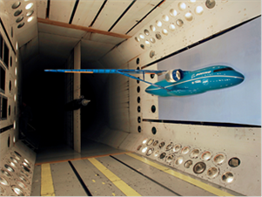
FY 2016 Budget Highlights
  World leading UAS integration research:
    Completes a flight test campaign to provide data to the FAA to verify and validate Minimum Operational Performance Standards to enable safe, limited operations of UAS in the National Airspace System.
    Expands upon UAS Traffic Management (UTM) Build 1 capabilities to enable dynamic UAS mission and trajectory adjustments providing increased safety and operational complexity for an expanded range of aircraft and business objectives.
Truss-Braced Wing Concept in the NASA Transonic Dynamics Wind Tunnel
  Transformative concepts and technologies:
    Develops a detailed conceptual design of a revolutionary hybrid gas-electric propulsion system which has potential benefits of reduced noise, emissions, and energy consumption compared to today’s turbine engines.
  Continued success in transitioning NextGen ATM technologies to the FAA:
    Completes development of the prototype Flight-Deck Interval Management Avionics for ATD-1 and prepare for future flight trial validation.
  High-Impact collaborations to reduce aircraft environmental impacts:
  Begins a series of flight demonstrations to both mature candidate environmentally friendly technologies and transfer them to US industry
  Begins high-fidelity validation experiments to improve accuracy of computational tools used in advanced aircraft design.

Slide 8
Notes:
NASA Presentation Sign-Off Page

Slide 9

What is the Transformative Aeronautics Concept Program?
While mission programs focus on solving challenges, this program focuses on cultivating opportunities.
Cultivates multi-disciplinary,
revolutionary concepts to enable
aviation transformation and harnesses convergence in aeronautics and non-aeronautics technologies to create new opportunities in aviation
Knocks down technical barriers and infuses internally and externally originated concepts into all six strategic thrusts identified by ARMD, creating innovation
for tomorrow in the aviation system.
Provides flexibility for innovators to
explore technology feasibility and
provide the knowledge base for
radical transformation.
Seedling Program
Transformative Aeronautics Concept Program
Solicits and encourages
revolutionary concepts
Creates the environment
for researchers to become
immersed in trying out
new ideas
Performs ground and
small-scale flight tests
Drives rapid turnover
into new concepts
Projects
Leading Edge Aeronautics Research for NASA
Transformational Tools And Technologies
Convergent Aeronautics Solutions

