Slide 1
ICAO Airplane CO₂ Emissions Standard :
February 10th, 2016

Slide 2
ICAO Airplane CO₂ Emissions Standard
Agreed applicability dates and regulatory limits:
“New Type” standard
Applicable to new aeroplane types which apply for certification on or after 1 January 2020, except those aeroplane types with a passenger seat capacity of less than or equal to 19 which have an applicability date of 1 January 2023.
“In-Production” standard
Applicable to newly produced in-production aeroplanes initially via a change criteria on or after 1 January 2023 and followed by a production cut-off from 1 January 2028.
Applies to airplanes weighing greater than Maximum Take Off Mass (MTOM):
Subsonic jets… 5.7 metric tonnes (12,566 pounds)
Propeller-driven… 8.6 metric tonnes (19k pounds)
Exemptions criteria agreed to provide flexibility for low volume production aeroplane types in exceptional circumstances.

Slide 3
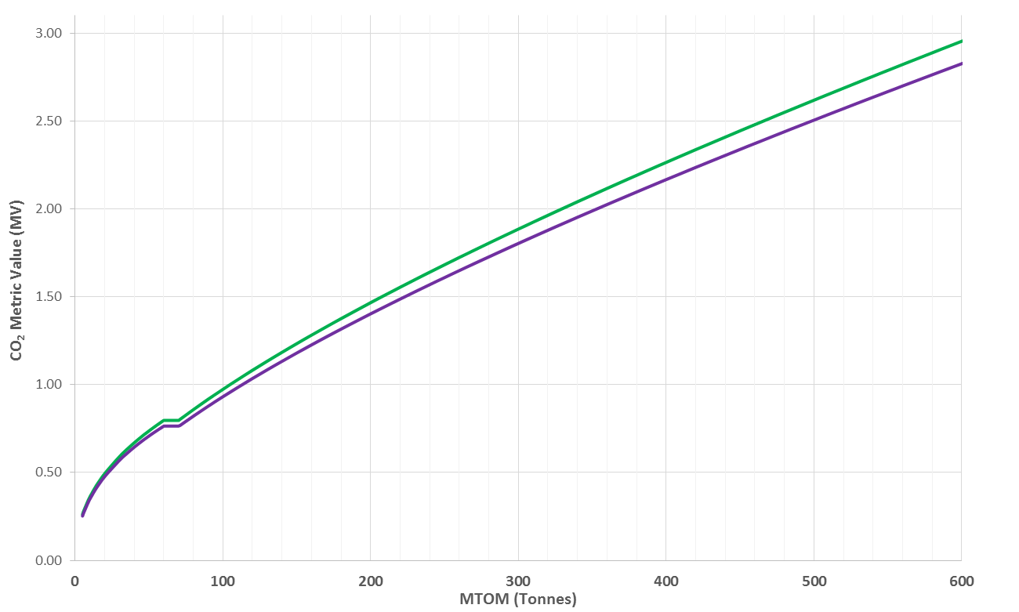
In Production (InP) and New Type (NT)
In Production (InP) CAEP/10
New Type (NT) CAEP/10
Better

