Slide 1
FY 2018 Environment and Energy Program Proposal
To: REDAC E&E Subcommittee
By: Dr. Jim Hileman Chief Scientific & Technical Advisor for Environment and Energy
Office of Environment and Energy
Date: April 4, 2016

Slide 2
Presentation Outline
Environment and Energy Portfolio Overview
Financial Summary
PPT Financial Summary Table
PPT 5-Year Financial Plan Table
Quad Charts
Summary

Slide 3
Aviation Environmental Challenges
NOISE AIR QUALITY WATER QUALITY ENERGY GLOBAL CLIMATE
Aviation impacts community noise, air quality, water quality, energy usage, and climate change
Environmental impacts from aviation could pose a critical constraint on capacity growth
FAA are pursuing aircraft technology, alternative jet fuels, operations, and policy measures to address the environmental challenges facing aviation

Slide 4
Vision and Principles
Vision:
Environmental protection that allows sustained aviation growth
Guiding Principles:
Limit and reduce future aviation environmental impacts to levels that protect public health and welfare.
Ensure energy availability and sustainability.
Want increased mobility with reduced environmental impacts and enhanced energy availability and sustainability
Aviation E&E Policy Statement (Federal Register 77-141, 2012): http://www.faa.gov/about/office_org/headquarters_offices/apl/environ_policy_guidance/policy/media/FAA_EE_Policy_Statement.pdf

Slide 5
Environment & Energy Goals
Aspect | Goal
Noise | Reduce the number of people exposed to significant noise around U.S. airports in absolute terms, notwithstanding aviation growth, and provide additional measures to protect public health and welfare and our national resources (population exposed to DNL 65 in 2018 is 300,000 people).
Air Quality | Achieve an absolute reduction of significant air quality health and welfare impacts attributable to aviation, notwithstanding aviation growth.
Energy | Improve National Airspace System (NAS) energy efficiency and develop and deploy alternative jet fuels for commercial aviation.
Climate | Limit the impact of aircraft CO2 emissions on the global climate by achieving carbon neutral growth by 2020 compared to 2005 (2020 CO2 emissions equal to 2005 levels), and net reductions of the climate impact from all aviation emissions over the longer term (by 2050).
Aviation E&E Policy Statement (Federal Register 77-141, 2012): http://www.faa.gov/about/office_org/headquarters_offices/apl/environ_policy_guidance/policy/media/FAA_EE_Policy_Statement.pdf

Slide 6
Environmental & Energy Strategy
PLAN
Environment and energy policy statement ¹
U.S. climate action plan ²
Research roadmaps ³
FAA VISION
Reach the next level of safety, efficiency, environmental responsibility and global leadership
GOALS
Noise
Air Quality
Climate
Energy
ADVANCE SCIENCE AND INTEGRATED MODELING
IMPROVE
Adapt roadmaps
Fill research pipeline
Source characterization
Propagation and dispersion
EVALUATE
Progress toward goals
Mitigation opportunities
Health and welfare impacts
Aviation Environmental Tool Suite
IMPLEMENT
Technology
Alternative Fuels
Operations
Policy
Notes:
Aviation E&E Policy Statement (Federal Register 77-141, 2012): http://www.faa.gov/about/office_org/headquarters_offices/apl/ environ_policy_guidance/policy/media/FAA_EE_Policy_Statement.pdf
U.S. Aviation GHG Emissions Reduction Plan: http://www.icao.int/environmental-protection/Pages/ClimateChange_ActionPlan.aspx
Environment and Energy Website: http://www.faa.gov/go/environment

Slide 7
The Five Pillar Approach
Science and Tools
Technology
Alternative Fuels
PILLAR 1: Improved Scientific Knowledge and Integrated Modeling
Decision-making based on solid scientific understanding
Work with research community through the Aviation Sustainability Center (ASCENT)
Understand public health and welfare impacts
Incorporate this knowledge within the Aviation Environmental Tool Suite
PILLAR 2: New Aircraft Technologies
Offer the greatest opportunity to reduce environmental impacts
Partner with industry, research community, NASA, and Department of Defense
Mature new engine and airframe technologies through the Continuous Lower Energy, Emissions and Noise (CLEEN) Program
PILLAR 3: Sustainable Alternative Aviation Fuels
Reduce environmental impacts, enhance energy security, and provide economic benefits
Collaborate with stakeholders through the Commercial Aviation Alternative Fuels Initiative (CAAFI)
Test alternative jet fuels to ensure they are safe for use through ASCENT and CLEEN
Analyze their potential for reducing the environmental impacts of aviation
Operations
Policy
PILLAR 4: Air Traffic Management Modernization and Operational Improvements
Increase efficiency of aircraft operations through the Next Generation Air Transportation System (NextGen)
Engage with industry, research community, NASA, and Department of Defense
Develop advanced operational procedures to optimize gate-to-gate operations
Integrate infrastructure enhancements to the National Airspace System (NAS), improving environmental performance
Calculate the environmental benefits of air traffic management modernization and operational improvements,
PILLAR 5: Policies, Environmental Standards, and Market Based Measures
Implement domestic policies, programs, and mechanisms to support technology and operational innovation
Develop and implement aircraft emissions and noise standards
Work within the International Civil Aviation Organization (ICAO) to pursue a basket of measures to address emissions that affect climate, including a global market based measure as a gap filler
Seek international partners to further our environmental and energy strategy
http://www.faa.gov/nextgen
http://www.caafi.org
http://www.faa.gov/go/cleen
http://ascent.aero

Slide 8
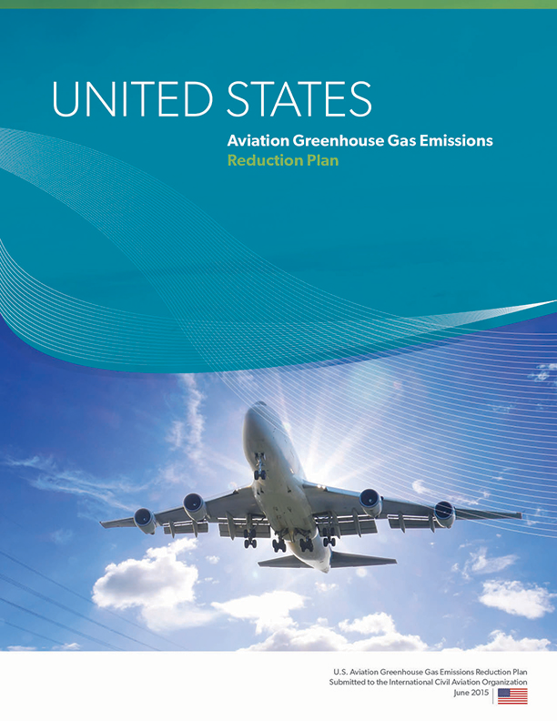
U.S. Aviation GHG Emissions Reduction Plan
Summarizes efforts across U.S. Government
Follows five pillar environment and energy strategy
Aircraft and engine technology improvement
Operational improvements
Alternative fuels development and deployment
Policies, environmental standards, and market based measures
Scientific understanding through research, modeling and analysis
Includes analysis examining potential for GHG emissions reductions
State Action Plans (including the U.S. plan) are available at:
http://www.icao.int/environmental-protection/Pages/ClimateChange_ActionPlan.aspx

Slide 9
Research Programs
ASCENT Center of Excellence (COE)
COE for Alternative Jet Fuel and Environment
PARTNER projects were transitioned to ASCENT
Continuous Lower Energy, Emissions and Noise (CLEEN)
Reduce aircraft fuel burn, emissions and noise through technology & advance alternative jet fuels
Cost share partnership with industry
CLEEN I: 2010-2015 & CLEEN II: 2015-2020
Additional Efforts
Commercial Aviation Alternative Fuels Initiative (CAAFI)
Contract mechanisms (e.g., SEMRS, PEARS)
Volpe Transportation Center
ASCENT: http://ascent.aero PARTNER: http://partner.aero
CLEEN Program: http://www.faa.gov/about/office_org/headquarters_offices/apl/research/aircraft_technology/cleen/
CAAFI: http://http://www.caafi.org/
Volpe Center: http://www.volpe.dot.gov/our-work/policy-planning-and-environment
Notes:
COE Technical Areas – Alt Jet Fuels
Feedstock Development, Processing and Conversion Research
Regional Supply and Refining Infrastructure
Environmental Benefits Analysis
Aircraft Component Deterioration and Wear Assessment
Fuel Performance Testing
Technical Areas – Environment
Aircraft Noise and Impacts
Aviation Emissions and Impacts
Aviation Modeling and Analysis
Aircraft Technology Assessment
Environmentally and Energy Efficient Gate-to-Gate Aircraft Operations

Slide 10
New ASCENT Research Projects (New NFOs)
AEDT Development Support
Examination of actual aircraft operations during taxi, takeoff / climb and approach
Reevaluation of Noise Power Distance (NPD) method
Noise Research Projects
Continued research on supersonic aircraft and Mach cut off
Background noise evaluation to support community survey
Fuels Analysis
Evaluation of jet fuel naphthalene removal
Operations
Noise Reduction Analysis of Advanced Operational Procedures
ICAO CAEP
Analysis to Support Development of an Aircraft Engine Particulate Matter Standard

Slide 11
Environment & Energy Portfolio
Core RE&D (A13.a) Environment & Energy
Improve scientific understanding of environment & energy constraints
Incorporate scientific knowledge into an integrated analytical tool suite
Analyze mitigation options for reducing environmental impacts including policy measures and environmental standards
NextGen RE&D (A13.b) Environmental Research
Mature airframe and engine technologies
Advance sustainable alternative jet fuels
NextGen F&E (1A08D) Environment Portfolio
Environmental analysis support to NextGen
FY16 is last year for these funds – zeroed out starting in FY17
Aviation E&E Policy Statement (Federal Register 77-141, 2012): http://www.faa.gov/about/office_org/headquarters_offices/apl/environ_policy_guidance/policy/media/FAA_EE_Policy_Statement.pdf

Slide 12
NARP Milestone Summary – RE&D A13.a & A13.b
Year | NARP Milestones – A13.a
2016 | Advance the understanding of noise impacts on social welfare and health
2016 | Develop new standard for aircraft carbon dioxide emissions
2016 | Develop methodologies to quantify and assess the impacts of aviation emissions
2017 | Refine methods for estimation of aircraft contribution to climate change and implement them in analytical tools
2017 | Advance the understanding of noise impacts on social welfare and health
2018 | Develop air quality model to capture global impacts of aviation emissions
2018 | Advance noise propagation methodology for implementation in analytical tools
2018 | Release improved version of Aviation Environmental Design tool
2019 | Develop new standard for particulate matter emissions
2019 | Explore appropriate metric for aircraft surface noise levels
2019 | Develop improved tool and methodologies for cost-benefit analysis
2020 | Enhance methodology for estimation of aviation contribution to climate change
2021 | Improve analytical capabilities of aviation environmental analysis tools
Year | NARP Milestones – A13.b
2016 | Refine the environmental and economic sustainability assessment of renewable alternative turbine engine fuels using the latest methods and knowledge
2016 | Develop methodology to estimate global lifecycle emissions of alternative jet fuels
2016 | Demonstrate technologies that can reduce energy use, emissions, and noise in year two of CLEEN II
2017 | Demonstrate CLEEN Advanced Turbine Components
2017 | Demonstrate technologies that can reduce energy use, emissions, and noise in year three of CLEEN II
2018 | Advance approval methodology for alternative jet fuels
2018 | Demonstrate technologies that can reduce energy use, emissions, and noise in year four of CLEEN II
2019 | Advance the understanding of alternative jet fuel composition and environmental performance
2019 | Utilize methodology to provide global lifecycle emissions of alternative jet fuels
2019 | Demonstrate technologies that can reduce energy use, emissions, and noise in year five of CLEEN II
2020 | Assess the environmental benefits of CLEEN II airframe and engine technologies
2020 | Initiate CLEEN Phase III activities to demonstrate technologies that can reduce energy use, emissions, and noise
2021 | Demonstrate technologies that can reduce energy use emissions and noise via CLEEN III

Slide 13
PPT Financial Summary
 | FY 16 Enacted |  | FY 17 Request |  | FY 18 Target
Program Title | In-House | Contracts | In-House | Contracts | In-House | Contracts
Base Program (Funding Appropriation)
A13.a. Environment and Energy (R,E&D) | 2,229,000 | 13,845,000 | 2,350,768 | 12,662,232 | 2,416,315 | 12,516,735
Base Subtotal | 2,229,000 | 13,845,000 | 2,350,768 | 12,662,232 | 2,416,315 | 12,516,735
NextGen Program (Funding Appropriation)
A13.b. NextGen Environmental Research – Aircraft Technologies, Fuels and Metrics (R,E&D) | 724,000 | 25,099,000 | 614,389 | 25,559,611 | 631,981 | 25,417,945
Above Target Request |  |  |  |  |  | 3,000,000
1A08D (F&E) NextGen Environment Portfolio |  | 1,000,000 |  | - |  | -
NextGen Subtotal | 724,000 | 25,099,000 | 614,389 | 25,559,611 | 631,981 | 25,417,945
With Above Target Request |  |  |  |  |  | 28,417,945
PPT Total | 2,953,000 | 38,944,000 | 2,965,157 | 38,221,843 | 3,048,297 | 37,934,679
With Above Target Request |  |  |  |  |  | 40,934,679

Slide 14
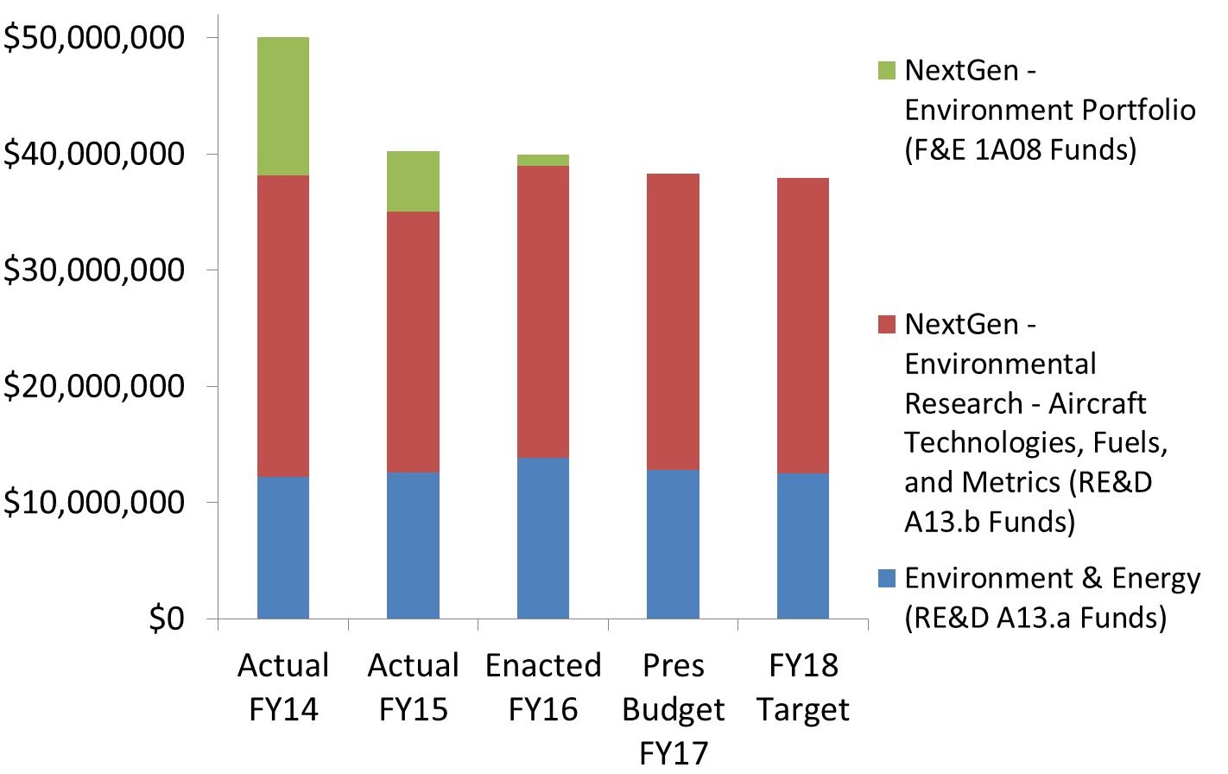
FY14-18 Financial Summary
Not shown on graph:
Office of Airports (ARP) providing ~$1.75M/year for environment and noise projects in FY16
Airports Cooperative Research Program (ACRP) provides ~$5M/year for environment projects
FAA FY 2017 President’s Budget Highlights https://www.transportation.gov/mission/budget/fiscal-year-2017-budget-highlights-book

Slide 15
PPT 5-Year Financial Plan
Program | Out-Year Contract Dollars
 | FY 2018 | FY 2019 | FY 2020 | FY 2021 | FY 2022
Base Program (Funding Appropriation)
A13.a. Environment & Energy | 12,516,735 | 12,774,125 | 12,911,592 | 13,157,362 | 13,282,874
Base Subtotal | 12,516,735 | 12,774,125 | 12,911,592 | 13,157,362 | 13,282,874
NextGen Program (Funding Appropriation)
A13.b. NextGen Environment & Energy-Aircraft Technologies, Fuels and Metrics (R,E&D) | 25,417,945 | 26,003,980 | 26,428,017 | 27,010,857 | 27,431,607
Above Target Request | 3,000,000 | 3,000,000 | 3,000,000 | 3,000,000 | 3,000,000
1A08D (F&E) NextGen Environment Portfolio | - | - | - | - | -
NextGen Subtotal | 25,417,945 | 26,003,980 | 26,428,017 | 27,010,857 | 27,431,607
With Above Target Request | 28,417,945 | 29,003,980 | 29,428,017 | 30,010,857 | 30,431,607
PPT Total | 37,934,679 | 38,778,105 | 39,339,610 | 40,168,219 | 40,714,480
With Above Target Request | 40,934,679 | 41,778,105 | 42,339,610 | 43,168,219 | 43,714,480

Slide 16
Core RE&D Program (A13.a) - Environment & Energy
FAA Strategic Plan
Research Goals
Deliver Benefits Through Technology and Infrastructure
Enhance global leadership
By 2018, advance air quality modeling capabilities to capture global impacts of aviation emissions to inform decision-making and enable solution development.
By 2018, release Aviation Environmental Design Tool (AEDT) Version 3 with improved noise, emissions, and fuel burn estimation methodologies.
By 2019, explore metrics for community exposure to aircraft noise.
By 2019, develop improved analytical tool and methodologies for cost-benefit analysis of both domestic and international policy options and scenarios.
By 2019, complete analyses to support the development of engine exhaust particulate matter standard in ICAO CAEP.
By 2019, complete analyses to inform the development of global market based measure for international aviation.
By 2020, develop enhanced methodology for estimation of aviation contribution to climate change
Need
Characterize environmental and energy challenges
Develop and implement mitigation solutions
Enhance international leadership on environment and energy matters
FY 2018 Milestones
Advance the understanding of noise impacts on social welfare and health.
Improve ability to model the air quality and climate impacts of aviation emissions.
Enhance the aviation environmental tool suite to improve its ability to calculate environmental consequences and impacts of aviation.
Analyze mitigation options for reducing environmental impacts including policy measures and standards being developed at the International Civil Aviation Organization Committee on aviation environmental protection (ICAO CAEP).
Out Year Funding Requirements
 | FY 2018 | FY 2019 | FY 2020 | FY 2021 | FY 2022
Funding Target ($000) | 12,517 | 12,774 | 12,912 | 13,157 | 13,283
Notes:
First three accomplishments are from NARP for FY14-FY16
Research goals are from Section 912 briefing, previous year PPT, and my thoughts

Slide 17
NextGen RE&D Program (A13.b) - Environmental Research - Aircraft Technologies, Fuels, and Metrics
FAA Strategic Plan
Research Goals
Deliver Benefits Through Technology and Infrastructure
Enhance global leadership
By 2018, develop methods to streamline the ASTM approval process for alternative jet fuels.
By 2019, advance the understanding of alternative jet fuel composition to enable fuels with lower emissions.
By 2019, develop lifecycle greenhouse gas emissions values for alternative jet fuels for use by ICAO CAEP.
Through 2020, support testing to ensure the approval of at least one alternative jet fuel type per year.
Through 2020, demonstrate certifiable aircraft and engine technologies via CLEEN II.
Need
Characterize environmental and energy challenges
Develop and implement mitigation solutions
Enhance international leadership on environment and energy matters
FY 2018 Milestones
Continue the second round of CLEEN activities (CLEEN II) in year 4 to assess and demonstrate aircraft and engine technologies that can reduce energy use, emissions, and noise.
Support the approval of additional alternative jet fuel pathways via ASTM International.
Evaluate regional alternative jet fuel supply chains to identify the key barriers to the development and deployment of sustainable ‘drop-in’ alternative jet fuels.
Support the inclusion of environmental and economic evaluations of alternative jet fuels into tools and databases for use by government, industry and academia.
Out Year Funding Requirements
 | FY 2018 | FY 2019 | FY 2020 | FY 2021 | FY 2022
Funding Target ($000) | 25,418 | 26,004 | 26,428 | 27,011 | 27,432
Above Target Request | 3,000 | 3,000 | 3,000 | 3,000 | 3,000
This above target request would accelerate the maturation of aircraft technologies and alternative jet fuels that would help to mitigate aviation’s impact on the environment.
Notes:
First three accomplishments are from NARP for FY14-FY16
Research goals are from Section 912 briefing, previous year PPT, and my thoughts

Slide 18
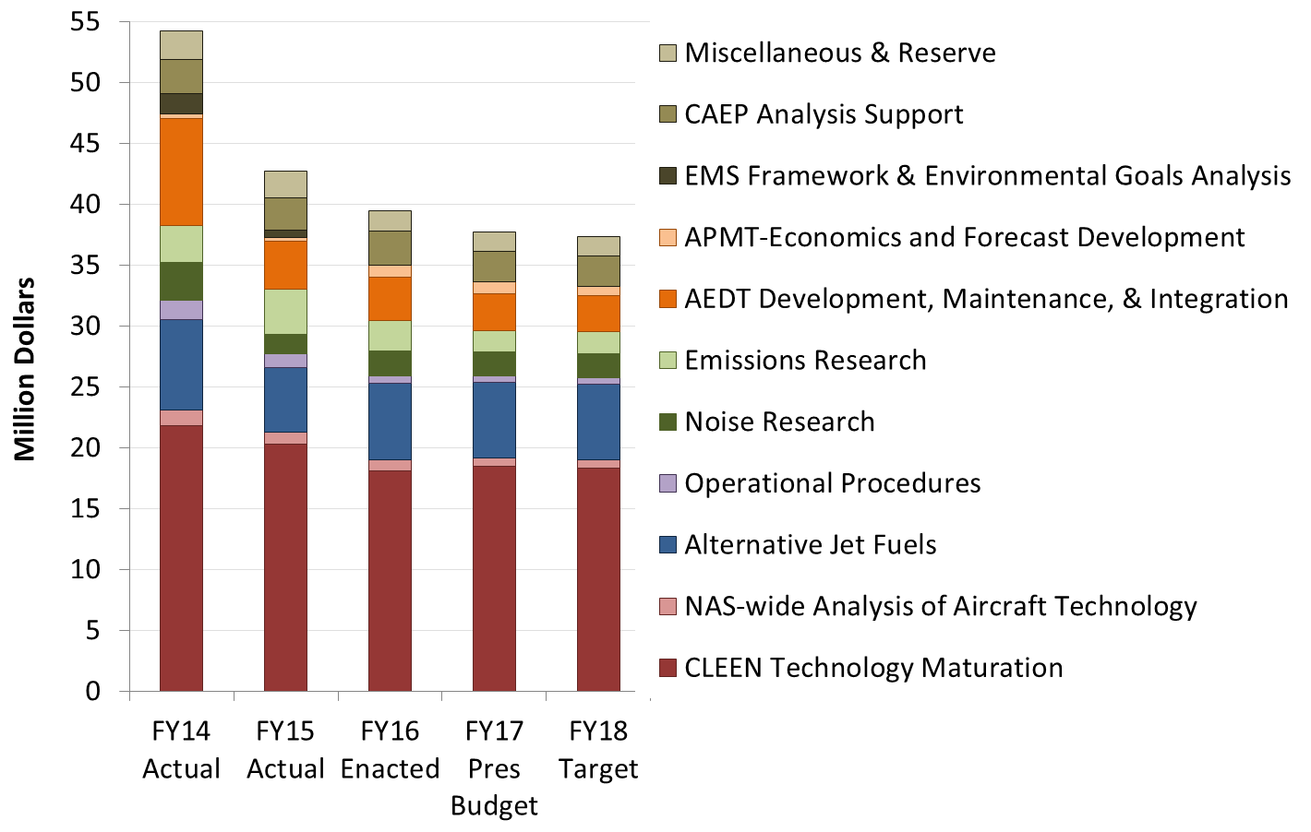
Environment and Energy Program Funding
Office of Airports (ARP) has been providing funding for community noise survey. Starting in FY16 they will be providing additional funds for environment projects too.

Slide 19
Summary
Noise, emissions and the need for a sustainable and secure energy supply remain critical issues facing the growth of aviation
Success in developing capabilities and solutions that are helping today:
Integrated tool suite and analyses provided the scientific data used to support the decision making for the ICAO CAEP CO₂ standard
Emissions measurements provided foundation for ICAO CAEP PM standard
Alternative fuels scenarios were adopted by ICAO CAEP for future trends assessment and years of research being leveraged in the LCA methodology that will be used to include alternative fuels in global market based measure for international aviation
ASCENT CLEEN aircraft and engine technologies appearing in next generation of aircraft with FMS technologies retrofitted into today’s fleet - reduces noise, emissions and fuel use for many years to come
Certification of five alternative jet fuel pathways – certification enabled United Airlines to buy and use biofuel at LAX as well as purchases by Gulfstream
Aviation Environmental Design Tool being used extensively
Reduced funding limits our ability to develop solutions that could prevent environment from being a constraint on aviation growth – above target request would help to overcome this

