Slide 1
Environment and Energy Research & Airport Environmental Research
To: REDAC E&E Subcommittee
By: Mrs. Lauren Collins, FAA Technical Center, Airport Technology Research, Airport Safety Section
Mr. Thomas Cuddy, FAA Airport Planning and Programming, Planning & Environmental Division
Date: April 4, 2016

Slide 2
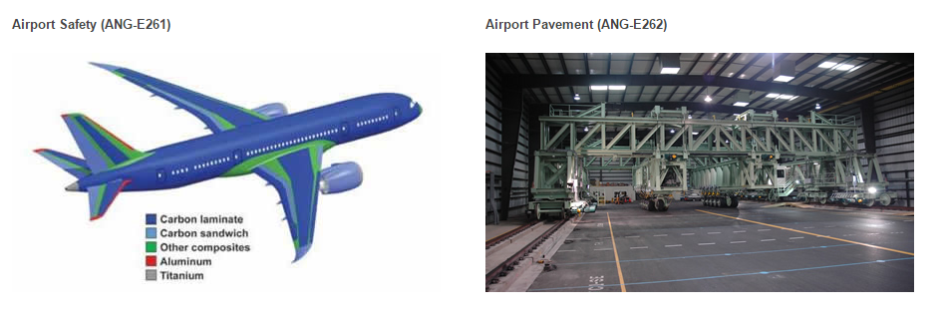
What is Airport Technology Research?
ATR uses AIP funds
ATR research is presented to the Airport REDAC Subcommittee
ATR encompasses: Safety, Pavement & Environmental

Slide 3
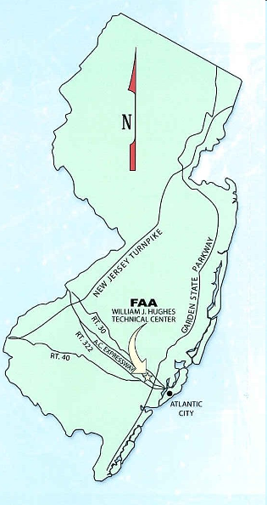
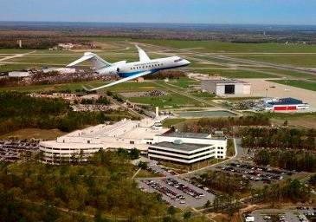
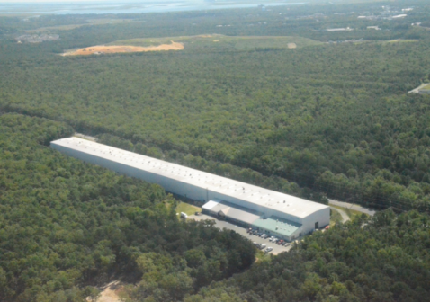
Where is Airport Technology R&D?
FAA William J. Hughes Technical Center
Airport Technology R&D Branch
Dr. Michel Hovan, Manager
Airport Safety R&D Section
Jim Patterson, Manager

Slide 4
ATR Safety Research Program Areas
Visual Guidance
Lights, Signs, Paint/Markings, LEDs, Other Visual Cues
Airport Rescue and Firefighting
ARFF Vehicles, Firefighting Systems, Agents, Tools, Composites, NLA Firefighting Strategies & Agent Methodology
Runway Surface Technology
Friction, Winter Ops, TALPA, Deicing, EMAS, Aircraft Braking Friction
Wildlife
Avian Radar, Wildlife Strike Database, Wildlife Management
Airport Design & Planning
Trapezoidal Grooves, FOD Detection, Taxiway Deviation Study, Capacity Simulation, Runway Incursion Prevention
Innovative Sensor Technologies
Aircraft Noise Annoyance

Slide 5
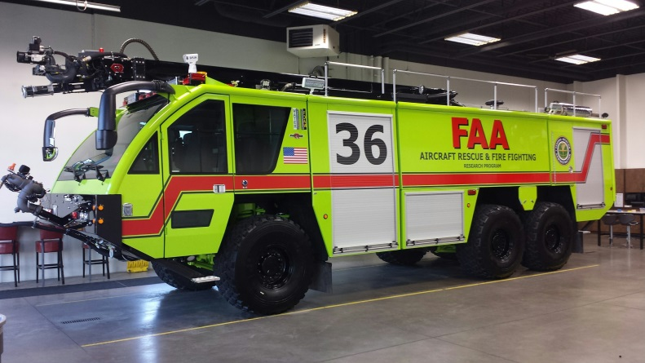
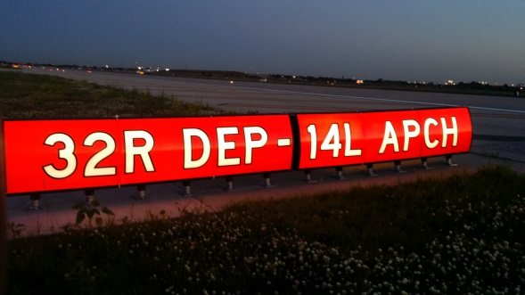
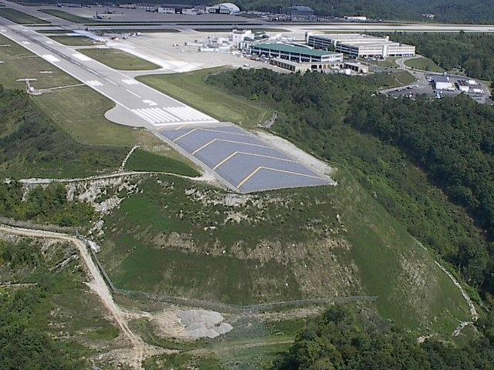
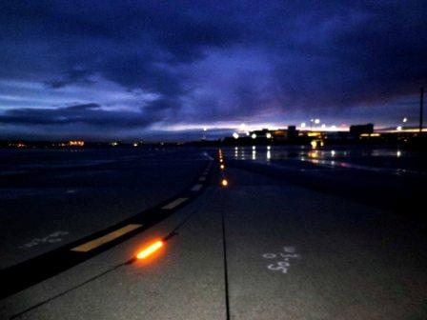
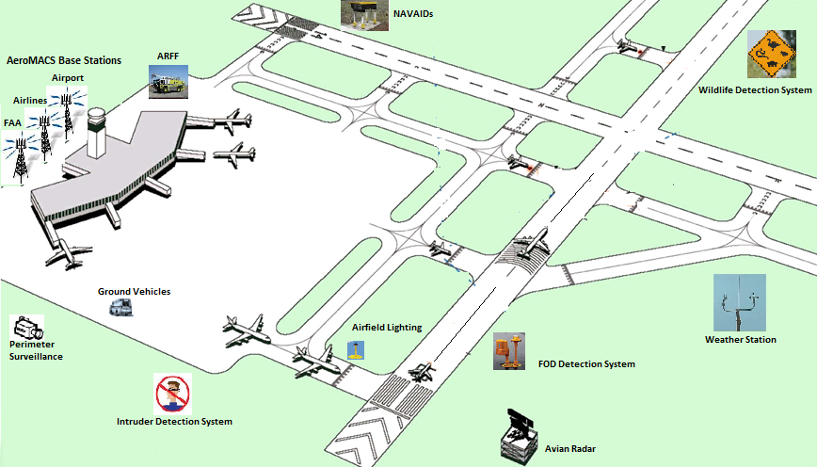
ATR Safety Research Program Areas
Notes:
Visual Guidance -Lights, Signs, Paint/Markings, LEDs, Other Visual Cues, Incursions
ARFF - ARFF Vehicles, Firefighting Systems, Agents, Tools, Composites
Runway Surface Technology - Friction, Winter Ops, TALPA, Deicing, EMAS
Wildlife - Avian Radar, Wildlife Strike Database, Wildlife Management
Airport Design -Trapezoidal Grooves, FOD Detection, Taxiway Deviation Study
Operation of New Large Aircraft (NLA) - NLA Firefighting Strategies & Agent Methodology, Other Future NLA Issues
Aircraft Braking Friction, Innovative Sensor Technologies, Low Cost Ground Surv.
Environmental Research, Noise, Runway Incursion Prevention

Slide 6
Doing Business ATR Mechanisms for Collaboration
Service Level Agreements (SLA)
Interagency Agreements (IAA)
Grants
Centers of Excellence (COE)
Traditional
Joint University Program (JUP)
Contracts
Multiyear Technical Support Contract
Single and Sole Source
SE2025
e-Fast
Memorandums of Agreement (MOA)
Airport Authorities
Other Transaction Agreements (OTA)
6

Slide 7
Airport Environmental Research
Extending model of airport technology research programs on pavement and airport safety to improve the performance of airports in reducing their environmental impacts while responding to community needs for transportation services
Following collaborative model used for community noise survey - coordinated effort among Office of Airports, Tech Center, and Office of Environment and Energy
Initiated with five projects using FY16 funding
Lead: Ryan King (Tech Center)
7

Slide 8
Draft Environmental Research Program Objectives
Support environmental goals by pursuing technical aspects of air quality and noise mitigation
Mitigating most airport environmental impacts comes down to interactions and tradeoffs, making it imperative to advance environmental planning within a sustainability framework that balances the lifecycle of cost and effect over time
Effective analytical capabilities will explore how to use technical information and digital tools for maximum benefit in the environmental process
Land use planning is where research is put to work in a decision-making context to improve airport management through better integration of plans, design criteria, and data.
Reduce/Mitigate Noise & Air Emissions
Sustainability
Enhance Analytical Capabilities
Land Use Planning

Slide 9
Airport Environmental Research FY16 Projects
Evaluating Fixed dB Values used in Determining Noise Level Reduction Requirements [with sound insulation programs]
Noise Dispersion with ELSO PBN departures
Develop air quality screening criteria for airport actions
Review of Airport Guidance for Climate Adaptation and Resiliency
Research on Airport Environmental Concerns and Mitigation Measures
9

Slide 10
Evaluating Fixed Decibel Values used in Determining Noise Level Reduction Requirements
Issue: ASTM E966, Standard Guide for Field Measurements of Airborne Sound Insulation of Building Facades and Facade Elements, is used to evaluate a structure’s sound insulation needs by analyzing how much noise penetrates the building envelope. This is called the Noise Level Reduction or NLR. ASTM E966 has fixed decibel adjustment values for testing residential sound insulation. The values are an approximation in many cases; i.e., in road traffic noise reduction. The values are essentially oriented to these non-aviation noise types of environments.
There is a need for analysis to evaluate and improve the accuracy of NLR testing. This issue was identified during ongoing NLR research funded by ARP and managed by AEE to update the Sound Insulation AC.
Note: Existing sound insulation (eligibility) work on NLR research and 65db noise level research are sufficient, progressing nicely, and are not in funding jeopardy. However, as noted above, fixed decibel adjustment values in the current testing standard came into question during the NLR research.
Deliverable:
Research, analysis, and validation of fixed decibel adjustment values for testing residential sound insulation around airports.
Benefits to Airports: This research will enhance the effectiveness of residential sound insulation, the public’s confidence in the testing program, and can be used as a basis to revise ASTM standards.
10
Notes:
Evaluating Fixed dB Values used in Determining Noise Level Reduction Requirements
The current research being completed is funded through ARP Admin Funds {from Jim Byers} secured last year to examine two aspects used to determine noise level reduction (how much noise penetrates the building envelope), one being the spectral class used and the other being the modeling methodology.
Approximations for aircraft noise are challenging for single family homes which are in sound insulation programs. The acoustic baffle effect is often weak due to a variety of technical and contextual factors. As a result, decibel adjustment values can become significantly lower, particularly at low frequencies.
This research would analyze and validate an appropriate fixed decibel adjustment used for noise level reduction for aircraft as the current values are oriented to non-aviation noise types.

Slide 11
Noise Dispersion with Equivalent Lateral Spacing Operations (ELSO) PBN Departures
Issue: PBN implementation at airports can result in heightened community noise concerns, as aircraft overflights are concentrated along specific points on the ground. Prior to PBN, there was more dispersion about the flight track. Research is needed to better inform conceptual procedure layout. Instead of dispersion around one heading, multiple PBN tracks can be used to ameliorate noise focusing from departures.
Deliverable:
Identify the minimum divergent heading needed between two PBN departure tracks that can provide a quantifiable reduction in community noise perceptions on the ground. Quantify using multiple headings (1-15 degrees) and variable distances from the airport out to 15 nautical miles. Evaluate changes in fuel burn and emissions to quantify tradeoffs of these considerations with noise.
Provide results for use by airports and FAA staff during ELSO implementation activities with updated planning guidance. Evaluate potential of divergent headings between 1-degree and 9-degrees.
Benefits to Airports: The noise data will provide an additional tool for airport operators to evaluate acceptable headings/tracks during the conceptual procedure layout in PBN work groups and could provide additional alternatives at locations with noise sensitive areas, and airport Part 150 studies.
11
Notes:
Noise Dispersion with Equivalent Lateral Spacing Operations (ELSO) PBN Departures
AEE research focuses on metrics
This research would use applicable metrics to identify the minimum divergent heading needed between two PBN departure tracks that can provide a quantifiable reduction in community noise perceptions on the ground. It would also evaluate the safety and efficiency of divergent headings.
For example, a preferred divergent heading could be selected to avoid a noise sensitive area instead of an alternative heading available through ELSO. Or for a runway with departure noise issues, a single PBN track could be replaced with two PBN tracks in order to reduce noise focusing.

Slide 12
Develop Air Quality Screening Criteria for Airport Actions
Issue: The analysis of air quality impacts for airport improvements varies greatly by region, scale of project, applicable regulations, type of construction, etc. With the implementation of AEDT 2b, and changes to the FAA Air Quality Handbook, some of the prior methods and procedures regarding how to scope and implement airport air quality analyses to adequately comply with the Clean Air Act and the National Environmental Policy Act (NEPA) have become obsolete. There is an immediate need for new methods and procedures to screen, scope, and conduct air quality analyses for airport actions. There is a particular need for screening small and medium scale airport projects for which the cost and time involved in use of AEDT 2b is likely unwarranted.
Deliverables:
Identify the spectrum of airport air quality analyses, from common projects at small GA airports up to capacity expansions at major hubs.
Analyze relevant policies, including the FAA ‘presumed to conform’ list, de minimis thresholds, and other applicable regulations.
Recommend new processes and/or methods of air quality analysis for airport projects that will ensure consistency and accuracy nationwide.
Provide the technical support documents that validate the procedures, and coordinate with EPA as necessary.
Benefit to Airports: New air quality screening procedures will help FAA staff and airport sponsors quickly identify the air quality requirements of a proposed project located in an attainment area, facilitate development and review, and streamline environmental analysis costs.
12
Notes:
Airport Air Quality Screening Methods
AEE develops the FAA Air Quality Handbook, which does not include a screening method for airport air quality analysis.
This research would develop a screening method to be used by airports, which could be incorporated into the Handbook and other airport guidance.

Slide 13
Review of Airport Guidance for Climate Adaptation and Resiliency
Issue: Executive Orders on the impacts of climate change underscore that resiliency is a priority that should be integrated into federal programs. Consideration of climate changes and future conditions is already built into several ARP programs. However, many questions remain about airports and climate change effects.
The goal of this research is to identify the various ways that FAA’s role in maintaining airport safety and sustainability can be used to enhance airport climate resiliency.
Deliverables:
Compare airport locations and possible impacts to airports, and consider future needs to ensure resiliency.
Place the findings into the context of FAA Airport programs - including engineering, safety, planning, financial support, and compliance.
Identify updates to programs, Orders, Advisory Circulars, and program guidance, or recommend follow up research, that will facilitate FAA’s role in ensuring airport climate resilience.
Benefit to Airports: Even the temporary closure of a runway can have large economic impacts for the sponsor, and send delays across a wide area of the country. Enhanced resiliency will provide better continuity of operations and system efficiency by anticipating and avoiding disruptions.
13
Notes:
Review of Airport Standards, AC/Orders, Design Criteria for Climate Adaptation and Resiliency
AEE research focuses on scientific understanding of climate change and aviation impacts to inform adaptation and resiliency decisions by FAA (e.g., ATO Tech Ops decisions regarding navigational infrastructure) and airports.
This research would use scientific understanding to identify climate change impacts on existing infrastructure and how to update advisory circulars/Orders, standards, design criteria, etc. to ensure that an adequate level of resiliency is built into future standards.

Slide 14
Research on Airport Environmental Concerns and Mitigation Measures
Issue: Planning and developing the airport system while protecting and enhancing environmental resources is a fundamental responsibility of the FAA Office of Airports. A commitment has been made to budget for research directed through the Airport Technology Research Program to improve the effectiveness and efficiency of ARP’s programs and guidance on both planning and environmental issues relating to airport development and operation.
To derive the greatest benefit from this initiative it is important to develop an overarching plan synthesizing the gaps in knowledge and guidance that are not being addressed elsewhere. This task will develop the rationale and needs to guide a research program through the next 10 years.
Deliverables:
Through workshops, brainstorming, or other means, conduct a focused review of research on topics related to airport planning and environmental concerns.
Coordinate with internal – AEE, AGC – and external – AAAE, ACI, NASAO, and others – for input on current and emerging issues affecting airport sustainability.
Provide a prioritized list of research recommendations.
Develop criteria for selecting future year topics for ATR research.
Benefits to Airports: Draw from the collective experience of FAA and industry specialists to deliver an effective research program that will Informs a sustainable, smart growth strategy for US airports, incorporate technology and data into airport development, and prioritize practical research with results that can be of direct use to the industry.
14
Notes:
Research on Airport Environmental Concerns and Mitigation Measures
AEE research focuses on aircraft technology, operational and policy measures to mitigate environmental impacts.
This research would be a focused synthesis and analysis of environmental issues and community concerns regarding airport actions and a prioritized list of solutions that can help airports and the FAA to engage with the community to address their concerns.

Slide 15
Airport Environmental Research Topic Areas FY17+
15

Slide 16
Summary
Airport Environmental Research
Collaborative effort among ARP, AEE and Tech Center
Starting five projects this year with FY16 funds
Developing long term research plan
Important funding source to develop environmental solutions to help airports and surrounding communities
 | FY16 | FY17 | FY18
Airport Environmental Research | $1.0M | $1.0M | $1.0M to $1.5M
Aircraft Noise Annoyance & Sleep Research | $0.75M | $0.75M | $1.0M
16

Slide 17
Airport Environmental Research
Questions?
Ryan King Tom Cuddy
ANG-E261 APP-400
Ryan.King@faa.gov Thomas.Cuddy@faa.gov
Lauren Collins
ANG-E261
Lauren.Collins@faa.gov
17

