Slide 1
Noise Research
Update on Selective Topics
REDAC – E&E Subcommittee
Rebecca Cointin, Manager, AEE-100
April 4, 2016

Slide 2
Noise Goal
Reduce the number of people exposed to significant noise around U.S. airports in absolute terms, notwithstanding aviation growth, and provide additional measures to protect public health and welfare and our national resources.
Specifically, by 2018, have the U.S. population exposed to significant aircraft noise around airports have been reduced to less than 300,000 persons
Research is examining the appropriateness of the level of significance, potential for other metrics and evaluating the long-term goal

Slide 3
Drivers of Research
Observation:
Even though the number of people in the U.S. exposed to significant aircraft noise since 1975 has dropped by over 95 percent, opposition and challenges continue to be an issue
Needs:
Gather data to determine if there has been a significant change the public perception of noise
Gather supplemental data to have a strong scientific support for any policy decisions regarding aviation noise

Slide 4
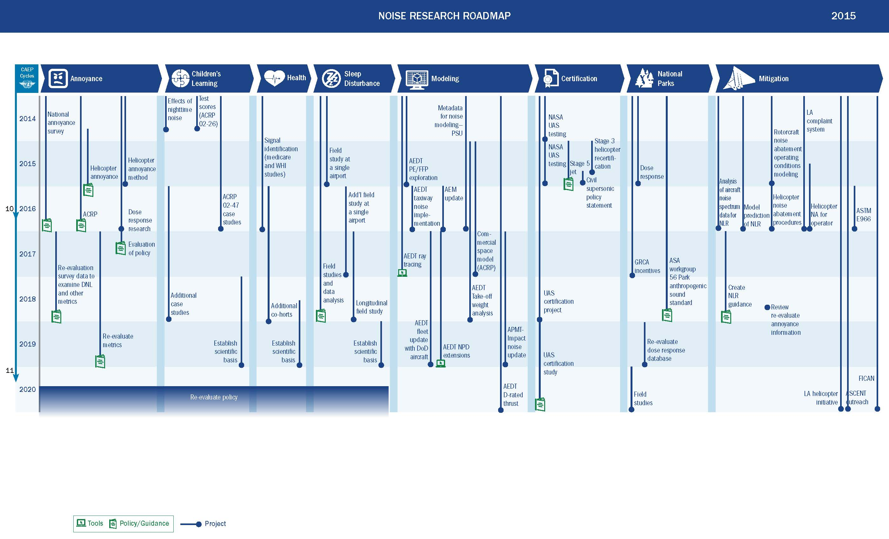
Note: Timelines are dependent on funding availability and are re-evaluated yearly

Slide 5
Research Covered
Supersonics
Unmanned Aircraft Systems
Research on Aviation Noise Impact on Sleep
Aviation Noise Impact on Annoyance – Survey Update

Slide 6
SUPERSONIC AIRCRAFT

Slide 7
Goal of Research – Near Term
Supersonic Airplane Research is focused on supporting:
Noise Certification standard development for Sonic Boom Noise Above Mach One
Concentration on Mach Cut-off Research
Sensitivity of metrics to atmospheric turbulence
Standard development

Slide 8
Standard Development Research Details
Researching Instrumentation to assess the fidelity of noise monitors to optimize measurement requirements and minimize costs in future field tests.
Explore subsonic regime procedures for supersonic standards.
Examine applicability of low boom work for Mach cut-off, including metrics and flight procedures

Slide 9
Current Supersonic Research Collaboration
CAEP SSTG: Standards setting is in-progress with involvement by: NASA, JAXA, Gulfstream, LHM, Boeing, and Aerion, providing data and analytical resources.
NASA R&D Programs:
Technical R&D on sonic boom noise studies through NRA’s for: simultaneous noise level acquisition & human response surveys planning, quiet supersonic transport Demonstrator (QUESST) and emissions reduction.
AEE ASCENT COE grants for:
- Sonic Boom metrics sensitivity/variability assessment
- Exploring the protocol for noise test community engagement
Notes:
NASA Aeronautics Strategic thrusts: (1) Safe, Efficient Growth in Global Operations; (2) Innovation in Commercial Supersonic Aircraft; (3) Ultra-Efficient Commercial Vehicles; (4) Transition to Low-Carbon Propulsion; (5) Real-Time System-Wide Safety Assurance; and (6) Assured Autonomy for Aviation Transformation.
Sonic Boom Community Response Metric and Methodologies Technical Lead: Alexandra Loubeau
Subtopic 2.1.1 – Propagation of Shaped Sonic Booms Through Atmospheric Turbulence
Subtopic 2.1.2 – Risk Reduction for Future Community Testing with a Low-Boom Flight Demonstration Vehicle
Low Noise Propulsion for Low Boom Aircraft Technical Lead: James Bridges
Subtopic 2.2.1 – Low-Cost Aeroacoustic Code for Supersonic Propulsion Exhaust System Design
Subtopic 2.2.2 – Low Noise Technologies for Low Boom Aircraft: Achieving Chapter 14 minus 10EPNdB
High Altitude Emissions Research Technical Lead: Clarence Chang
Subtopic 2.3.1 – Global Impact of High-Altitude Emissions from Supersonic Cruise Aircraft
Flight Research and Validation Technical Lead: Dan Banks
Subtopic 2.4.1 - Development and Flight Validation of a Sonic Boom Cockpit Display
Subtopic 2.4.2 - In Flight Flow Measurement and Visualization

Slide 10
Recent Accomplishments & Findings
Sonic Boom Metrics Downselection (5) supporting ICAO:
Steven's Mark VII Perceived Level
Indoor sonic boom annoyance predictor
A-weighted Sound Exposure Level
B-weighted Sound Exposure Level
E-weighted Sound Exposure Level
Sonic Boom Metric Sensitivity (NASA SCAMP*)
Substantial variability/high sensitivity due to turbulence identified in boom (N-wave) data.
Noticeable decrease in variability of off-track measurements.
Impulsive Noise Databases & Annoyance Drivers
Five modes of single event annoyance rank the strongest drivers as: [1] interference (.76), [2] startle (.70),[3] loudness (.55), [4] vibration (.45) and [5] rattle (.42)
*Sonic Boom Caustic Analysis and Measurement Program (SCAMP)

Slide 11
UNMANNED AIRCRAFT SYSTEM

Slide 12
Current Research
Collect data to determine if appropriate lower weight limits to exclude noise certification exists
Collaborating with UAS COE, ASSURE to test a UAS
Looking for collaboration opportunities with National Park Service, Department of Defense, NASA, and others
Examining if there is a need for different certification procedures
Determine NEPA needs, including modeling (covered in ops briefing)

Slide 13
Helicopters

Slide 14
Annoyance
Assessing Community Annoyance of Helicopter Noise:
Determine the factors that influence annoyance to helicopter noise and develop a research method
This ACRP project has completed their work at two of their three locations, but does not expect to conduct the work at the third location until spring 2016.
Small Scale Helicopter Noise Survey
Effort to test a methodology to gather community response of annoyance for residences in the vicinity of helicopter operations. The data has been gathered and the analysis is underway.
Reviewing draft report
Compare methodologies to determine the best way to conduct a helicopter noise annoyance survey. At that time, a decision on the feasibility to conduct a large scale helicopter noise survey will be made.

Slide 15
Modeling
Helicopter Modeling Performance Enhancement for AEDT
Improve helicopter performance modeling capabilities for more accurate operational impact representation and analysis.
Work is almost complete and is being incorporated into AEDT.
Helicopter Noise Modeling Guidance
TRB Project completed published in first quarter 2016
AEE evaluating results and prioritize the modeling improvements needed in AEDT

Slide 16
Noise Abatement Procedures
Helicopter Operations Noise Prediction Modeling
First phase focused on integrating the tools needed to predict helicopter source noise and providing the necessary integration with AEDT.
Second phase focuses on developing the noise abatement procedures for either individual helicopters or classes of helicopters.
Working to collaborate with NASA on flight tests
Helicopter Noise Abatement Procedures for Operators
Educate operators on the benefits of noise abatement procedures, when they should operate them, and the
Notes:
This project begins to look at these issues by developing a strategy for pilot awareness of noise abatement techniques, looking at ways to illustrate the benefits through modeling and examining the potential for video training illustrating how to incorporate noise abatement procedures. This project will conclude at the end of calendar year 2016 and will provide a final report which will document a proposed strategy and method to heighten the awareness of the effects of pilot technique on lessening the psycho-acoustic and overall acoustic impact of helicopter operations in urban and semi-urban environments, illustrate the benefits through modeling, document proposed training videos to illustrate the benefits of the operator’s noise abatement procedures, and document a proposed self-training program for operators for fly neighborly techniques

Slide 17
RESEARCH ON AVIATION NOISE IMPACT ON SLEEP

Slide 18
Goal of the Project and Current Accomplishments
Develop inexpensive, scientifically sound methodology to obtain objective measures of sleep and noise.
Completed a field study around Philadelphia Airport
Recruitment of subjects within control area and aircraft noise exposed area
40 aircraft noise exposed subject and 40 control subjects
Data collection for 3 nights for each subject
Data Analysis:
Multiple metrics
Examine control and exposed group
Compare results to NORAH study around Frankfurt Airport
Notes:
Calculate single aircraft event noise metrics and cumulative nighttime noise levels
Identify awakenings using ECG and actigraphy data
Compare sleep fragmentation and subjective results between control and aircraft noise exposed subjects
Calculate models relating awakenings to single event aircraft noise metrics
Compare results to the NORAH sleep study conducted around Frankfurt Airport

Slide 19
Future Plans
Further simplify the study methodology and reduce methodological expense by eliminating staff in the field
Additional field study at single airport by end of 2016
Continue collaboration with DLR on data acquisition and analysis
Planning and completion of large nationwide study
Re-evaluate policy based on results of nationwide study

Slide 20
AVIATION NOISE IMPACT ON ANNOYANCE – SURVEY UPDATE

Slide 21
National Survey
Objective
Conduct a nation-wide survey to update the scientific evidence of the relationship between aircraft noise exposure and its effects on communities around airports
Status
Surveys have begun
First few waves of both the phone and mail surveys have been initiated
Response rates are right where we expected
Expect analysis to be completed in early 2017, then FAA will begin policy determination
Notes:
We are nearly halfway through the yearlong data collection. The main focus of the survey is to collect annoyance levels at various DNL exposures around the 20 sampled airports. This is done via a mail survey. Our survey design calls for six waves of sample to be released over the course of a year to capture seasonal variation in noise exposure and annoyance levels. Each of the six waves receives the gold standard protocol for mail surveys as follows:
Initial mailing via USPS of cover letter on DOT letterhead, $2 bill pre-paid incentive, business-reply envelope, and survey with frequently asked questions (subsequently referred to as survey packet).
One week later we send a thank you/reminder postcard to all addresses receiving the initial mailing.
Two weeks after the postcard we send a second survey packet (sans incentive) via Fed Ex to the addresses that have not yet returned a survey or been identified as undeliverable.
Three weeks after the Fed Ex mailing, we send a third and final survey packet (sans incentive) via USPS to those addresses that have not yet returned a survey or been identified as undeliverable.
The above process takes 6 weeks from initial to final mailing and the initial mailing for each wave is spaced 2 months apart. Although returns tend to taper off within a couple weeks of the final mailing for each wave we do continue to process and use all returns received. In other words, there is no data collection end date for each wave. The reason is that for seasonality measures we will associate the survey with date of return as opposed to date of mailing. Our first mailing was sent October 13, 2015 and our last mailing will be sent September 27, 2016. All materials in each mailing are provided in both English and Spanish.
A secondary focus of the data collection is to administer a telephone survey to explore potential factors contributing to annoyance levels. To that end, respondents to the mail survey are invited to participate in a telephone survey. Addresses that could be matched to a phone number are sent an advance letter informing them of the telephone survey and that we will be calling in a few days. Matched numbers that are determined to be non-working or reach the wrong address as well as those that do not have a matched phone number are sent a letter explaining the purpose of the telephone interview with a request for their telephone number. All telephone requests are followed a week later with a thank you/reminder postcard and those that do not respond are sent a second phone request 2 weeks after the post card. Respondents to the telephone survey are provided with a $10 post-paid incentive. Mailings of the advance letters, telephone requests, postcards, follow-up requests, and incentives are sent on a weekly basis to the appropriate addresses.
As of March 11, 2016 we are in the middle of Wave 3, having just sent the second survey packet via Fed Ex on March 8. To date we have obtained 4,676 completed mail surveys toward our final target of 10,000 (47% of goal) and 850 completed telephone surveys toward our target of 2,140 (39% of goal). While as a percentage of target the phone surveys are trailing the mail completes, this is due to the necessary lag in administration based upon our protocol outlined above. Both survey modes are slightly ahead of schedule to meet targets due to a larger than needed sample release in Wave 2. This was due to conservative estimates made in the middle of Wave 1 that had to be done in time to draw the sample for Wave 2 on our schedule defined above. Wave 3 and beyond benefit from more robust yield rates that will allow us to dial in the exact sample release within each airport and noise strata to meet the survey targets. Overall our survey response rates for the mail survey are tracking right at the anticipated 40% response rate, while the telephone survey is performing slightly above expectations.

Slide 22
Planned Research Associated with National Survey (new ASCENT Projects)
Examine possible NEPA significance thresholds and implications given possible threshold changes from outcome of survey
Examine the sound insulation criteria and other mitigation options available given possible threshold changes from outcome of survey

Slide 23
FY16 Projects
Noise Health Impacts | ASCENT
Outreach | ASCENT
Sleep Study - Multi-Site Preparation | ASCENT
Rotorcraft Noise Abatement Procedures | ASCENT
Noise emission and propagation modeling (to be renamed) | ASCENT
Noise Power Distance Re-Evaluation | ASCENT
Supersonics | ASCENT
Mach Cut-Off Evaluation | ASCENT
Background Noise Evaluation | ASCENT
GREAT - change baseline year and provide AEE shadow/ support of noise activities | ASCENT
Rapid Fleetwide Tool Development | ASCENT
Certification | Contract
Inventories | Contract
AEM Update | Contract
Rerun Inventories | Contract
Los Angeles helicopter complaint system | Contract
Parks Research and Support | Contract
FICAN | Contract
Ray Tracing | Contract
Annoyance Research - dB change | ATR funded
Annoyance Research - interior threshold | ATR funded
Launch Noise Measurements | AST funded

Slide 24
QUESTIONS

