Slide 1
Office of Environment and Energy’s (AEE)
Air Traffic Management Modernization / Operations Research Program Update
Presented to:
By:
Date:
REDAC E&E Subcommittee
Julie Marks and Stephen Merlin (AEE-400)
April 5, 2016

Slide 2
Air Traffic Management Modernizations (ATMM) Offer Important Potential E&E Improvements
AEE E&E ATMM Research Program Goals
  Identify and accelerate the implementation of air traffic management concepts that will reduce aviation environmental impacts and/or improve energy efficiency
  Investigate the E&E effects of operational changes implemented by the FAA.
Core Program Elements
  Research Process: Identifies, conducts, evaluates and transitions ATMM research for implementation
  Roadmap: Describes areas for ATMM Research near, medium, and long term.
  Portfolio Metrics: Assesses the portfolio’s balance with regard to addressing E&E issues and the maturity progression of research project.
Coordination/collaboration key to AEE ATMM Research, e.g., with ATO, ANG, NASA, etc.

Slide 3


AEE ATMM Research Roadmap (FY 2016)
Core Focus Area | FY 2013-2014 | FY 2015 | FY 2016 | FY 2017 | FY 2018
P43: PHASE III Exploration of aircraft mission specification changes enroute
CLEEN transition
1
Exploration of
Steeper glide slopes
Investigation of Barriers to steeper glide slopes
Steeper Glideslope & Displace Threshold procedure design and development
1
2
Evaluate potential benefits resulting from OPC use
2
ATM/
Operations
and Development
Noise Dispersion utilizing Fanned PBN procedures & ELSO Standard
Aircraft Operational Evaluation Analysis-CASO (ASCENT-15)
3
Aircraft Operational Evaluation Analysis-DDAs
2
P21: Airport surface movement optimization (N-control)
2
N-Control: Integration with S-CDM Elements
3
ATO transition
Advancing Ops Noise Modeling
(ASCENT)
Advancing Ops Noise
Modeling (ASCENT-23)
Noise Power Distance Re-Evaluation
(Co-Lead with AEE-100)
3
3
Scoping study to identify and evaluate promising concepts
Enhanced Approach Modeling in AEDT
1
Environmental Benefits and
Impact Assessment
Interdependencies
associated with PBN departure procedures
E&E Trade-off Analysis during the design phase of PBN
Enhanced Taxi Modeling in AEDT
3
3
Enhanced Climb Modeling in AEDT
Evaluation of Env Models and Methodologies for UAS
UAS Modeling and Analysis for NEPA Guidance
2
2
Projects funded prior to FY16
FY16 Proposed Projects
Rotorcraft Noise Abatement Operating Procedures Modeling
Active Projects
Linkages to Noise Research Roadmap
X
Concept Maturity Level (higher # = increasing maturity)
Evaluation of PBN Impacts on Noise
Examine Airline Flight Data to Improve Flight Performance Modeling

Slide 4
UAS NAS Operations

Slide 5
Phase I & II Overview –
Investigation of E&E Benefits/Impacts of UAS in the NAS
Phase I Major Outcomes
Phase II Major Outcomes
Matrix of UAS Fleet/Operational Data
Review of Modeling VTOL and Life Cycle Emissions
Classification of UAS for E&E Assessment
Understanding of AEDT Capabilities for Modeling UAS
Qualitative E&E Assessment of UAS
UAS E&E Modeling Roadmap

Slide 6
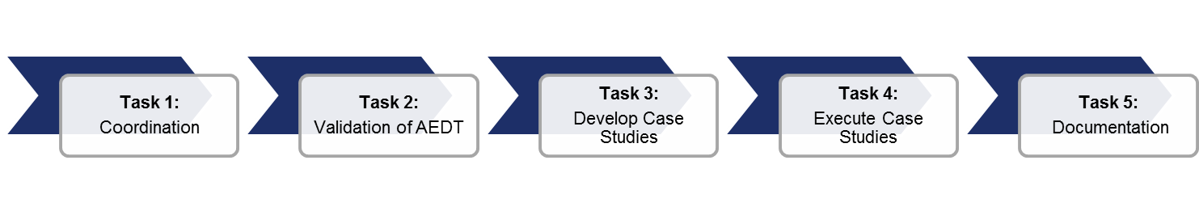
Phase III Project Overview –
Investigation of E&E Benefits/Impacts of UAS in the NAS
Expected Outcomes
Coordination with key stakeholders to leverage on-going research for information and/or data sharing
Detailed assessment and validation of AEDT 2b for modeling UAS (continuation from Phase II)
Development of case studies to assist in identifying potential updates to NEPA guidance/policy
Modeling guidance and recommendations for aircraft substitutions when modeling UAS
Updated UAS E&E Modeling Research Roadmap to track relevant research by AEE and other agencies

Slide 7
Phase III – Status Update
Project Tasks:
  Coordination: Review quantitative literature on UAS E&E impacts and collect relevant data that can be applied to UAS E&E impact quantification.
  AEDT Modeling: Modify the Aviation Environmental Design Tool (AEDT) to simulate the E&E impacts UAS.
  Case Studies: Use quantitative E&E impact results to evaluate the impact of UAS operations at UAS-relevant airports. Develop policy recommendations for these airports that anticipate NEPA regulatory challenges due to UAS operations.
Completed-to-date:
  Coordination: Working with NASA to acquire data related to UAS vehicles and flight missions.
  AEDT Modeling: AEDT has been modified to simulate hybrid manned aircraft, which can be altered to represent UAS. The modifications are being validated.
  Case Studies: Scoping potential UAS NEPA case studies, including evaluating airports with potential for increased UAS operations.

Slide 8
Phase III: Next Steps
Next Steps:
  Coordination: UAS flight and E&E data continue to be collected from SMEs.
  AEDT Modeling: Validate hybrid aircraft simulations and quantify UAS impacts.
  Case Studies: Select relevant airports for NEPA-UAS evaluation.

Slide 9
Cruise Altitude and Speed Optimization (CASO)
ASCENT Project 15 (PARTNER Project 32)

Slide 10
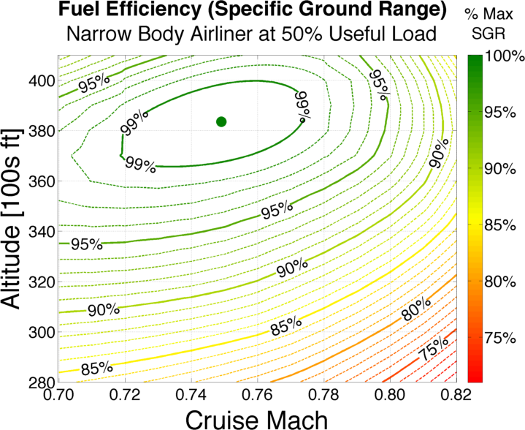
Cruise Altitude and Speed Optimization (CASO)
Fuel burn reduction with current schedule and fleet benefits airlines, passengers, and communities
  Airline economics
  Environmental impact
Typical cruise speeds/altitudes do not minimize fuel
  Opportunities in flight planning, dispatch, and cockpit procedures
  Potential applications in NextGen ATM systems and workflows
Working with airlines to understand operational and business constraints
Typical Narrow Body Jet
Efficiency Contours
Typical Operating Regime
(fast,
off-optimal alt)

Slide 11
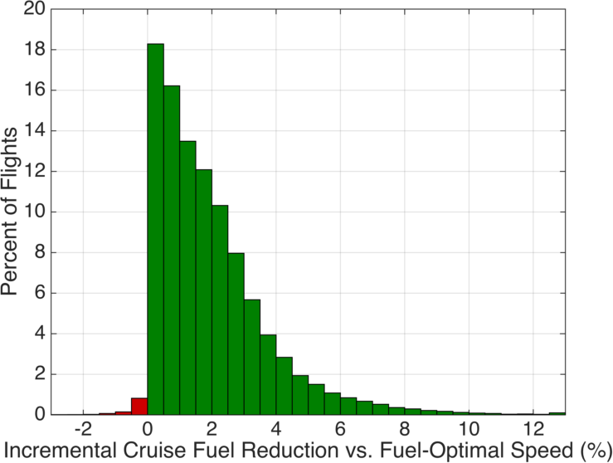
CASO: Potential Benefits Analysis
Currently analyzing sample set of 18 representative days from 2015
  Each flight optimized for speed, altitude, and combined speed/altitude
  Compared to as-flown baseline
Identifying potential high-benefit operations
  Least-efficient quartile of all flights had 2.70% or greater fuel reduction potential from speed optimization
  Similar analysis for altitude optimization
Working to identify causes, opportunities for improvement
  Analyzing delay data, flight schedules, and network structures
  Meeting with airline flight operations and efficiency departments
Fuel Burn Reduction Potential from
Speed Optimization (US Domestic Flights)
2015 Data: 105,000 Flights
High-Benefit Operations

Slide 12
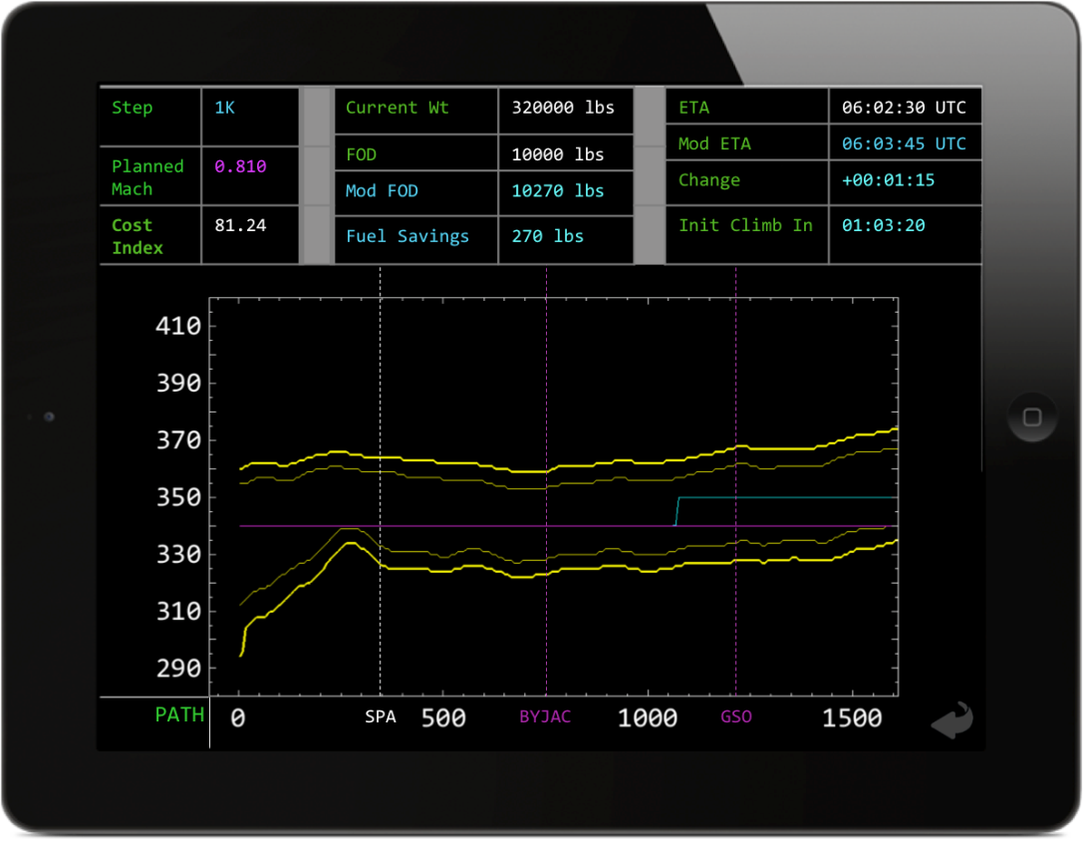
CASO: Current Status & Next Steps
Completing updated analysis for 2015 operations
Evaluating potential operational application through a pilot decision support tool
  Building mockup Electronic Flight Bag (EFB) application
  Preliminary phase of developing a web-based human-in-the-loop study to evaluate pilot valuation of CASO information
  Meeting with NASA about ongoing research on in-cockpit trajectory optimization tools
Extending analysis framework to a subsets of oceanic and international operations with available flight track data
Mockup of CASO decision support EFB application

Slide 13
Delayed Deceleration Approach (DDA)
PARTNER Project 32

Slide 14
Delayed Deceleration Approach (DDA)
Keep aircraft “clean” for longer on approach, when appropriate, without impacting terminal area entry or final approach stabilization criteria
Study objective:
estimate & enable DDA
benefits in near-term
operations
Prior work demonstrated
fuel & emissions saving
potential at range of key airports
Notes:
Terminal area entry speed and final approach speeds are fixed
Slower is typical because it’s easier to manage the aircraft when they’re going slower

Slide 15

DDA: Current Status
Understanding DDA noise impacts
  DDA modifies airframe and engine noise impacts at different distances from the airport
  Conducted noise measurement campaign (Nov 2015-Jan 2016) for BOS RNAV arrivals at 10-30 nmi range of main DDA interest
  Noise data correlated with
  airspeed, aircraft type and
  inferred aero configuration
  Data being made available to
  other AEE programs
Updated approach speed
profiles
  Allows comparison of 2011 and
  2015 characteristics

Slide 16
DDA: Next Steps
Latest deceleration analysis
  Model latest deceleration profiles for different aircraft types
  Quantify differences between observed and theoretical latest deceleration points at different airports to account for fleet mix
RNAV DDA procedure analysis
  For airport(s) with highest potential, use simulators to develop operationally-feasible speed overlays to existing RNAV procedures to gain DDA benefits
  Socialize and refine for operational viability with stakeholders

Slide 17
Surface Congestion Management

Slide 18
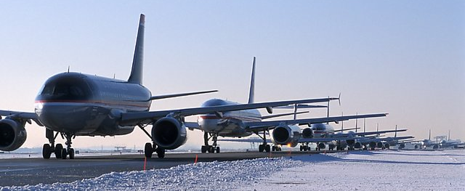

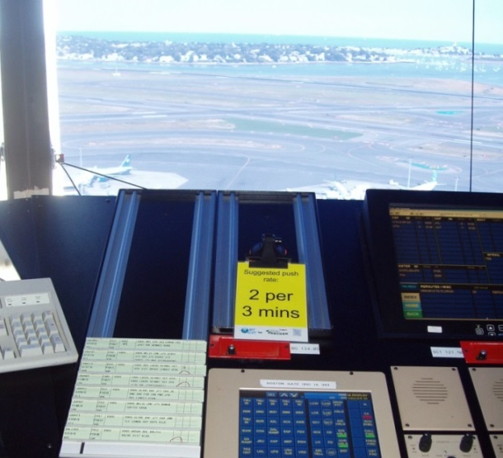
Past Work: BOS N-Control Trials
Design of “light-weight” surface congestion management for BOS based on recommended push-back rate, excess aircraft held at gate
Tested during 2010/11 in live operations
Average fuel savings observed of 50-60 kg per held flight
Adaptation to other airports with very different operating characteristics explored
Lincoln/campus team
Pushback
rate card in
BOS ATCT
Pushback
rate cards

Slide 19
Framework Developed for Airport Adaptation
Framework applied to BOS, LGA, PHL (past), CLT (current)
= Required LGA site adaptations compared to BOS

Slide 20
Current Work: S-CDM Alignment
Benefits Assessment of departure metering aligned with S-CDM ConOps
Airlines
(Outputs)
EOBT (t)
for all scheduled flights
Airlines
EOBT (t)
for all scheduled flights
Earliest off-block times;
Wheels-On times; Gate assignments
EOBT (t)
for all scheduled flights
EOBT (t)
for all scheduled flights
(Inputs/
data-elements)
Target pushback times
METERED
SCHEDULE
DEMAND
Departure Metering
Algorithm
Actual pushback & taxi times; Actual departure throughput
Departure throughput
Desired parameters:
e.g., queue lengths
(Parameters)
KPAs
CAPACITY
(Predictions)
(Outcomes)

Slide 21
Planned Next Steps
Investigate effect on departure metering algorithms/benefits of incorporation of S-CDM data elements (e.g., EOBT, gate information, etc)
  Impact of information uncertainties
  Identify appropriate approaches for different types of airports
  Determine metrics to assess & refine departure metering
Coordinate with related activities
  NASA ATD-2: Exploring potential value of proposed analysis for CLT activities
  TFDM: Exploring role to facilitate TFDM tech transfer
  RTCA: Exploring value to RTCA NIWG surface team “rolling plan”

Slide 22
Continuous Climb Operations (CCO)

Slide 23
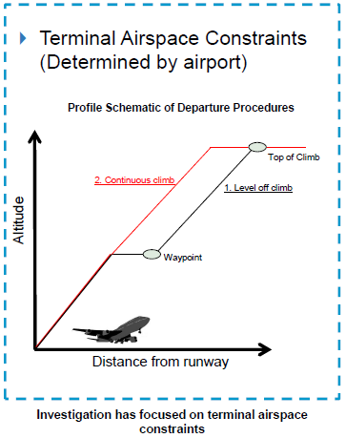
Continuous Climb Operations
Climb phase characterized by high fuel flow configurations (i.e., full throttle and high gross weight)
Constraints such as airspace/sector boundaries can cause level-offs during climb → increased fuel, emissions, noise
Objective of AEE study:
  Quantify prevalence of level-offs in NAS
  Calculate potential benefits of removing level-offs
  Identify causes of level-offs and mechanisms to implement continuous climbs

Slide 24

Assessed the Impact of Metroplex Airspace Improvements on Level Offs
Performed statistical analysis of Level off metrics at Houston Metroplex for years 2011 (pre implementation), 2014 and 2015 (post implementation).
Analyzed Level off counts, time and distance in level off and time weighted level off altitude metrics
Analysis shows 5 to 13% improvement in Level off metrics statistics, post Metroplex Program Implementation at Houston
90th Percentile
Mean Value
Median Value
10th Percentile
Example -
Notes:
2011 pre-metroplex
2014 year metroplex completed
2015 metroplex in place for appx 1 year
IAH – Houston Int.
SGR – Sugar Land Reginal
DWH – David Wayne Hooks

Slide 25
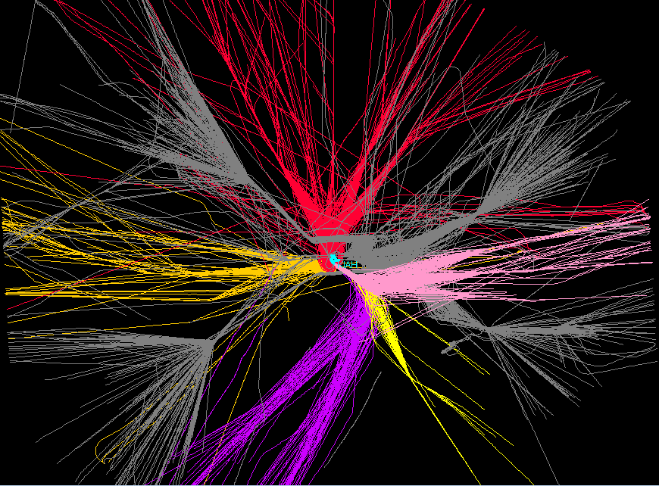
Started Flow Analysis at Houston Metroplex to Identify Barriers to Continuous Climb
Gray = Arrival Flow
Working to understand operational drivers of remaining climb inefficiency.
2-D demonstration of the departure and arrival flow interaction

Slide 26
Next Steps
Complete Assessments of Environmental and Energy Benefits of Continuous Climb using AEDT at an airport.
Complete flow analysis at Houston, including 4D visualization of arrival and departure flows and identify causes of level offs.
Provide recommendations on benefits and barriers to implementation of Continuous Climb.

Slide 27
Steeper Glide Slope and
Displaced Threshold

Slide 28
Project Overview
Project Details
Conducts analyses on steeper glide slopes and displaced thresholds with the ultimate goal of noise reduction in proximity to airports
Evaluate potential for a U.S. application of steeper approaches.
Based on the findings from the desk research and stakeholder outreach, conduct high-level analysis to identify the potential benefits and challenges for select airports.
Establish a better understanding of the influence that the change in the glide slope / displaced threshold may have on noise
Assess possible challenges for the implementation of steeper glide slopes and/or displaced thresholds for noise relief at U.S. airports.

Slide 29
Tasks 1 – Literature Review
The team collected and reviewed about 30 existing studies on the topic, authored by researchers from Europe and the US, about the noise benefits and risks from Steeper Glide Slopes and Displaced Thresholds
The extensive literature review served as a starting point for the stakeholder outreach plan (Task 2)

Slide 30
Task 2 - Stakeholder Outreach
  The team created a database containing over 60 POCs in 35 different organizations
  The selected POCs are based on a combination of our own industry contacts, authors identified in relevant studies and recommendations gathered in interviews
  For most POCs we had backup POCs that became relevant when the primary POC did not respond to outreach attempt
  Collected contact information in comprehensive Excel spreadsheet, which was updated whenever new POCs were identified (through lit review or interviews)
  To date, the team has conducted 21 interviews with experts from airports, research institutions, airlines, associations in the US and Europe

Slide 31
Results from Stakeholder Outreach
All 21 stakeholder interviews were summarized in a matrix containing over 320 collected statements that were grouped and analyzed
On a high-level, domestic interviewees were more negative regarding Steeper Glideslopes and Displaced Thresholds than European ones
Airlines and pilots were more skeptical than researchers and airports
Domestic | International
Cessna NBAA AOPA Southwest Airlines American Airlines ALPA Boeing (Flight Team) Southwest Florida International Airport Boeing (ATM Team) ACI International UPS | Dr. Filippone (Manchester University) Dr. Volker Gollnick (DLR) Dr. Robert Geister (DLR) Fraport London Heathrow Dr. Bernd Korn (DLR) Lugano Airport Condor Airlines Lufthansa CAA
Red – Mostly skeptical Yellow – Undecided Green – Mostly in favor
http://www.icas.org/ICAS_ARCHIVE/ICAS2010/PAPERS/529.PDF

Slide 32
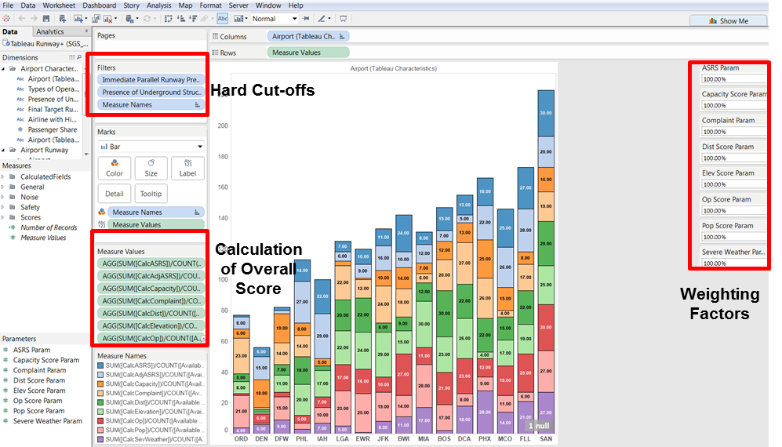
Task 3 – Airport identification (Ongoing)
During the stakeholder interviews, we identified the following criteria for a successful implementation in the US:
  Airport Characteristics:
    Number and types of average daily operations
    Airport Elevation
    ACRP - Capacity Non-Issue Ranking
    Fleet Mix
  Runway Characteristics:
    Available Runways
    Immediate Parallel Runway Presence
    Runway Length and width
    Procedure guidance (e.g. ILS, VASI/PAPI, etc.)
    Tunnels underneath runway (identified using Google
    Maps) and affected runway end
  Noise Characteristics:
    Distance and direction of airport from the city center
    Number of people in 65 dB contour
    Number of noise complaints
  Safety Characteristics:
    Percentage Operations Under "Severe WX” Conditions
    Number of ASRS Reports
    Number of ATSAP Reports
All collected data for these criteria is then used to rank the Core 30 airports for identifying the best candidates
Screenshot of Tableau Interface that enables dynamic weighting of factors

Slide 33
Next Steps:
Conduct remaining stakeholder interviews with FAA-internal experts to identify potential regulatory hurdles of the implementation in the US
Continue to refine selection criteria for candidate airports
Draft Final Report

Slide 34
Questions?

