Slide 1
Modeling &
Tools Update
Presented to: E&E REDAC Subcommittee
By: Dr. Jim Hileman
Office of Environment and Energy
Federal Aviation Administration
Date: April 5, 2016

Slide 2
Outline
Overview of tools and analysis
Tools and analysis roadmap
Updates on efforts to develop tool suite – focusing on AEDT and new FLEET-Builder tool
Updates on analyses – focusing on aircraft performance assessment
Summary
2

Slide 3
Tools and Analysis
We develop tools for specific purposes:
CAEP analyses
  Noise
  Emissions (NO_{X}, CO₂, and Black Carbon)
  Global Market Based Measure
Technology evaluation (e.g., CLEEN Program)
NextGen analyses
  Performance reporting (annual basis)
  Future goals analysis (out to 2050)
  Assessing benefits of NextGen
Air space and airport design and planning (e.g., NEPA reviews)
Note this is not an all-inclusive list
3

Slide 4
Solution Development and Interdependencies
Modeling wide range of solutions and their consequences on fuel use, noise and emissions (e.g., basket of measures for CO₂ and a balanced approach for noise)
Policy and Scenarios
Including outputs from other tools and analyses as appropriate
Aviation Environmental Design Tool (AEDT)
Aviation Environmental Impacts Analysis (APMT-I)
Aircraft Design
Existing Aircraft, New
Aircraft, and/or Generic Fleet
Alternative Fuels
Source and Composition
Single
Flight/Airport
Regional
Global
Studies
Integrated
Noise,
Emissions,
and
Fuel Burn
Analyses
Emissions
Climate
Impacts
Emissions
& Noise
Operations
Air Quality Impacts
Emissions
Fleet Evolution, Estimation and Evaluation
Noise
Impacts
Noise
Collected
Costs
Emissions,
Noise, & Fuel Burn
Monetized
Impacts
Cost Benefit Analysis
4

Slide 5
Tools and Analysis Roadmap
Objective:
  Develop a multi-year schedule for the development and use of the environmental modeling assessment tools
  Ensure clear linkage of research efforts to AEE and other Line of Business (LOB) analysis needs (e.g., ATO, ANG, ARP)
  Install environmental modeling assessment tools in the AEE modeling lab
  Develop user manuals for the environmental modeling assessment tools
Process:
  Identify analyses and deadlines for deliverables, (e.g., CAEP, CLEEN Tech Assessment, Inventory Generation, Goals Analysis)
  Create flowchart of tools and data that are required for each analysis
  Link to other AEE roadmaps, as needed
  Gather information on:
    Existing linkages among tools within the AEE Tool Suite
    Internal (AEE) and external (e.g., ACRP) efforts that could aid analysis and tool development
  Create timeline of tool and database development that overcomes identified gaps to deliver analysis capabilities as needed
5

Slide 6
Tools and Analysis Roadmap
LEGEND
Milestone, Interim deliverable/report
Final deliverable/report
Analysis Tools

Slide 7
Efforts to build In-House Tools and Analytical Capabilities
Some Previous Efforts:
Leverage existing noise and emissions inventories
Use TASOPT for aircraft technology evaluation
Query PDARS data streams for analysis projects
Shadow APMT-Impacts analysis for CO₂ standard
Some Planned Efforts in 2016
Shadow annual fuel burn and noise inventory creation using AEDT
Examine methods for importing radar data into AEDT
Generate noise inventory for a large hub airport using AEDT to support ASCENT noise research
Continue to use APMT-Impacts for CAEP support
7

Slide 8
R&D efforts related to E&E analytical capabilities
Details provided in this briefing
AEDT
APMT-Economics / FLEET-Builder
Aircraft performance analysis
Covered elsewhere in briefings
Alternative fuels analysis (covered in alt fuels briefing)
Operations modeling (covered in noise/ops briefing)
Not covered during this meeting
APMT-Impacts
Rapid fleet wide tool development
Goals analysis
8

Slide 9
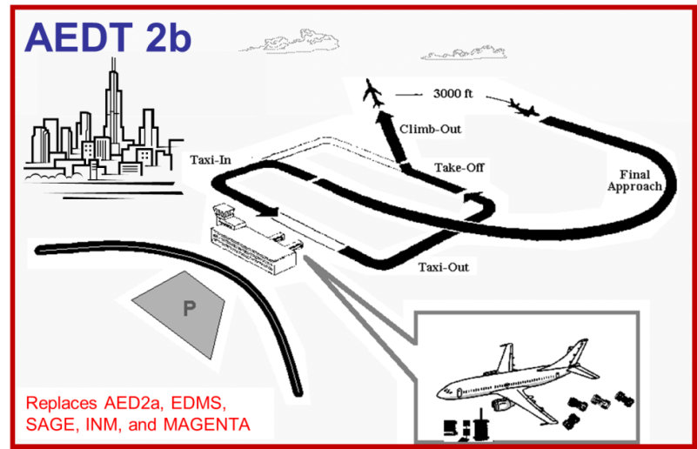
AEDT 2b Update
Release - May 29th 2015
Recent Uses
  FAA: VALE, Environmental Impact and Operational Analysis
  ICAO CAEP: stringency and trends analyses
Additional Releases
  Feature Pack 1 (FP1)
  AERMOD/AERMET (2 embedded EPA tools)
  Fixed dispersion related issues
  Service Pack 2 (SP2)
  Improved interface per customer recommendations,
  Updated reference emissions data, and
  Provided a fix for 40 software issues including continued updating the tool based on back log
9

Slide 10
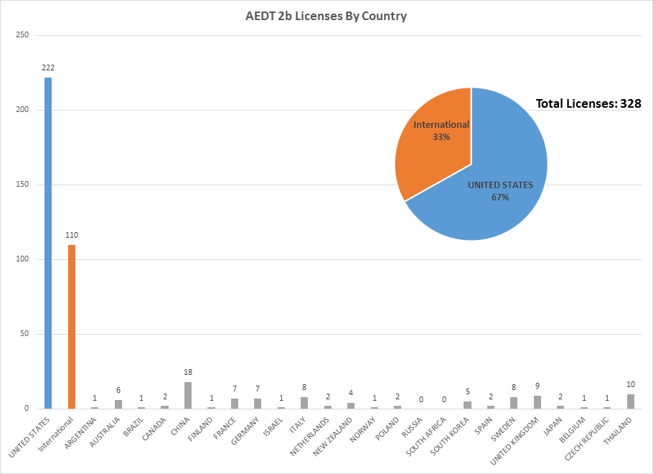
AEDT2b Licenses by Country

Slide 11
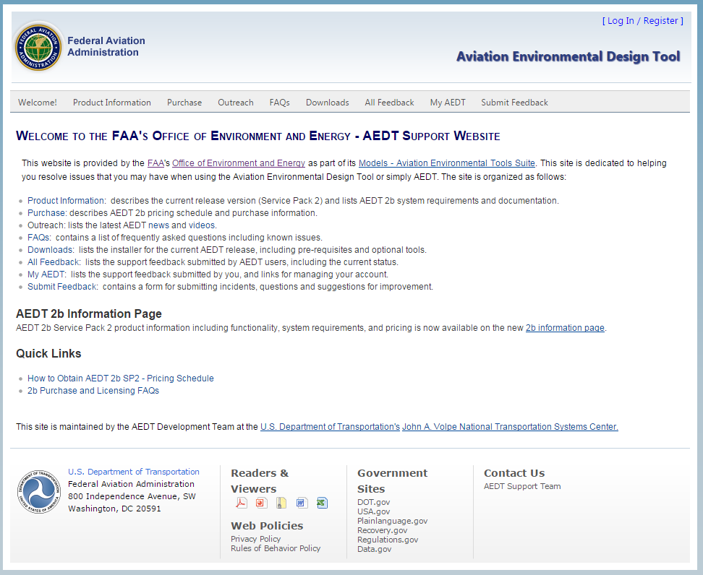
AEDT
Support
Website
https://aedt.faa.gov/
11

Slide 12
AEDT 2b – Plans for Additional Service Packs
Four Additional Service Packs will be released by October 2017
  New service pack release every 12 weeks
  Next release in June 2016
Continue to address software/usability issues as they surface
Working to improve the tool interface and functionality
Expanding AEDT features
  Inclusion of Environmental Justice (EJ) capabilities
  Support large scenario generation for VALE reporting
  Support operational screening use cases
  Handling sensor path data
    User defined flexibility on constraints of performance modeling processing
    Error reporting to facilitate troubleshooting of sensor path data failures
    Inclusion of high fidelity weather in aircraft performance modeling computation
  Further support of EPA MOVES model data and processing integration
  Particle Matter mass and number computation implementation
12

Slide 13
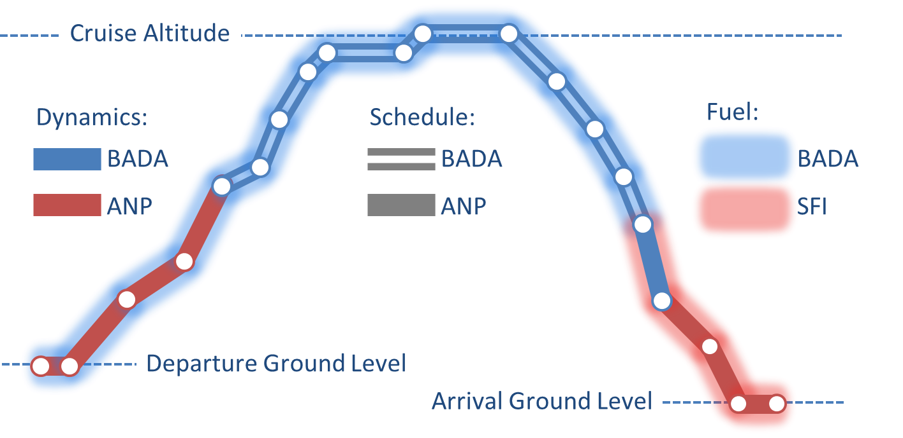
AEDT Aircraft Performance Module (APM) Workshop
Washington D.C. - December 7-9 2015
55 experts from industry, academia, and government
Focused on aircraft performance
  APM = key factor in all environmental modeling computations
  Considered taxi, take-off, climb, cruise, descent, and landing
13

Slide 14
AEDT APM Workshop Results
Several key needs identified
  Complete high fidelity weather modeling implementation
  Improved ability to use radar data (partial sensor path, full sensor path), relax constraints on radar data use, and better consider aircraft speed/trajectory
  Improve taxi modeling
  Improve take-off performance by improving modeling assumptions
    Fixed take-off weight, full thrust take-off power, 8-knot headwind, fixed 160 knot fixed drag/lift, fixed rate of climb
  Improve approach modeling and NPD curves
  Extend BADA4 modeling to descent and approach phases of flight
  Improve modeling of supersonic aircraft and helicopters
  Update noise propagation modeling and implement supplemental metrics
Next Steps:
  Currently Prioritizing Development Features for AEDT3
  Full implementation would require 6+ years of effort at current funding
14

Slide 15
Intersection of Noise, Operations and AEDT Development
A23: Analytical Approach for Quantifying Noise from Advanced Operational Procedures
  Developing analytical approach to address current noise modeling gaps such that it will be possible to capture changes in community noise due to the use of advanced operational procedures
A35: Airline Flight Data Examination
  Using airline data to improve flight performance modeling
  Examining key performance related parameters such as takeoff weight and reduced takeoff thrust
  New ASCENT Projects
  Surface Analysis to Support AEDT APM development
  Takeoff / Climb Analysis to Support AEDT APM development
  Noise Power Distance Re-Evaluation
15

Slide 16
APMT-Economics and a new FLEET-Builder* tool
Challenges:
  Cumbersome APMT-E structure makes setting-up and modifying analyses time consuming
  Lack of AEDT to APMT-E data interface introduces opportunities for data alignment errors
  Cumbersome APMT-E structure has reduced tool use to primarily CAEP analyses
  Limited interface to AEDT requires additional set-up steps providing opportunities for errors
  Lack of noise or emissions parameters in APMT-E limits analysis capabilities
Options:
  Potential range of analysis and tool needs were identified
  Options to fulfill missing capabilities and potential complexity were assessed
  Some infrequently exercised capabilities will continue to be fulfilled by APMT-E
  Some needs can be met with other tools (e.g., Purdue FLEET model)
  Objectives streamlined to fleet evolution and analysis-building
  Requirements:
  Allocate fully-defined aircraft and project AEDT-compatible schedule and operating costs
  Allow analyses that alter the relative importance of aircraft properties in the fleet allocation process, vary geographical scope, vary criteria by market, impact environmental performance
  AEDT-compatible, upload bulk data inputs, fast, modular, document set-up for transparency
16
* FLEET-Builder stands for FLeet Evolution, Estimation and evaluaTion Builder

Slide 17
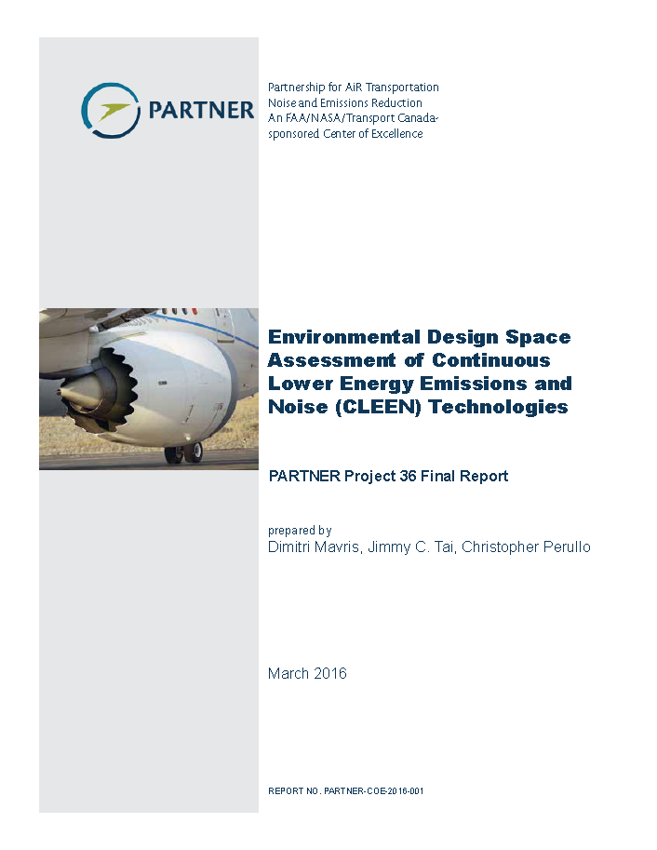
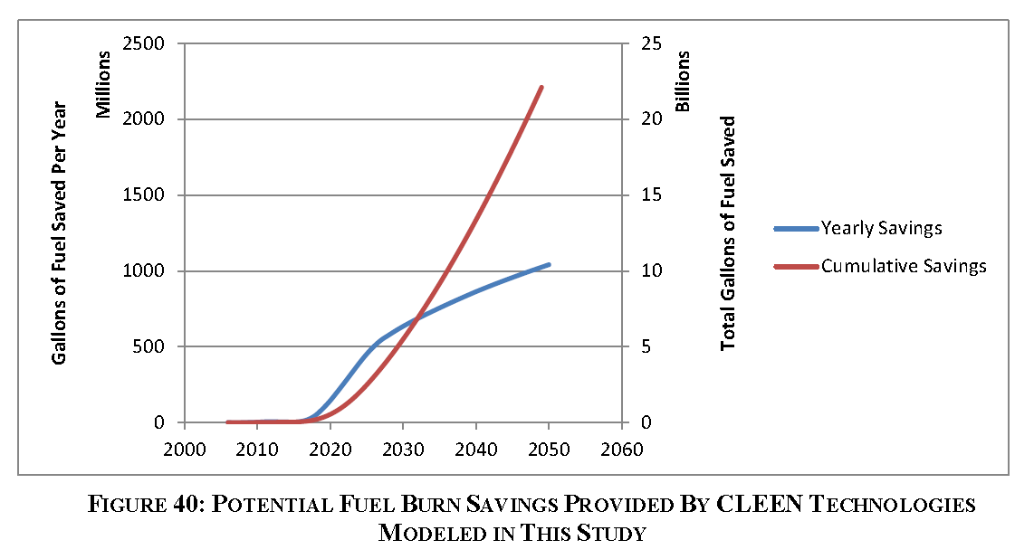
Aircraft Performance Analysis
PARTNER Project 36 (Georgia Tech)
Environmental Design Space (EDS) used to provide independent assessment of technologies (leverage PARTNER Project 14 and NASA efforts)
Did not model all GE technologies
  Open rotor engine
  Engine control/flight management system integration
  Flight management system/air traffic management integration
2% reduction in fleet fuel burn from 2025 through 2050
Follow-on Efforts
ASCENT Project 10 (GaTech-Stanford-Purdue) – evaluating all CLEEN technologies for CO₂, NO_{X} and noise
ASCENT Project 37 (GT) CLEEN II Technology Evaluation
22 billion gallons of
cumulative jet fuel saved
PARTNER project 36 report can be downloaded at: http://partner.mit.edu/sites/partner.mit.edu/files/PARTNER-Project-36-final-report.pdf
17

Slide 18
Summary - Analysis/Tools R&D Direction
Developed roadmap to direct tool development and coordinate analyses
Tool development and analyses support both AEE and other FAA lines of business
Continuing to develop in-house analytical capabilities
Conducted workshop that has laid foundation for future AEDT development - focus on aircraft performance modeling
Starting work to develop FLEET Builder tool
Continuing efforts on aircraft performance analysis
18

Slide 19
Backup Slides
ASCENT Project 10 Update
AEDT Development Details

Slide 20
ASCENT Project 10:
Aircraft Technology Modeling and Assessment
Project Team: Georgia Tech, Purdue, Stanford
Objective:
Define scenarios to bound demand for future aviation activity
Assess effects of fleet composition and aircraft technology on fuel burn, emissions, and noise
Evaluate this set of future scenarios, out to 2050, showing potential benefits of technology on fuel burn, emissions, and noise
Primary Accomplishments:
Completed 4 workshops with government, industry, academia experts.
  2 workshops focused on future aviation demand and fleet evolution.
    Determined parameters important to define future demand and fleet evolution, potential values for various futures
    Defined assumptions on future aircraft life, production rates, technology insertion opportunities (development program duration, timing)
    Proposed high level scenarios for future aviation demand
  2 workshops focused on future technologies. Gathered feedback on:
    3 generations of future airframe, engine and operational technologies – potential benefits, maturity, time to market, and applicability
20

Slide 21
ASCENT Project 10 (Continued)
Broad Participation - Organizations represented in workshops:
Airports Council International – North America, Booz Allen Hamilton, Boeing, Department of Transportation Volpe Center, Embraer, FAA Office of Environment and Energy, FAA Office of Aviation Policy & Plans, Georgia Tech, General Electric, Honeywell, Lufthansa, Mitre, NASA, Pratt & Whitney, Purdue, Rolls-Royce, Stanford, Textron Aviation, U.S. Air Force, Virginia Tech.
Next Steps/Outcomes:
Team working final scenario definition now with workshop input. Mapping detailed technology input into fleet-level demand and evolution scenarios.
Plan to capture workshop responses and resulting scenario definitions in public domain document, available for future analyses to use/reference.
Analysis of scenarios will take place over the next year, resulting in fleet level fuel burn, emissions, and noise for a range of scenarios – bounding possible futures and impacts of technology.
21

Slide 22
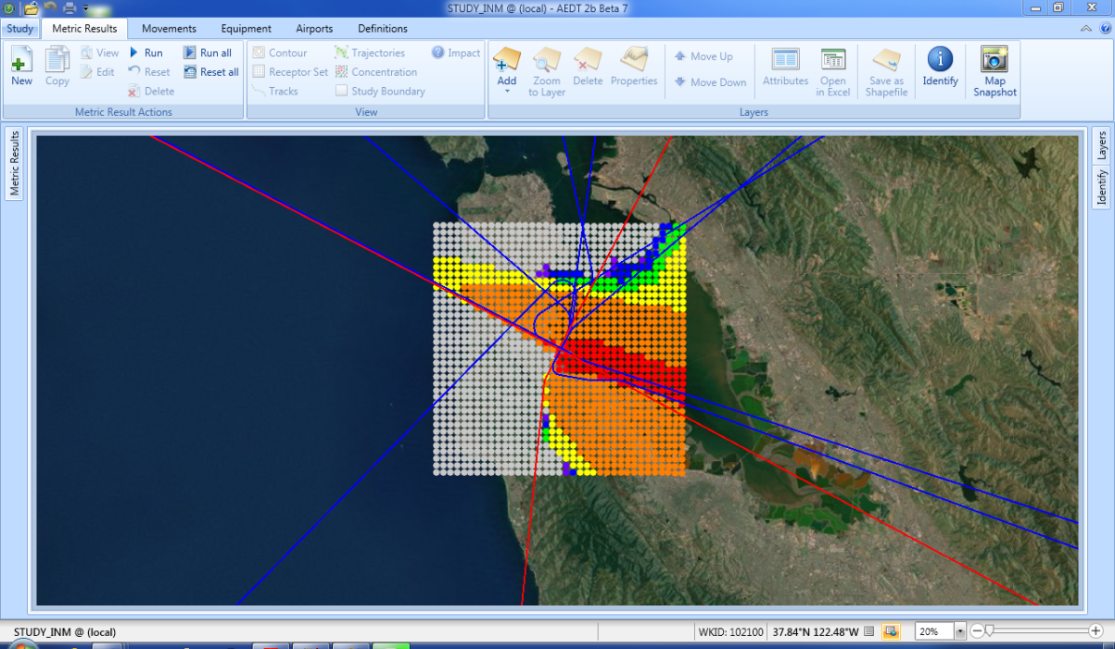
AEDT Development – FY16 Effort
Currently Prioritizing Development Features for Upcoming Cycles – AEDT3
Full implementation of the current list of priorities = 6+ years of effort at current funding expectations
FY16 effort:
  Bug fixes and usability improvements
  Black carbon emissions indices for mass and number for takeoff, cruise and approach
  High fidelity weather to capture actual wind for computation of cruise speed
  BADA 4 for performance modeling (subject to acceptability for noise modeling)
  Improved ability to use radar data (partial sensor path, full sensor path), relax constraints on radar data use, and better consider aircraft speed/trajectory
22

Slide 23
AEDT Development – FY17+ (1 of 2)
Taxiway
  Develop a taxiway “drive cycle” that better accounts for idle, acceleration, and ground roll during ground operations (potentially using real or synthetic radar data) and include taxiway noise modeling (based on ACRP 02-27) and improved taxiway emissions modeling (based on ACRP 02-45)
Takeoff Weight Estimation
  Improve takeoff weight estimation using load factor and improve the estimation of takeoff thrust and departure profiles (ASCENT P35, ACRP 02-41, ACRP 02-55, BAH Fuel Efficiency Project)
Approach Modeling
  Improve approach modeling to include aircraft configuration variations and augment noise-power-distance curves to account for airframe configuration changes (ASCENT P23, ACRP 02-55)
Noise Propagation
  Improve noise propagation modeling use the ray-tracing method and better account for ground surface variation (ACRP 02-52)
23

Slide 24
AEDT Development – FY17+ (2 of 2)
Supersonic aircraft performance
Helicopter modeling improvements
Supplemental noise metrics
En-route noise modeling – model shock cell noise from exhaust for propagation to ground, and
Update databases and increase ability to use new databases (e.g., GIS airport layout)
24

