Slide 1
Continuous Lower Energy, Emissions and Noise (CLEEN) Program
CLEEN Update and CLEEN II Status
REDAC Subcommittee on Environment and Energy
Levent Ileri, CLEEN Program Manager
Jim Skalecky, CLEEN Deputy Manager
Arthur Orton, CLEEN Program Engineer
March 3, 2016

Slide 2
Outline
CLEEN / CLEEN II Status
CLEEN Update
  Accomplishments
  Benefits
CLEEN II Update
Summary

Slide 3
Status Updates
Develop CLEEN Communication Materials
  New web site: http://www.faa.gov/go/CLEEN
  Last CLEEN Fact Sheet update completed Aug 2014
    http://www.faa.gov/news/fact_sheets/news_story.cfm?newsId=16814
  New CLEEN Fact Sheet update under review March 2016
CLEEN program technologies’ expected EIS
  TAPS II advanced low NOx combustor starting in 2016 –
    Airbus A320neo, Boeing 737MAX, COMAC C919
  CLEEN model brings technologies to point of readiness for product development
  Other TRL 6-7 technologies in product planning, not publicly announced
  Of the 10 CLEEN technology projects:*
    4 with EIS prior to 2020, >8000 engines
    6 with EIS after 2020, >4000 engines
* Based on November 2015 data. These numbers will increase as soon as the companies finalize their trade studies.
Notes:
Additional public communication of successes:
Boeing presentation at United States Advanced Ceramics Association (USACA) conference on CMC nozzle

Slide 4


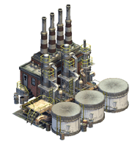

CLEEN + CLEEN II Program Goals
Develop and demonstrate (TRL 6-7) certifiable aircraft technology
 | CLEEN | CLEEN II
Noise (cum below Stage 4) | -32 dB | -32 dB | and/or reduces the noise contour area in absolute terms
LTO NOx Emissions (below CAEP 6) | -60% | -75% (-70% vs. CAEP/8) | and/or reduces absolute NOx production over the aircraft’s mission
Aircraft Fuel Burn | -33% | -40% | and/or supports the FAA’s goal to achieve a net reduction in climate impact from aviation
Advance use of “drop-in” renewable alternative fuels
Bio feedstock
Fuel Production
Jet fuel
Notes:
CLEEN I baseline:1) Certifiable aircraft technology that reduces fuel burn by 33% compared to current technology, reducing energy consumption and greenhouse gas (CO2) emissions; In CLEEN goal 1, current technology refers to the contractor's current technology reference aircraft and mission.
CLEEN II baseline: 1) - the 40% reduction is to be measured in terms of kilograms of fuel consumed per available ton-kilometer, compared with a year 2000 best-in-class in-service aircraft baseline (e.g., Embraer E-190, Boeing 737-800, Boeing 777-200LR).
These goals are described in the National Aeronautics Research and Development Plan and puts CLEEN in context with NASA’s environmental technology programs.
While initial NASA studies considered a single aisle baseline configuration (B737-800 with a CFM56-7B engine), the CLEEN solicitation did not specify a baseline and encouraged technologies that could apply across multiple aircraft classes.
CLEEN I program goals are to:
1. Develop and demonstrate certifiable aircraft technology at Technology Readiness Level 6-7 that:
a. Reduces fuel burn by 33 percent relative to current subsonic aircraft technology, reducing energy consumption and greenhouse gas (CO₂) emissions;
b. Reduces landing and takeoff cycle (LTO) nitrogen oxide (NOx) emissions by 60 percent, at a pressure ratio of 30, over the International Civil Aviation Organization (ICAO) standard adopted at CAEP 6, with commensurate reductions over the full pressure ratio range, while limiting or reducing other gaseous or particle emissions;
c. Reduces noise levels by 32 EPNdB cumulative, relative to Stage 4 standards;
2. Determine the suitability of new technology for engine and aircraft retrofit to accelerate penetration into the commercial fleet.
3. Develop and demonstrate use of “drop in” alternative fuels in aircraft systems and quantify the benefits. This includes facilitating ASTM International approval of “drop-in” alternative fuels for commercial use.
Committee on Aviation Environmental Protection (CAEP) - The Committee on Aviation Environmental Protection (CAEP) is a technical committee of the ICAO Council established in 1983. CAEP assists the Council in formulating new policies and adopting new Standards and Recommended Practices (SARPs) related to aircraft noise and emissions, and more generally to aviation environmental impact.
Alt fuel goal (industry wide, commercial and military) is 1 billion gallons by 2018

Slide 5

CLEEN Program Overview
CLEEN Program (2010-2015)
  Industry partners: Boeing, General Electric, Honeywell, Pratt & Whitney, Rolls-Royce
  Federal Funding: $125M (1:1 minimum cost share is required)
CLEEN II Program (2015-2020)
  Industry partners: Aurora Flight Sciences, Boeing, Delta/MDS/America’s Phenix, General Electric, Honeywell, Pratt & Whitney, Rohr/UTC Aerospace Systems, and Rolls-Royce
  Federal Funding: $100M (1:1 minimum cost share is required)
Notes:
Following the success of the initial CLEEN Program, FAA decided to pursue a follow-on program, CLEEN II, to develop new aircraft technologies that further reduce fuel burn, emissions and noise, as well as continue the advancement of sustainable alternative fuels.

Slide 6



CLEEN II
Program model based on successful CLEEN I
  Requires cost share and tech maturation from TRL 3-5 to demonstration at TRL 6-7
  Program work conducted 2015-2020
  Requires industry to show path to commercial product so tech realizes benefits in the fleet
Milestones:
  Market survey conducted May-July 2013
  Draft solicitation released publicly November 2013
  Industry day held in Washington D.C. December 2013
  Solicitation Released September 29, 2014
  Solicitation Closed February 2, 2015
  Contracts awarded in August 2015
  Issued a Press Release on September 8, 2015
  Kick off meetings took place November 17-19, 2015
Notes:
Summary
CLEEN II is planned as a follow-on effort for new projects in the areas of aircraft technology development and alternative jet fuels. With work planned 2015-2020, technologies are planned to provide fuel burn, emissions, and noise benefit toward advanced goals and enter into service by 2025.
Metrics: Noise -32dB,
-75% LTO NOX emissions,
-40% A/C fuel burn,
and qualitative goals for technologies not affecting certification points. Technologies will be developed from 2015-2020 with the goal of entry into service before 2026. We must recognize however, that market demands will ultimately dictate the timing of when these technologies are commercialized.

Slide 7
CLEEN Update

Slide 8
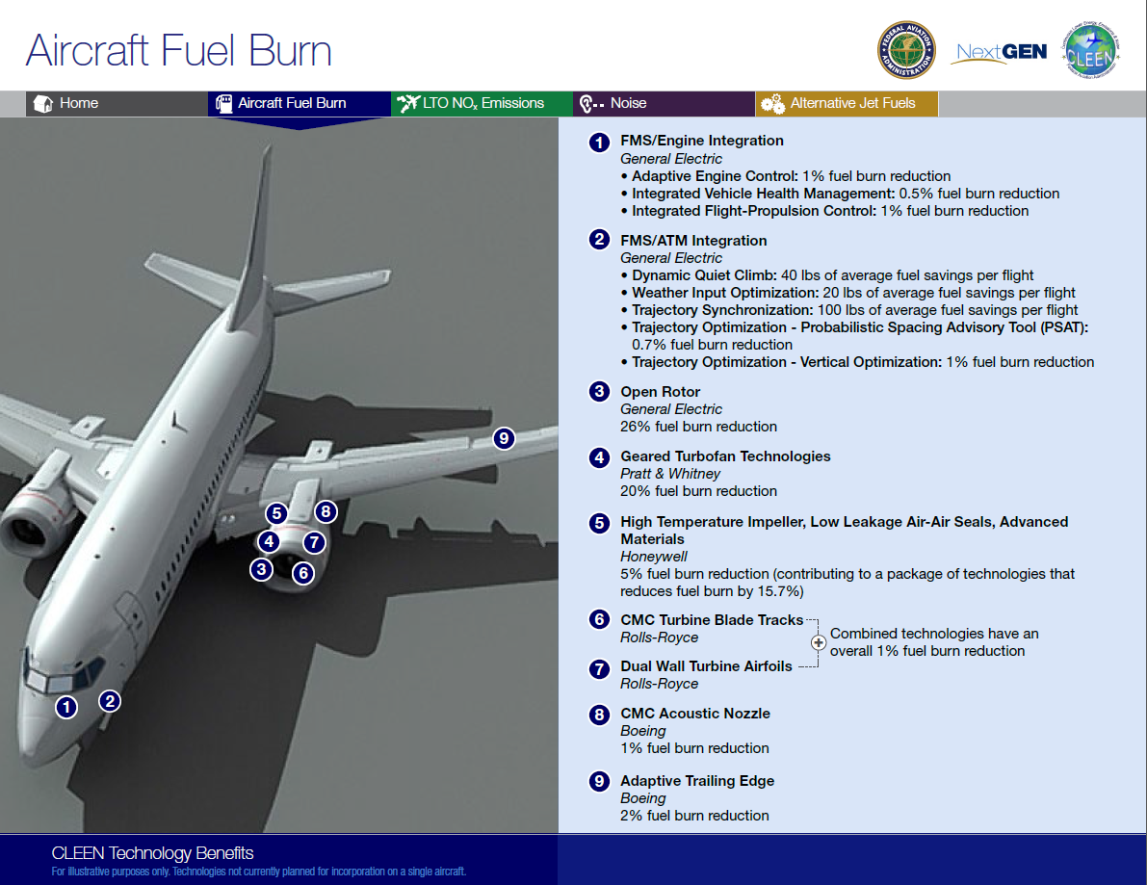
(Benefits above are not necessarily additive.)

Slide 9
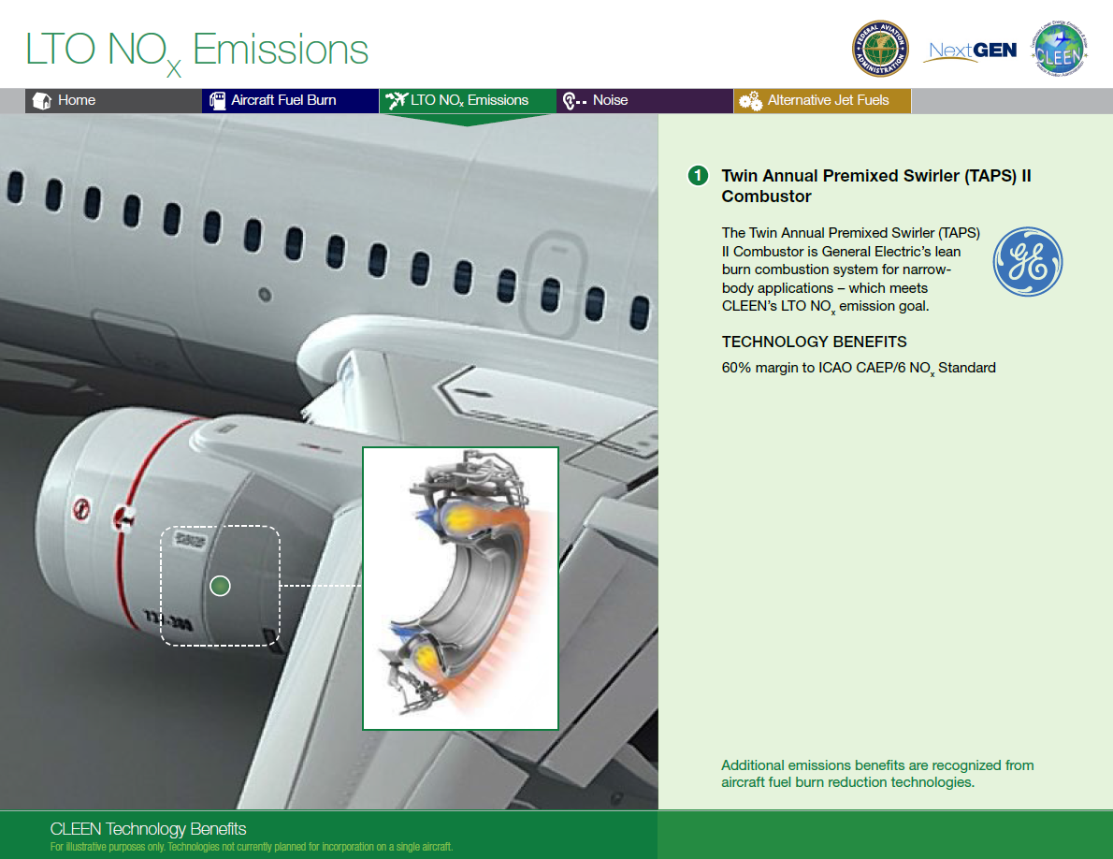
(Benefits above are not necessarily additive.)

Slide 10
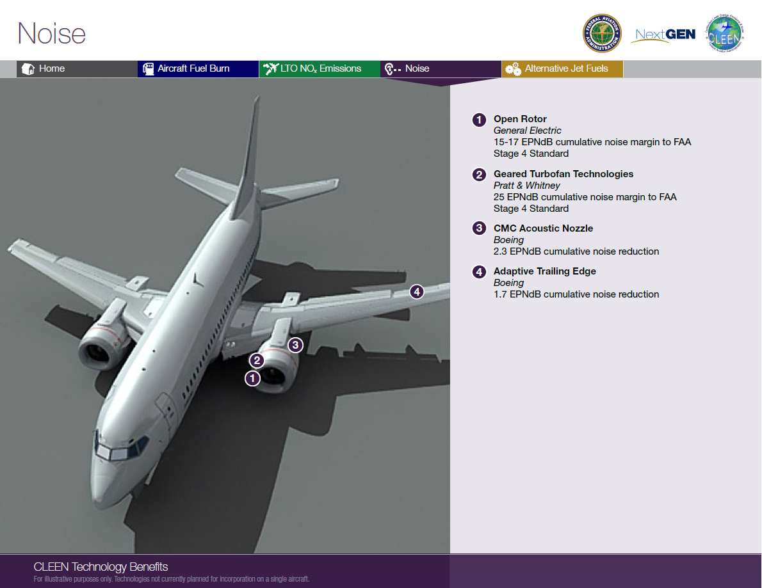
(Benefits above are not necessarily additive.)

Slide 11
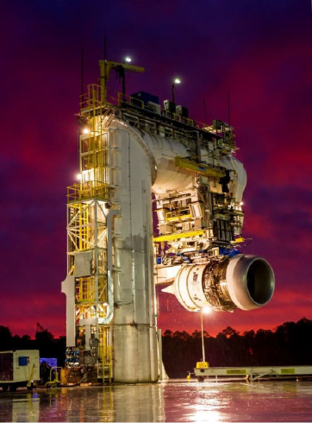
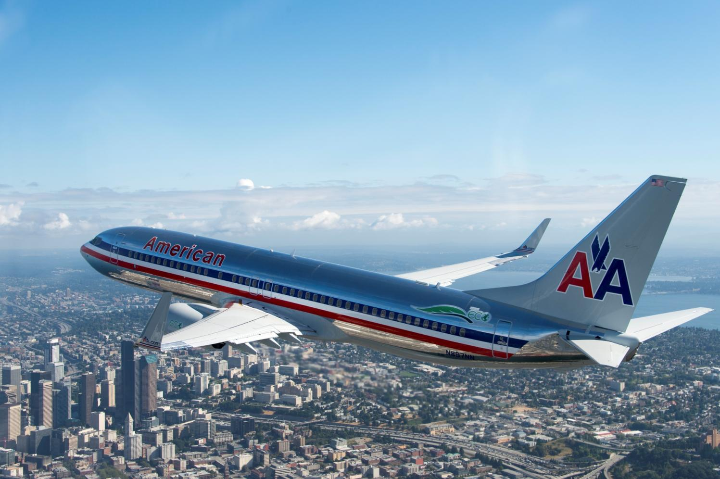
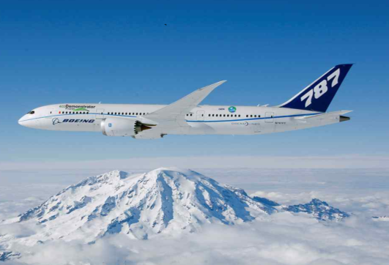
Boeing CLEEN Technologies - COMPLETED
Adaptive Trailing Edge
Up to 2% fuel burn reduction, -1.5dB cumulative EPNdB noise reduction.
Ceramic Matrix Composite Acoustic Nozzle
Up to 1% fuel burn reduction
Noise attenuation on parity or better than metallic nozzle.
Alternative Jet Fuels
Completed study with University of Dayton Research Institute to capture effects of alternative fuels on non-metallic fuel system materials
Photo: Bob Ferguson
Adaptive Trailing Edge Flight Demonstration (TRL 7)
Ceramic Matrix Composite Nozzle Ground Test (TRL 6)
Ceramic Matrix Composite Nozzle Flight Test (TRL 7)
2010 | 2011 | 2012 | 2013 | 2014 | 2015
Images courtesy of Boeing
Notes:
Purpose:
ATE - This technology will improve wing aerodynamic efficiency, reducing fuel consumption, and decrease aircraft approach noise.
CMC- This technology will reduce weight and increase temperature capability of the nozzle.
Demos:
ATE
-Wind tunnel test (May 2011)
-Flight Test on 737 (Summer 2012)
CMC Nozzle
-Engine Ground Test on Trent 1000 (2013)
-Flight Test on 787 (Summer 2014)
Result:
ATE enables the wing to be aerodynamically tailored to improve aircraft performance, and resulted in reduced fuel burn at cruise and reduced noise at takeoff and approach.
CMC nozzle enables more efficient engine operation at higher temperature, while providing weight reduction – thereby fuel burn reduction – and noise attenuation. Both of these technologies are matured to TRL 7.

Slide 12
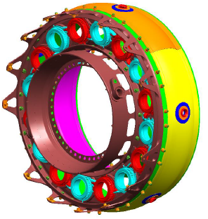
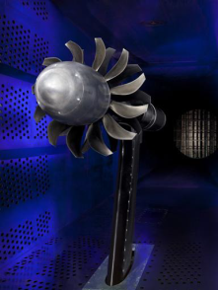


GE CLEEN Technologies (1 of 2)
TAPS II Low NOx Combustor
Demonstrated in rig and core engine test > 60% NOx margin to CAEP/6, exceeding CLEEN goal. – 2016 EIS with ~8000 orders
Open Rotor Fan Blade Development
~26% reduction in fuel burn (re: 737-800) and ~15-17EPNdB cumulative noise margin to Stg. 4
Core Test of TAPS II Combustor (TRL 6)
Open Rotor Wind Tunnel Tests (TRL 5)
TAPS II 2016 EIS with ~8000 orders
2010 | 2011 | 2012 | 2013 | 2014 | 2015
Images courtesy of GE Aviation
Notes:
Purpose:
TAPS II – New combustor design that will greatly reduce Nox emissions
Open Rotor – New engine architecture to greatly reduce fuel burn and noise.
Demos:
TAPS II - Core engine test (2011)
Open Rotor - Scaled wind tunnel test (2012)
Result:
TAPS II provided 60% margin to CAEP/6 LTO NOx. TAPS will be going into service in 2016 with over 8000 orders in place on the LEAP engine.
Demonstrated 26% fuel burn reduction and 15-17 EPNdB noise margin to Stage 4. Open rotor technology cannot be developed into a product until an airframe OEM initiated an integrated design effort.

Slide 13

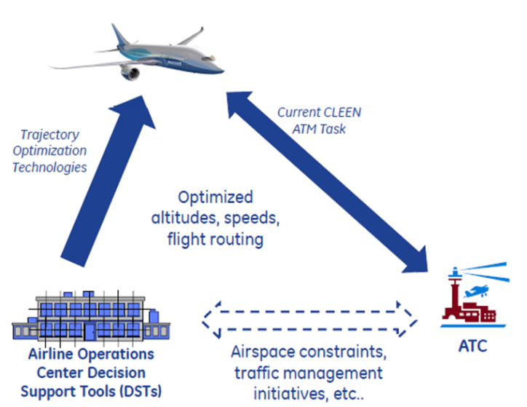

GE CLEEN Technologies (2 of 2)
FMS/ATM Integration
0.7% fuel burn reduction from probabilistic spacing advisory tool
1% fuel burn reduction from vertical flight path optimization
FMS/Engine Control Integration
1% fuel burn reduction from Adaptive control
0.5% fuel burn reduction from Integrated Vehicle Health Management
1% fuel burn reduction from Integrated Flight-Propulsion Control
Completed Dynamic Quiet Climb and Wind Input Optimization Tasks
Completed Trajectory Synchronization Simulation (TRL 6)
FMS/Engine Technology Logic Design Complete
FMS/Engine Effort Complete Q2 2016
2010 | 2011 | 2012 | 2013 | 2014 | 2015
Images courtesy of GE Aviation and Aviation Systems
Notes:
Purpose:
FMS/ATM - Integrate aircraft avionics with aircraft systems sensors and ground-based ATM systems to optimize aircraft trajectories for fuel burn and noise.
FMS/Engine – Mature FMS algorithms to provide adaptive engine control, integrated vehicle health management, and integrated flight-propulsion control.
Demos:
FMS/ATM
-Hardware (FMS) in the loop simulations of optimization algorithms (2013)
FMS/Engine
-Flight testing on LEAP 1-B ( May 2015)
-Engine ground test on GE9X - Upcoming (Aug. 2015)
Result:
FMS/ATM Trajectory optimization explored ATM enhancements that could result by integrating enhanced on board avionics with a/c system sensors and control and ground based ATM systems and using automatics data communications. This integration results in recused atc workload, erroneous collision alerts and impacts of NAS wide disruptions as well as increase capacity and improve environmental performance.

Slide 14
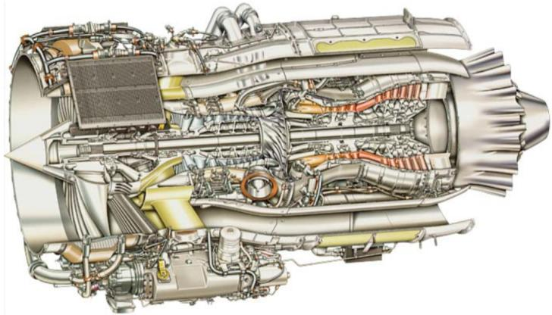
Honeywell CLEEN Technologies
Engine Core Fuel Burn Reduction Technologies
5% fuel burn reduction as part of a 15.7% fuel burn reduction engine package.
Alternative Jet Fuels
Completed study on impact of aromatics on materials
Completed biofuel life cycle analyses with MIT
High Temperature Impeller
Low leakage air-air seals
Advanced materials
Final CLEEN Engine Test (TRL 6) for All Technologies
Early Engine Test Opportunities (Some Technologies to TRL 6)
Core Engine Testing of High T3 Impeller
2010 | 2011 | 2012 | 2013 | 2014 | 2015
Images courtesy of Honeywell
Notes:
Purpose: Mature suite of engine technologies to increase engine efficiency and reducing engine weight. Honeywell is introducing advanced materials and coatings into this engine.
Demos:
Engine ground test (2012, 2014, 2015*)
Core Engine ground test (2015)
Result:
A high temp impeller compressor and a number of turbine engine components that reduce weight and increase operating temperature involving advanced materials and cooling. These technologies enable greater thermal efficiency and lower weight, leading to a total of 15.7% reduction in fuel burn.
Result of AJF:
Support ASTM approval of fuels
14

Slide 15
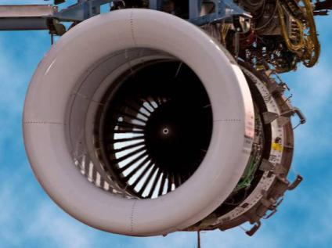
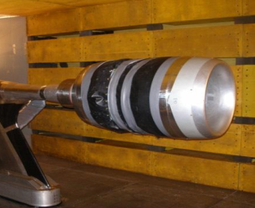
Pratt & Whitney CLEEN Technologies
Ultra High Bypass Geared Turbofan with Advanced Fan System
Technologies expand design space for engine with ~ 20% fuel burn reduction, 25 EPNdB cumulative noise margin to Stage 4
Alternative Jet Fuels
Engine and combustor testing of alternative jet fuels from multiple production pathways
Ground Test
Wind Tunnel Tests
Ultra High Bypass Rig Test with Advanced Fan Exit Guide Vanes
Integrated Ultra High Bypass Rig Demo
CLEEN Engine Design Complete
CLEEN Engine Test Q2/3 2016
2010 | 2011 | 2012 | 2013 | 2014 | 2015
Images courtesy of Pratt & Whitney
Notes:
Purpose: Ultra High Bypass Geared Turbo Fan – Mature new engine architecture to improve fuel burn and noise.
Demos:
Fan Rig Testing (2014, 2015)
Scaled Engine Testing* - Upcoming (2016)
Result:
A new design of a fan blade and short inlet components of a GTF. Two fan rig tests and an engine ground test demonstration are planned with an option to do a flight test.
Result of AJF:
Support ASTM approval of fuels

Slide 16
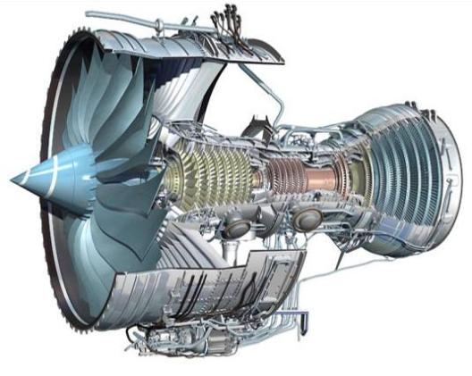
Rolls-Royce CLEEN Technologies
Dual Wall Turbine Airfoils + CMC Blade Tracks
CMC blade tracks offer > 50% reduction in cooling and component weight.
Dual Wall turbine airfoils provide > 20% reduction in cooling and increased operating temperature capability.
CLEEN technologies provide ~1% fuel burn reduction
Novel Alternative Fuels Project
Lab, rig, and APU testing complete
Dual Wall Vane Testing
CMC Blade Tracks Engine Test 1
CMC Blade Tracks Engine Test 2 (TRL 6)
2010 | 2011 | 2012 | 2013 | 2014 | 2015
Images courtesy of Rolls-Royce
Notes:
Purpose: Introduce novel airfoil designs and CMC materials into turbine to significantly reduce cooling flows, reduce engine weight and increase operating temperature capability.
Demos:
Engine Testing (2013, 2014, 2016*)
Result:
CLEEN technologies will provide 1% fuel burn reduction.
APU: Auxiliary power unit
Engine core efficiency (high temp)
Dual Wall Turbine Airfoils – advanced cooling design – to cool the vane
CMC Blade Tracks - - advanced materials Ceramic Matrix Composites

Slide 17
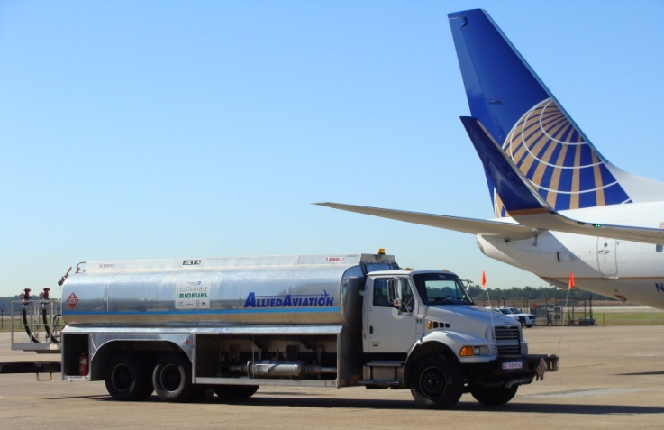
In Summary
CLEEN* has successfully accelerated aircraft technology development to reduce noise, emissions and fuel burn
CLEEN has helped and is helping to accelerate alternative jet fuel development
* For more information on the CLEEN Program, its benefits, and accomplishments to date, please see the CLEEN Program Fact Sheet at
http://www.faa.gov/news/fact_sheets/news_story.cfm?newsId=16814

Slide 18
CLEEN II Update

Slide 19
CLEEN II Overview
Purpose:
  Mature previously conceived noise, emissions and fuel burn reduction technologies for civil subsonic airplanes from Technology Readiness Levels (TRL) of 3-5 to TRLs of 6-7 to enable industry to expedite introduction of these technologies into current and future aircraft and engines
  Assess the benefits and advance the development and introduction of “drop-in” alternative jet fuels, including blends
CLEEN II technologies expected to be on a path for introduction into commercial aircraft by 2026
Notes:
Moving on to CLEEN II…

Slide 20
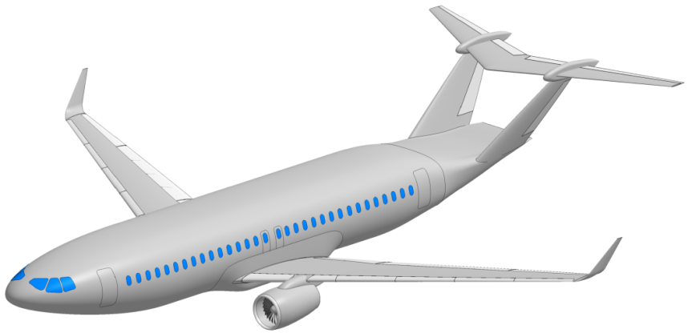
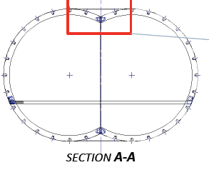
Aurora CLEEN II Technologies
Technology | Goal Impact | Benefits and Application
Double bubble aircraft fuselage: Advanced composite structure and Y-joint demonstration | Fuel burn, enables NOx and noise reduction | Wing-Mounted engine configuration benefit: ~20% fuel burn reduction when compared to 737-8 Enables ~16 EPNdB cumulative noise reduction and ~21% LTO NOx reduction With current technology and integrated engines, configuration provides: Up to 49% fuel burn reduction 40 EPNdB noise reduction 52% reduction in LTO NO_{X} emissions (re: CAEP/6) Additional technologies’ benefits may stack on top of configuration benefit.
Notes:
Aurora has been awarded to conduct the design of a composite center fuselage section of the D8, or double bubble, lifting fuselage aircraft configuration, previously studied under NASA N+3 efforts.
What is being studied under CLEEN II is a mid-2020s configuration with underwing engines, more in line with CLEEN II’s timeframe for application.
Aurora will fabricate and test a key section of this fuselage, the Y-joint at the top of the double bubble cross-section.
Advanced composites technologies will be used in this design and fabrication.
This is a key enabling technology and demonstration for the D8 configuration. The configuration is estimated to provide 25% fuel burn reduction in this mid-2020s under-wing engine configuration, and enable significant noise and emissions reductions: ROM – 16 EPNdB cumulative noise reduction and 21% LTO NOx reduction. This would stack up with other technologies such as those in the engines to provide additional benefits.
With current technology levels and integrated engines, the D8 may provide up to 49% fuel burn reduction, 39.7 dB noise reduction, and 51.9% Nox emissions reduction. Further benefits are possible with advancement in engine technology.

Slide 21
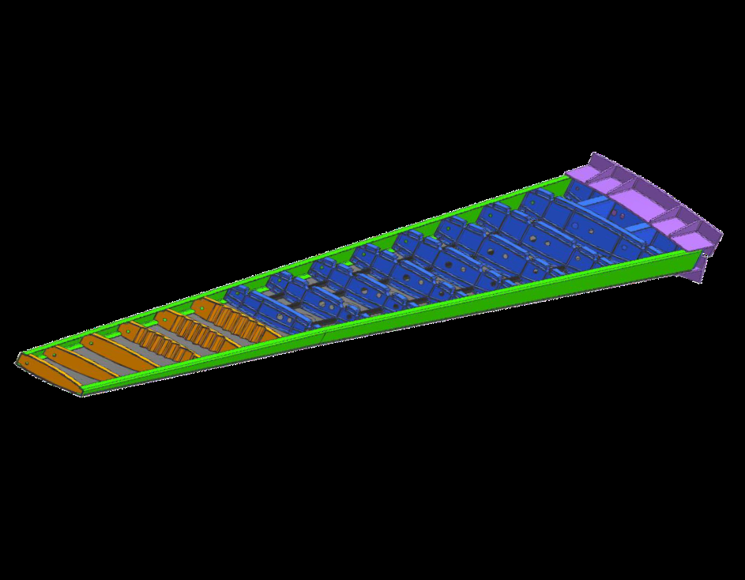
Boeing CLEEN II Technologies
Technology | Goal Impact | Benefits and Application
Structurally Efficient Wing - enabled by advanced manufacturing and composites technologies | Fuel Burn | Lower weight, higher performance wing, reducing fuel burn by 3.5%
Notes:
Boeing is applying a suite of advanced composites technologies to build the Structurally Efficient Wing technology.
The result is a strong, light structure that will reduce fuel consumption by 3.5%.

Slide 22

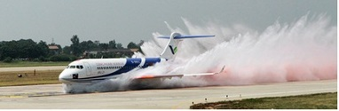
Delta/MDS/America’s Phenix CLEEN II Technologies
Technology | Goal Impact | Benefits and Application
Leading Edge Protective Coating for Turbofan Blades | Fuel Burn & Emissions | Up to 1% fuel savings at cruise Up to 2% fuel savings at max power Application: 1st stage turbofan blades on a breadth of engines
Notes:
The team of Delta Tech Ops, MDS Coating Technologies and America’s Phenix are developing a leading edge protective coating for turbofan blades.
This coating is designed to reduce fan blade erosion that reduces fuel efficiency over the life of an engine in service.
The team estimates 1% fuel savings at cruise and up to 2% fuel savings at max power conditions.

Slide 23
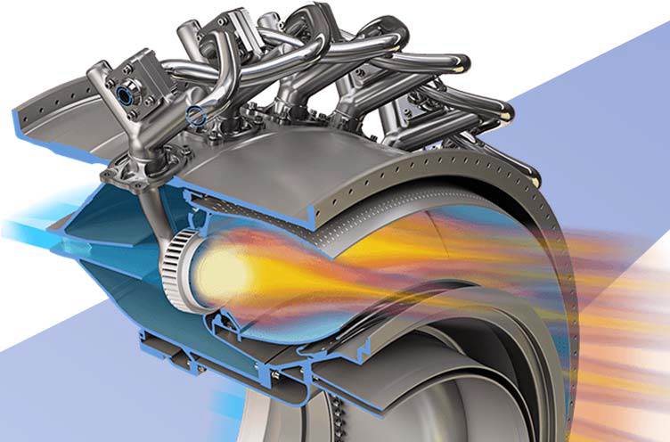
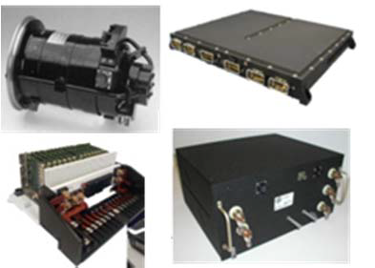
GE CLEEN II Technologies (1 of 2)
Technology | Goal Impact | Benefits and Application
TAPS III Low-NOx Combustor Development | Emissions | 40% margin to CAEP/6 NOx @ 55 OPR – large twin aisle class aircraft
More Electric Systems and Technologies for Aircraft in the Next Generation (MESTANG) | Fuel burn | Up to 3% fuel burn reduction for single-aisle aircraft
Notes:
GE has been awarded to conduct 4 projects under CLEEN II
The first of these is a technology package for the TAPS III low-Nox combustor in the GE9X engine applied to the 777X. Advanced combustion design will be used to achieve significant Nox reductions for a high pressure ratio engine.
The next technology is More Electric Systems and Technologies for Aircraft in the Next Generation, or MESTANG, a suite of technologies in the area of “more electric” aircraft, from power generation to distribution. The result is up to a 3% fuel burn reduction for single-aisle aircraft.
Note: The images for the MESTANG technology are aircraft power conditioning and distribution components.

Slide 24
GE CLEEN II Technologies (2 of 2)
Technology | Goal Impact | Benefits and Application
Flight Management System (FMS) – Engine Integration | Fuel burn | Up to 1% fuel burn reduction
Alternative Jet Fuel Test and Evaluation | Alternative Fuels | Testing of drop-in alternative jet fuels to support ASTM International approval
Notes:
GE is also working on advancements to the integration of data from the flight management system, engine, and air traffic management to improve flight efficiency in operation.
Finally, GE has been awarded to conduct testing of drop-in alternative jet fuels to support ASTM International approval of new fuels.
Note: the fuels have not yet been finalized.

Slide 25
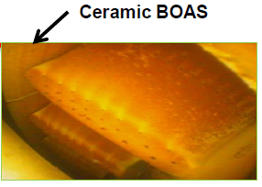
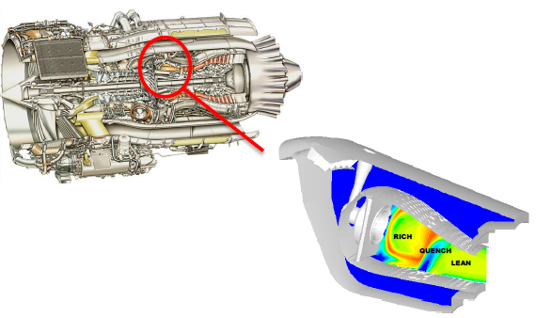
Honeywell CLEEN II Technologies
Technology | Goal Impact | Benefits and Application
Singular Annular Combustor for Emissions Reduction (SABER) Compact Combustor | Emissions, fuel burn | 53% margin to ICAO CAEP/8 NOx Reduced weight, emissions
Advanced Turbine Blade Outer Air Seal | Fuel burn | Contributes to package that delivers 27% fuel burn reduction vs. in service baseline
Notes:
Honeywell is working on two engine core technologies under CLEEN II:
The first is the SABER compact combustor, which will achieve large Nox reductions, in combination with reduced weight, benefiting engine fuel burn.
The second is the advanced turbine blade outer air seal, made of ceramics. This high pressure turbine technology contributes to a package of technology that in total reduces fuel burn 27% vs. the Honeywell baseline.

Slide 26
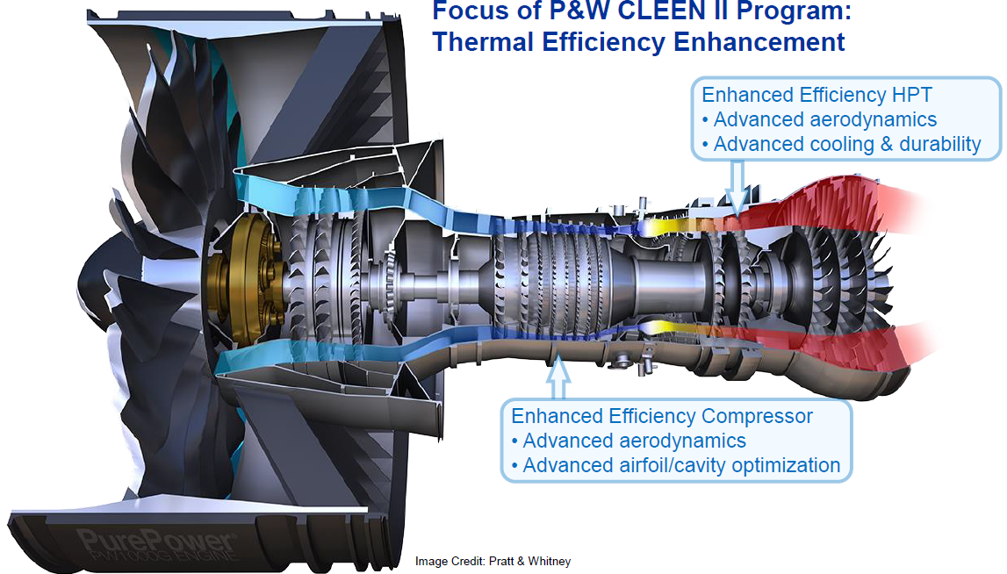
Pratt & Whitney CLEEN II Technologies
Technology | Goal Impact | Benefits and Application
Compressor Aero-Efficiency Technologies | Fuel burn | 0.8-1.0% fuel burn reduction
Turbine Aero-Efficiency and Durability Technologies | Fuel burn | 0.8-1.0% fuel burn reduction
Notes:
Pratt & Whitney is working on two engine core technology projects under CLEEN II.
The projects apply advanced aerodynamics, cooling, and optimization techniques to improve compressor and turbine efficiency.
Each is estimated to reduce fuel burn up to 1%

Slide 27
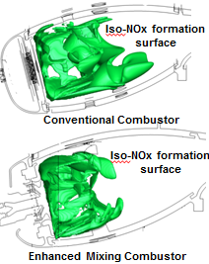
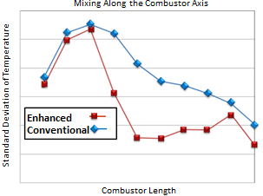
Rolls-Royce CLEEN II Technologies
Technology | Goal Impact | Benefits and Application
Advanced Rich Quench Lean (RQL) Low NOx Combustion System | NOx Reduction, Fuel burn | First generation: 60% margin NOx to CAEP/6 Second generation: 75% NOx reduction to CAEP/6
Alternative Jet Fuel Test and Evaluation (Area A) | Alternative Fuels | Testing of drop-in alternative jet fuels to support ASTM International approval
Notes:
Rolls-Royce is developing an advanced rich quench lean (RQL) low Nox combustion system under CLEEN II.
The project will be conducted in two phases. The first will achieve 60% margin to CAEP/6 Nox, and the second will improve further to 75% reduction to CAEP/6, achieving the CLEEN II Nox goal.
Rolls-Royce, like GE, will be conducting testing of drop-in alternative jet fuels to support ASTM International approval

Slide 28
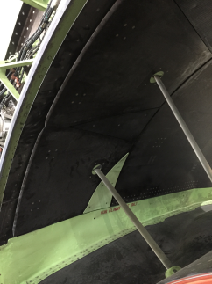


Rohr / UTAS CLEEN II Technologies
Thrust reverser demonstrator
Technology | Benefits
Short, Integrated Fan Duct Thrust Reverser | ~1.0% Fuel Burn Reduction
Advanced Acoustics | ~2.5 EPNdB noise reduction*
Legacy Thrust Reverser Fan Duct
CLEEN II Thrust Reverser Fan Duct
* to offset short fan duct
Notes:
Rohr, also known as United Technologies Aerospace Systems (UTAS), is developing an advanced thrust reverser technology under CLEEN II.
This technology effort enables next generation ultra high bypass engines by reducing nacelle weight and fan duct losses
This effort improves thrust reverser integration into the nacelle, as you can see from the image in the upper right. Linkages conventionally in the fan duct can be hidden and better integrated.
Advanced acoustics technologies in this area also provide noise reduction, up to 2.5 EPNdB.

Slide 29
In Summary
CLEEN has successfully accelerated aircraft technology development to reduce noise, emissions and fuel burn
CLEEN has helped and is helping to accelerate alternative jet fuel development
Initial CLEEN Program wrapping up
CLEEN II has been awarded – work now underway

